Slide 1
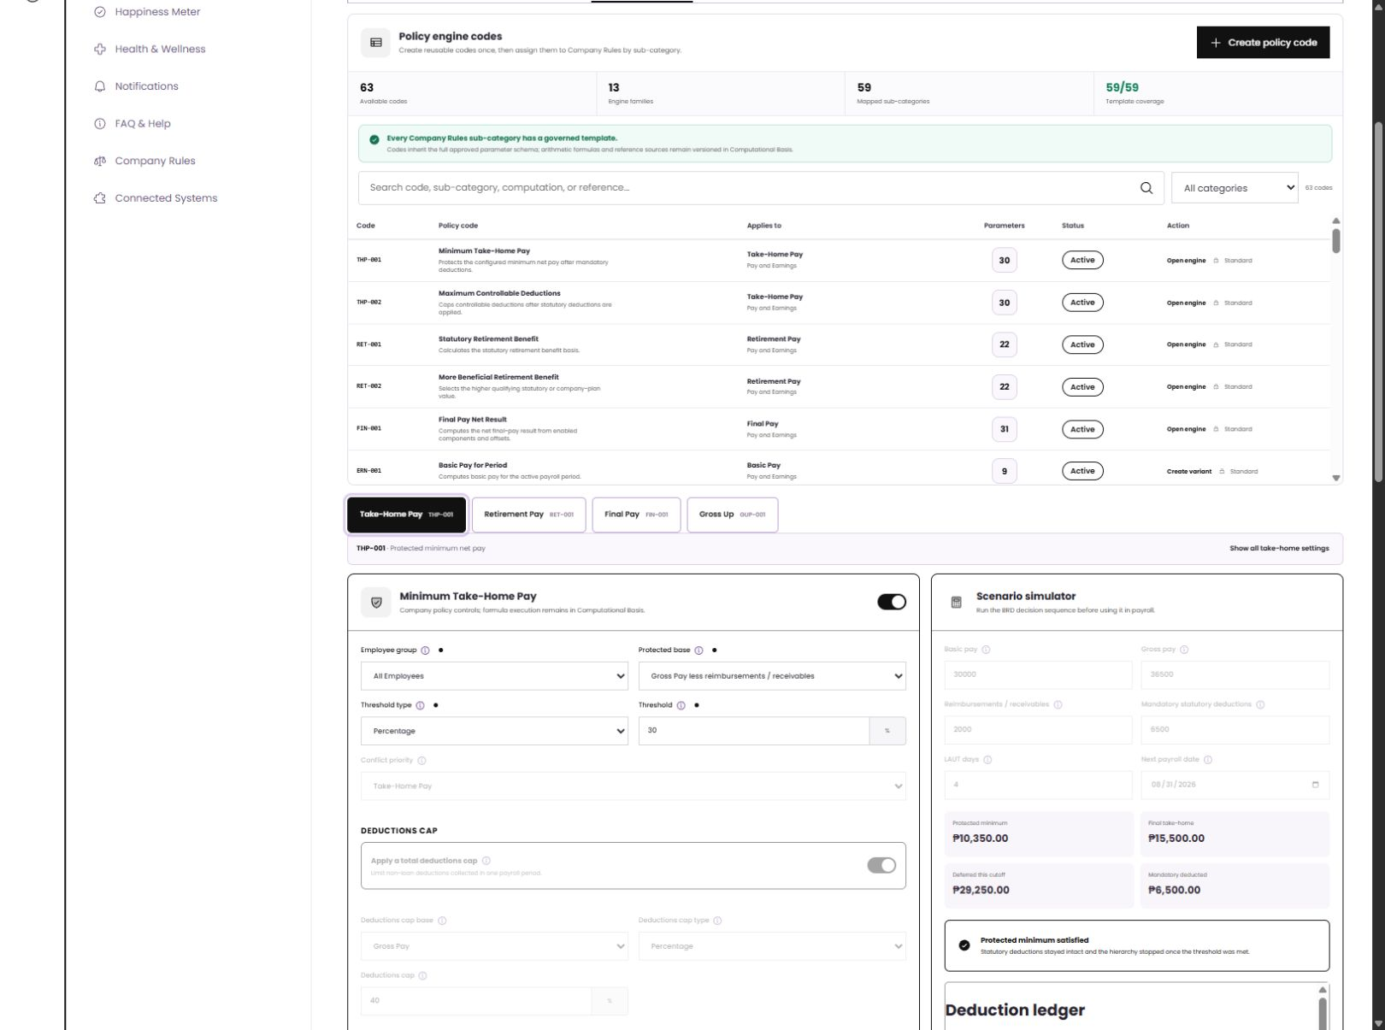
ATLAS
Computational
Basis
How payroll requirements become governed, testable company policy
BUSINESS WIREFRAME DEMO
Take-Home Pay / Retirement Pay / Final Pay / Gross Up
10 AUG 2026
Notes:
Presenter cue: Open by framing this as a payroll-policy conversation, not a technical system tour. The four engines are the visible proof points.
[Sources]
- ATLAS wireframe, http://localhost:5173/wireframe, client view captured 2026-08-10.
- Phase 2 - Payroll - Project Plan.xlsx, Non-existing in Phase 1 and Modules and Features tabs.
- 02Annex B_ Employee Masterfile Payroll Data Tables from Dorado.xlsx, Gross Up, Take Home Pay, Retirement Pay, and Final Pay tabs.
[/Sources]

Slide 2
FROM SOURCE OF TRUTH TO PAYROLL OUTCOME
BUSINESS MODEL
A rule chooses who and when. A policy engine chooses how.
The wireframe separates business scope from calculation logic while keeping the link visible.
01
02
03
04
05
Source workbooks
Computation
Policy code
Company Rule
Payroll result
Policy examples, tables, formulas
Controlled formula or approved variant
Company values and thresholds
Employee group, category, timing
Trace, ledger, report, audit
VISIBLE
TESTABLE
TRACEABLE
ATLAS / MODEL
02
Notes:
Presenter cue: Explain the five objects in plain language. The important design choice is that company-specific values live in a reusable policy code, while the Company Rule determines the audience and activation.
[Sources]
- ATLAS_Phase2_Master_Requirements_for_Codex_Claude.md, sections 8, 11, and 12.
- Phase 2 - Payroll - Project Plan.xlsx, requirement rows HTP018, HTP019, HTP023, HTP073-HTP075.
[/Sources]

Slide 3
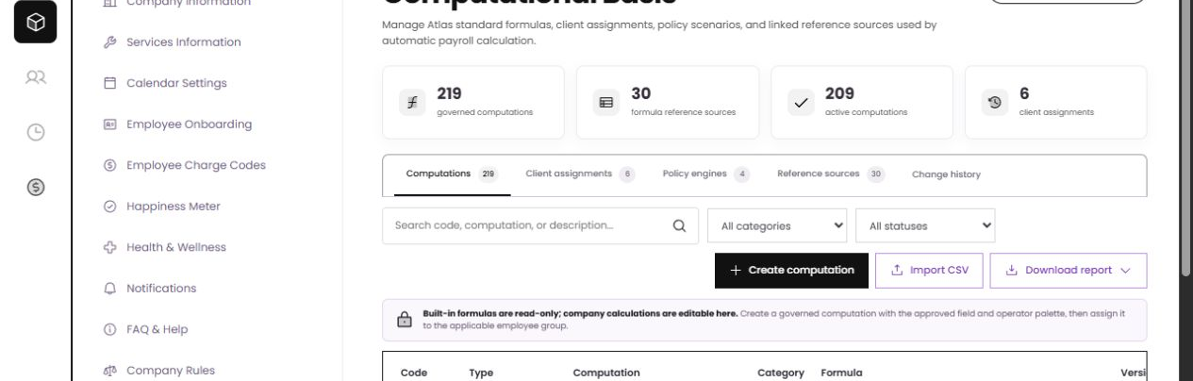
THE CONTROLLED WORKSPACE
WIREFRAME
One workspace governs the calculation lifecycle
219
30
4
6
Client view
governed computations
reference sources
pay policy engines
client assignments
Built-ins stay controlled. Company-owned calculations and assignments remain configurable.
ATLAS / WORKSPACE
03
Notes:
Presenter cue: Use the tabs as the mental model: formulas, assignments, engines, sources, and history. Avoid treating the inventory counts as final contractual totals until the source discrepancy is reconciled.
[Sources]
- ATLAS wireframe, Computational Basis client view, captured 2026-08-10.
- Phase 2 - Payroll - Project Plan.xlsx, Computational Basis requirements; source materials contain an inventory/target discrepancy between 219 and roughly 300 computations, and between 18 and 30 reference tables.
[/Sources]

Slide 4
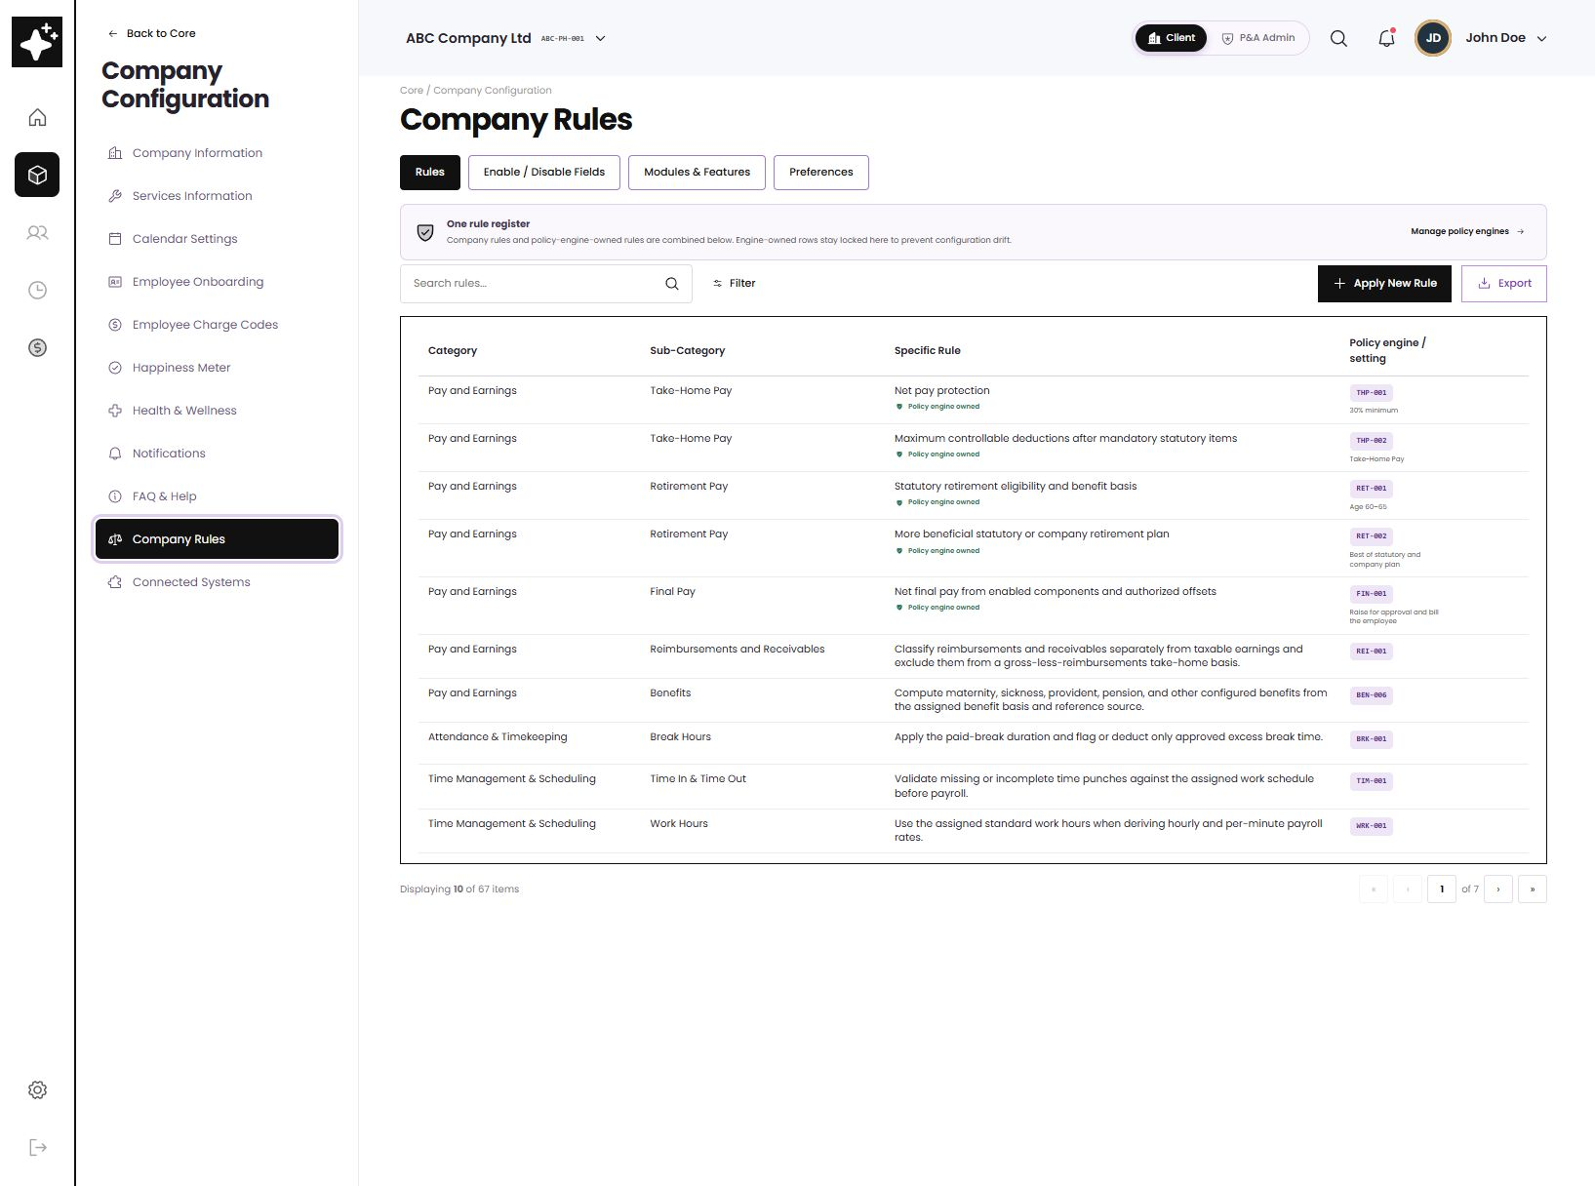
COMPANY RULES
GOVERNANCE
One rule register—without duplicating engine settings
Payroll users can see every active rule in one place and open the owning policy engine when values need to change.
Engine-owned rows
Locked in the register to prevent drift.
Company-owned rules
Editable, searchable, exportable.
Open policy engine
Navigate directly to the live values.
ATLAS / COMPANY RULES
04
Notes:
Presenter cue: Show that Take-Home Pay, Retirement Pay, and Final Pay appear in the same register as ordinary company rules, but their values remain owned by the policy engine. This is the control that prevents two copies of the same setting.
[Sources]
- ATLAS wireframe, Company Rules client view, captured 2026-08-10.
- Phase 2 BRD Audit Summary.xlsx, Rules Setup requirement H61:I61 and computational-basis notes J63:J64.
[/Sources]

Slide 5
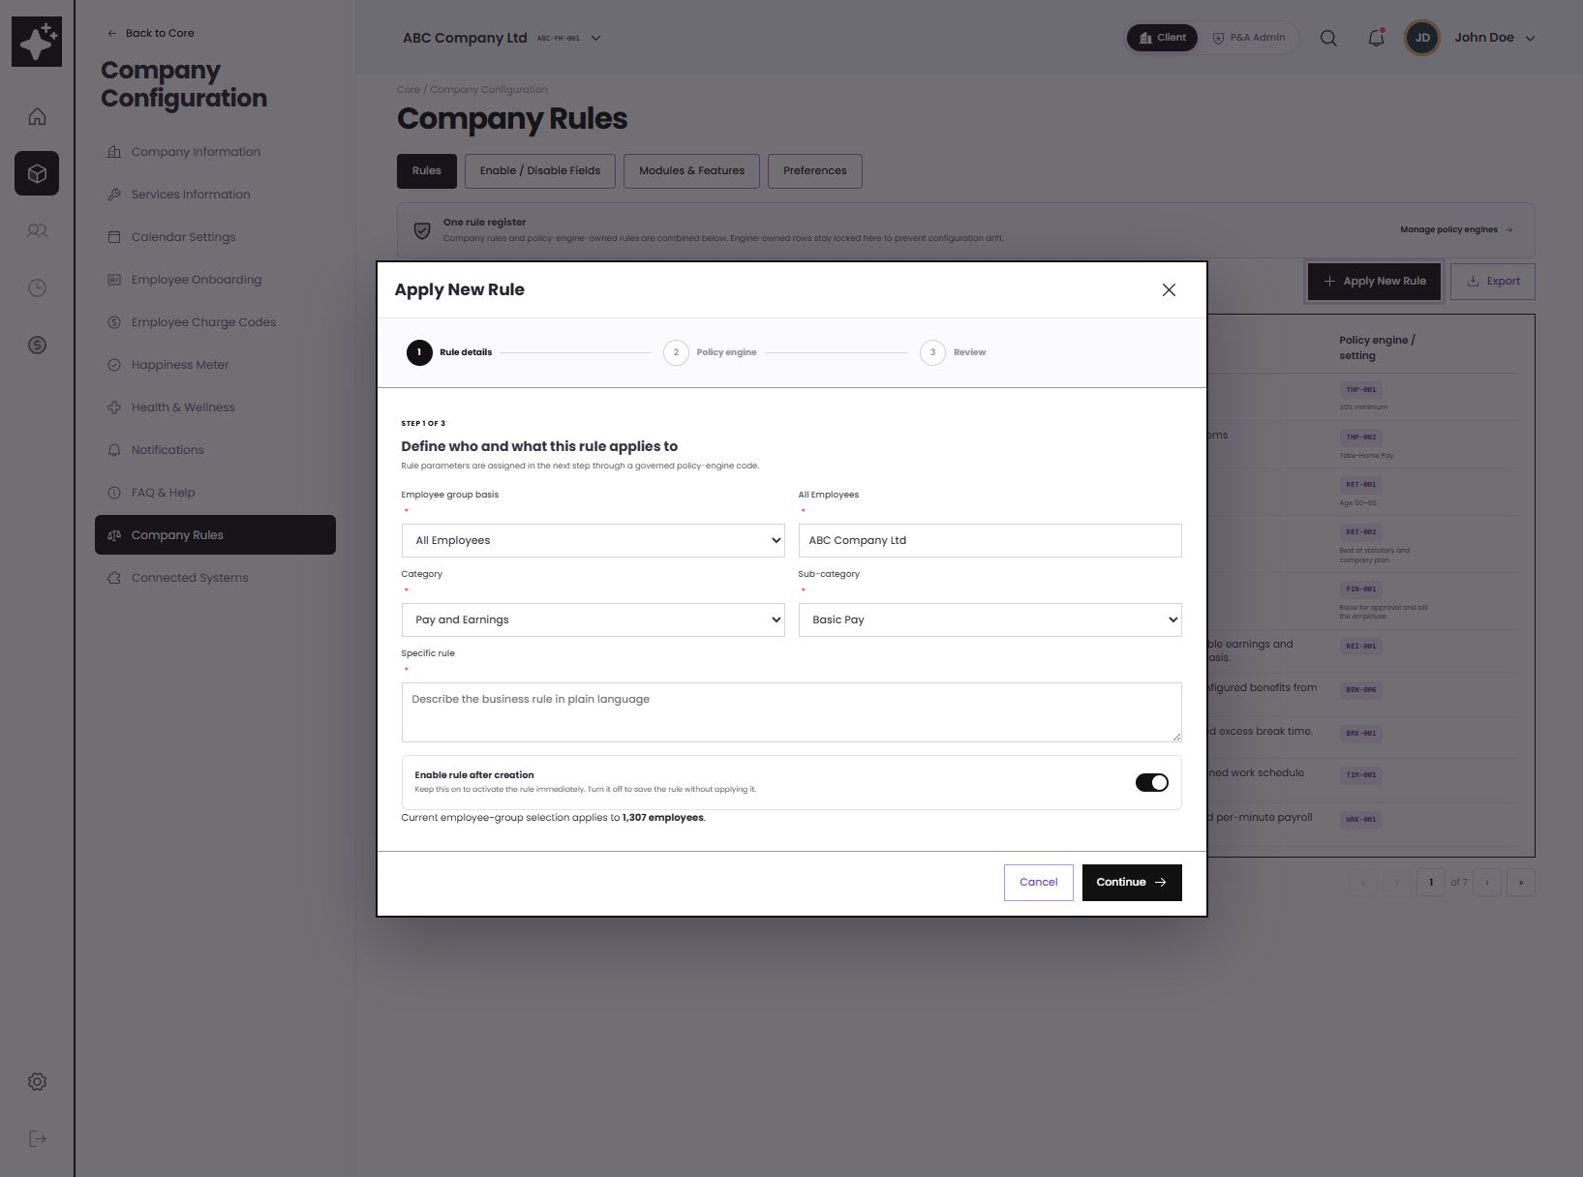
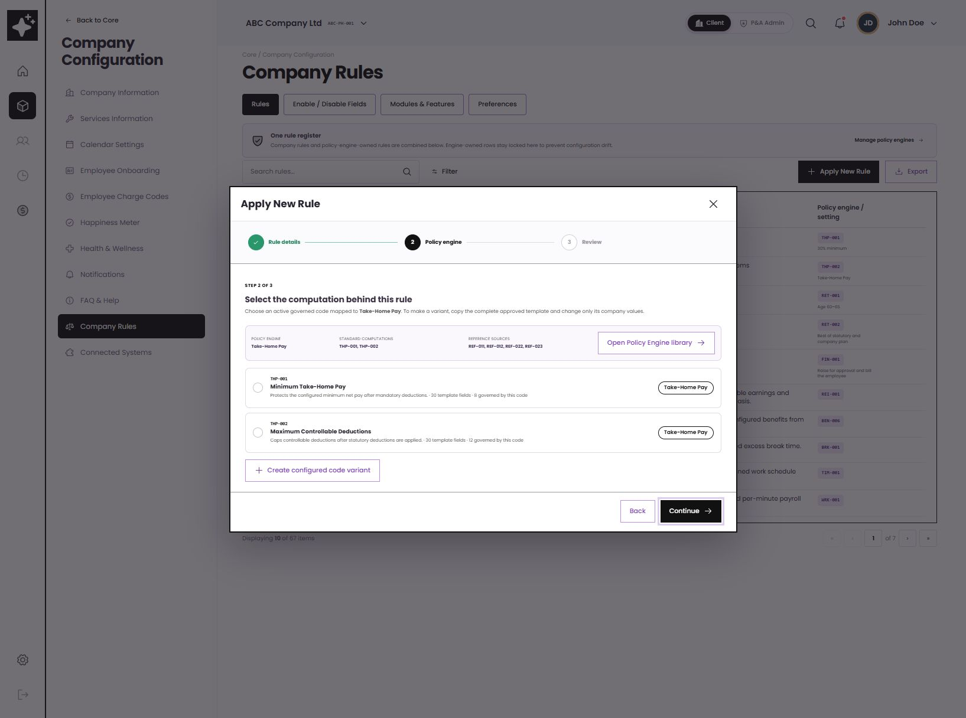
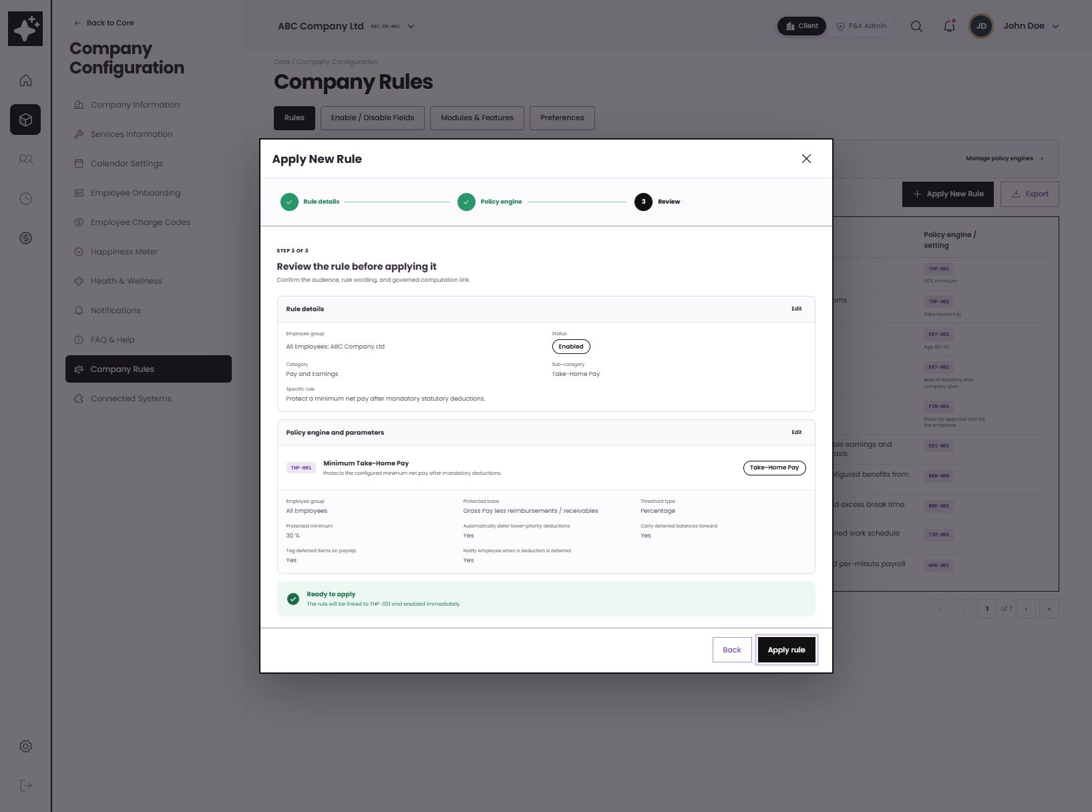
APPLY NEW RULE
3-STEP FLOW
Scope first. Governed calculation second. Review before activation.
1 Rule details
2 Policy engine
3 Review
Who, category, sub-category, plain-language rule
Choose a mapped code or create a configured variant
Confirm live parameter values before applying
ATLAS / RULE FLOW
05
Notes:
Presenter cue: Walk left to right. The sub-category is selected from governed options, the policy code is filtered to that sub-category, and the review screen exposes the effective values rather than hiding them behind a code.
[Sources]
- ATLAS wireframe, Apply New Rule steps 1-3, captured 2026-08-10.
- Phase 2 BRD Audit Summary.xlsx, company rule setup and employee/group assignment requirements.
- 02Annex B_ Employee Masterfile Payroll Data Tables from Dorado.xlsx, employee-group assignment examples in Take Home Pay and Retirement Pay tabs.
[/Sources]

Slide 6
TAKE-HOME PAY
THP-001 / THP-002
Take-home protection preserves the statutory layer first
EXCEL → APP
Base
₱36,500 − ₱2,000
₱34,500
Protected minimum
30% × ₱34,500
₱10,350
Statutory deductions
Applied in full
₱6,500
Lower-priority items
Reduce / defer
Carry forward
Policy options in the source are alternatives—not simultaneous constraints.
ATLAS / TAKE-HOME PAY
06
Notes:
Presenter cue: Use the example as a business translation: the selected basis is gross less reimbursements, the protected minimum is 30%, mandatory statutory deductions remain whole, and controllable items are the only ones reduced or deferred.
[Sources]
- 02Annex B_ Employee Masterfile Payroll Data Tables from Dorado.xlsx, Take Home Pay tab, A4:C183; includes alternative percentage, fixed-amount, loan-cap, LAUT-cap, hierarchy, deferral, notification, ledger, and employee-group examples.
- ATLAS wireframe, Take-Home Pay policy and scenario simulator, captured 2026-08-10.
[/Sources]

Slide 7
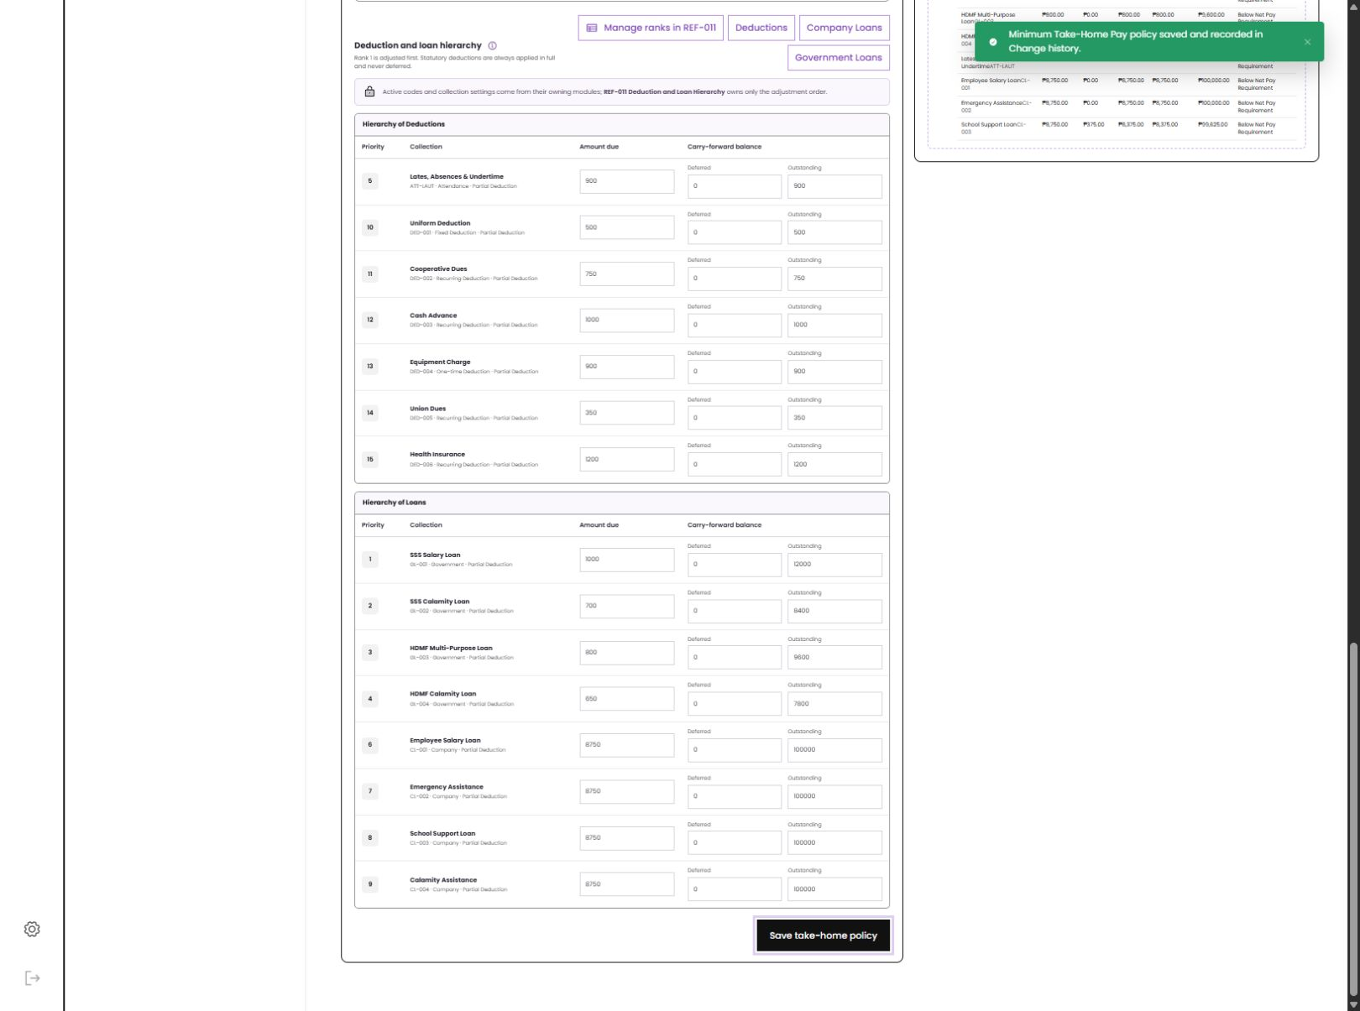
TAKE-HOME PAY DEPENDENCIES
INTERCONNECTED MODULES
Amounts stay with their owning modules; the engine owns the adjustment order
Deductions
Codes, due amounts, schedules
Company Loans
REF-011
Amortization and balances
Deduction & Loan Hierarchy
Government Loans
Priority only
SSS / HDMF collections
Statutory items remain mandatory; eligible lower-priority items may be deferred.
ATLAS / DEPENDENCIES
07
Notes:
Presenter cue: Stress module ownership. Take-Home Pay does not recreate loan or deduction setup. It reads the active collections, applies REF-011 ordering and the company threshold, and returns posted versus deferred amounts with carry-forward balances.
[Sources]
- 02Annex B_ Employee Masterfile Payroll Data Tables from Dorado.xlsx, Take Home Pay tab, hierarchy and carry-forward sections A90:C158; Deductions and Loans source tabs.
- ATLAS wireframe, Take-Home Pay hierarchy showing navigation to Deductions, Company Loans, Government Loans and REF-011, captured 2026-08-10.
[/Sources]

Slide 8
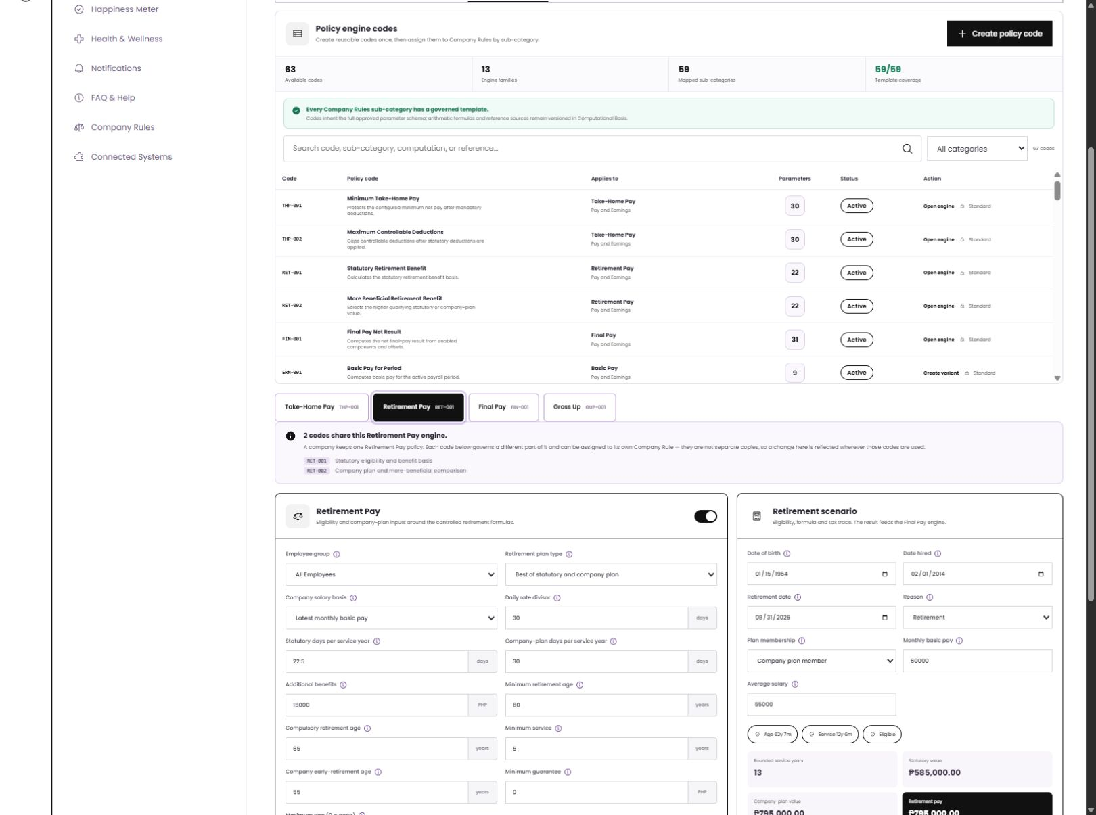
RETIREMENT PAY
RET-001 / RET-002
Eligibility, service rounding, and the more-beneficial result are visible
SOURCE EXAMPLE
₱20,000 ÷ 30
× 22.5 days × 10 years
= ₱150,000
Wireframe scenario
12y 6m → 13 years
Statutory ₱585,000
Company plan ₱795,000
System uses the higher qualifying value.
ATLAS / RETIREMENT PAY
08
Notes:
Presenter cue: Start with the simple source example, then point to the richer app scenario. The business can configure plan type, salary basis, divisor, days per service year, eligibility, rounding, tax treatment, caps, and additional benefits; the simulator compares qualifying values.
[Sources]
- 02Annex B_ Employee Masterfile Payroll Data Tables from Dorado.xlsx, Retirement Pay tab, A1:C72.
- 05Sample Computation - Retirement.xlsx, Definition and Retirement tabs; example monthly pay ₱20,000, 22.5 days, 10 years, result ₱150,000.
- ATLAS wireframe, Retirement Pay policy and scenario, captured 2026-08-10.
[/Sources]

Slide 9
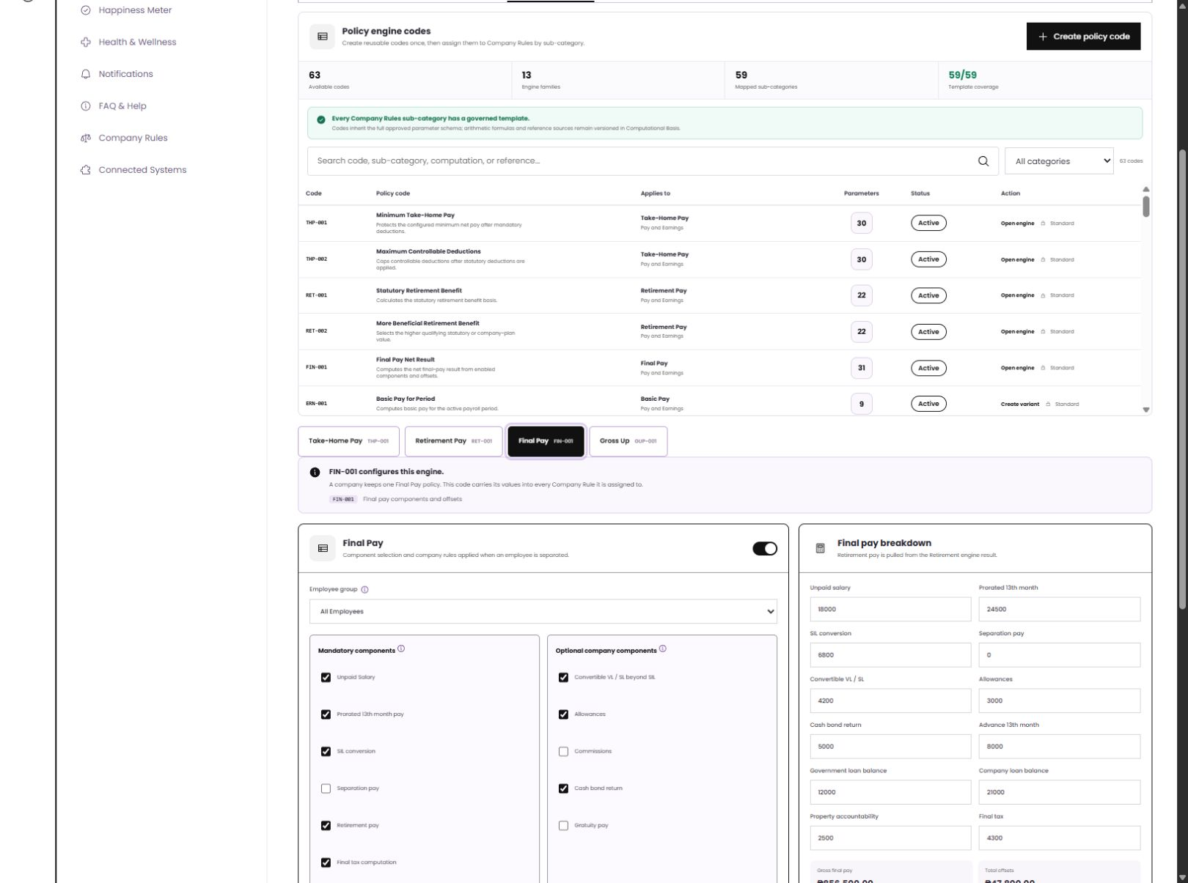
FINAL PAY
FIN-001
Final pay assembles approved components, then applies offsets and tax
1
Earnings
Unpaid salary, 13th month, leave, allowances
2
Linked benefit
Retirement result when applicable
3
Authorized offsets
Government loans, company loans, accountabilities
4
Tax + net
Final/annualized tax and itemized breakdown
Retirement is pulled from RET—not recomputed here.
ATLAS / FINAL PAY
09
Notes:
Presenter cue: Show the dependency chain. Final Pay is the assembly point: it turns on applicable components, pulls leave/timekeeping and retirement results, offsets authorized balances, applies tax treatment, and produces an itemized final-pay result.
[Sources]
- 02Annex B_ Employee Masterfile Payroll Data Tables from Dorado.xlsx, Final Pay tab, A2:B36.
- Phase 2 BRD Audit Summary.xlsx, Final Pay setup and assignment requirements H55:J55.
- ATLAS wireframe, Final Pay configuration and breakdown, captured 2026-08-10.
[/Sources]

Slide 10
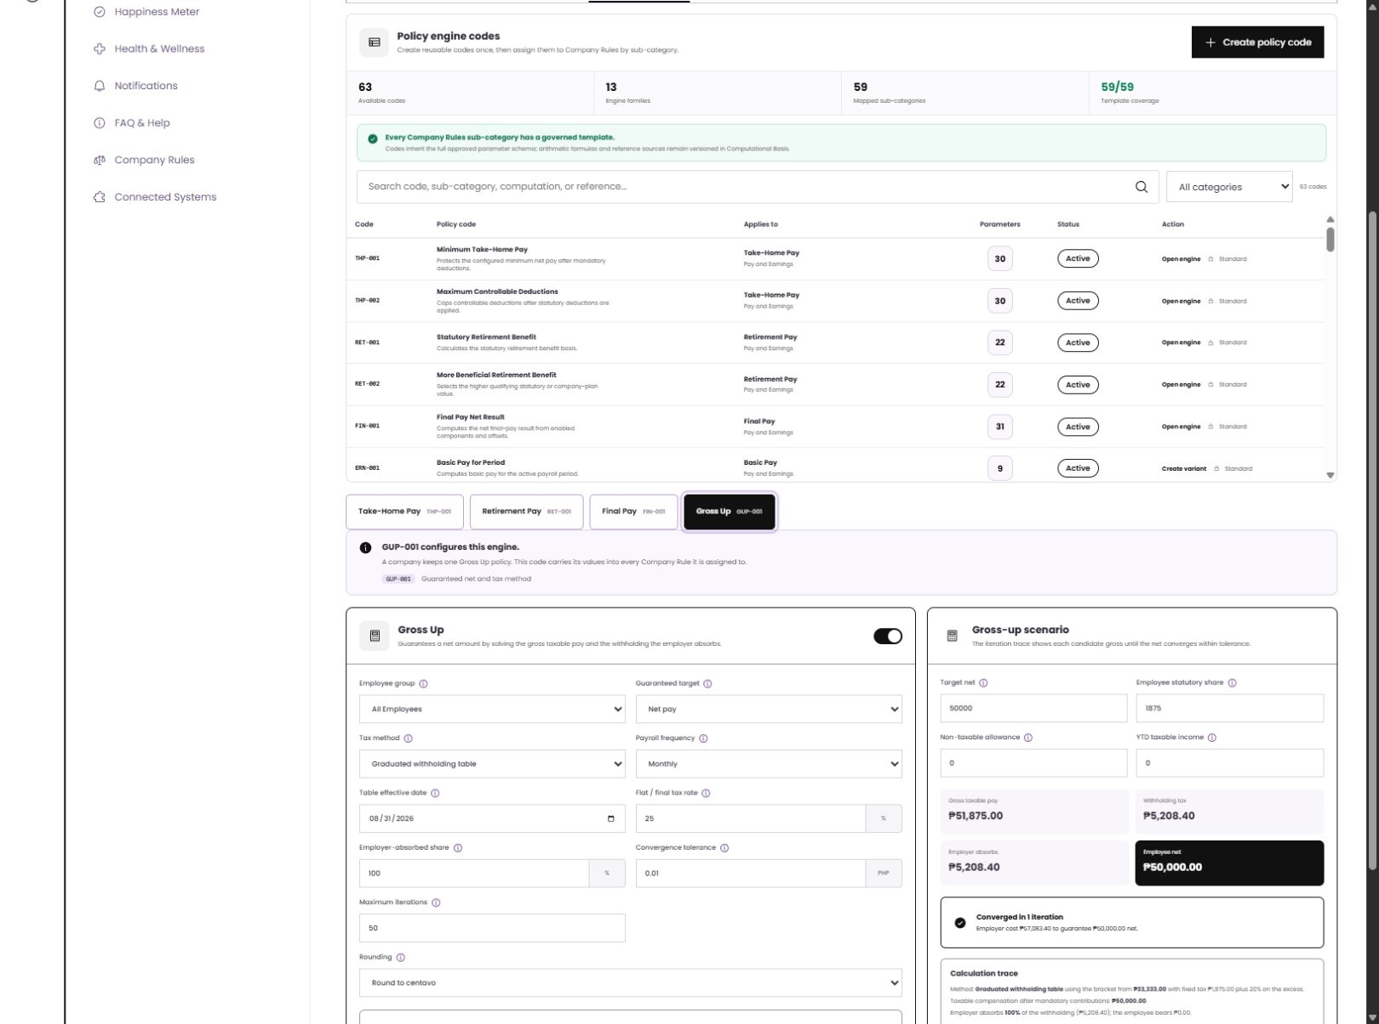
GROSS UP
GUP-001
Gross-up solves backward from the employee’s promised net
SOURCE EXAMPLE
Promised net
₱10,000
÷ (1 − 20%)
Gross required ₱12,500
Employer tax ₱2,500
The production flow uses the active tax table and iterates until the net converges within tolerance.
ATLAS / GROSS UP
10
Notes:
Presenter cue: The simple example explains the principle. The wireframe generalizes it: select the target, tax method, effective table date, employer share, tolerance, iterations and rounding, then show the candidate gross and calculation trace.
[Sources]
- 02Annex B_ Employee Masterfile Payroll Data Tables from Dorado.xlsx, Gross Up tab, A2:B18.
- 04Sample Gross Up of Earnings.xlsx, Gross up Earnings and Tax computation tabs; simple net ₱10,000 / (1-20%) example.
- 06Sample Computation and Gross Up_Final Tax.xlsx, Final Tax and Gross Up tabs.
- ATLAS wireframe, Gross Up configuration and scenario, captured 2026-08-10.
[/Sources]

Slide 11
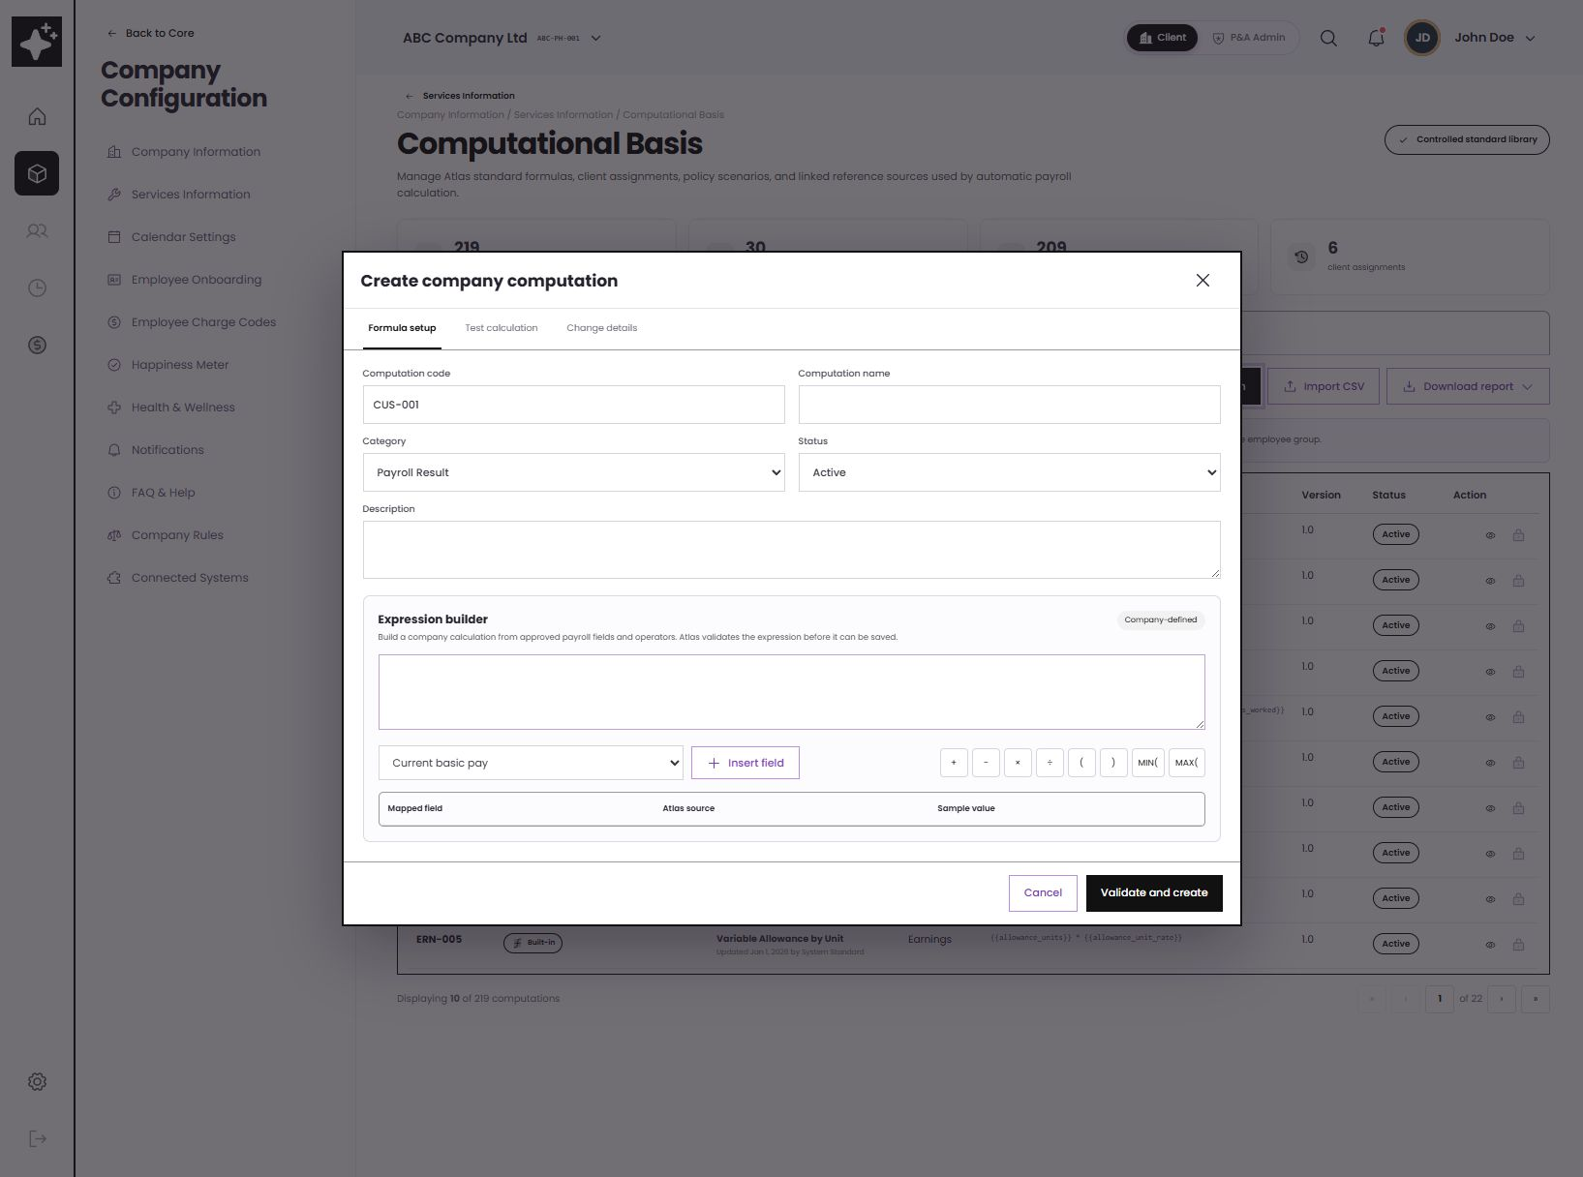
COMPANY CALCULATIONS
CONTROLLED FLEXIBILITY
Clients can create a calculation without changing the standard library
01
Choose approved payroll fields
02
Build with allowed operators
03
Validate and test the expression
04
Save as company-owned and assign
Control boundary
Built-ins stay read-only; company-owned formulas are editable.
ATLAS / CUSTOM COMPUTATION
11
Notes:
Presenter cue: This resolves the source conflict safely. Atlas standard computations stay controlled; a client may create a company-owned computation only through the approved field and operator palette, with validation before save.
[Sources]
- Phase 2 - Payroll - Project Plan.xlsx, HTP019 and HTP073-HTP075; source wording conflicts between customizable/add-edit behavior and no creation of new standard computations.
- ATLAS_Phase2_Master_Requirements_for_Codex_Claude.md, section 8.1 conflict note.
- ATLAS wireframe, Create company computation modal, captured 2026-08-10.
[/Sources]

Slide 12
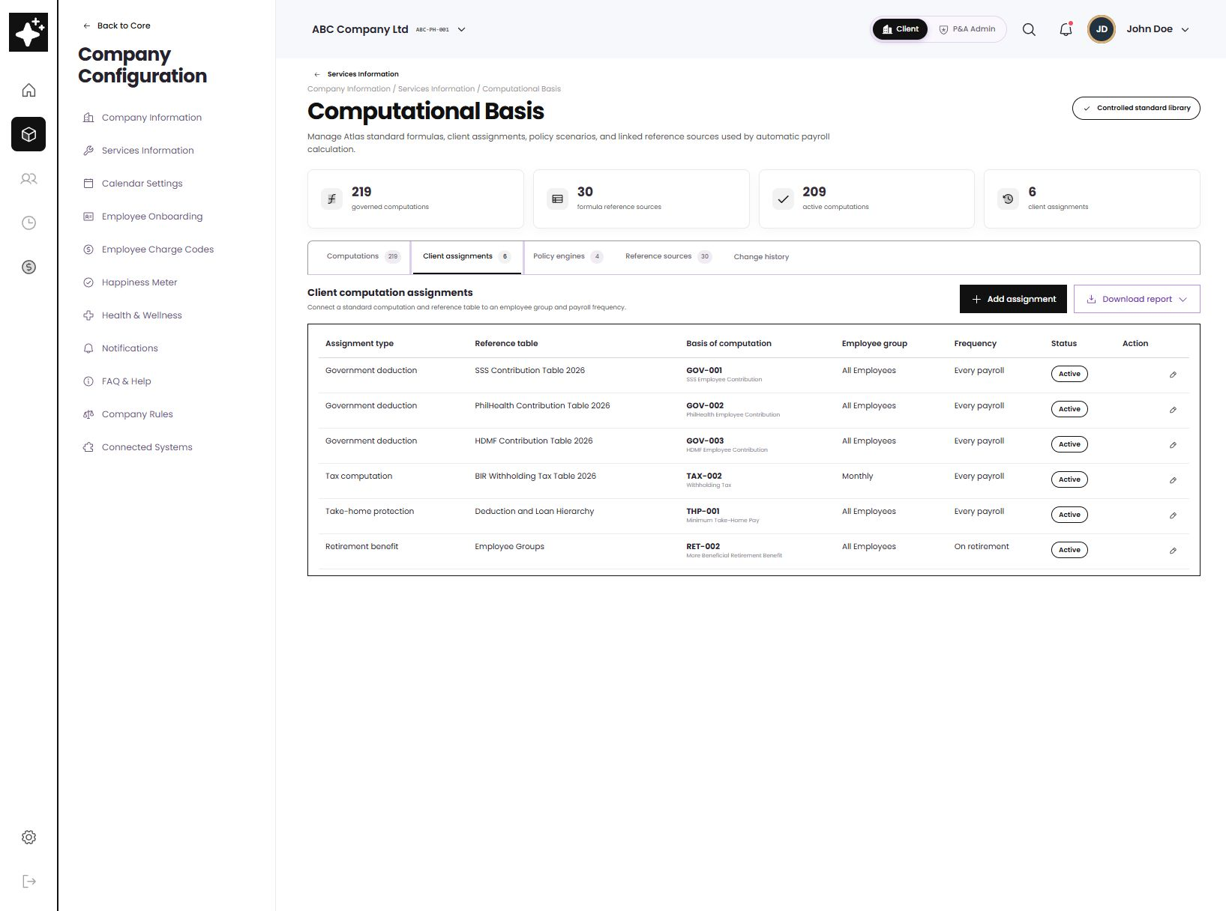
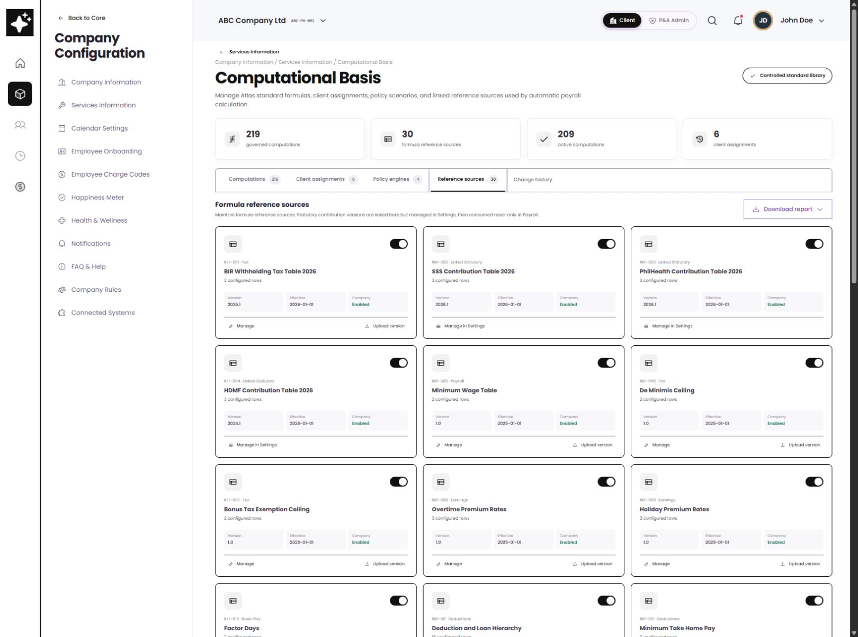
ASSIGNMENTS AND REFERENCE SOURCES
DATA GOVERNANCE
The formula, its effective data, and its audience remain separately controlled
CLIENT ASSIGNMENTS
REFERENCE SOURCES
FORMULA
EFFECTIVE DATA
AUDIENCE
FREQUENCY
ATLAS / GOVERNANCE
12
Notes:
Presenter cue: Show that a calculation does not become active merely because it exists. A client assignment links the approved computation to a reference version, employee group and frequency. Reference tables remain effective-dated and can be enabled per client.
[Sources]
- Phase 2 - Payroll - Project Plan.xlsx, HTP023 and HTP073-HTP075.
- PHASE 2 - REFERENCE TABLE [CORE].xlsx and ATLAS-3001 Reference Tables.docx, reference-table inventory and administration requirements.
- ATLAS wireframe, Client assignments and Reference sources views, captured 2026-08-10.
[/Sources]

Slide 13
RECOMMENDED BUSINESS DEMO SEQUENCE
LIVE WALKTHROUGH
Four actions tell the complete story
1
2
3
4
Choose a payroll scenario
Configure company values
Run the scenario
Apply the Company Rule
Take-home, retirement, final pay, or gross-up
Basis, thresholds, components, eligibility
See the result and calculation trace before payroll
Select the audience, code, review, and activate
Business validation questions
Correct basis?
Correct precedence?
Correct employee group?
Correct output?
Clear audit trail?
ATLAS / DEMO FLOW
13
Notes:
Presenter cue: Use this slide as the live-demo script. For each engine, business owners should validate the basis, ordering, assignment scope, result and trace—not just whether the screen can save.
[Sources]
- ATLAS wireframe workflow captured 2026-08-10.
- ATLAS_Phase2_Master_Requirements_for_Codex_Claude.md, confirmed intent for validation, exception alerts, employee/admin notification, audit logging and deterministic policy traces.
[/Sources]

Slide 14
BUSINESS TAKEAWAY
Payroll policy becomes
visible, testable, and traceable.
VISIBLE
TESTABLE
TRACEABLE
The rule, owning engine, and effective values are shown together.
Payroll can run a scenario before using the policy in payroll.
Source, version, assignment, result, and change history stay linked.
Next business workshop
Validate one representative scenario per engine • confirm employee groups • confirm owners and effective dates
14
Notes:
Presenter cue: Close the main presentation here. Ask the business to validate one representative scenario for each engine and to confirm employee-group assignments, data owners and effective dates. The remaining slides are the sourced annex.
[Sources]
- Synthesis of supplied payroll workbooks, requirements summary, and ATLAS wireframe evidence cited throughout slides 2-13.
[/Sources]

Slide 15
ANNEX A
TRACEABILITY
Requirement-to-wireframe map
Business area
Source of truth
Wireframe translation
Demo evidence
Take-Home Pay
Annex B — Take Home Pay
BRD Audit H54:J54
THP-001/002 + REF-011 + deferral and module links
Slides 6–7
Retirement Pay
Annex B — Retirement Pay
Retirement sample workbook
RET-001/002 + eligibility, rounding, plan comparison
Slide 8
Final Pay
Annex B — Final Pay
BRD Audit H55:J55
FIN-001 + leave, retirement, loans, accountabilities, tax
Slide 9
Gross Up
Annex B — Gross Up
Gross-up sample workbooks
GUP-001 + target net, tax method, iteration trace
Slide 10
Company Rules
BRD Audit H61:J64
Project Plan HTP018/019/023
One register + 3-step mapped policy-code flow
Slides 4–5
Interpretation rule: source samples are configurable policy options; they are not all applied at once.
ATLAS / ANNEX A
15
Notes:
Presenter cue: Use this table when a stakeholder asks where a screen came from. It points to the source tab and the exact wireframe object used in the main story.
[Sources]
- 02Annex B_ Employee Masterfile Payroll Data Tables from Dorado.xlsx, Take Home Pay, Retirement Pay, Final Pay and Gross Up tabs.
- Phase 2 BRD Audit Summary.xlsx, computational-basis, rules and reference-table rows cited in the table.
- Phase 2 - Payroll - Project Plan.xlsx, HTP018, HTP019, HTP023, HTP073-HTP075.
[/Sources]

Slide 16
ANNEX B
SCENARIO PACK
Representative business validation scenarios
01
Take-Home
02
Retirement
INPUT
30% of gross less reimbursements
INPUT
₱20k monthly / 30 × 22.5 × 10
EXPECTED
Statutory full; controllable items stop or defer
EXPECTED
₱150,000 statutory example
03
Final Pay
04
Gross Up
INPUT
Salary + 13th + leave + retirement
INPUT
₱10k net at 20% simple rate
EXPECTED
Less authorized balances and final tax
EXPECTED
₱12,500 gross; ₱2,500 employer tax
Use these as starting cases. Add client-specific exceptions only after the base outcome is agreed.
ATLAS / ANNEX B
16
Notes:
Presenter cue: These are workshop-friendly starting cases derived from the supplied files. Use them to agree the expected result before expanding into exceptions and edge cases.
[Sources]
- 02Annex B_ Employee Masterfile Payroll Data Tables from Dorado.xlsx, Gross Up, Take Home Pay, Retirement Pay and Final Pay tabs.
- 04Sample Gross Up of Earnings.xlsx and 05Sample Computation - Retirement.xlsx.
[/Sources]

Slide 17
GLOSSARY
PLAIN LANGUAGE
Six terms used in the demo
Computation
Policy code
A controlled formula that produces a payroll value.
A reusable company configuration of an approved engine/template.
Company Rule
Reference source
The audience, business wording, category and activation link.
Versioned data used by formulas: tax, contributions, ceilings, hierarchy.
Client assignment
Scenario simulator
The link between a computation, data source, group and frequency.
A safe preview of the result and decision trace before payroll.
ATLAS / GLOSSARY
17
Notes:
Presenter cue: Use this only if terminology becomes a distraction during discussion. The separation between computation, policy code, rule and assignment is the key distinction.
[Sources]
- Terminology aligned to the ATLAS wireframe information architecture and supplied requirement documents.
[/Sources]

Slide 18
SOURCES
SOURCE OF TRUTH
Files used to derive this wireframe story
PRIMARY PAYROLL TABLES
COMPUTATION EXAMPLES
02Annex B_ Employee Masterfile Payroll Data Tables from Dorado.xlsx
Tabs: Gross Up, Take Home Pay, Retirement Pay, Final Pay, Pay Items, Deductions, Loans
05Sample Computation - Retirement.xlsx
04Sample Gross Up of Earnings.xlsx
06Sample Computation and Gross Up_Final Tax.xlsx
PROJECT / BRD ALIGNMENT
CONSOLIDATED REQUIREMENTS
Phase 2 - Payroll - Project Plan.xlsx
Phase 2 BRD Audit Summary.xlsx
Tabs/rows: Modules and Features, HTP018/019/023, HTP073-075, H54-55, H61-64
ATLAS_Phase2_Master_Requirements_for_Codex_Claude.md
Sections 8, 11, 12 and source inventory
REFERENCE TABLES
WIREFRAME EVIDENCE
PHASE 2 - REFERENCE TABLE [CORE].xlsx
ATLAS-3001 Reference Tables.docx
ATLAS local prototype
http://localhost:5173/wireframe
Client view captured 10 Aug 2026
Interpretation notes
Source samples are treated as configurable alternatives. Built-in formulas remain controlled; company-owned calculations use approved fields/operators. Inventory targets (219 vs ~300 computations; 18 vs 30 reference tables) require business reconciliation before production sign-off.
ATLAS / SOURCES
18
Notes:
Presenter cue: This is the derivation record. Call out the two inventory discrepancies and the implementation interpretation around company-created calculations. Statutory rates and effective values must be validated by the designated business/legal owner before production.
[Sources]
- All source files listed on this slide were supplied by the user and inspected locally for this deck.
- ATLAS wireframe, http://localhost:5173/wireframe, captured 2026-08-10.
[/Sources]

