Slide 1
ATLAS PHASE 2 · PAYROLL
Computational Basis
How your take-home pay, retirement, final pay and gross-up rules
work inside the application
Take-Home Pay
Retirement Pay
Final Pay
Gross Up
Working prototype · wireframe view · every screen in this deck is a live screenshot
Notes:
Purpose: show the payroll team that their written policies in Annex B are now configurable, computable and traceable in the application. Every screenshot is taken from the running prototype in wireframe view.

Slide 2
AGENDA
What we will walk through
1
The chain
Your written policy becomes a governed code, then a Company Rule, then a payroll result.
2
Four engines
Take-Home Pay, Retirement Pay, Final Pay and Gross Up — each configured, each with a live scenario.
3
Worked examples
The same numbers your Annex B samples use, computed on screen.
4
What it connects to
Company Rules, reference tables, statutory tables and the employee masterfile.
5
Traceability
Appendix maps every screen back to the exact workbook rows it came from.
Notes:
Frame the session: this is about traceability from their Excel to a working screen, not about software internals.

Slide 3
THE IDEA IN ONE PICTURE
From your written policy to a payroll result
1
2
3
4
5
Your policy
Governed code
Company Rule
Policy engine
Payroll result
Annex B, written in
plain business language
A reusable policy-engine
code, e.g. THP-001
Assigned to an employee
group with its own values
Computes and shows
its full working
Deductions, deferrals,
ledger and payslip tags
The same code can be reused by many rules. The values change per rule; the approved formula never does.
Source · BRD “Rules Set Up — Client-defined Rules”; Annex B Take Home Pay rows 113–156
Notes:
Key message: nobody edits a formula. They pick an approved code and set its values for a group of employees.

Slide 4
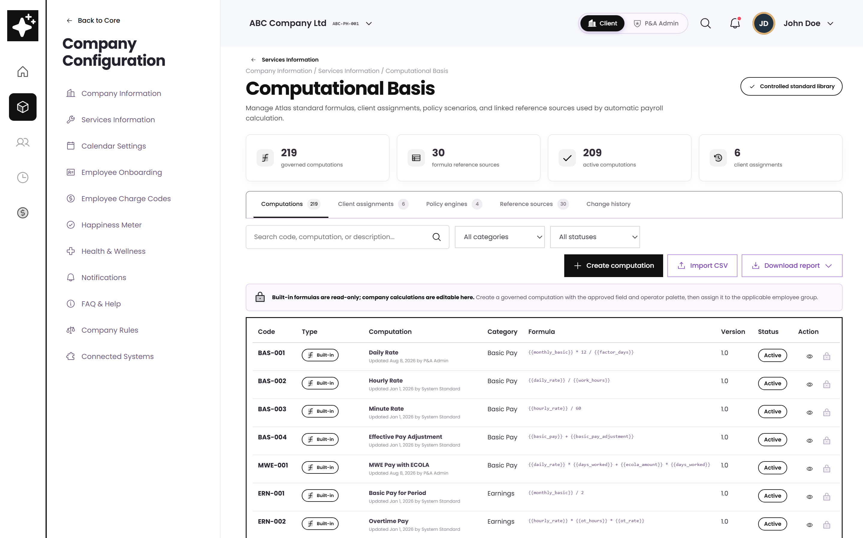
ORIENTATION
Where Computational Basis sits
One controlled library
Standard formulas, the client assignments that use them, the four policy engines, and the reference sources they read.
Nothing is hand-typed
Rates, brackets and ceilings live in versioned tables — not inside a formula.
Reached from
Company Configuration → Services Information → Computational Basis.
Computational Basis — wireframe view
Source · BRD Computational Basis Module (feature points 73–82)

Slide 5
SCOPE OF TODAY
The four policy engines
1
2
3
4
Take-Home Pay
Retirement Pay
Final Pay
Gross Up
THP-001 · THP-002
RET-001 · RET-002
FIN-001
GUP-001
Protects a minimum net pay and caps controllable deductions, deferring the rest in a set order.
Applies the statutory 22.5-day formula, compares it with the company plan, and takes the better one.
Adds every enabled component, offsets authorised balances, and returns a net final pay breakdown.
Solves the gross needed to guarantee a net amount, using the effective BIR withholding table.
Source · Annex B sheets: Take Home Pay · Retirement Pay · Final Pay · Gross Up
Notes:
Each engine has its own tab. The code beside the tab name is the governed policy code you assign in Company Rules.

Slide 6
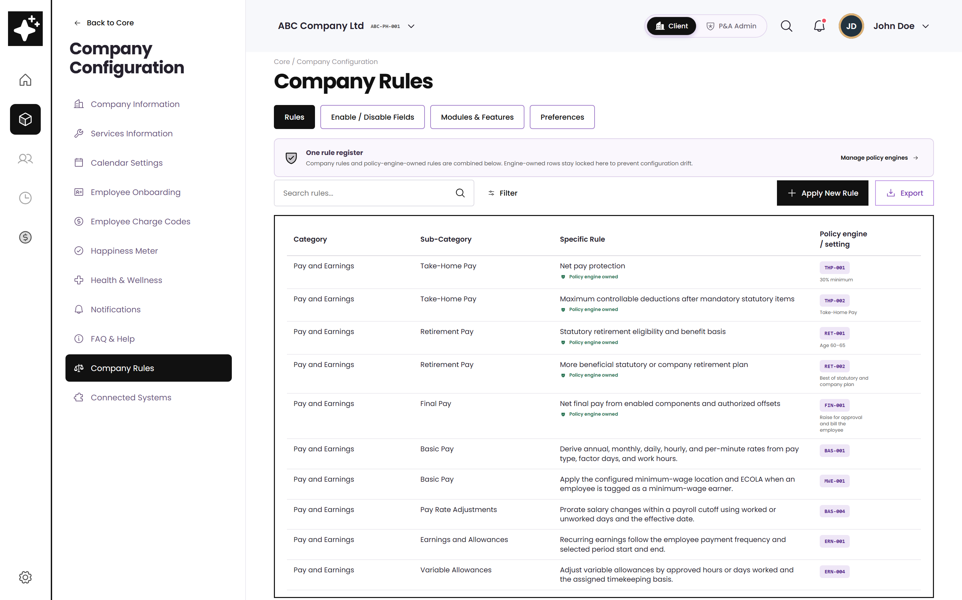
THE CONNECTION
Company Rules is where a policy is applied
One register
Every rule for the company, whichever engine computes it.
Engine-owned rows are locked
A rule backed by a policy engine can only be changed in that engine — so the register can never disagree with the calculation.
Apply New Rule
Three steps: who it applies to, which governed code, then the values.
Company Rules register — wireframe view
Source · BRD feature point 60, “Rules Set Up — Client-defined Rules”

Slide 7
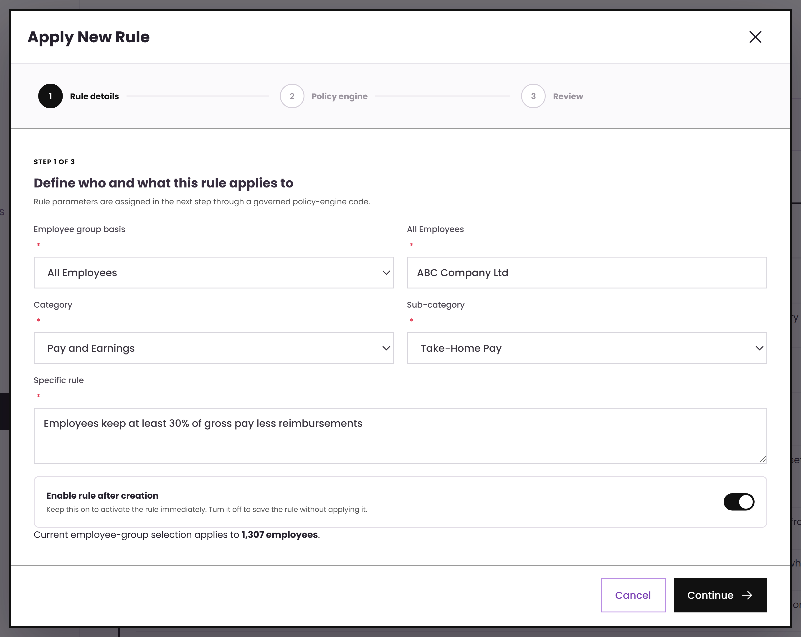
APPLYING A RULE
Step 1 — who and what it applies to
The rule in your own words
“Employees must receive at least 30% of their total gross pay less reimbursements / receivables.”
Employee group basis is chosen first, so the same policy can differ by group — exactly as your samples are written “(employee group assignment)”.
Source · Annex B “Take Home Pay” rows 21–27 (policy 3)
Notes:
This is the wording from their own sample policy 3, typed straight into the rule.

Slide 8
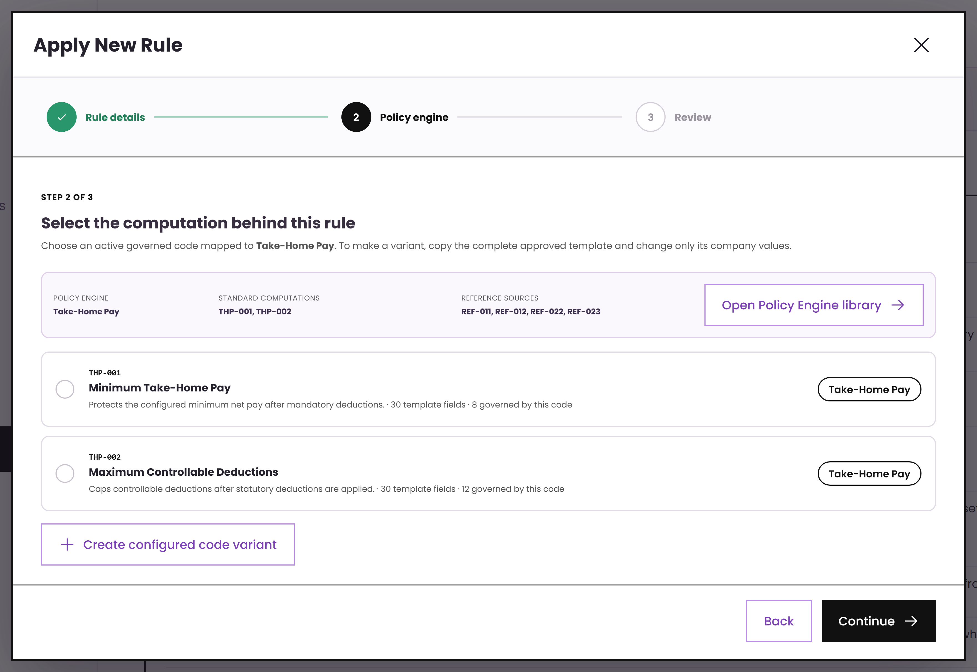
APPLYING A RULE
Step 2 — pick the governed computation
Only approved codes appear
The list is filtered to codes mapped to the chosen sub-category. A user cannot invent a formula here — they can only start a variant from an approved template.
THP-001 Minimum Take-Home Pay
THP-002 Maximum Controllable Deductions
Source · Annex B rows 4–5 (policy 1) and 45–51 (loan cap)
Notes:
Two codes on one engine: one governs the protected minimum, the other the caps. Both are assignable to their own rule.

Slide 9
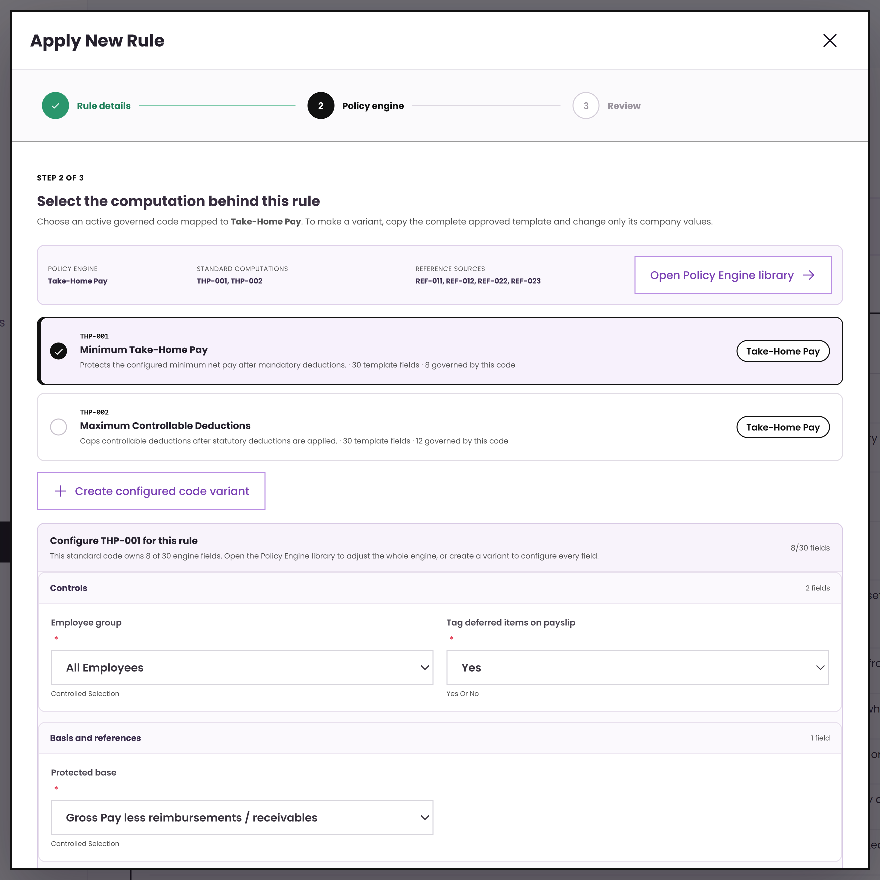
APPLYING A RULE
Step 3 — set the values for this rule
Values vary, the schema does not
The parameter list comes from the approved code. This rule sets its own base, threshold type and threshold — another rule on the same code can set different ones.
This is what makes one policy library serve many companies and many employee groups without copying formulas.
Source · Annex B rows 113–124, “Possible Company Set Up” 1–5
Notes:
Emphasise reuse: the schema is governed centrally, the values are the client decision.

Slide 10
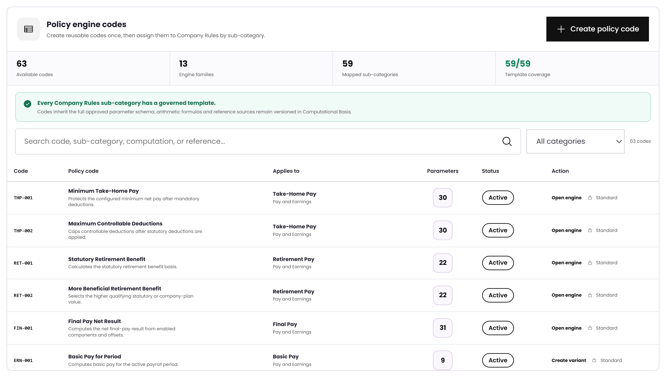
THE LIBRARY
Every sub-category has a governed code
Coverage is measured
The header shows how many Company Rules sub-categories already have an approved template behind them.
Standard vs variant
Standard codes are locked. A client variant starts from a standard code and only its values differ.
Open engine
Jumps straight to the engine that computes that code.
Policy engine code library — wireframe view
Source · BRD feature points 19–20, Computational Basis set-up

Slide 11
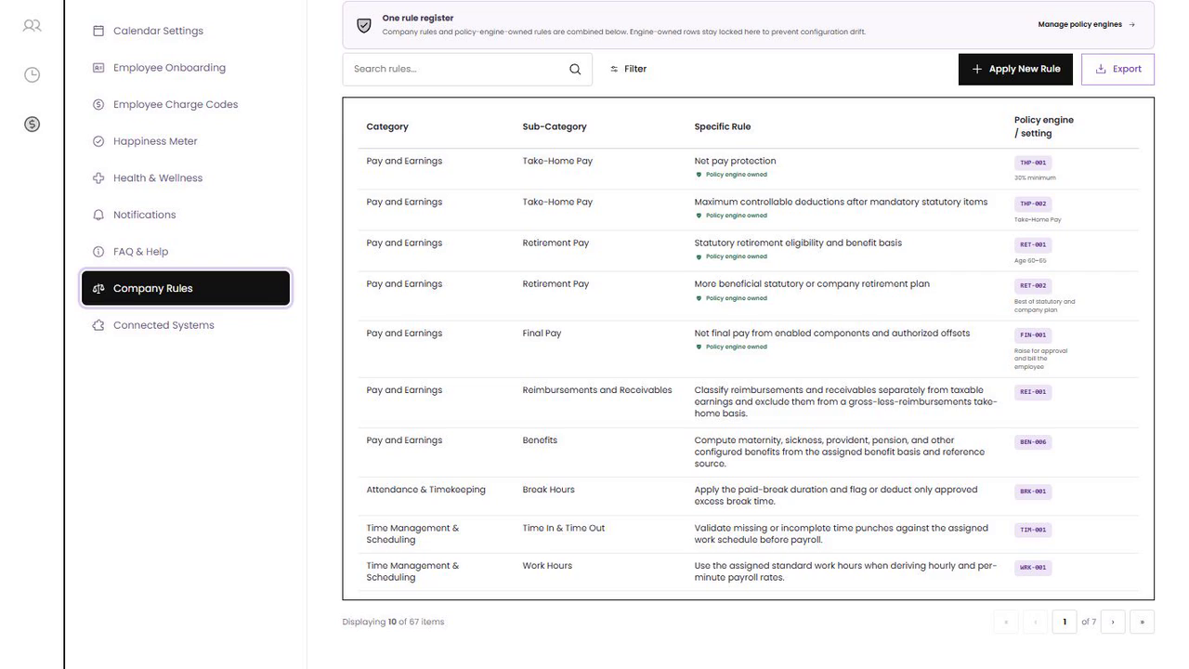
COMPANY RULES · DEMO
From business rule to governed computation
Watch the three-step flow
1 · Define the employee scope, category and plain-language rule.
2 · Select an approved policy-engine code. 3 · Review its parameters and linkage before applying.
▶ EMBEDDED 14-SECOND VIDEO · CLICK TO PLAY
Notes:
Demo cue: Atlas wireframe — Company Rules / Apply New Rule.
The 1280×720 MP4 is embedded in the slide. Select the video frame to play it in Slide Show mode.
[Sources]
- http://localhost:5173/wireframe (Atlas wireframe, captured 2026-08-10)
- C:\Users\josrp\OneDrive\Documents\Atlas\ATLAS_Demo_Videos\01-company-rules.mp4
[/Sources]

Slide 12
ENGINE 1 OF 4
Take-Home Pay
1
Protected minimum
2
Deduction and loan caps
Protect a minimum net pay, cap what can be deducted, and defer the rest in a defined order.
3
Adjustment hierarchy
4
Defer and carry forward

Slide 13
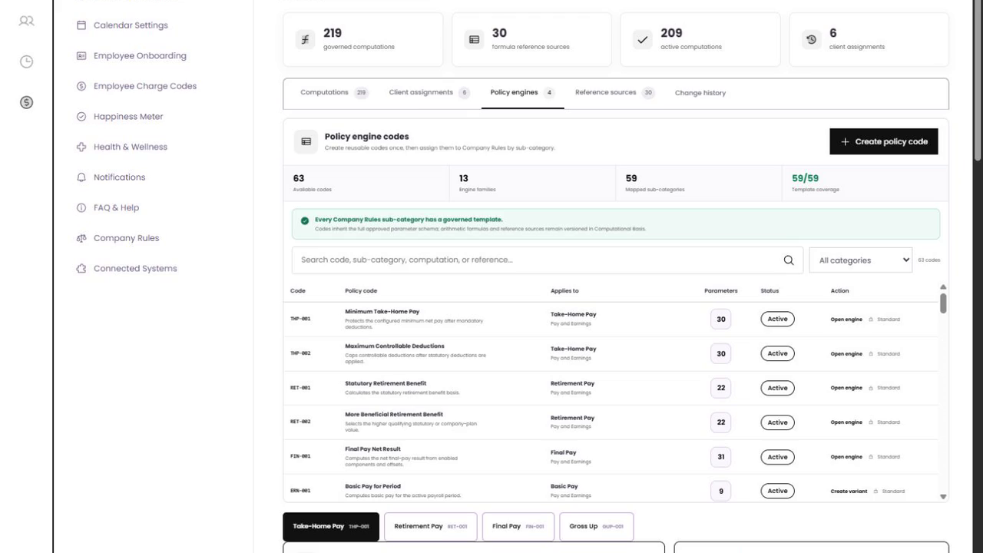
TAKE-HOME PAY · DEMO
Configure protection, caps and deferral
1 · Choose code
Open THP-001 from the governed library.
2 · Configure
Set the protected base, minimum threshold and deduction / loan caps.
3 · Validate
Use the simulator and deduction ledger before saving.
What to watch
▶ EMBEDDED 7-SECOND VIDEO · CLICK TO PLAY
Notes:
Demo cue: Atlas wireframe — THP-001 Minimum Take-Home Pay.
The 1280×720 MP4 is embedded in the slide. Select the video frame to play it in Slide Show mode.
[Sources]
- http://localhost:5173/wireframe (Atlas wireframe, captured 2026-08-10)
- C:\Users\josrp\OneDrive\Documents\Atlas\ATLAS_Demo_Videos\02-take-home-pay.mp4
[/Sources]

Slide 14
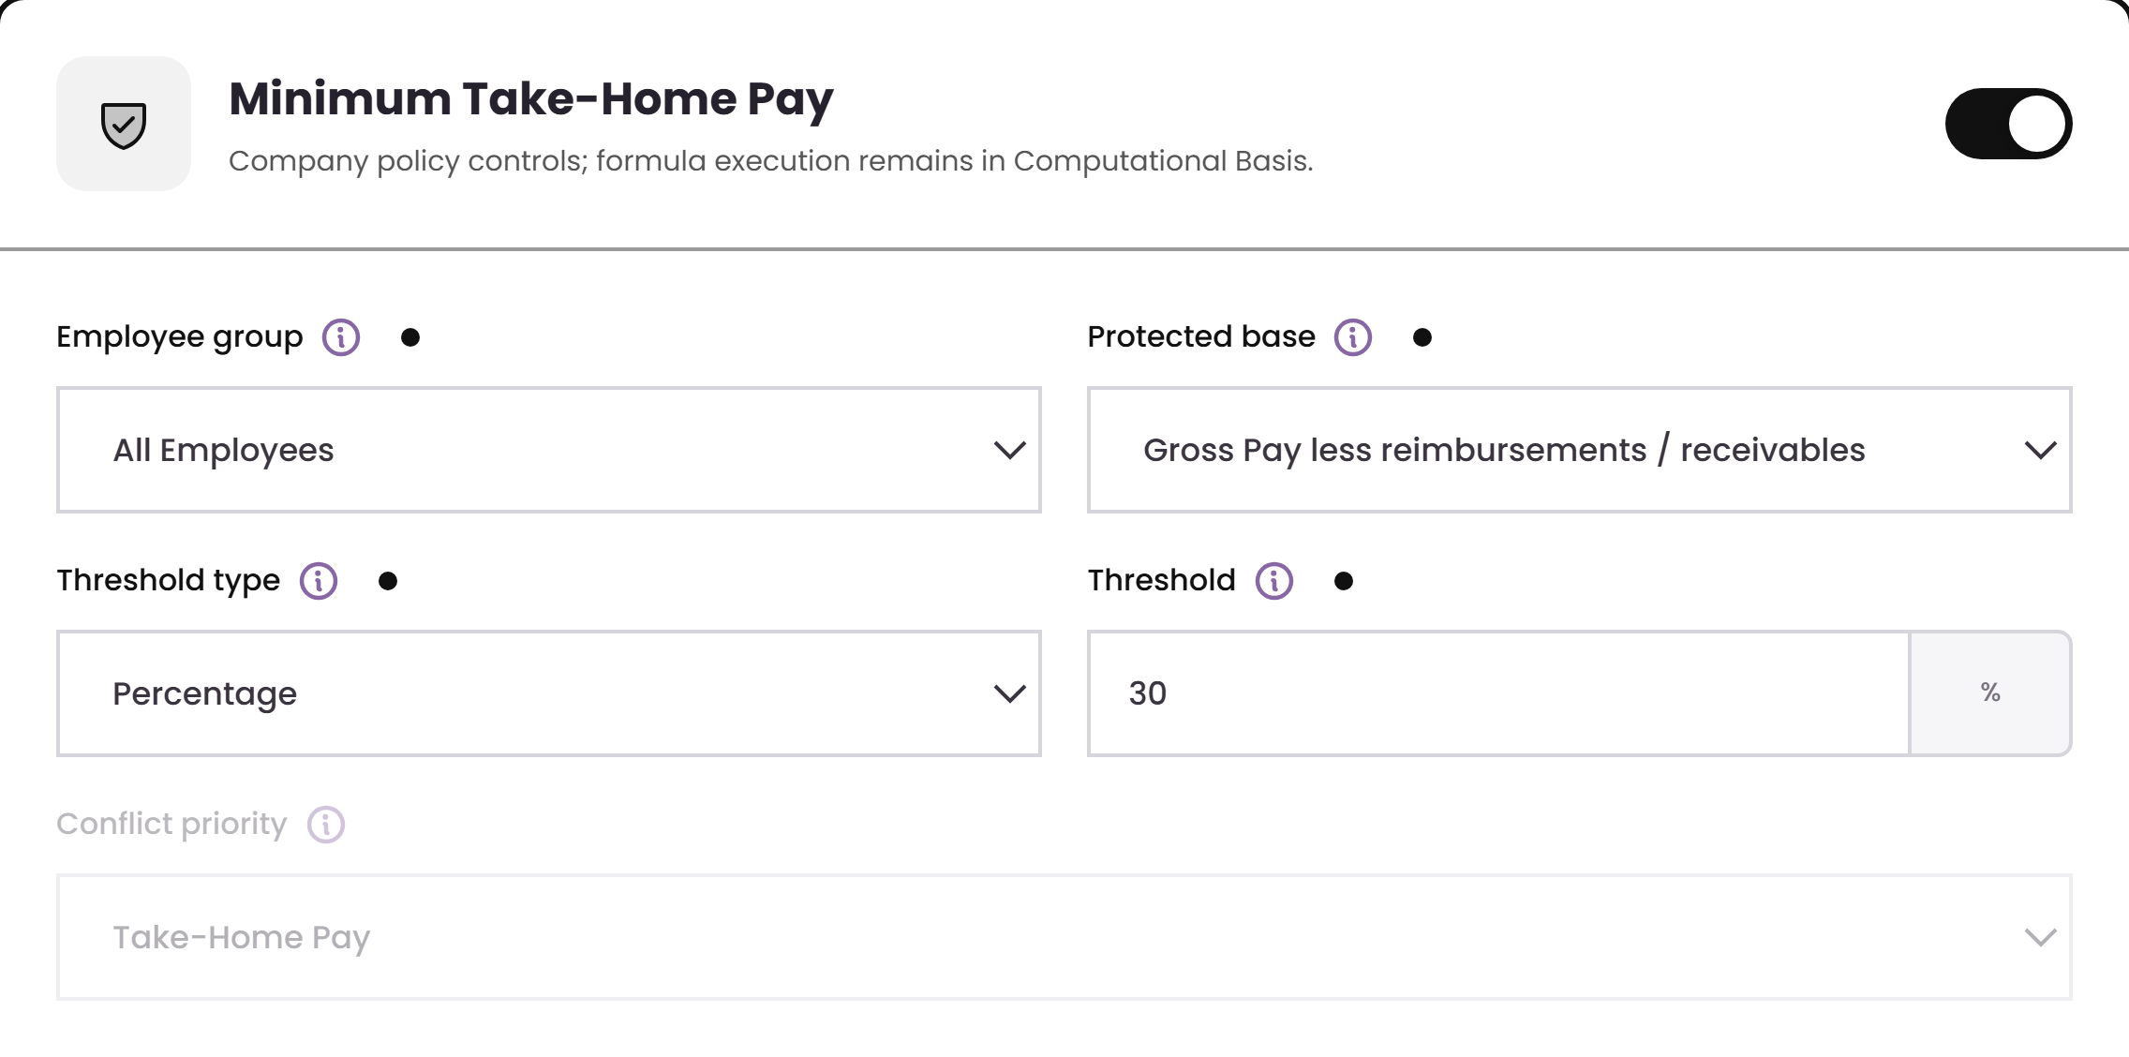
TAKE-HOME PAY · SETUP
Your protected minimum, configured
Base
Basic Pay · Gross Pay · Gross Pay less reimbursements — the three bases your samples describe.
Threshold
A percentage or a fixed peso amount, including zero.
Result
30% of ₱34,500 = a protected minimum of ₱10,350 for this scenario.
Minimum Take-Home Pay settings
Source · Annex B “Take Home Pay” rows 4, 13, 21, 29, 37

Slide 15
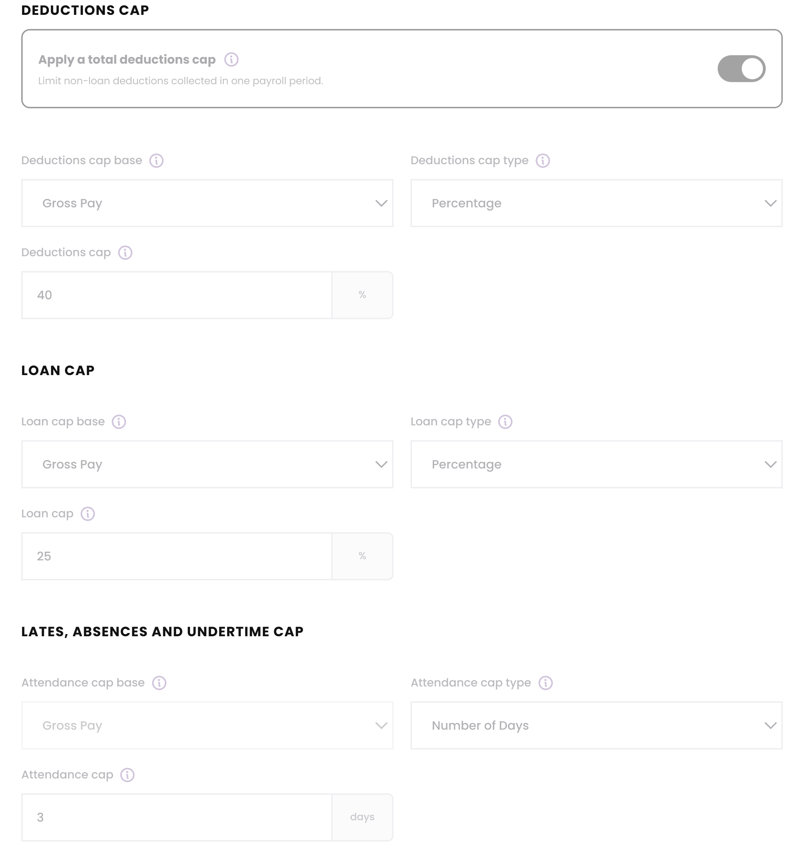
TAKE-HOME PAY · SETUP
Caps on deductions, loans and attendance
Loan cap
“Total loan repayments may not exceed 25% of gross salary” — or a fixed amount such as ₱10,000.
LAABS cap
Lates, absences and undertime capped by percentage, peso amount, or a number of days.
Conflict priority
When loans are already at their cap but net pay is still short, the company decides which rule wins.
Cap configuration
Source · Annex B rows 45–84 (caps) and 106–109 (conflict priority)

Slide 16
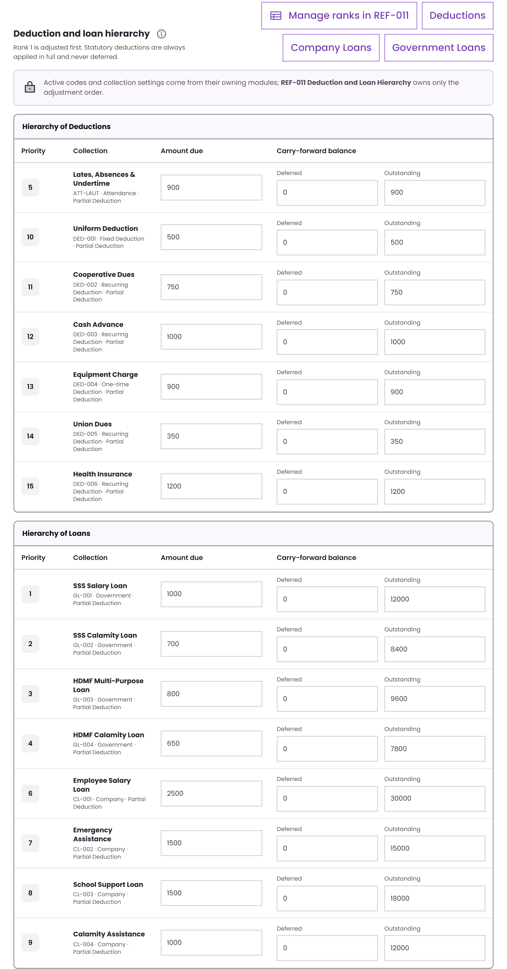
TAKE-HOME PAY · SETUP
The adjustment hierarchy, exactly as you ranked it
Ranked, not guessed
Statutory deductions are rank 0 and always applied in full. Everything else is adjusted in your stated order.
Partial adjustment
The engine only trims as much as it needs. If adjusting rank 1 is enough to meet the minimum, it stops there.
Maintained as a reference table
The order is data, so it can change without touching the calculation.
Deduction and loan hierarchy
Source · Annex B rows 85–103, hierarchy table and note at row 87

Slide 17
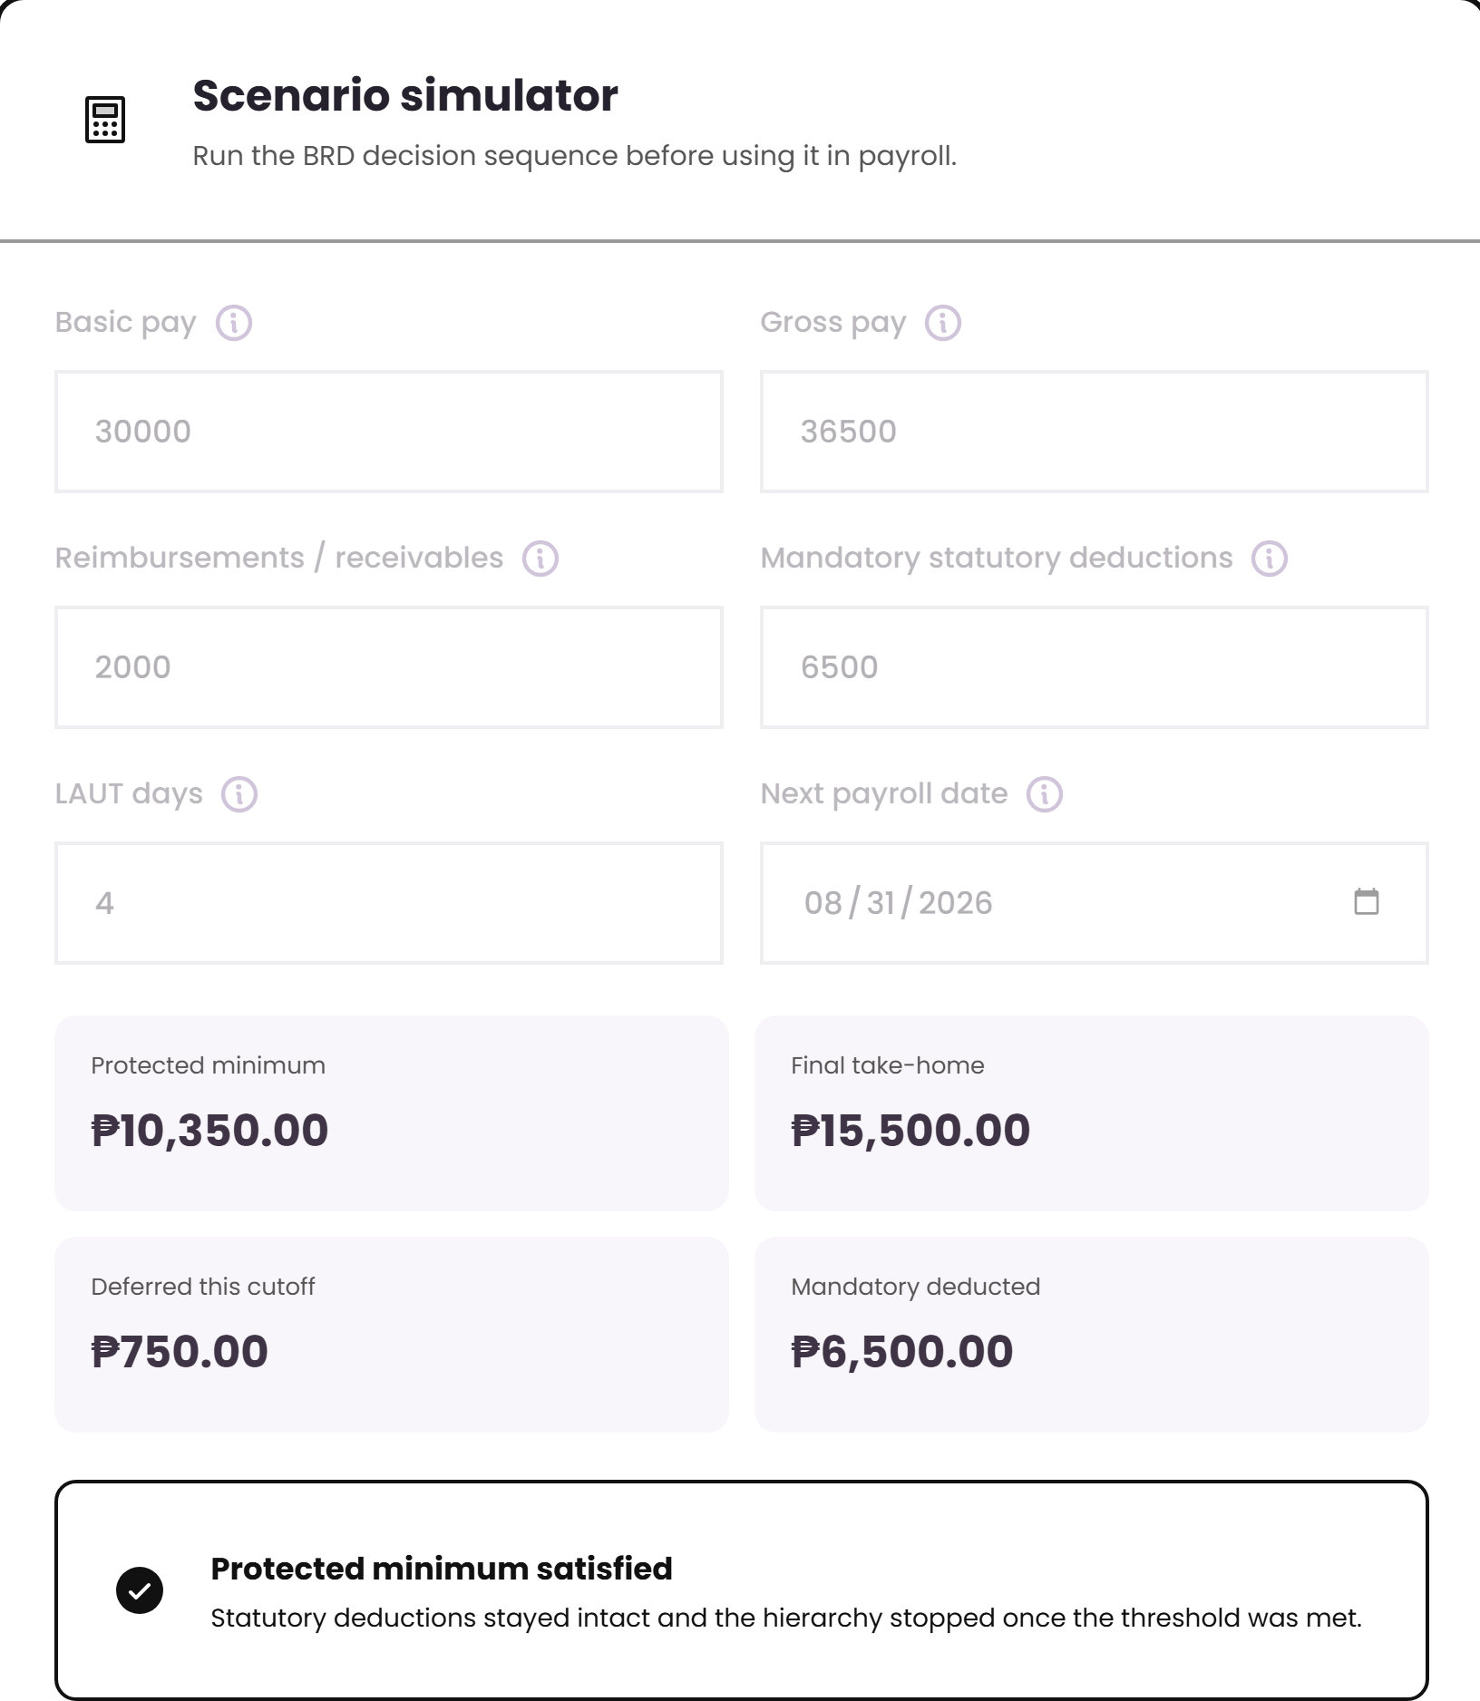
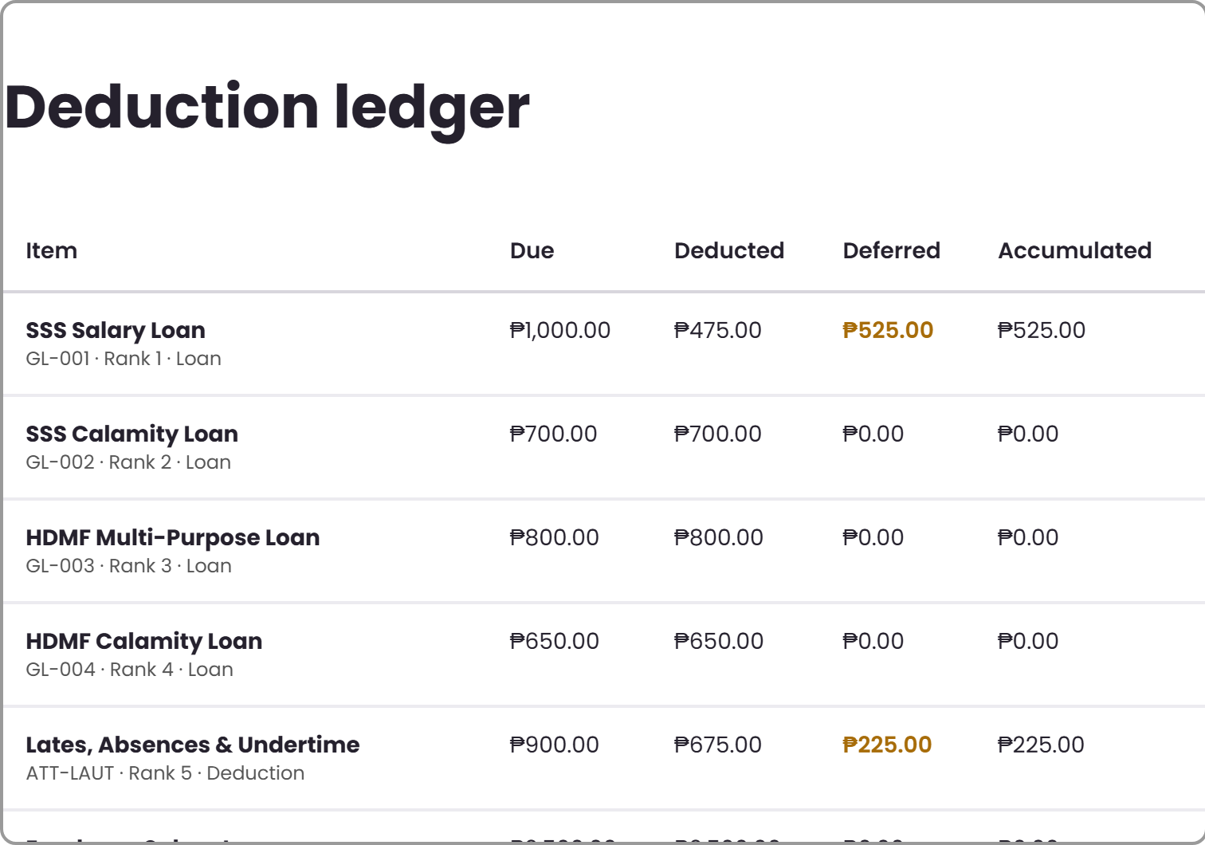
TAKE-HOME PAY · WORKED EXAMPLE
One payroll period, computed on screen
Gross pay
₱36,500
Less reimbursements
₱2,000
Protected base
₱34,500
Protected minimum (30%)
₱10,350
Statutory stayed whole at ₱6,500. Only the ranked items moved.
Final take-home
₱15,500
Source · Annex B rows 8–11 (statutory in full, defer, carry over, notify)
Deferred this cutoff
₱750
Notes:
Walk the room through the ledger: due, deducted, deferred, accumulated. This is their row 143-152 payslip requirement made real.

Slide 18
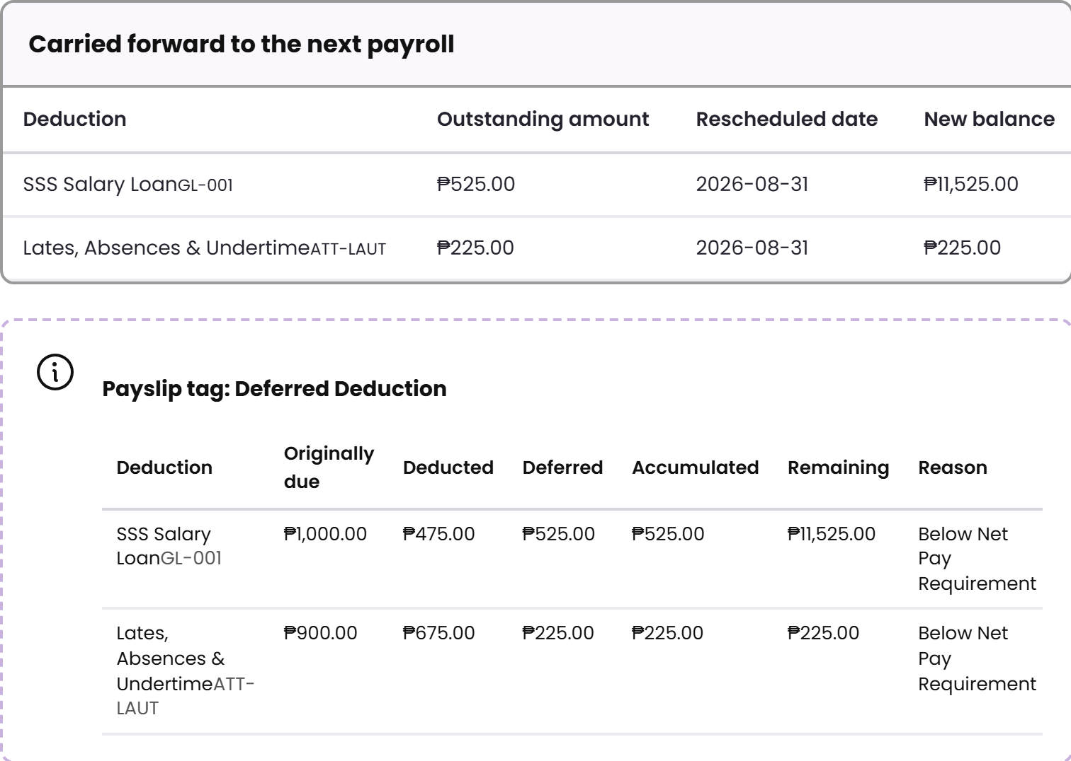
TAKE-HOME PAY · WORKED EXAMPLE
Deferred amounts are tracked, not lost
Carried forward
Outstanding amount, rescheduled deduction date and the new balance — the three fields you asked for.
Payslip tag
Name, originally due, deducted, deferred, accumulated, remaining balance and the reason.
Why it matters
The employee can trace a repayment across several cutoffs, and loan balances stay correct.
Carry-forward and payslip tagging
Source · Annex B rows 138–155

Slide 19
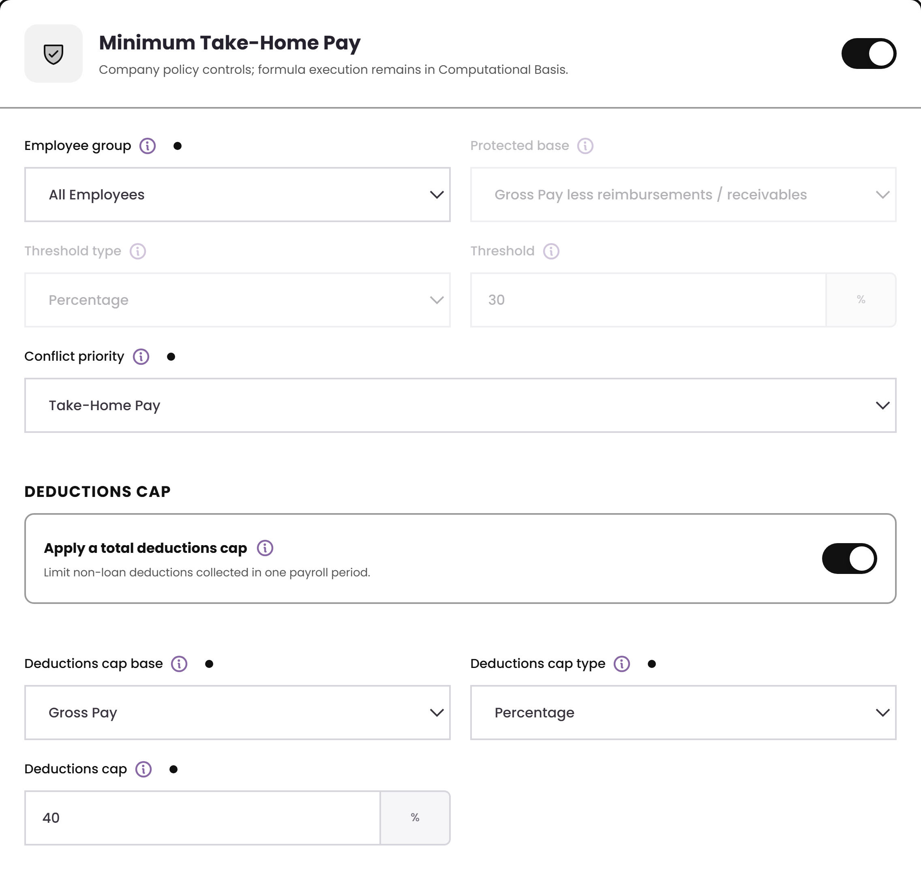
TAKE-HOME PAY · GOVERNANCE
Two codes, one company policy
THP-001
Governs the protected minimum: base, threshold and deferral behaviour.
THP-002
Governs the caps: deductions, loans, attendance and conflict priority.
One policy underneath
A company keeps one take-home policy. The two codes let you assign its parts to different rules without duplicating it.
Opened from THP-002
Source · Annex B rows 113–130, set-up items 1–6b

Slide 20
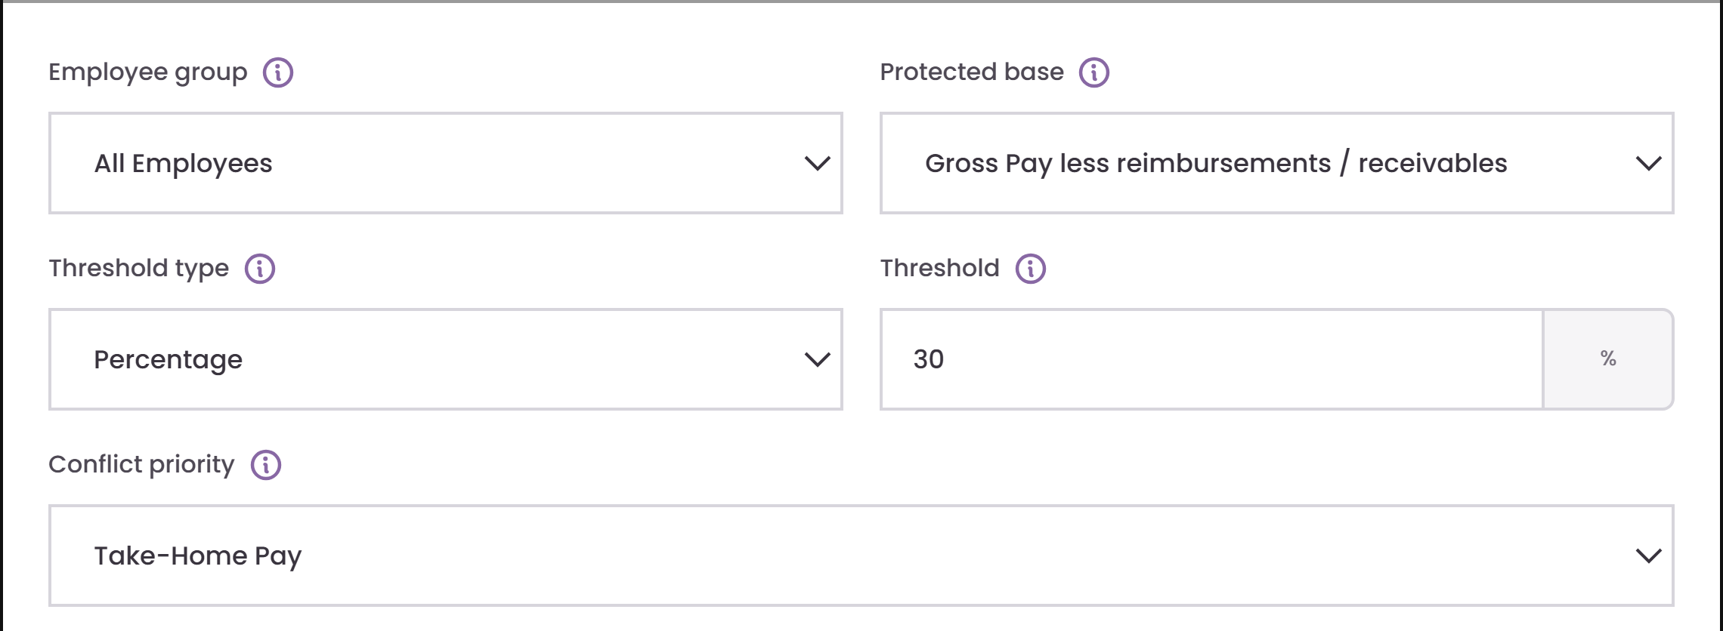
TAKE-HOME PAY · FIELD GUIDE 1 OF 4
Protected minimum fields
1
Employee group
Limits this rule to a defined employee population, e.g. Rank and File.
2
Protected base
The earnings amount used to calculate the minimum take-home threshold.
1
2
3
Threshold type
3
4
Whether the protected minimum is a percentage or a fixed peso amount.
5
4
Threshold
The protected minimum value applied to the selected base.
5
Conflict priority
What happens when loans are already at their cap but net pay is still short — protect take-home pay, or protect loan collection instead.

Slide 21
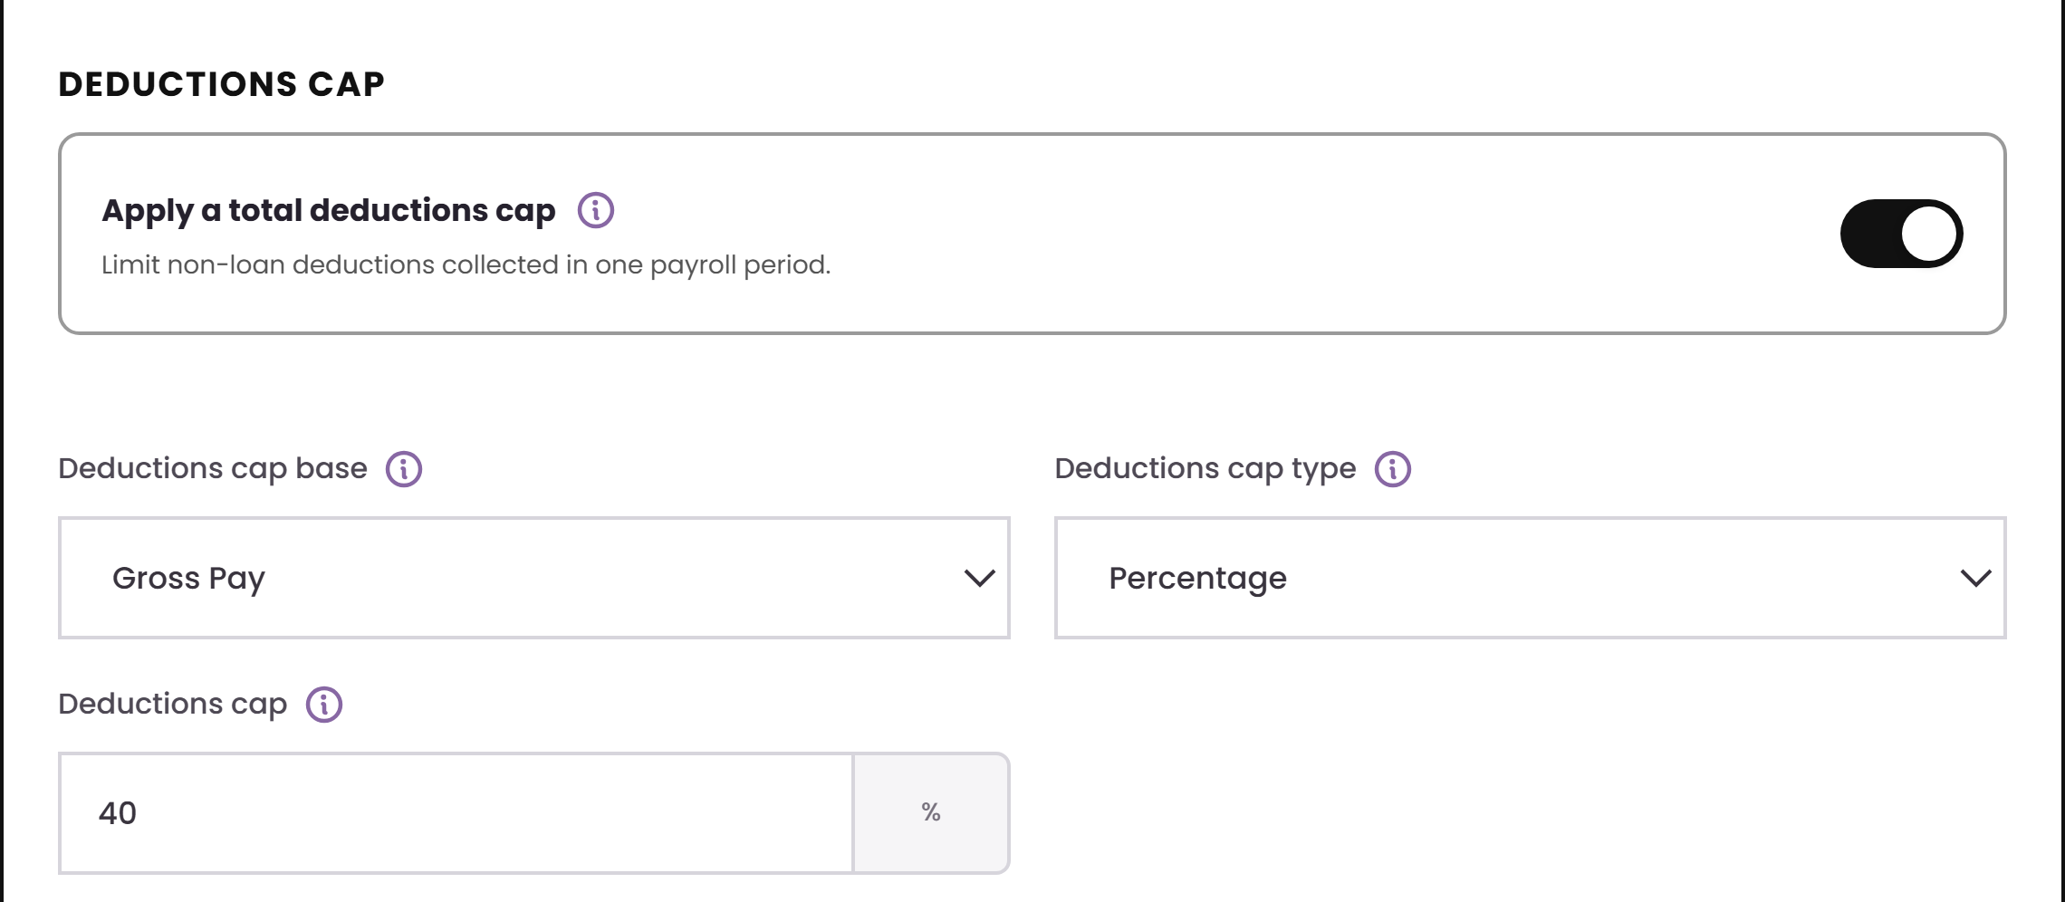
TAKE-HOME PAY · FIELD GUIDE 2 OF 4
Deductions cap fields
1
Apply a total deductions cap
Limits the total non-loan deductions that may be collected in one payroll period.
2
Deductions cap base
1
Earnings amount the deductions cap percentage is measured against.
2
3
3
Deductions cap type
Whether the deductions cap is a percentage of the base or a fixed amount.
4
4
Deductions cap
Maximum total non-loan deduction allowed for the payroll period.

Slide 22
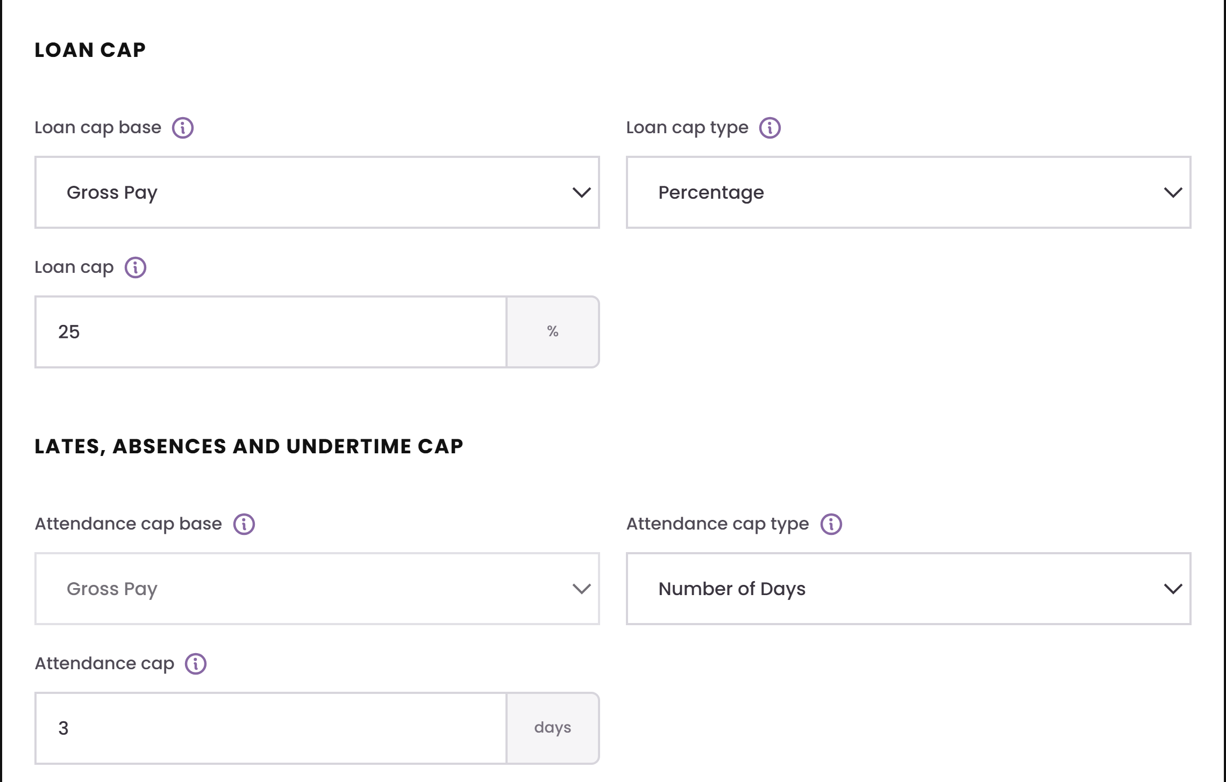
TAKE-HOME PAY · FIELD GUIDE 3 OF 4
Loan cap and attendance cap fields
1
Loan cap base
Earnings amount the loan cap percentage is measured against.
2
Loan cap type
1
2
Whether the loan cap is a percentage of the base or a fixed amount.
3
Loan cap
3
Maximum total loan repayment that can be deducted in the current payroll.
4
Attendance cap base
Earnings amount the attendance cap percentage is measured against.
4
5
5
Attendance cap type
6
Whether the attendance limit is days, a percentage, or a fixed amount.
6
Attendance cap
Maximum lates / absence / undertime adjustment allowed per payroll.

Slide 23
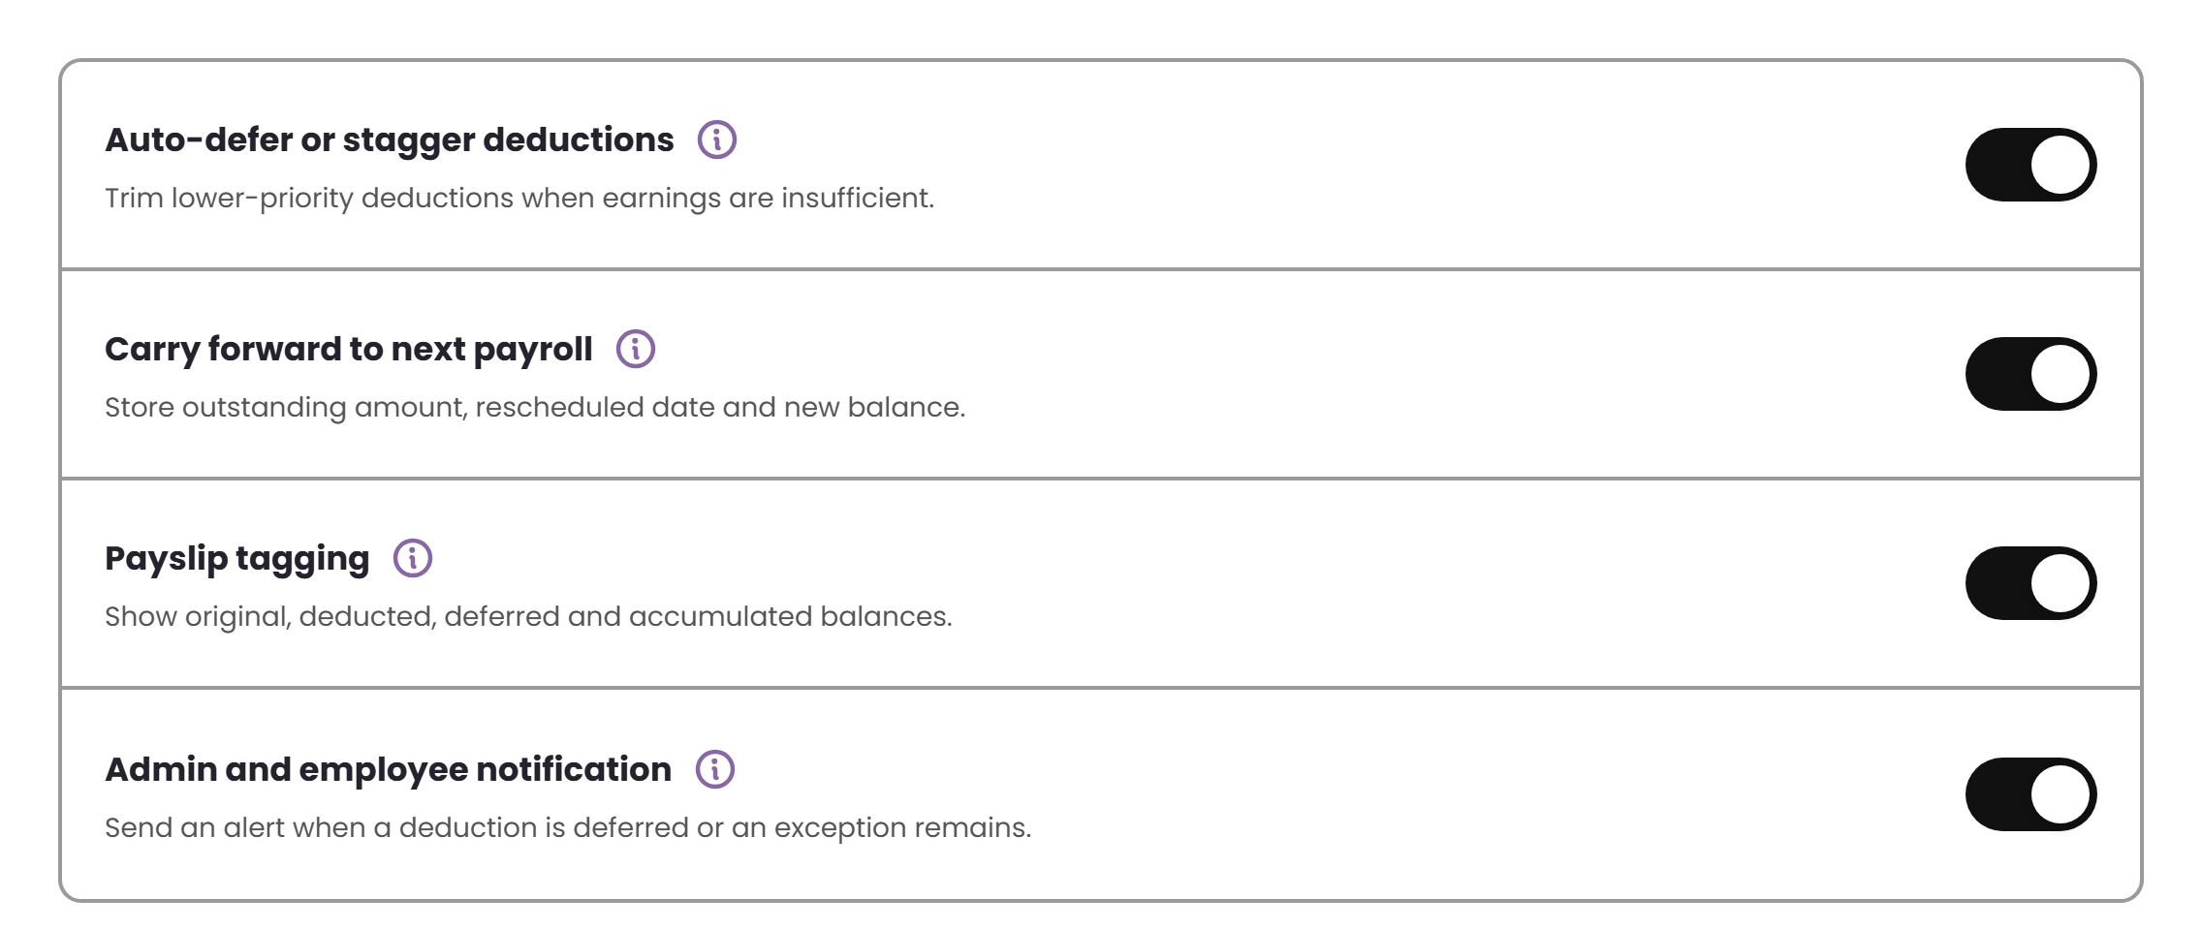
TAKE-HOME PAY · FIELD GUIDE 4 OF 4
Automation and payslip behaviour
1
Auto-defer or stagger deductions
Moves eligible lower-priority deductions to a later payroll when the protected minimum would be breached.
2
Carry forward to next payroll
1
Stores the outstanding amount, next schedule, and remaining balance for the next payroll.
2
3
3
Payslip tagging
Shows the original due, deducted, deferred and accumulated balance on the payslip.
4
4
Admin and employee notification
Creates an alert when a deduction is deferred or an exception remains.

Slide 24
ENGINE 2 OF 4
Retirement Pay
1
Plan type and formula
2
Eligibility rules
Apply the statutory formula, compare it with the company plan, and use whichever is more beneficial.
3
Service-year rounding
4
Tax treatment

Slide 25
RETIREMENT PAY · DEMO
Configure eligibility and benefit basis
1 · Choose code
Open RET-001 from the governed library.
2 · Configure
Set plan type, service-year basis, age and salary inputs.
3 · Validate
Compare statutory and company-plan outcomes before saving.
What to watch
▶ EMBEDDED 7-SECOND VIDEO · CLICK TO PLAY
Notes:
Demo cue: Atlas wireframe — RET-001 Retirement Pay.
The 1280×720 MP4 is embedded in the slide. Select the video frame to play it in Slide Show mode.
[Sources]
- http://localhost:5173/wireframe (Atlas wireframe, captured 2026-08-10)
- C:\Users\josrp\OneDrive\Documents\Atlas\ATLAS_Demo_Videos\03-retirement-pay.mp4
[/Sources]

Slide 26
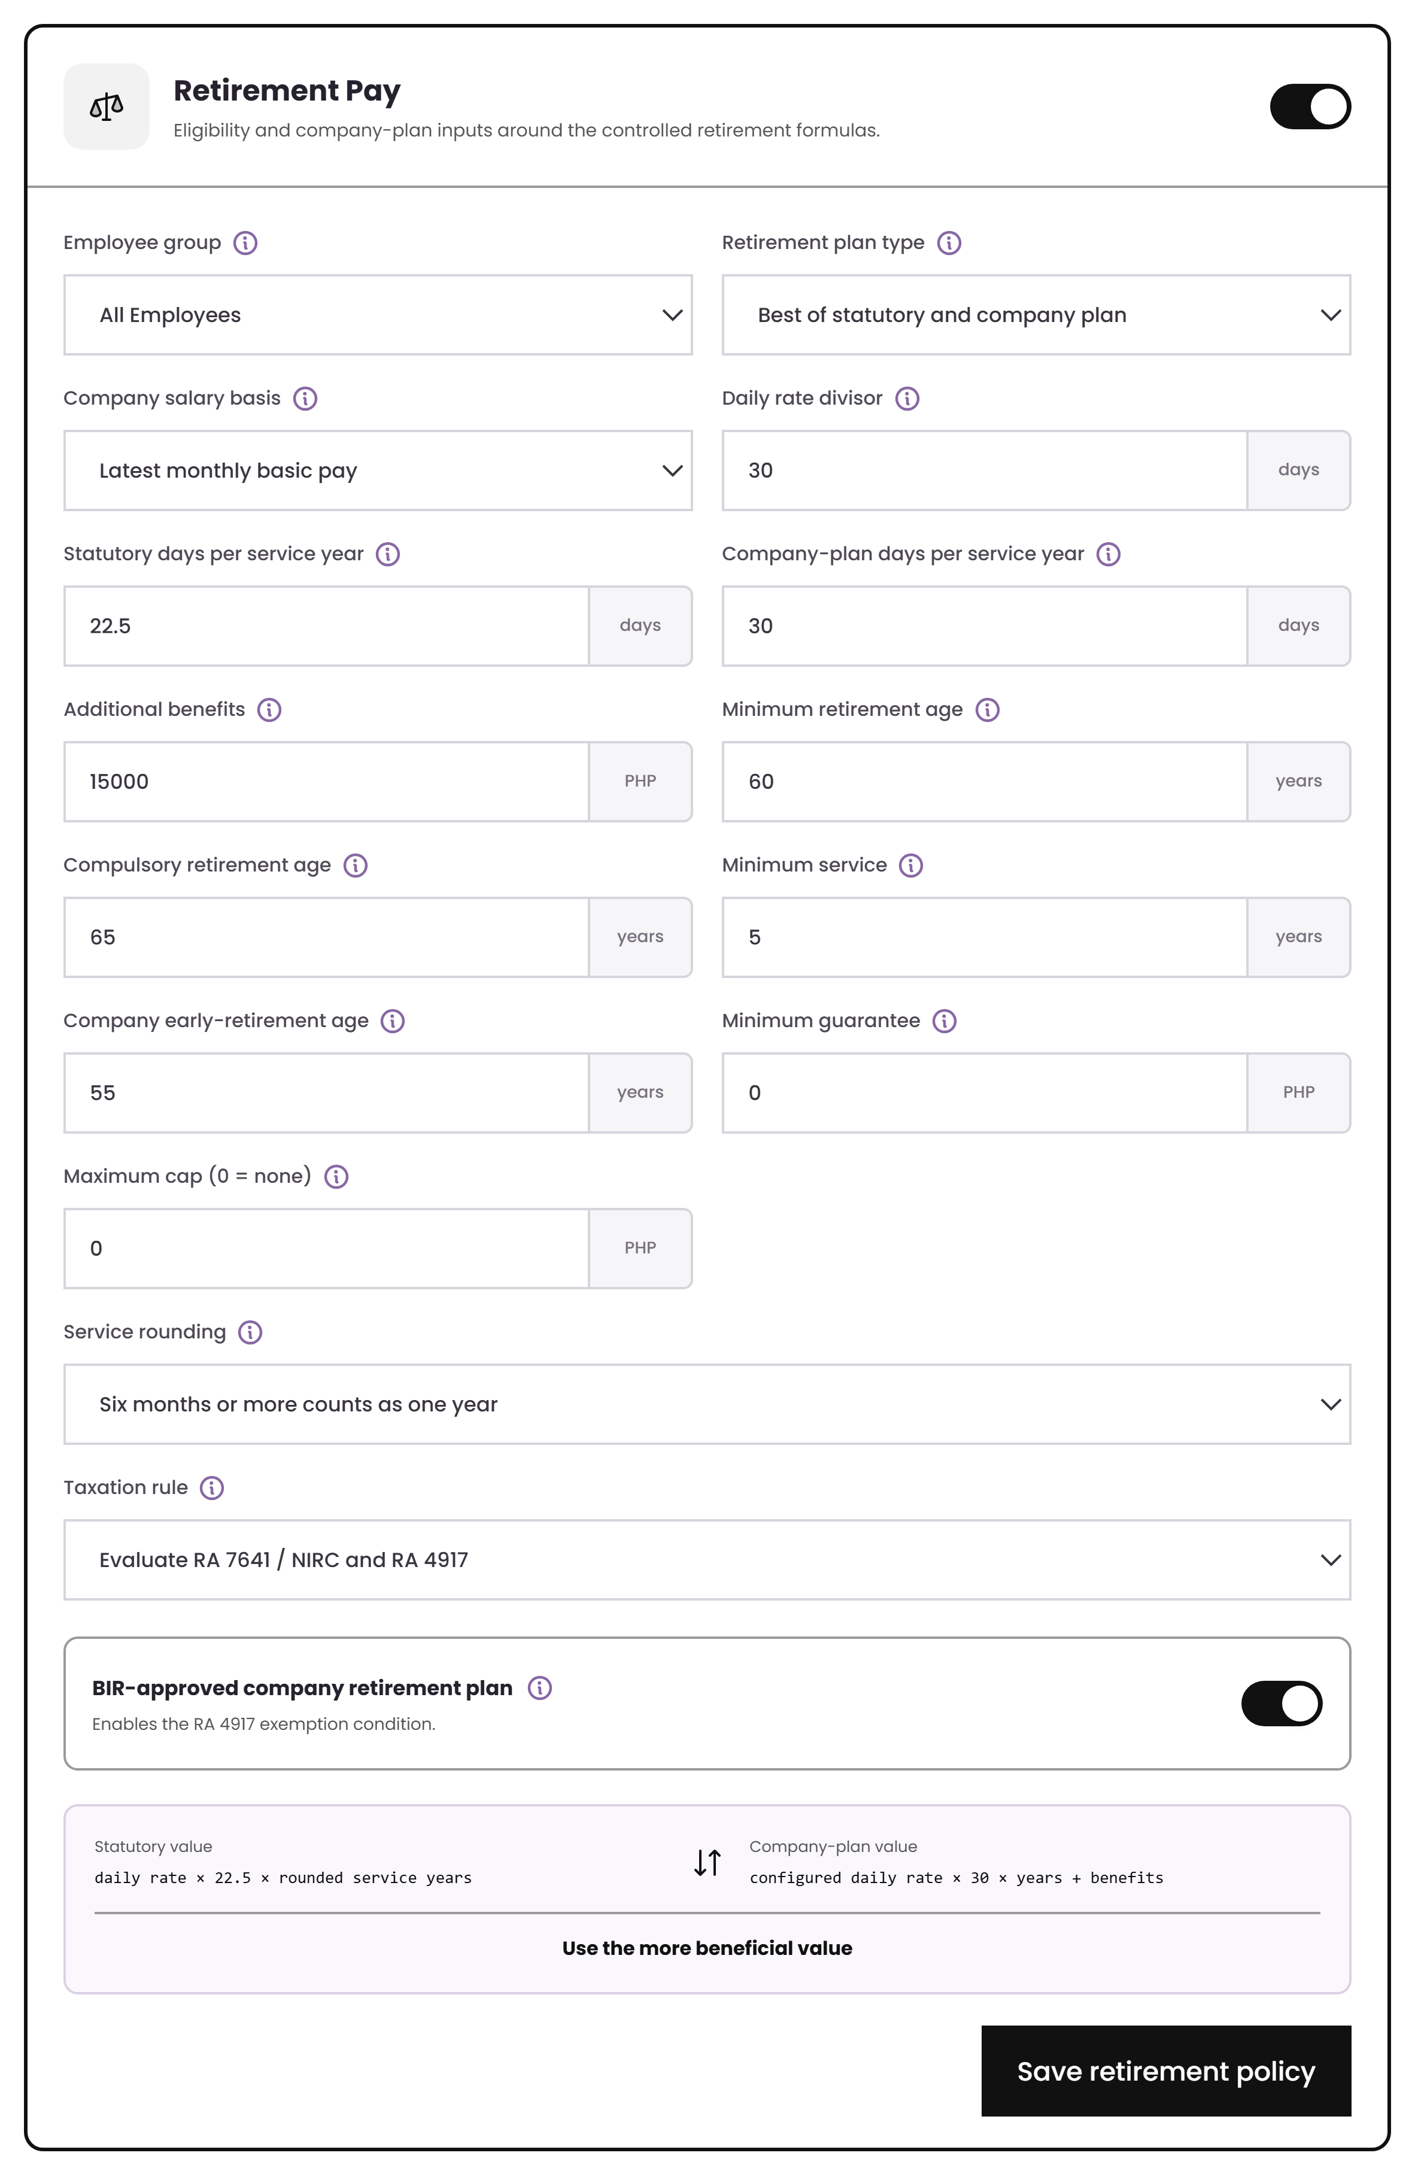
RETIREMENT PAY · SETUP
Statutory and company plan, side by side
Plan type
Statutory RA 7641, a company plan, or “best of both”.
Every input is configurable
Daily-rate divisor, days per service year, salary basis, additional benefits, minimum guarantee and maximum cap.
Eligibility
Minimum age 60, compulsory 65, five years of service, plus an optional company early-retirement age.
Retirement Pay settings
Source · Annex B “Retirement Pay” rows 11–37

Slide 27
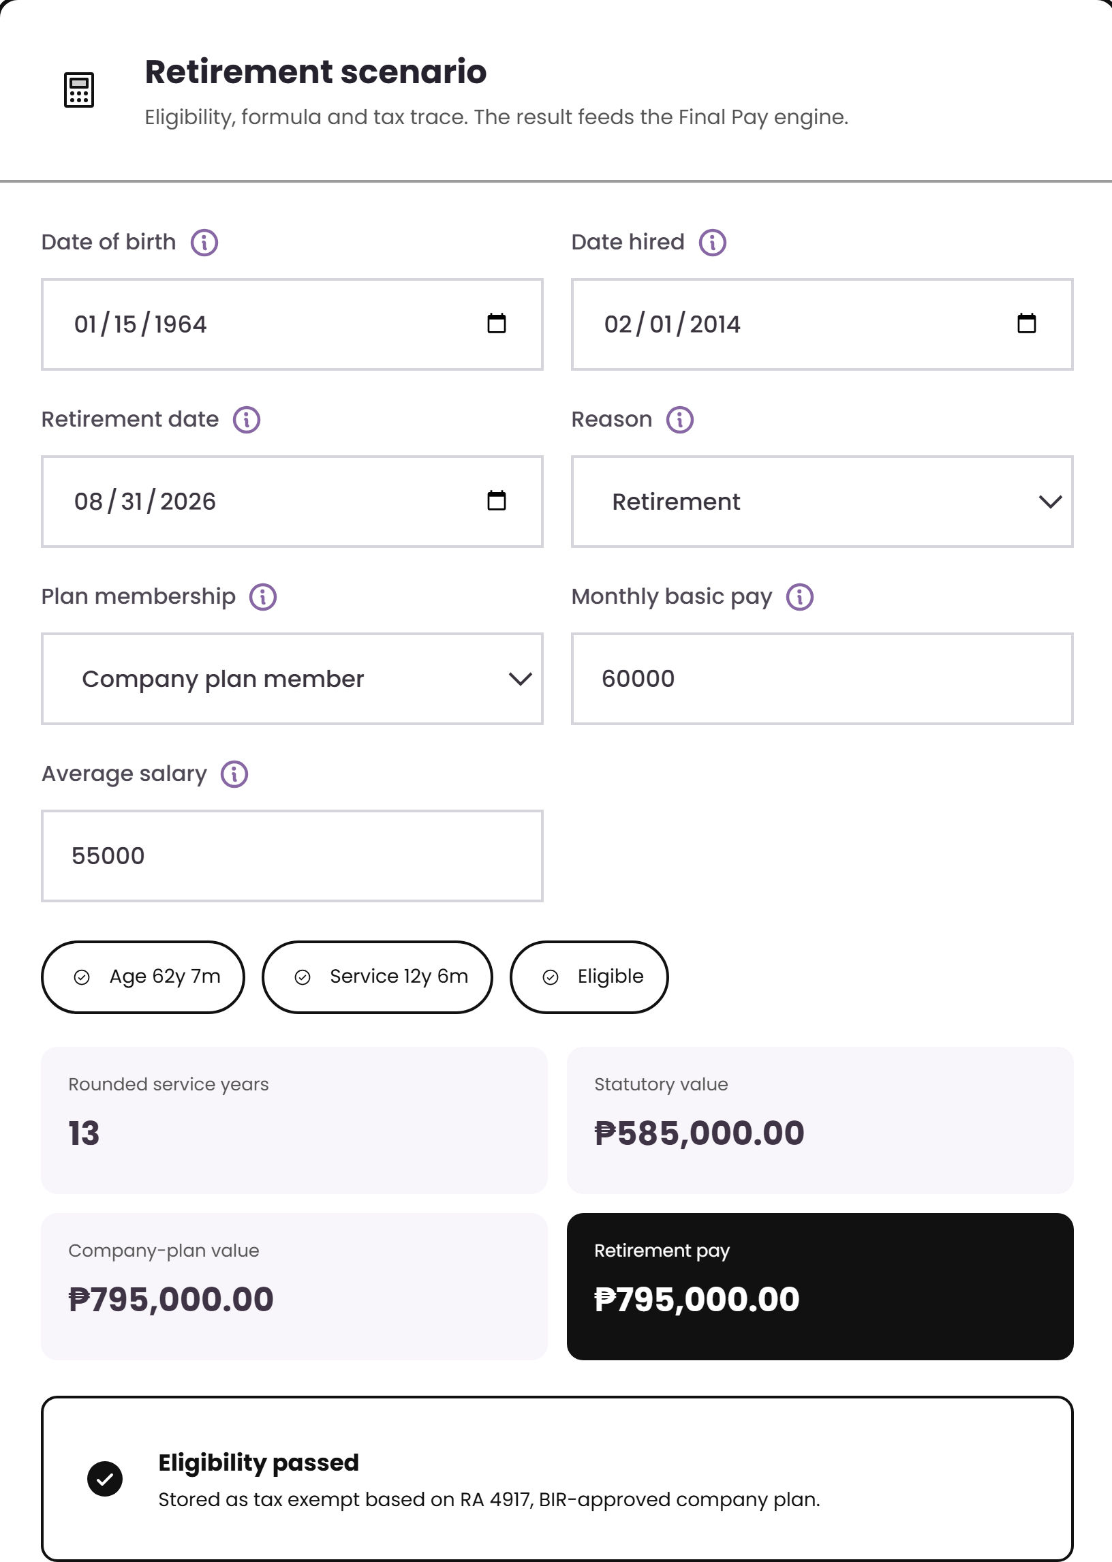
RETIREMENT PAY · WORKED EXAMPLE
The 6-month rule, visible in the result
Service 12 years 6 months
rounds to 13 qualifying years, because a fraction of six months or more counts as a full year.
Statutory value
₱585,000
₱60,000 ÷ 30 × 22.5 × 13
Company-plan value
₱795,000
company divisor, days and benefits
Retirement pay used
₱795,000
the more beneficial of the two
Stored as tax exempt under RA 4917 — the BIR-approved company plan condition.
Source · Annex B “Retirement Pay” rows 3–6, 30, 38–41, 67–72
Notes:
The comparison is the point: the system computes both and uses the better one, and records why it is tax exempt.

Slide 28
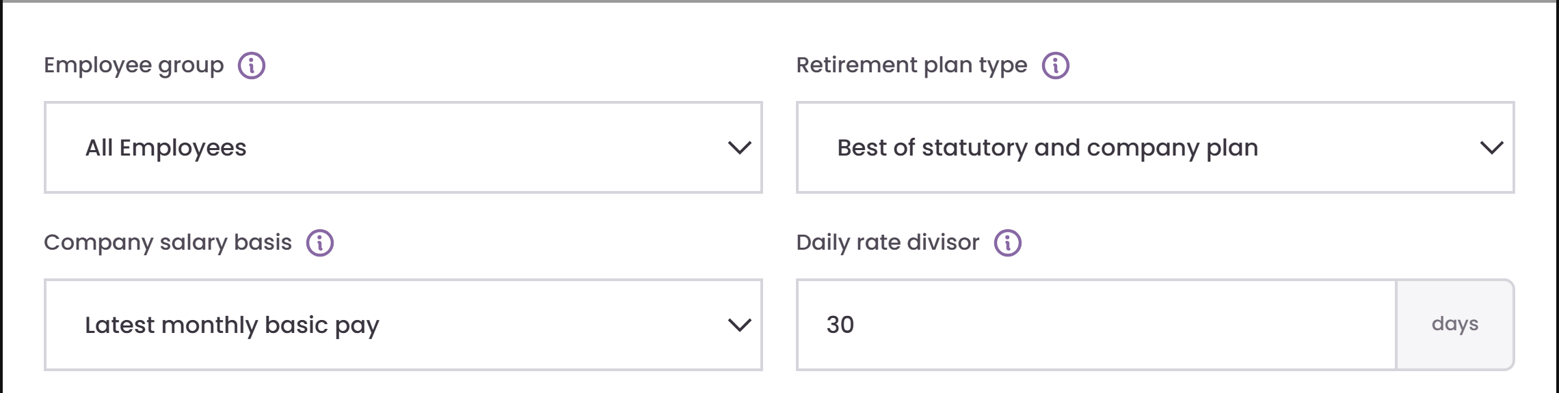
RETIREMENT PAY · FIELD GUIDE 1 OF 4
Plan type and salary basis
1
Employee group
Limits this rule to a defined employee population, e.g. Rank and File.
2
Retirement plan type
Chooses the statutory plan, the company plan, or the more beneficial of the two.
1
2
3
4
3
Company salary basis
Salary measure used to calculate the company retirement-plan value.
4
Daily rate divisor
Divides monthly basic pay to derive the daily rate used in the formula.

Slide 29
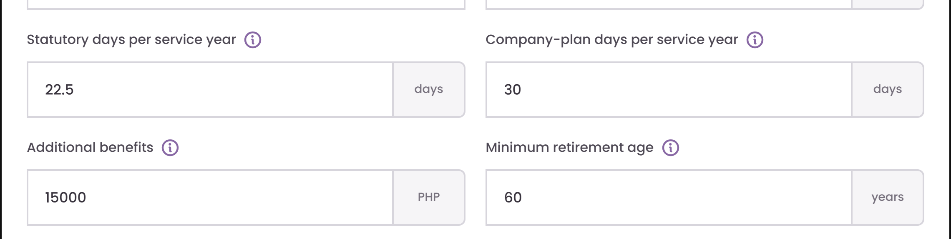
RETIREMENT PAY · FIELD GUIDE 2 OF 4
Formula and benefit inputs
1
Statutory days per service year
The statutory retirement-day equivalent per rounded service year (22.5 days).
2
Company-plan days per service year
Company-plan days applied for each qualifying service year.
1
2
3
4
3
Additional benefits
Qualifying lump sum, gratuity, or similar benefit added to the company-plan value.
4
Minimum retirement age
Earliest statutory age used for normal retirement eligibility.

Slide 30
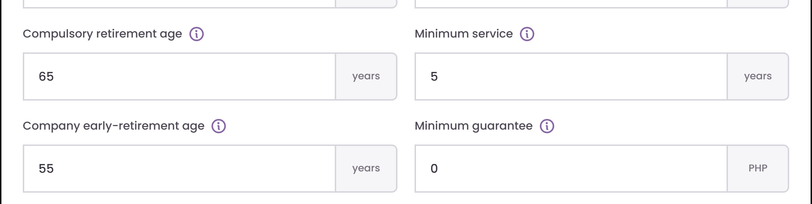
RETIREMENT PAY · FIELD GUIDE 3 OF 4
Eligibility conditions
1
Compulsory retirement age
Age at which compulsory retirement eligibility is reached.
2
Minimum service
Minimum completed service required before the retirement benefit qualifies.
1
2
3
4
3
Company early-retirement age
Optional earlier age allowed for a qualifying company-plan member.
4
Minimum guarantee
Floor applied to the company-plan value when configured.

Slide 31
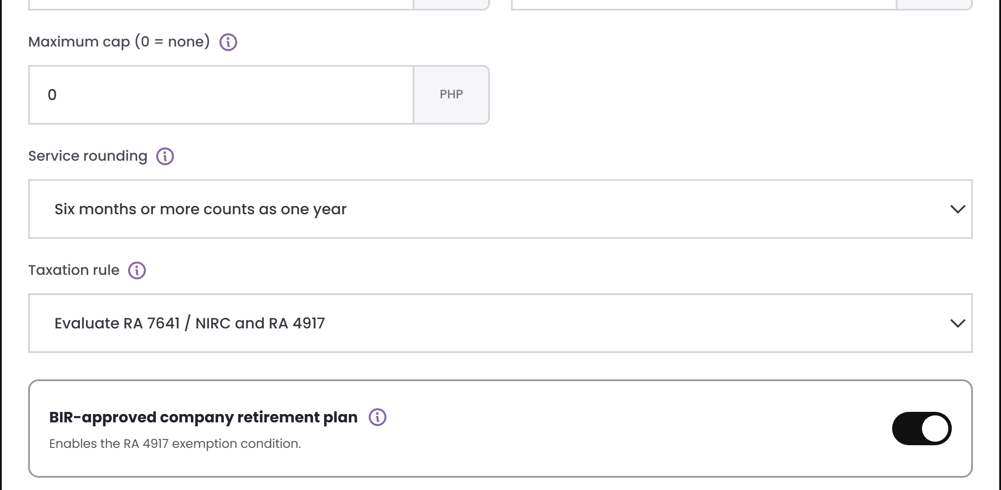
RETIREMENT PAY · FIELD GUIDE 4 OF 4
Caps, rounding and tax treatment
1
Maximum cap (0 = none)
Optional ceiling on the company-plan value; zero means no ceiling.
1
2
Service rounding
How a fractional final year of service is converted into whole years.
2
3
3
Taxation rule
Which exemption conditions are evaluated for the retirement result.
4
4
BIR-approved company retirement plan
Marks whether the company plan meets the RA 4917 approval condition.

Slide 32
ENGINE 3 OF 4
Final Pay
1
Mandatory components
2
Optional components
Assemble every enabled component, offset authorised balances, and show the full breakdown.
3
Authorised offsets
4
Negative net rule

Slide 33
FINAL PAY · DEMO
Select components, offsets and settlement rules
1 · Choose code
Open FIN-001 from the governed library.
2 · Configure
Enable pay components and define authorized offsets.
3 · Validate
Review the employee-level breakdown and negative-net handling.
What to watch
▶ EMBEDDED 7-SECOND VIDEO · CLICK TO PLAY
Notes:
Demo cue: Atlas wireframe — FIN-001 Final Pay.
The 1280×720 MP4 is embedded in the slide. Select the video frame to play it in Slide Show mode.
[Sources]
- http://localhost:5173/wireframe (Atlas wireframe, captured 2026-08-10)
- C:\Users\josrp\OneDrive\Documents\Atlas\ATLAS_Demo_Videos\04-final-pay.mp4
[/Sources]

Slide 34
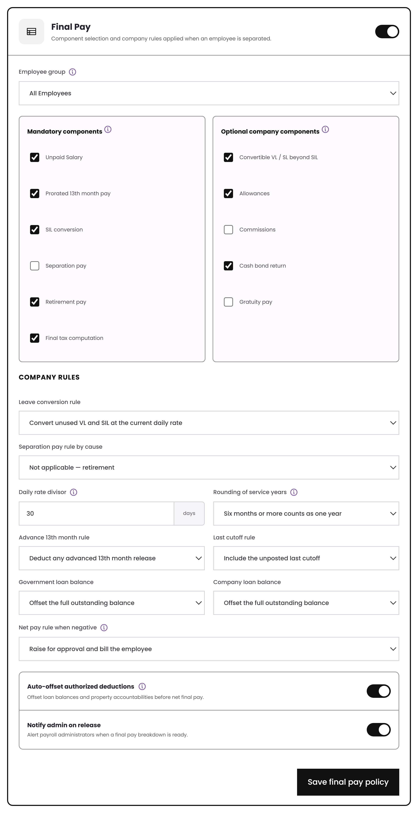
FINAL PAY · SETUP
Components are switches, not code
Mandatory
Unpaid salary, prorated 13th month, SIL conversion, separation pay, retirement pay, final tax.
Optional
Convertible VL/SL beyond SIL, allowances, commissions, cash bond return, gratuity.
Company rules
Leave conversion, divisor, rounding, advance 13th month recovery, loan balance treatment and the negative-net rule.
Final Pay settings
Source · Annex B “Final Pay” rows 5–18 (components) and 19–29 (rules)

Slide 35
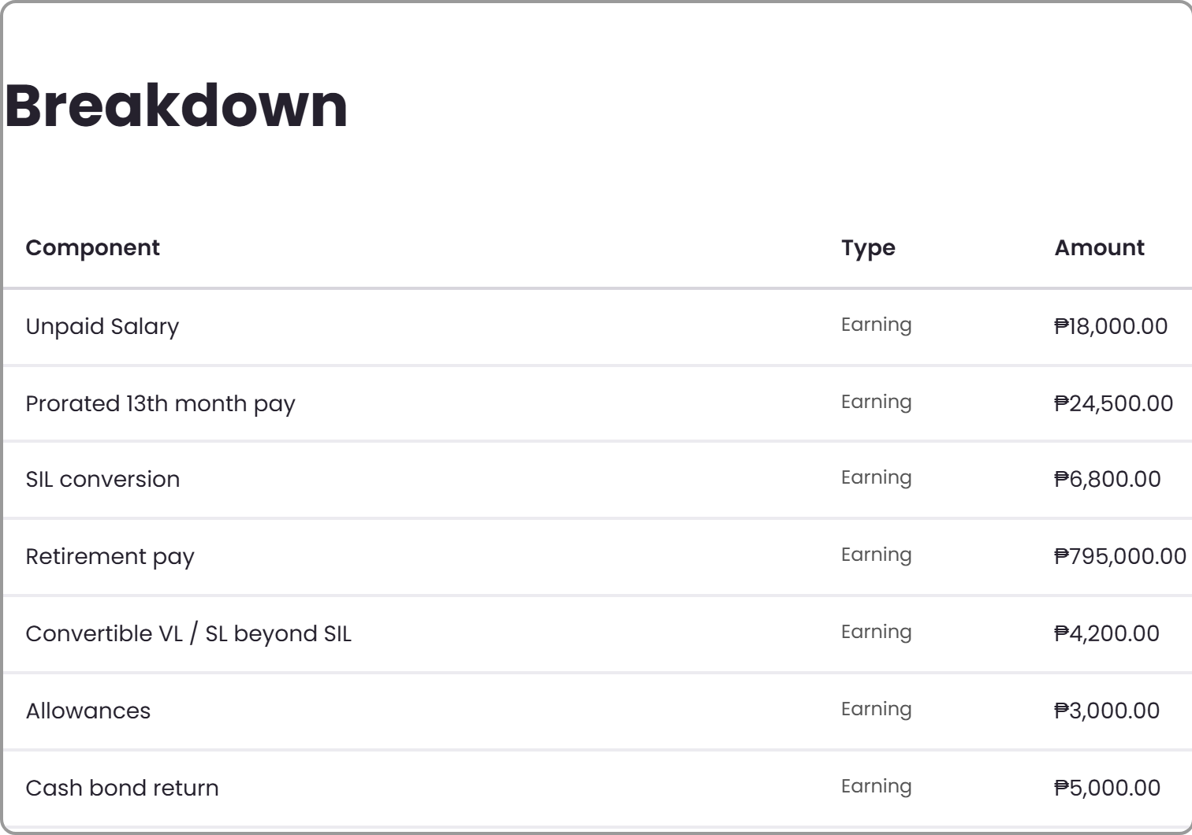
FINAL PAY · WORKED EXAMPLE
Retirement pay flows straight in
Gross final pay
₱856,500
Retirement pay included
₱795,000
Total offsets
−₱47,800
The ₱795,000 comes from the Retirement engine on the previous slide. It is not re-entered — the two engines are linked.
Net final pay
₱808,700
Source · Annex B “Retirement Pay” rows 46–49; “Final Pay” rows 30–34
Notes:
Call out the link: retirement pay forms part of final pay, exactly as row 48 requires.

Slide 36
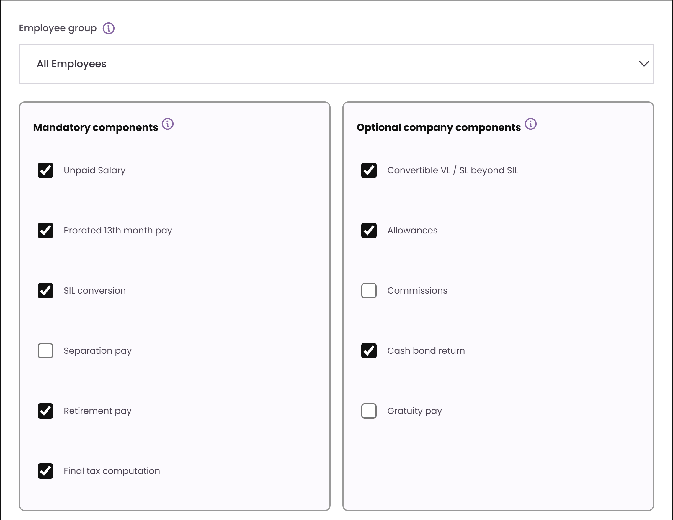
FINAL PAY · FIELD GUIDE 1 OF 4
Scope and components
1
1
Employee group
Limits this rule to a defined employee population, e.g. Rank and File.
2
Mandatory components
Pay items that always form part of final pay when applicable.
2
3
3
Optional company components
Company-specific items added to final pay.

Slide 37
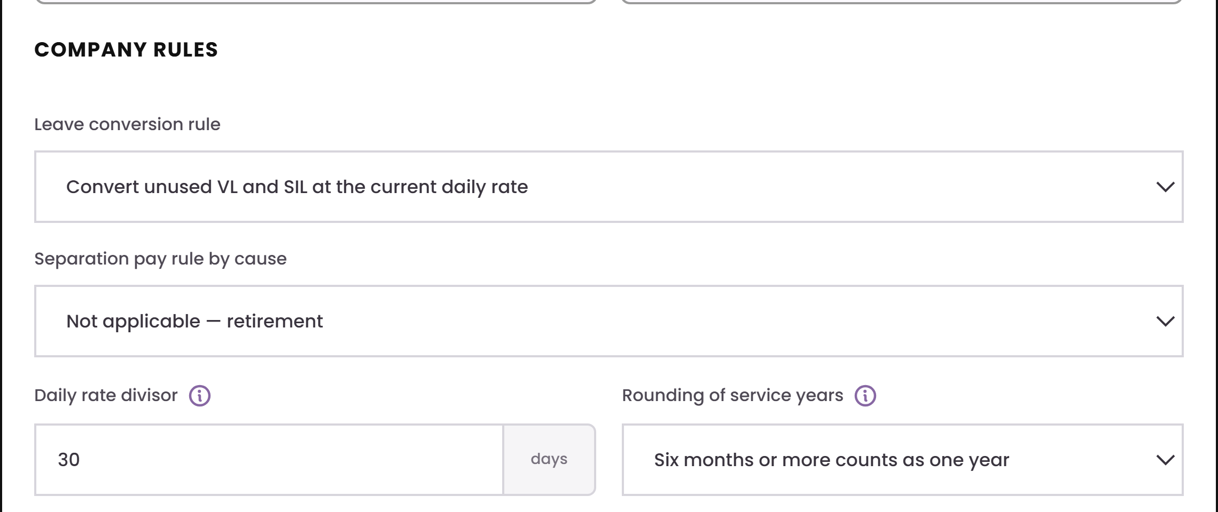
FINAL PAY · FIELD GUIDE 2 OF 4
Separation and timing rules
1
Leave conversion rule
Which unused leave (VL / SIL) converts to cash in final pay, and at what rate.
2
Separation pay rule by cause
Selects the separation-pay formula for the stated reason — redundancy, retrenchment, or none.
1
2
3
Daily rate divisor
Divides monthly basic pay to derive the daily rate used in the formula.
3
4
4
Rounding of service years
How a fractional final year of service is converted into whole years for final pay.

Slide 38
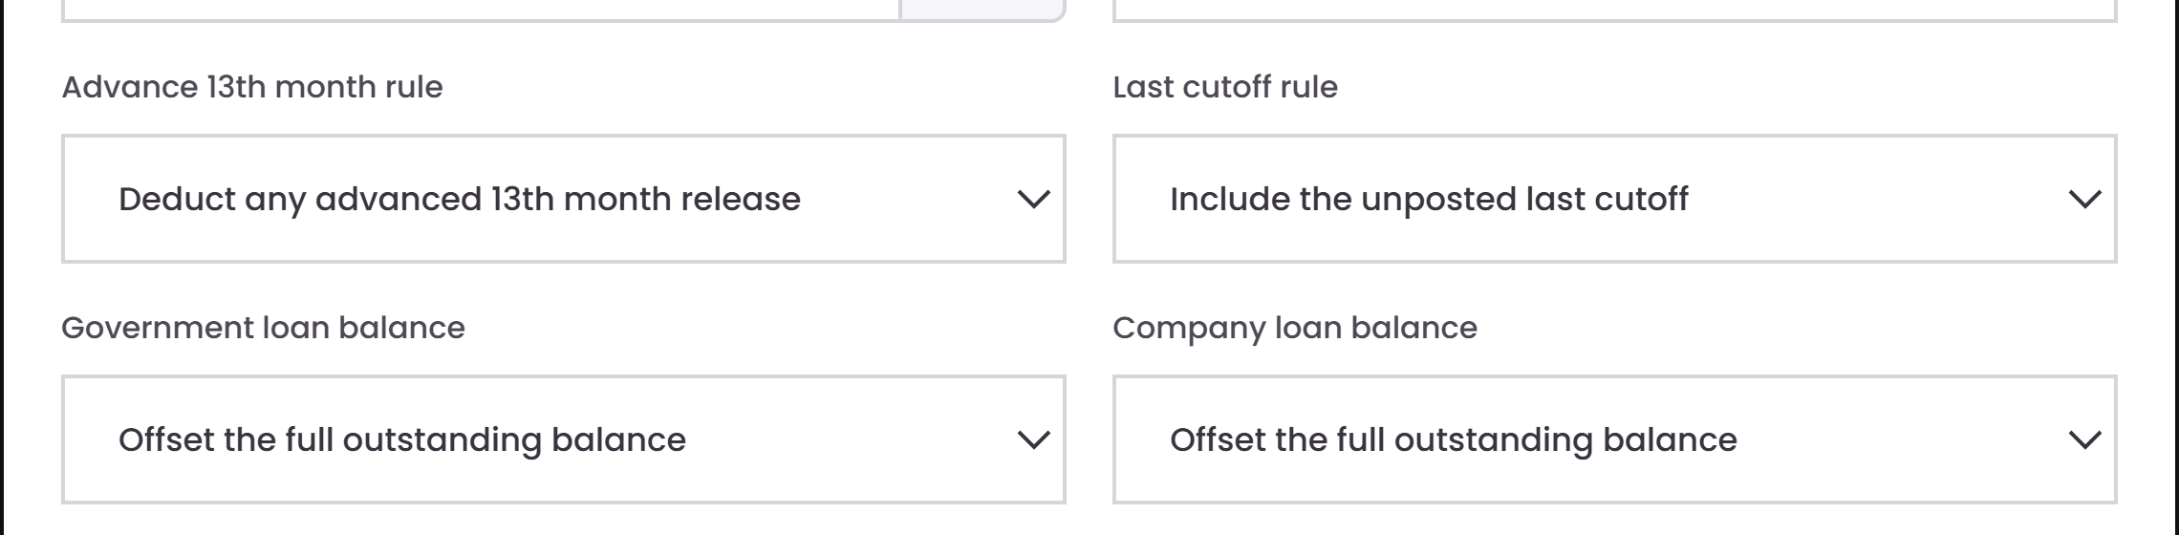
FINAL PAY · FIELD GUIDE 3 OF 4
Recovery and outstanding balances
1
Advance 13th month rule
Whether an already-released 13th month advance is deducted back from final pay.
2
Last cutoff rule
Whether the still-unposted last payroll cutoff is folded into final pay or processed separately.
1
2
3
4
3
Government loan balance
How an outstanding government loan balance (SSS, HDMF) is settled at separation.
4
Company loan balance
How an outstanding company loan balance is settled at separation.

Slide 39
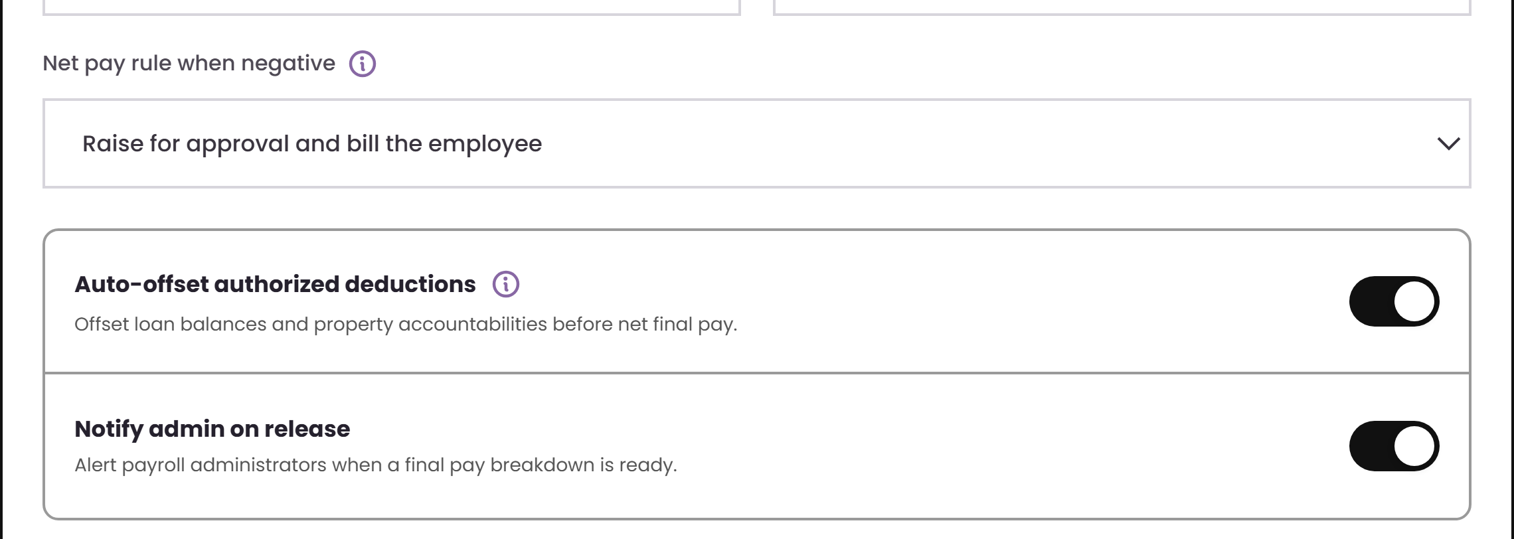
FINAL PAY · FIELD GUIDE 4 OF 4
Net pay outcome rules
1
Net pay rule when negative
What happens when deductions exceed the final pay earnings.
1
2
Auto-offset authorized deductions
Offsets loan balances and property accountabilities before net final pay.
2
3
3
Notify admin on release
Alerts payroll administrators once the final pay breakdown is ready for review.

Slide 40
ENGINE 4 OF 4
Gross Up
1
Guaranteed net target
2
Graduated BIR table
Solve the gross amount that leaves the employee a guaranteed net, with the employer absorbing the tax.
3
Iterate to convergence
4
Employer cost shown

Slide 41
GROSS UP · DEMO
Define the net target and tax absorption method
1 · Choose code
Open GUP-001 from the governed library.
2 · Define target
Choose guaranteed net, tax method and rate source.
3 · Control
Set employer share, rounding and convergence limits.
4 · Validate
Confirm the calculated gross and employer tax cost.
What to watch
▶ EMBEDDED 7-SECOND VIDEO · CLICK TO PLAY
Notes:
Demo cue: Atlas wireframe — GUP-001 Gross Up.
The 1280×720 MP4 is embedded in the slide. Select the video frame to play it in Slide Show mode.
[Sources]
- http://localhost:5173/wireframe (Atlas wireframe, captured 2026-08-10)
- C:\Users\josrp\OneDrive\Documents\Atlas\ATLAS_Demo_Videos\05-gross-up.mp4
[/Sources]

Slide 42
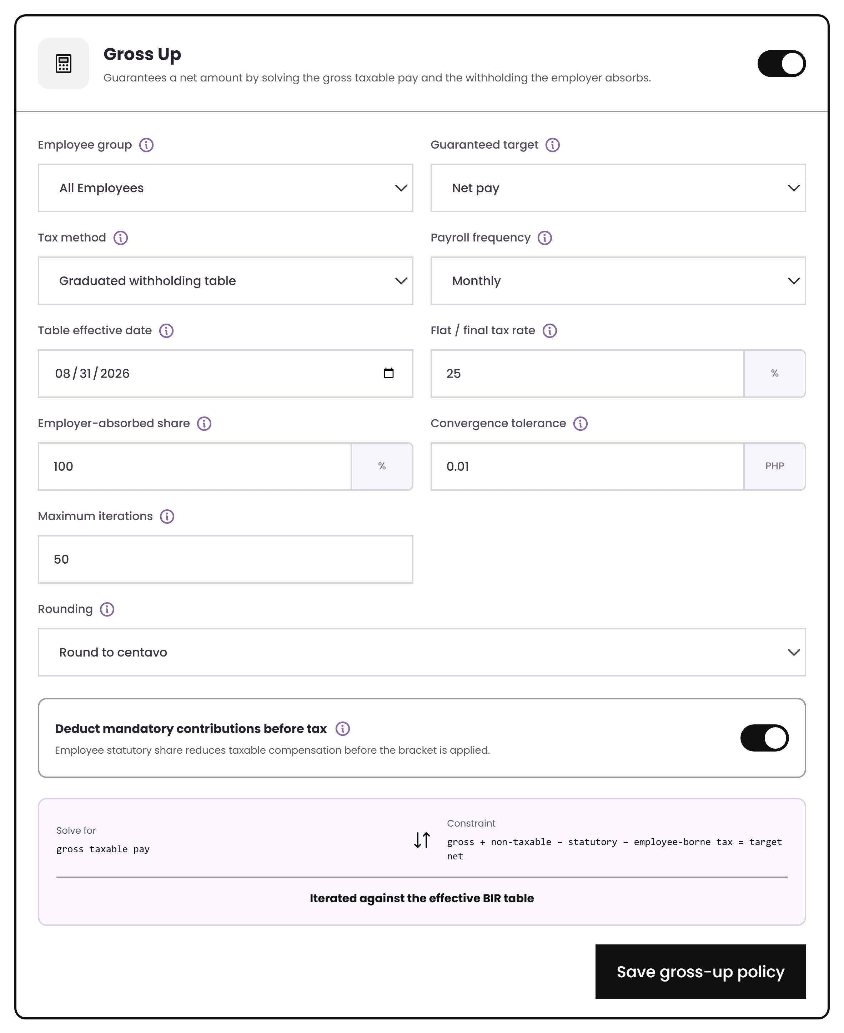
GROSS UP · SETUP
Which income, which method, who absorbs the tax
Target
A guaranteed net pay or net benefit, entered or uploaded.
Method
The graduated BIR withholding table, or a flat rate for final and expanded tax cases.
Employer share
100% for a classic gross-up, or a split such as 50/50.
Controls
Convergence tolerance, iteration limit and rounding stage are all set by the company.
Gross Up settings
Source · Annex B “Gross Up” rows 6–18

Slide 43
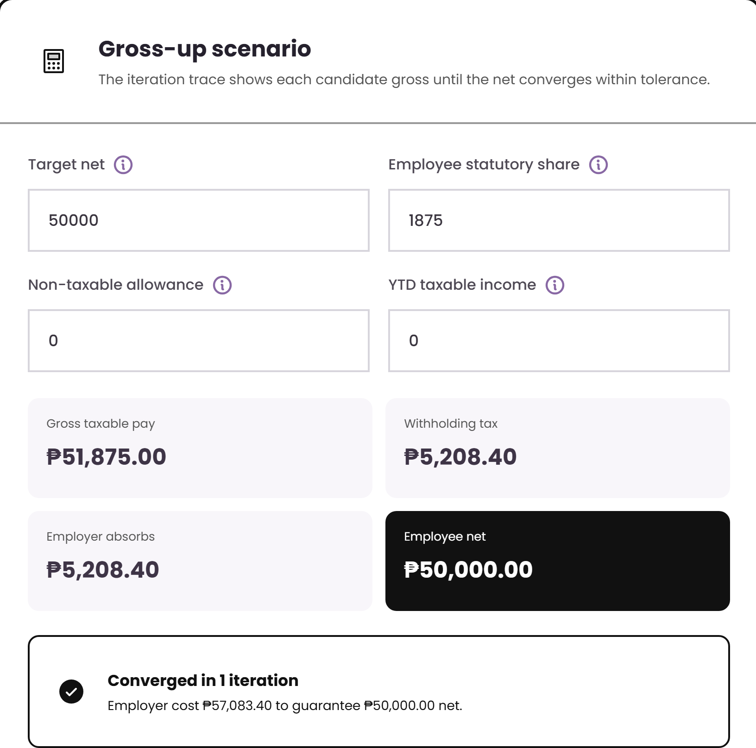
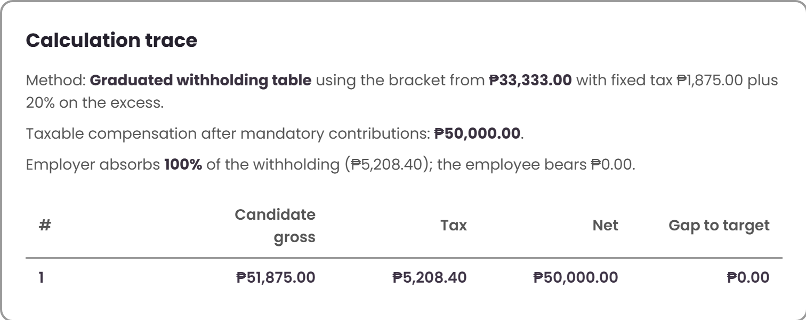
GROSS UP · WORKED EXAMPLE
Guarantee ₱50,000 net
Why it is not simply net ÷ (1 − rate)
That shortcut assumes one flat rate. Compensation tax is graduated, so the engine tests a gross, reads the bracket, recomputes the net and repeats until it lands on the target.
Gross taxable pay
₱51,875.00
Withholding tax absorbed by employer
₱5,208.40
Net released to employee
₱50,000.00
Total employer cost
₱57,083.40
Source · Annex B “Gross Up” rows 2–4 and steps 4–12
Notes:
Bracket used: from ₱33,333 with fixed tax ₱1,875 plus 20% on the excess. The trace shows the iteration and the gap closing to zero.

Slide 44
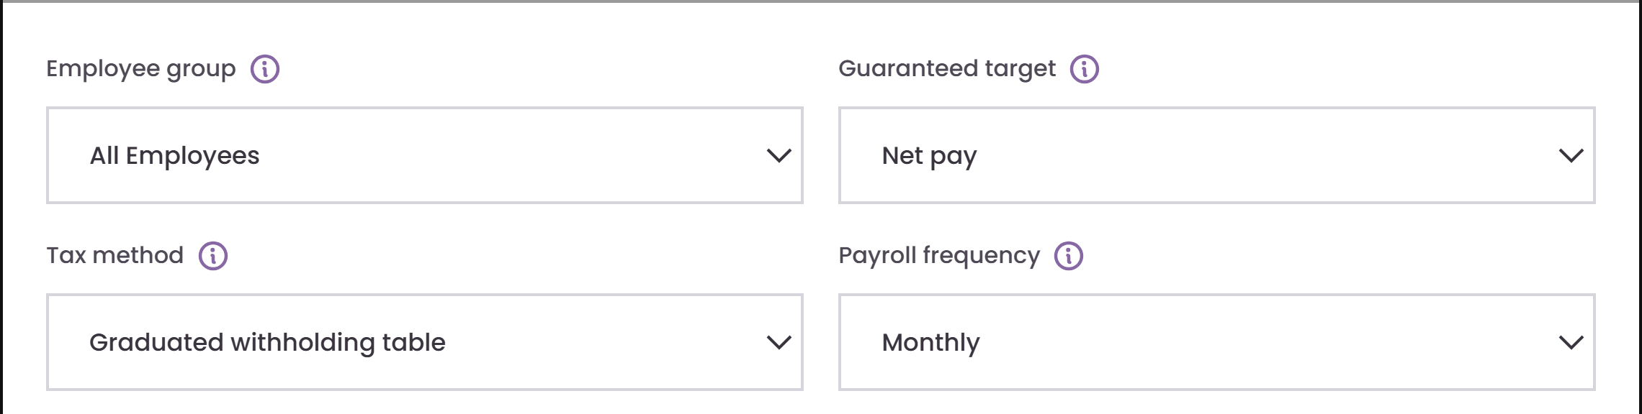
GROSS UP · FIELD GUIDE 1 OF 3
Target and method
1
Employee group
Limits this rule to a defined employee population, e.g. Rank and File.
2
Guaranteed target
Whether the company guarantees a net pay figure or a net benefit amount.
1
2
3
4
3
Tax method
Graduated iterates against the effective BIR table; flat applies a single final/expanded rate.
4
Payroll frequency
Which frequency of the effective withholding table the iteration reads.

Slide 45
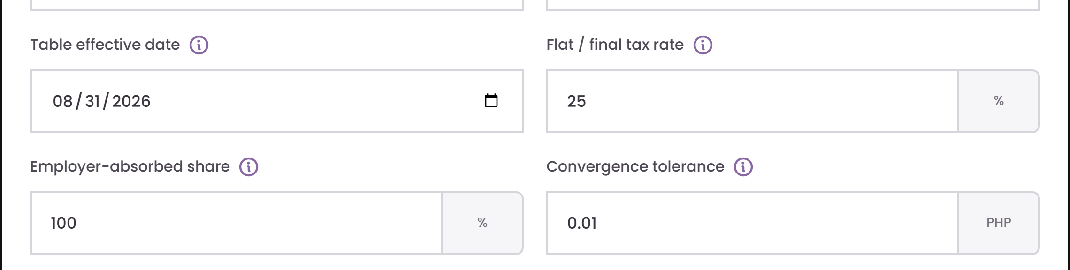
GROSS UP · FIELD GUIDE 2 OF 3
Effective table and tax rate
1
Table effective date
Date used to pick the statutory table version in force for the run.
2
Flat / final tax rate
Single rate used for a final or expanded tax scenario instead of graduated withholding.
1
2
3
4
3
Employer-absorbed share
Portion of the withholding the employer shoulders — 50% models a shared gross-up.
4
Convergence tolerance
How close the computed net must land to the target before the iteration stops.

Slide 46
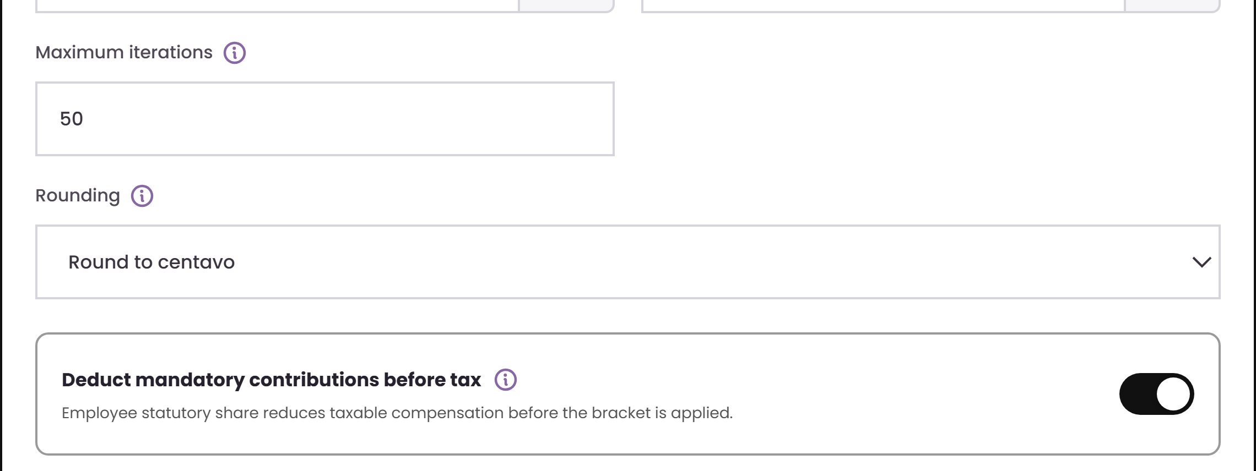
GROSS UP · FIELD GUIDE 3 OF 3
Iteration limits and rounding
1
Maximum iterations
Safety limit so a non-converging setup fails visibly instead of looping.
1
2
Rounding
2
Rounding stage applied to the solved gross before the final tax is computed.
3
3
Deduct mandatory contributions before tax
Deducts the employee statutory share from taxable pay before the bracket is applied.

Slide 47
THE WIRING
What each engine reads and feeds
Reads from
Produces
Take-Home Pay
Deduction hierarchy reference table · employee loan and deduction balances
Deferred amounts, carry-forward schedule, payslip tags
Retirement Pay
Employee dates of birth, hire and retirement · plan membership · salary basis
Retirement pay value and its tax status
Final Pay
Retirement engine result · leave balances · outstanding loan and deduction balances
Net final pay breakdown for release
Gross Up
Effective BIR withholding table · employee statutory share
Gross to pay and the tax the employer absorbs
Notes:
Nothing is re-keyed between engines. This is the answer to "does it connect".

Slide 48
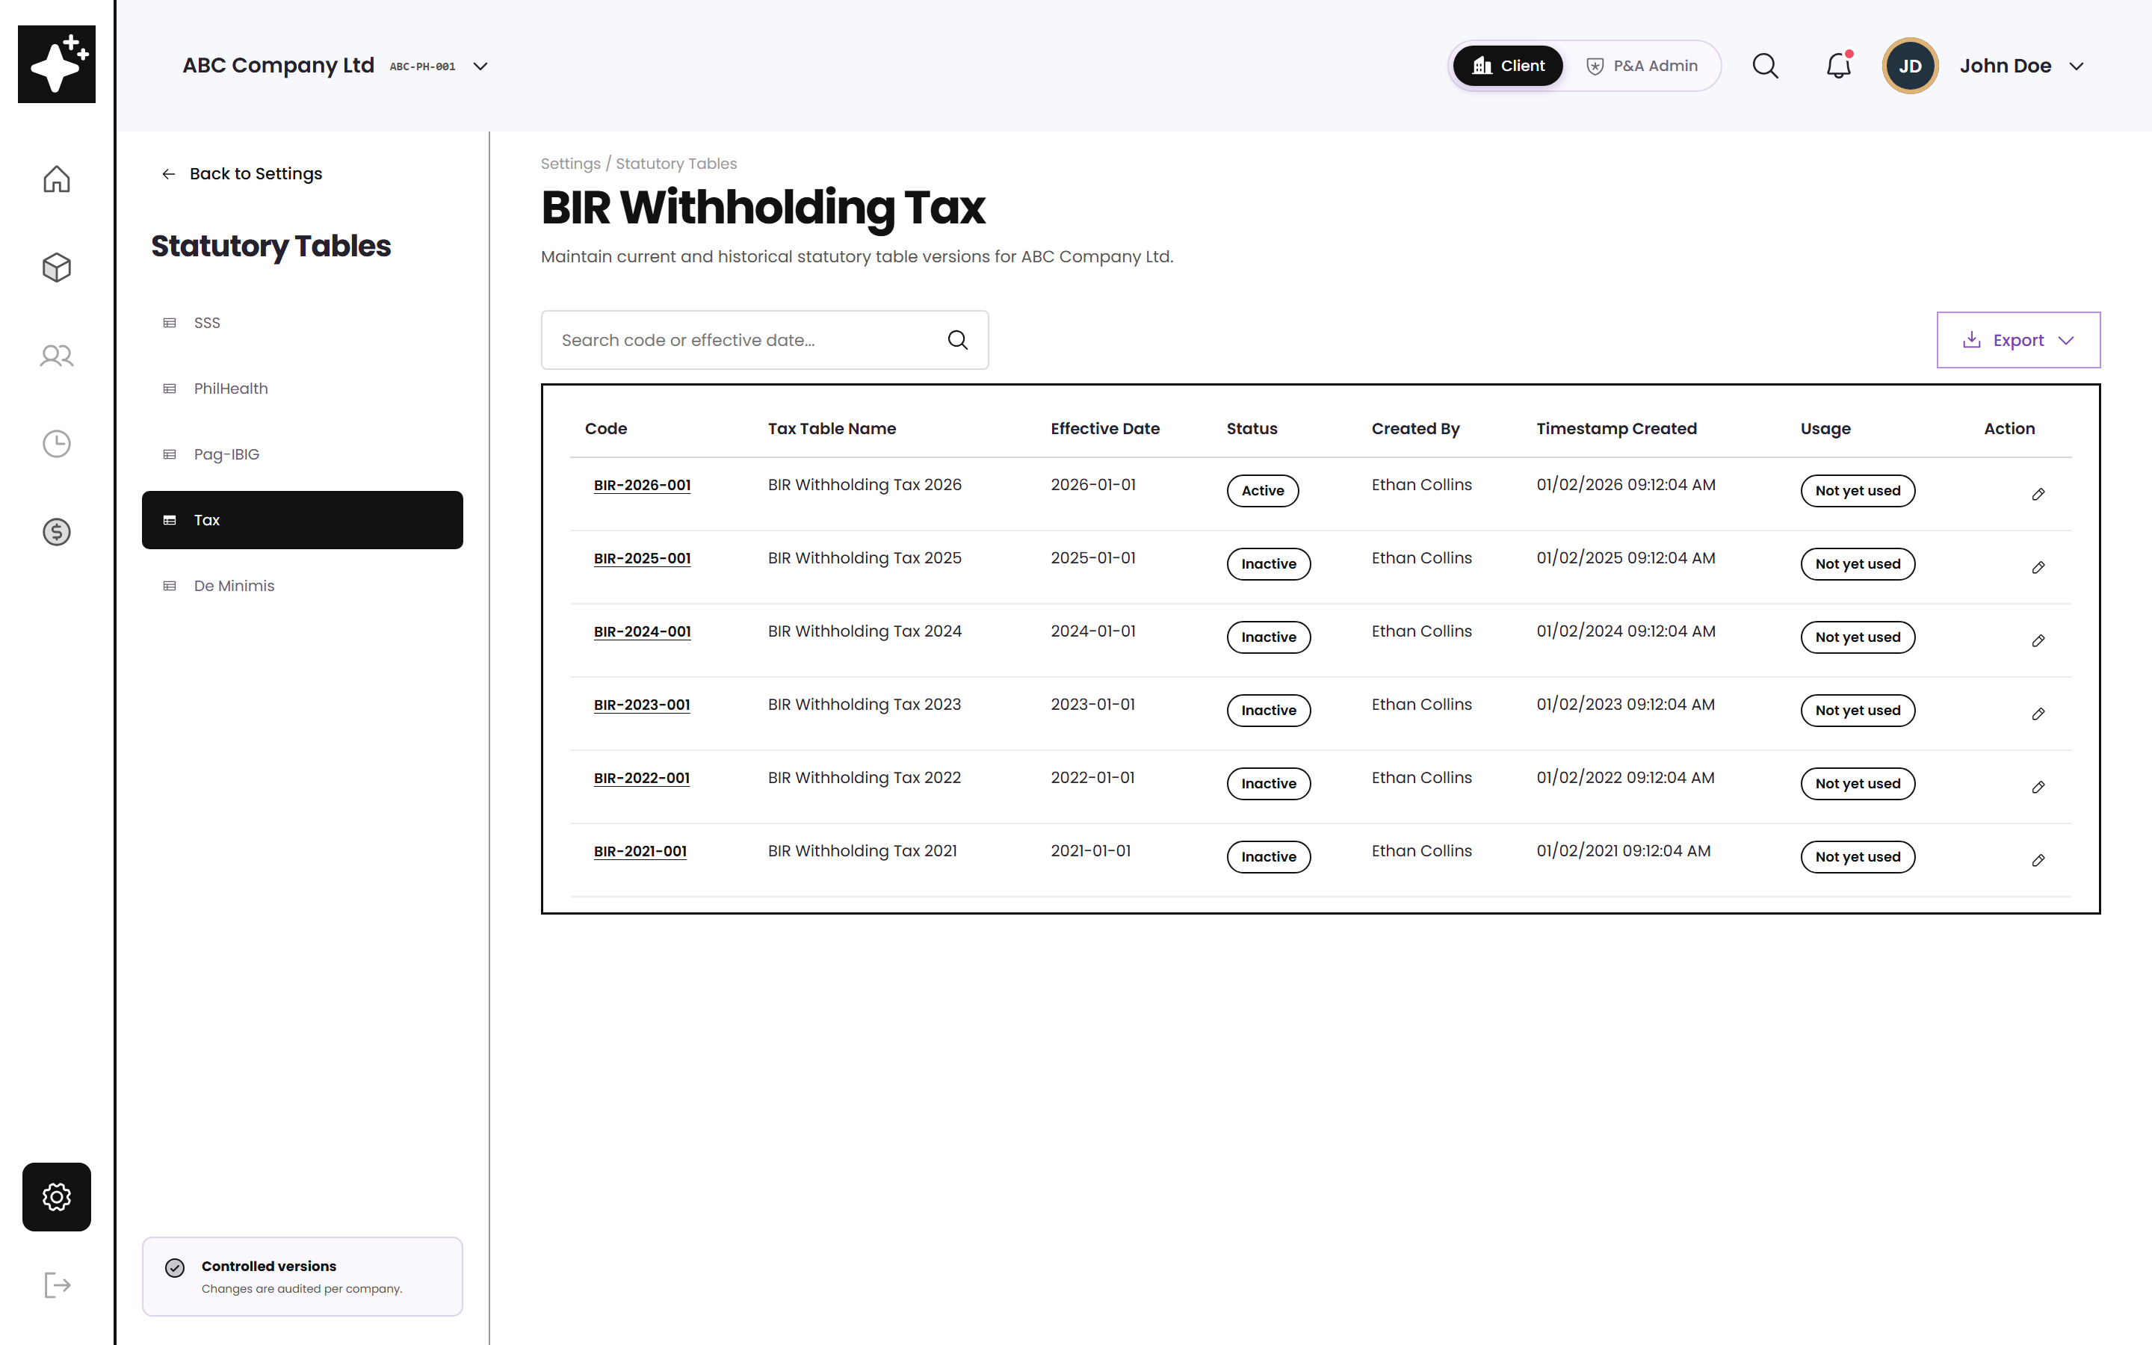
CONNECTED DATA
Rates and ceilings live in versioned tables
Effective-dated
Payroll picks the version in force for the run, so a historical payroll can always be reproduced.
Locked once used
A table a payroll has consumed cannot be edited — you publish a new version instead.
Feeds Gross Up
The bracket in the gross-up trace is read from this table, never hard-coded.
BIR withholding table — wireframe view
Source · Tax Tables Flow v2 (14 May 2026); BRD Statutory Requirements 180–184

Slide 49
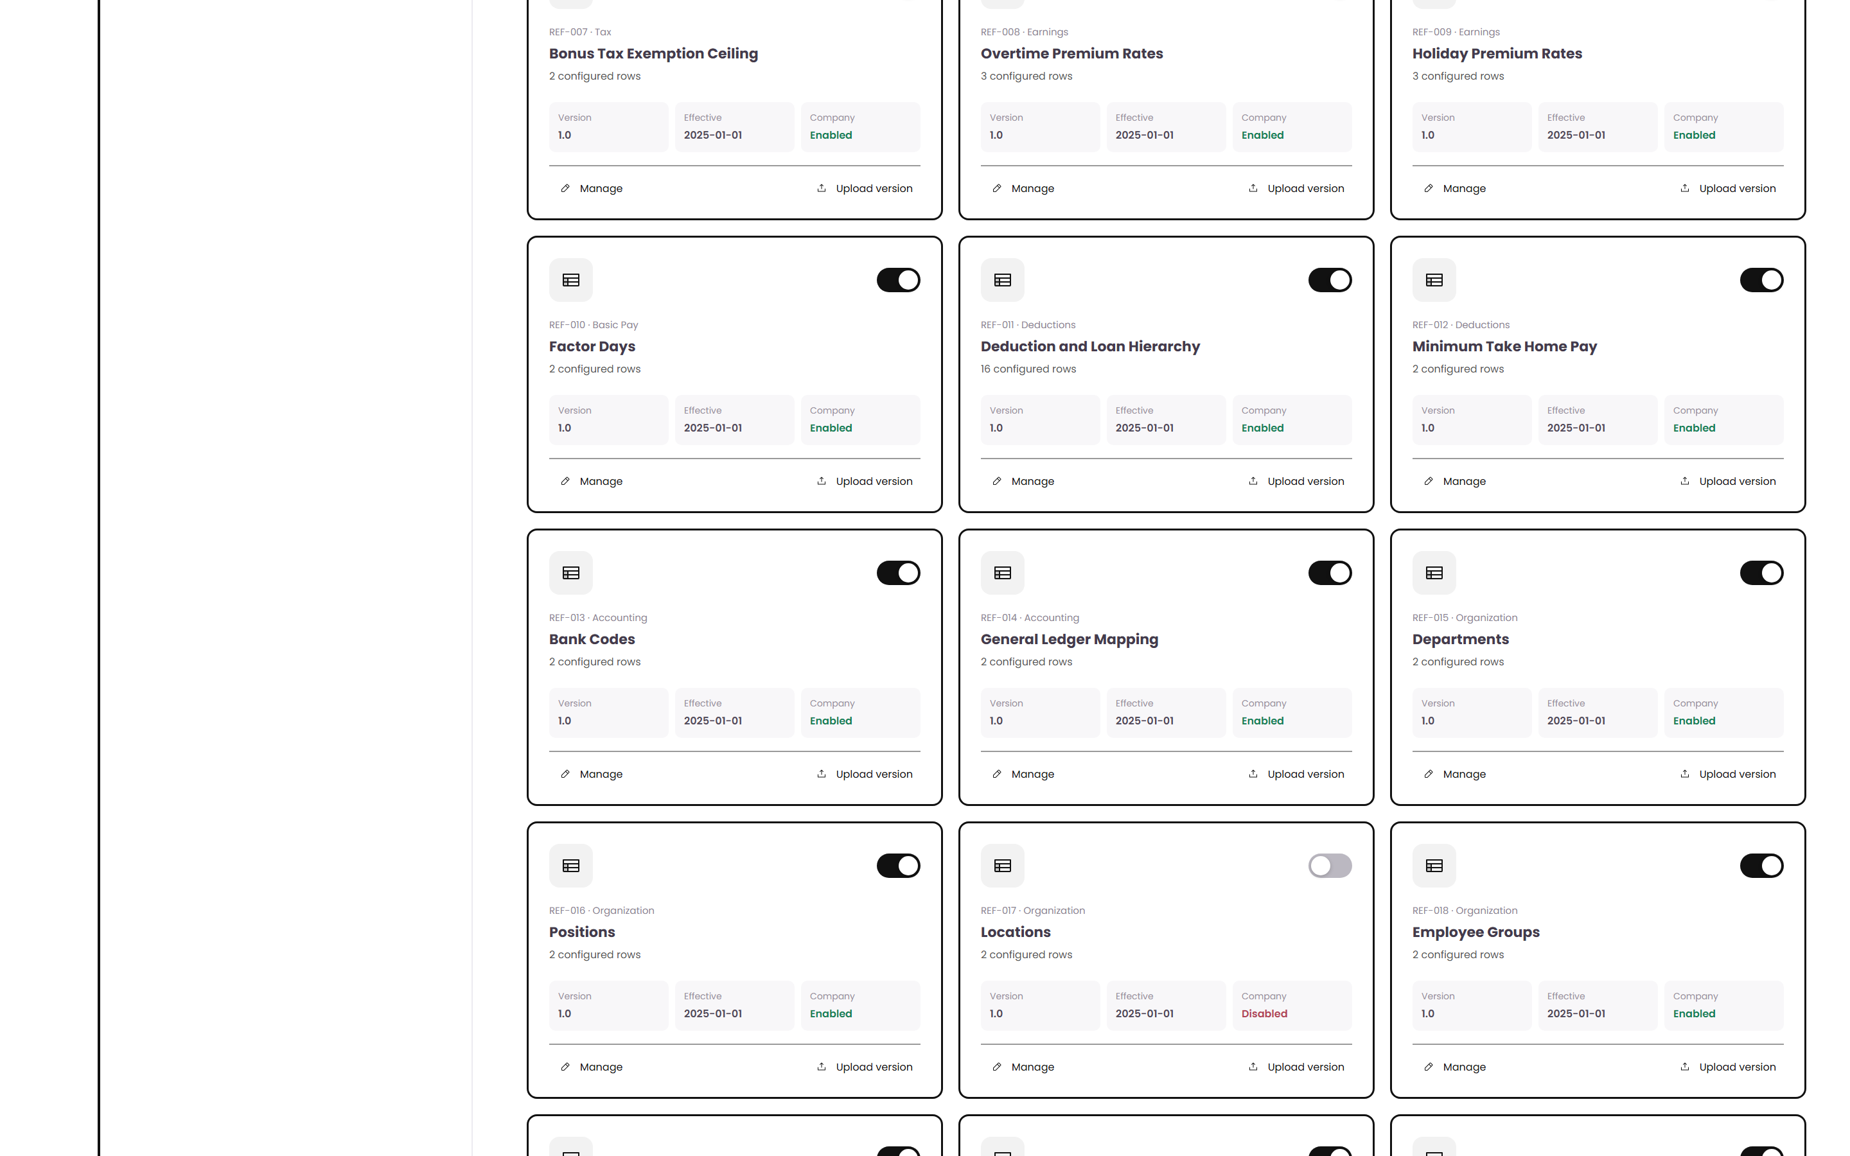
CONNECTED DATA
Reference sources behind the formulas
Named sources
Each formula input points at a maintained reference source rather than a number typed into a rule.
Deduction hierarchy
The take-home adjustment order is one of these sources, so it is maintained by the business.
Change once
Update the source and every rule that reads it follows.
Formula reference sources — wireframe view
Source · BRD Reference Table Module (feature points 62–63, 97–98)

Slide 50
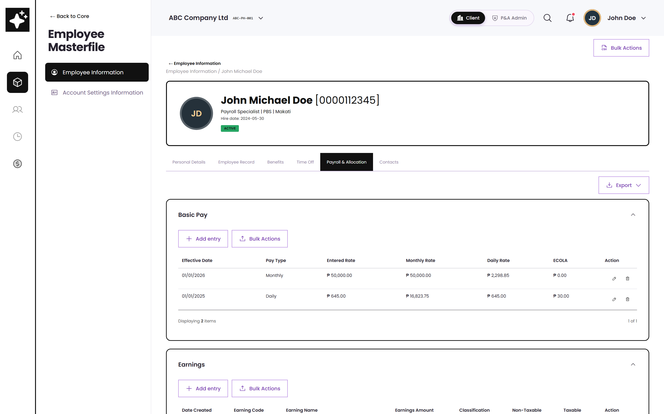
CONNECTED DATA
Employee payroll records feed the engines
Loans and deductions
Balances, amortisation, holds and remarks — the values the take-home engine adjusts.
Dates and plan type
Hire date, birth date and plan membership drive retirement eligibility.
Ceilings applied here too
Bonus and De Minimis ceilings split taxable and non-taxable amounts on the record itself.
Employee Masterfile — payroll data
Source · Annex B Dorado sheets: Loans, Deduction, Cost Allocation, Previous Employer

Slide 51
E N D - T O - E N D F L O W
How company policy becomes a payroll result
Use this as the “map” before showing the individual Computational Basis screens and the four policy engines.
SETUP PATH
Company Configuration
Services Information
Computational Basis
Company Rules + Policy Engines
1
Written policy
2
Governed code
3
Company Rule
4
Policy engines
5
Payroll output
Annex B / client policy is captured in business terms. Example: protected net pay, retirement formula, final pay components.
Computational Basis stores the approved formula/template. Codes are reusable, versioned, and not hand-typed per rule.
Apply New Rule from the Company Rules register. Choose who it applies to, then the code, then company/group values.
The selected engine runs the active rule during payroll. Formula stays controlled; values differ by company or group.
Result feeds payroll calculation, deduction ledger, deferrals, carry-forward, and payslip tags. Traceability shows what rule/code produced the result.
THP
RET
FIN
GUP
CREATE RULE
1 Employee group
2 Approved code
3 Company values
4 Enable + compute
RULE GUARDRAILS
Only approved codes
Formula locked
Register cannot disagree
References are versioned
List is filtered by the selected sub-category.
Standard codes stay controlled; rule values vary.
Engine-owned rule rows are edited in the engine.
Rates, ceilings and brackets live in tables.
Source · Existing deck pages 3–10: orientation, Company Rules, and policy-engine library

Slide 52
APPENDIX
Where every screen came from
Sources, row-level traceability and a glossary
Notes:
Leave this open during Q&A so anyone can challenge a screen and be shown the row it came from.

Slide 53
APPENDIX A
Source documents
Annex B
Sheets used: Take Home Pay · Retirement Pay · Final Pay · Gross Up · Dorado Loans · Dorado Deduction · Dorado Cost Allocation · Dorado Previous Employer · De Minimis Ceiling Set Up · 13th Mo Pay & Other Bonuses
Employee Masterfile Payroll Data Tables from Dorado
Annex C
Payroll transaction preparation, inputs, calculation and approval lifecycle. Referenced for how a computed policy is consumed by a payroll run.
Sub Module 3 — Payroll
Phase 2 BRD Audit Summary
Computational Basis module (feature points 73–82), Settings module set-up rows 18–20 and 50–55, Statutory Requirements 180–184.
Overall status — 331 requirement rows
Tax Tables Flow
Table structure, effectivity selection, and the rule that a table used by a payroll transaction may not be edited.
v2 dated 14 May 2026 (supersedes v1)
Notes:
These four are the source of truth. Anything on screen that is not in one of these is flagged on the last slide.

Slide 54
APPENDIX B
Take-Home Pay traceability
Annex B → sheet “Take Home Pay”
Source rows | What the workbook says | Where it appears in the app
Rows 4–5 | Minimum take-home based on basic salary, 40% example | Protected base = Basic Pay; threshold type Percentage
Rows 13–14 | Guarantee on gross pay, 30% example | Protected base = Gross Pay
Rows 21–22 | Guarantee on gross less reimbursements, 30% | Protected base = Gross Pay less reimbursements — used in the demo
Rows 29–30 | Guaranteed minimum peso net pay, ₱8,000 example | Threshold type = Fixed Amount
Rows 8–11 | Statutory in full; loans may be deferred; carry over; notify | Statutory rank 0; auto-defer, carry-forward and notification switches
Rows 45–59 | Loan repayment cap, 25% of gross or a fixed ₱10,000 | Loan cap base, type and value
Rows 61–83 | LAABS and undertime cap by %, days, or protected net | Attendance cap base, type and value
Rows 85–103 | Hierarchy table, statutory rank 0, optional last | Deduction and loan hierarchy, maintained as a reference source
Rows 106–109 | Loans at cap but net still short — choose what wins | Conflict priority selector
Rows 138–155 | Deferred tracking, payslip tag fields, deduction ledger | Carry-forward table, payslip tag block and deduction ledger

Slide 55
APPENDIX C
Retirement Pay traceability
Annex B → sheet “Retirement Pay”
Source rows | What the workbook says | Where it appears in the app
Rows 3–6 | Daily rate × 22.5 × years of service | Statutory value shown in the scenario
Row 5 | Fractions of six months or more count as one year | Service rounding rule; 12y 6m → 13 years
Rows 13–15 | Statutory RA 7641, company plan, or override if more beneficial | Retirement plan type selector
Rows 24–29 | Divisor, days per year, salary basis, benefits, rounding, cap | Formula inputs, all configurable
Row 30 | RetirementPay = MAX(statutory, company plan) | “Best of” option; both values displayed
Rows 31–37 | Age 60, compulsory 65, five years service, early retirement | Eligibility rules and the eligibility strip
Rows 38–41 | RA 7641 and RA 4917 tax exemption conditions | Taxation rule; the result records why it is exempt
Rows 46–49 | Retirement pay forms part of final pay | Result feeds the Final Pay engine automatically

Slide 56
APPENDIX D
Final Pay traceability
Annex B → sheet “Final Pay”
Source rows | What the workbook says | Where it appears in the app
Rows 5–11 | Mandatory: unpaid salary, 13th month, SIL, separation, retirement, final tax | Mandatory component switches
Rows 12–18 | Optional: convertible leave, allowances, commissions, cash bond, gratuity | Optional component switches
Rows 19–29 | Company rules: conversion, divisor, rounding, advance 13th, loan balances, negative net | Company rule selectors on the settings card
Rows 30–31 | Pull last days worked, leave balances, unpaid OT and LAABS | Scenario inputs drawn from the employee record
Rows 32–34 | Only authorised deductions; auto-offset before net | Offsets shown as negative lines in the breakdown
Row 36 | Output — final pay breakdown | Component-by-component breakdown table

Slide 57
APPENDIX E
Gross Up traceability
Annex B → sheet “Gross Up”
Source rows | What the workbook says | Where it appears in the app
Row 2 | Employer shoulders the tax so the employee receives a guaranteed net | Employer-absorbed share, default 100%
Row 3 | Divide the intended net by (1 − rate) | Available as the flat / final tax method
Row 4 | Use BIR tables: taxable income, correct bracket, base tax + excess % | Graduated method, reading the effective BIR table
Rows 7–8 | Choose the income and enable gross-up | Guaranteed target selector and engine switch
Rows 10–11 | Add grossed-up income; subtract mandatory contributions | Taxable compensation line in the calculation trace
Rows 12–14 | Identify bracket; apply base tax + excess × rate | Bracket named in the trace, e.g. from ₱33,333, ₱1,875 + 20%
Row 15 | Recompute gross until net equals the required amount | Iteration table with the gap closing to zero
Rows 16–18 | Show gross, employer-absorbed tax, and net released | The four result tiles

Slide 58
APPENDIX F
Glossary
Computational Basis
Hierarchy / rank
The controlled library of standard formulas, policy engines and the reference sources they read.
The order in which controllable deductions are trimmed. Statutory items are rank 0 and never adjusted.
Policy engine
Deferral / carry-forward
A screen that computes one family of payroll policy and shows its full working. There are four.
An amount not collected this cutoff, rescheduled with its outstanding balance preserved.
Policy code
Effective-dated
A reusable, approved handle on an engine — for example THP-001. Assigned to Company Rules.
A version with a start date. Payroll uses the version in force for that run.
Company Rule
Convergence
One policy applied to an employee group, with its own parameter values.
For gross-up: repeating the calculation until the computed net matches the target within tolerance.
Protected minimum
The net pay a rule guarantees, expressed as a percentage of a base or a fixed amount.

Slide 59
APPENDIX G
What still needs a business decision
These are places where the workbooks offer alternatives or leave a value open. The app makes each one configurable rather than assuming an answer.
1
Which take-home policy is active
Annex B lists five alternative minimum-net policies and several cap rules. Only one set should be switched on per company or group.
Take Home Pay rows 4–43
2
Bonus threshold priority
When several bonus types share one non-taxable ceiling, the consuming order must be agreed.
BRD 13th month / bonus ceiling
3
Final pay when net is negative
The treatment of a residual balance needs a stated rule.
Final Pay row 29
4
Gross-up convergence
Tolerance, iteration limit and rounding stage are currently set to sensible defaults in the app.
Gross Up rows 15–16
5
Statutory values
All rates, brackets and ceilings on screen are sample data and must be confirmed against the effective official tables before use.
Statutory tables
Notes:
Be explicit that statutory numbers on screen are sample data pending confirmation.

Slide 60
What this demonstrates
1
Your written policies are configurable settings, not code changes.
2
Every result shows its working — base, threshold, ranks, brackets and iterations.
3
The engines feed each other; nothing is re-keyed between them.
4
Every screen traces back to a row in your own workbooks.
Notes:
Close by inviting them to challenge any screen — the appendix has the row reference for each one.

