Slide 1
ATLAS PHASE 2 · PAYROLL
Computational Basis Demo
How the setup drives take-home pay, retirement pay, final pay, and gross-up calculations
Take-Home Pay
Retirement Pay
Final Pay
Gross Up
Demo build · wireframe screenshots · sample values for walkthrough only
Notes:
Purpose: show the payroll team that their written policies in Annex B are now configurable, computable and traceable in the application. Every screenshot is taken from the running prototype in wireframe view.

Slide 2
AGENDA
Demo walkthrough
1
Start with the policy
We start from the written rule, turn it into an approved code, then apply it as a Company Rule.
2
Show the four setups
Take-Home Pay, Retirement Pay, Final Pay, and Gross Up — each with its own setup and sample run.
3
Use real sample numbers
The examples follow the Annex B samples so the calculation can be checked on screen.
4
Connect the pieces
Company Rules, reference tables, statutory tables, and employee payroll records all feed the result.
5
End with traceability
The appendix shows where each screen and rule came from, plus the items still needing confirmation.
Notes:
Frame the session: this is about traceability from their Excel to a working screen, not about software internals.

Slide 3
THE FLOW
From policy to payroll result
1
2
3
4
5
Written policy
Approved code
Company Rule
Policy engine
Payroll result
Annex B rule, written in
business terms
Reusable calculation code,
for example THP-001
Applied to an employee
group with its own values
Runs the calculation and
shows the working
Deduction changes, deferrals,
ledger, and payslip tags
The formula stays controlled. The values can change per company rule or employee group.
Source · BRD “Rules Set Up — Client-defined Rules”; Annex B Take Home Pay rows 113–156
Notes:
Key message: nobody edits a formula. They pick an approved code and set its values for a group of employees.

Slide 4
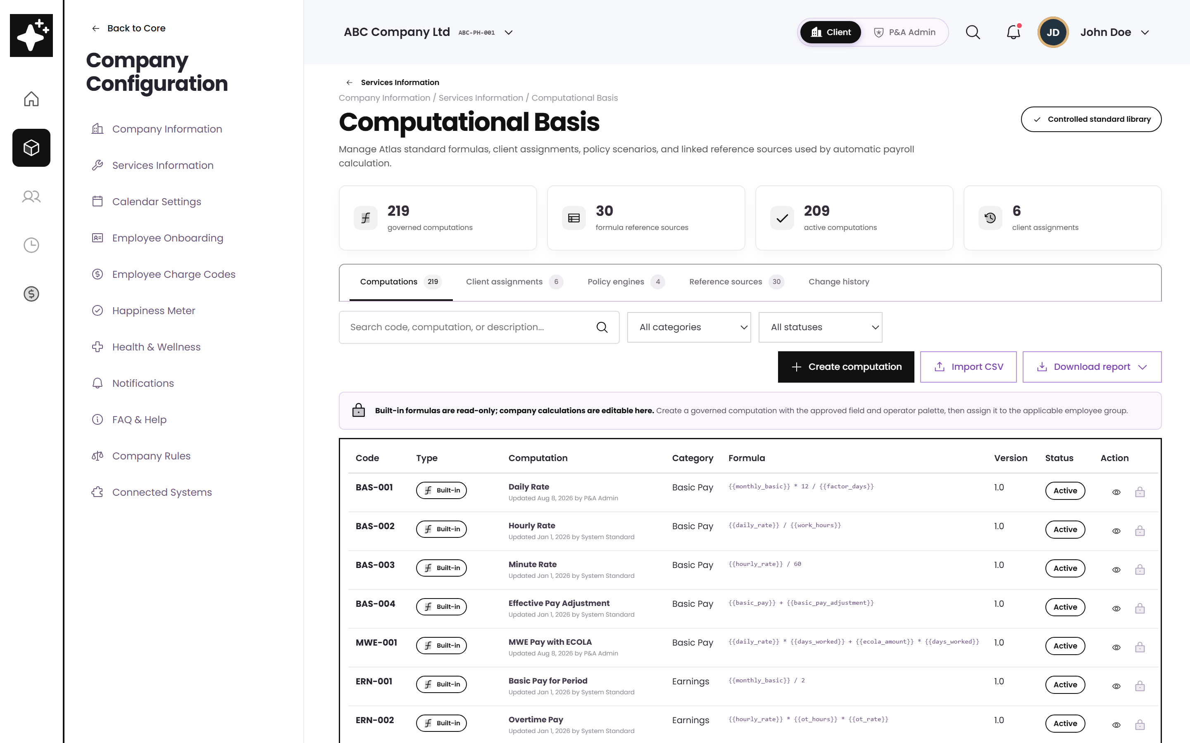
ORIENTATION
Where to find Computational Basis
One place for the logic
This is the controlled area for standard formulas, client assignments, policy engines, and the reference sources they use.
No hidden numbers inside formulas
Rates, brackets, and ceilings are maintained in versioned tables instead of being typed directly into a formula.
Navigation path
Company Configuration → Services Information → Computational Basis.
Computational Basis — wireframe view
Source · BRD Computational Basis Module (feature points 73–82)

Slide 5
TODAY’S SCOPE
The four calculation areas in this demo
1
2
3
4
Take-Home Pay
Retirement Pay
Final Pay
Gross Up
THP-001 · THP-002
RET-001 · RET-002
FIN-001
GUP-001
Protects the employee’s minimum net pay, caps controllable deductions, and defers the rest in the set order.
Checks the statutory formula against the company plan and uses the more beneficial result.
Builds the final pay breakdown, applies authorized offsets, and returns the net amount for release.
Finds the gross amount needed to release a guaranteed net amount to the employee.
Source · Annex B sheets: Take Home Pay · Retirement Pay · Final Pay · Gross Up
Notes:
Each engine has its own tab. The code beside the tab name is the governed policy code you assign in Company Rules.

Slide 6
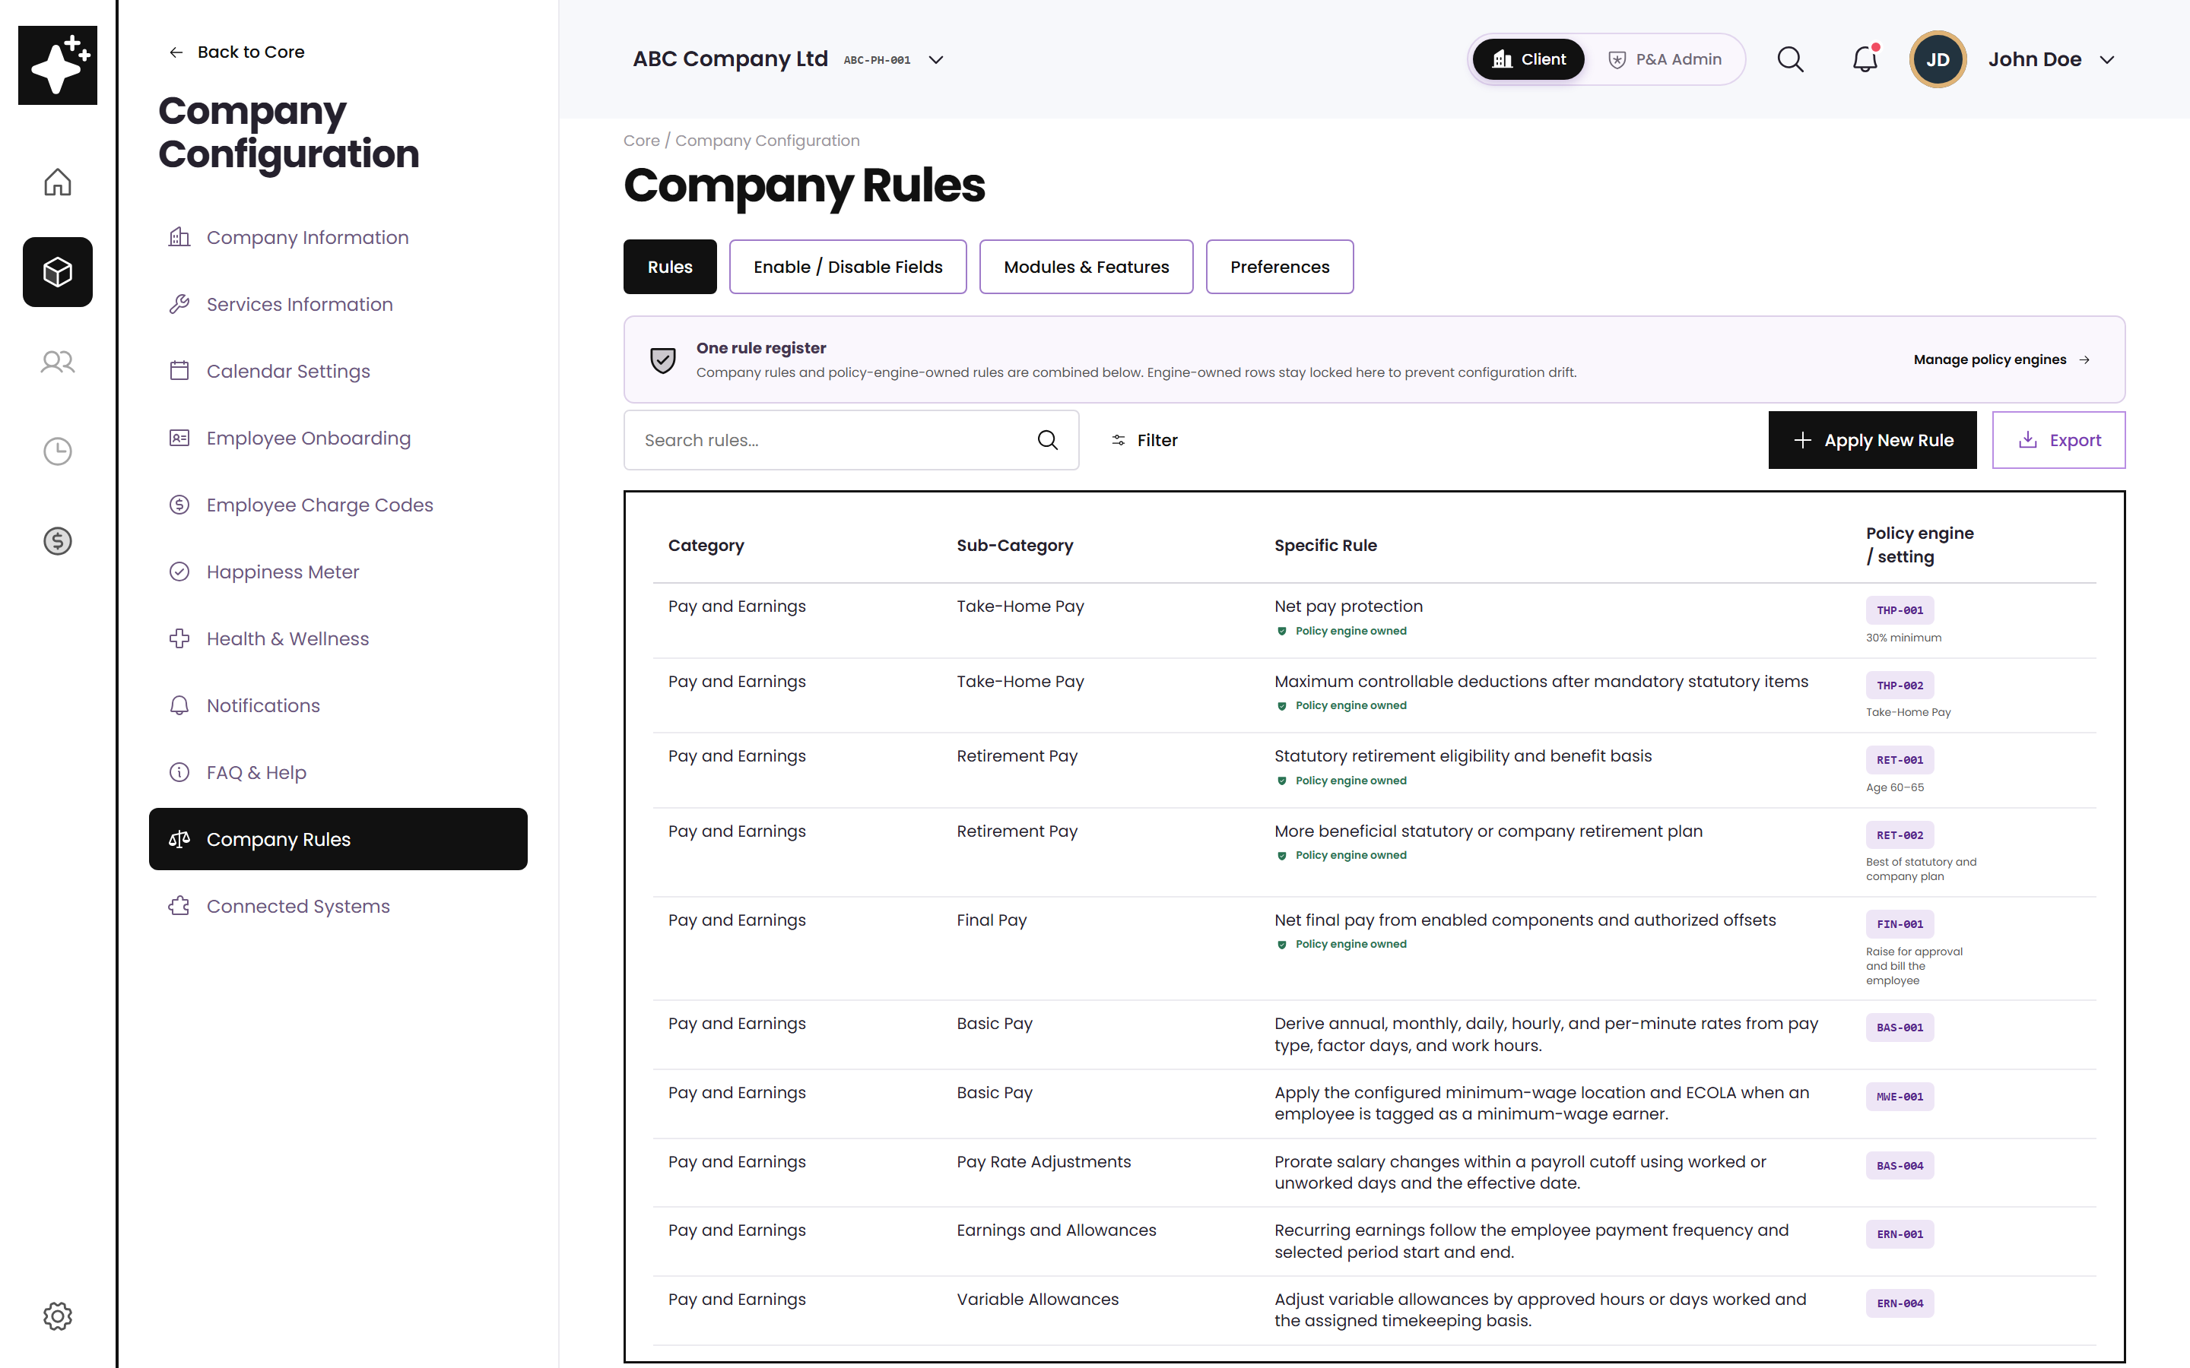
HOW IT CONNECTS
Company Rules is where the setup is applied
One rule register
All company rules sit in one place, even when different engines calculate them.
Engine-owned rows stay locked
If a rule is backed by a policy engine, the calculation details are changed inside that engine only.
Apply New Rule
Three steps: choose who it applies to, select the approved code, then enter the rule values.
Company Rules register — wireframe view
Source · BRD feature point 60, “Rules Set Up — Client-defined Rules”

Slide 7
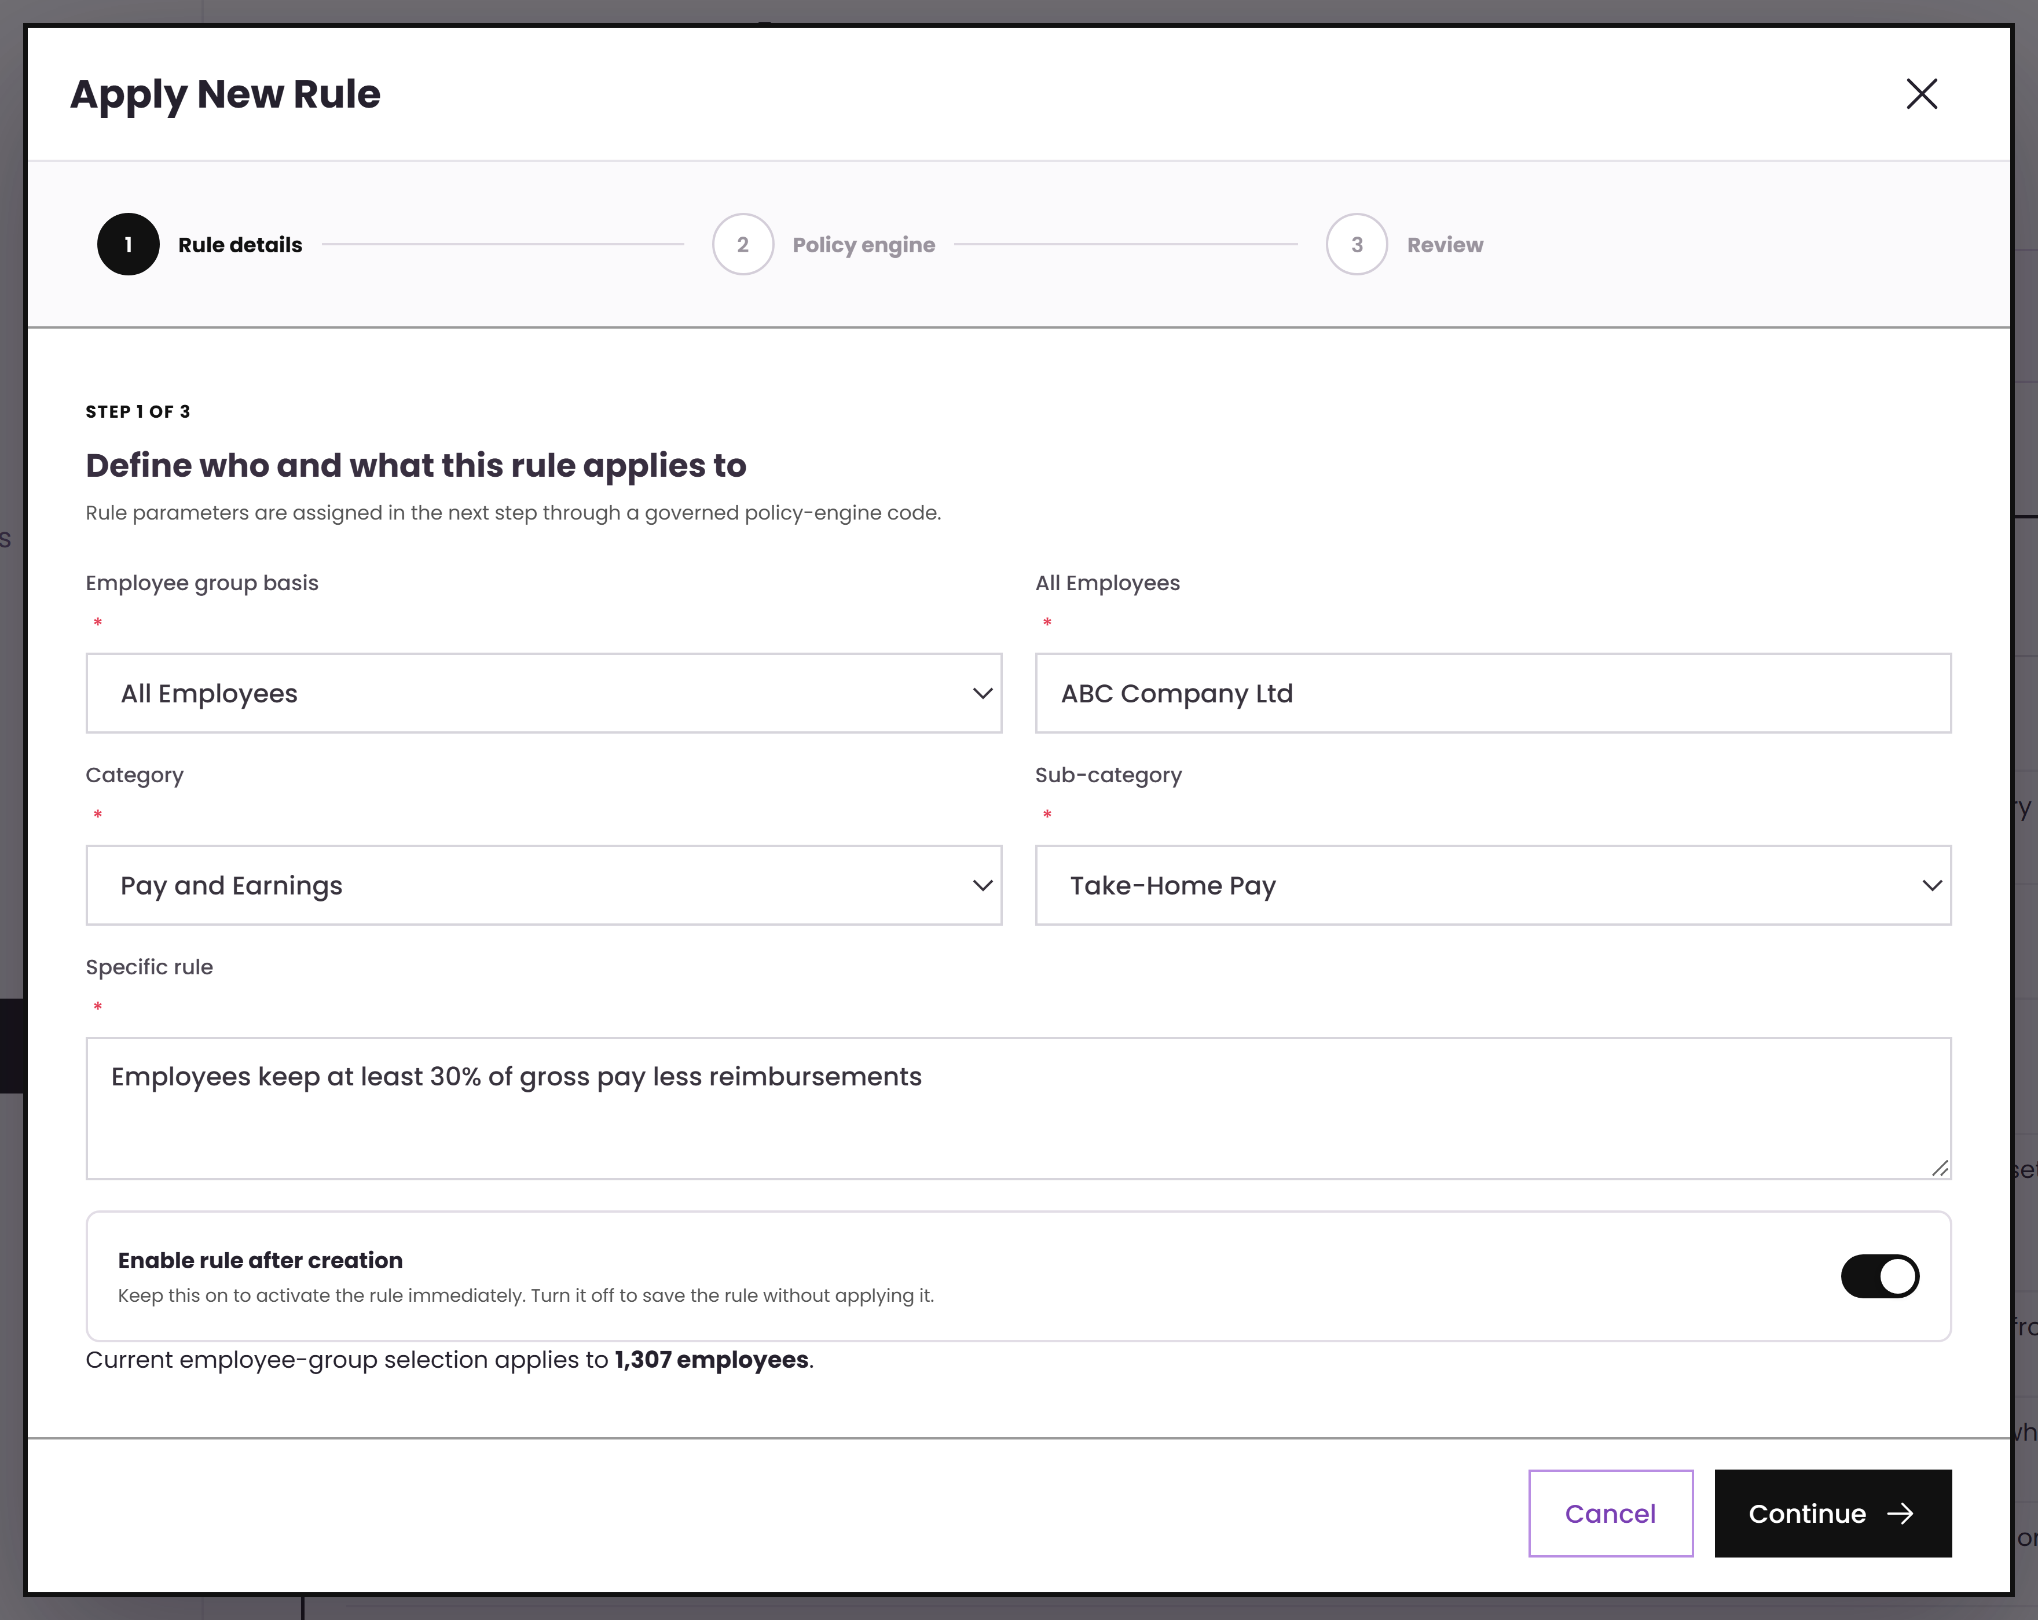
APPLYING A RULE
Step 1 — define who the rule applies to
Plain-language rule
“Employees must receive at least 30% of gross pay after reimbursements / receivables are removed.”
The employee group is selected first, so the same rule can still have different values by group.
Source · Annex B “Take Home Pay” rows 21–27 (policy 3)
Notes:
This is the wording from their own sample policy 3, typed straight into the rule.

Slide 8
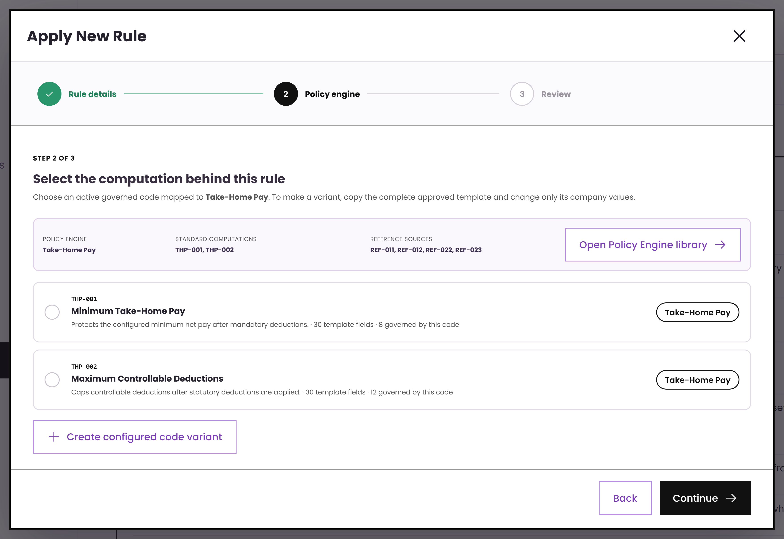
APPLYING A RULE
Step 2 — choose an approved computation
Only approved codes are available
The list is filtered by the selected sub-category. Users pick from approved templates instead of creating a formula from scratch.
THP-001 Minimum Take-Home Pay
THP-002 Maximum Controllable Deductions
Source · Annex B rows 4–5 (policy 1) and 45–51 (loan cap)
Notes:
Two codes on one engine: one governs the protected minimum, the other the caps. Both are assignable to their own rule.

Slide 9
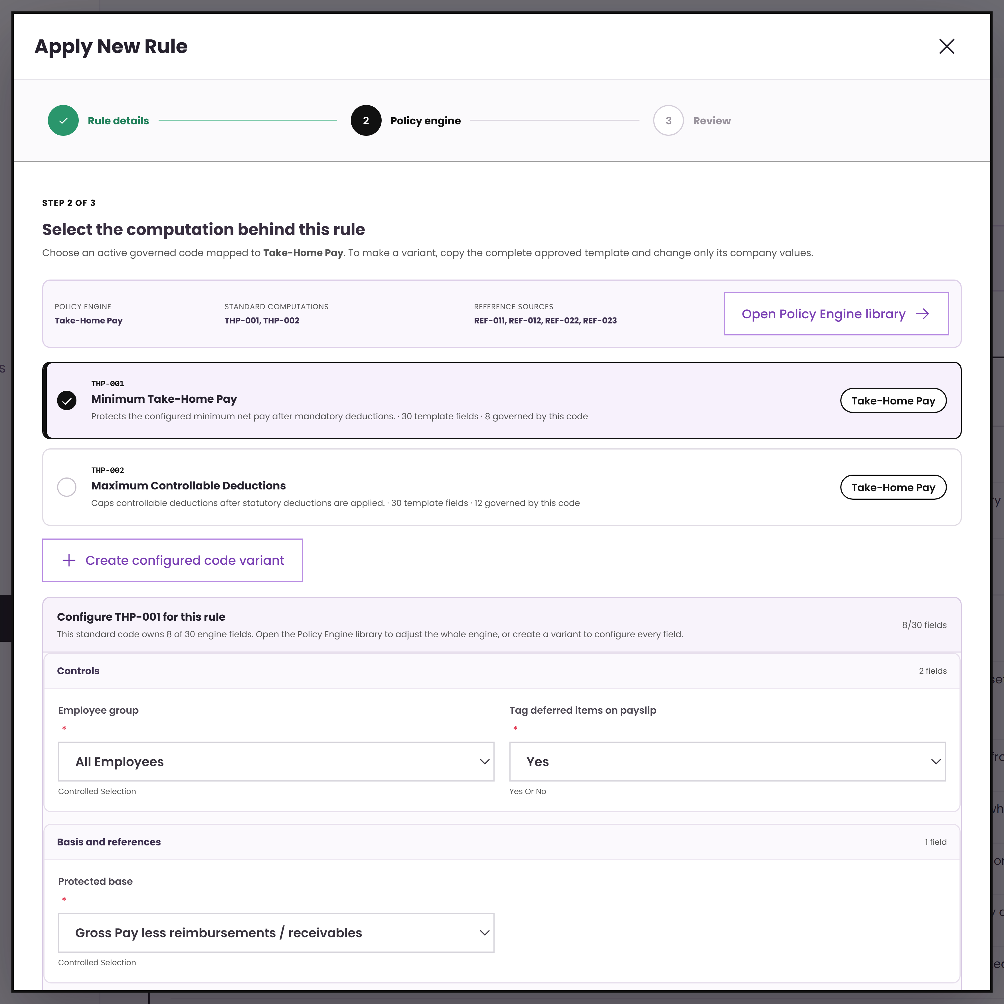
APPLYING A RULE
Step 3 — enter the values for this rule
Same structure, different values
The approved code defines the fields. This rule supplies its own base, threshold type, and threshold value.
That is how one policy library can support different companies and employee groups without copying formulas.
Source · Annex B rows 113–124, “Possible Company Set Up” 1–5
Notes:
Emphasise reuse: the schema is governed centrally, the values are the client decision.

Slide 10
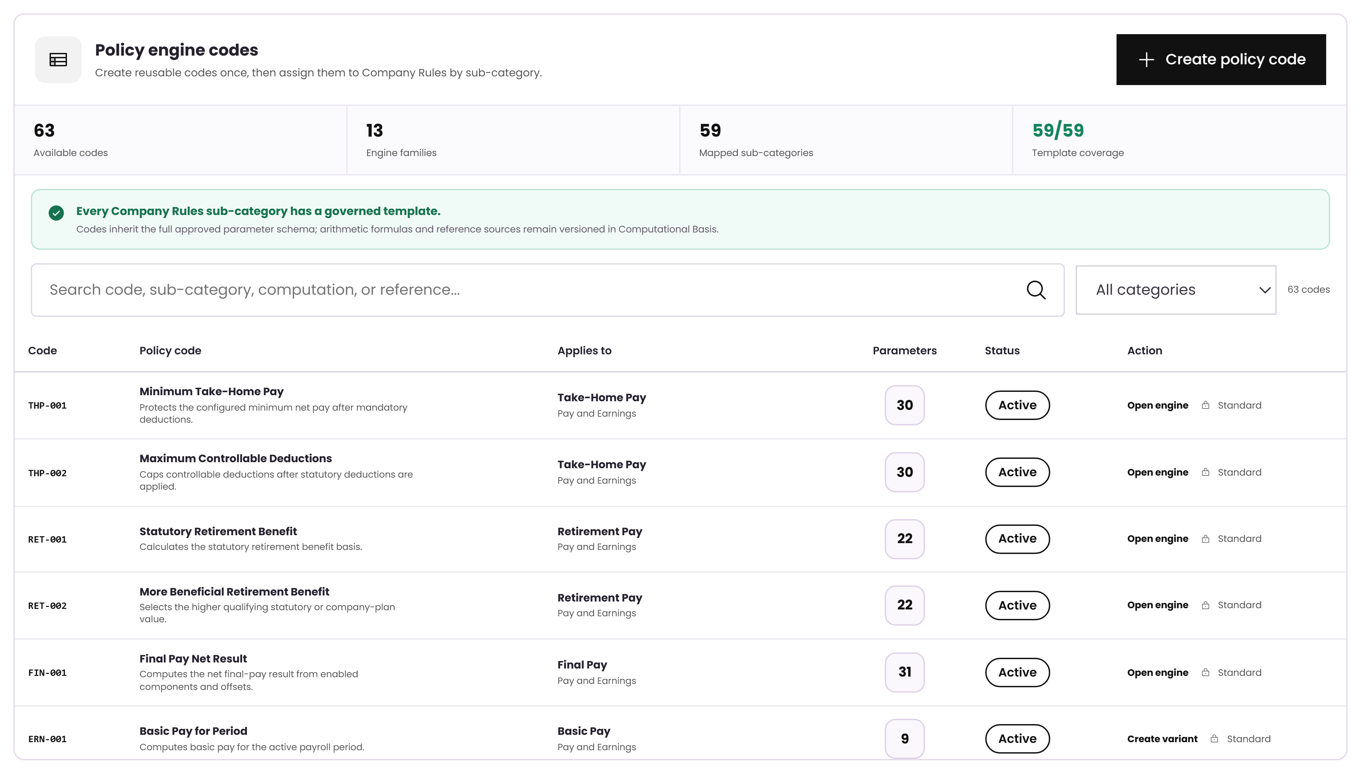
THE LIBRARY
The library keeps the formulas controlled
Coverage is visible
The header shows how many Company Rules sub-categories already have an approved template.
Standard vs client variant
Standard codes stay locked. A client variant starts from the standard code and only changes the allowed values.
Open the engine
This opens the screen that calculates the selected code.
Policy engine code library — wireframe view
Source · BRD feature points 19–20, Computational Basis set-up

Slide 11
ENGINE 1 OF 4
Take-Home Pay
1
Protected minimum
2
Deduction and loan caps
Protect minimum net pay, cap selected deductions, and carry forward what cannot be deducted this cutoff.
3
Adjustment order
4
Deferral and carry-forward

Slide 12
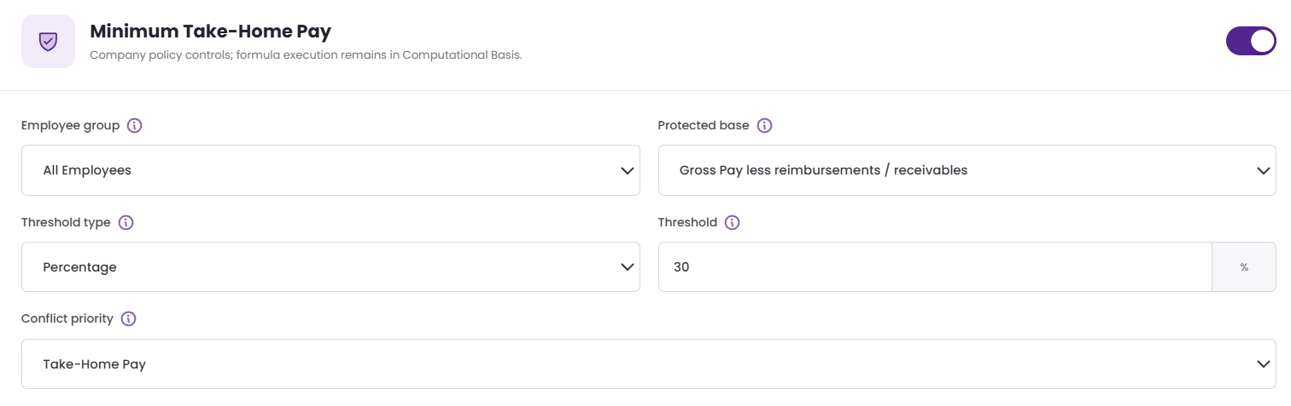
TAKE-HOME PAY · SETUP
Set the protected minimum
Base
Basic Pay, Gross Pay, or Gross Pay less reimbursements — these match the sample bases in Annex B.
Threshold
The minimum can be a percentage or a fixed peso amount, including zero.
Result
For this sample, 30% of ₱34,500 gives a protected minimum of ₱10,350.
Minimum Take-Home Pay settings
Source · Annex B “Take Home Pay” rows 4, 13, 21, 29, 37

Slide 13
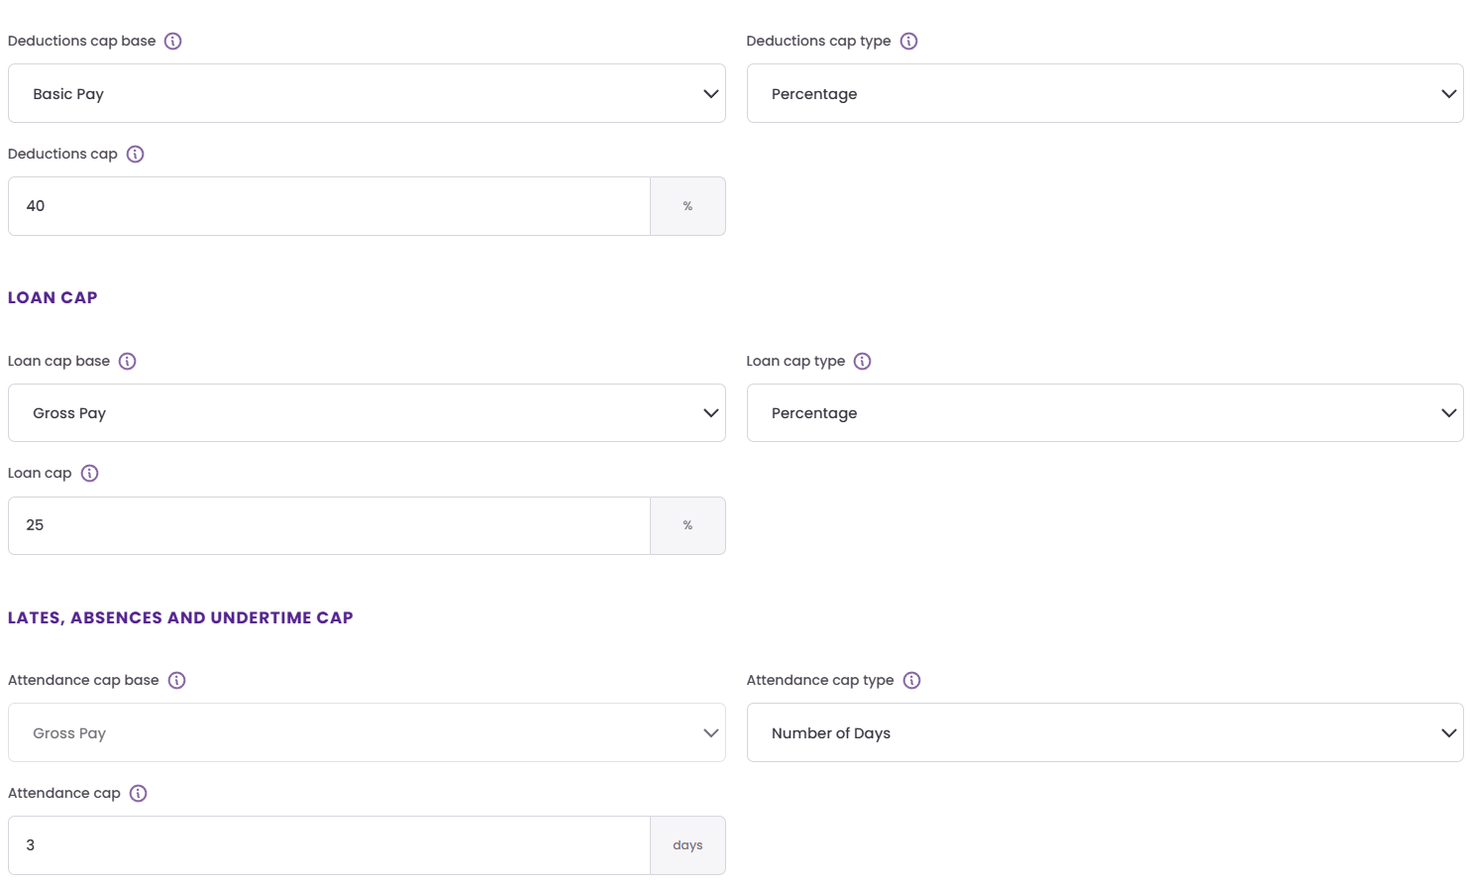
TAKE-HOME PAY · SETUP
Set caps for deductions, loans, and attendance
Loan cap
Loan repayments can be capped by percentage of gross pay or by a fixed amount, such as ₱10,000.
LAABS cap
Lates, absences, and undertime can be capped by percentage, fixed amount, or number of days.
Conflict priority
When more than one rule applies, the company decides which rule takes priority.
Cap configuration
Source · Annex B rows 45–84 (caps) and 106–109 (conflict priority)

Slide 14
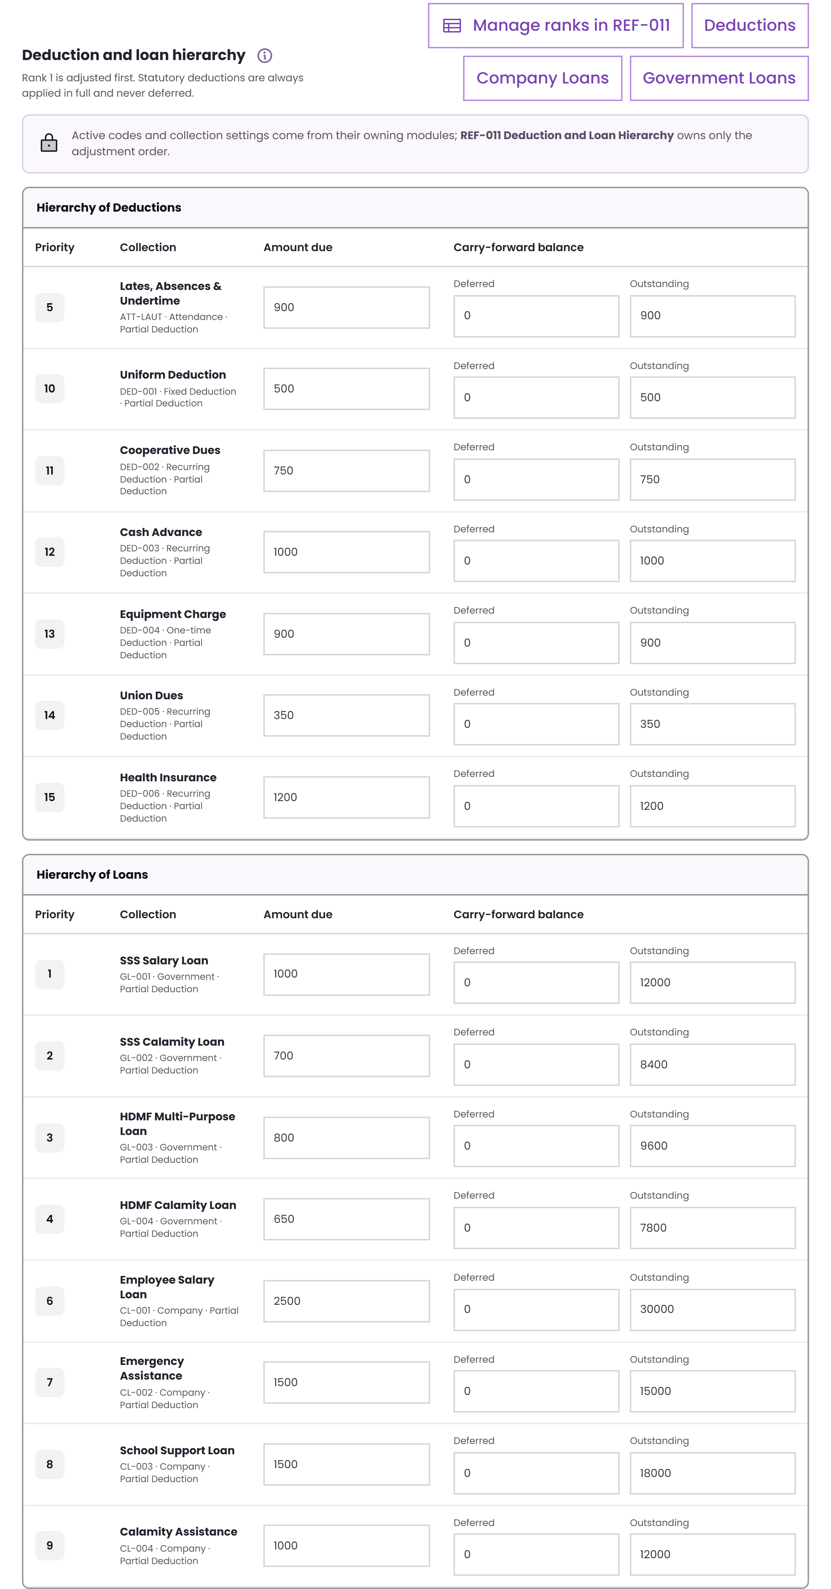
TAKE-HOME PAY · SETUP
Set the adjustment order
Ranked order
Statutory deductions stay at rank 0 and are always deducted in full. The other items follow the agreed order.
Only adjust what is needed
The engine trims just enough to meet the protected minimum. If rank 1 is enough, it stops there.
Maintained as a table
The order is data. It can be updated without changing the calculation code.
Deduction and loan hierarchy
Source · Annex B rows 85–103, hierarchy table and note at row 87

Slide 15
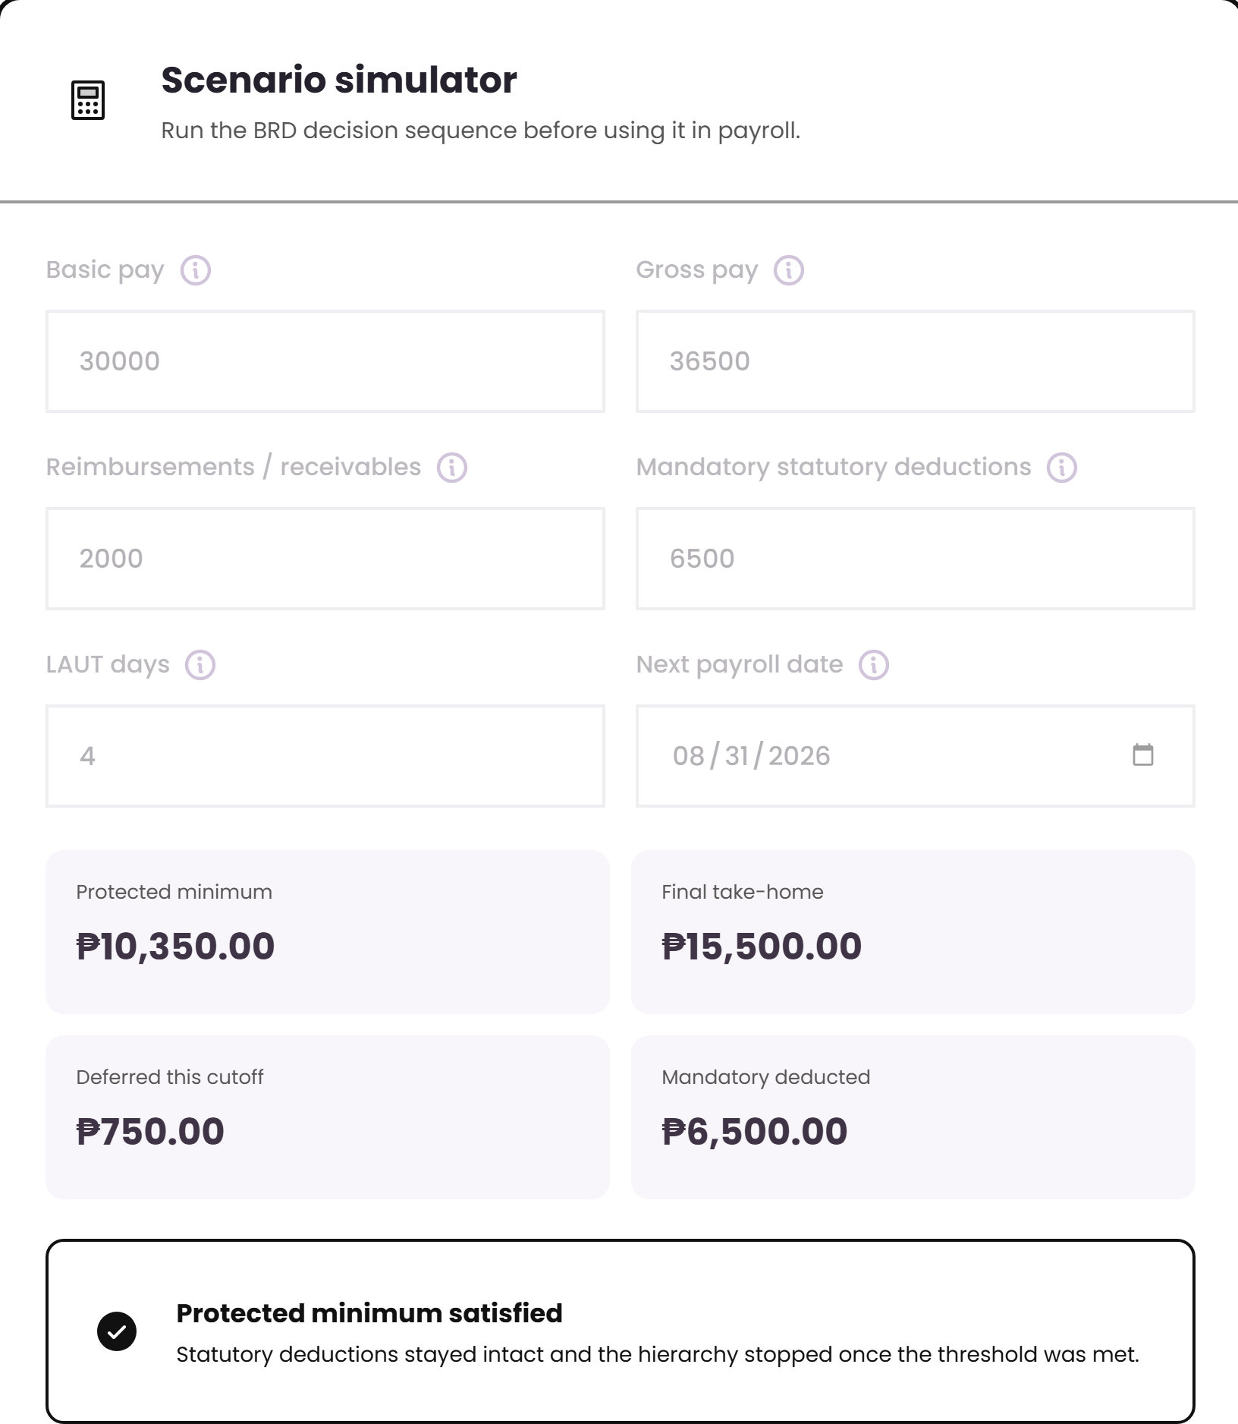
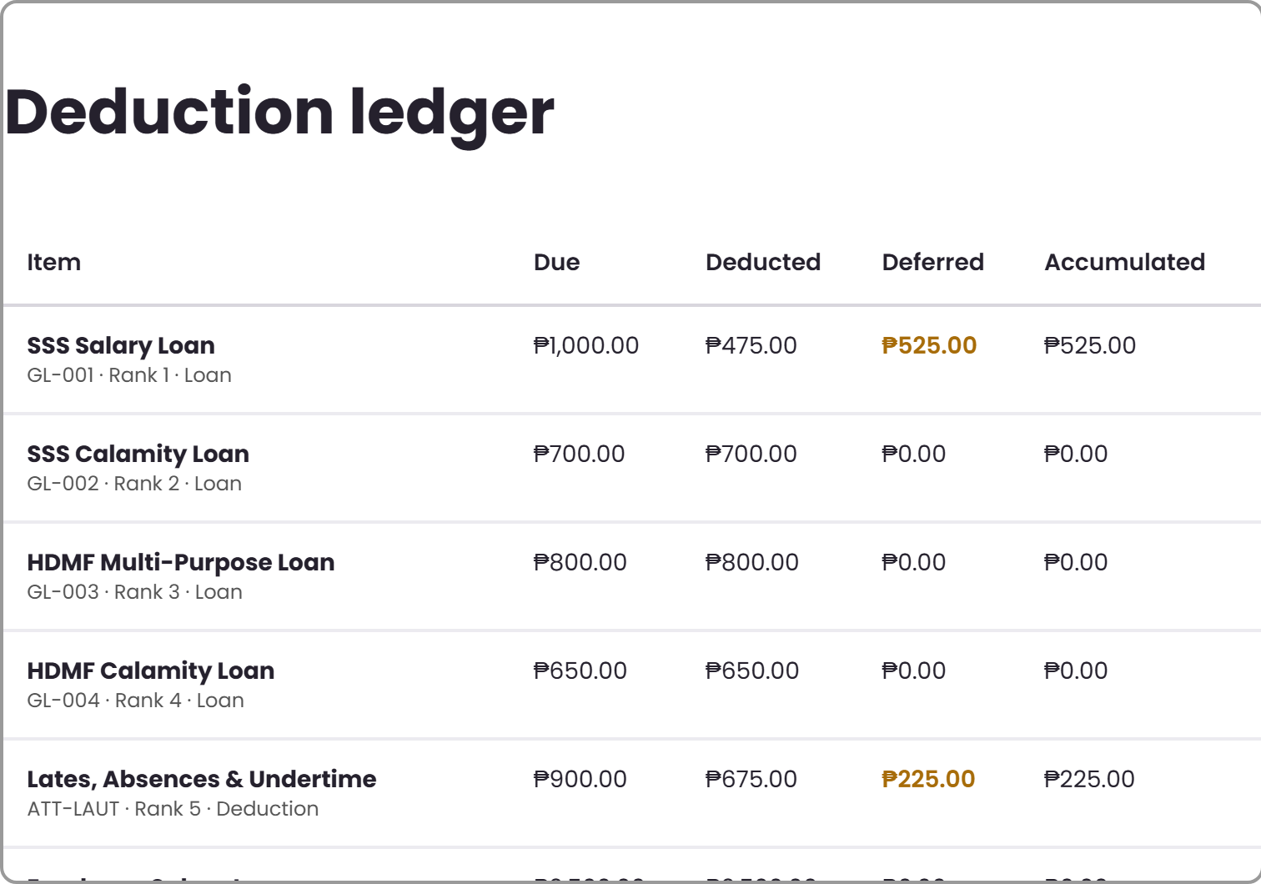
TAKE-HOME PAY · WORKED EXAMPLE
Sample payroll run
Gross pay
₱36,500
Less reimbursements
₱2,000
Protected base
₱34,500
Protected minimum (30%)
₱10,350
Statutory deductions stayed whole at ₱6,500. Only the ranked controllable items were adjusted.
Final take-home
₱15,500
Source · Annex B rows 8–11 (statutory in full, defer, carry over, notify)
Deferred this cutoff
₱750
Notes:
Walk the room through the ledger: due, deducted, deferred, accumulated. This is their row 143-152 payslip requirement made real.

Slide 16
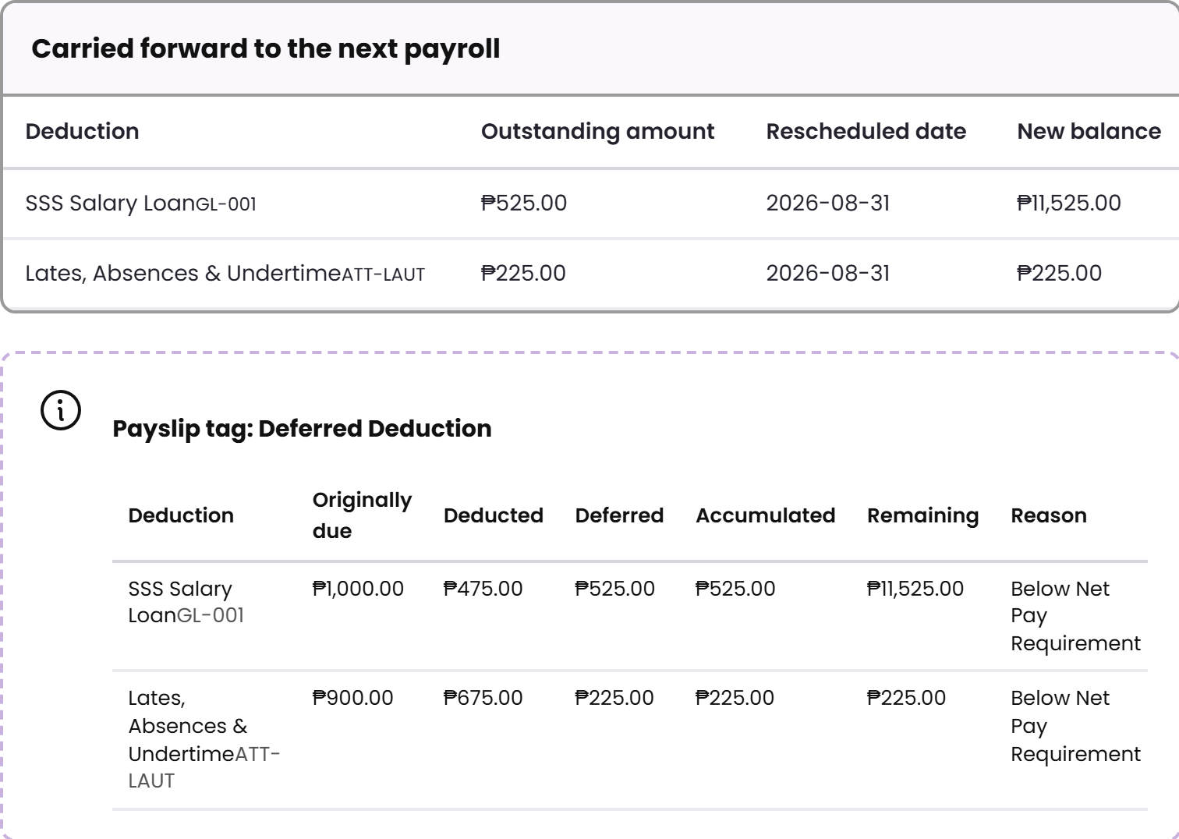
TAKE-HOME PAY · WORKED EXAMPLE
Deferred amounts carry forward
Carried forward
Outstanding amount, rescheduled deduction date, and new balance are shown for each deferred item.
Payslip tag
The payslip can show the original due amount, amount deducted, deferred amount, accumulated amount, remaining balance, and reason.
Why it matters
This gives the employee a clear trail across cutoffs, and keeps the loan or deduction balance accurate.
Carry-forward and payslip tagging
Source · Annex B rows 138–155

Slide 17
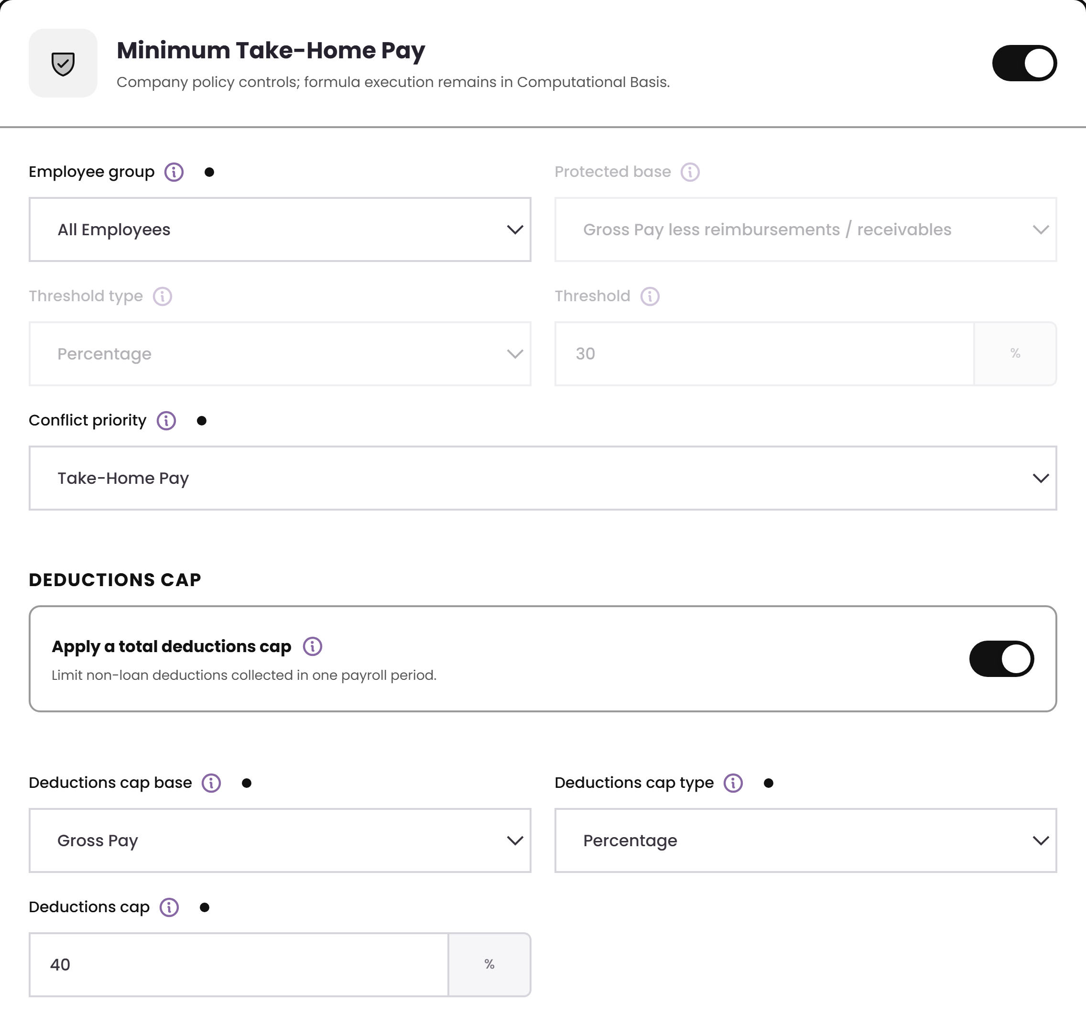
TAKE-HOME PAY · GOVERNANCE
Two codes support one take-home policy
THP-001
Handles the protected minimum: base, threshold, and deferral behavior.
THP-002
Handles the caps: deductions, loans, attendance, and conflict priority.
Why it is split
The company still has one policy. The two codes just let the setup stay cleaner and easier to maintain.
Opened from THP-002
Source · Annex B rows 113–130, set-up items 1–6b

Slide 18
ENGINE 2 OF 4
Retirement Pay
1
Plan type and formula
2
Eligibility rules
Calculate statutory retirement pay, compare it with the company plan, and use the better amount.
3
Service-year rounding
4
Tax treatment

Slide 19
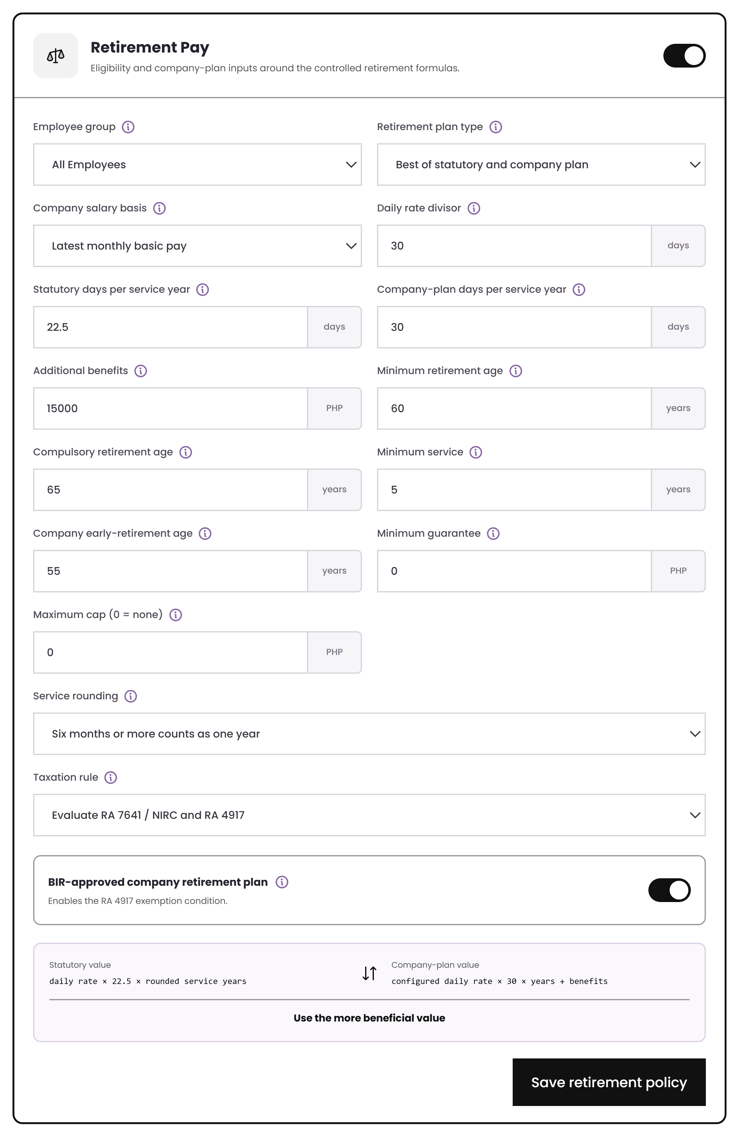
RETIREMENT PAY · SETUP
Set the plan and eligibility rules
Plan type
Use statutory RA 7641, a company plan, or the “best of both” option.
Inputs are editable
Daily-rate divisor, days per service year, salary basis, additional benefits, minimum guarantee, and maximum cap can be configured.
Eligibility
Age 60, compulsory age 65, five years of service, and optional company early-retirement age are part of the rule.
Retirement Pay settings
Source · Annex B “Retirement Pay” rows 11–37

Slide 20
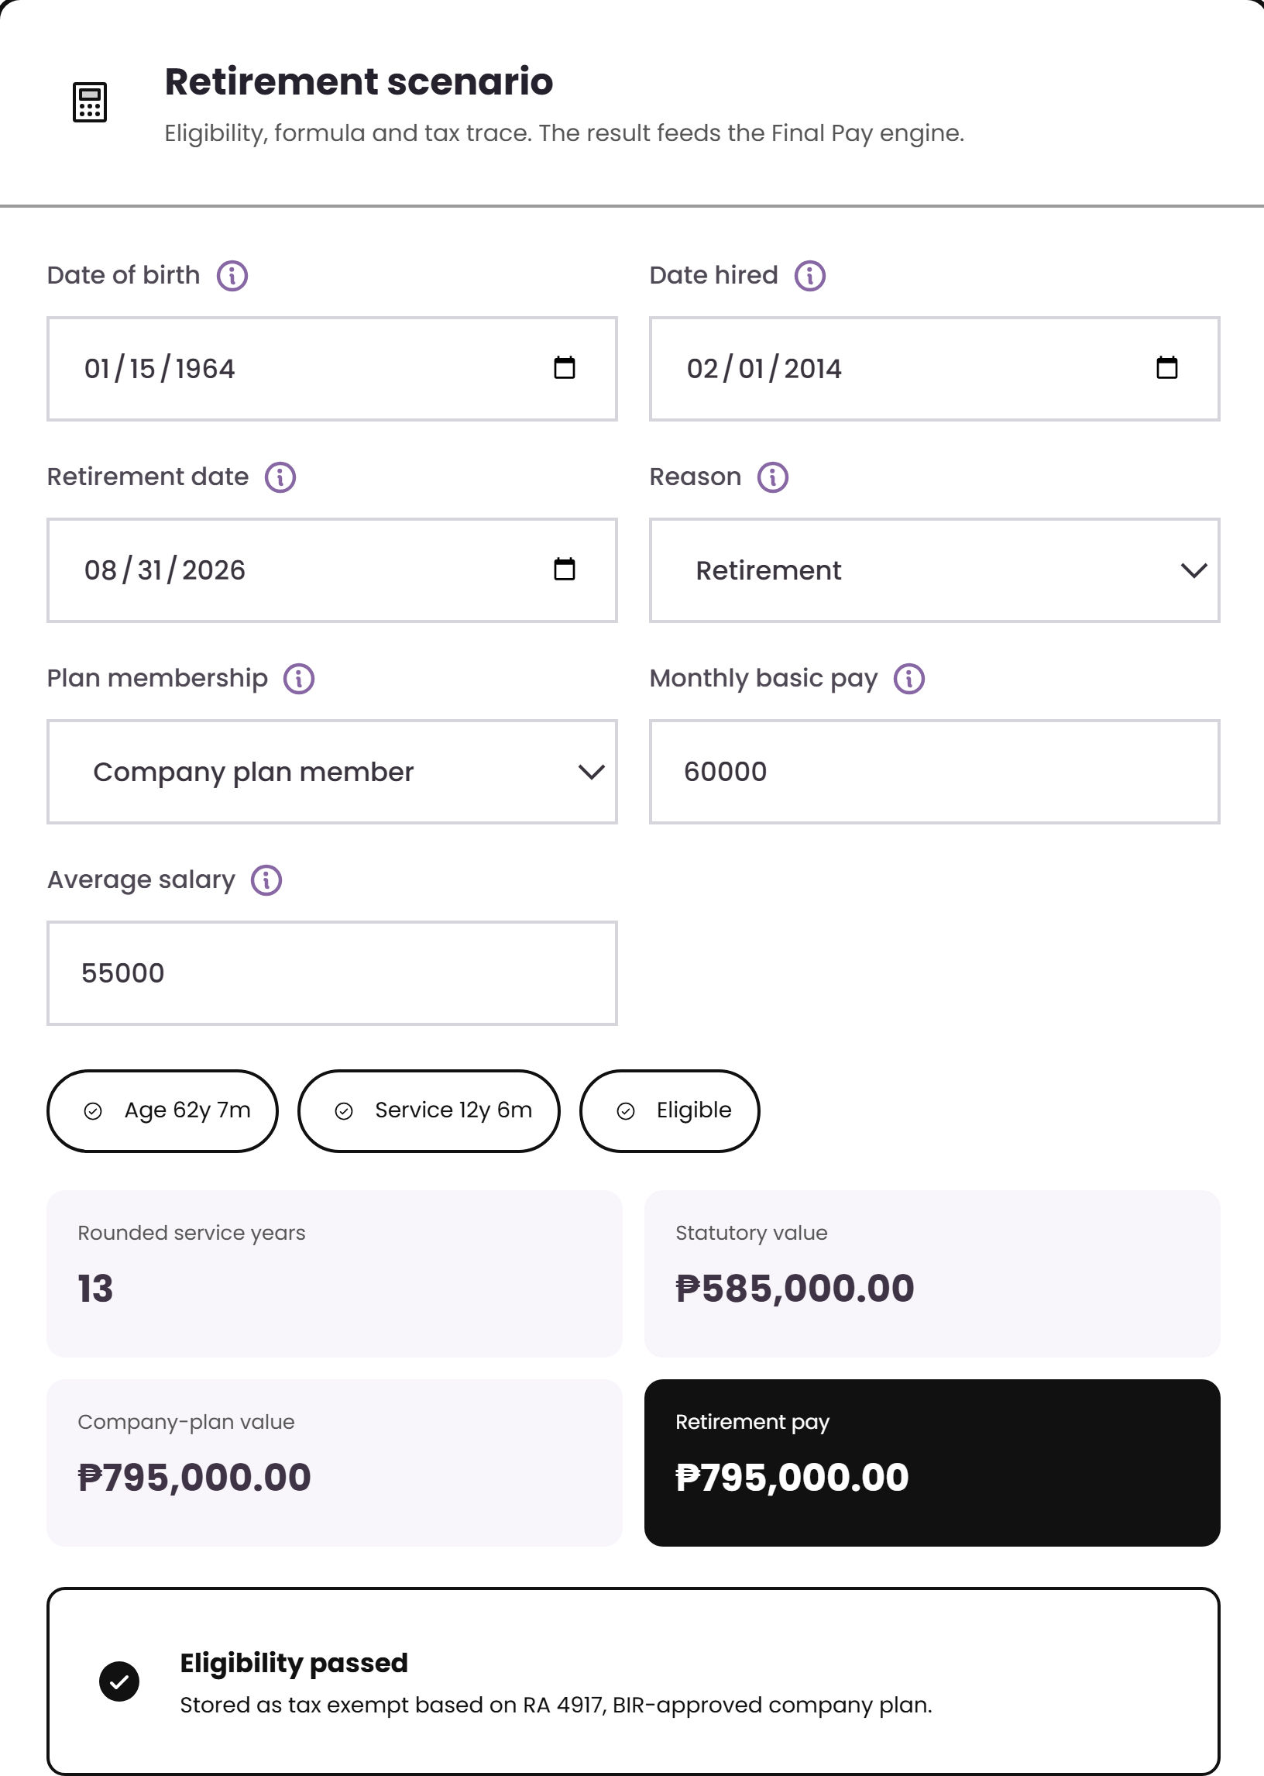
RETIREMENT PAY · WORKED EXAMPLE
Sample retirement calculation
Service 12 years 6 months
rounds to 13 qualifying years because six months or more counts as a full year.
Statutory value
₱585,000
₱60,000 ÷ 30 × 22.5 × 13
Company-plan value
₱795,000
using the company divisor, days, and benefits
Retirement pay used
₱795,000
the better amount between statutory and company plan
The result is stored as tax exempt under RA 4917 when the company-plan conditions are met.
Source · Annex B “Retirement Pay” rows 3–6, 30, 38–41, 67–72
Notes:
The comparison is the point: the system computes both and uses the better one, and records why it is tax exempt.

Slide 21
ENGINE 3 OF 4
Final Pay
1
Mandatory components
2
Optional components
Build the final pay breakdown, apply authorized offsets, and show the net amount for release.
3
Authorized offsets
4
Negative net rule

Slide 22
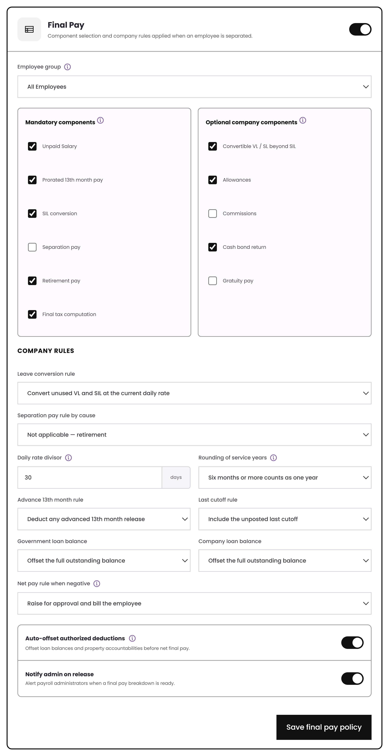
FINAL PAY · SETUP
Final pay components are switched on or off
Mandatory
Unpaid salary, prorated 13th month, SIL conversion, separation pay, retirement pay, and final tax.
Optional
Convertible VL/SL beyond SIL, allowances, commissions, cash bond return, and gratuity.
Company rules
Leave conversion, divisor, rounding, advance 13th month recovery, loan balance treatment, and negative-net handling.
Final Pay settings
Source · Annex B “Final Pay” rows 5–18 (components) and 19–29 (rules)

Slide 23
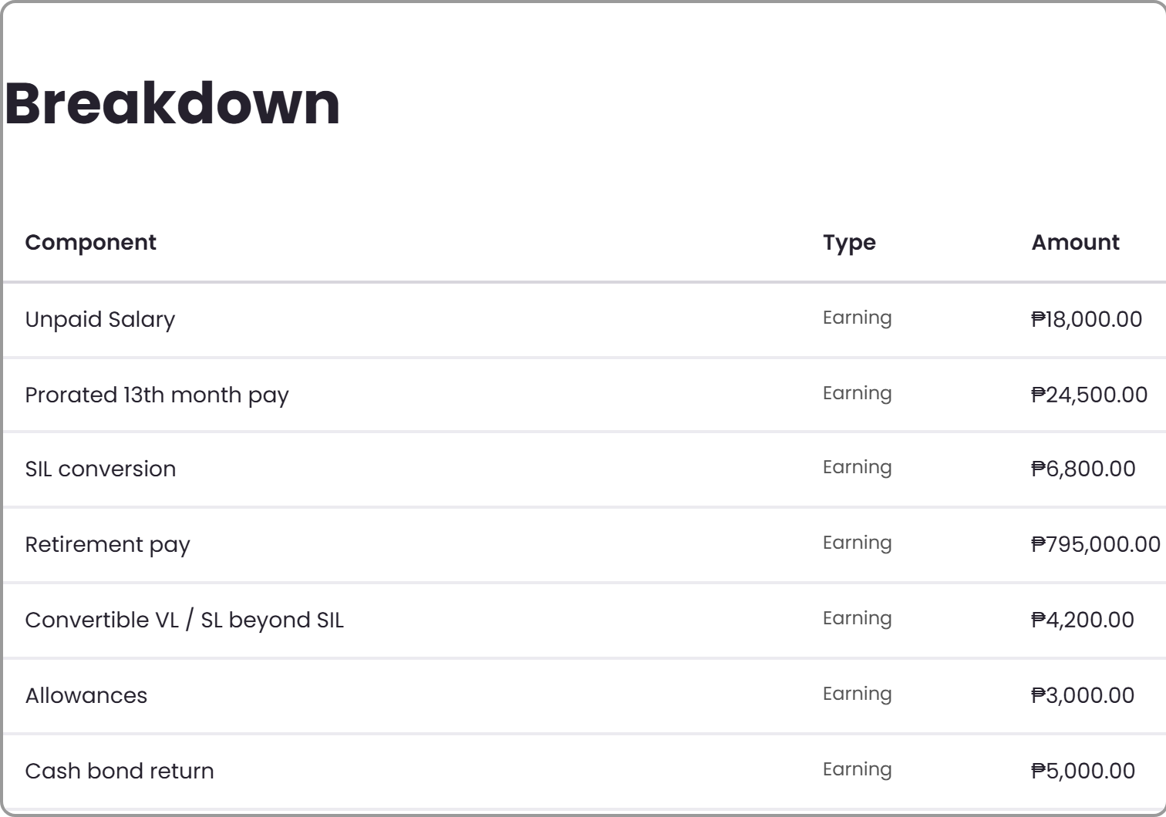
FINAL PAY · WORKED EXAMPLE
Retirement pay flows into final pay
Gross final pay
₱856,500
Retirement pay included
₱795,000
Total offsets
−₱47,800
The ₱795,000 comes from the Retirement Pay engine. It is pulled into Final Pay instead of being re-entered.
Net final pay
₱808,700
Source · Annex B “Retirement Pay” rows 46–49; “Final Pay” rows 30–34
Notes:
Call out the link: retirement pay forms part of final pay, exactly as row 48 requires.

Slide 24
ENGINE 4 OF 4
Gross Up
1
Guaranteed net target
2
BIR withholding table
Calculate the gross amount needed so the employee receives the guaranteed net amount.
3
Repeat until matched
4
Employer cost shown

Slide 25
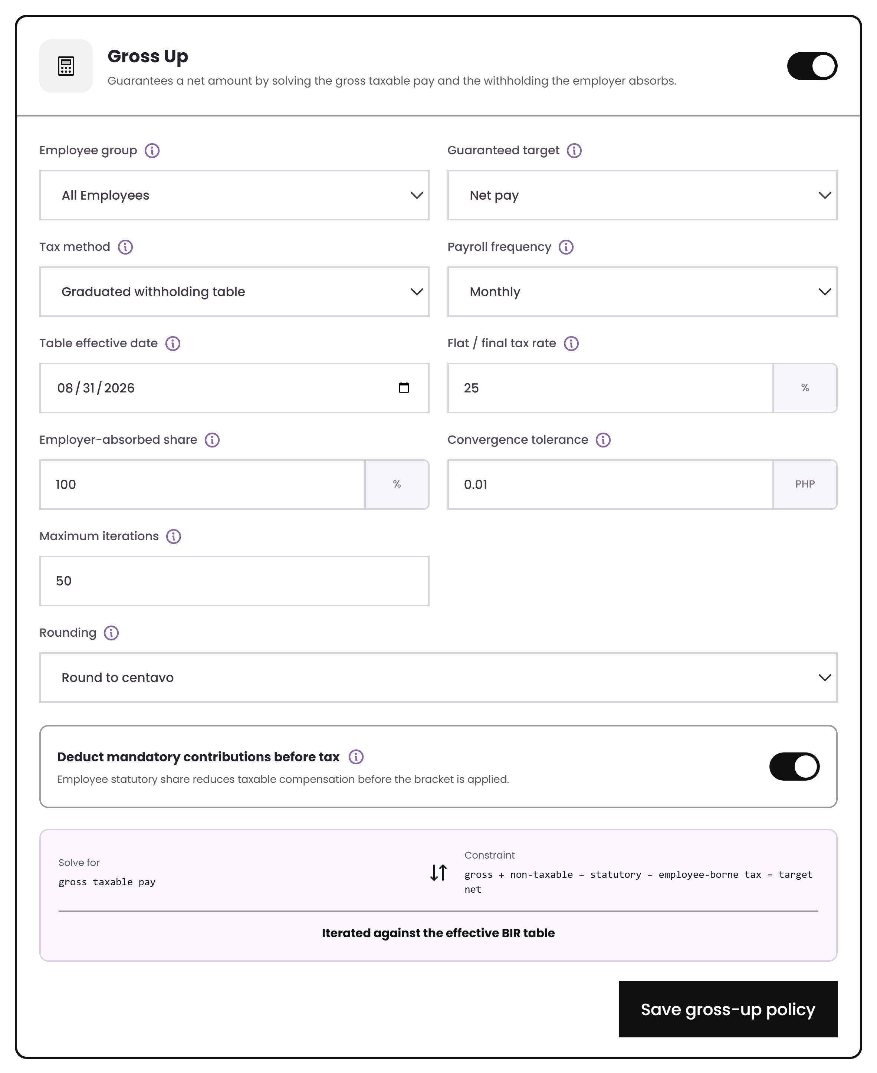
GROSS UP · SETUP
Set the target, method, and tax share
Target
A guaranteed net pay or net benefit can be entered or uploaded.
Method
Use the graduated BIR withholding table, or a flat rate for final and expanded tax cases.
Employer share
Set to 100% for a classic gross-up, or use a split such as 50/50.
Controls
Tolerance, iteration limit, and rounding stage are configurable by company.
Gross Up settings
Source · Annex B “Gross Up” rows 6–18

Slide 26
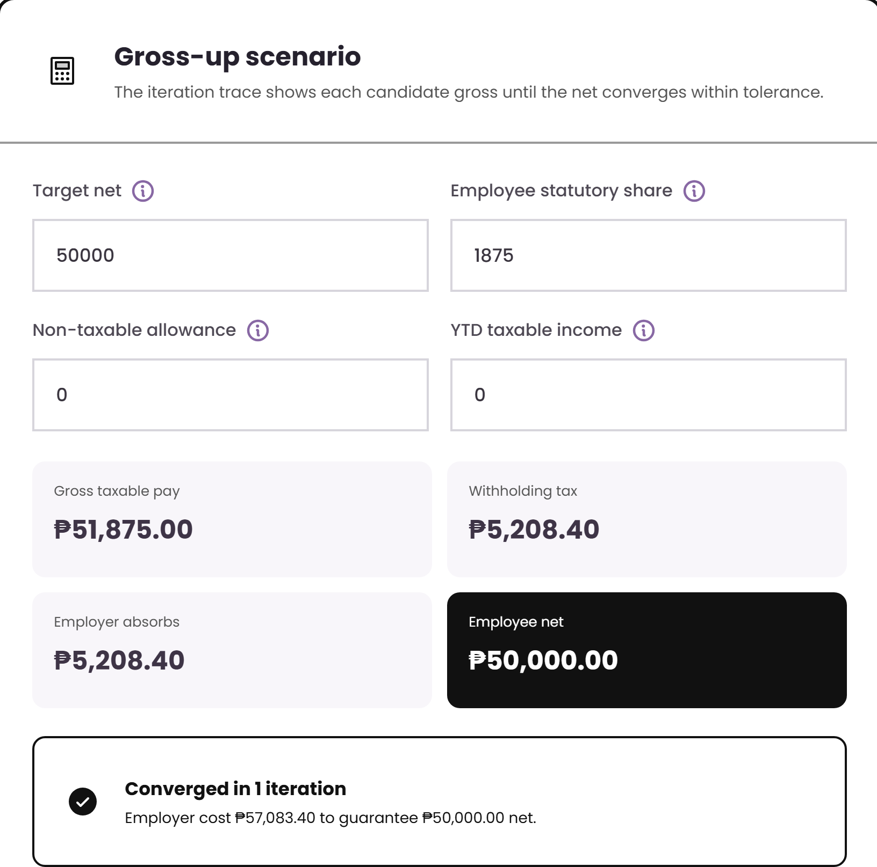
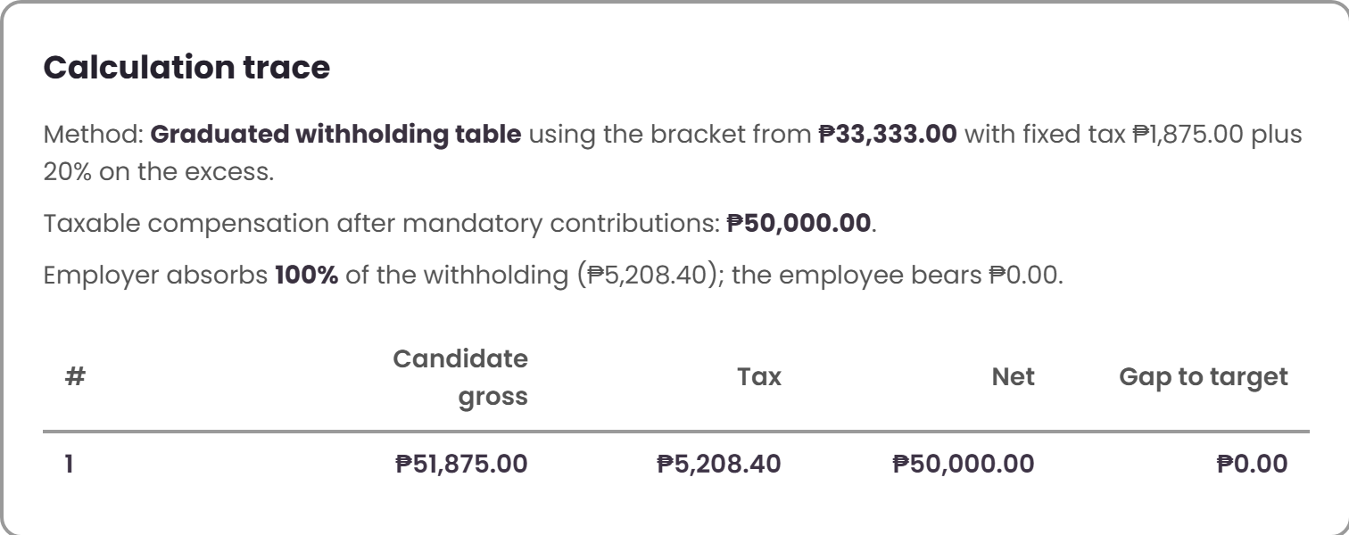
GROSS UP · WORKED EXAMPLE
Sample gross-up calculation
Why it is not just net ÷ (1 − rate)
That shortcut only works with one flat rate. For compensation tax, the engine tests a gross amount, reads the bracket, recomputes the net, and repeats until the target is reached.
Gross taxable pay
₱51,875.00
Withholding tax absorbed by employer
₱5,208.40
Net released to employee
₱50,000.00
Total employer cost
₱57,083.40
Source · Annex B “Gross Up” rows 2–4 and steps 4–12
Notes:
Bracket used: from ₱33,333 with fixed tax ₱1,875 plus 20% on the excess. The trace shows the iteration and the gap closing to zero.

Slide 27
THE CONNECTIONS
What each engine reads and produces
Reads
Produces
Take-Home Pay
Deduction hierarchy table · employee loan and deduction balances
Deferred amounts, carry-forward schedule, and payslip tags
Retirement Pay
Birth date, hire date, retirement date, plan membership, and salary basis
Retirement pay amount and tax status
Final Pay
Retirement result, leave balances, and outstanding loan/deduction balances
Net final pay breakdown for release
Gross Up
Effective BIR withholding table and employee statutory share
Gross amount to pay and tax absorbed by employer
Notes:
Nothing is re-keyed between engines. This is the answer to "does it connect".

Slide 28
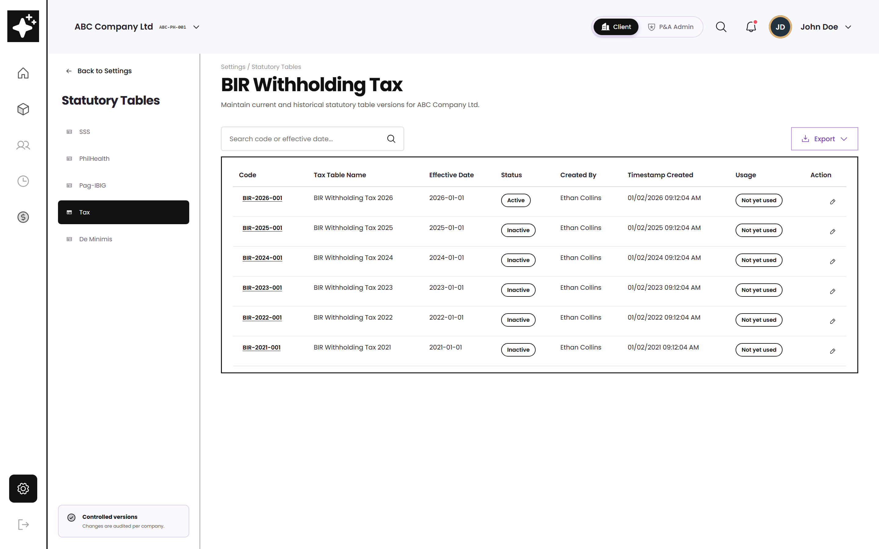
CONNECTED DATA
Rates and ceilings are versioned
Effective date matters
Payroll uses the table version active for that run, so old payroll results can still be reproduced.
Used tables are locked
Once a payroll has used a table, it cannot be edited. A new version must be published instead.
Feeds Gross Up
The gross-up trace reads the bracket from this table instead of hard-coding it.
BIR withholding table — wireframe view
Source · Tax Tables Flow v2 (14 May 2026); BRD Statutory Requirements 180–184

Slide 29
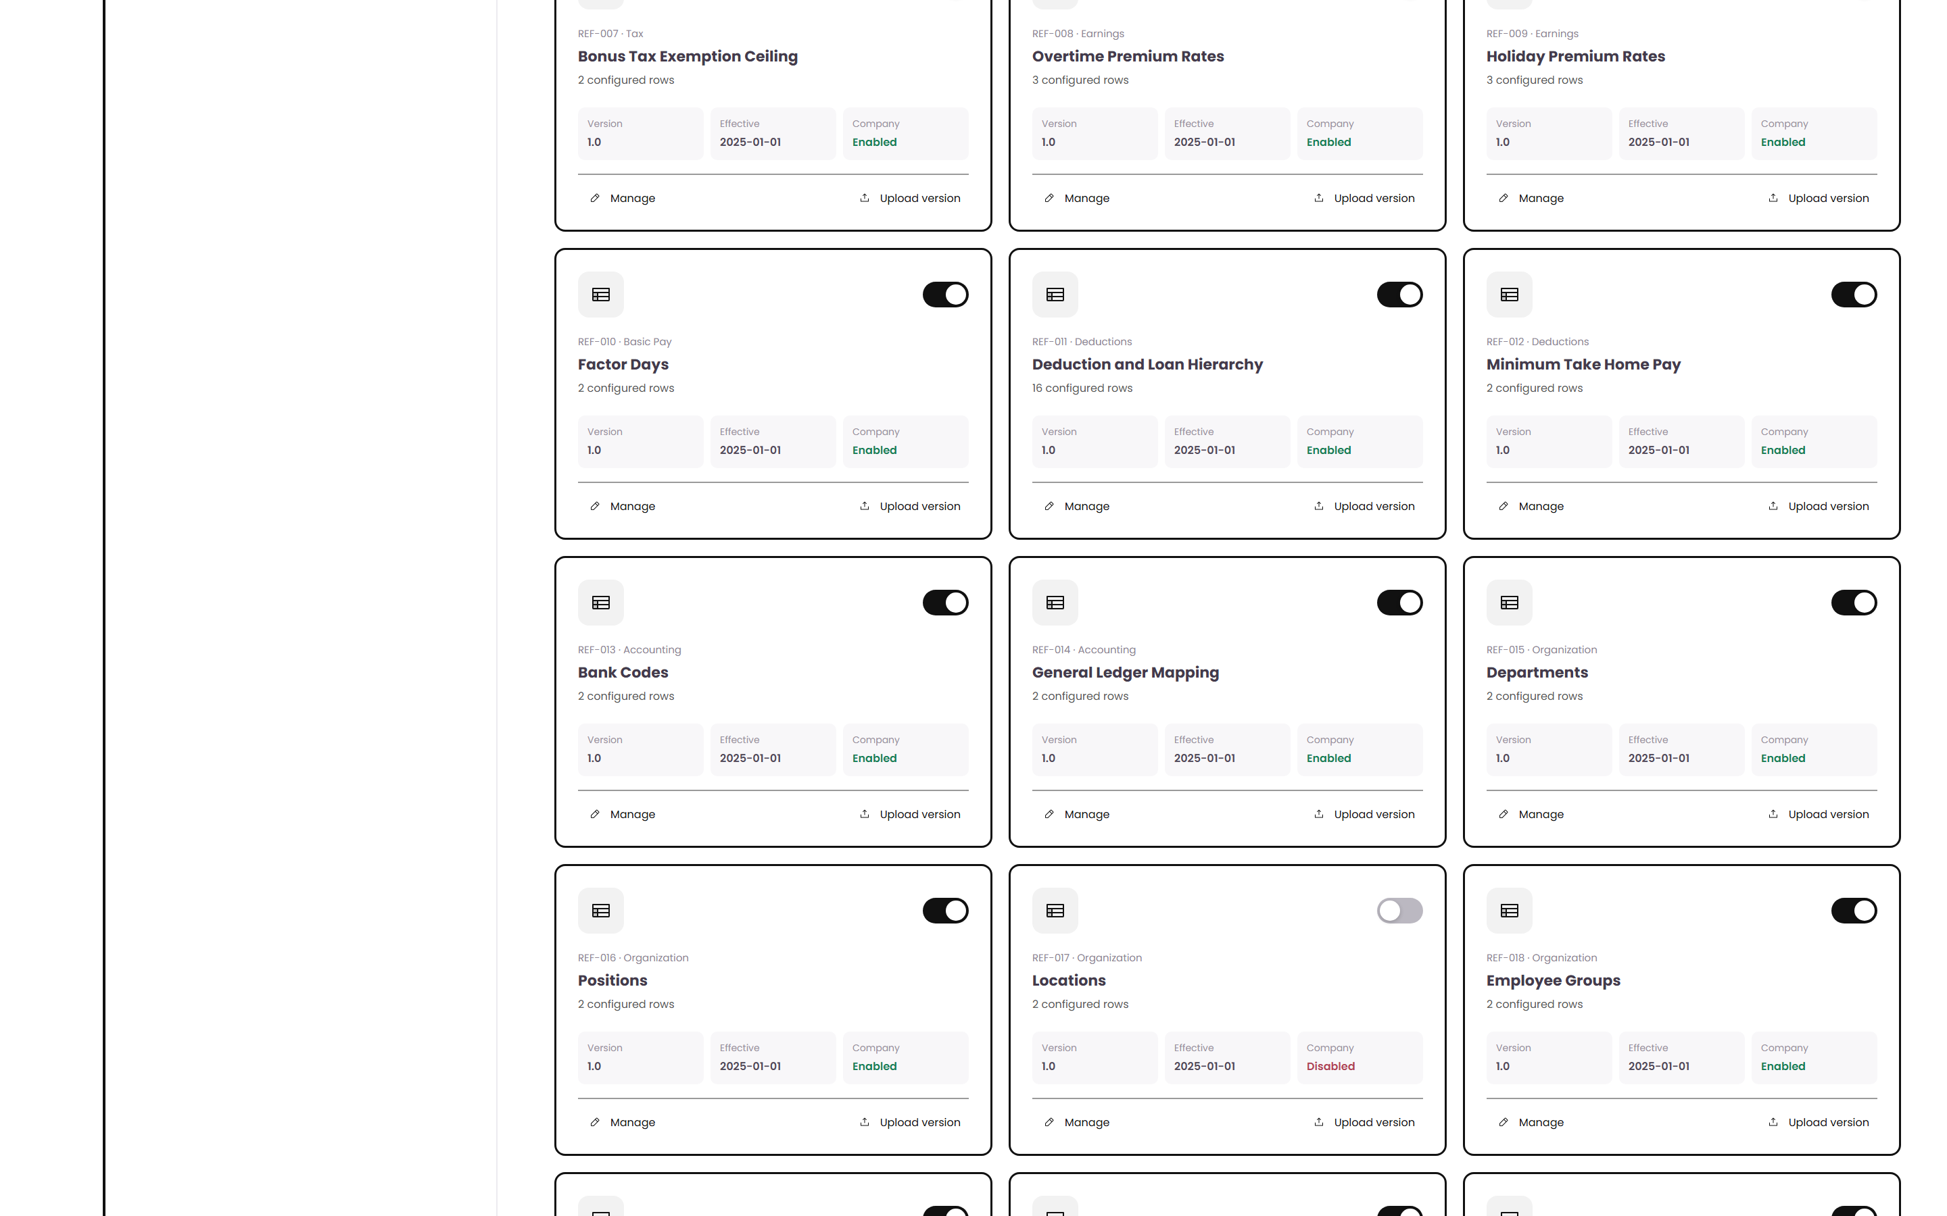
CONNECTED DATA
Reference sources sit behind the formulas
Named sources
Formula inputs point to maintained reference sources instead of numbers typed directly into a rule.
Deduction hierarchy
The take-home adjustment order is one of these sources, so the business can maintain it.
Update once
When the source is updated, every rule that reads it follows the new version.
Formula reference sources — wireframe view
Source · BRD Reference Table Module (feature points 62–63, 97–98)

Slide 30
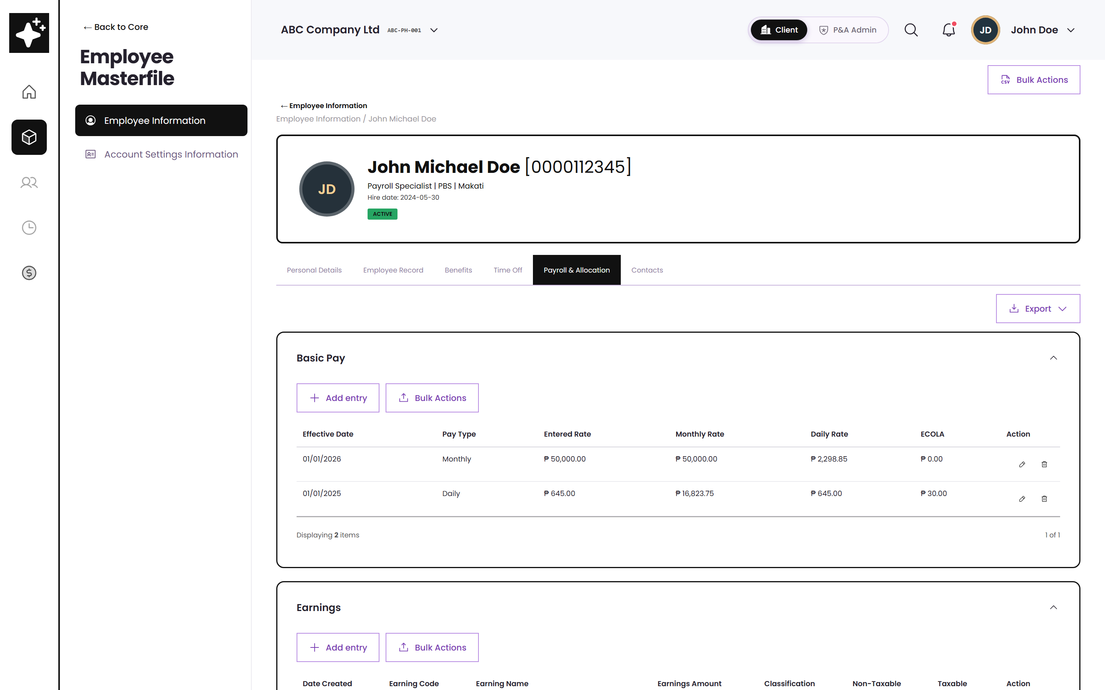
CONNECTED DATA
Employee payroll records feed the engines
Loans and deductions
Balances, amortization, holds, and remarks are the values adjusted by the take-home engine.
Dates and plan type
Hire date, birth date, and plan membership drive retirement eligibility.
Ceilings are applied here too
Bonus and De Minimis ceilings split taxable and non-taxable amounts on the employee record.
Employee Masterfile — payroll data
Source · Annex B Dorado sheets: Loans, Deduction, Cost Allocation, Previous Employer

Slide 31
POLICY ENGINE FIELD GUIDE
Every field, explained
Focused wireframe crops · numbered arrows · plain-language payroll purpose
Notes:
Presenter cue: Introduce the next section as a practical field-by-field guide for payroll reviewers.
[Sources]
- ATLAS wireframe, http://localhost:5173/wireframe, client view captured 2026-08-10.
- Policy engine field counts shown in Computational Basis: Take-Home Pay 30, Retirement Pay 22, Final Pay 31, Gross Up 11.
[/Sources]

Slide 32
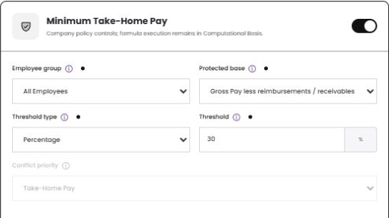
TAKE-HOME PAY · FIELD GUIDE
Scope and protected minimum
Enable engine
Turns the Take-Home policy on or off without deleting its approved configuration.
1
2
Employee group
Defines which assigned population receives this configuration; the Company Rule carries the same scope.
3
Protected base
Chooses the pay amount protected by the rule: Basic Pay, Gross Pay, or Gross less reimbursements/receivables.
4
Threshold type + Threshold
5
Selects percentage or fixed PHP and stores the protected-minimum value used in the cutoff.
Conflict priority
Resolves overlapping assignments so payroll applies one authoritative protection policy.
Numbered arrows point to the live wireframe control; values shown are demo data.
Source · ATLAS local wireframe · Client view
Notes:
Presenter cue: Use the numbered arrows to explain Scope and protected minimum from top to bottom.
[Sources]
- ATLAS wireframe, http://localhost:5173/wireframe, thp-core.png, client view captured 2026-08-10.
- Field inventory shown on this slide: Enable engine; Employee group; Protected base; Threshold type + Threshold; Conflict priority.
- 02Annex B_ Employee Masterfile Payroll Data Tables from Dorado.xlsx, corresponding Take Home Pay, Retirement Pay, Final Pay, or Gross Up tab.
[/Sources]

Slide 33
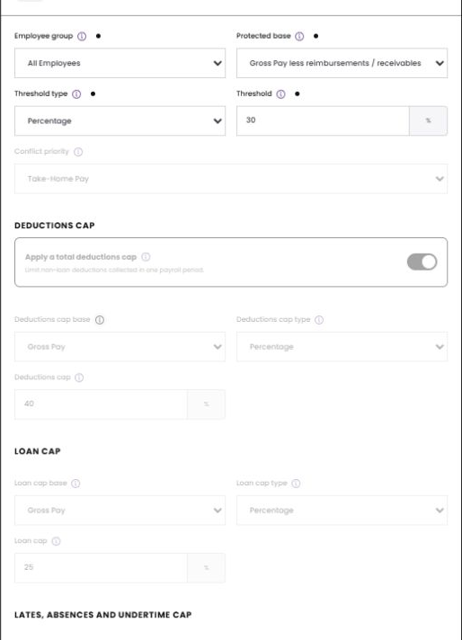
TAKE-HOME PAY · FIELD GUIDE
Deduction and loan caps
Apply total deductions cap
Enables one overall ceiling for controllable non-loan deductions in the payroll period.
Deductions cap base
Selects the pay amount used to calculate the deduction ceiling.
1
Deductions cap type + cap
Defines whether the ceiling is a percentage or fixed amount and stores the limit.
2
3
Loan cap base
Selects the pay amount used when limiting loan collections.
4
Loan cap type + cap
Defines percentage or fixed treatment and the maximum loan collection for the cutoff.
5
Numbered arrows point to the live wireframe control; values shown are demo data.
Source · ATLAS local wireframe · Client view
Notes:
Presenter cue: Use the numbered arrows to explain Deduction and loan caps from top to bottom.
[Sources]
- ATLAS wireframe, http://localhost:5173/wireframe, thp-caps.png, client view captured 2026-08-10.
- Field inventory shown on this slide: Apply total deductions cap; Deductions cap base; Deductions cap type + cap; Loan cap base; Loan cap type + cap.
- 02Annex B_ Employee Masterfile Payroll Data Tables from Dorado.xlsx, corresponding Take Home Pay, Retirement Pay, Final Pay, or Gross Up tab.
[/Sources]

Slide 34
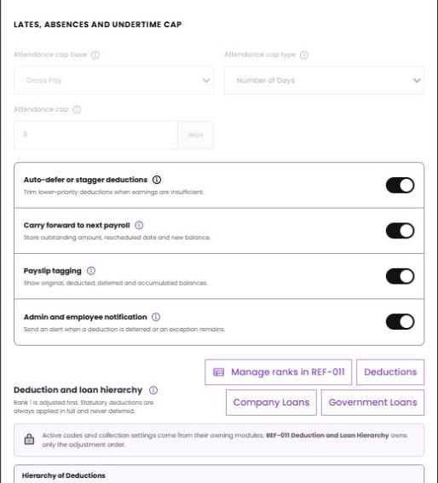
TAKE-HOME PAY · FIELD GUIDE
Deferral, disclosure, and ownership
Attendance cap base/type/cap
1
Defines the attendance ceiling before the engine begins adjusting lower-priority collections.
Auto-defer or stagger deductions
Allows the engine to reduce or postpone lower-priority deductions when earnings are insufficient.
2
Carry forward to next payroll
Stores outstanding amount, reason, rescheduled date, and new balance for the next cutoff.
3
Payslip tagging
4
Shows original due, deducted, deferred, accumulated, and remaining values to the employee.
5
Admin and employee notification
Sends an alert when an item is deferred or an exception still requires action.
6
REF-011 + module links
Deduction, Company Loan, and Government Loan modules own codes/balances; REF-011 owns only their adjustment order.
Numbered arrows point to the live wireframe control; values shown are demo data.
Source · ATLAS local wireframe · Client view
Notes:
Presenter cue: Use the numbered arrows to explain Deferral, disclosure, and ownership from top to bottom.
[Sources]
- ATLAS wireframe, http://localhost:5173/wireframe, thp-deferral.png, client view captured 2026-08-10.
- Field inventory shown on this slide: Attendance cap base/type/cap; Auto-defer or stagger deductions; Carry forward to next payroll; Payslip tagging; Admin and employee notification; REF-011 + module links.
- 02Annex B_ Employee Masterfile Payroll Data Tables from Dorado.xlsx, corresponding Take Home Pay, Retirement Pay, Final Pay, or Gross Up tab.
[/Sources]

Slide 35
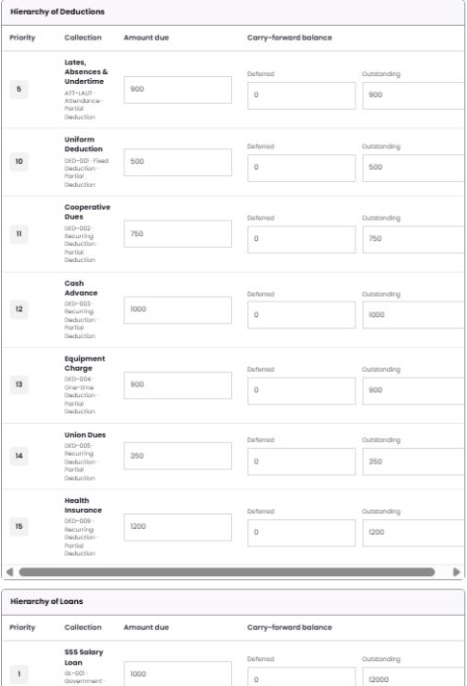
TAKE-HOME PAY · FIELD GUIDE
Hierarchy rows and carry-forward balances
1
Priority
Lower rank numbers are adjusted first; statutory deductions remain protected and outside deferral.
2
Collection
Displays the owning module code, classification, and partial/full-deduction behavior.
3
Amount due
Current cutoff amount requested by the owning deduction or loan module.
4
Deferred
Amount not collected this cutoff because the net-pay requirement or cap was reached.
5
Outstanding / carry-forward
Remaining module balance after the current deduction and any deferral are posted.
Deduction and loan sections
6
Separate lists preserve module ownership while a single REF-011 order controls the combined calculation.
Numbered arrows point to the live wireframe control; values shown are demo data.
Source · ATLAS local wireframe · Client view
Notes:
Presenter cue: Use the numbered arrows to explain Hierarchy rows and carry-forward balances from top to bottom.
[Sources]
- ATLAS wireframe, http://localhost:5173/wireframe, thp-hierarchy.png, client view captured 2026-08-10.
- Field inventory shown on this slide: Priority; Collection; Amount due; Deferred; Outstanding / carry-forward; Deduction and loan sections.
- 02Annex B_ Employee Masterfile Payroll Data Tables from Dorado.xlsx, corresponding Take Home Pay, Retirement Pay, Final Pay, or Gross Up tab.
[/Sources]

Slide 36
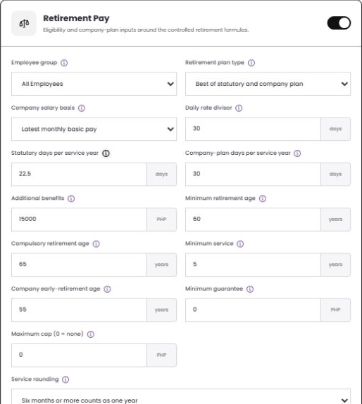
RETIREMENT PAY · FIELD GUIDE
Plan choice and formula inputs
Employee group
1
Assigns the retirement configuration to all employees or a governed population.
2
Retirement plan type
Chooses statutory RA 7641, company plan, or the more-beneficial comparison.
3
Company salary basis + daily divisor
Selects latest basic pay or average salary and converts the basis to a daily rate.
4
Statutory + company-plan days/year
Stores the benefit-day multipliers used by each formula.
5
Additional benefits
Adds approved company-plan amounts after the core service-based computation.
More-beneficial comparison
6
Calculates statutory and company-plan values independently, then selects the higher qualifying result.
Numbered arrows point to the live wireframe control; values shown are demo data.
Source · ATLAS local wireframe · Client view
Notes:
Presenter cue: Use the numbered arrows to explain Plan choice and formula inputs from top to bottom.
[Sources]
- ATLAS wireframe, http://localhost:5173/wireframe, ret-formula.png, client view captured 2026-08-10.
- Field inventory shown on this slide: Employee group; Retirement plan type; Company salary basis + daily divisor; Statutory + company-plan days/year; Additional benefits; More-beneficial comparison.
- 02Annex B_ Employee Masterfile Payroll Data Tables from Dorado.xlsx, corresponding Take Home Pay, Retirement Pay, Final Pay, or Gross Up tab.
[/Sources]

Slide 37
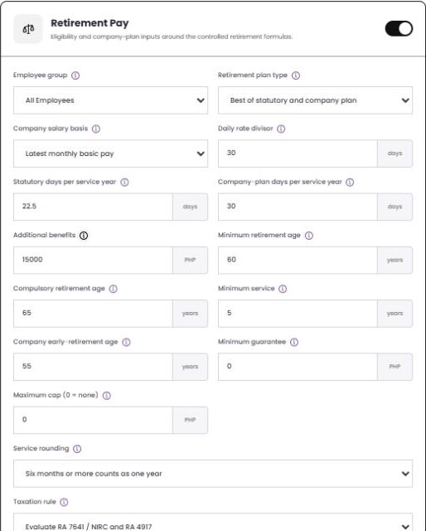
RETIREMENT PAY · FIELD GUIDE
Eligibility, limits, rounding, and tax
1
Minimum retirement age
Earliest standard age that can pass the retirement eligibility test.
2
Compulsory retirement age
Age at which the employee is treated as compulsorily retired under the configured plan.
3
Minimum service + early-retirement age
Combines required service with the optional company early-retirement threshold.
4
Minimum guarantee + maximum cap
Applies a floor and an optional ceiling; zero maximum means no cap.
5
Service rounding
Controls whether partial service years round down, round up, or count after six months.
Taxation rule + BIR-approved plan
6
Evaluates RA 7641/NIRC/RA 4917 treatment and enables the approved-plan exemption condition.
Numbered arrows point to the live wireframe control; values shown are demo data.
Source · ATLAS local wireframe · Client view
Notes:
Presenter cue: Use the numbered arrows to explain Eligibility, limits, rounding, and tax from top to bottom.
[Sources]
- ATLAS wireframe, http://localhost:5173/wireframe, ret-eligibility.png, client view captured 2026-08-10.
- Field inventory shown on this slide: Minimum retirement age; Compulsory retirement age; Minimum service + early-retirement age; Minimum guarantee + maximum cap; Service rounding; Taxation rule + BIR-approved plan.
- 02Annex B_ Employee Masterfile Payroll Data Tables from Dorado.xlsx, corresponding Take Home Pay, Retirement Pay, Final Pay, or Gross Up tab.
[/Sources]

Slide 38
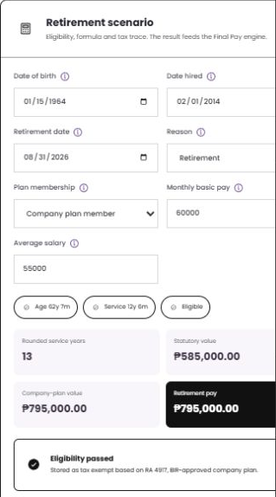
RETIREMENT PAY · FIELD GUIDE
Scenario inputs and calculated result
Date of birth / hired / retirement
1
Derives age and service at the selected retirement date.
2
Reason
Identifies retirement as the separation event used by eligibility and downstream Final Pay.
3
Plan membership
States whether the employee participates in the company plan or statutory basis only.
4
Monthly basic pay + average salary
Provides both possible salary bases so the selected policy can use the correct one.
5
Age / service / eligible
Displays the resolved eligibility facts before the benefit amount is accepted.
Rounded years + values + tax trace
6
Shows statutory, company-plan, selected retirement pay, tax status, and calculation trace.
Numbered arrows point to the live wireframe control; values shown are demo data.
Source · ATLAS local wireframe · Client view
Notes:
Presenter cue: Use the numbered arrows to explain Scenario inputs and calculated result from top to bottom.
[Sources]
- ATLAS wireframe, http://localhost:5173/wireframe, ret-scenario.png, client view captured 2026-08-10.
- Field inventory shown on this slide: Date of birth / hired / retirement; Reason; Plan membership; Monthly basic pay + average salary; Age / service / eligible; Rounded years + values + tax trace.
- 02Annex B_ Employee Masterfile Payroll Data Tables from Dorado.xlsx, corresponding Take Home Pay, Retirement Pay, Final Pay, or Gross Up tab.
[/Sources]

Slide 39
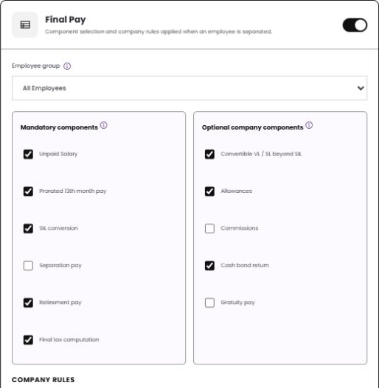
FINAL PAY · FIELD GUIDE
Included earnings and company components
1
Enable engine
Activates Final Pay processing for separated employees without removing the policy.
2
Employee group
Applies the policy to the governed employee population.
3
Mandatory components
Unpaid Salary, prorated 13th month, SIL conversion, Separation Pay, Retirement Pay, and Final Tax.
4
Optional company components
Convertible VL/SL beyond SIL, Allowances, Commissions, Cash Bond return, and Gratuity Pay.
5
Retirement Pay linkage
Pulls the approved Retirement engine result rather than asking payroll to re-enter the value.
Component checkboxes
6
Each selection determines whether the item is included in the scenario, breakdown, and net result.
Numbered arrows point to the live wireframe control; values shown are demo data.
Source · ATLAS local wireframe · Client view
Notes:
Presenter cue: Use the numbered arrows to explain Included earnings and company components from top to bottom.
[Sources]
- ATLAS wireframe, http://localhost:5173/wireframe, final-components.png, client view captured 2026-08-10.
- Field inventory shown on this slide: Enable engine; Employee group; Mandatory components; Optional company components; Retirement Pay linkage; Component checkboxes.
- 02Annex B_ Employee Masterfile Payroll Data Tables from Dorado.xlsx, corresponding Take Home Pay, Retirement Pay, Final Pay, or Gross Up tab.
[/Sources]

Slide 40
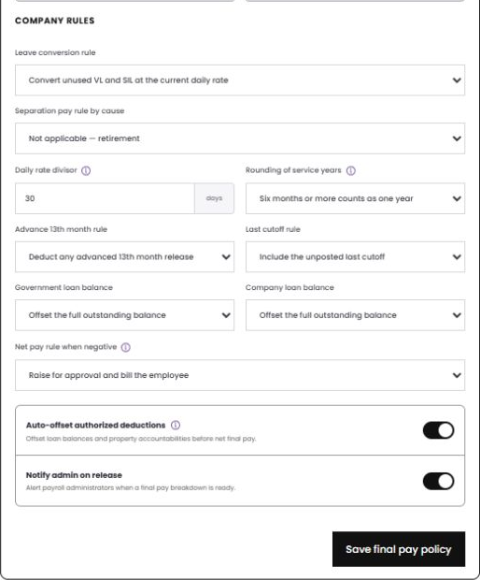
FINAL PAY · FIELD GUIDE
Company rules for conversion and offsets
1
Leave conversion rule
Controls whether unused VL/SIL is converted and which daily rate is used.
2
Separation pay rule by cause
Maps retirement, redundancy, retrenchment, resignation, or just cause to the correct benefit rule.
3
Daily divisor + service rounding
Converts salary to a daily rate and resolves partial service years consistently.
4
Advance 13th + last cutoff
Controls recovery of prior 13th-month releases and whether an unposted cutoff is included.
5
Government + company loan balances
Offsets, endorses, or converts outstanding balances according to the owning module policy.
Negative net + auto-offset + notice
6
Routes a negative result, applies authorized balances/accountabilities, and notifies payroll on release.
Numbered arrows point to the live wireframe control; values shown are demo data.
Source · ATLAS local wireframe · Client view
Notes:
Presenter cue: Use the numbered arrows to explain Company rules for conversion and offsets from top to bottom.
[Sources]
- ATLAS wireframe, http://localhost:5173/wireframe, final-rules.png, client view captured 2026-08-10.
- Field inventory shown on this slide: Leave conversion rule; Separation pay rule by cause; Daily divisor + service rounding; Advance 13th + last cutoff; Government + company loan balances; Negative net + auto-offset + notice.
- 02Annex B_ Employee Masterfile Payroll Data Tables from Dorado.xlsx, corresponding Take Home Pay, Retirement Pay, Final Pay, or Gross Up tab.
[/Sources]

Slide 41
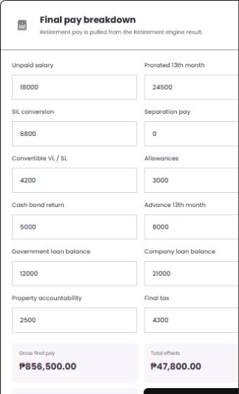
FINAL PAY · FIELD GUIDE
Scenario inputs
1
Unpaid salary + prorated 13th
Current salary due and the earned 13th-month portion through the separation date.
2
SIL conversion + separation pay
Leave conversion value and cause-based separation benefit.
3
Convertible VL/SL + allowances
Company-enabled leave and allowance amounts included as earnings.
4
Cash bond + advance 13th
Returns eligible cash bond and recovers an advance when the policy requires it.
5
Government + company loan balances
Outstanding balances supplied by their owning loan modules for configured treatment.
6
Property accountability + final tax
Authorized accountability offset and the final withholding/tax adjustment.
Numbered arrows point to the live wireframe control; values shown are demo data.
Source · ATLAS local wireframe · Client view
Notes:
Presenter cue: Use the numbered arrows to explain Scenario inputs from top to bottom.
[Sources]
- ATLAS wireframe, http://localhost:5173/wireframe, final-inputs.png, client view captured 2026-08-10.
- Field inventory shown on this slide: Unpaid salary + prorated 13th; SIL conversion + separation pay; Convertible VL/SL + allowances; Cash bond + advance 13th; Government + company loan balances; Property accountability + final tax.
- 02Annex B_ Employee Masterfile Payroll Data Tables from Dorado.xlsx, corresponding Take Home Pay, Retirement Pay, Final Pay, or Gross Up tab.
[/Sources]

Slide 42
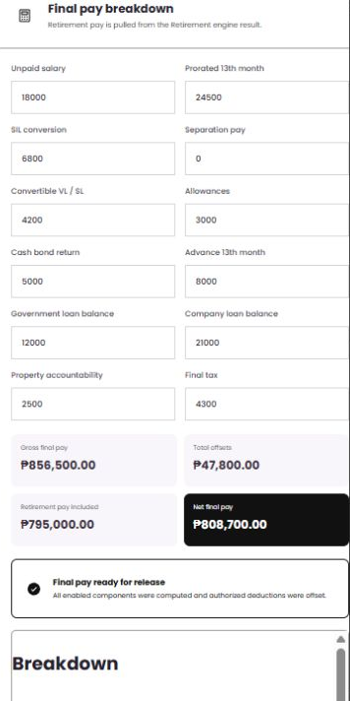
FINAL PAY · FIELD GUIDE
Result, readiness, and breakdown
1
Gross final pay
Total enabled earnings before authorized offsets and final tax.
2
Total offsets
Sum of recoveries, balances, accountabilities, and final-tax items.
3
Retirement pay included
Confirms the amount received from the Retirement Pay engine.
4
Net final pay
Gross final pay less all authorized offsets.
5
Release readiness
Confirms that enabled components were calculated and required offsets were applied.
6
Breakdown table
Itemizes every earning and offset so payroll can explain, approve, and audit the result.
Numbered arrows point to the live wireframe control; values shown are demo data.
Source · ATLAS local wireframe · Client view
Notes:
Presenter cue: Use the numbered arrows to explain Result, readiness, and breakdown from top to bottom.
[Sources]
- ATLAS wireframe, http://localhost:5173/wireframe, final-results.png, client view captured 2026-08-10.
- Field inventory shown on this slide: Gross final pay; Total offsets; Retirement pay included; Net final pay; Release readiness; Breakdown table.
- 02Annex B_ Employee Masterfile Payroll Data Tables from Dorado.xlsx, corresponding Take Home Pay, Retirement Pay, Final Pay, or Gross Up tab.
[/Sources]

Slide 43
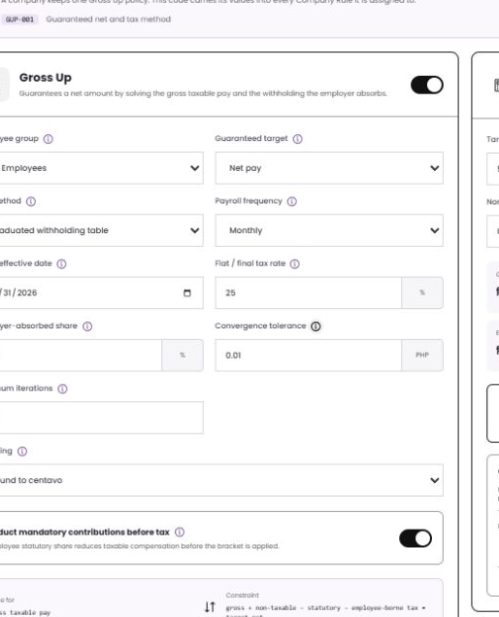
GROSS UP · FIELD GUIDE
Policy settings for a guaranteed net
1
Enable engine + employee group
Activates the policy and identifies the governed population.
2
Guaranteed target
Selects the promise being solved—normally employee Net Pay.
3
Tax method + table date
Uses the effective graduated withholding table or a flat/final tax method.
4
Payroll frequency + flat rate
Chooses the bracket frequency and stores the alternative flat/final percentage.
5
Employer-absorbed share
Defines how much of the calculated withholding is paid by the employer.
6
Tolerance / iterations / rounding / statutory-first
Controls convergence, precision, stopping limit, and deduction of mandatory contributions before tax.
Numbered arrows point to the live wireframe control; values shown are demo data.
Source · ATLAS local wireframe · Client view
Notes:
Presenter cue: Use the numbered arrows to explain Policy settings for a guaranteed net from top to bottom.
[Sources]
- ATLAS wireframe, http://localhost:5173/wireframe, gup-config.png, client view captured 2026-08-10.
- Field inventory shown on this slide: Enable engine + employee group; Guaranteed target; Tax method + table date; Payroll frequency + flat rate; Employer-absorbed share; Tolerance / iterations / rounding / statutory-first.
- 02Annex B_ Employee Masterfile Payroll Data Tables from Dorado.xlsx, corresponding Take Home Pay, Retirement Pay, Final Pay, or Gross Up tab.
[/Sources]

Slide 44
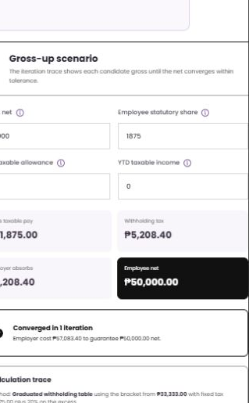
GROSS UP · FIELD GUIDE
Scenario inputs and convergence result
1
Target net
Employee net amount the engine must guarantee.
2
Employee statutory share
Mandatory employee contributions deducted before the withholding bracket is applied.
3
Non-taxable allowance
Amount included in cash received but excluded from taxable compensation.
4
YTD taxable income
Prior taxable earnings used when the selected method requires year-to-date context.
5
Gross / tax / employer / net outputs
Shows candidate gross taxable pay, withholding, employer absorption, and resulting employee net.
6
Convergence + calculation trace
Confirms the gap is within tolerance and records each iteration for review and audit.
Numbered arrows point to the live wireframe control; values shown are demo data.
Source · ATLAS local wireframe · Client view
Notes:
Presenter cue: Use the numbered arrows to explain Scenario inputs and convergence result from top to bottom.
[Sources]
- ATLAS wireframe, http://localhost:5173/wireframe, gup-scenario.png, client view captured 2026-08-10.
- Field inventory shown on this slide: Target net; Employee statutory share; Non-taxable allowance; YTD taxable income; Gross / tax / employer / net outputs; Convergence + calculation trace.
- 02Annex B_ Employee Masterfile Payroll Data Tables from Dorado.xlsx, corresponding Take Home Pay, Retirement Pay, Final Pay, or Gross Up tab.
[/Sources]

Slide 45
APPENDIX
Reference section
Source documents, row-level mapping, glossary, and open decisions
Notes:
Leave this open during Q&A so anyone can challenge a screen and be shown the row it came from.

Slide 46
APPENDIX A
Source documents used
Annex B
Sheets used: Take Home Pay · Retirement Pay · Final Pay · Gross Up · Dorado Loans · Dorado Deduction · Dorado Cost Allocation · Dorado Previous Employer · De Minimis Ceiling Set Up · 13th Mo Pay & Other Bonuses
Employee Masterfile Payroll Data Tables from Dorado
Annex C
Payroll transaction preparation, inputs, calculation, and approval lifecycle. Used to show how a computed policy is consumed in payroll.
Sub Module 3 — Payroll
Phase 2 BRD Audit Summary
Computational Basis module (feature points 73–82), Settings module set-up rows 18–20 and 50–55, Statutory Requirements 180–184.
331 requirement rows reviewed
Tax Tables Flow
Table structure, effectivity selection, and the rule that a table used by a payroll transaction may not be edited.
v2 dated 14 May 2026 (supersedes v1)
Notes:
These four are the source of truth. Anything on screen that is not in one of these is flagged on the last slide.

Slide 47
APPENDIX B
Take-Home Pay traceability
Annex B → sheet “Take Home Pay”
Source rows | What the workbook says | Where it appears in the app
Rows 4–5 | Minimum take-home based on basic salary, 40% example | Protected base = Basic Pay; threshold type Percentage
Rows 13–14 | Guarantee on gross pay, 30% example | Protected base = Gross Pay
Rows 21–22 | Guarantee on gross less reimbursements, 30% | Protected base = Gross Pay less reimbursements — used in the demo
Rows 29–30 | Guaranteed minimum peso net pay, ₱8,000 example | Threshold type = Fixed Amount
Rows 8–11 | Statutory in full; loans may be deferred; carry over; notify | Statutory rank 0; auto-defer, carry-forward and notification switches
Rows 45–59 | Loan repayment cap, 25% of gross or a fixed ₱10,000 | Loan cap base, type and value
Rows 61–83 | LAABS and undertime cap by %, days, or protected net | Attendance cap base, type and value
Rows 85–103 | Hierarchy table, statutory rank 0, optional last | Deduction and loan hierarchy, maintained as a reference source
Rows 106–109 | Loans at cap but net still short — choose what wins | Conflict priority selector
Rows 138–155 | Deferred tracking, payslip tag fields, deduction ledger | Carry-forward table, payslip tag block and deduction ledger

Slide 48
APPENDIX C
Retirement Pay traceability
Annex B → sheet “Retirement Pay”
Source rows | What the workbook says | Where it appears in the app
Rows 3–6 | Daily rate × 22.5 × years of service | Statutory value shown in the scenario
Row 5 | Fractions of six months or more count as one year | Service rounding rule; 12y 6m → 13 years
Rows 13–15 | Statutory RA 7641, company plan, or override if more beneficial | Retirement plan type selector
Rows 24–29 | Divisor, days per year, salary basis, benefits, rounding, cap | Formula inputs, all configurable
Row 30 | RetirementPay = MAX(statutory, company plan) | “Best of” option; both values displayed
Rows 31–37 | Age 60, compulsory 65, five years service, early retirement | Eligibility rules and the eligibility strip
Rows 38–41 | RA 7641 and RA 4917 tax exemption conditions | Taxation rule; the result records why it is exempt
Rows 46–49 | Retirement pay forms part of final pay | Result feeds the Final Pay engine automatically

Slide 49
APPENDIX D
Final Pay traceability
Annex B → sheet “Final Pay”
Source rows | What the workbook says | Where it appears in the app
Rows 5–11 | Mandatory: unpaid salary, 13th month, SIL, separation, retirement, final tax | Mandatory component switches
Rows 12–18 | Optional: convertible leave, allowances, commissions, cash bond, gratuity | Optional component switches
Rows 19–29 | Company rules: conversion, divisor, rounding, advance 13th, loan balances, negative net | Company rule selectors on the settings card
Rows 30–31 | Pull last days worked, leave balances, unpaid OT and LAABS | Scenario inputs drawn from the employee record
Rows 32–34 | Only authorised deductions; auto-offset before net | Offsets shown as negative lines in the breakdown
Row 36 | Output — final pay breakdown | Component-by-component breakdown table

Slide 50
APPENDIX E
Gross Up traceability
Annex B → sheet “Gross Up”
Source rows | What the workbook says | Where it appears in the app
Row 2 | Employer shoulders the tax so the employee receives a guaranteed net | Employer-absorbed share, default 100%
Row 3 | Divide the intended net by (1 − rate) | Available as the flat / final tax method
Row 4 | Use BIR tables: taxable income, correct bracket, base tax + excess % | Graduated method, reading the effective BIR table
Rows 7–8 | Choose the income and enable gross-up | Guaranteed target selector and engine switch
Rows 10–11 | Add grossed-up income; subtract mandatory contributions | Taxable compensation line in the calculation trace
Rows 12–14 | Identify bracket; apply base tax + excess × rate | Bracket named in the trace, e.g. from ₱33,333, ₱1,875 + 20%
Row 15 | Recompute gross until net equals the required amount | Iteration table with the gap closing to zero
Rows 16–18 | Show gross, employer-absorbed tax, and net released | The four result tiles

Slide 51
APPENDIX F
Glossary
Computational Basis
Hierarchy / rank
The controlled area for approved formulas, policy engines, and the reference sources they read.
The order for trimming controllable deductions. Statutory items stay rank 0 and are not adjusted.
Policy engine
Deferral / carry-forward
A screen for one payroll policy area that runs the calculation and shows the working.
An amount not collected in the current cutoff and moved to a later deduction schedule.
Policy code
Effective-dated
A reusable approved code, such as THP-001, that can be assigned to Company Rules.
A version with a start date. Payroll uses the version active during the payroll run.
Company Rule
Convergence
A policy applied to a company or employee group, with its own values.
For gross-up: repeating the calculation until the computed net matches the target within tolerance.
Protected minimum
The minimum net pay guaranteed by a rule, either as a percentage of a base or a fixed amount.

Slide 52
APPENDIX G
Items to confirm before sign-off
These are the items where the workbook gives options or leaves the value open. The demo keeps them configurable instead of assuming the answer.
1
Active take-home policy
Annex B lists several minimum-net options and cap rules. Confirm which set should be active per company or group.
Take Home Pay rows 4–43
2
Bonus threshold priority
If multiple bonus types share one non-taxable ceiling, confirm the consuming order.
BRD 13th month / bonus ceiling
3
Negative final pay
Confirm how any remaining balance should be handled when final pay becomes negative.
Final Pay row 29
4
Gross-up tolerance
Confirm tolerance, iteration limit, and rounding stage. The current screen uses demo defaults.
Gross Up rows 15–16
5
Statutory values
Rates, brackets, and ceilings shown here are sample values. They need confirmation against the effective official tables.
Statutory tables
Notes:
Be explicit that statutory numbers on screen are sample data pending confirmation.

Slide 53
Close-out message
1
Policies are handled as configurable settings, not one-off code changes.
2
Each result shows the working: base, threshold, ranks, brackets, and iterations.
3
The engines pass results to each other, so values are not re-keyed.
4
The appendix maps the screens back to the source workbook rows for review and sign-off.
Notes:
Close by inviting them to challenge any screen — the appendix has the row reference for each one.

