Slide 1
Capstone Project

Slide 2
Introduction
This project will analyze the New York City data. First, we will find the most visited commercial shop
according to the number of check-ins, then we will try to find the neighborhoods that are lacking the selected
type of shop which could be potential business opportunity.

Slide 3
Target Audience
The target audience of this report is any one that is interested in opening a shop but have no idea what kind
of and in which neighborhood

Slide 4
Data Selection
The data comes from Dingqi Yang from the following link
https://sites.google.com/site/yangdingqi/home/foursquare-dataset
(https://sites.google.com/site/yangdingqi/home/foursquare-dataset). It contains 227,428 check-ins in New
York city. The data contains a file in tsv format. Each file contains 8 columns, which are:
1. User ID (anonymized)
2. Venue ID (Foursquare)
3. Venue category ID (Foursquare)
4. Venue category name (Foursquare)
5. Latitude
6. Longitude
7. Time zone offset in minutes (The offset in minutes between when this check-in occurred and the same
time in UTC)
8. UTC time

Slide 5
Application
We will find the most visited type of shop (commercial) according to the number of check-ins given in the
data, then we will try to find neighborhoods that has none of this type of shop.
Examples are for 2000 venues, and the red dot is the center neighborhood which has the most number of
Bars between selected coordinates. We did find two neighborhoods that are closest to it having none Bars
within 4 kilometers

Slide 6
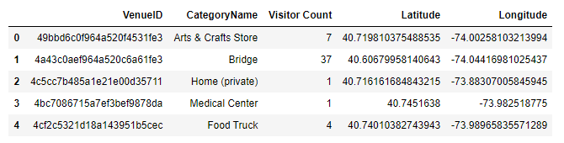
Conclusion

Slide 7
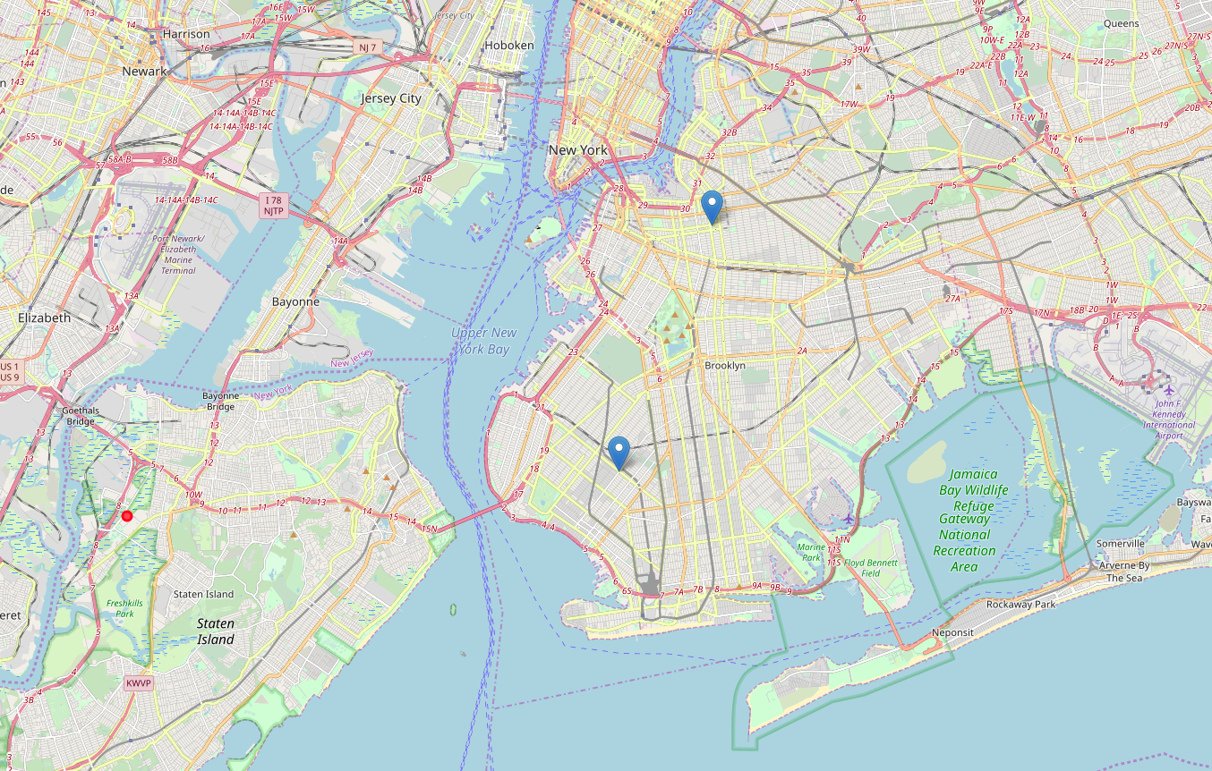
Conclusion

