Slide 1
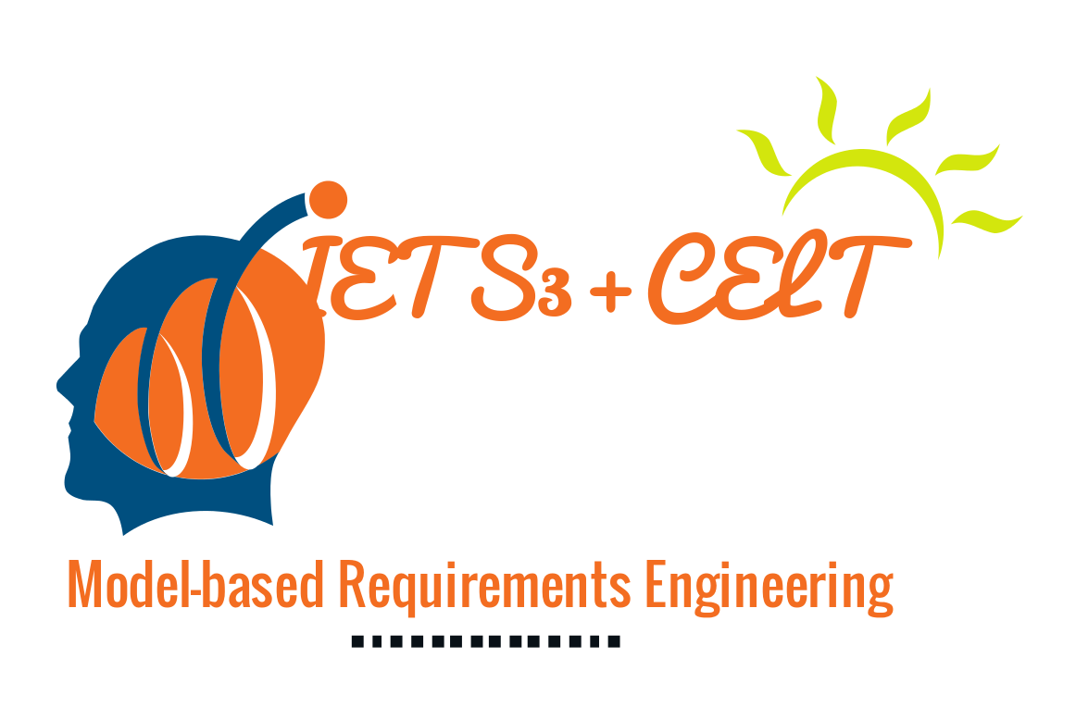



EARS-CTRL Generating Controllers for Dummies
September 20, 2017
Levi Lúcio, Salman Rahman, Saad Bin-Abid (fortiss)
Alistair Mavin (Rolls-Royce)

Slide 2
Purpose of EARS-CTRL
A push-button approach for directly generating software controllers from requirements written in English
A push-button approach for verifying the produced controllers are correct

Slide 3
Tool Chain
MPS (Meta-Programming System)
AutoCode4 (LTL-based controller synthesizer)
MATLAB Simulink
EARS [1] (Easy Approach to Requirements Syntax)
[1] A. Mavin, P. Wilkinson, A. Harwood, and M. Novak. Easy approach to requirements
syntax (ears). In 2009 17th IEEE International Requirements Engineering
Conference, pages 317-322, Aug 2009.

Slide 4
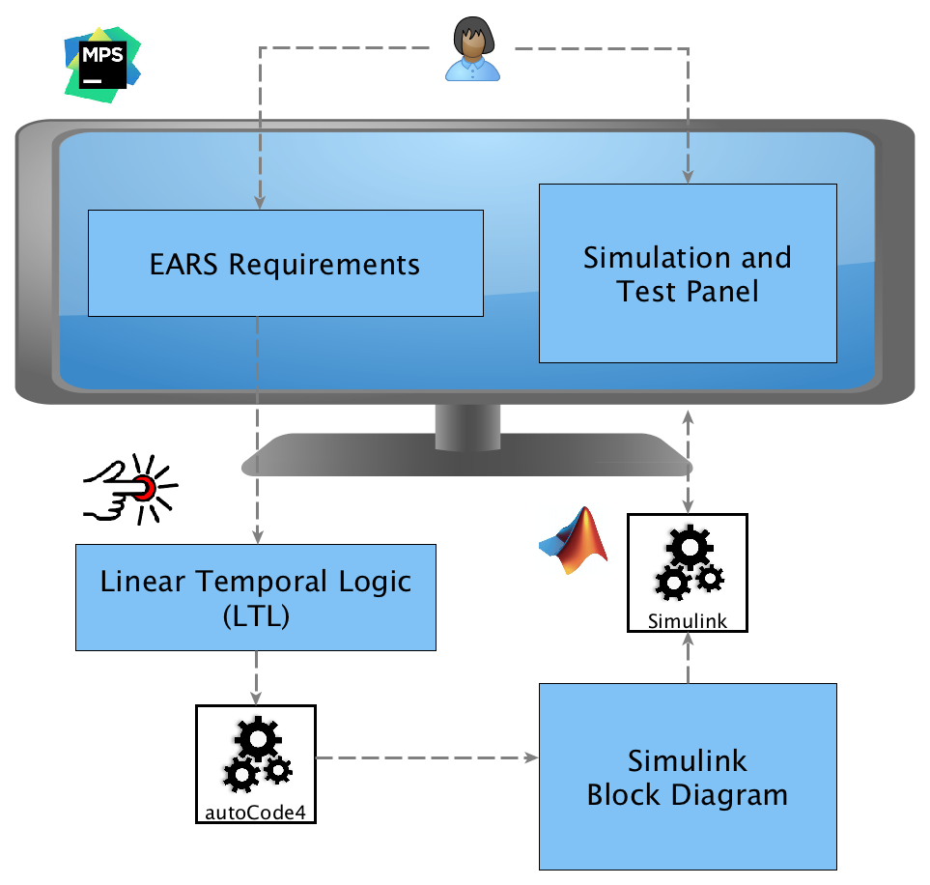

Slide 5
Summary
We have created a push button tool for generating and verifying controllers from requirements written in structured English
Some more scalability experiments with real-world controllers are needed
Further work with Rolls-Royce in the pipeline

Slide 6
GitHub: https://github.com/saadbinabid1/EARS-CTRLReqAnalysis/
Video: https://youtu.be/IOyFRd6mbd0
Contact // Dr. Levi Lúcio
fortiss GmbH
An-Institut Technische Universität München
Guerickestraße 25 · 80805 München · Germany
tel +49 (89) 360 35 22 26 fax +49 (89) 360 35 22 50
lucio@fortiss.org
www.fortiss.org

