Slide 1




EARS-CTRL Generating Controllers for Dummies
October 6, 2017
Levi Lúcio, Salman Rahman, Saad Bin-Abid (fortiss)
Alistair Mavin (Rolls-Royce)

Slide 2
MPS@fortiss
fortiss: research + transfer + consulting
3 people team, parallel and synergic work with AutoFOCUS (Eclipse-based)
Currently IETS3 project, trying to branch out
Raising awareness about MPS in industry and academia
Academic projects (PhD thesis)
Industrial collaboration with Rolls-Royce

Slide 3
Purpose of EARS-CTRL
A push-button approach for directly generating software controllers from requirements written in English
A push-button approach for verifying the produced controllers are correct

Slide 4
Tool Chain
MPS (Meta-Programming System)
AutoCode4 (LTL-based controller synthesizer)
MATLAB Simulink
EARS [1] (Easy Approach to Requirements Syntax)
[1] A. Mavin, P. Wilkinson, A. Harwood, and M. Novak. Easy approach to requirements
syntax (ears). In 2009 17th IEEE International Requirements Engineering
Conference, pages 317-322, Aug 2009.

Slide 5
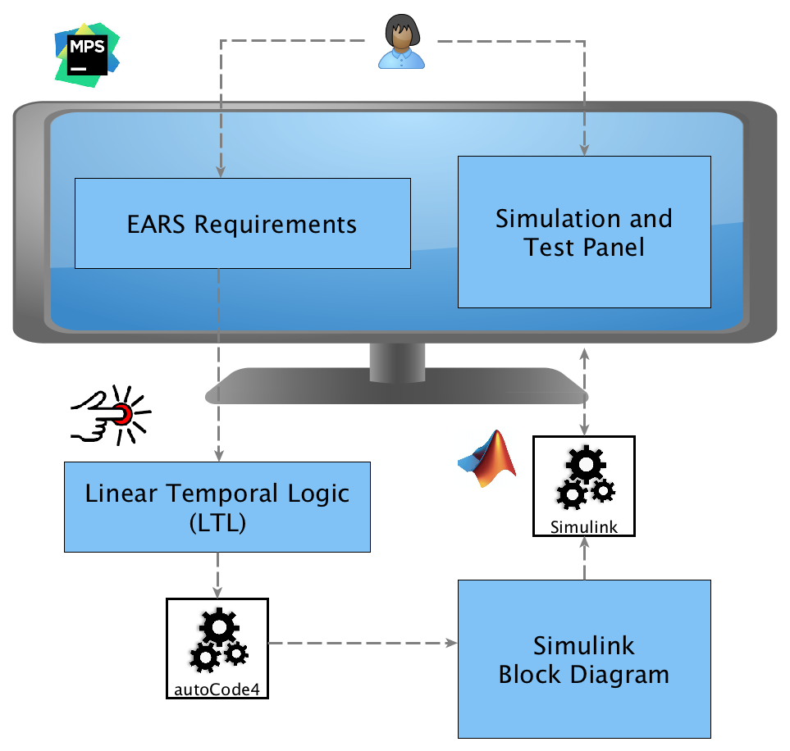

Slide 6
Summary
We have created a push button tool for generating and verifying controllers from requirements written in structured English
Some more scalability experiments with real-world controllers are needed
Further work with Rolls-Royce in the pipeline

Slide 7
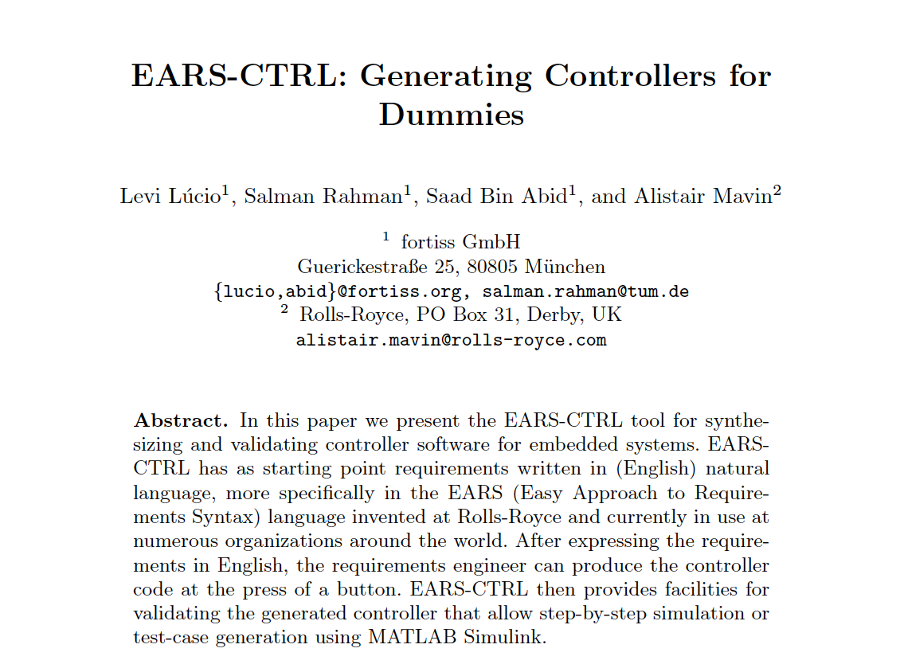
Publications
EARS-CTRL: Generating Controllers for Dummies, Levi Lúcio, Salman Rahman, Saad Bin-Abid,
Alistair Mavin, Proceedings of the 20th International Conference on Model Driven Engineering
Languages and Systems (MoDELS), Demo and Poster track, Austin, Texas, 2017. (to appear)

Slide 8
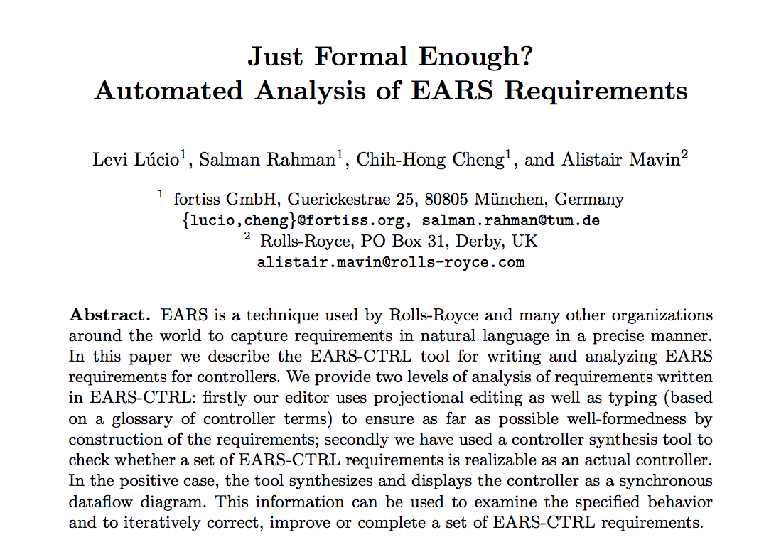
Publications
Just Formal Enough? Automated Analysis of EARS Requirements, Levi Lucio, Salman Rahman,
Chih-Hong Cheng, Alistair Mavin, Proceedings of the 9th NASA Formal Methods Symposium
(NFM 2017). Lectures Notes in Computer Science (LNCS), Volume 10227, pp.427-434, 2017.

Slide 9
GitHub: https://github.com/saadbinabid1/EARS-CTRLReqAnalysis/
Video: https://youtu.be/IOyFRd6mbd0
Contact // Dr. Levi Lúcio
fortiss GmbH
An-Institut Technische Universität München
Guerickestraße 25 · 80805 München · Germany
tel +49 (89) 360 35 22 26 fax +49 (89) 360 35 22 50
lucio@fortiss.org
www.fortiss.org

