Slide 1


Verification of Model Transformations and DSLs in Industry
Levi Lúcio
Joint work with:
Bentley James Oakes, Cláudio Gomes,
Salman Rahman and Hans Vangheluwe
August 23, 2016

Slide 2
Talk Map
Verification of Model Transformations
Current MDD projects and interaction with the industry
Conclusion and Wrap-up

Slide 3
Talk Map
Verification of Model Transformations
Current MDD projects and interaction with the industry
Conclusion and Wrap-up

Slide 4
Verification of Model Transformations
What?
A push-button tool for the automatic analysis of model transformations
Automatic proof construction for pre- / post- condition contracts
Formal methods in practice: a proof is valid for all inputs
How?
By using a model transformation language with reduced expressiveness: DSLTrans
Contracts are proved on a symbolic execution-based abstraction
Challenges
Handling all constructs of the model transformation language
Reaching full automation
Scale to real-world transformations
Going mainstream

Slide 5
VIDEO
(video editing by Bentley James Oakes)
and live demo

Slide 6

Implementation
Principle:
Development of the tool should be model-driven (as much as as possible)
“MPM: Model everything explicitly at the most appropriate
level(s) of abstraction using the most appropriate formalisms”
First class citizens:
Metamodels
Models
(Higher-Order) Model Transformations

Slide 7



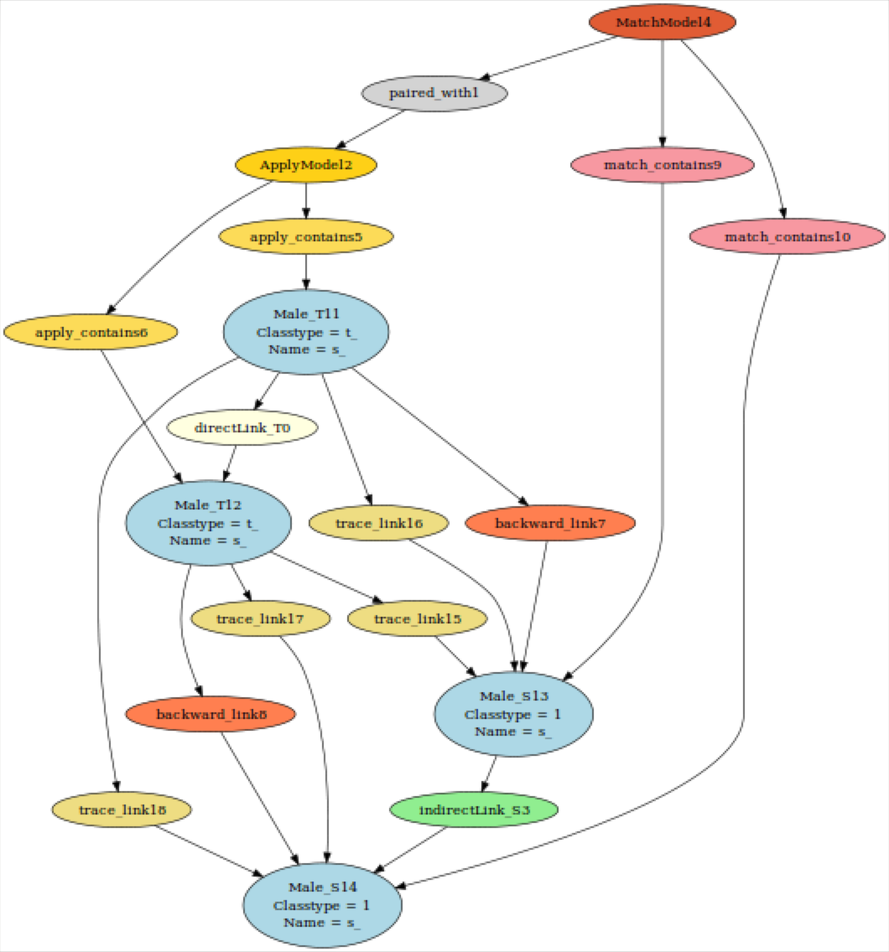
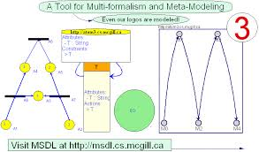






Tools and Developers
T-Core
igraph / Himesis
Levi Lúcio
fortiss / McGill U.
Bentley J. Oakes
McGill U.
Gehan Selim
Queen’s U.
Cláudio Gomes
Antwerp U.

Slide 8

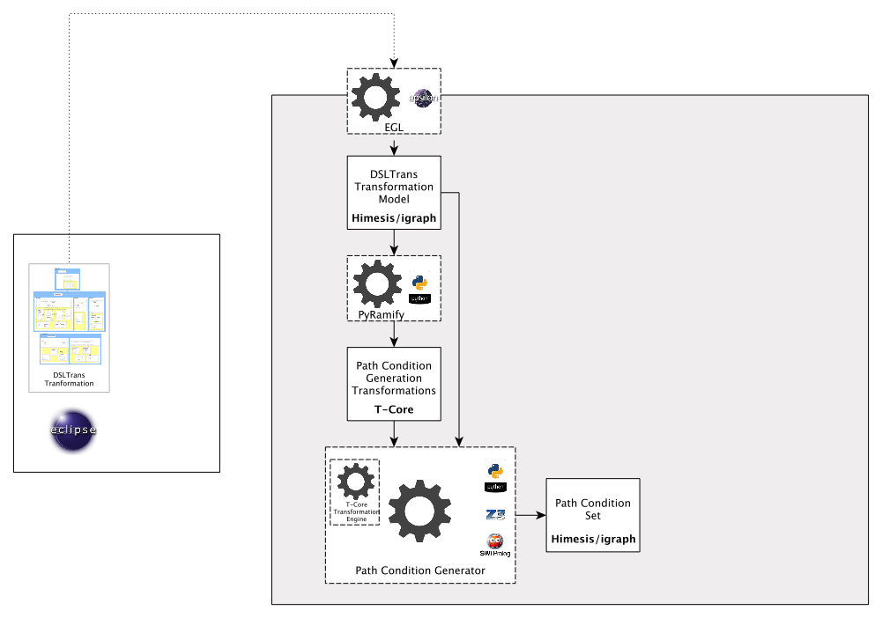
SyVOLT’s Architecture

Slide 9
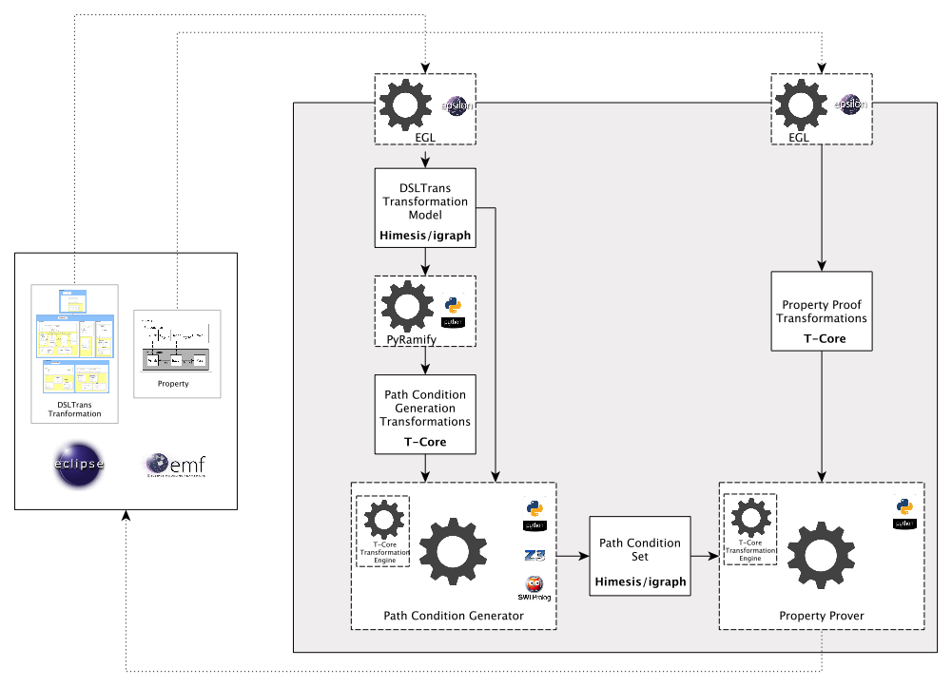
SyVOLT’s Architecture

Slide 10
SyVOLT is a GitHub Project
https://github.com/levilucio/SyVOLT/

Slide 11
Talk Map
Verification of Model Transformations
Current MDD projects and interaction with the industry
Conclusion and Wrap-up

Slide 12
Talk Map
Verification of Model Transformations
Current MDD projects and interaction with the industry
Conclusion and Wrap-up

Slide 13
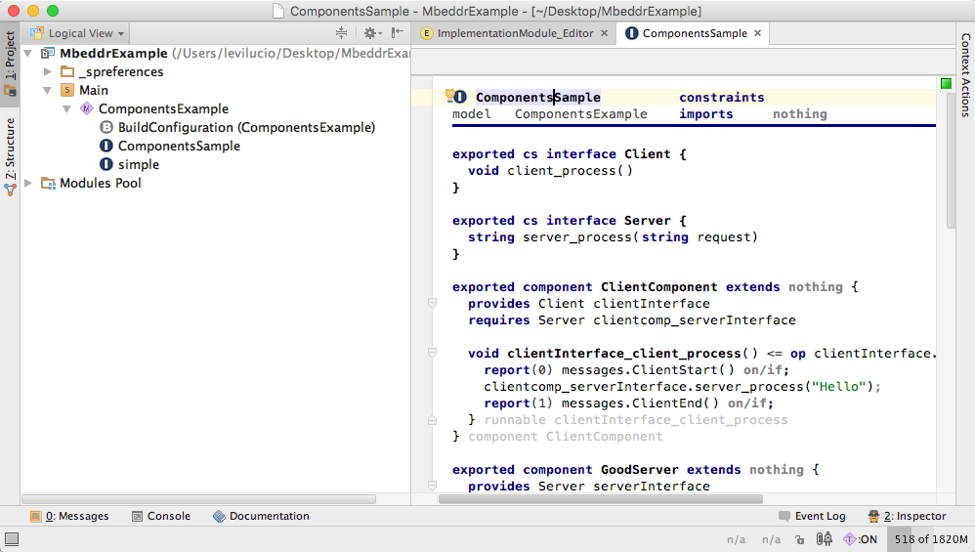


cert-mbddr Project
mbeddr is a set of DSLs written in MPS, to ease the writing of C code. C code is generated through a model transformation.

Slide 14


Objective
However, the guarantees that mbeddr’s generated C code is correct are
currently not enough for mbeddr’s industrial users.
mbeddr’s qualification requires arguments about the correctness of the C code model transformation generators.

Slide 15
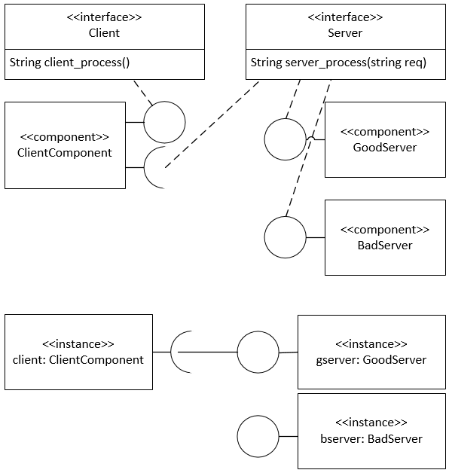
Component calls in mbeddr
An abstraction used in mbeddr is the notion of component.
Components provide and require services.
Is this abstraction correctly translated into C?
Notes:
Switch to MPS and to the C files to show the runtime.

Slide 16
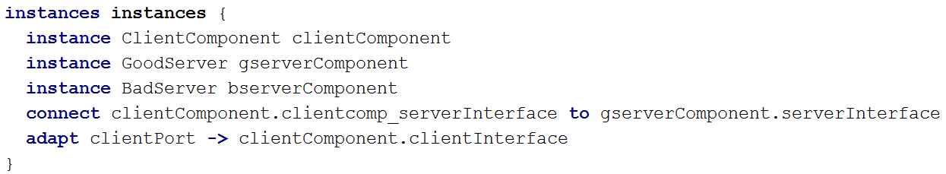
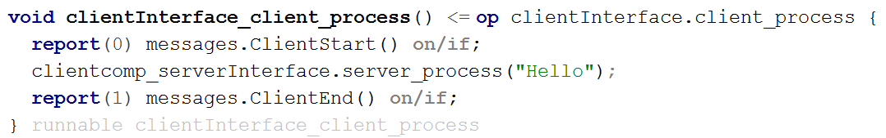
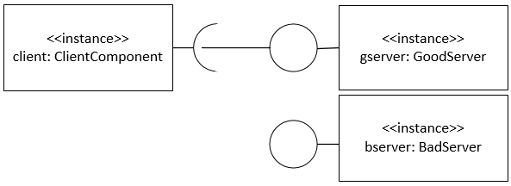
What can go wrong in a method call (mbeddr)?

Slide 17
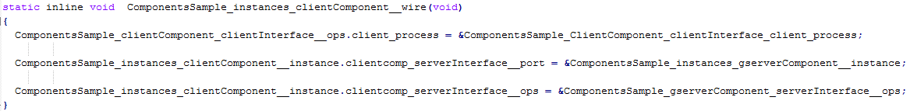
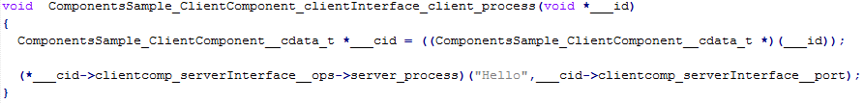
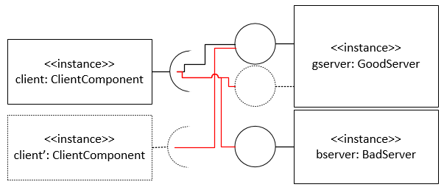
What can go wrong in a method call (C)?
C code complexity required to realize OO paradigm
Several levels of indirection (pointers)

Slide 18
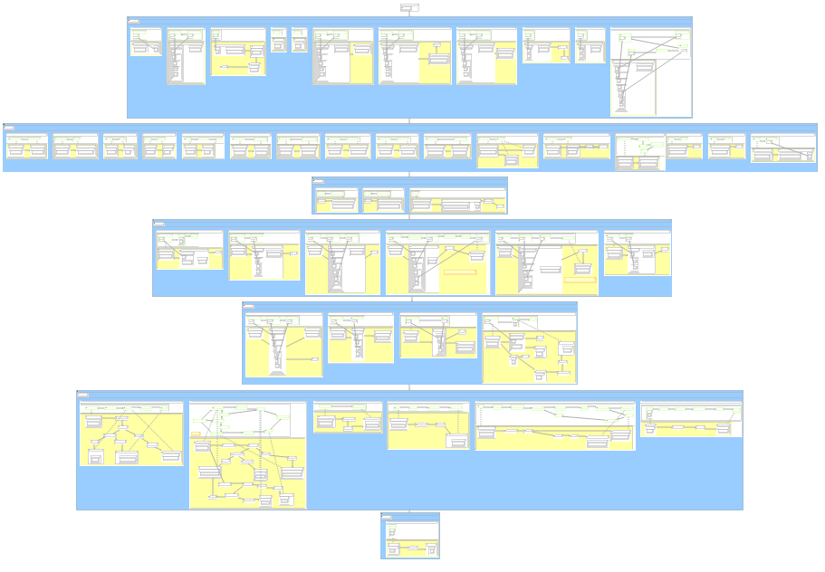
DSLTrans mbeddr -> C Transformation
Notes:
layer0rule7
Layer0rule9
layer0rule10
layer1rule10
If there is time: layer3rule4

Slide 19
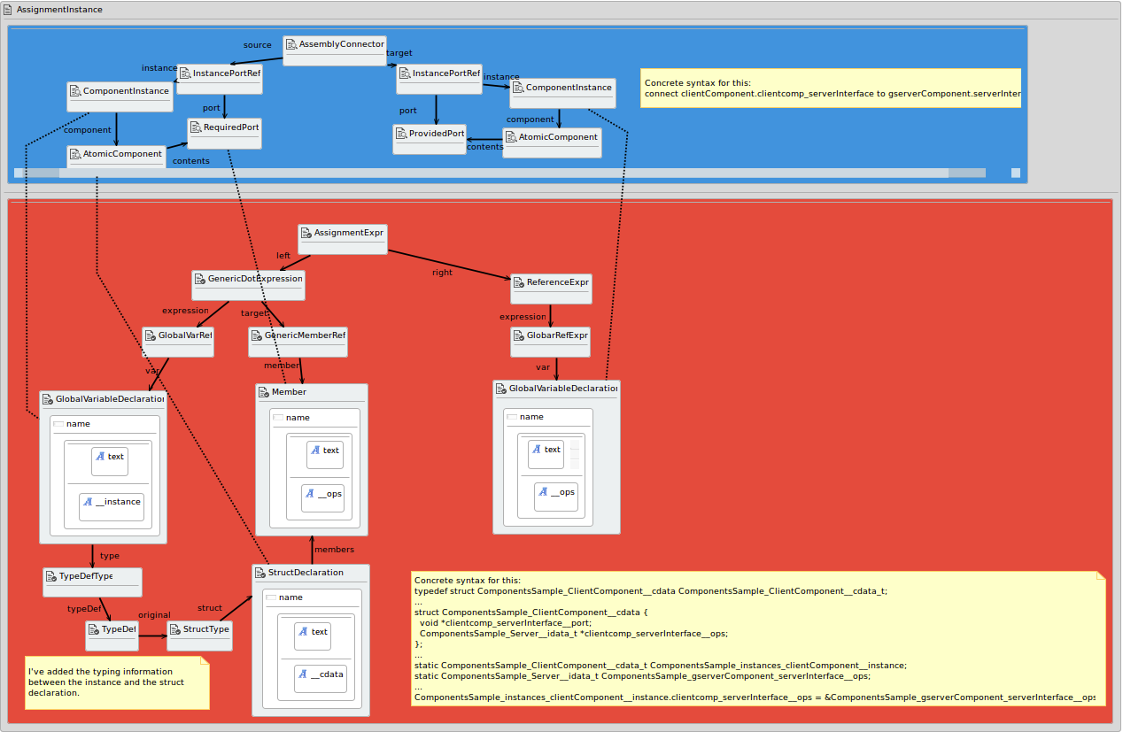
Example contract for mbeddr
Shows that the interface of the provided port is assigned to operations of the right requiring component type.
Is proved in under 2 mins!
Notes:
Sabemos que a ligacao e feita entre uma instancia de um cliente correcto e uma operacao de uma instancia do servidor correcto.

Slide 20
A Correctness Argument is Missing Several SyVOLT Contracts more, e.g.:
The assignment is made prior to any method call;
The correct component instance is passed to the method call (both for the source instance as well as for the target instance)
etc…
Notes:
Sabemos que a ligacao e feita entre uma instancia de um cliente correcto e uma operacao de uma instancia do servidor correcto.

Slide 21
SyVOLT Optimizations for analyzing the C generator for mbeddr
Parallelization of path condition (symbolic execution) construction
Saved space on path condition representation (trimmed and zipped to disk)
Contract-based slicing of DSLTrans model transformations
Path condition elimination based on EMF containment constraints

Slide 22
DSLTrans and SyVOLT: From Eclipse to MPS
MPS (Meta Programming System), from JetBrains
Meta editing facilities for DSL construction
Model transformation languages (model-to-model, model-to-text)
Base languages (Java, C, others)
Projectional editing
Part of the cert-mbeddr project
Integrate DSLTrans in MPS
Integrate SyVOLT in MPS

Slide 23
DSLs in MPS
Highlight projectional editing

Slide 24

Live Demo of MPS

Slide 25


Something (a bit) different: The IETS3 Project
Requirement management is difficult for critical systems
Especially critical for the Aerospace and Automotive industry
Compliance with standards is required (e.g. DO-178C in aerospace)
Traceability is required from High Level Requirements to Low Level requirements to code
There is space for improvement wrt. currently used tools: DOORS, Word, Excel, Enterprise Architect,…

Slide 26
Examples of what can be Improved
We received a requirements document from Diehl for a Fan Unit system to cool down door controllers in the A380
Thousands of pages
Manually built traceability along different abstraction levels
Many requirements are just text
Parts of the requirements documents are reversed engineered from code

Slide 27
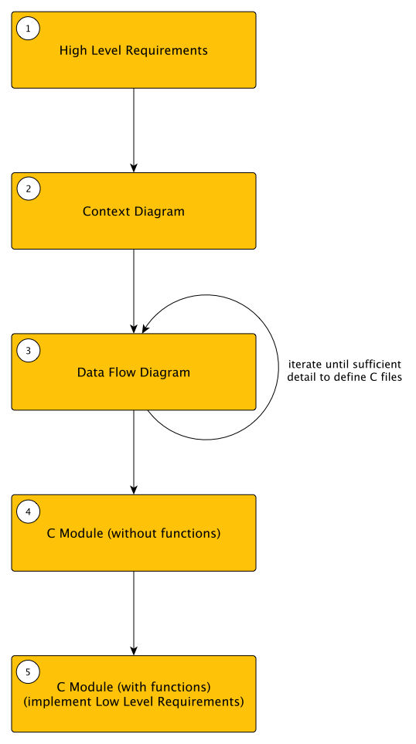
Examples of what can be Improved

Slide 28
Live Demo of IETS3

Slide 29
IETS3: How can Modeling Technology Help in Requirements Engineering?
Requirements can be written more formally than just text and pictures / tables
A requirements document becomes an interconnected model where traceability is provided by construction
Static checks for correctness-by-construction
Support for requirements’ refinement
Support for documentation or code generation
Support for automated analyses

Slide 30
Conclusion
Model transformation verification ( and Model-Driven technologies in general) are in demand in industry
Good abstractions allow correctness-by-construction and verification
The theory is mature enough, but the tools are not
Add to that the difficulties of adoption
One way to move forward are focused industrial projects
and…

Slide 31
We are looking for partners
for new projects!
Drop me a line at:
levi.lucio@fortiss.org
Notes:
Offer:
- contacts with industry
semi-professional tool development environment
financing opportunities
possibilities for PhD thesis, real case studies and continuation to a career in the industry
Appreciate:
Ideas with an eye on industrial impact
Willingness to follow industrial case studies but to bring you grain(s) to salt
Tool development interest

Slide 32
Model-Driven Development: Challenges
Challenges
Insufficient higher-order model transformation technology (AToM3) models are not built for memory-intensive applications Transformations and code have to be developed together in an interleaved fashion

Slide 33
Model-Driven Development: Advantages
Advantages
(Surprisingly) speed! Adapted to the domain Models simplify the usage of complex data types

Slide 34
Model-Driven Development: Ambivalent
Ambivalent
Right level of abstraction through the usage of metamodels and model transformations Visual edition and debugging of metamodels, models and model transformations

