Slide 1



Analysing ATL Model Transformations
Levi Lúcio and Bentley James Oakes
Joint work with:
Javier Troya, University of Vienna
Manuel Wimmer, University of Vienna
School of Computer Science, McGill University, Montreal, Canada
June 17, 2015

Slide 2
Outlook
Transforming ATL transformations into DSLTrans
SyVOLT contracts for ATL transformations
Slicing for scalability
Results

Slide 3
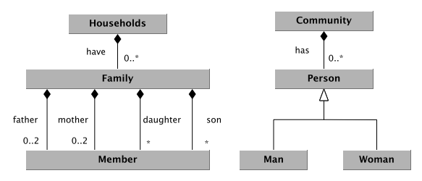
Transforming ATL into DSLTrans

Slide 4
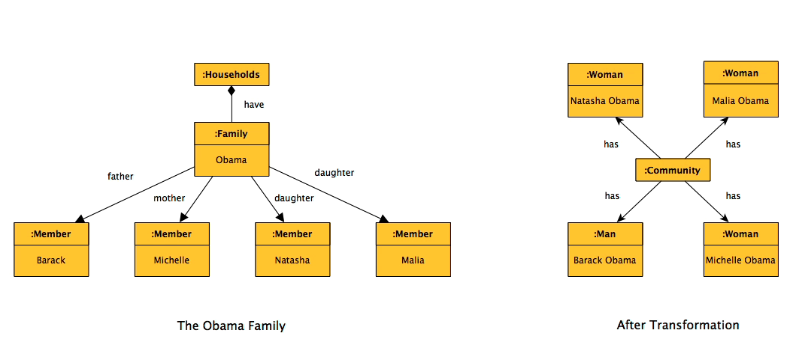
Transforming ATL into DSLTrans

Slide 5
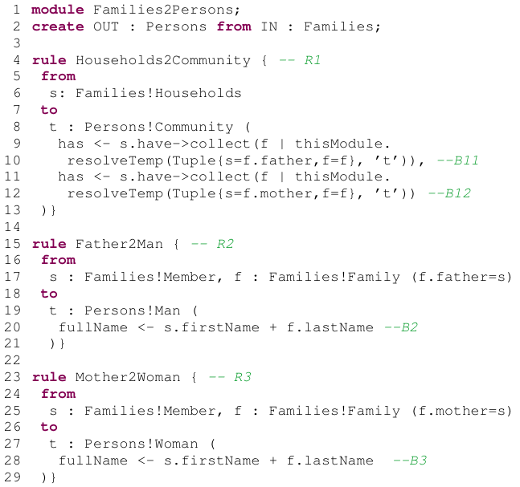
Transforming ATL into DSLTrans

Slide 6
Transforming ATL into DSLTrans

Slide 7
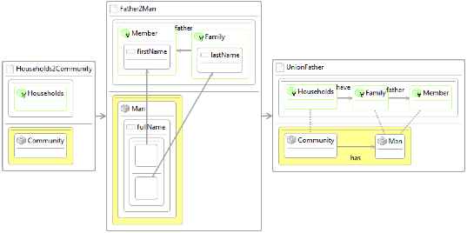
Transforming ATL into DSLTrans
R1

Slide 8
Transforming ATL into DSLTrans

Slide 9
Transforming ATL into DSLTrans
R2
B2

Slide 10
Transforming ATL into DSLTrans

Slide 11
Transforming ATL into DSLTrans
B11

Slide 12
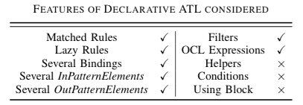
Treated ATL Subset (declarative)

Slide 13
Slicing for scalability
Select only rules from a DSLTrans transformation which contribute elements to the proof of a property
Extremely effective for not-too-large properties
Tradeoff between verification time and property size

Slide 14
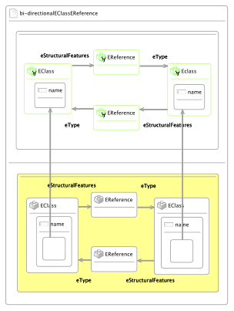
Example Property used to Slice the Ecore-Copier
“All bi-directional associations (represented by two inverse EReference instances)
between EClass instances should have the same end points, i.e., the EClass
Instances should have the same names.”
Notes:
Talk about ease of writing the contracts when we gave it to our partners.

Slide 15
Results
Transformation | ATL / DSLTrans rules | Path Conds. Gen. | Time (s) | Properties Proved | Time (s) | Memory (MB)
Families-to-Persons | 5 / 9 | 52 | 1.54 | 4 | 31.45 | 45
“Fully Verifying Transformation Contracts for Declarative ATL”, B. Oakes, J. Troya, L. Lúcio, M. Wimmer.
Submitted to MoDELS 2015

Slide 16
Results
Transformation | ATL / DSLTrans rules | Path Conds. Gen. | Time (s) | Properties Proved | Time (s) | Memory (MB)
Families-to-Persons | 5 / 9 | 52 | 1.54 | 4 | 31.45 | 45
ER-Copier | 5 / 9 | 70 | 0.48 | 1 | 1.70 | 43
“Fully Verifying Transformation Contracts for Declarative ATL”, B. Oakes, J. Troya, L. Lúcio, M. Wimmer.
Submitted to MoDELS 2015

Slide 17
Results
Transformation | ATL / DSLTrans rules | Path Conds. Gen. | Time (s) | Properties Proved | Time (s) | Memory (MB)
Families-to-Persons | 5 / 9 | 52 | 1.54 | 4 | 31.45 | 45
ER-Copier | 5 / 9 | 70 | 0.48 | 1 | 1.70 | 43
Ecore-Copier | 11 / 24 | 57890 | 2894.44 | 1 | 1401.45 | 7800
“Fully Verifying Transformation Contracts for Declarative ATL”, B. Oakes, J. Troya, L. Lúcio, M. Wimmer.
Submitted to MoDELS 2015

Slide 18
Results
Transformation | ATL / DSLTrans rules | Path Conds. Gen. | Time (s) | Properties Proved | Time (s) | Memory (MB)
Families-to-Persons | 5 / 9 | 52 | 1.54 | 4 | 31.45 | 45
ER-Copier | 5 / 9 | 70 | 0.48 | 1 | 1.70 | 43
Ecore-Copier | 11 / 24 | 57890 | 2894.44 | 1 | 1401.45 | 7800
Sliced Ecore-copier (prop with 2 input types, 2 output types) | 15 / 63 > 13 | 73 | 3.50 | 1 | 9.11 | 72
“Fully Verifying Transformation Contracts for Declarative ATL”, B. Oakes, J. Troya, L. Lúcio, M. Wimmer.
Submitted to MoDELS 2015

Slide 19
Results
Transformation | ATL / DSLTrans rules | Path Conds. Gen. | Time (s) | Properties Proved | Time (s) | Memory (MB)
Families-to-Persons | 5 / 9 | 52 | 1.54 | 4 | 31.45 | 45
ER-Copier | 5 / 9 | 70 | 0.48 | 1 | 1.70 | 43
Ecore-Copier | 11 / 24 | 57890 | 2894.44 | 1 | 1401.45 | 7800
Sliced Ecore-copier (prop with 2 input types, 2 output types) | 15 / 63 > 13 | 73 | 3.50 | 1 | 9.11 | 72
Sliced Ecore-copier (prop with 2 input types, 2 output types) | 15 / 63 > 17 | 28 | 0.95 | 1 | 0.46 | 71
“Fully Verifying Transformation Contracts for Declarative ATL”, B. Oakes, J. Troya, L. Lúcio, M. Wimmer.
Submitted to MoDELS 2015

Slide 20
Results
Transformation | ATL / DSLTrans rules | Path Conds. Gen. | Time (s) | Properties Proved | Time (s) | Memory (MB)
Families-to-Persons | 5 / 9 | 52 | 1.54 | 4 | 31.45 | 45
ER-Copier | 5 / 9 | 70 | 0.48 | 1 | 1.70 | 43
Ecore-Copier | 11 / 24 | 57890 | 2894.44 | 1 | 1401.45 | 7800
Sliced Ecore-copier (prop with 2 input types, 2 output types) | 15 / 63 > 13 | 73 | 3.50 | 1 | 9.11 | 72
Sliced Ecore-copier (prop with 2 input types, 2 output types) | 15 / 63 > 17 | 28 | 0.95 | 1 | 0.46 | 71
GM to Autosar | 5 / 9 | 5 | 0.17 | 9 | 0.26 | 48
“Fully Verifying Transformation Contracts for Declarative ATL”, B. Oakes, J. Troya, L. Lúcio, M. Wimmer.
Submitted to MoDELS 2015

Slide 21
GM (VCS) to Autosar
ATL version, using a bounded SAT solver approach*
~100 seconds per contract
DSLTrans version
~.1 seconds to build the symbolic execution
~.1 seconds per contract
ATL version, transformed into DSLTrans
~.1 seconds to build the symbolic execution
~.1 seconds per contract
* “Automated Verification of Model Transformations in the Automotive Industry”, G. Selim, F. Büttner, J.R. Cordy, J. Dingel, S. Wang: MoDELS 2013, Miami, FL, USA. (LNCS)

Slide 22
TO BE CONTINUED…

Slide 23
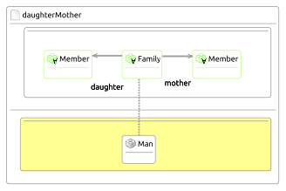
SyVOLT Contracts for ATL Transformations
‘A family with a mother and a daughter will always produce a community with a man.’

Slide 24
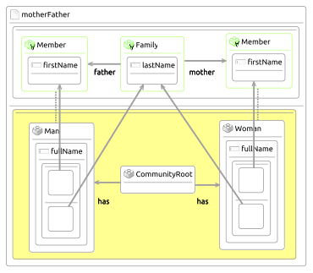
SyVOLT Contracts for ATL Transformations
‘A mother and a father in a Family produce respectively a man and a woman
in the community and their full names are correctly formed.‘

Slide 25
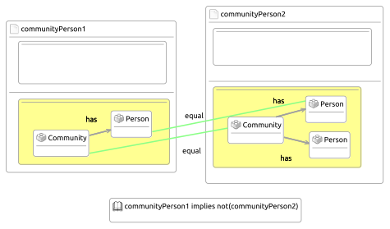
SyVOLT Contracts for ATL Transformations
‘A Community is connected to one and only one Person element’.

