Slide 1
Symbolic execution of DSLTrans’ transformations using
AToM^3 and T-Core

Slide 2
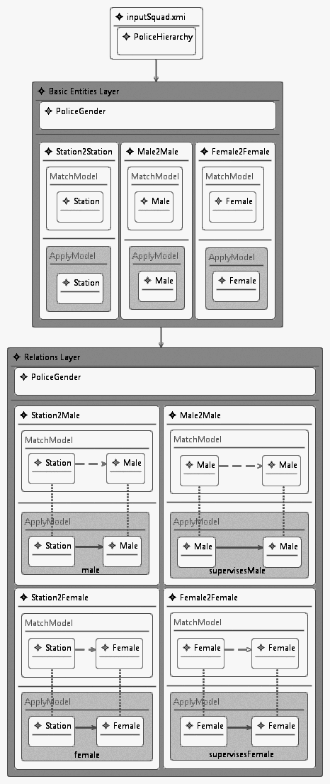
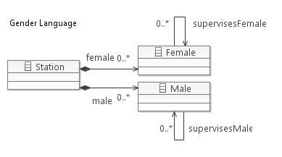
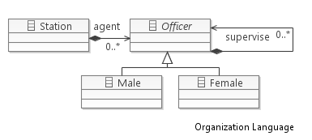
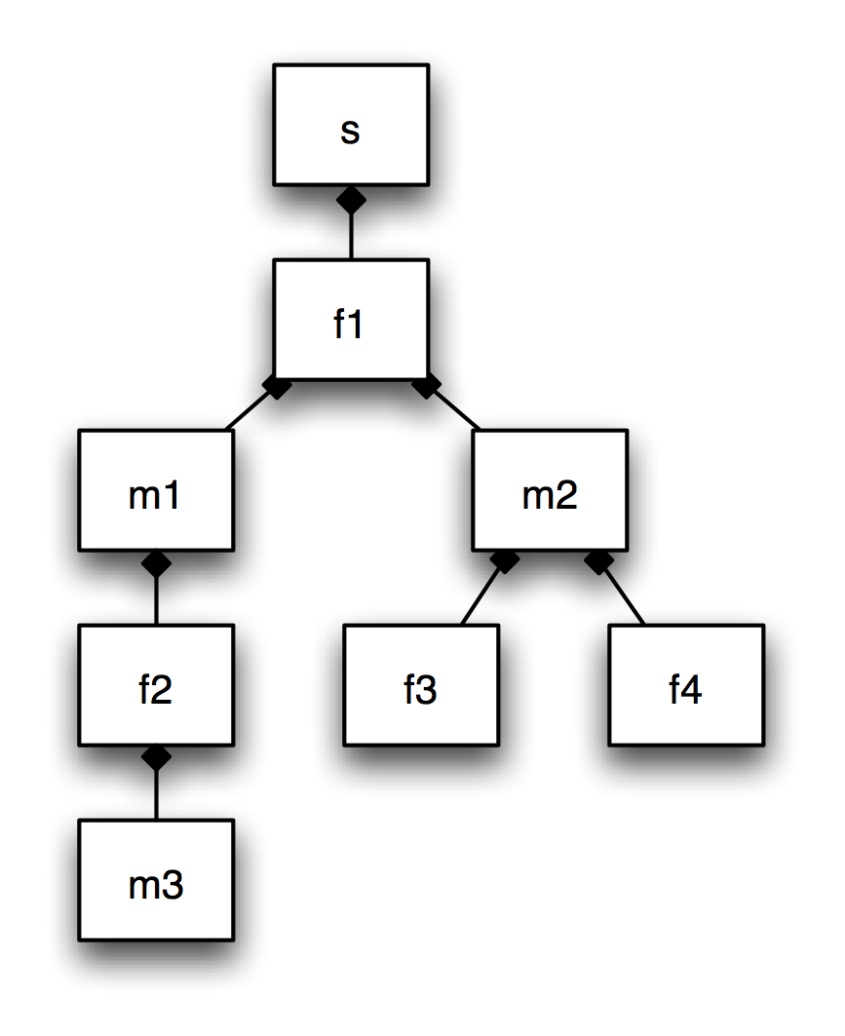
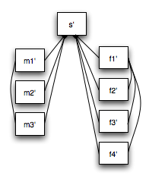

Slide 3

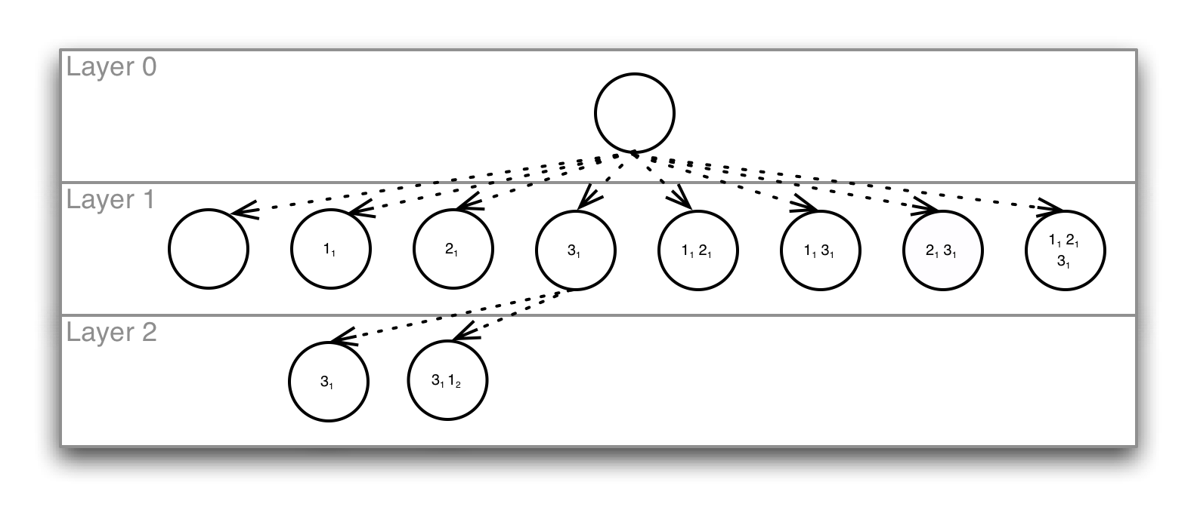
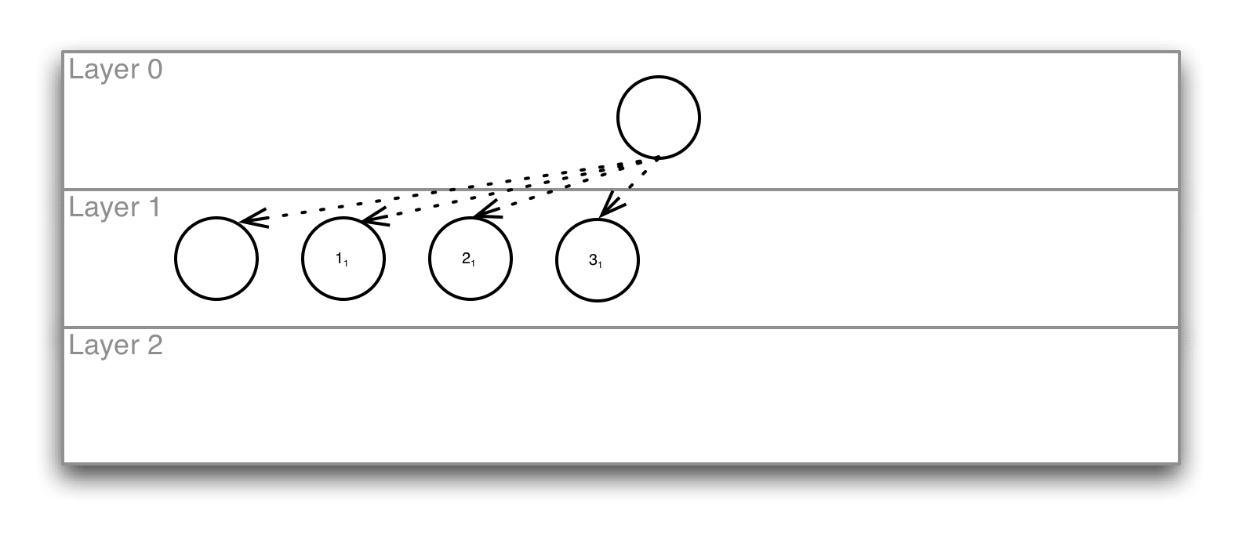
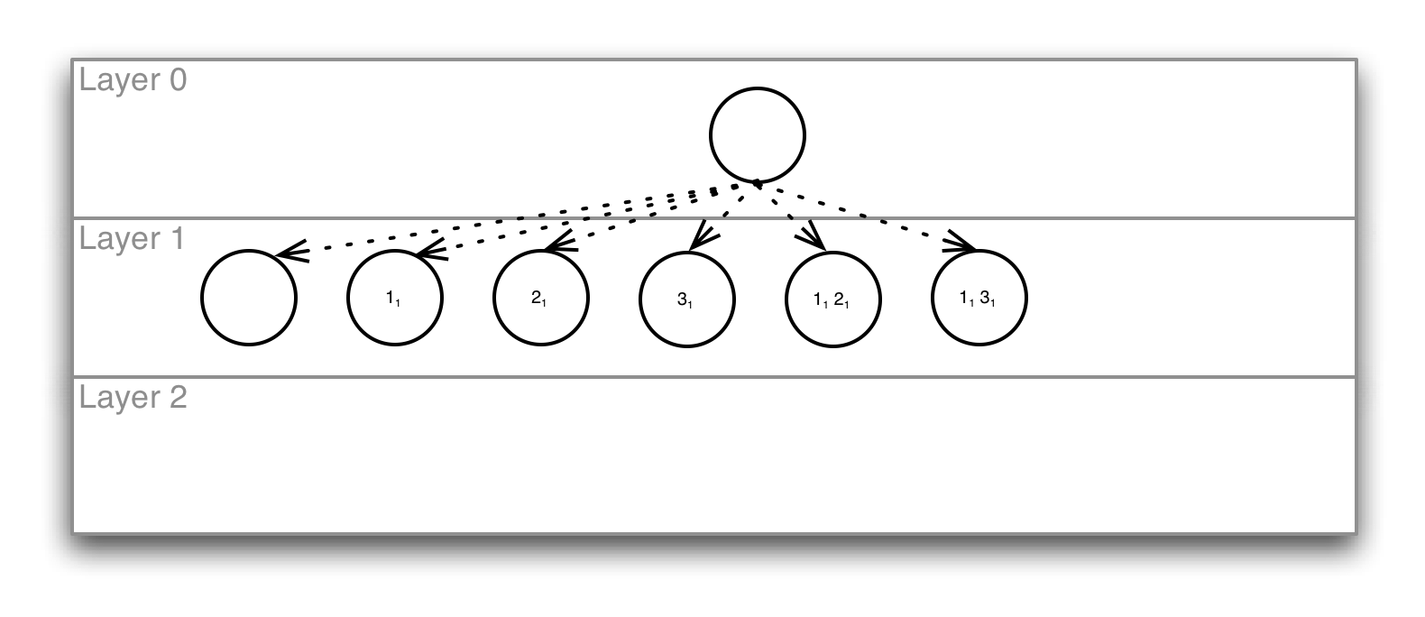
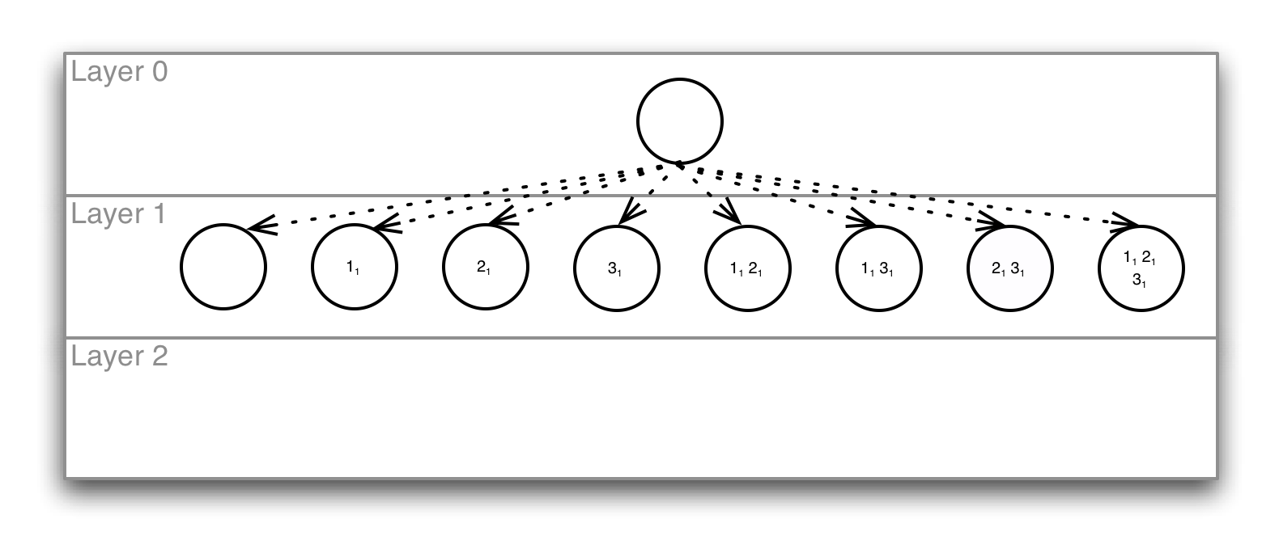
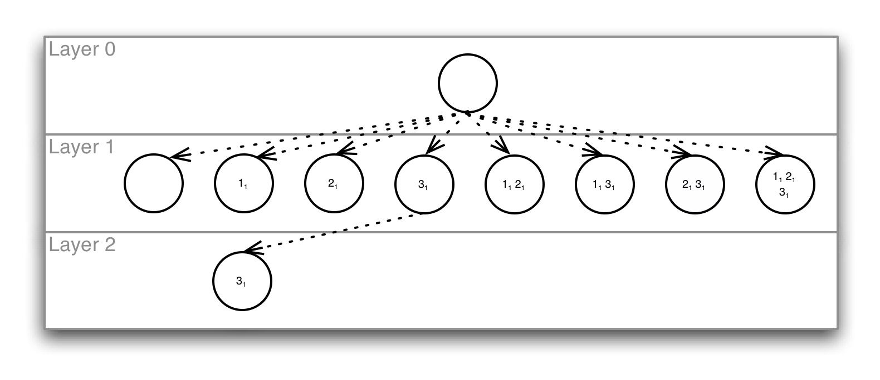
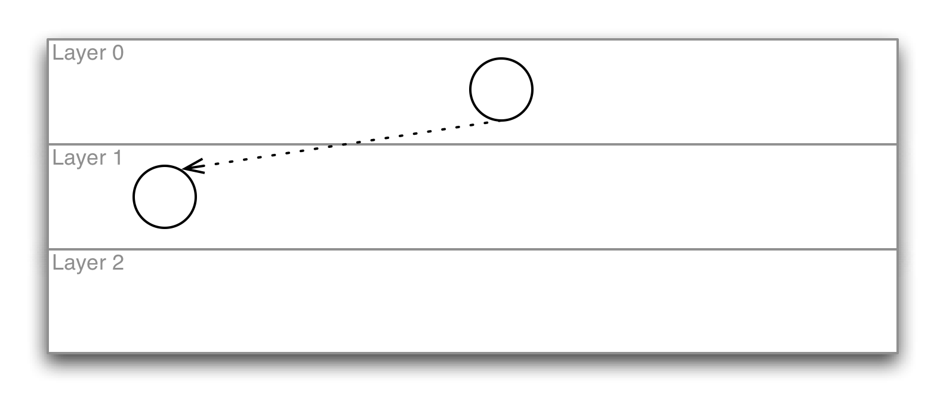
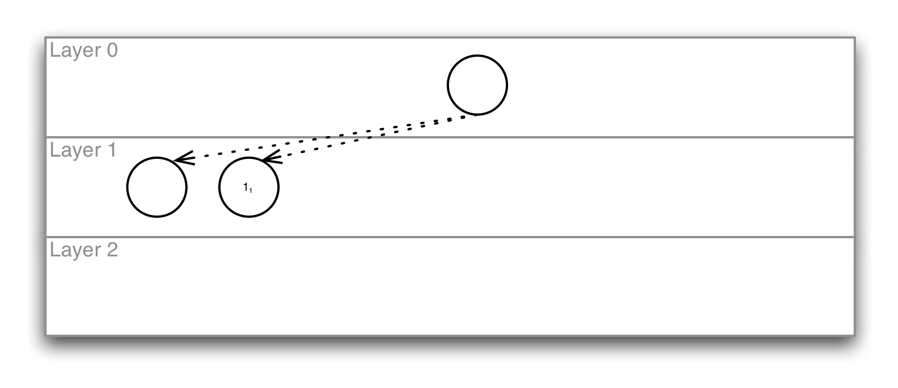
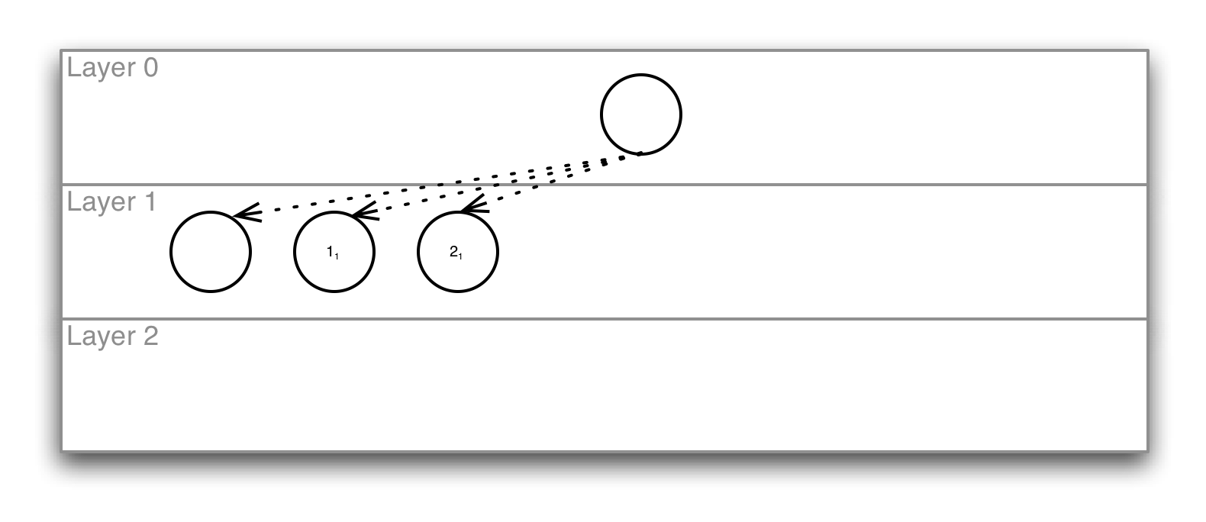
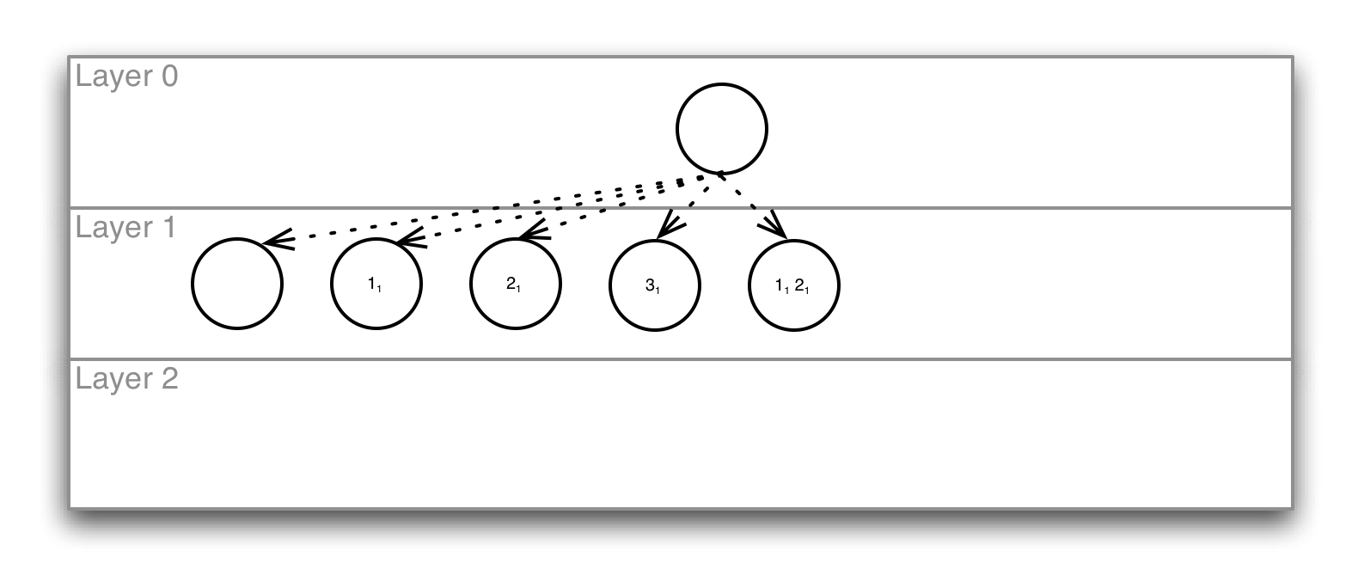
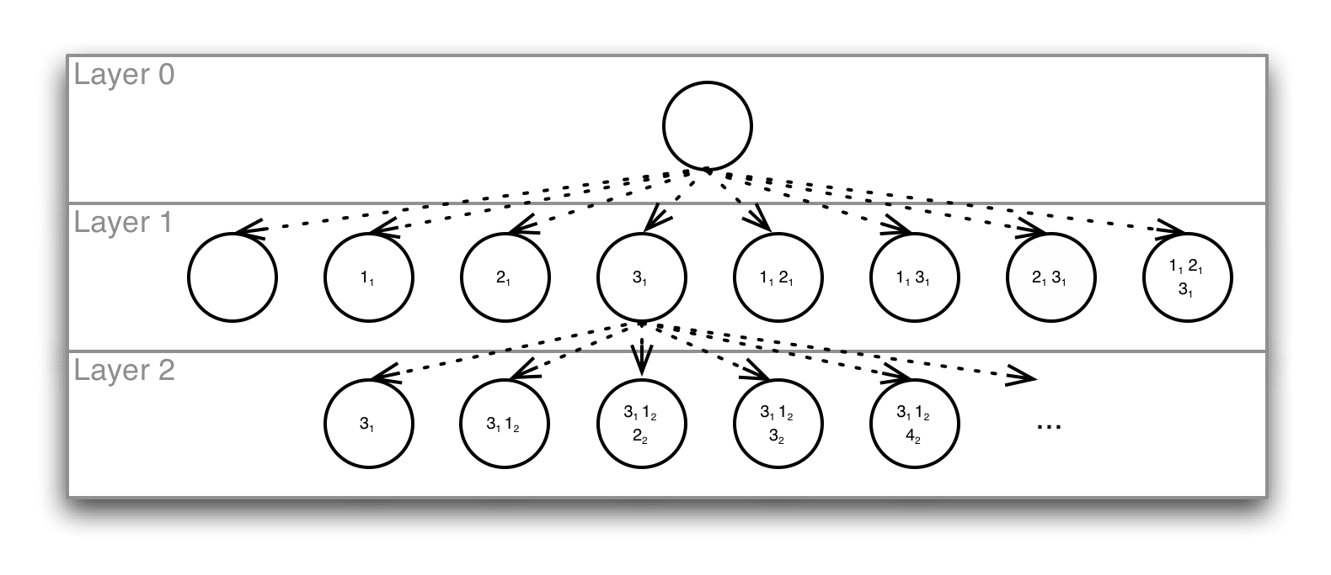
Building the set of Symbolic
Executions for a Transformation
1₁
2₁
3₁
1₂
2₂
3₂
4₂

Slide 4


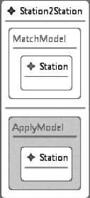
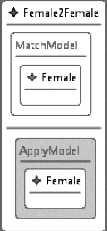
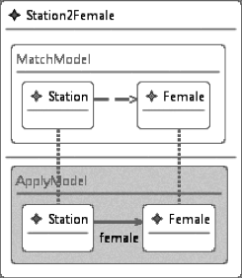
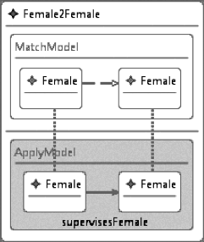
Only rules with the right backward dependencies with a previous state are kept
+
+
+

Slide 5
Approach
We use as input (an abstraction of) the DSLTrans transformation to analyze
AToM^3 is used to model the abstraction of the DSLTrans transformation to analyze (individual rules are modeled)
AToM^3 is used to model the matching transformation rules that allow checking if a rules in a layer N can be executed (depending on rules executed in layers 0..N-1)
The backward links between match and apply elements from previous layers are already built
A python script is used to import the (abstraction of) the DSLTrans transformations, the match transformation rules, T-Core (for rule execution) and execute the algorithm

Slide 6
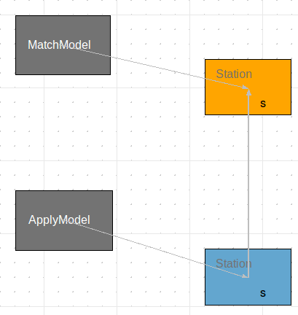
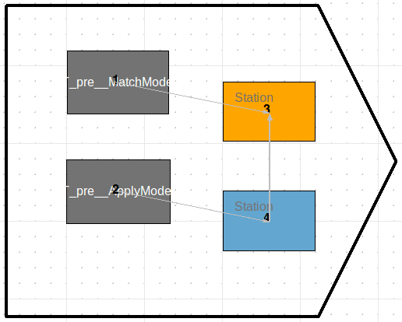
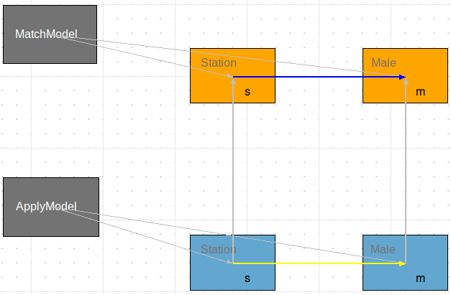
AToM^3 DSLTrans Rules and Matchers for our example
Station2Station
Station2Station Matcher
Station2Male

Slide 7
Preliminary scalability tests
Layers and rules | # Rules | # States | Execution time (seconds)
(Layer 1, 1 rule) | 1 | 2 | ﻿2e-05
(Layer 1, 2 rules) | 2 | 4 | ﻿﻿1.1e-05
(Layer 1, 2 rules), (Layer 2, 1 rules) | 3 | 5 | ﻿0.0019
(Layer 1, 2 rules), (Layer 2, 2 rules) | 4 | 8 | ﻿﻿0.0082
(Layer 1, 2 rules), (Layer 2, 3 rules) | 5 | 16 | ﻿0.0099
(Layer 1, 3 rules), (Layer 2, 2 rules) | 5 | 16 | ﻿0.0048
(Layer 1, 3 rules), (Layer 2, 4 rules) Models’ paper example | 7 | ﻿﻿34 | ﻿0.011
(Layer 1, 6 rules), (Layer 2, 4 rules) | 10 | ﻿556 | ﻿0.05
(Layer 1, 6 rules), (Layer 2, 6 rules) | 12 | ﻿2224 | ﻿0.137
(Layer 1, 6 rules), (Layer 2, 6 rules) (Layer 3, 2 rules) | 14 | ﻿17244 | ﻿0.32

Slide 8
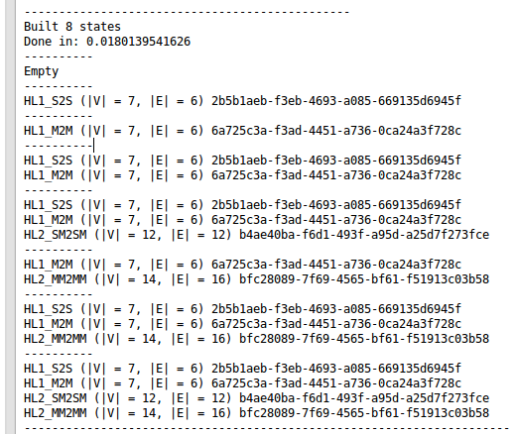
Example state space

Slide 9
ToDos
State space construction refinement
  More scalability tests and scalability improvement using caches
  Handle transitive traces
State space analysis
  Prove, for all executions, if an element of a given source type is consumed then another element of a target type is produced
  Dead rules?
Automatically build (using transformations):
  The DSLTrans abstraction for analysis
  The backward link match rules for state space construction
Test the approach with Gehan’s GM transformation_x0013_

