Slide 1



Analysing Model Transformations for Real Tool, Case Studies and Scalability
Levi Lúcio, Bentley James Oakes and Hans Vangheluwe
Joint work with:
Gehan Selim, Queen’s University
Cláudio Gomes, University of Antwerp
School of Computer Science, McGill University, Montreal, Canada
June 17, 2015

Slide 2
VIDEO
(video editing by Bentley James Oakes)

Slide 3
Main News Since Last Year
Theory (and tool)
Inclusion of attribute (Strings) manipulation in symbolic execution
Tool
Fully automatic synthesis of all artifacts for symbolic execution*
Scalability (parallelisation and persistence of path conditions)
Integration with the Eclipse IDE
Case Studies
Verification of an large industrial model transformation, part of the mbeddr tool (Itemis/fortiss)
*“Model Transformations to Verify Model Transformations”, Levi Lúcio and Hans Vangheluwe.
Online Proceedings of Verification of Model Transformations (VOLT) 2013, Budapest, Hungary, 2013.

Slide 4



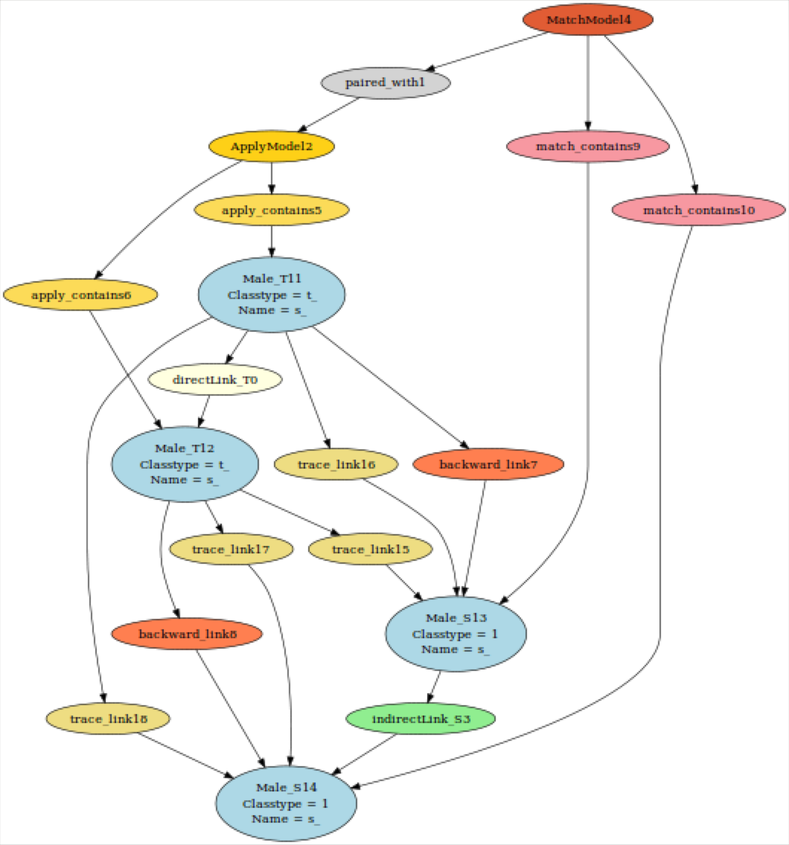
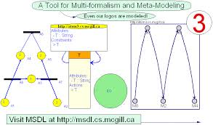






Tools and Developers
T-Core
igraph / Himesis
Levi Lúcio
McGill U.
Bentley J. Oakes
McGill U.
Gehan Selim
Queen’s U.
Cláudio Gomes
Antwerp U.

Slide 5

Implementation
Principle:
Development of the tool should be model-driven (as much as as possible)
“MPM: Model everything explicitely at the most appropriate
level(s) of abstraction using the most appropriate formalisms”
“Eat your own dog food!”
First class citizens:
Metamodels
Models
(Higher-Order) Model Transformations

Slide 6

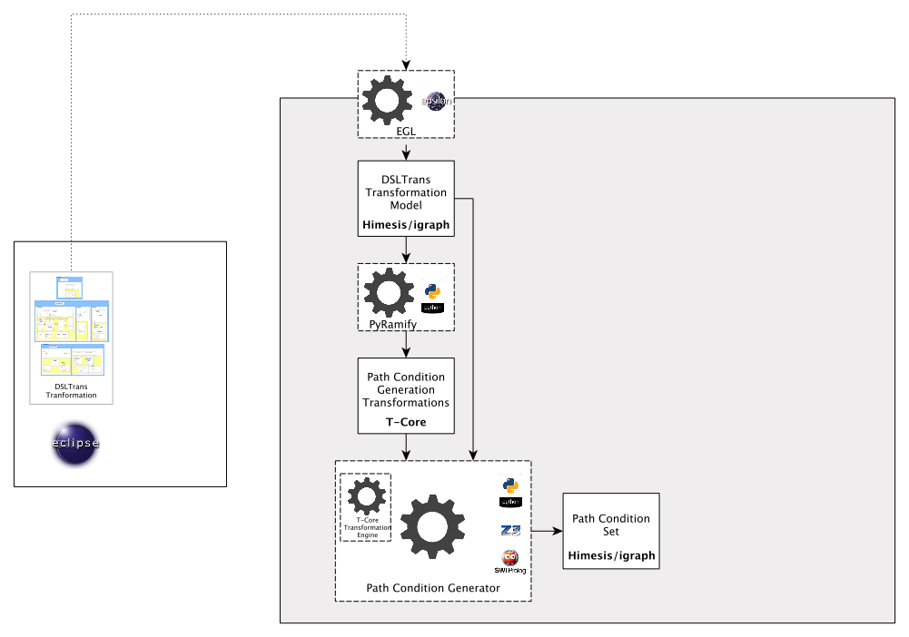
SyVOLT’s Architecture

Slide 7
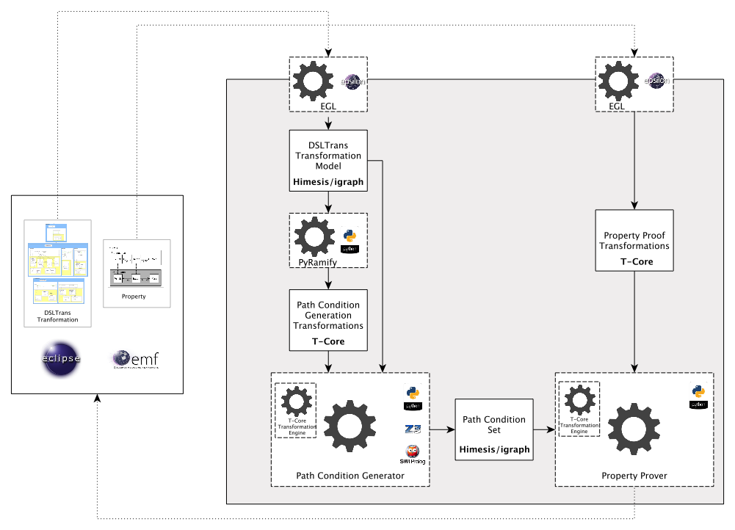
SyVOLT’s Architecture

Slide 8
Live Demo

Slide 9
Outcomes
Theoretically sound SyVOLT contract prover for model transformations
Applicability and scalability to real model transformations, including a migration model transformation from GM
Validation of the contract language’s expressiveness and ease of use (Gehan Selim’s PhD thesis)
Collaboration with fortiss/Itemis to prove properties of a model transformation part of the mbeddr tool

Slide 10
Outcomes
Indication that properties about the preservation of the semantics of transformed models can be proved
Analysis of ATL transformations through mapping onto DSLTrans

Slide 11
Future Work
Tool
Scale up to the requirements of the mbeddr transformation
More experimentation with slicing
Complete integration with ATL
Theory
Improve abstraction level to explain soundness and completeness (work with Bernhard Schaetz, fortiss)
Including NACs in the theory of path condition construction

Slide 12

Development Philosophy
Theory
SyVOLT Tool
Case Studies

Slide 13
Quick Recap
What?
A push-button tool for the automatic analysis of model transformations
Automatic proof construction for pre- / post- condition contracts
Formal methods in practice: a proof is valid for all inputs
How?
By using a model transformation language with reduced expressiveness: DSLTrans
Contracts are proved on a symbolic execution abstraction
Challenges
Handling all constructs of the model transformation language
Reaching full automation
Scale to real-world transformations
Going mainstream (language and technology)

