Slide 1


cert-mbeddr
Building Certified
Embedded Software in C
Levi Lúcio and Vincent Aravantinos

Slide 2







Motivation
mbeddr is gaining momentum in the industry. itemis AG is currently
building proprietary extensions to mbeddr to support data-flow modeling (Simulink-like) and Ontologies.
Companies that are currently either using or evaluating mbeddr
Prototype satellite onboard software
Robot control DSLs
Industrial engine control
Prototype drill machine control software
Data structure modeling
Control of stable automation system

Slide 3


Objective
However, the guarantees that mbeddr’s generated C code is correct are
currently not enough for mbeddr’s industrial users.
We propose making use of mbeddr’s (and MPS’) native capabilities to allow the creation, maintenance and reuse of convincing technical and logical arguments that support the claim that the C code produced using the mbeddr stack is certified to be correct.

Slide 4
Method
Build multiple mbeddr-based technical certification arguments:
WP1: Contract-based code generation correctness
WP2: Traceability reports (requirements down to C code)
WP3: Profiles making code comply to industrial standards
WP4: Integrate all these technical arguments into a logical certification argument of the C code generated by mbeddr
Notes:
Mention OHB as a domain for certification, requires going towards a particular kind of standard
Working with Carmen on certification

Slide 5
Project Management
Project Duration: 2 years
Developers
Industrial Partners
and financing
fortiss
Levi Lúcio (1/2 time)
Research staff member (1/2 time)
M.Sc. student
HiWi student
itemis
Markus Voelter
the mbeddr team
itemis (€4000)
Siemens (€5000)
OHB (Aerospace) (financing possible in the future)
Academic Partners
Bentley Oakes (McGill University)
Cláudio Gomes (University of Antwerp)

Slide 6
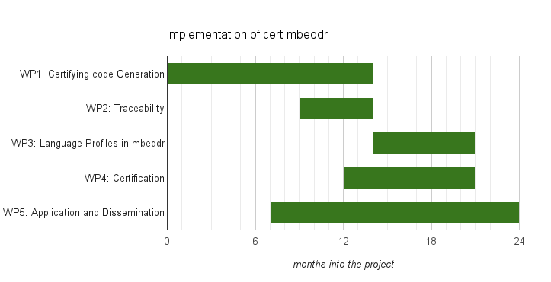
Project Planning (work package view)

Slide 7
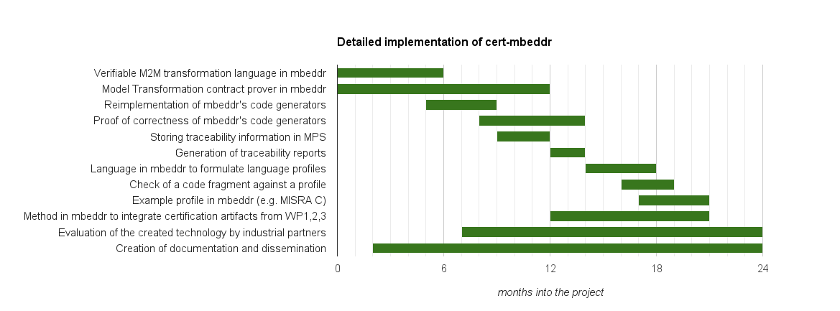
Project Planning (task view)
D1.1
D1.2
D1.3
D1.4
D2.1
D2.2
D3.1
D3.2
D3.3
D4.1
D5.1
D5.2

Slide 8
Strategic Relevance of cert-mbeddr
mbeddr addresses core topics of fortiss’ profile:
Support for code-centric development as targeted by CCE@fortiss (Center for Code Excellence)
Focus on dependability of systems as an over-arching fortiss-theme
Tailor-made DSL-extentions of programming languages specifically relevant for SMEs
Notes:
Project based on existing needs and on existing (model-driven based development) technology, that can be bring a plus value to the development process.
Looking forward to hearing your opinion on it.

Slide 9
Thank you!

