Slide 1


cert-mbeddr
Building Certified
Embedded Software in C
Levi Lúcio and Vincent Aravantinos

Slide 2







Motivation
mbeddr is gaining momentum in the industry. Itemis AG is currently
building proprietary extensions to mbeddr to support data-flow modeling (Simulink-like) and Ontologies.
Other companies that are currently either using or evaluating mbeddr
Industrial engine control
Robot control DSLs
Prototype satellite onboard software
Prototype drill machine control software
Data structure modeling
Control of stable automation system

Slide 3


Objective
However, the guarantees that mbeddr’s generated C code is correct are
currently not enough for mbeddr’s industrial users.
We propose making use of mbeddr’s native capabilities to allow the creation, maintenance and reuse of convincing technical and logical arguments that support the claim that the C code produced using the
mbeddr front-end is certified to be correct.

Slide 4
Method
Build multiple mbeddr-based technical certification arguments:
WP1: Contract-based code generation correctness
WP2: Traceability reports (requirements down to C code)
WP3: Profiles making code comply to industrial standards
WP4: Integrate all these technical arguments into a logical certification argument of the C code generated by mbeddr

Slide 5
Project Management
Project Duration: 2 years
Developers
Industrial Partners
and financing
fortiss
Levi Lúcio (1/2 time)
Research staff member (1/2 time)
M.Sc. student
HiWi student
itemis
Markus Voelter
the mbeddr team
itemis (€4000)
Siemens (€5000)
OHB (Aerospace) (financing possible in the future)
Academic Partners
Bentley Oakes (McGill University)
Cláudio Gomes (University of Antwerp)

Slide 6
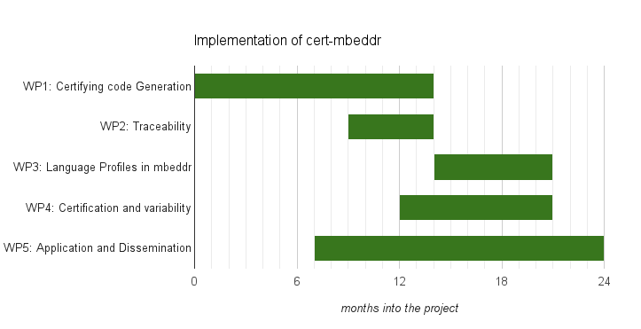
Project Planning (work package view)

Slide 7
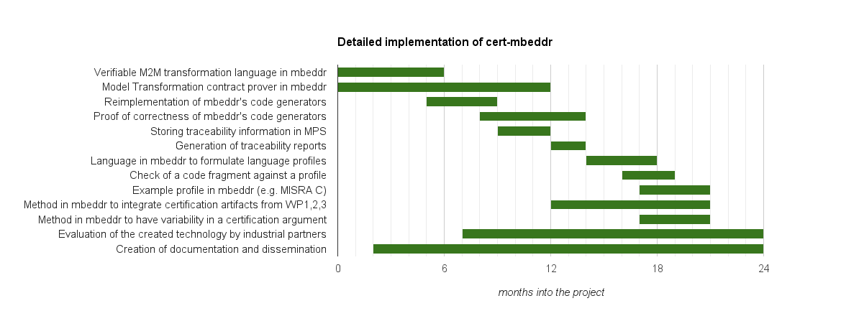
Project Planning (task view)
D1.1
D1.2
D1.3
D1.4
D2.1
D2.2
D3.1
D3.2
D3.3
D4.1
D4.2
D5.1
D5.2

