Slide 1

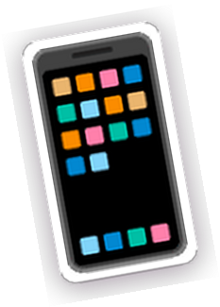



















drop photo

Slide 2















drop photo
I'm a creative and marketing enthusiast with experience in content creation, social media, graphic design, event management, and brand partnerships.
With a background in agricultural community development, I've had the opportunity to work across different environments—from student organizations and research projects to building a wellness community through Sawala Space.
I enjoy turning ideas into clear, engaging, and purposeful creative work.

Slide 3
























Content creation · social media · copywriting
Graphic design · visual communication · campaign materials
Campaign development · event management · brand partnerships
Community engagement · collaboration · project coordination

Slide 4







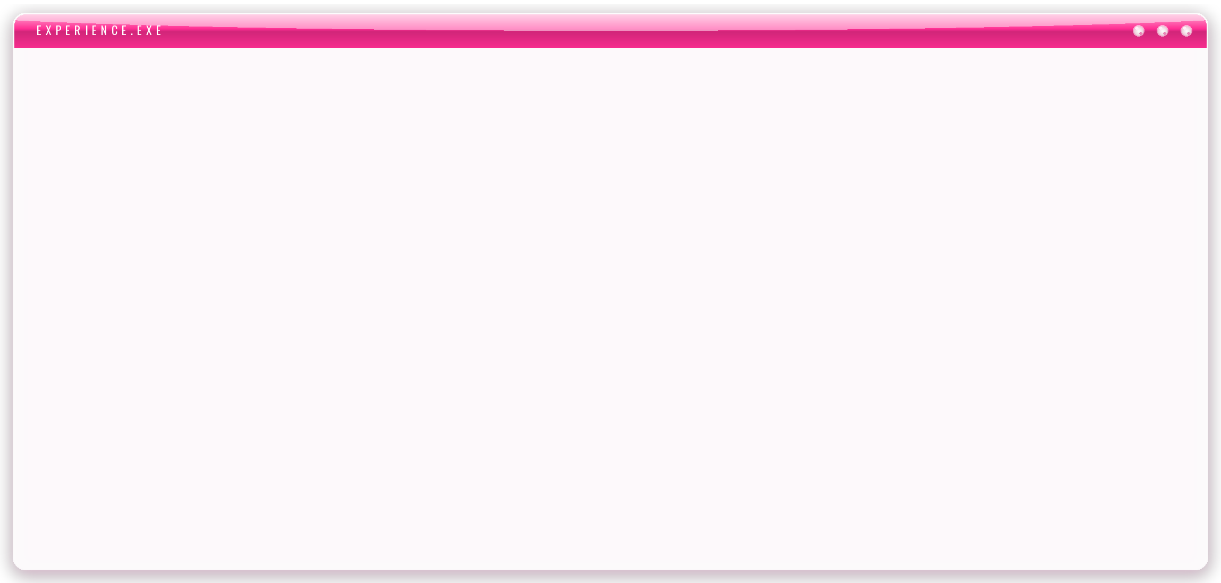











Co-Founder · Creative & Marketing
Intern · Administration & Partnership Support
Research Assistant
Intern · Agriculture & Content Creation
Head of Media & Branding

Slide 5


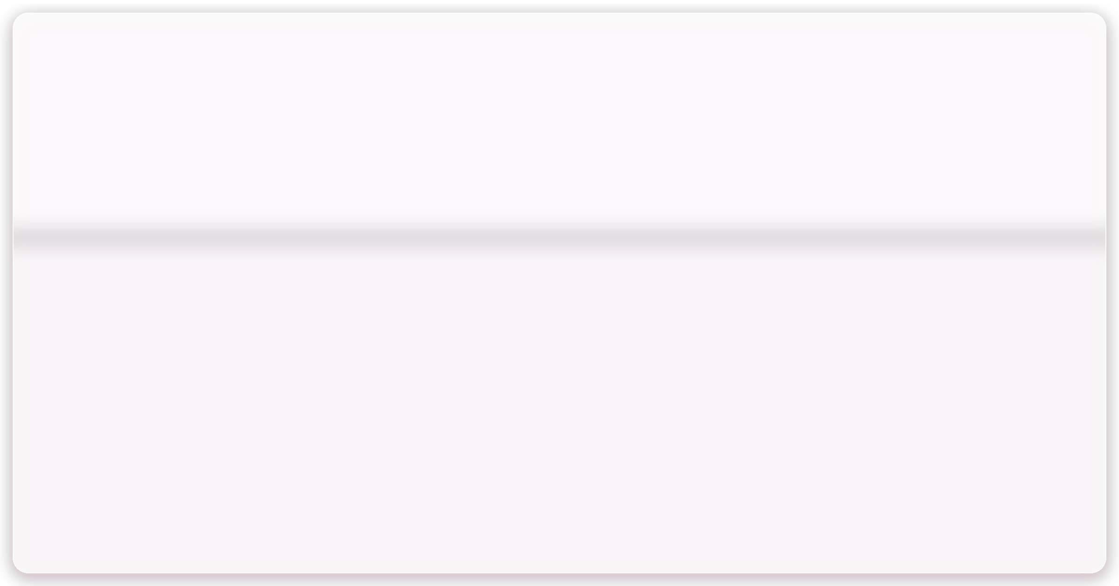





















drop photo
As a co-founder, I contribute to the creative and marketing side of Sawala Space, from developing event concepts and promotional content to managing brand partnerships and supporting event execution.
drop photo
drop photo

Slide 6


















A selection of social media content, event materials, promotional visuals, and other creative work I've developed across different projects.
drop photo
drop photo
drop photo
drop photo
drop photo
drop photo
drop photo
drop photo

Slide 7




















drop photo
drop photo
A wellness event combining movement, community, and support for animal welfare.
Campaign concept
drop photo
Event promotion
Social media content
Partnership communication
Event coordination

Slide 8













My creative experience also grew through student organizations, academic projects, and collaborative work.
HIMPUNAN MAHASISWA PPP
PEKAN SENI BUDAYA IPB
ACADEMIC & RESEARCH PROJECTS
Head of Media & Branding
Vice Head / Staff DKV
Visual communication · presentation · documentation

Slide 9


































Graphic Design
Social Media
Copywriting
Campaign Development
Content Creation
Event Management
Visual Communication
Partnership

Slide 10



















Thank you for taking the time to explore my work. I'm always open to new creative opportunities, collaborations, and projects.
+62 8xx-xxxx-xxxx
hello@email.com
linkedin.com/in/username

