Slide 1
The Sentinel Firewall
Safe-product substitution as a high-return lead exposure intervention David I. Levine

Slide 2
Talk Roadmap
Lead exposure: why economists should care
Why informal consumer products create a policy problem
The Sentinel Firewall idea
Economic model and main assumptions
Results and uncertainty
What the tool lets ministries, NGOs and researchers do locally

Slide 3
Why Lead Matters
Lead is a neurotoxin with no known safe threshold for children.
The biggest losses are often invisible: cognition, learning, behaviour, adult productivity.
Adult cardiovascular disease is also important, but this talk focuses mainly on child cognition and earnings.
Exposure during pregnancy and early childhood is especially damaging because the brain is developing rapidly.

Slide 4
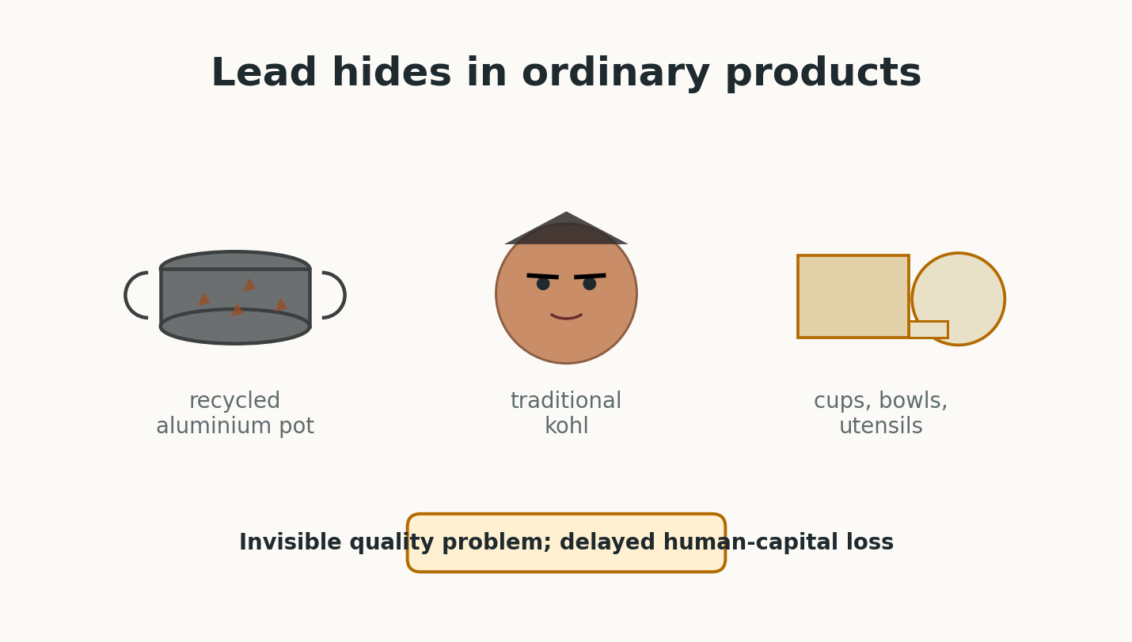
The Post-Gasoline Lead Problem
Rich countries largely reduced lead through gasoline, paint and formal-sector regulation.
Many LMIC exposures now come from harder-to-regulate sources:
artisanal aluminium cookware made from mixed scrap
traditional cosmetics such as kohl, kajal or surma
lead-contaminated ceramics, cups, bowls and utensils
These products are ordinary household goods, not obvious “industrial pollution” to consumers.
Common informal lead sources

Slide 5
Why This Is an Economics Problem
Households often cannot observe lead content or delayed cognitive harm.
Informal producers may not internalise downstream health and productivity losses.
Regulators may not know which products or supply chains are dangerous.
The key market failure is not only pollution; it is hidden product quality plus delayed human-capital damage.

Slide 6
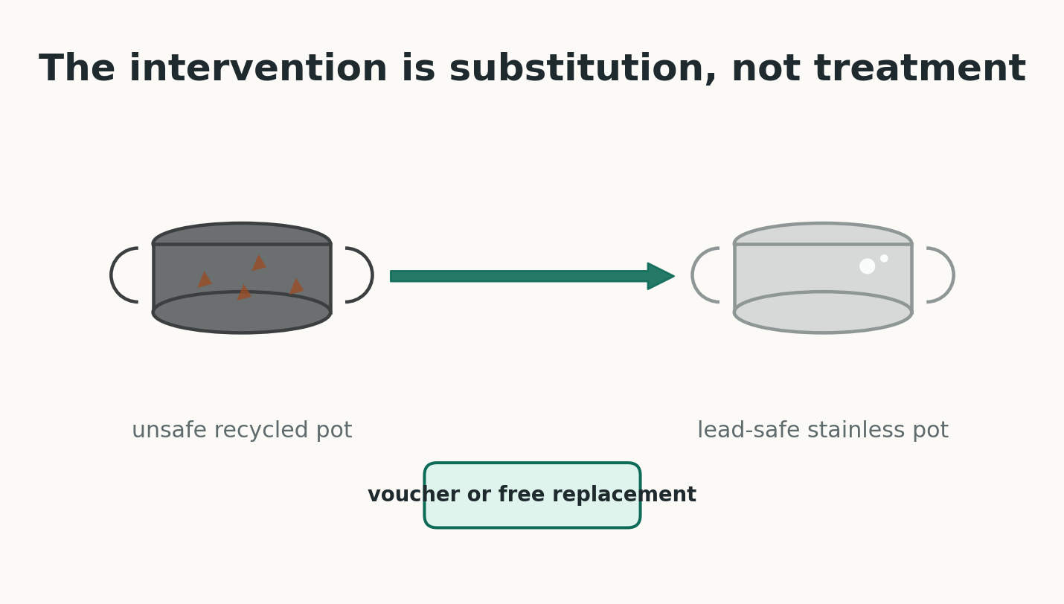
Policy Gap
First-best policy: remove lead from products and supply chains.
But enforcement and industrial upgrading can be slow.
Pregnant women and infants are exposed now.
Question: can health systems create a temporary consumer firewall while regulation catches up?
Unsafe recycled pot replaced by lead-safe stainless steel pot

Slide 7
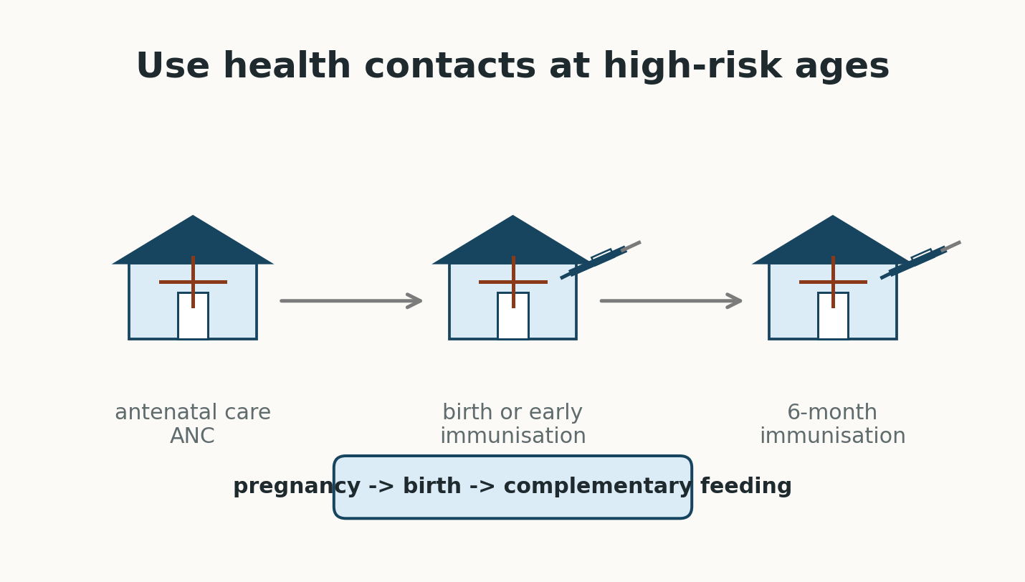
Sentinel Firewall
Use sentinel screening to identify high-risk districts or catchments.
Deploy modular safe-product packages through existing maternal and child health contacts.
Use uptake, surrendered products and biomonitoring to inform enforcement.
This is harm reduction, not a substitute for eliminating lead from production.
Maternal and child health contact points

Slide 8
Modelled Packages
Kitchen Package:
ANC voucher for a lead-safe cooking pot
ANC calcium supplements
safe child feeding utensils at immunisation
Kohl Package:
safe maternal kohl through ANC
safe infant kohl through facility delivery or early-immunisation catch-up

Slide 9
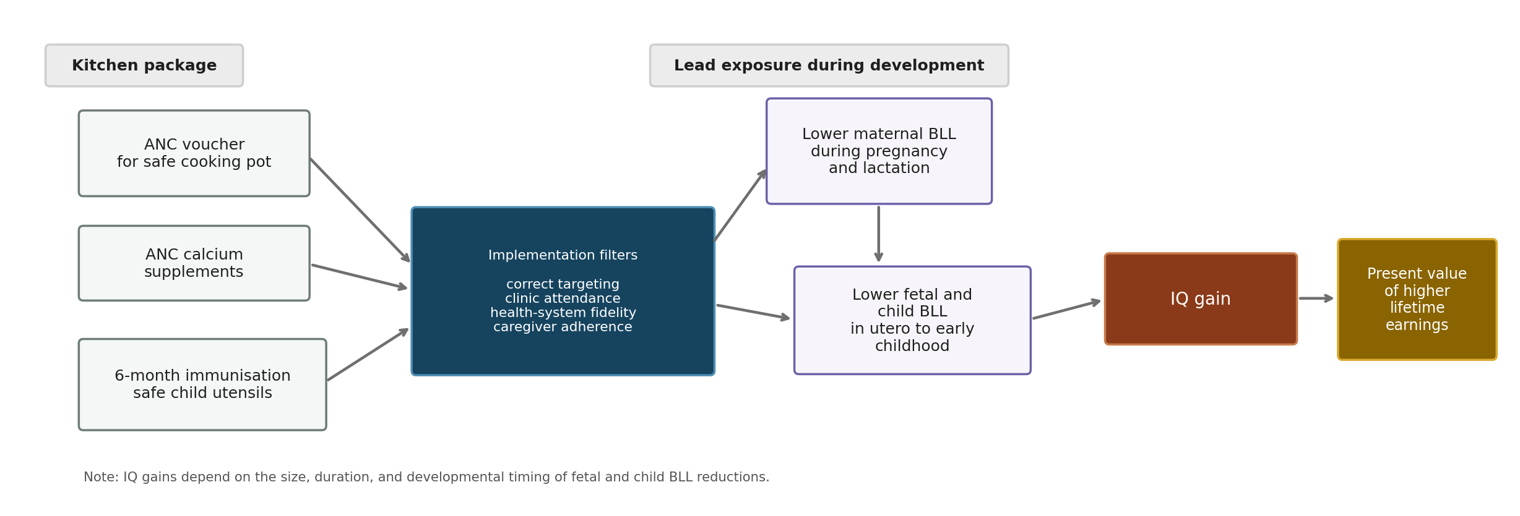
Pathway For The Kitchen Package
Kitchen package cognition pathway

Slide 10
Economic Model
Unit: mother-child pair in a targeted high-risk setting.
Costs: product costs, counselling, distribution, programme overhead and fixed screening cost per birth.
Benefits: child IQ gains mapped to lifetime earnings; maternal/neonatal and adult CVD benefits are secondary extensions.
Main output: benefit-cost ratio.

Slide 11
Earnings Channel
Present value of lifetime earnings:
productivity = GDP PPP per capita x labour share of national income
year-by-year survival from birth to adulthood and through working life
real growth and social discounting
Lead channel:
lower BLL -> IQ gain -> higher lifetime earnings

Slide 12
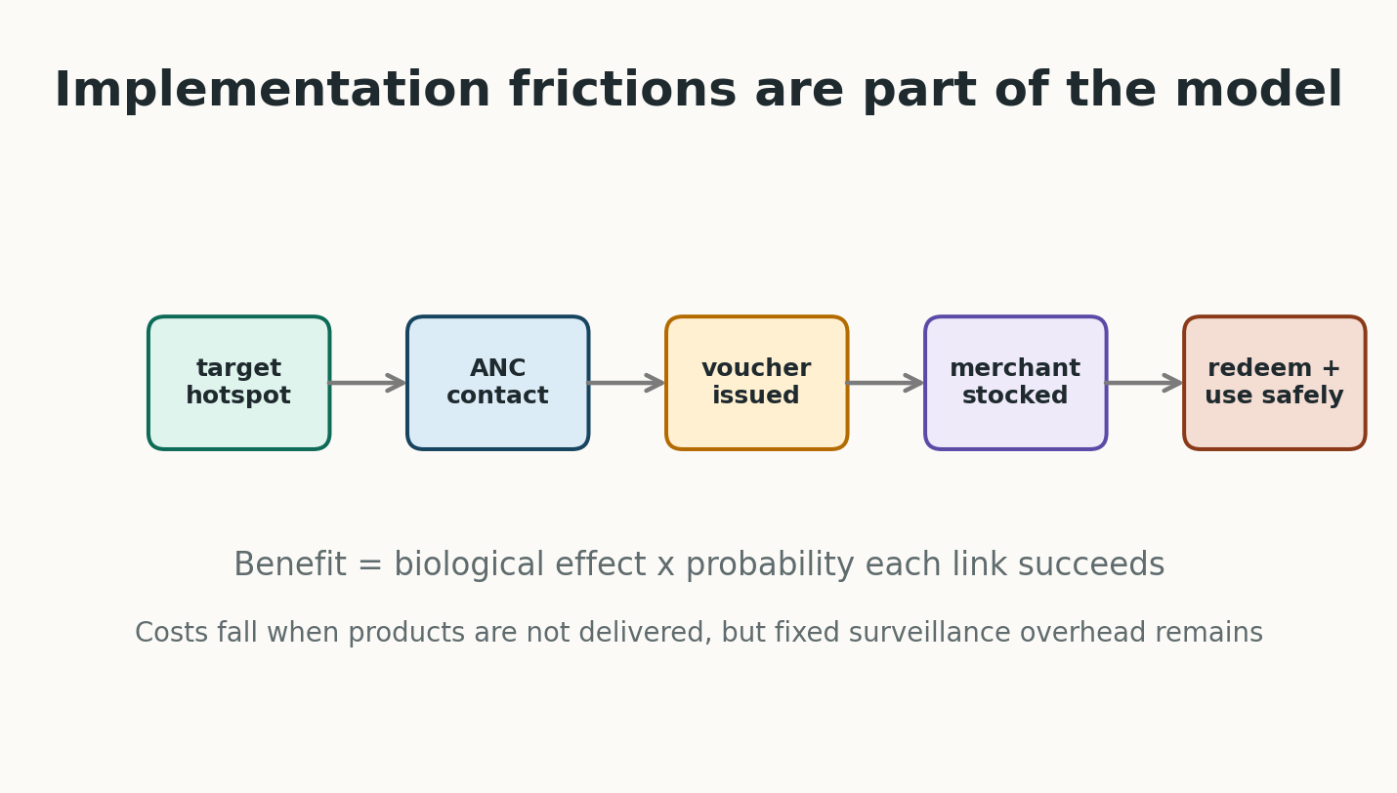
Why The Model Is Conservative In Spirit
It does not assume every targeted household benefits.
Benefits are attenuated by:
hazardous product prevalence
ANC, delivery or immunisation contact
health-system fidelity
voucher issuance, merchant stock and redemption for pots
caregiver adherence and residual unsafe use
developmental timing: a one-year intervention does not equal lifelong exposure removal
Voucher implementation chain

Slide 13
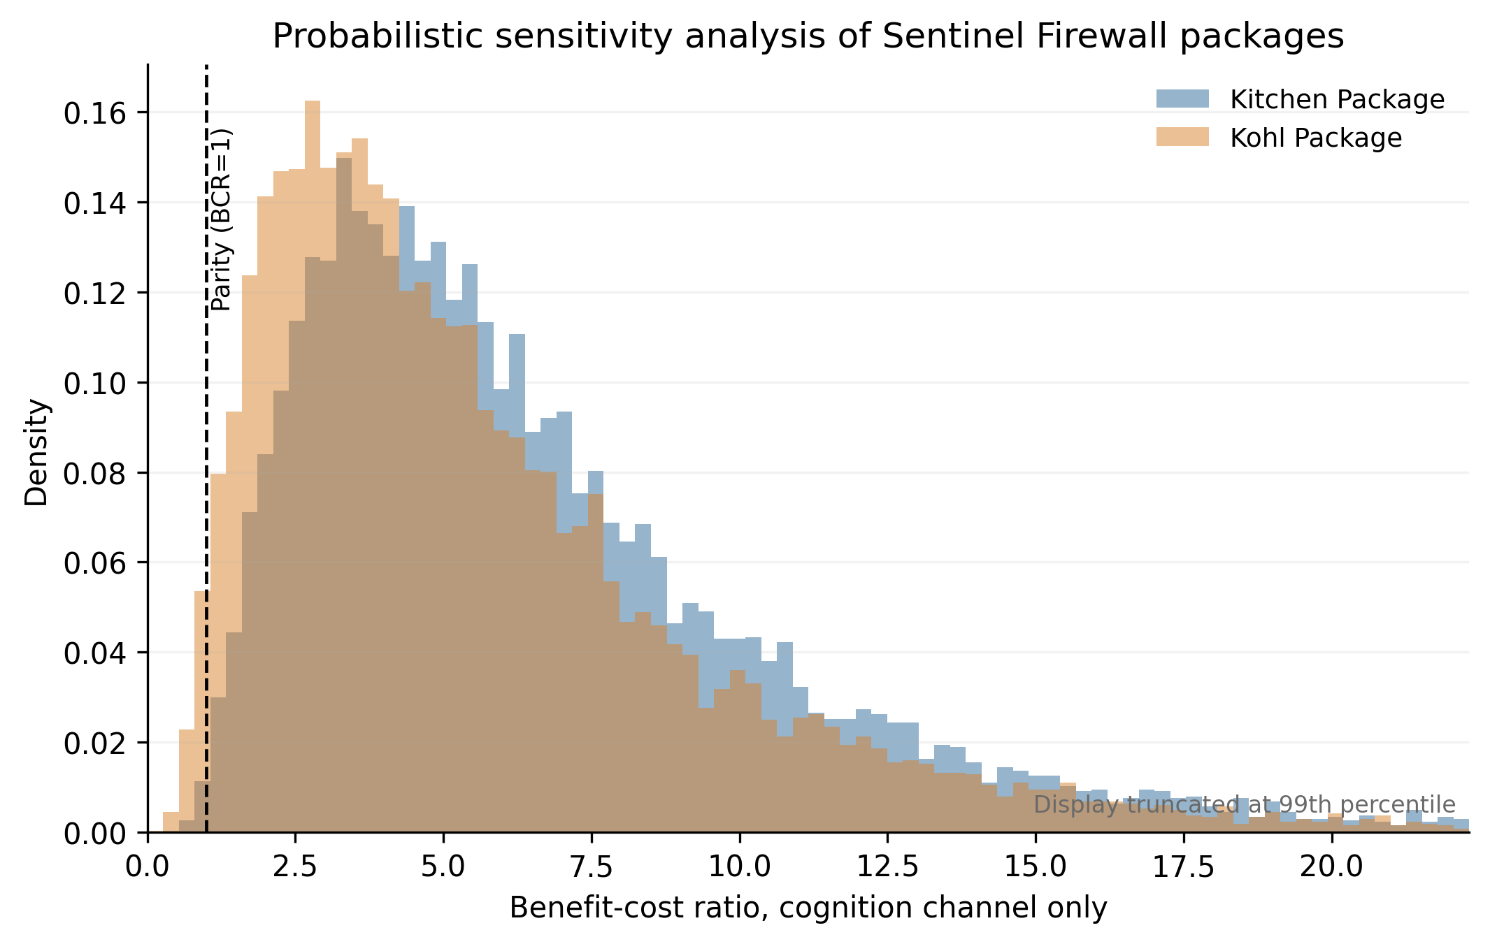
Main Results
BCR distributions

Slide 14
Result Magnitudes
Kitchen Package cognition BCR:
median 5.59
5th-95th percentile range 1.99 to 14.92
0.32% of simulations below parity
Kohl Package cognition BCR:
median 4.64
5th-95th percentile range 1.45 to 13.93
1.45% below parity

Slide 15
Interpretation For Economists
These are not universal LMIC estimates.
They are a demonstration using plausible LMIC values in settings where the hazardous product is common.
The high returns come from a large human-capital externality relative to low substitution costs.
The uncertainty is real, but much of it is measurable in pilots.

Slide 16
What Drives The Results?
Product-specific BLL reduction: does the product really matter locally?
Prevalence: are we targeting a true hotspot?
Implementation: does the health system deliver and do households use the safe good?
BLL-to-IQ and IQ-to-earnings parameters
Discounting and local productivity

Slide 17
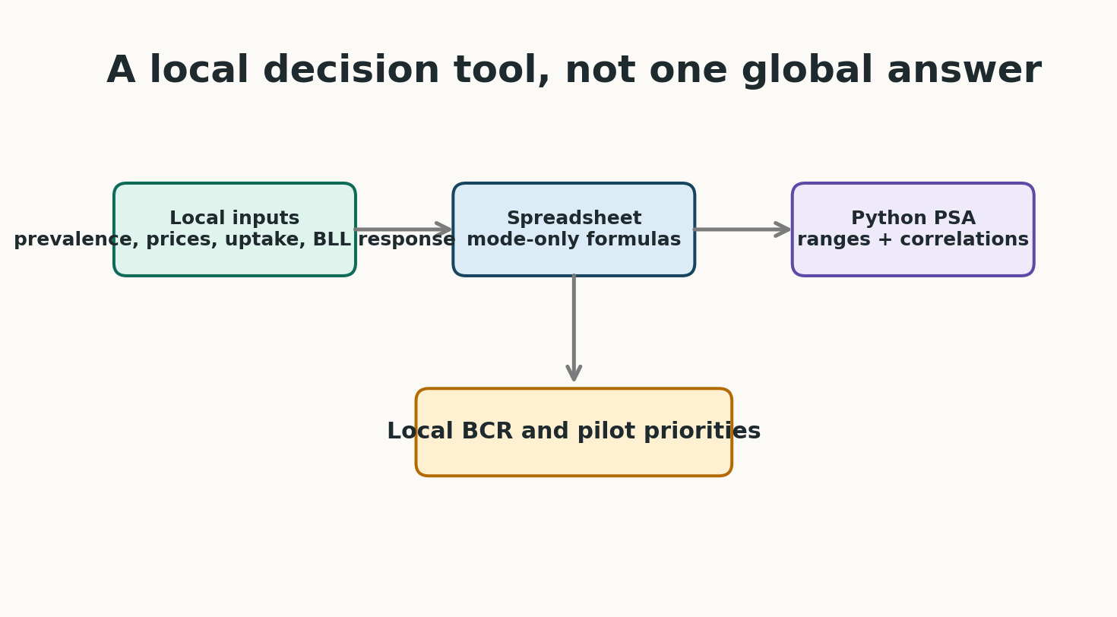
Local Adaptation Tool
The Python model runs the full probabilistic sensitivity analysis.
The Excel/Google Sheets version is a deterministic mode-only tool.
Local users can change:
product prevalence
product prices
attendance and fidelity
redemption and use
expected BLL response
productivity and discounting
Local adaptation workflow

Slide 18
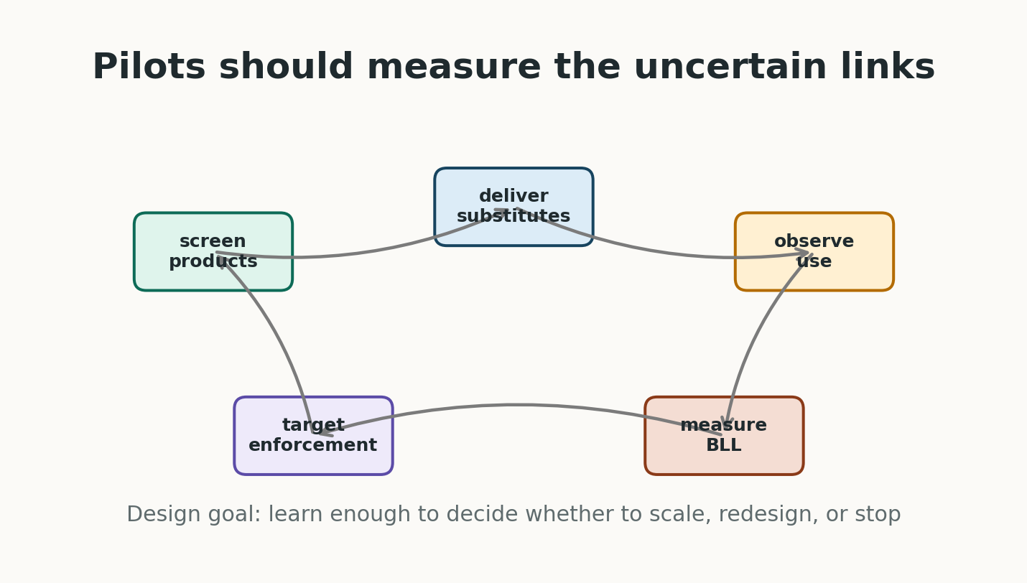
What A Pilot Should Measure
Baseline product contamination and household use
Voucher issuance and redemption
Merchant stock and prices
Sustained use by pregnant women and young children
Residual use of unsafe products
Measured child or maternal BLL response
Pilot measurement and learning loop

Slide 19
Contribution
Reframes lead control as a targeted human-capital investment.
Connects environmental health, maternal-child health platforms and benefit-cost analysis.
Makes assumptions transparent enough to challenge.
Provides code and spreadsheet tools so local teams can decide whether substitution is attractive in their own setting.

Slide 20
Selected References
Lanphear et al. 2005; Canfield et al. 2003; Jusko et al. 2008 on lead and cognition.
Crawfurd et al. 2025 on lead and learning in developing countries.
Ozawa et al. 2022; Grosse et al. 2002; Hanushek and Woessmann 2008 on cognition and earnings.
Weidenhamer et al. 2014, 2023 and Sargsyan et al. 2024 on contaminated products.
Larsen and Sanchez-Triana 2023 on global lead burden and costs.

Slide 21
Discussion
Where would substitution be most attractive?
What parameter would you most want to identify causally?
Should the first pilot randomise vouchers, prices or information?
How should we value cognition gains in largely informal labour markets?

