Slide 1

UNDERSTANDING MICROSERVICES
Ervin Capar, Marko Marinkovic
Novi Sad, 2024

Slide 2
01Common software architecture
AGENDA
02Microservices architecture
04Docker
pattern
03Liquibase
05Splitting of monolithic application to microservices
2

Slide 3
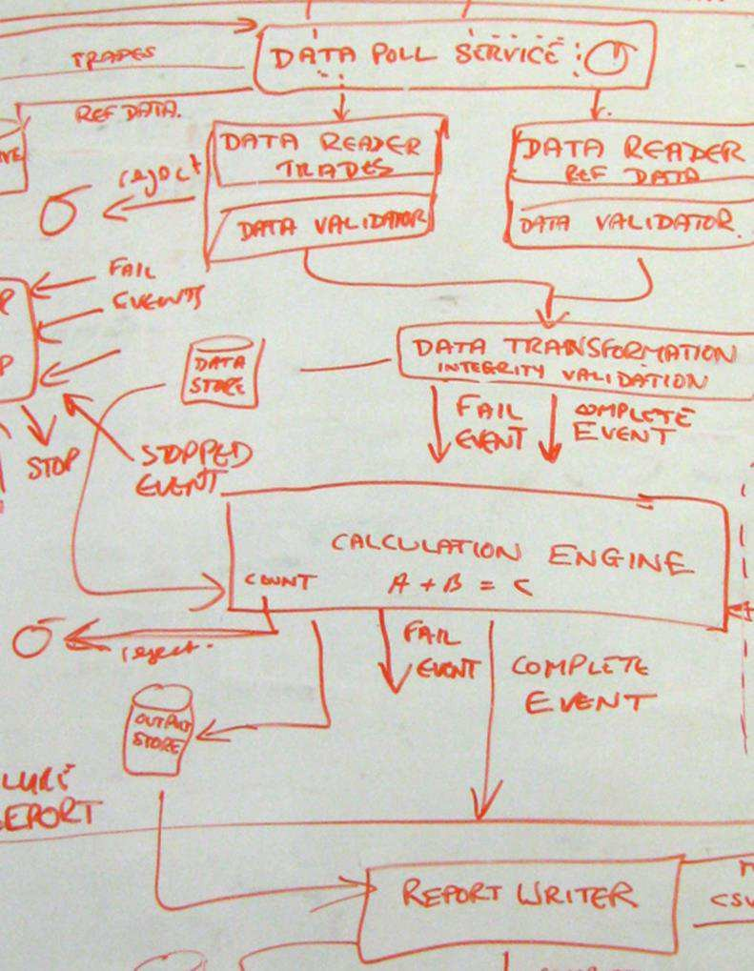
01
COMMON
SOFTWARE
ARCHITECTURE PATTERNS
3

Slide 4
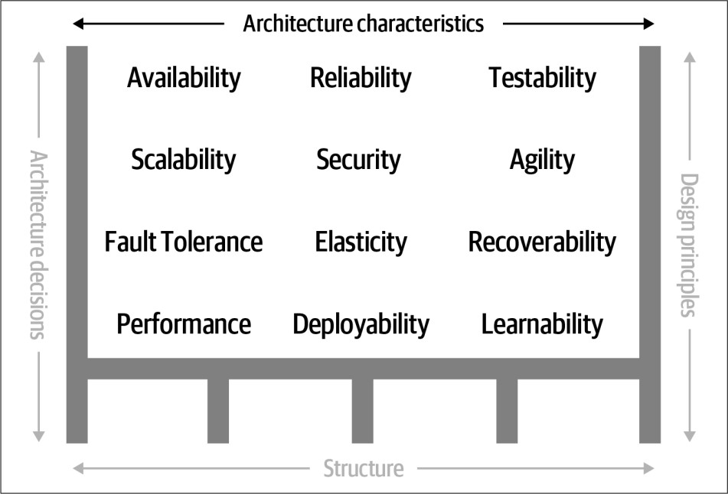
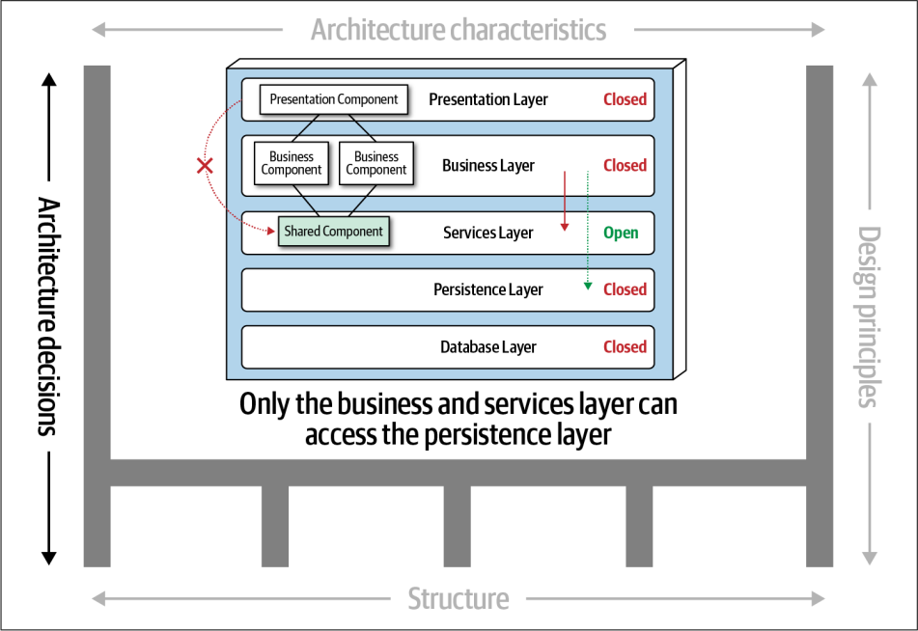
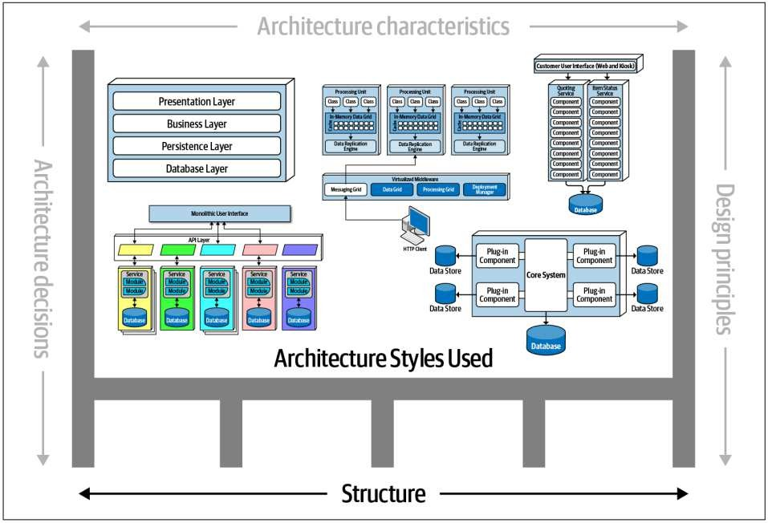
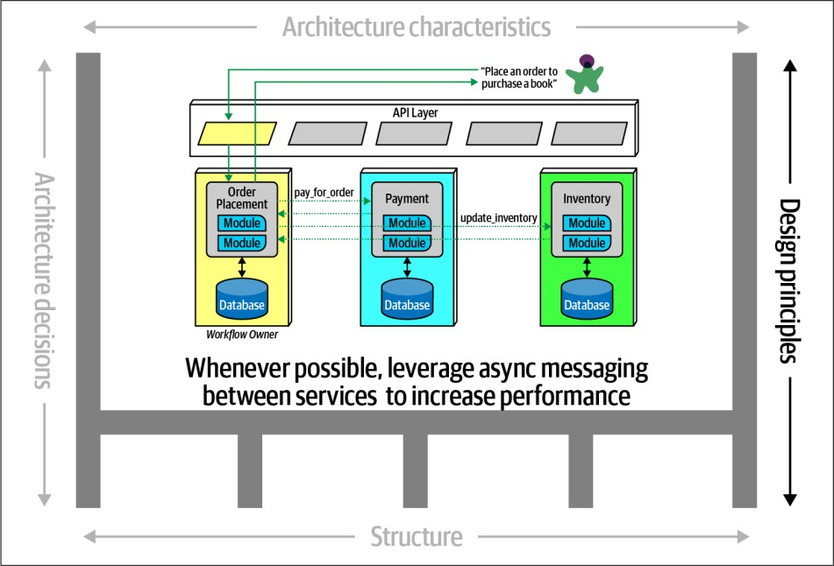
DEFINING SOFTWARE ARCHITECTURE
4
Fundamentals of Software Architecture: An Engineering Approach, Neal Ford and Mark Richards

Slide 5

COMMON SOFTWARE ARCHITECTURE PATTERNS
Monolithic
Layered (n-tier) architecture
Modular monolith
Microkernel architecture
Distributed
Event-driven architecture
Space-based architecture
Microservices architecture
Service-oriented architecture
Service-based architecture
5
Fundamentals of Software Architecture: An Engineering Approach, Neal Ford and Mark Richards

Slide 6
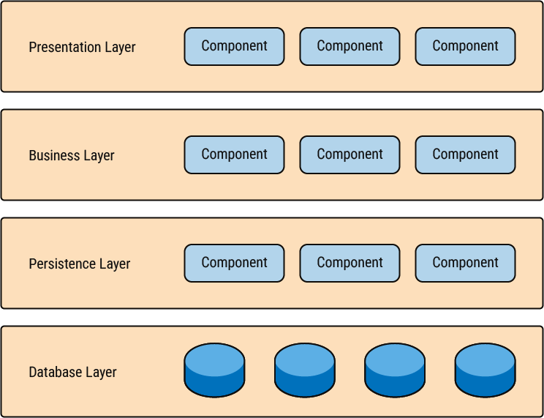
LAYERED (N-TIER) ARCHITECTURE
PROS:
Inexpensive architecture, suitable for projects with budget and time constraints
Familiar and easy to implement
Effective when most changes are technical-based
CONS:
Layer isolation, which is an important goal for the architecture, can also make it hard to understand the architecture without understanding every module.
Inefficient when most changes are domain-based, as changes must be applied across all layers.
Coders can skip past layers to create tight coupling and produce a logical mess full of complex interdependencies.
Monolithic deployment - small changes can require a complete redeployment of the application
Slow time to market
Single deployment unit
Organized into horizontal layers
Each layer performing a specific role within the application
6

Slide 7
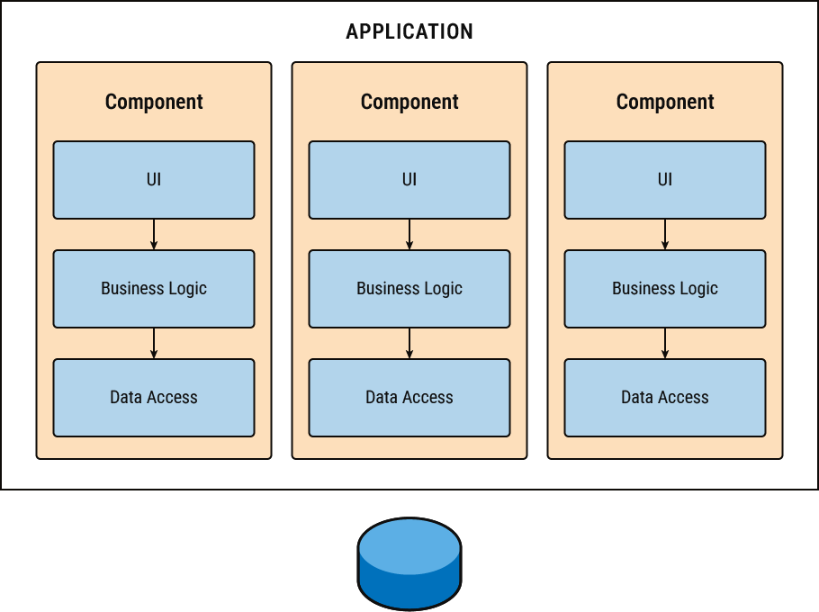
MODULAR MONOLITH
PROS:
Inexpensive architecture, suitable for projects with budget and time constraints
Effective when most changes are domain-based
CONS:
Poor fit for systems requiring high elasticity, scalability, or fault tolerance
Challenging if most changes are technical in nature(e.g., frequent UI or database changes)
Monolithic deployment - small changes can require a complete redeployment of the application
Slow time to market
Single deployment unit
Functionality is grouped by domain areas, e.g., inventory management, payment and billing
7

Slide 8
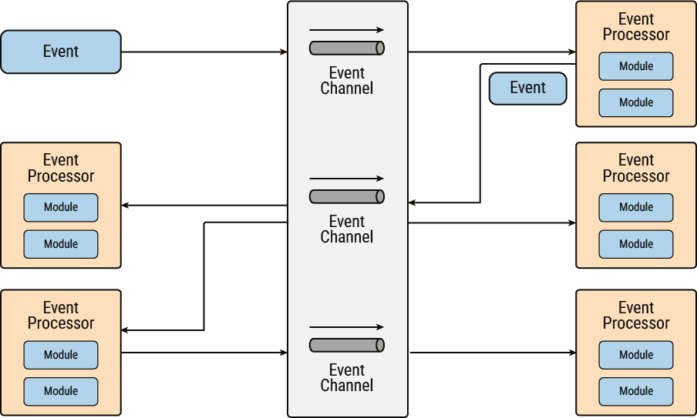
EVENT-DRIVEN ARCHITECTURE
PROS:
Ideal for systems requiring high performance due to asynchronous processing and parallel execution
Excellent for scalable and elastic systems
Fault tolerance
Effective for domains where events trigger multiple subsequent actions
CONS:
Event-driven systems can be complex to design, implement, and test
Difficult to ensure tight control over the ordering of events
If most processing needs to be synchronous event-driven architecture may not be the best fit
Asynchronous and parallel processing
System responds to events rather than direct requests
Two general categories:
Mediator - orchestrate with a central mediator
Broker topology - chain simple events
8

Slide 9
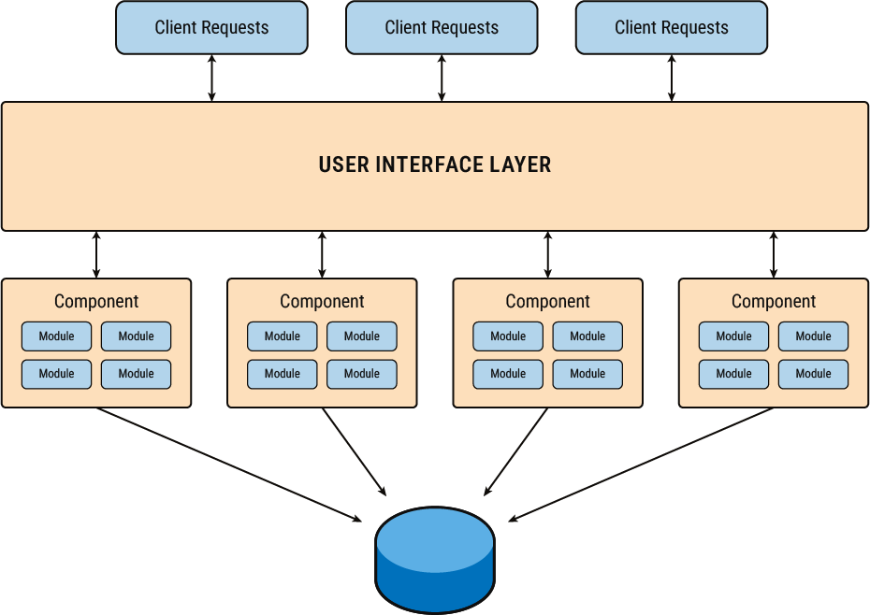
SERVICE-BASED ARCHITECTURE
PROS:
Agility
Deployment
Testability
Can handle systems with a monolithic database that is difficult to break apart
CONS:
Slower response to immediate high loads compared to microservices
Inefficient for systems with high semantic coupling between domains due to excessive inter-service communication
Independent domains deployed as separate units of software.
Services can share a single database, making this suitable for systems with monolithic databases
9

Slide 10










MODULAR MONOLITH ARCHITECTURE
EVENT-DRIVEN
ARCHITECTURE
SERVICE-BASED
ARCHITECTURE
New applications that need to be built quickly
Effective when most changes are domain-based
Suitable for projects with budget constraints
Allows domain changes to be managed by a single team
Applications that have asynchronous data flow systems
Complex applications requiring seamless data flow or those applications that would eventually grow
Ideal for systems requiring high performance
Ideal for systems with well-defined domains that do not heavily interact
Suitable for environments requiring high agility and fast time to market
Useful as a migration target towards microservices
Not suitable for environments requiring rapid time to market
Poor fit for systems requiring high elasticity, scalability, or fault tolerance
Not well suited for transactional support - event processor components are highly decoupled and distributed
Inefficient for systems with high semantic coupling between domains due to excessive inter-service communication

Slide 11
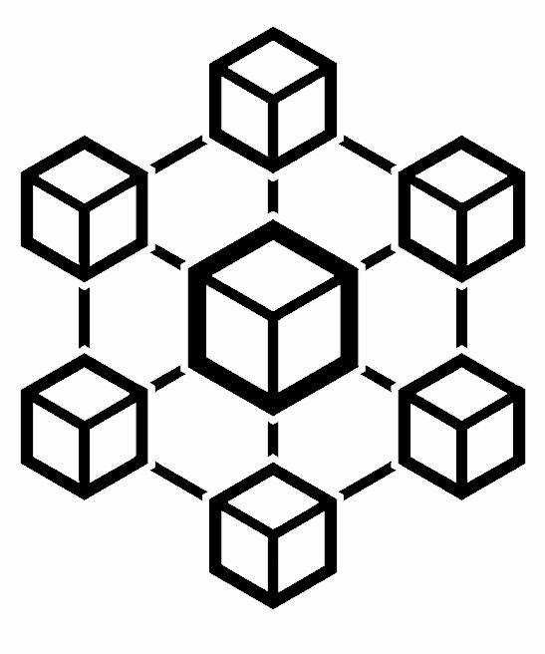
02
MICROSERVICES ARCHITECTURE
11

Slide 12

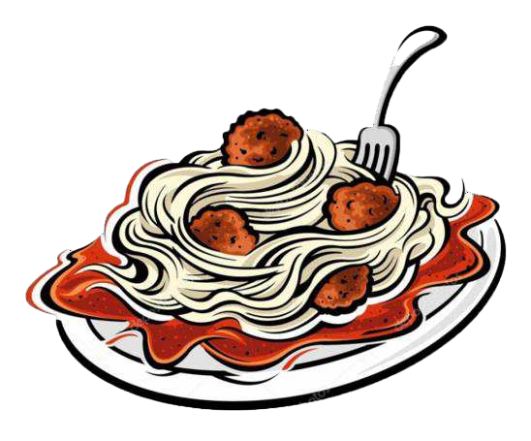

MOTIVATION
Majestic App
Majestic App
Codebases grow as we write code to add new features.
Tightly coupled code
Business logic all over the place
Fixing bugs and adding new features becomes more difficult
Big Bang releases
Harder for understanding
FRONTEND
FRONTEND
BACKEND
BACKEND
DATABASE
DATABASE

Slide 13
MOTIVATION RESULT
MONOLITH
MICROSERVICES

Slide 14
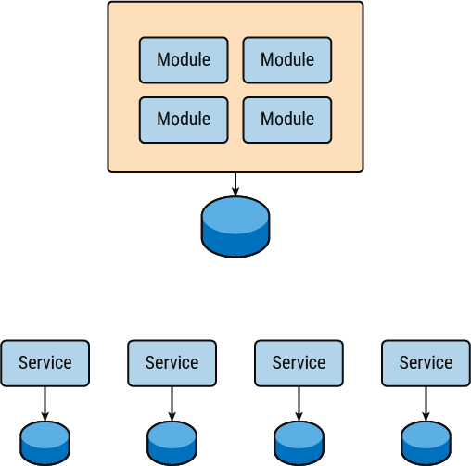
FROM MONOLITH TO MICROSERVICES
Not all monolithic architectures are large, unmanageable, and tightly coupled systems (“big ball of mud” or “spaghetti code”)
With thoughtful design, it is possible to create modular monoliths that are well-structured and maintainable
A well-defined, modular monolith can be easier to maintain, evolve, and migrate to microservices

Slide 15
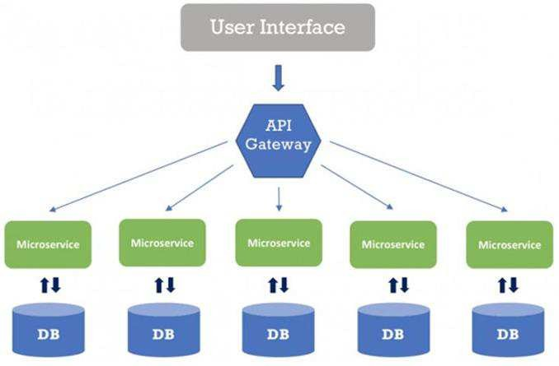
MICROSERVICES - DEFINITION
Small and Focused on Doing One Thing Well
Characteristics of Microservices
Breaking down software into components, which are independently replaceable and upgradable
Services in a microservice architecture are often processes that communicate over a network to fulfill a goal using technology-agnostic protocols (e.g., HTTP)
Organization around business capabilities
Services are implemented using different programming languages, databases, hardware, and software environments
Independently deployable and released with automated processes
Decentralized data management: Each service is responsible for its own data and persistence
https://martinfowler.com/articles/microservices.html

Slide 16









BENEFITS
Modularity
Scalability
Integration
Heterogeneity
Microservices are considered a viable means for modernizing existing monolithic software applications.
We can decide to use different technologies inside each one.
This allows us to pick the right tool for each job, rather than having to select a standardized approach that often ends up being the lowest common denominator.
This makes the application
Microservices are implemented and deployed independently of each other (they run within independent processes) - they can be monitored and scaled independently.
easier to understand, develop,
test, and become more resilient
to architecture erosion.
This benefit is often argued in comparison to the complexity of monolithic architectures.
The process for Software
modernization of legacy
applications is done using an
incremental approach.
Resilience
Deployment
Distributed development
Replaceability
We can make a change to a single service and deploy it independently of the rest of the system – faster deployment.
If a problem does occur, it can be isolated quickly to an individual service, making fast rollback easy to achieve.
Teams working on smaller
If one component of a system fails, but that failure doesn’t cascade, you can isolate the problem and the rest of the system can carry on working.
codebases tend to be more productive.
Microservices allow us to better
With our individual services
being small in size, the cost to
replace them with a better
align our architecture to our organization by minimizing the number of people working on any codebase.
implementation, or even
delete them altogether, is much
easier to manage.
16

Slide 17
CRITICISM AND CONCERNS
Communication between services can be complex
More services equals more resources
Testing
Debugging
Difficult to manage many services
17

Slide 18
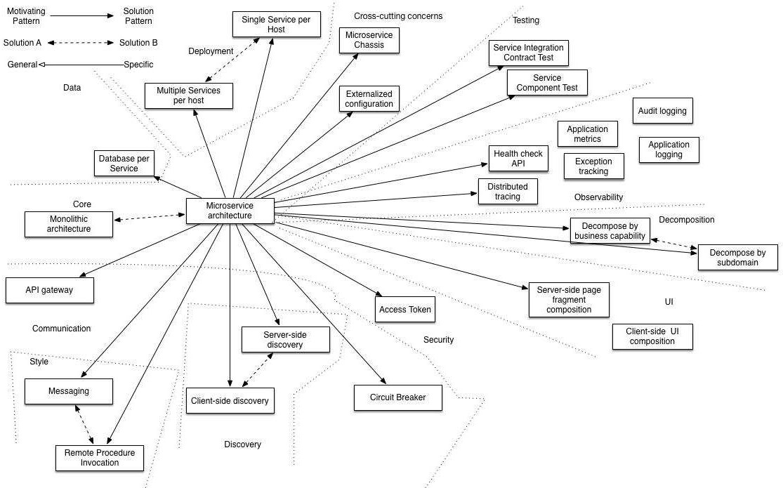
MICROSERVICE PATTERNS
18
https://microservices.io/patterns/microservices.html

Slide 19
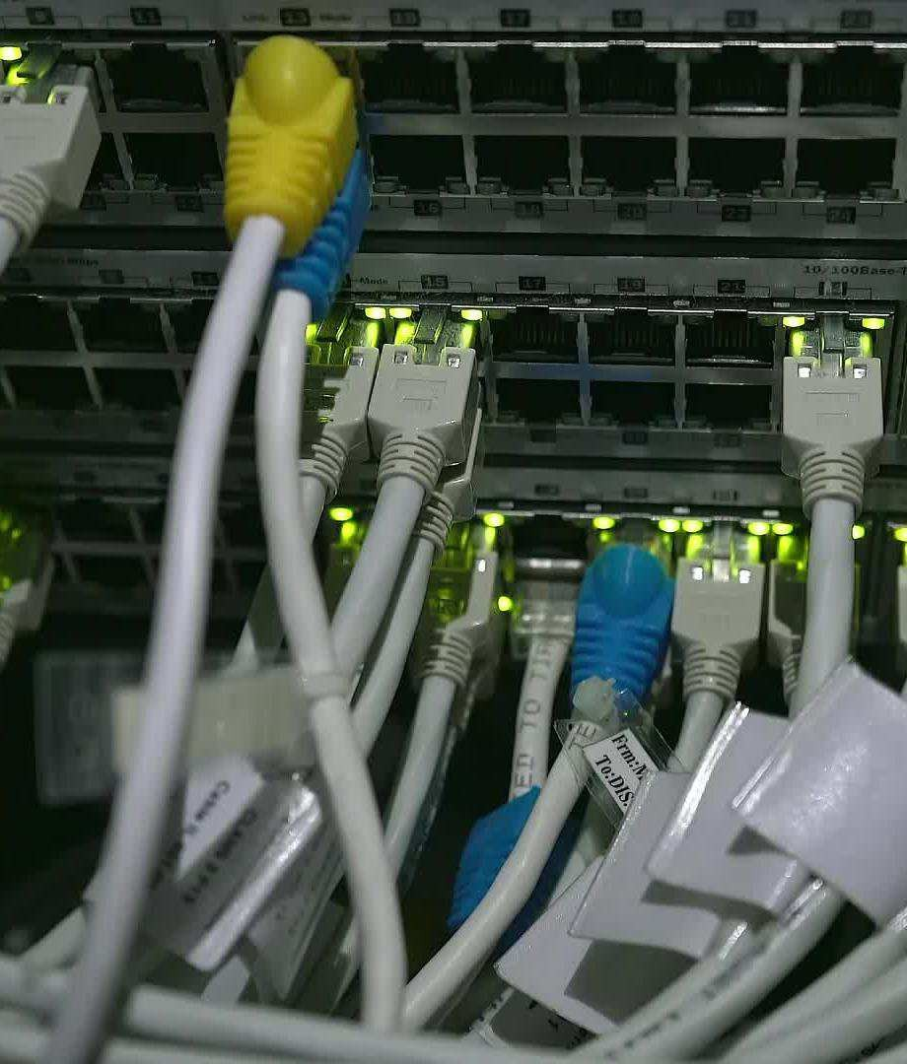
SERVICE COMMUNICATION
Synchronous communication
http – rest
Asynchronous communication
messaging
19

Slide 20
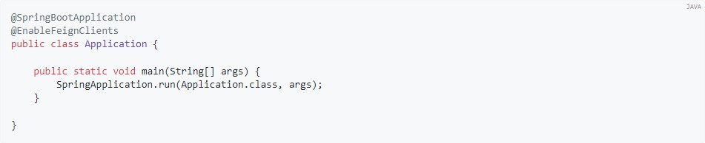
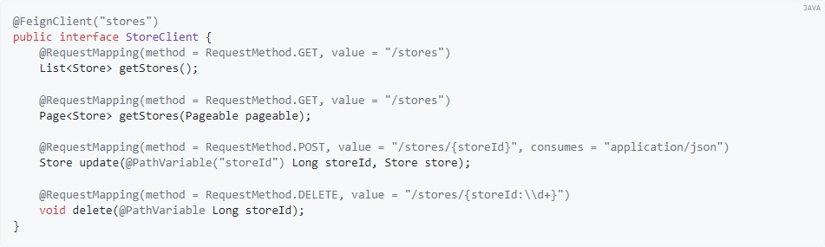
REST (FEIGN CLIENT, REST TEMPLATE)
20
https://docs.spring.io/spring-cloud-openfeign/docs/current/reference/html/

Slide 21
MESSAGING (RABBITMQ)
Add dependency to project pom.xml
<dependencies>
<dependency>
<groupId>org.springframework.boot</groupId>
<artifactId>spring-boot-starter-amqp</artifactId>
<version>3.1.0</version>
</dependency>
</dependencies>
Add application properties
spring.rabbitmq.port is used to specify the port to which the client should connect, and defaults to 5672.
spring.rabbitmq.username is used to specify the (optional) username.
spring.rabbitmq.password is used to specify the (optional) password.
spring.rabbitmq.host is used to specify the host, and defaults to localhost.
spring.rabbitmq.virtualHost is used to specify the (optional) virtual host to which the client should connect.
Create queue:
@Bean
public Queue myQueue() {
return new Queue("myQueue", false);
}
Send message:
rabbitTemplate.convertAndSend("myQueue", "Hello world!");
Consume message:
@RabbitListener(queues = "myQueue") public void listen(String in) {
System.out.println("Message read from myQueue : " + in);
}
21

Slide 22
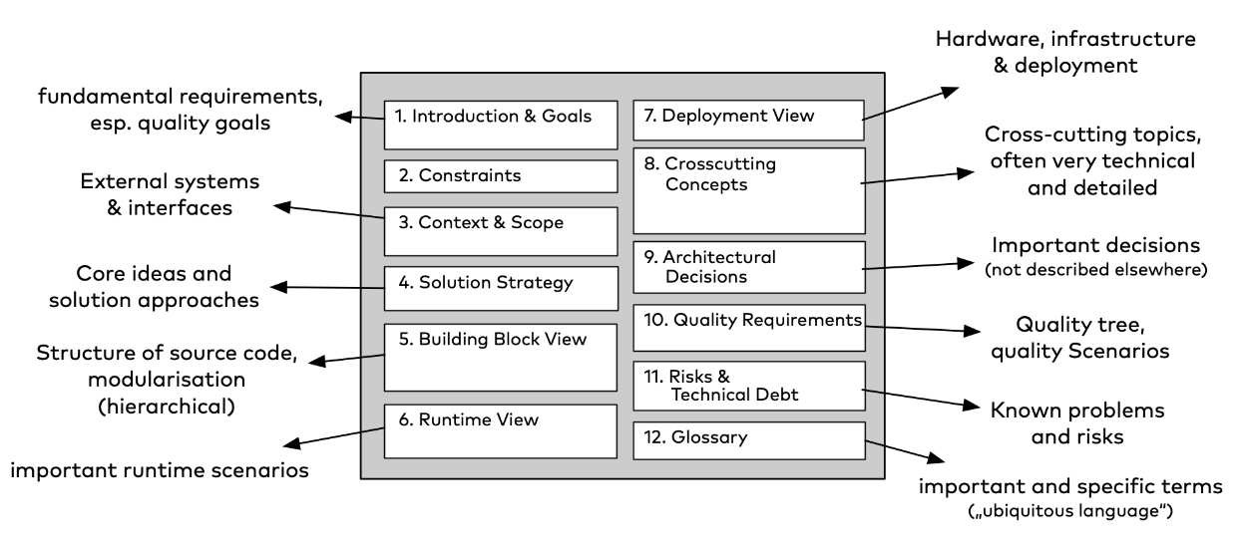
ARCHITECTURE DOCUMENTATION
22
https://arc42.org/overview

Slide 23

03
LIQUIBASE
23

Slide 24
LIQUIBASE
And open source solution for managing revisions of your database schema scripts
Works across different types of SQL databases and supports different file formats for defining DB structure
The most attractive feature of Liquibase is its ability to roll changes back and forward from a
specific point
You don’t need to remember which scripts was executed at which time
Liquibase is doing this for you this out of the box
Tracking the changes using its own tables in schema to ensure consistency and to avoid corruption due to incorrectly altered changelogs
While it's running updates, it puts a "lock" on the database so there is no possibility that by accident two changelogs are run concurrently.

Slide 25
CHANGELOGS
Changelogs are written using domain-specific languages
It can be written in JSON, YAML, XML or one of a few other supported formats.
Consist of a series of changesets
Changeset represents a single change on the database:
Creating a table
Adding a column
Adding an index
Some SQL statements

Slide 26
CHANGELOGS
<databaseChangeLog
xmlns=http://www.liquibase.org/xml/ns/dbchangelog”….>
<changeSet author=”Code9User" id="createTable">
<createTable tableName="app_user">
<column autoIncrement="true" name="id" type="BIGINT">
<constraints primaryKey="true"/>
</column>
<column name="email" type="VARCHAR(255)">
<constraints nullable="false"/>
</column>
….
</createTable>
</changeSet>
</databaseChangeLog>

Slide 27
CHANGELOGS
<databaseChangeLog
xmlns=http://www.liquibase.org/xml/ns/dbchangelog”….>
<changeSet author=”Code9User" id="createTable">
…
</changeSet>
<changeSet author=”Code9User" id=”populateData">
…
</changeSet>
<changeSet author=”Code9User" id=”addIndexToUserTable">
…
</changeSet>
….
</databaseChangeLog>

Slide 28
CHANGELOGS
<databaseChangeLog
xmlns=http://www.liquibase.org/xml/ns/dbchangelog”….>
<include file="com/levi9/code9/db/changelog/createTable.xml”>
<include file="com/levi9/code9/db/changelog/populateData.xml”>
<include file="com/levi9/code9/db/changelog/ addIndexToUserTable.xml”>
…
</databaseChangeLog>

Slide 29
PRECONDITIONS
<databaseChangeLog
xmlns=http://www.liquibase.org/xml/ns/dbchangelog”….>
<changeSet id="addColumn" author="liquibase">
<preConditions onError="MARK_RAN" onFail="MARK_RAN">
<tableExists tableName="person" />
<not>
<columnExists columnName="score" tableName="person" />
</not>
</preConditions>
...
</databaseChangeLog>

Slide 30
HOW LIQUIBASE WORKS
First time when liquibase is run, two tables are created in schema
DATABASECHANGELOG
DATABASECHANGELOGLOCK
--------------------------------------------------------------------------------------------------------------------------------------------------------------------------------
|Id | author | filename | dateexecuted | orderexecuted| exectype | md5sum | description |
+---------------+-----------------+---------------------+----------------------------------------+------------------+-------------+------------+-----------------------+
|createTable | Code9User | createTable.xml | 2021-05-24 09:17:05.270418 | 1 | EXECUTED | 8:aa1….| Creation of tables |
--------------------------------------------------------------------------------------------------------------------------------------------------------------------------------
------------------------------------------------------------------------
|Id | locked | lockgranted | lockedby |
+--------------+-----------------+-------------------+------------+
|1 | false | null | null |
------------------------------------------------------------------------

Slide 31
STEPS FOR RUNNING LIQUIBASE
Add liquibase as a dependency (https://www.baeldung.com/liquibase-refactor-schema-of-java-app)
Create the changeset (inside of changelogs or not, it is up to developer)
In the configuration of the application set path to the changelog file
Perform corresponding changes on application code
E.g. create model which will do mapping in Java code
Test application code together with the database changes
When everything is working correctly, commit the changes and start with deploying both scripts and code
Advice:
Be sure that liquibase changes will be applied before codebase
Don’t change already applied liquibase file

Slide 32
MOTIVATION FOR USING LIQUIBASE
Easy tracking of the changes on database
Allows having different focus on development and different focus on database
Same data state can be applied easily on a different machine
You can’t delete a script which some other developer has written
A rollback can be easily applied to some of previous version

Slide 33
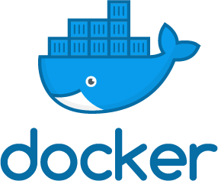
04
DOCKER
33

Slide 34
INTRODUCTION TO DOCKER
Do you know the famous phrase It works on my machine?
With Docker it is not an excuse anymore
Docker allows you to locally run the same (or almost the same) environment which will be used in production

Slide 35
INTRODUCTION TO DOCKER
Docker is a computer program that performs operating-system-level virtualization,
also known as “containerization”
Tool to make it easier to build, deploy and run applications using containers
Containers allow us to package all the things that our application needs like such as libraries and other dependencies and ship it all as a single package.
In this way, our application can be run on any machine and have the same behaviour.

Slide 36
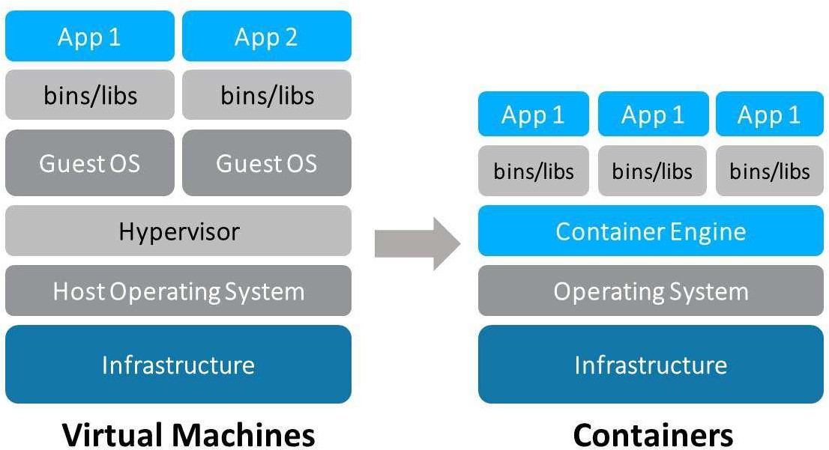
DOCKER ≠ VIRTUAL MACHINE
Docker is not a virtual machine (VM)
A Docker container, unlike a virtual machine, does not require or include a separate operating system. Instead, it relies on the kernel’s functionality and uses resource isolation for CPU and memory, and separate namespaces to isolate the application’s view of the operating system.
Docker containers are simpler than virtual machines and using it we can avoid the overhead of starting and maintaining VMs

Slide 37
DOCKER TERMINOLOGY
Images
The blueprints of our application which form the basis of containers.
Containers
Created from Docker images and run the actual application.
Docker Daemon
The background service running on the host that manages building, running and
distributing Docker containers
Docker Client
The command line tool that allows the user to interact with the daemon, issuing
commands and managing containers
Docker Hub
A registry of Docker images
”Directory” of all available Docker images

Slide 38
DOCKERFILE
Text file that contains a list of commands that the Docker client calls while creating an image
Simple way to automate the image creation process.
Commands written in a Dockerfile are almost identical to their equivalent Linux commands
Container image is built with docker build command
docker build –t image-name .

Slide 39
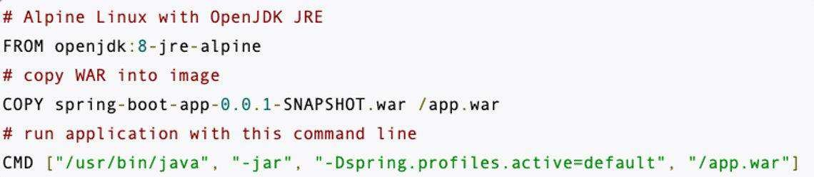
DOCKERFILE INSTRUCTIONS
FROM – specifies the base image (an official image from Docker Hub or a customer image) upon which the new image will be built
RUN – executes a command inside the Docker image during the image build process: installing packages, configuring software or setting up dependencies within the image
COPY – copies files or directories from the host machine into the Docker image.
argument: the source path (on the host)
argument: the destination path (in the image)
CMD/ENTRYPOINT – specifies the default command to be executed when a container is created from the image. Difference: CMD can be overridden at runtime by providing arguments to the 'docker run', which is not case with ENTRYPOINT.

Slide 40
STARTING CONTAINER
When image is created, application can be run via command docker run name-of-image
One of the stuff which is commonly used is port mapping
It is allowing access to application
-p flag in docker run command is doing port mapping
-p 3000:3000
Mapping between the host’s port 3000 to the container’s port 3000
Command docker ps or docker container ls is showing all active docker containers
Command for seeing all docker images on environment is docker image ls or docker images
root@user: $ docker ps
CONTAINER ID IMAGE
780464b51916 my_docker_image
NAMES CREATED
my container 1 hours ago
STATUS PORTS
Up 9 minutes 0.0.0.0:8080->8080, :::8080->8080/tcp

Slide 41
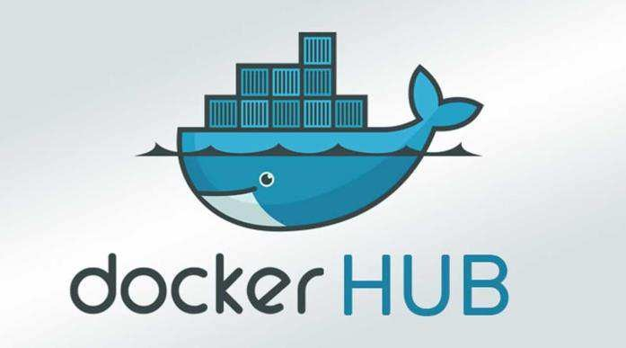
PUSHING DOCKER IMAGES
Docker Hub repositories allow you share container images with your team, customers, or the Docker community at large.
Images are pushed to Docker Hub through the docker push command. A single Docker Hub repository can hold many Docker images (stored as tags)
To push an image to Docker Hub, you must first name your local image using your Docker Hub username and the repository name that you created through Docker Hub on the web.
Steps:
docker build -t <hub-user>/<repo-name>[:<tag>]
docker push <hub-user>/<repo-name>:<tag>
The image is then uploaded and available for use by your teammates and/or the community.

Slide 42
DOCKER COMPOSE
Tool for defining and running multi-container Docker applications
Usage of YAML file allowing to configure application’s services
With a single command, create and start all the services from YAML configuration
docker-compose up from folder where file is stored or docker-compose –f file.yml up for some specific file
version: "3.2"
services:
rabbitmq:
image: rabbitmq:3-management-alpine restart: always
container_name: 'rabbitmq' ports:
- 5672:5672
- 15672:15672
db:
image: postgres:latest
environment:
POSTGRES_USER: user
POSTGRES_PASSWORD: password

Slide 43
SCALING
When demand for your application is soaring and you recognize a need to expand the app’s accessibility,
power and presence you need to do some type of scaling
The heart of the difference is the approach to adding computing resources to your infrastructure.
Two main types of scaling are:
Vertical scaling
With vertical scaling (a.k.a. “scaling up”), you’re adding more power to your existing machine
Horizontal scaling
In horizontal scaling (a.k.a. “scaling out”), you get the additional resources into your system by adding
more machines to your network, sharing the processing and memory workload across multiple devices.

Slide 44
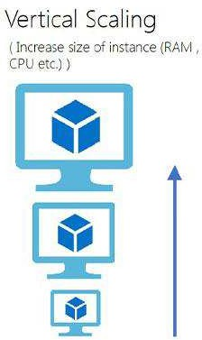
VERTICAL SCALING
Vertical scaling refers to adding more resources (CPU/RAM/DISK) to your server (database or application server is still remains one) as on demand.
Commonly used in applications and products of middle-range as well as small and middle- sized companies
Means upgrade of server hardware

Slide 45
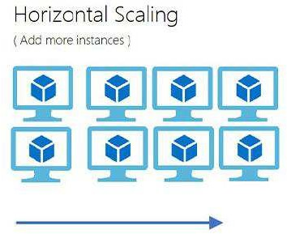
HORIZONTAL SCALING
Horizontal Scaling is a must use technology – whenever a high availability of (server) services are required
Involves adding more processing units or physical machines to your server or database.
It involves growing the number of nodes in the cluster, reducing the responsibilities of each member node by spreading the key space wider and providing additional end-points for client connections
Horizontal Scaling has been historically much more used for high level of computing and for application and services.

Slide 46
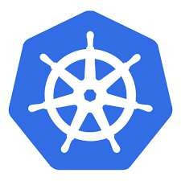
DOCKER AUTOSCALING
Concept of autoscaling can be done via Docker Swarm or via Kubernetes, or via some Cloud provider
Since Docker Swarm is not used so much anymore, in place came Kubernetes
For understanding of Kubernetes you need to know Docker and his concepts (more about Kubernetes https://kubernetes.io/docs/tutorials/)
Kubernetes allow us to make configuration when autoscaling need to be done
e.g when target CPU utilization came to 50% create new instance
e.g what will be min and what will be the max count of replicas

Slide 47

05
SPLIT OF MONOLITHIC APPLICATION TO MICROSERVICES
49

Slide 48
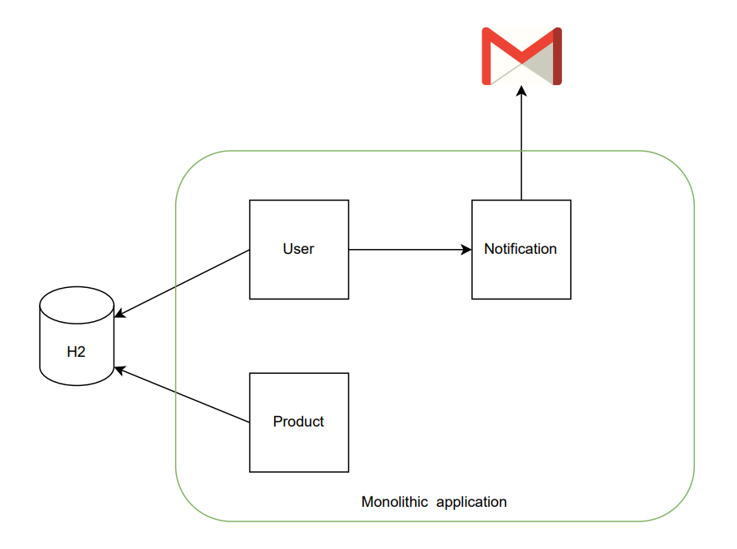
MONOLITHIC ARCHITECTURE (EXAMPLE)
Components:
User module
Notification module
Product module Resources:
H2 database
Mail server
GitHub repo:
https://github.com/nemanjaromanic/monolithic-app (main branch)

Slide 49
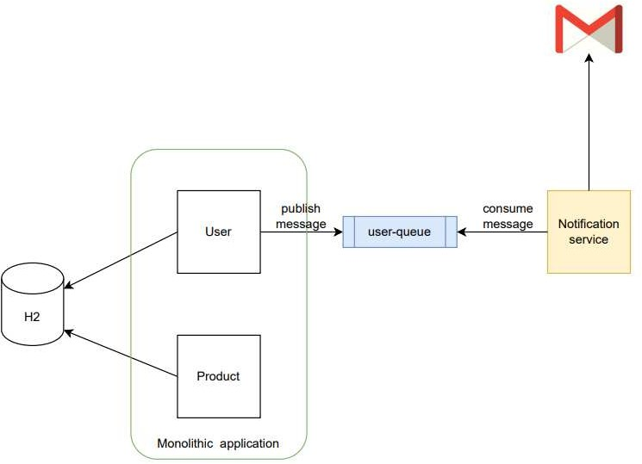
MICROSERVICE ARCHITECTURE - STEP 1
Tasks:
Extract notification service from
monolithic application
Publish user message to user- queue from monolith
Consume user message with
notification service
For messaging use RabbitMQ
GitHub repo:
https://github.com/nemanjaromanic/monolithic-app (refactor/split-monolith branch)
https://github.com/nemanjaromanic/notification-service (main branch)

Slide 50
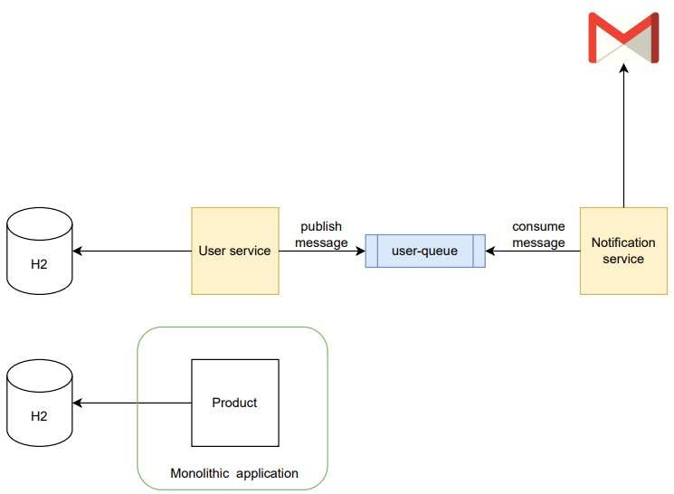
MICROSERVICE ARCHITECTURE - STEP 2
Tasks:
Extract user service
Extract user related tables to new DB used only by user service
Clean old code from monolithic
application

Slide 51
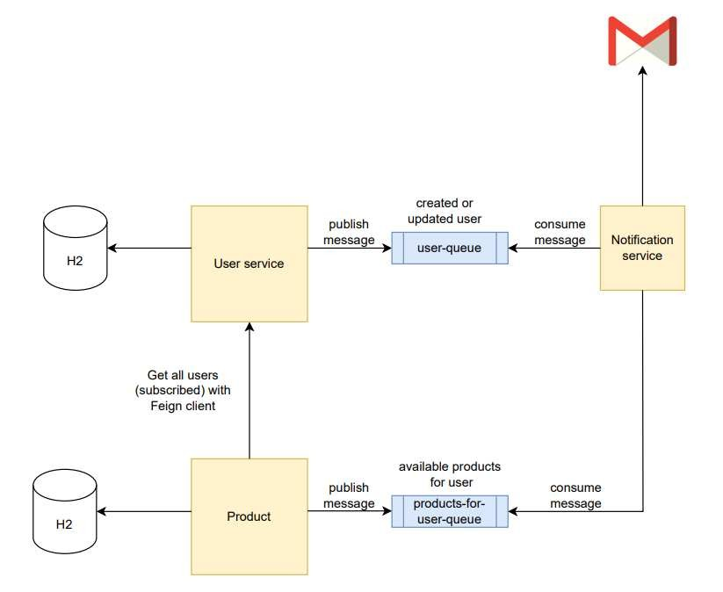
MICROSERVICE ARCHITECTURE – FINAL STEP
Tasks:
Extract product service
Create
service
endpoint on product to send all
available products in email to all
subscribed users
Product service
fetch all from user
subscribed users
service with Feign client
Product service publish
messages to new queue
Notification service consume messages and send emails to subscribed users
3. Delete monolithic application

Slide 52
54

