Slide 1
EXAMFLOW
Implementation, Testing & Demonstration
DBMS Project 24 | PHASE 3

Slide 2
Prototype Architecture
ExamFlow | Examination Scheduling & Result Processing System
• Python and Streamlit provide the user interface.
• SQLite stores prototype data locally.
• CSV export supports downstream review.
• The database is created locally; the generated database file is not committed.

Slide 3
Dashboard
ExamFlow | Examination Scheduling & Result Processing System
• Shows counts for students, faculty, subjects, exams and results.
• Provides a quick view of scheduled examinations.
• Dashboard numbers reflect the loaded sample database.

Slide 4
Master Data Modules
ExamFlow | Examination Scheduling & Result Processing System
• Student records can be added and reviewed.
• Faculty and invigilator details are maintained.
• Subject catalogue and room capacity records support scheduling.

Slide 5
Exam Scheduling
ExamFlow | Examination Scheduling & Result Processing System
• Choose subject, date, start/end time, section, room and invigilator.
• The prototype checks scheduling conflicts for overlapping assignments.
• Demonstrate a valid schedule and a rejected conflict during the video.

Slide 6
Results Processing
ExamFlow | Examination Scheduling & Result Processing System
• Select an exam and student, then enter marks.
• The interface supports draft/published result status.
• Demonstrate saving a result and checking it in the table.

Slide 7
Reports and Database Explorer
ExamFlow | Examination Scheduling & Result Processing System
• Select report views and export CSV files.
• Read-only explorer displays table data and permits SELECT queries.
• Use only safe SELECT queries in the demonstration.

Slide 8
Testing Evidence
ExamFlow | Examination Scheduling & Result Processing System
• User-reported checks: dashboard counts and large sample dataset.
• User-reported checks: student persistence and subject compatibility.
• User-reported checks: overlapping room validation and CSV exports.

Slide 9
Known Limitations
ExamFlow | Examination Scheduling & Result Processing System
• Prototype uses local SQLite, not a production server database.
• Sample data is fictional.
• Capacity and all grading/business rules should be re-verified against the final code before claiming full enforcement.

Slide 10
Demonstration Plan
ExamFlow | Examination Scheduling & Result Processing System
• 0:00–0:30 introduce the problem and architecture.
• 0:30–1:30 show dashboard and master data.
• 1:30–2:30 demonstrate exam scheduling and conflict validation.
• 2:30–3:30 enter marks and publish a result.
• 3:30–4:30 show reports, CSV export and database explorer.
• 4:30–5:00 summarize outcomes and limitations.

Slide 11
Conclusion
ExamFlow | Examination Scheduling & Result Processing System
• ExamFlow demonstrates a connected examination workflow.
• Relational tables organize master, schedule and result data.
• Future work: authentication, role-based access, stronger validation and deployment.

Slide 12
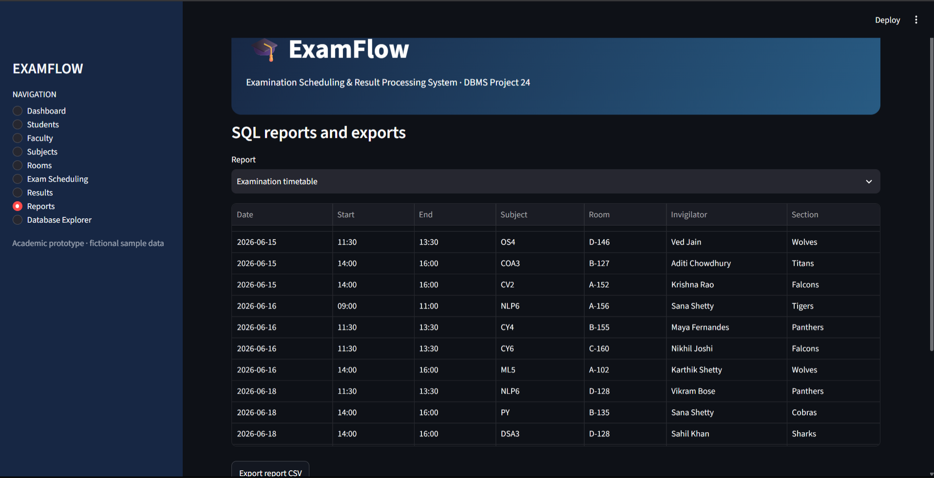
Dashboard overview
Actual prototype screenshot supplied for project documentation

Slide 13
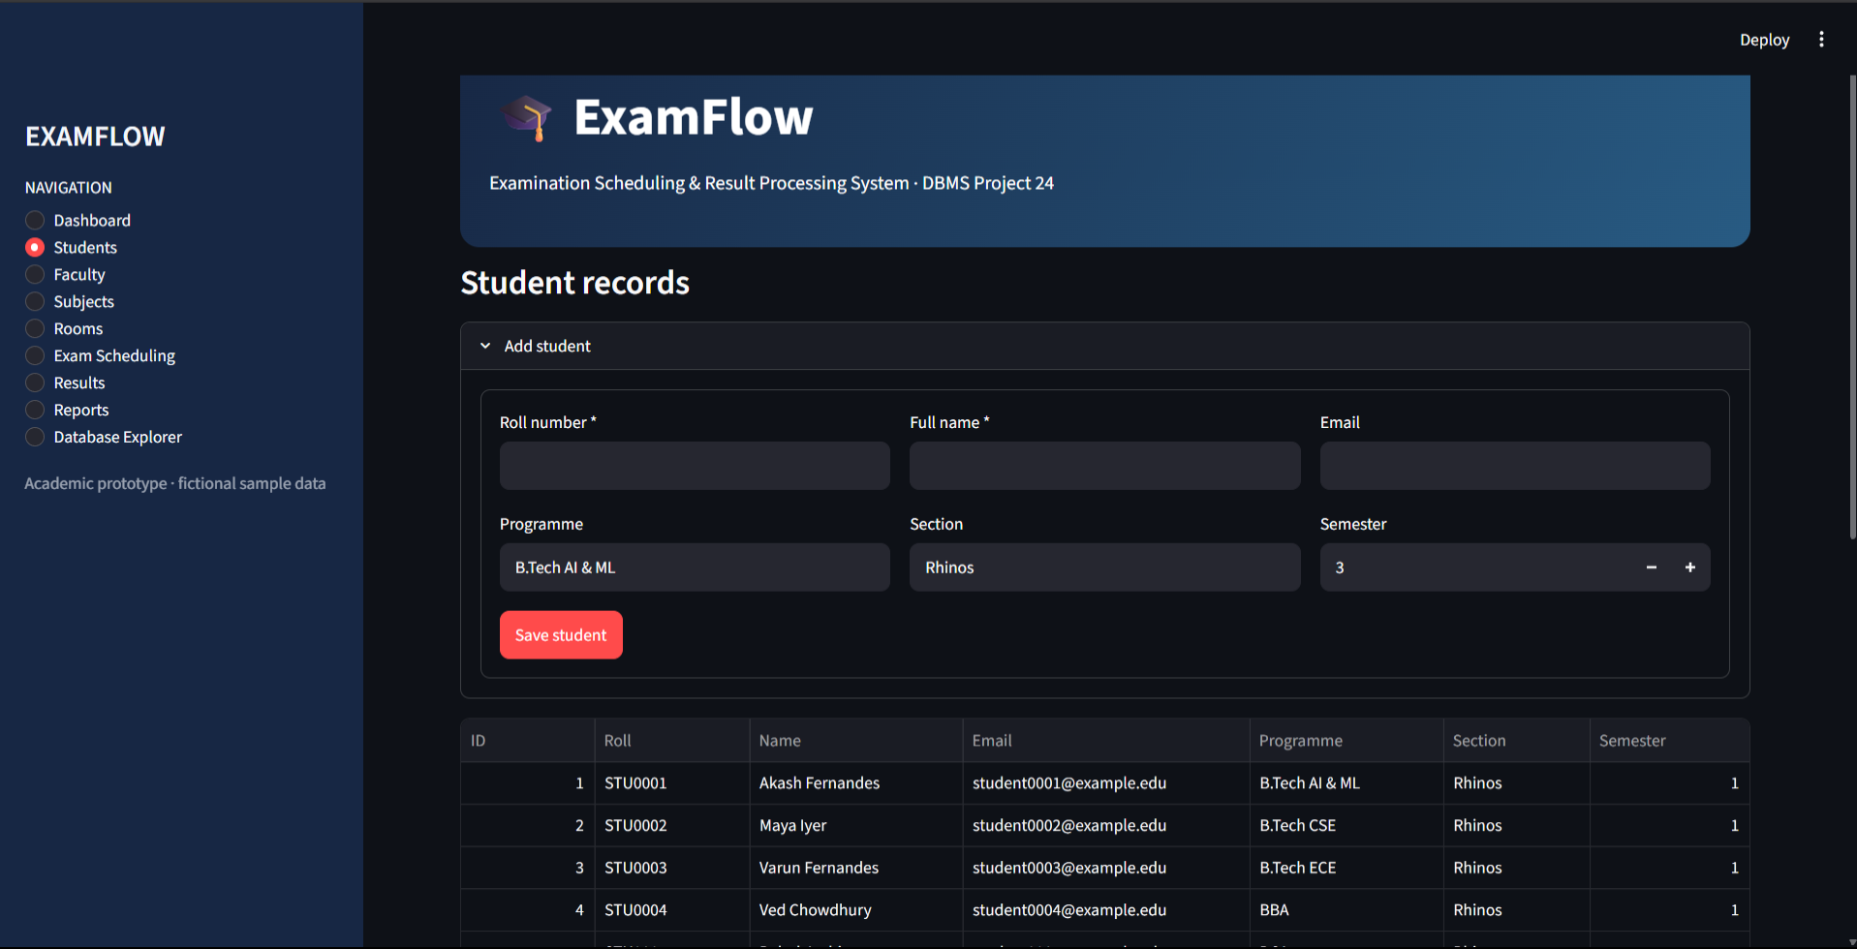
Student records
Actual prototype screenshot supplied for project documentation

Slide 14
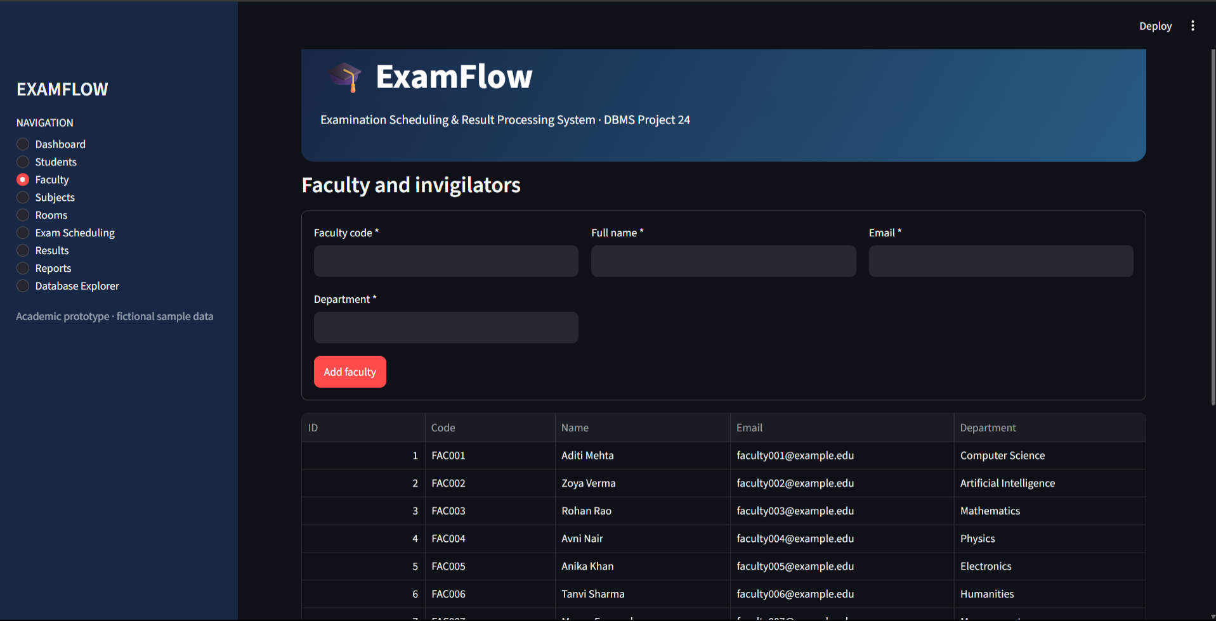
Faculty and invigilators
Actual prototype screenshot supplied for project documentation

Slide 15
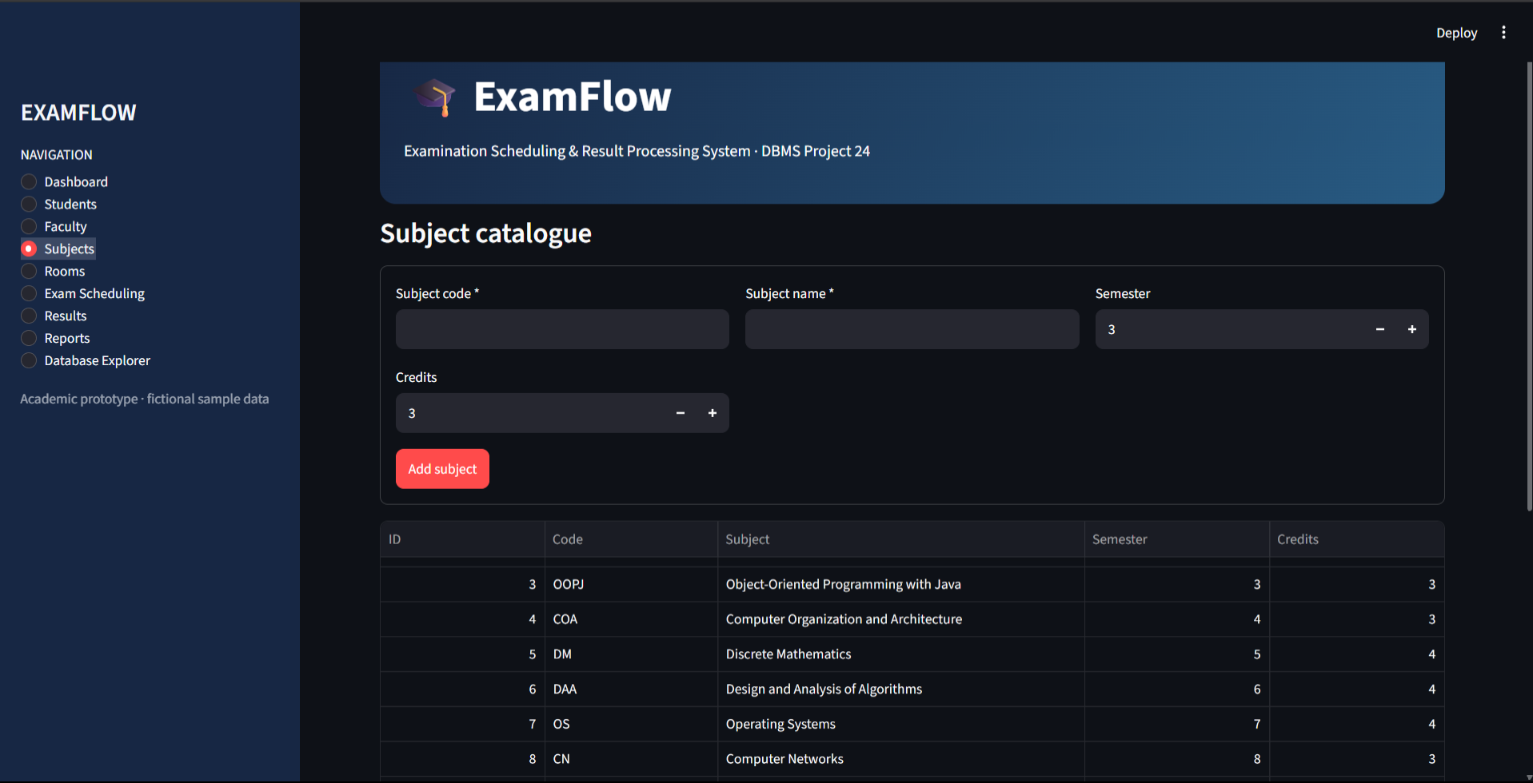
Subject catalogue
Actual prototype screenshot supplied for project documentation

Slide 16
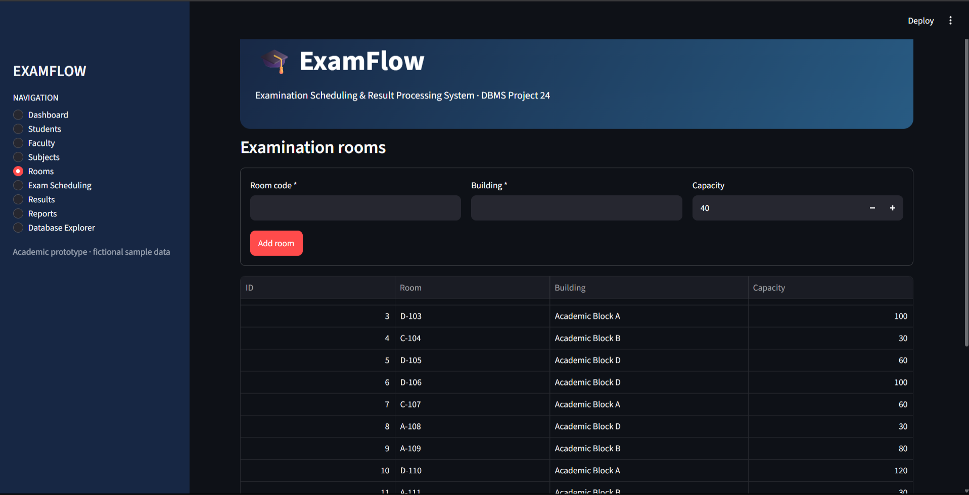
Examination rooms
Actual prototype screenshot supplied for project documentation

Slide 17
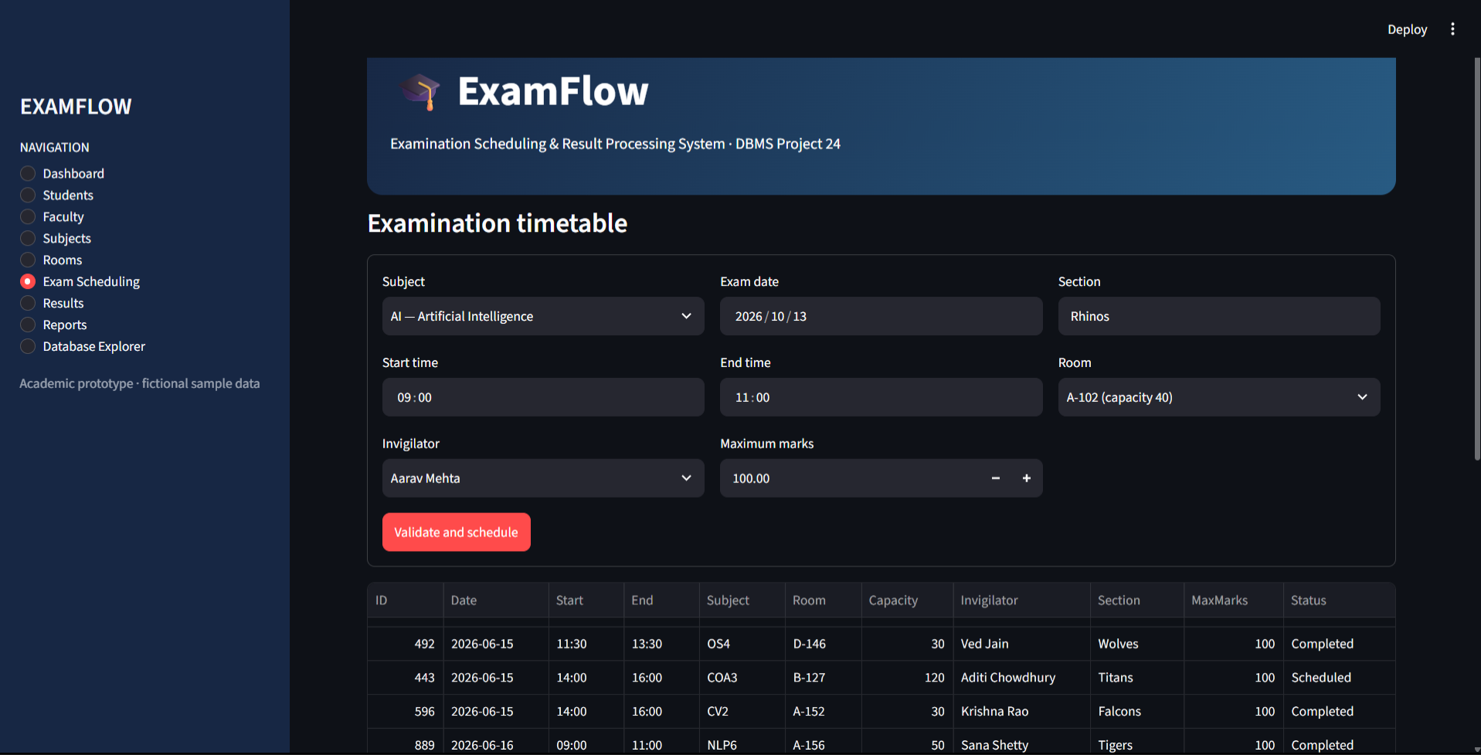
Examination timetable
Actual prototype screenshot supplied for project documentation

Slide 18
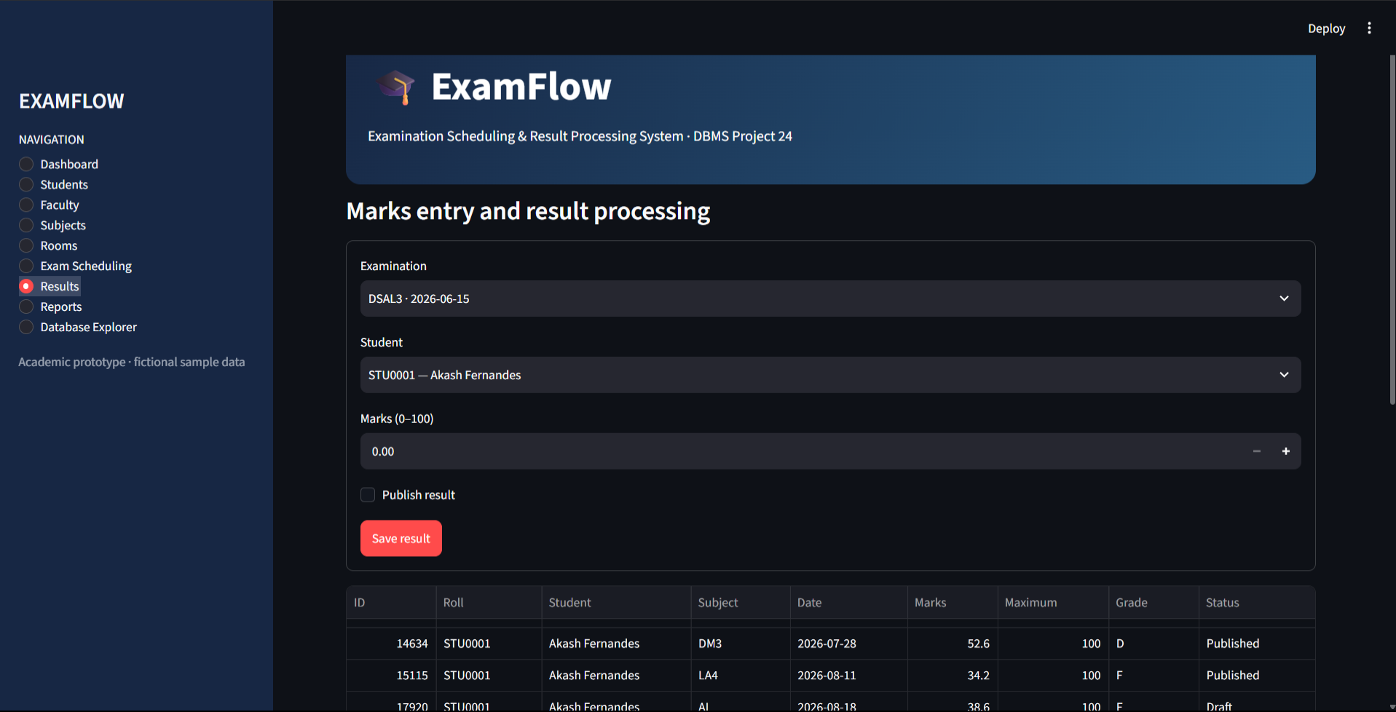
Marks entry and result processing
Actual prototype screenshot supplied for project documentation

Slide 19
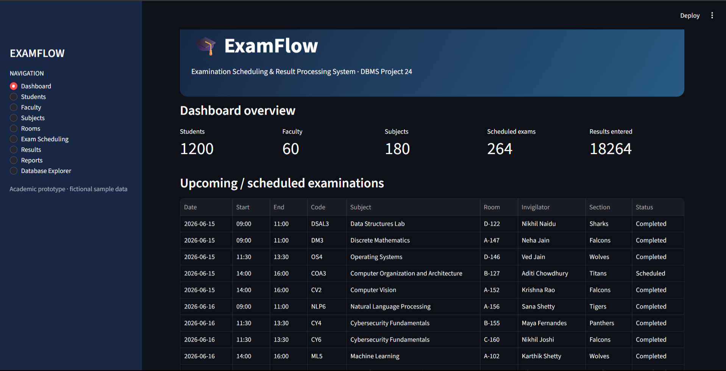
SQL reports and exports
Actual prototype screenshot supplied for project documentation

Slide 20
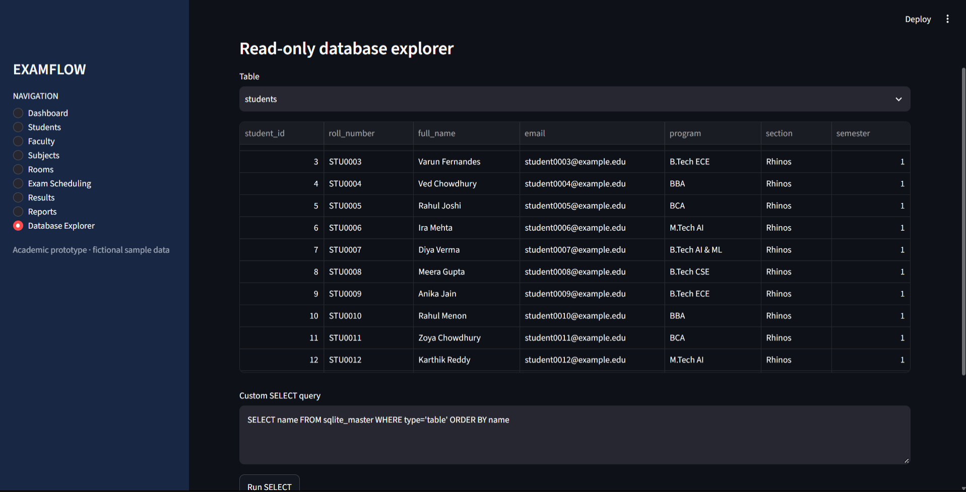
Read-only database explorer
Actual prototype screenshot supplied for project documentation

Slide 21
ENTITY RELATIONSHIP DIAGRAM
ExamFlow core entities and one-to-many relationships
STUDENTS
SUBJECTS
PK student_id
UK roll_number, email
full_name, program
section, semester
PK subject_id
UK subject_code
subject_name
department, semester, credits
1 : N
1 : N
EXAMS
PK exam_id
FK subject_id
FK room_id
FK invigilator_id
exam_date, start/end time
section, max_marks, status
FACULTY
PK faculty_id
UK faculty_code, email
full_name, department
1 : N
student → results
1 : N
RESULTS
ROOMS
1 : N
PK result_id
FK student_id
FK exam_id
marks_obtained, grade
published
PK room_id
UK room_code
building, capacity
PK = Primary Key | FK = Foreign Key | UK = Unique Key | 1:N = One-to-many

Slide 22
RELATIONAL SCHEMA & KEY MAPPING
Table-level view of primary keys, foreign keys, and unique identifiers
STUDENTS
SUBJECTS
PK student_id
UK roll_number, email
full_name, program, section, semester
PK subject_id
UK subject_code
subject_name, department
semester, credits
EXAMS
PK exam_id
FK subject_id → SUBJECTS
FK room_id → ROOMS
FK invigilator_id → FACULTY
date/time, section, max_marks, status
FACULTY
PK faculty_id
UK faculty_code, email
full_name, department
RESULTS
PK result_id
FK student_id → STUDENTS
FK exam_id → EXAMS
marks, grade, published
ROOMS
PK room_id
UK room_code
building, capacity
Design aim: reduce duplication and keep entity attributes in their own tables; validate final SQL constraints before submission.

