Slide 1
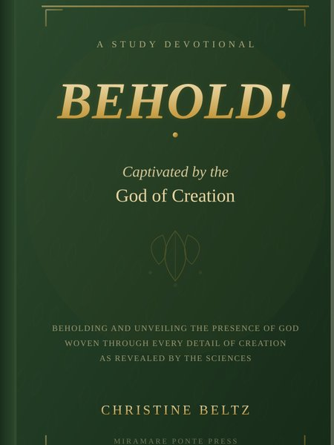
BeCaptivatedBooks.com
Website Presentation
BEHOLD! Captivated by the God of Creation
by Christine Beltz
Prepared for Christine Beltz | March 2026

Slide 2
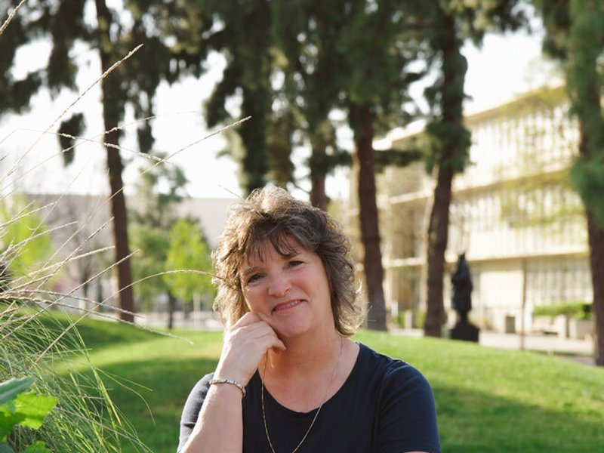



The Vision
BeCaptivatedBooks.com is designed to be more than just a book website. It's a digital extension of your ministry — a warm, inviting space where readers discover the wonder of creation and deepen their faith.
A website that reflects the wonder and beauty of God's creation — just like the book itself.
Captivate visitors from first click
Reflect your nature-inspired message
Build lasting reader relationships

Slide 3







Your Complete Website
9 beautifully crafted pages, ready to publish
Home
The Book
About Christine
Hero carousels, book showcase, animated CTAs
3D cover display, formats, reader journey
Bio, photo gallery, personal story
Study Devotionals
Blog
Contact
All 20 devotionals with numbered cards
9 posts, category filters, newsletter
Contact form, speaking & events
Blog Post 1
Blog Post 2
Blog Post 3
Why Science Deepens My Faith
What Does It Mean to Behold?
God's Signature in the Salmon Run

Slide 4
Design That Captivates
Every design choice is intentional — rooted in the themes of your book
Nature-Inspired Palette
Elegant Typography
Forest greens, warm golds, and soft creams mirror the earthy beauty of creation. Colors chosen to evoke wonder and warmth.
Cormorant Garamond headings paired with clean Lato body text — timeless, readable, and distinctly literary.
Immersive Photography
3D Book Showcase
Rotating author carousels with Ken Burns zoom effects, crossfade transitions, and hover-pause interactivity.
CSS perspective transforms create a realistic book display — the cover tilts and responds to user interaction.

Slide 5
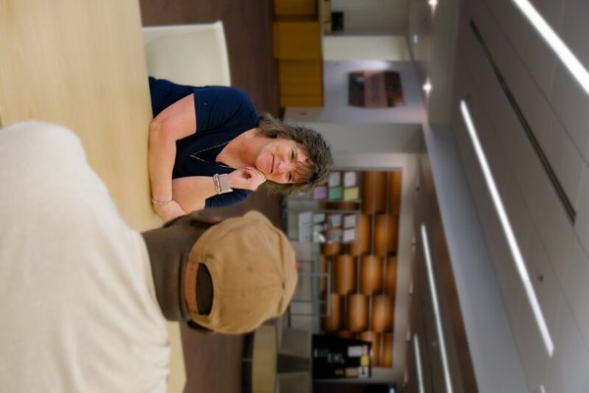
Features Built for Ministry
1
Blog with Category Filters
Faith & Science, Devotional, Creation, Teaching, and Family. Pre-loaded with 3 full articles and 9 post cards.
2
20 Study Devotionals
Each devotional study beautifully presented with numbered cards, making content accessible online.
3
Newsletter Signup
Built-in email capture to grow your audience and keep readers engaged between books.
4
Speaking & Events
Dedicated section to showcase availability for speaking engagements, retreats, and book signings.
5
Reader's Journey
Visual 4-step path guiding visitors into deeper engagement with the book and your ministry.

Slide 6
Connecting With Your Audience
Faith-Curious Readers
Study Group Leaders
Event Organizers
People drawn to the intersection of science and faith. Your blog posts and devotionals give them a reason to keep returning.
Small group facilitators looking for creation-centered Bible study material. 20 devotionals as ready-made curriculum.
Churches and retreat centers seeking speakers. Your contact page and speaking section make you easy to book.
Blog + Newsletter
20 Devotionals
Contact + Events

Slide 7
Why This Website Works
9
20
9
18
Crafted Pages
Study Devotionals
Blog Posts
Author Photos
Each designed with purpose
Full content online
SEO-ready content
Professional gallery
Scroll-triggered animations bring every section to life as readers explore
Consistent design system with CSS custom properties ensures brand cohesion
Responsive design adapts beautifully from desktop to tablet to phone
Fast-loading, SEO-friendly HTML — no heavy frameworks or slow load times

Slide 8
Ready to Launch
1
Review & Refine
Walk through every page. Flag anything you'd like adjusted — text, photos, layout.
2
Add Real Links
Connect Amazon, Barnes & Noble, and social media to actual purchase and profile URLs.
3
Domain Setup
Point becaptivatedbooks.com to your hosting provider and upload the website files.
4
Go Live
Share your website with the world. Start driving traffic from social media and your network.
"Every detail of creation is a reflection of the Creator's character."
— Christine Beltz

