Slide 1
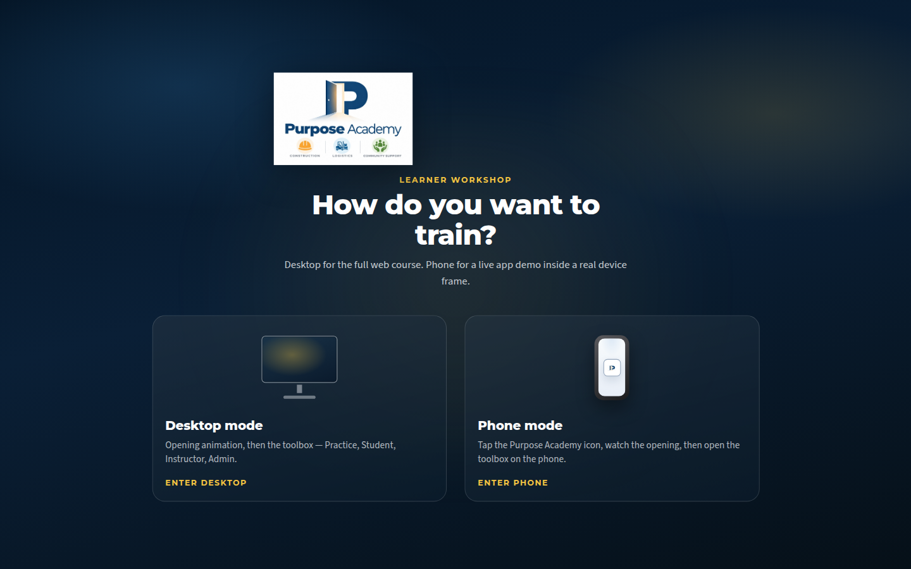
GRANT OVERVIEW · CALGARY TRADES SCHOOL LEARNING APP
Purpose Academy
A concise look at what exists today: three pathways, Practice spine, desktop night stage, and honest progress toward employment readiness.
Desktop or Phone — learner workshop entry.

Slide 2

NEWCOMERS & FIRST-TIME TRADES LEARNERS
Who it’s for
Adults who want workplace English and trades foundations without exam theatre. Soft learner-fear chrome. Adult dignity — no childish gamification.
2 / 9 · Night-stage opening: three doors into work.

Slide 3
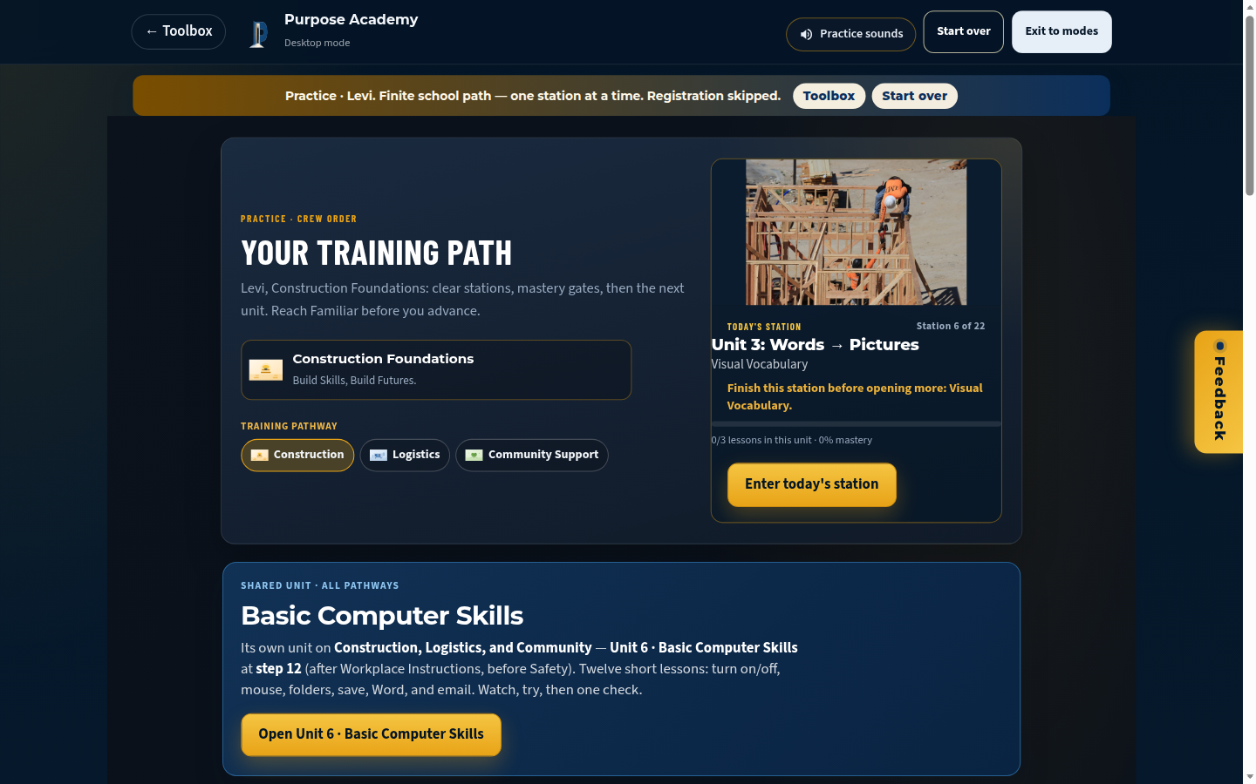
ONE SCHOOL · THREE DOORS
Three pathways
Construction · Logistics · Community Support Foundations. Same Practice spine; specialty vocabulary and scenes per pathway.
3 / 9 · Practice hub — choose pathway, one station at a time.

Slide 4
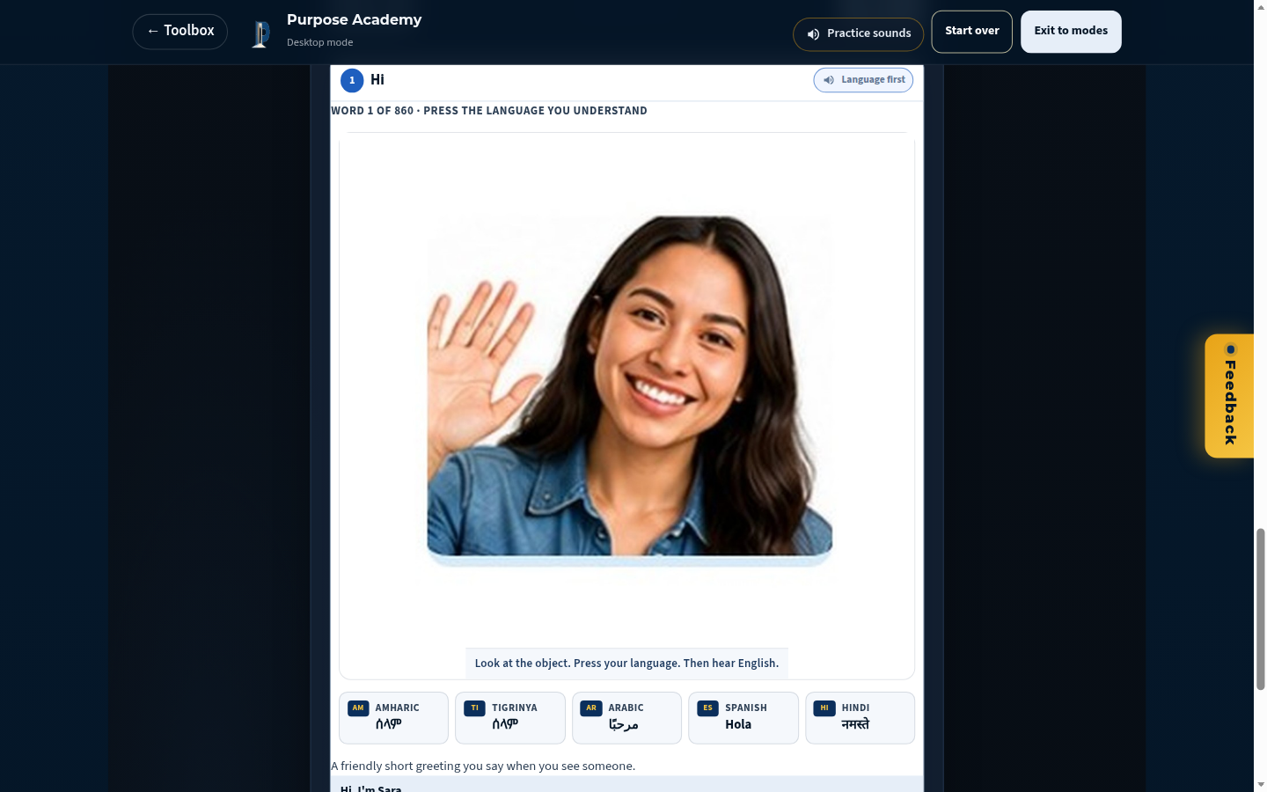
SEE → HEAR HOME LANGUAGE → HEAR ENGLISH → TYPE
Practice loop
Visual Vocabulary: look at the object, press a language you trust, hear the English workplace word, then type. Finite stations. Done for now when you need to stop.
4 / 9 · VocabSheet on desktop night stage + paper card.

Slide 5
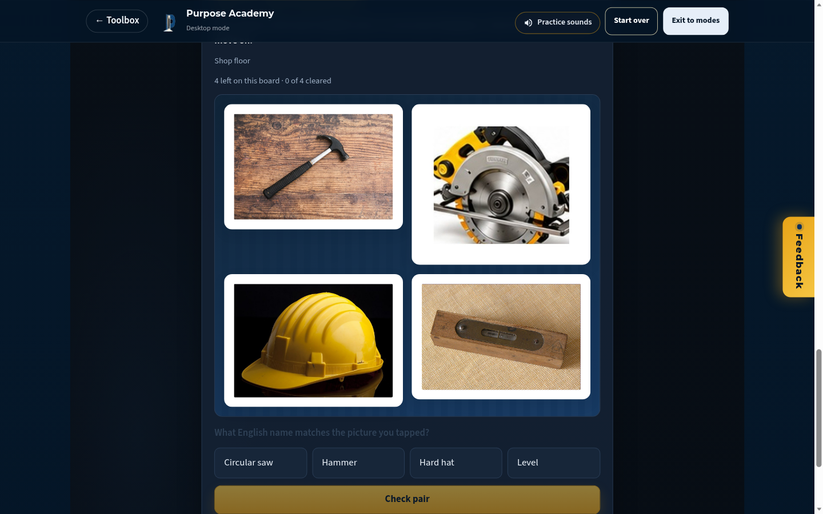
ENGLISH EYE SPY
Clear the board
Tap a picture, name it in English, clear the board. Same words, busy shop scenes — concrete win without scoreboard shame.
5 / 9 · Eye Spy exercise mode — clear every pair.

Slide 6
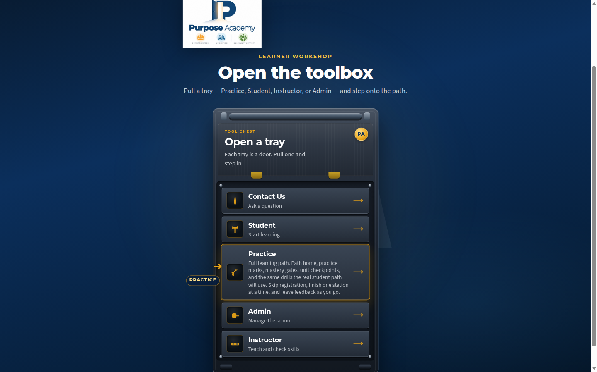
TOOLBOX → PRACTICE / STUDENT / INSTRUCTOR / ADMIN
Desktop experience
Desktop mode opens the toolbox trays, then the full web course on a calm night stage. Phone mode is a live device-frame demo of the same school.
6 / 9 · Tool Chest trays — Practice highlighted.

Slide 7
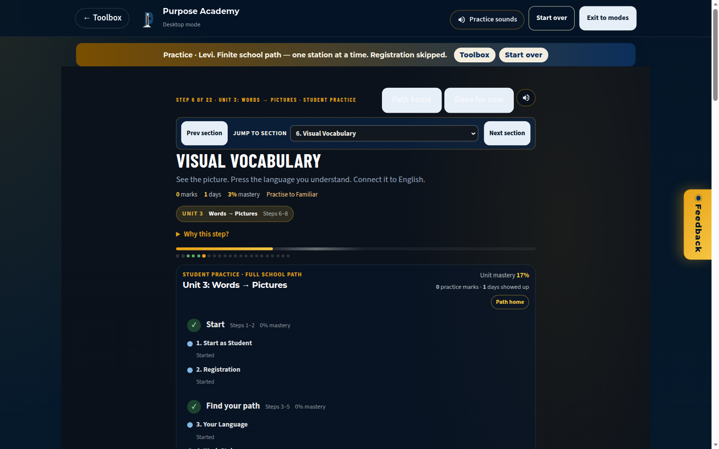
SOFT CHROME · FINITE PATH
Learner dignity
One station in focus. Practice banner names the finite path. Done for now is always available. We refuse casino streaks and “prove yourself” exam language in learner chrome.
7 / 9 · Practice surface with Done for now / soft chrome.

Slide 8
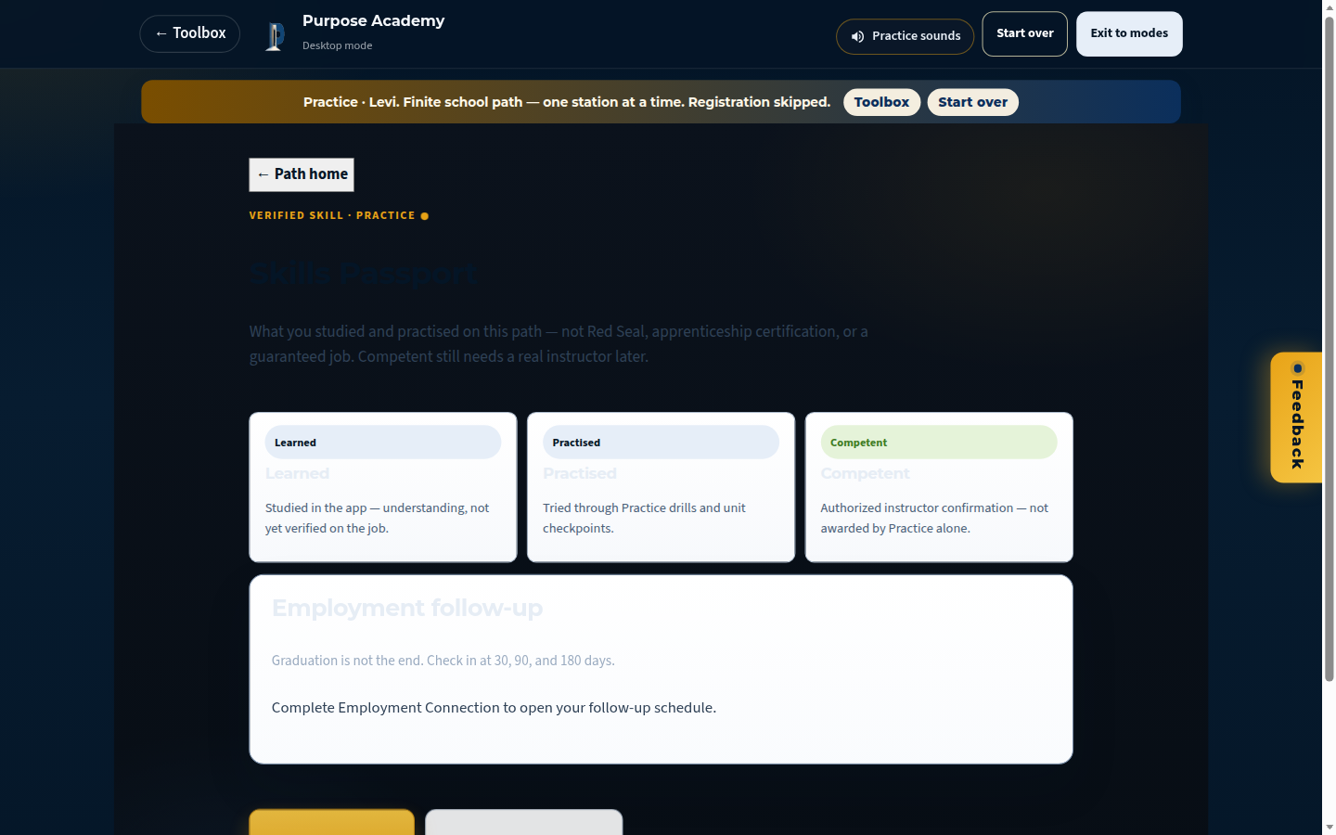
HONEST CONTINUUM — NOT A GUARANTEE
Progress & Skills Passport
Learned → Practised → Competent. Practice alone is not Red Seal, apprenticeship certification, or a job guarantee. Competent still needs a real instructor.
8 / 9 · Skills Passport honesty copy in Practice.

Slide 9
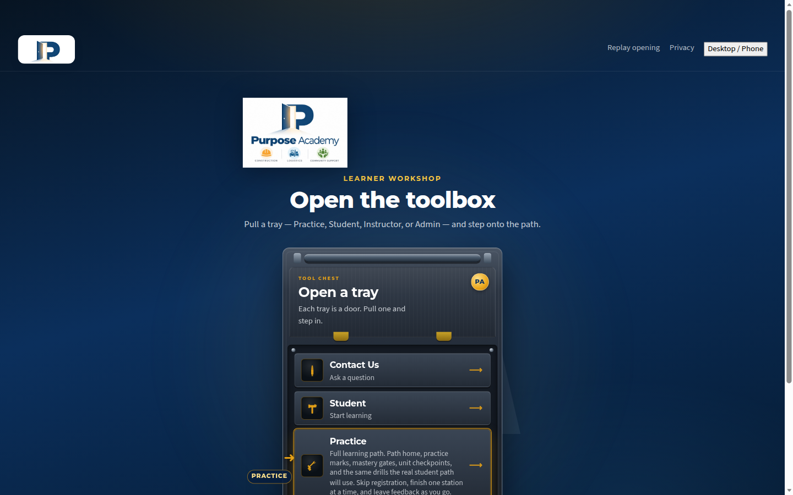
CONTACT & NEXT STEP
Built in Calgary
Purpose Academy Application — Construction, Logistics, Community Support Foundations. For partnership or grant follow-up, use the Contact tray in the toolbox or the school’s public contact channel.
9 / 9 · Programs surface — three pathways, honest depth.

