Slide 1
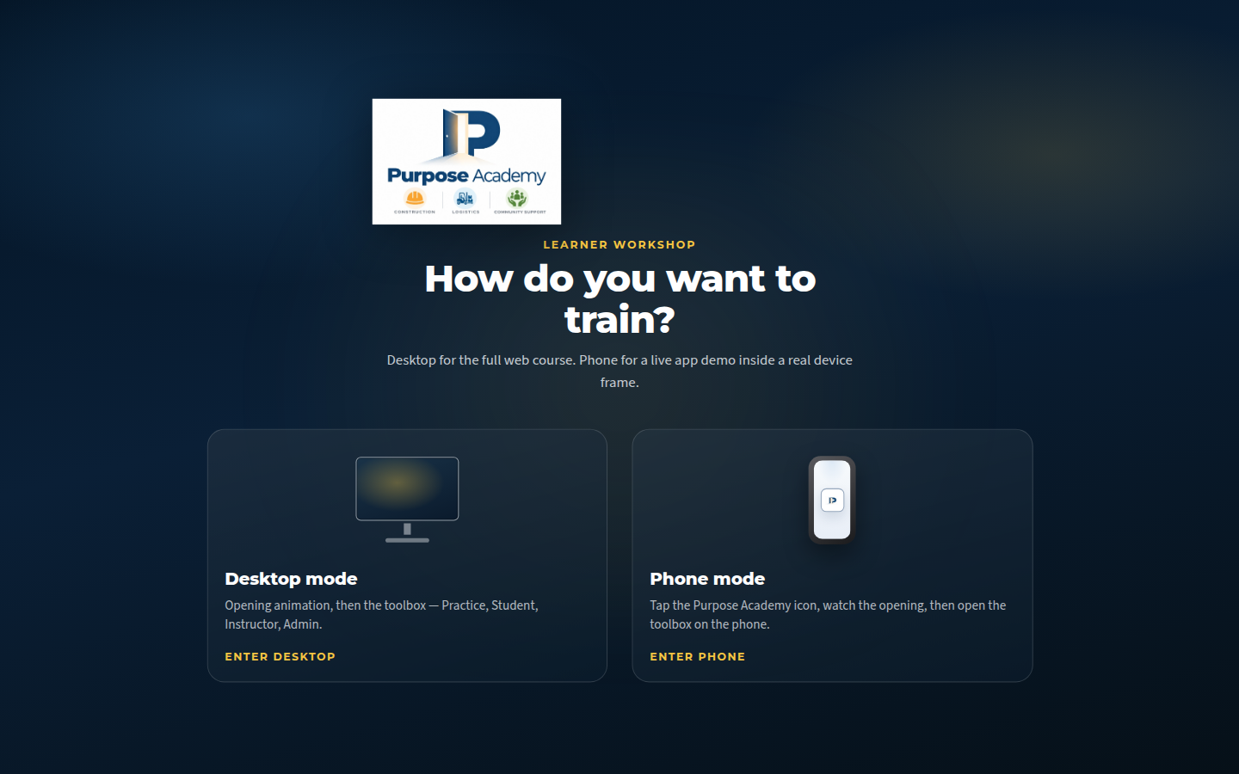
PRODUCT OVERVIEW · CALGARY TRADES SCHOOL LEARNING APP
Purpose Academy
Workplace English and trades foundations — Construction, Logistics, and Community Support — practised one station at a time.
1 / 10 · Desktop or Phone — same school, two ways in.

Slide 2

ADULT LEARNERS FIRST
Who it’s for
Newcomers and first-time trades learners who want workplace English with adult dignity. Soft chrome for people who may fear school — never childish gamification.
2 / 10 · Night-stage door — open into the workshop.

Slide 3
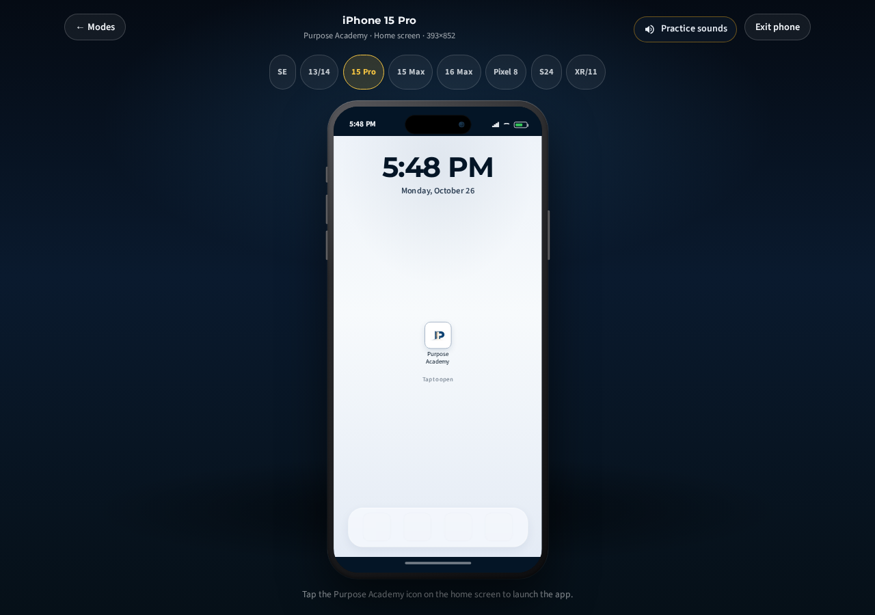
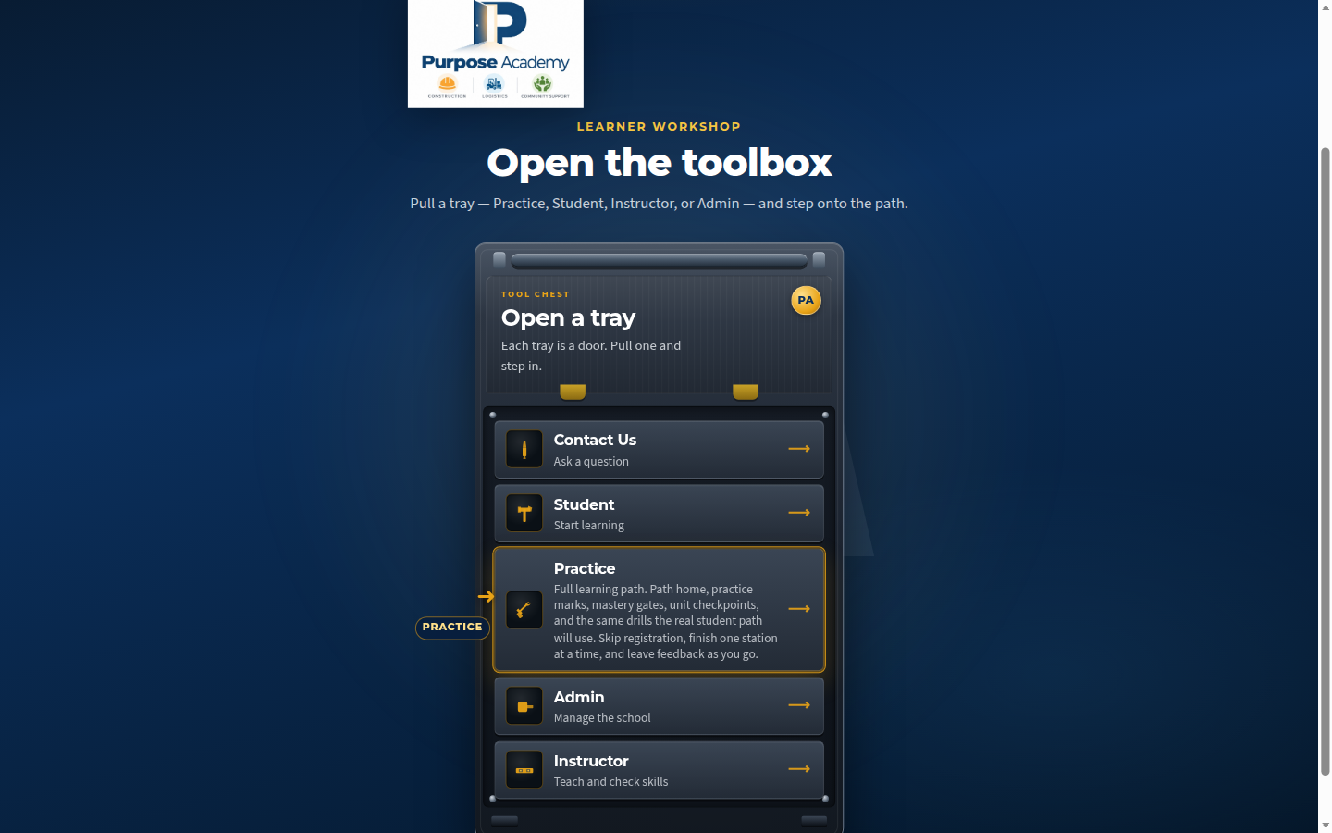
ONE SCHOOL · TWO SURFACES
Desktop and phone
Desktop opens the toolbox, then the full web course on a calm night stage. Phone is a live device-frame demo of the same path.
Toolbox trays
Phone home
3 / 10 · Toolbox trays · Phone home

Slide 4
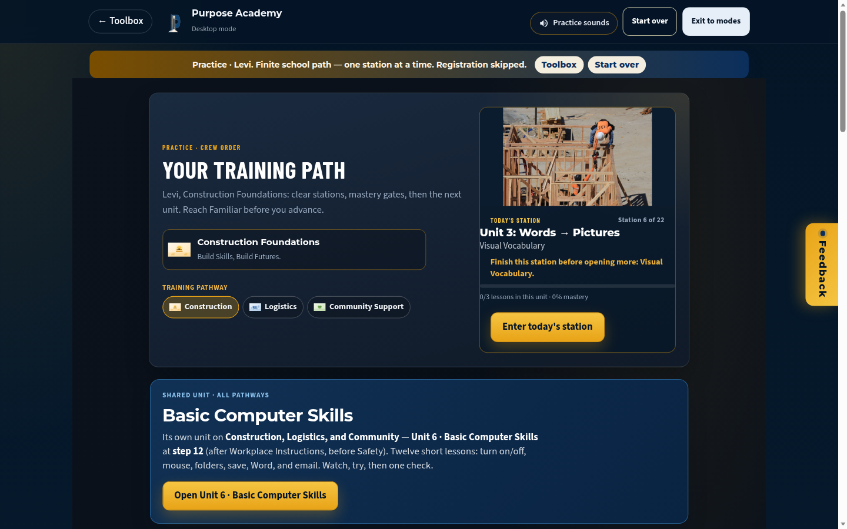
CONSTRUCTION · LOGISTICS · COMMUNITY SUPPORT
Three pathways
Same Practice spine for every door. Specialty vocabulary and scenes change with the pathway. Today’s station stays in focus.
4 / 10 · Practice hub — pick a pathway, enter today’s station.

Slide 5
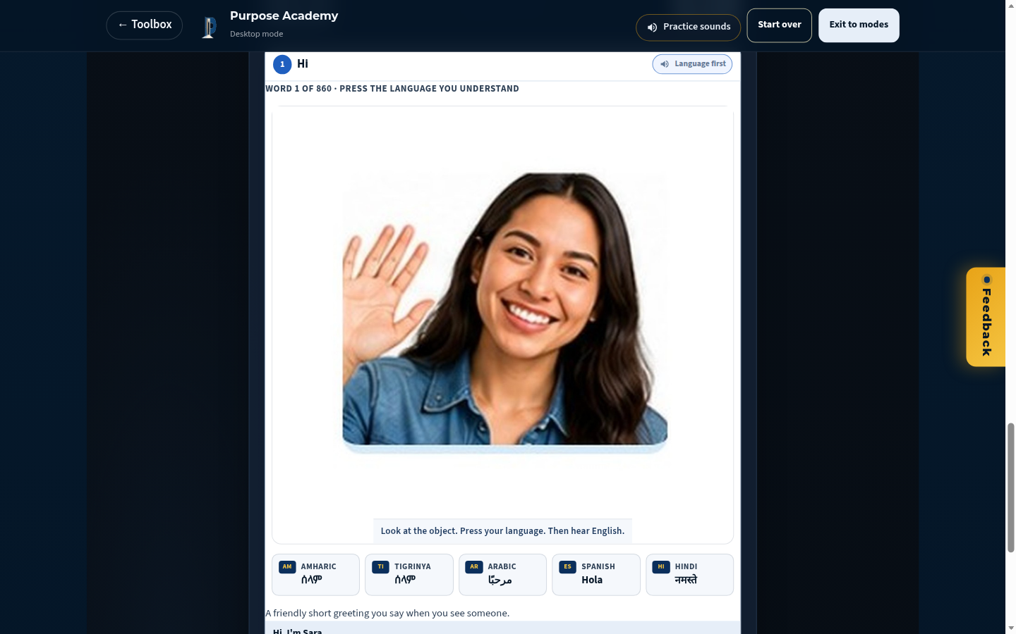
SEE → HEAR HOME LANGUAGE → HEAR ENGLISH → TYPE
Visual Vocabulary
Look at the object. Press a language you trust. Hear the English workplace word. Then type it. Finite pages — leave when you need to.
5 / 10 · VocabSheet on the desktop night stage.

Slide 6
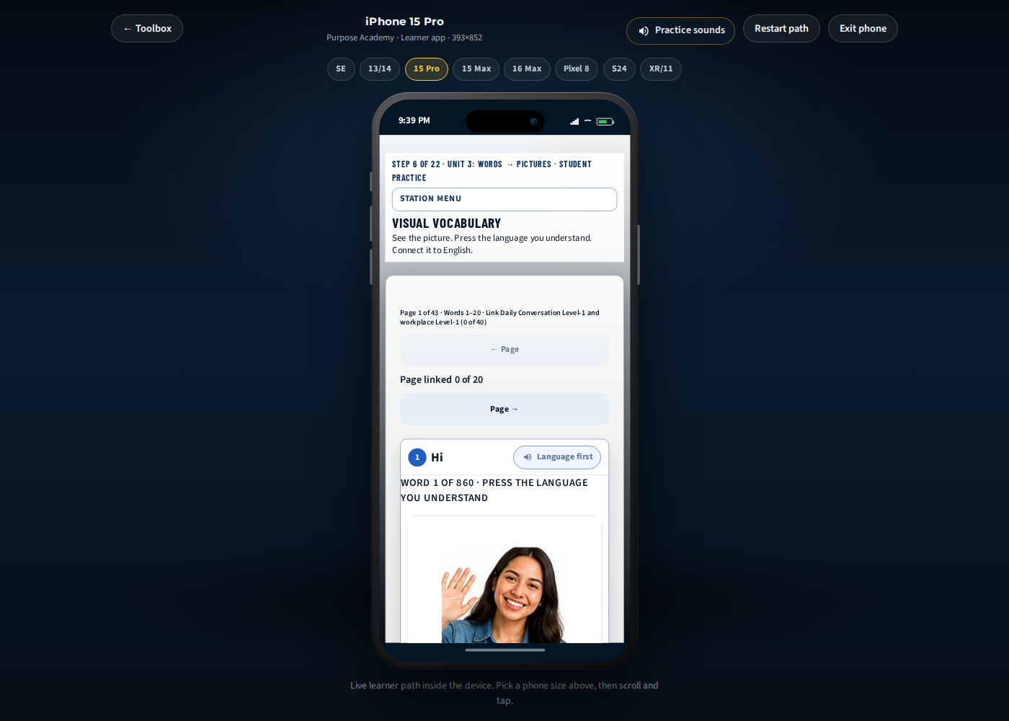
PRACTICE ON PHONE AND DESKTOP
Stations that stay clear
The same Visual Vocabulary station fits inside the phone frame. Task, picture, and languages stay unmistakable — no cluttered exam board.
Desktop VocabSheet
Phone station
6 / 10 · Desktop VocabSheet · Phone station

Slide 7
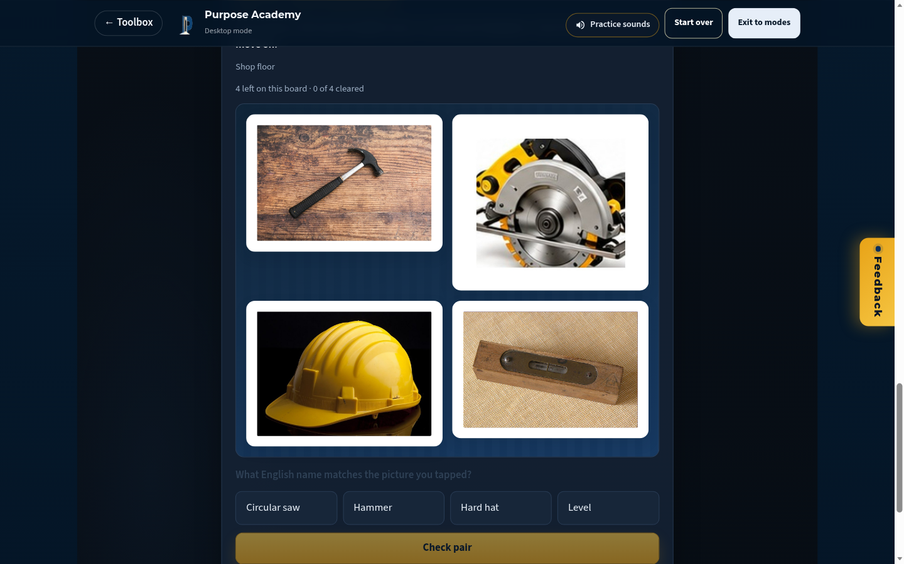
CLEAR THE BOARD
Eye Spy
Tap a picture, name it in English, clear the board. Same workplace words in busy shop scenes — a concrete win without scoreboard shame.
7 / 10 · Eye Spy — match the English name, clear every pair.

Slide 8
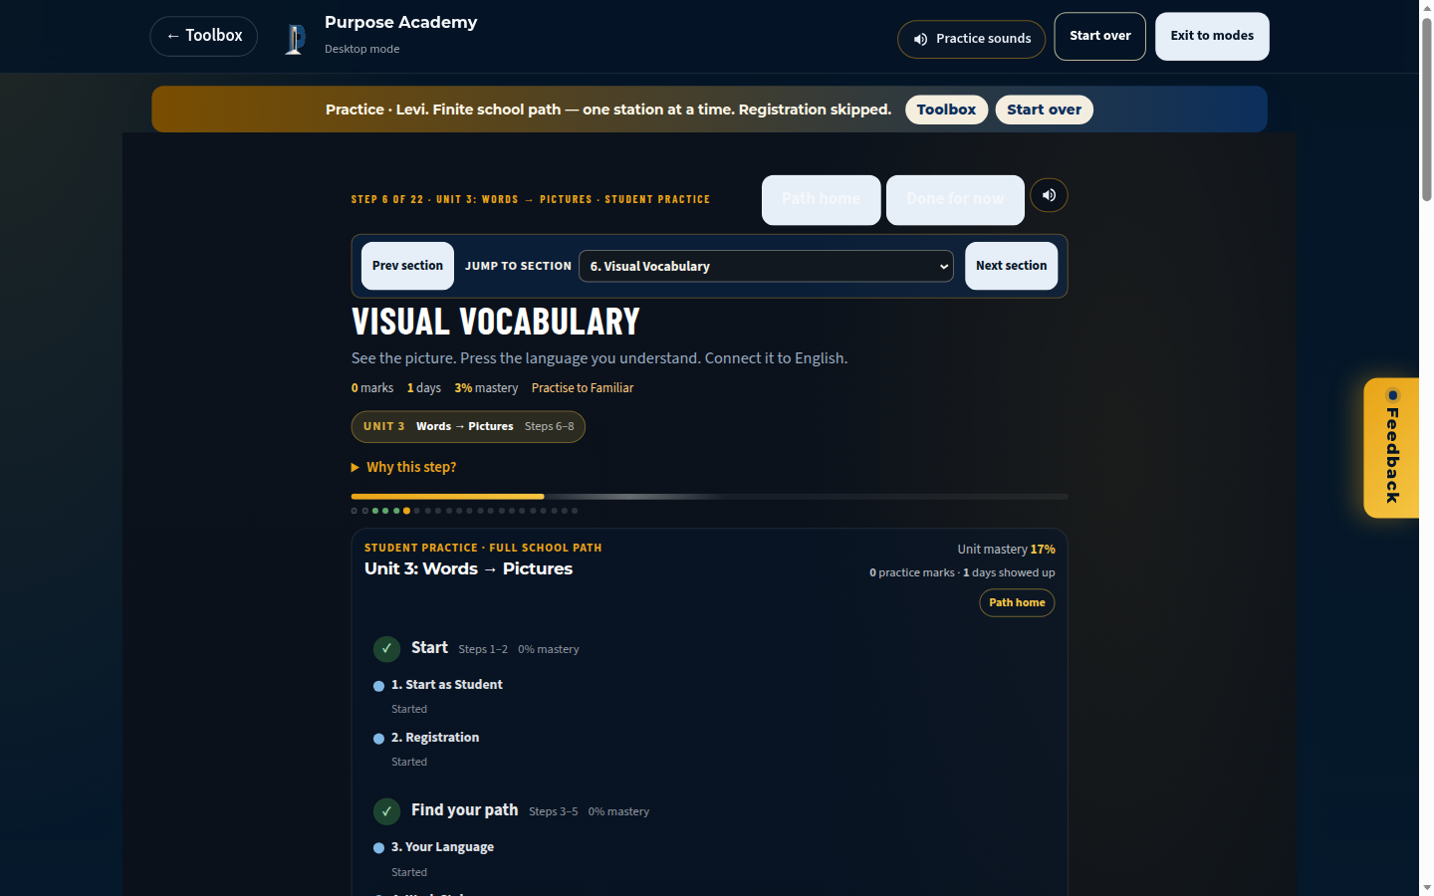
FINITE PATH · DONE FOR NOW
Learner dignity
One station in focus. The Practice banner names the path. Done for now is always available. No casino streaks. No “prove yourself” exam theatre in learner chrome.
8 / 10 · Soft Practice chrome with Done for now.

Slide 9
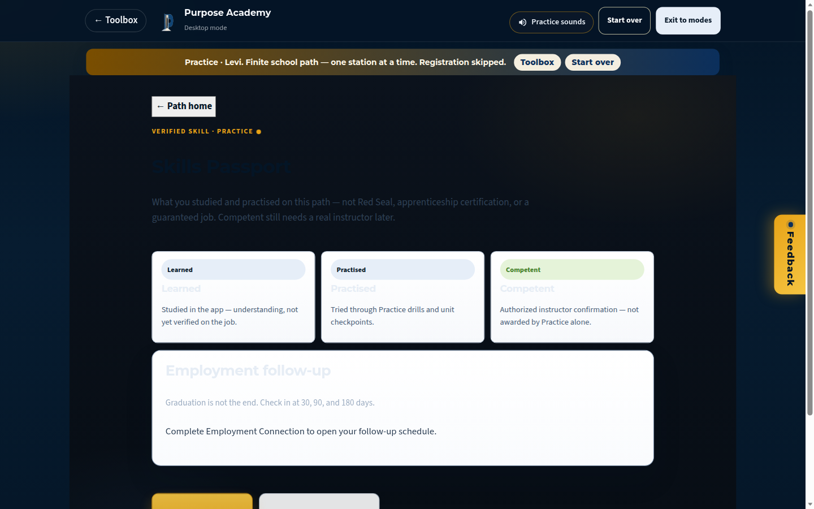
HONEST CONTINUUM — NOT A GUARANTEE
Skills Passport
Learned → Practised → Competent. Practice alone is not Red Seal, apprenticeship certification, or a job guarantee. Competent still needs a real instructor.
9 / 10 · Skills Passport honesty copy in Practice.

Slide 10
PURPOSE ACADEMY APPLICATION
Built in Calgary
Construction · Logistics · Community Support Foundations. Open the Contact tray in the toolbox when you want to talk next.
10 / 10 · One school. One station at a time.

