Slide 1



UNIVERSITY OF
CALIFORNIA

Slide 2
Applications of TBT BPM data
Levon Dovlatyan
Using TBT data for measurements and analysis
29 July 2015

Slide 3
Applications of TBT data
Model Independent Analysis (MIA) techniques
    Increased BPM precision
    Lattice error diagnostic tools
Phase and beta function approximations
Mixed BPM tune measurements

Slide 4
MIA basics
Assume b is the transverse beam position of a pulse
Zero order is sensitive to unknown BPM offset errors.
Subtracting out the average < b > will remove this term
Wang, Chun-xi. Model Independent Analysis of Beam Centroid Dynamics in Accelerators. Thesis. SLAC, 1999.
Notes:
Transverse beam position depends on various physical variables (magnet settings, rf conditions, etc...).
One can Taylor expand the beam position b over all these possible variables

Slide 5
MIA basics
Where B is a BPM data matrix with P turns and M BPMs
N (P x M) contains noise associated with each BPM.
Wang, Chun-xi. Model Independent Analysis of Beam Centroid Dynamics in Accelerators. Thesis. SLAC, 1999.
Notes:
The column vector qi contains the P values of the i-th physical variable and fi contains the M components of the corresponding physical pattern. The q’s are referred to as temporal patterns or time structures of pulses, and the f’s as spatial patterns or physical vectors.
Dimension d determined by dynamics/ d can be calculated with MIA
D ~ 10
M ~ 100
P ~ 1000

Slide 6
MIA basics
Perform a principal components analysis (PCA) on matrix B via single value decomposition (SVD)
Wang, Chun-xi. Model Independent Analysis of Beam Centroid Dynamics in Accelerators. Thesis. SLAC, 1999.
Notes:
D is the number of nonzero singular values
\sigma_i is the I-th largest singular value of B
Each set of singular vectors forms an orthogonal basis of the various spaces of the matrix.
Dimension d = # of physical variables
U and V are unitary matrices representing orthogonal temporal and spatial patterns
Spatial eigenvectors and temporal eigenvectors form two complete orthogonal bases
S carries the corresponding eigenvalues

Slide 7
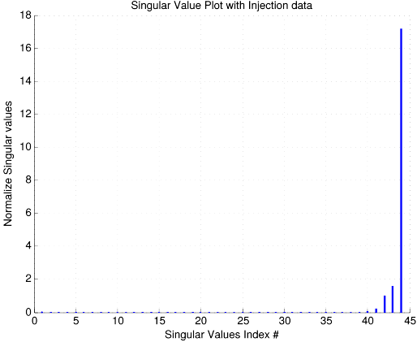
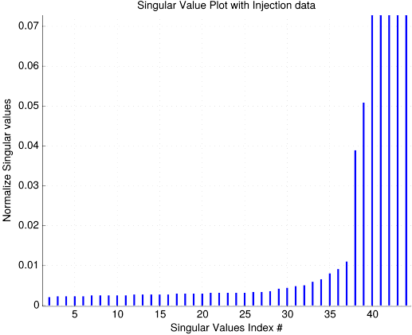
MIA – singular values
Plotting the singular values in S (diagonal elements)
same plot, zoomed in
Noise floor
Notes:
there are more than 10 significant singular values, which tell us the degrees of freedom of the system, valuable information for a beam dynamics analysis.
For example, it indicates that the beam dynamics is much more complicated than simple linear betatron motions
Normalized values because they reflect the average amplitudes of the signals
Why is that a noise floor:
Assume there was no noise. And since we know our dimension d ~ 10, this means that only the first ~10 singular values should be non zero. Since we have way more non zero terms, they must be due to noise.
Noise floor decreases with increasing BPMs used. If coherent signal this would not be the case. Decreases by 1/sqrt(M) roughly
Noise floor stays roughly constant with various P (turn) values.

Slide 8
MIA – increased resolution technique
Create BPM matrix B via excited beam
Compute an SVD of B
Set singular values due to the noise floor to zero
Recompute noise reduced BPM matrix B

Slide 9
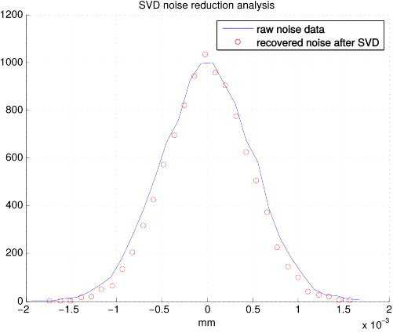
MIA – simulation
10,000 turn, 3mm kick in the horzontal and vertical with random Gaussian noise added to a single BPM.
95% CI between
-0.014 – 0.012 mm
Notes:
p =0.8478
Ci = -0.01462 0.01202 mm
stats =
tstat: -0.1919
df: 19998
sd: 4.8051e-04
Mean1:-3.788473e-06 mean2:-2.484111e-06 std1:5.013450e-04 std2:4.587260e-04

Slide 10
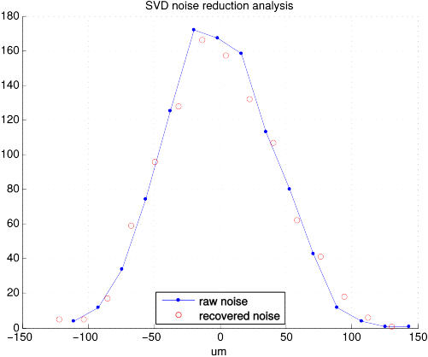
MIA – simulation
10,000 turn, 3mm kick in the horzontal and vertical with random Gaussian noise added to a single BPM.
95% CI between
-2.9 – 2.4 um
Notes:
0 mean 40 micron std noise
p =
0.8392
ci =
1.0e-05 *
-0.2927 0.2378
stats =
tstat: -0.2030
df: 999
sd: 4.2751e-05

Slide 11
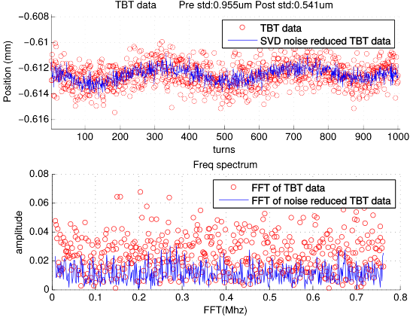
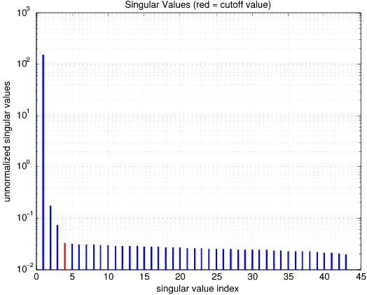
MIA – stable beam
Notes:
Injection_Set2, turn_start = 26000, turns = 1000

Slide 12
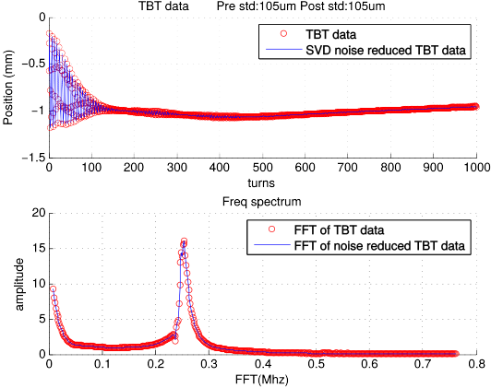
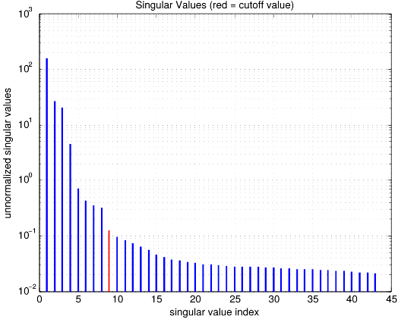
MIA – excited beam
Notes:
Injection_set2, turn_start = 27540, turns = 1000

Slide 13
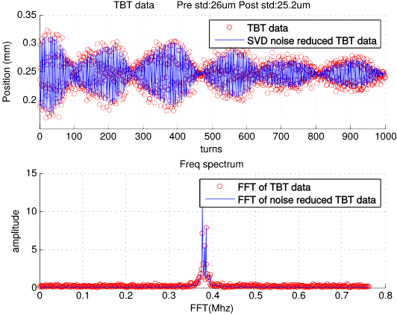
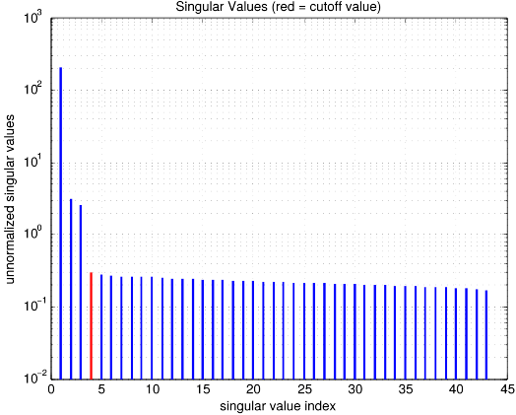
MIA – pinger excited beam (Vertical)
Notes:
Pinger, 28500 turn start, 1000 turns Vertical.

Slide 14
MIA – spatial and temporal vectors

Slide 15
MIA – spatial and temporal vectors
Singular values are eigenvalues and U & V are the corresponding eigenvectors
Column vectors of V & U are the eigenvectors of
Is the sample covariance matrix of B; this should always stay the same.
Therefore V is a stable machine property while U changes from one group to the next.
Wang, Chun-xi. Model Independent Analysis of Beam Centroid Dynamics in Accelerators. Thesis. SLAC, 1999.

Slide 16
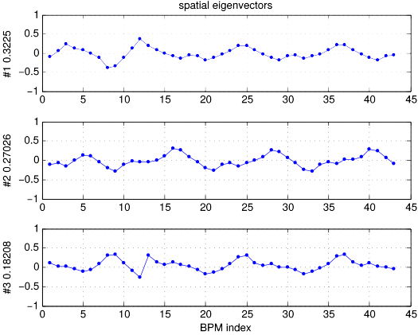
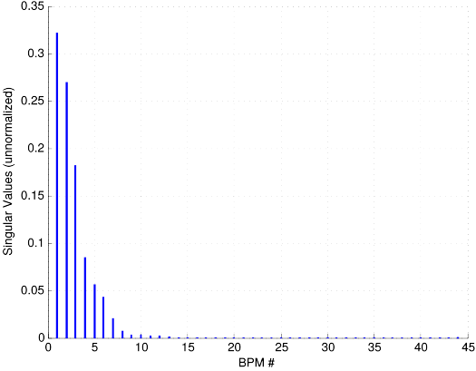
MIA – simulation of spatial vector
10,000 turn, 3mm kick in the horzontal and vertical with random Gaussian noise added to two BPMs.

Slide 17
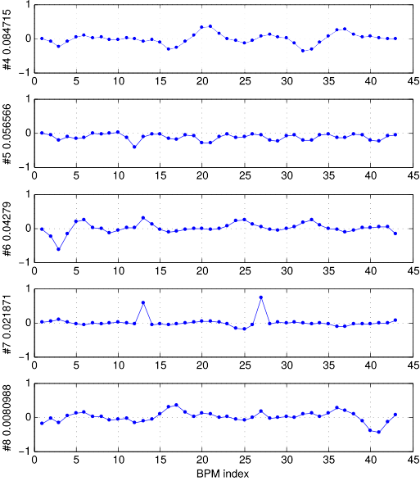
MIA – simulation of spatial vector
Noisy BPM
#13
Noisy BPM
#27

Slide 18
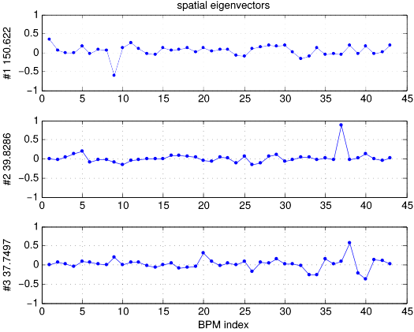
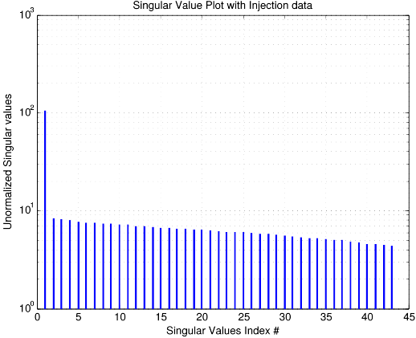
MIA – magnetic error – stable beam
Increased QF (10,2) strength by 2 Amps (~2%)

Slide 19
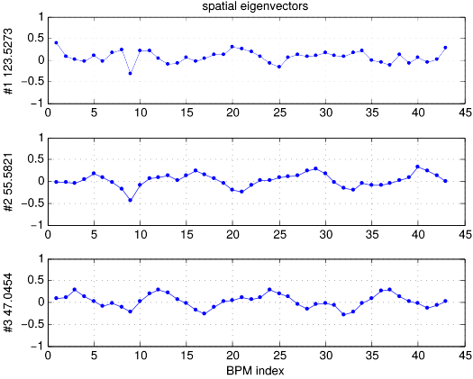
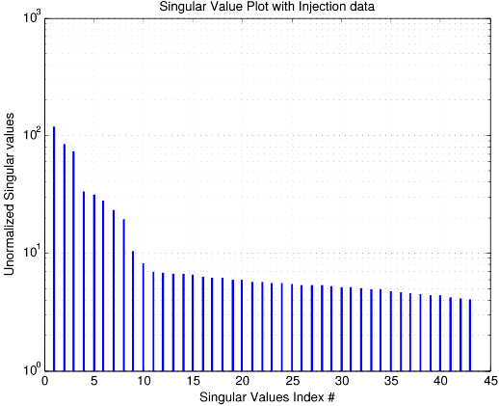
MIA – magnetic error – excited beam
Increased QF (10,2) strength by 2 Amps (~2%)

Slide 20
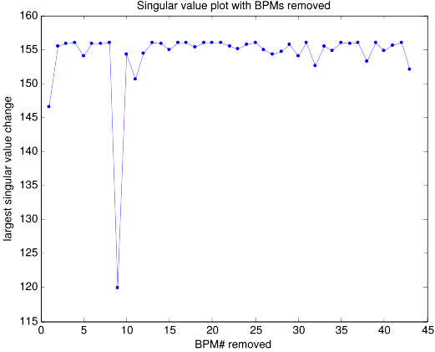
MIA – Singular values w/ removed BPMs
Increased QF (10,2) strength by 2 Amps (~2%)

Slide 21
MIA – summary
BPM precision increased by a factor of
Works best with stable beam
Deciding where the noise floor starts can be better optimized
Works well in simulation up to ~ 15-20 micron noise
Spatial vectors can be used to detect small irregularity

Slide 22
Phase & Beta measurements
Phase measurements can be made at each BPM
        With excited beam where is the amplitude at the frequency corresponding to the tune.
Taking the phase measurement differences will give the phase advances between BPMs
Use the phase advances at three consecutive BPMs to measure an approximate Beta function.
P. Castro-Garcia Thesis

Slide 23
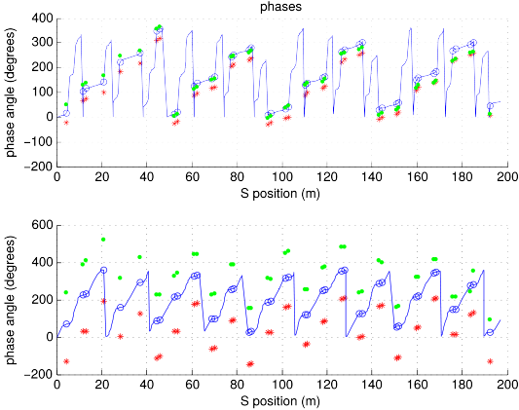
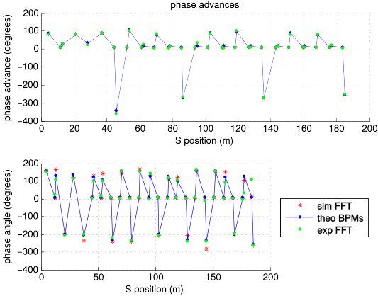
BPM phase advance

Slide 24
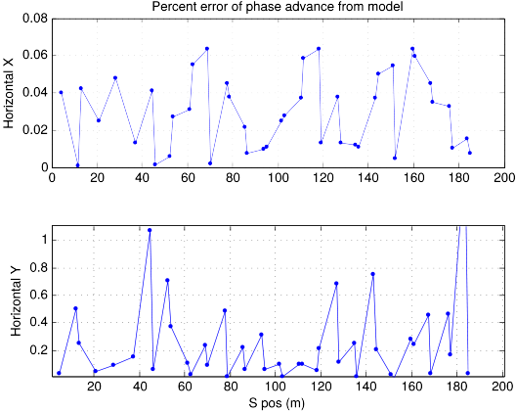
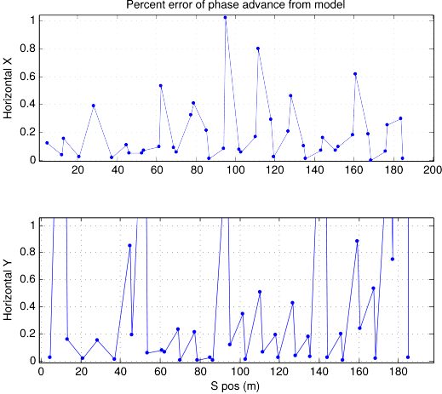
BPM phase advance errors

Slide 25
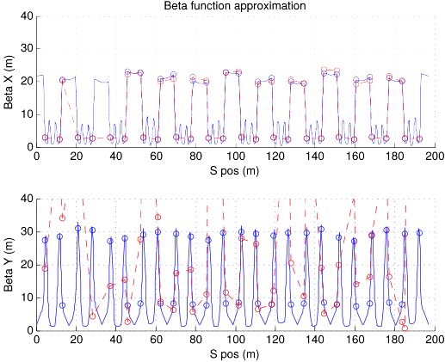
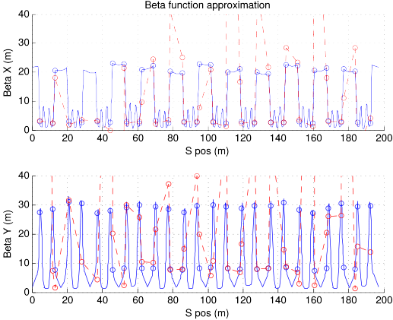
Beta Function approximations
Simulation
Experimental

Slide 26
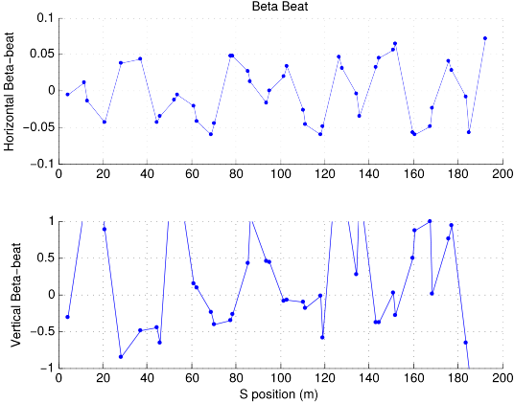
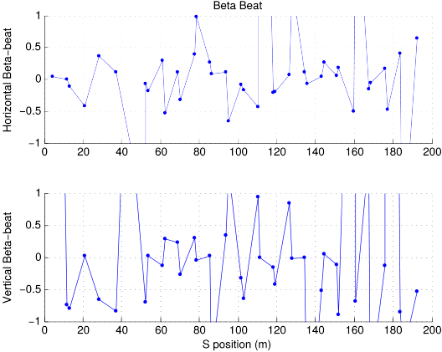
Beta-beat
Simulation
Experimental

Slide 27
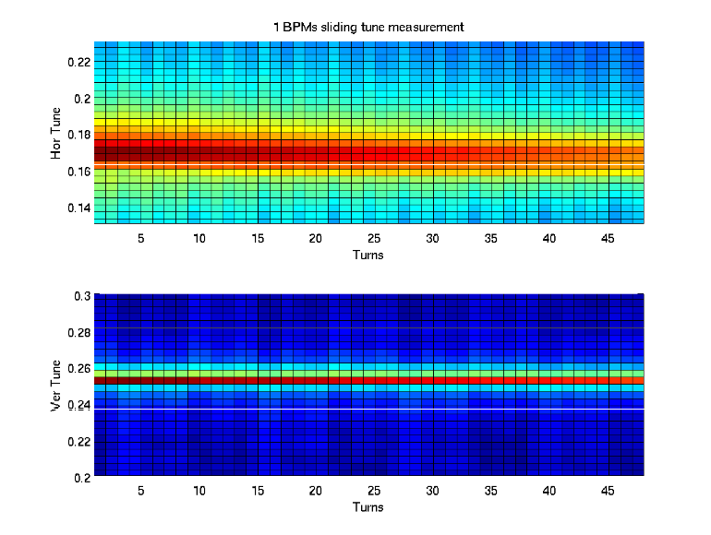
Tune Measurements
Single BPM sliding FFT from Injection
Notes:
128 turn fft, 175 data points
Injection Data

Slide 28
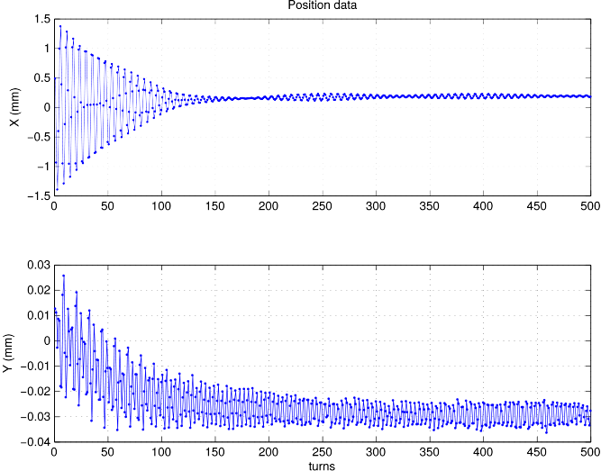
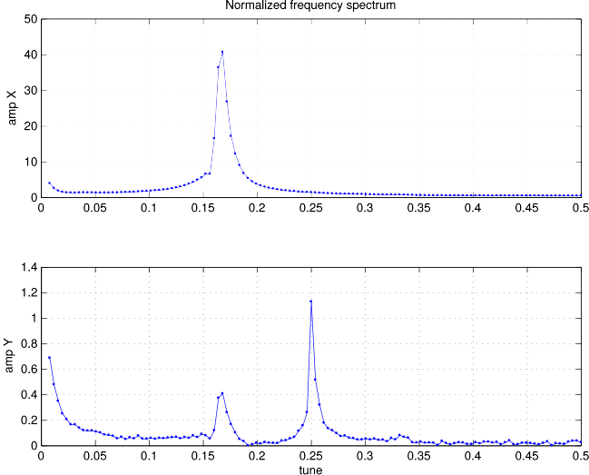
Tune Measurements
Single BPM Position & Frequency Data
Notes:
128 turn fft, 175 data points
Injection Data

Slide 29
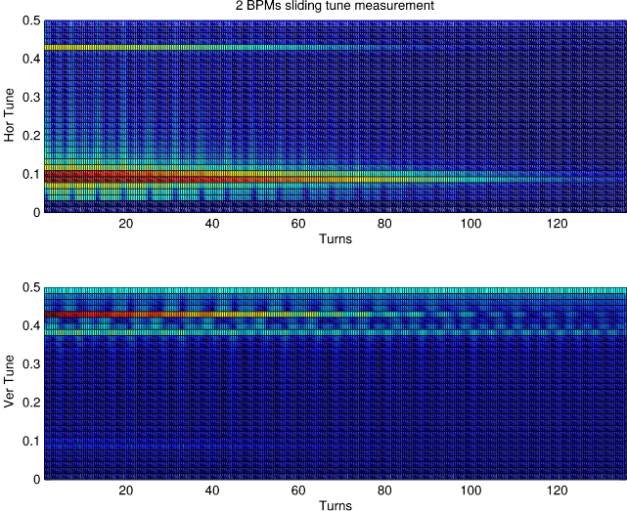
Tune Measurements
2 BPM sliding FFT from Injection
Notes:
128 turn fft, 175 data points
Injection Data

Slide 30
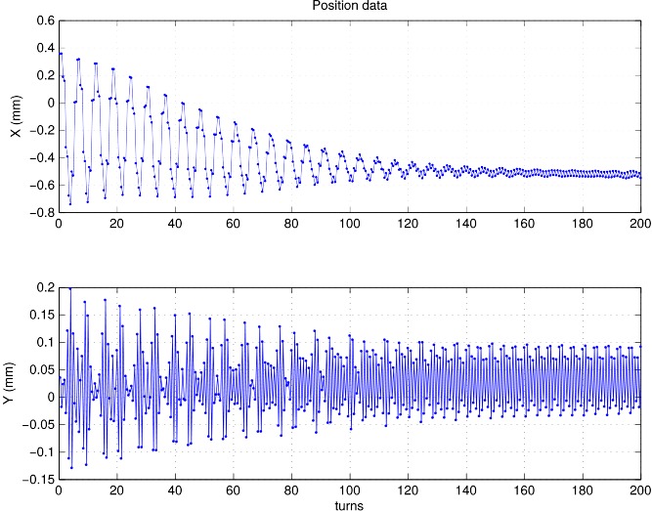
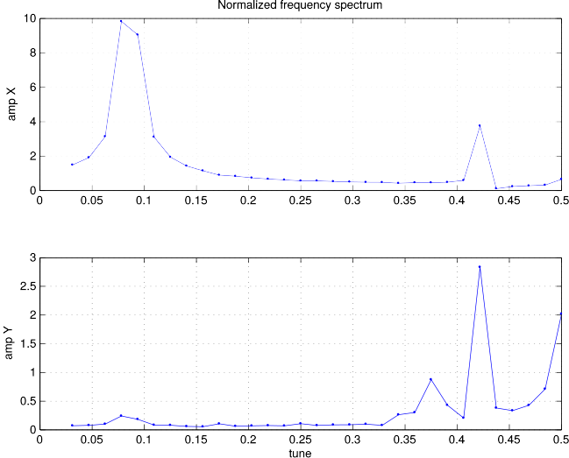
Tune Measurements
2 BPM Position & Frequency Data
Notes:
128 turn fft, 175 data points
Injection Data

Slide 31
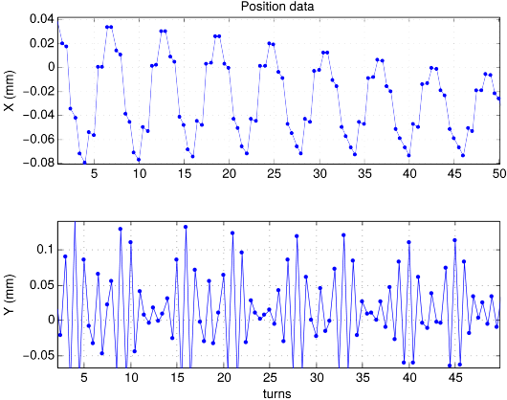
Tune Measurements
2 BPM zoomed in TBT data
Notes:
128 turn fft, 175 data points
Injection Data

Slide 32
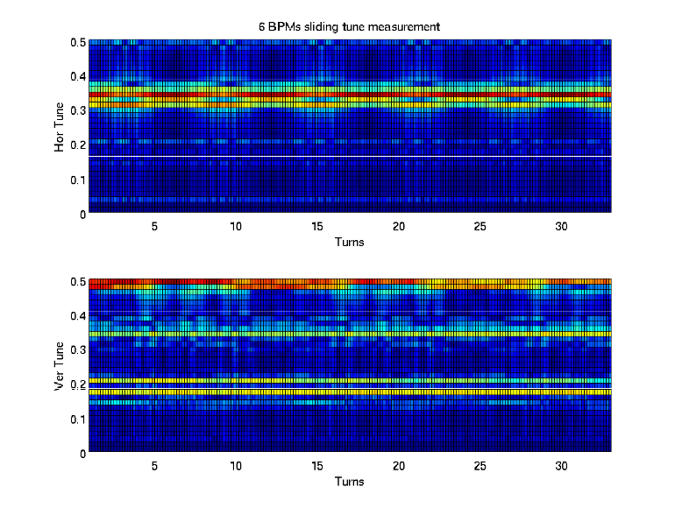
Tune Measurements
6 BPM sliding FFT from Injection
Notes:
128 turn fft, 175 data points
Injection Data

Slide 33
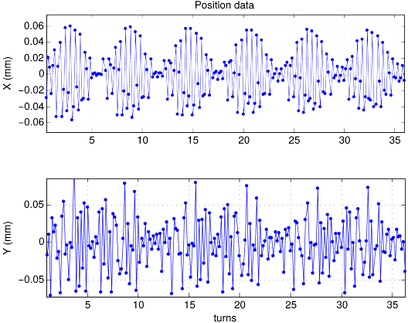
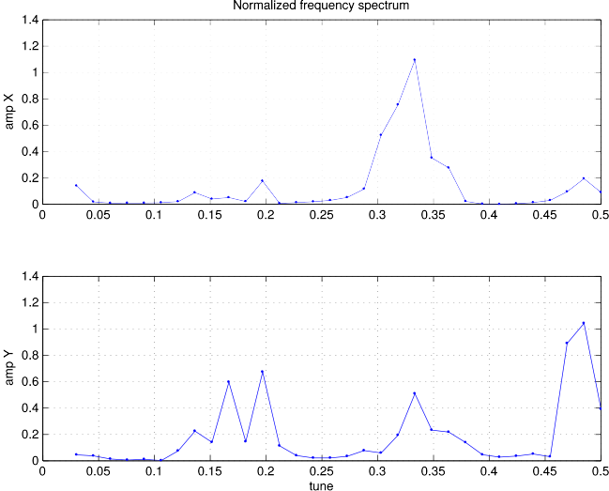
Tune Measurements
6 BPM Position & Frequency Data
Notes:
128 turn fft, 175 data points
Injection Data

Slide 34
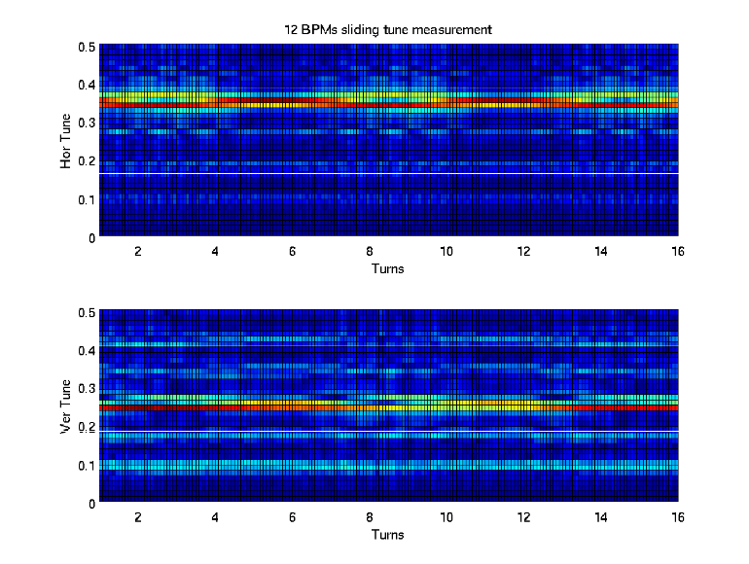
Tune Measurements
12 BPM sliding FFT from Injection
Notes:
128 turn fft, 175 data points
Injection Data

Slide 35
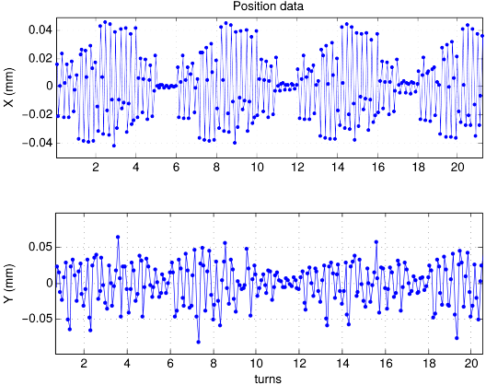
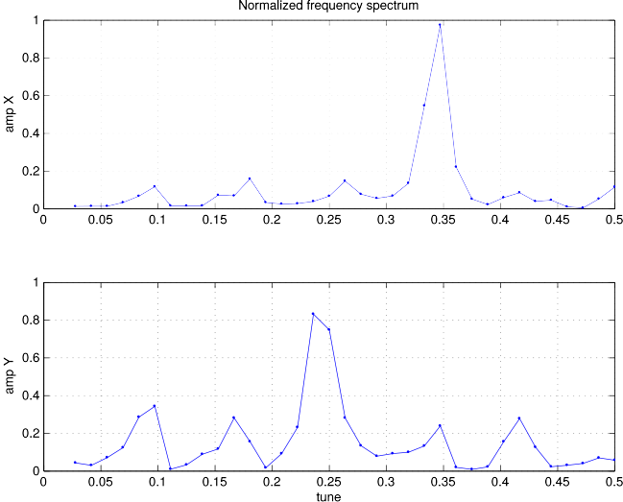
Tune Measurements
12 BPM Position & Frequency Data
Notes:
128 turn fft, 175 data points
Injection Data

Slide 36
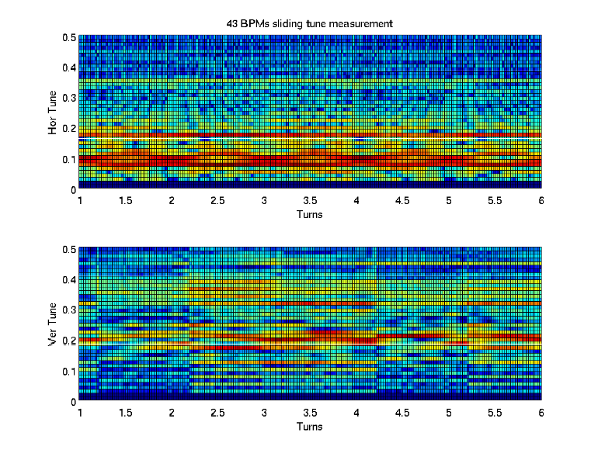
Tune Measurements
43 BPM sliding FFT from Injection
Notes:
128 turn fft, 175 data points
Injection Data

Slide 37
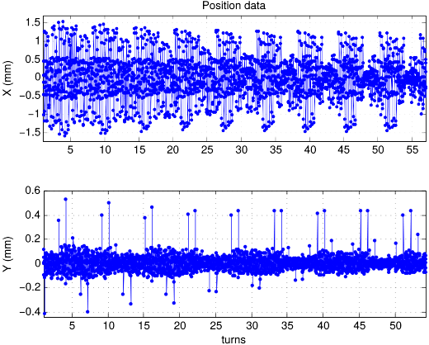
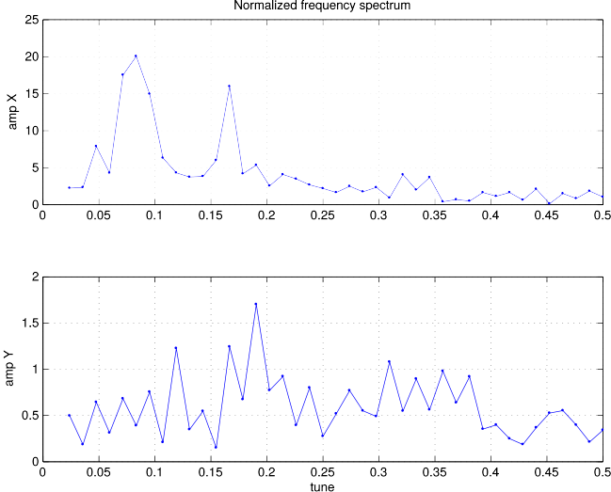
Tune Measurements
43 BPM Position & Frequency Data
Notes:
128 turn fft, 175 data points
Injection Data

Slide 38
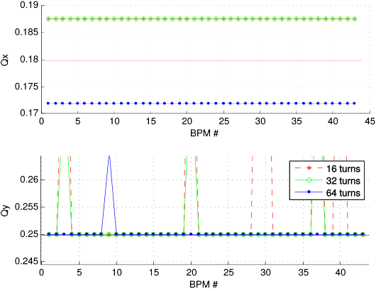
Tune Measurements
Single BPM with various FFT lengths
Notes:
128 turn fft, 175 data points
Injection Data

Slide 39
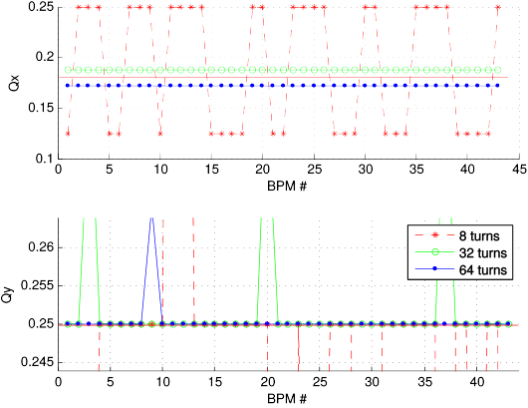
Tune Measurements
Single BPM with various FFT lengths
Notes:
128 turn fft, 175 data points
Injection Data

Slide 40
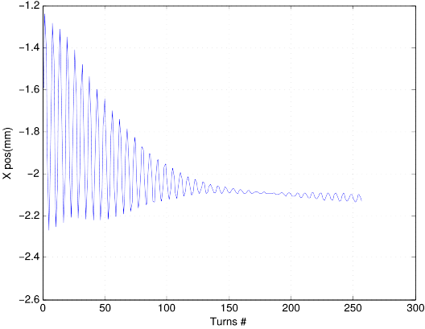
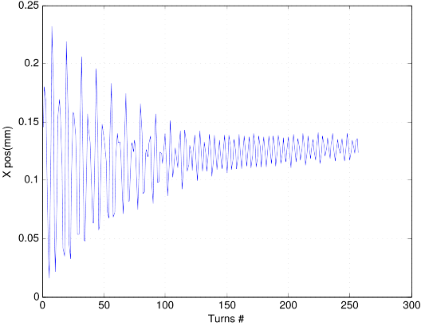
Tune Measurements
Single BPM with various FFT lengths, TBT data
Notes:
128 turn fft, 175 data points
Injection Data

Slide 41
Tune, Phase, and Beta functions
Single BPM tune measurements still the best option
BPM gains might be affecting mixed BPM tune measurements
Phase & phase advance measurements worked well
Beta function approximations did not work out well
Try measurements again when more BPMs are installed

Slide 42
For the future
Degrees of freedom plot analysis with singular values
Coupling correction with TBT data
Linear optics with TBT data (alternative to LOCO)
Try to fix mixed BPM tune measurements
Phase & Beta function measurements with MIA techniques

