Slide 1
Motivation
ALS-U requires that commissioning be completed in a few months
Turn-by-turn BPMs allow the ability to measure certain machine properties such as tunes and phase advances with very few turns
Being able to measure these machine properties with very few turns will reduce the time it takes for lattice calibration during commissioning
<number>
Notes:
<number>

Slide 2
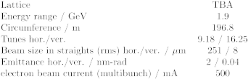
BPMs & ALS parameters
43 state of the art turn-by-turn (TbT) BPMs were installed in the ALS storage ring last year
Plans to install ~160 BPMs across the ALS storage ring, booster ring, and linac line later this year
BPMs provide TbT data to single digit micron resolutions

Slide 3
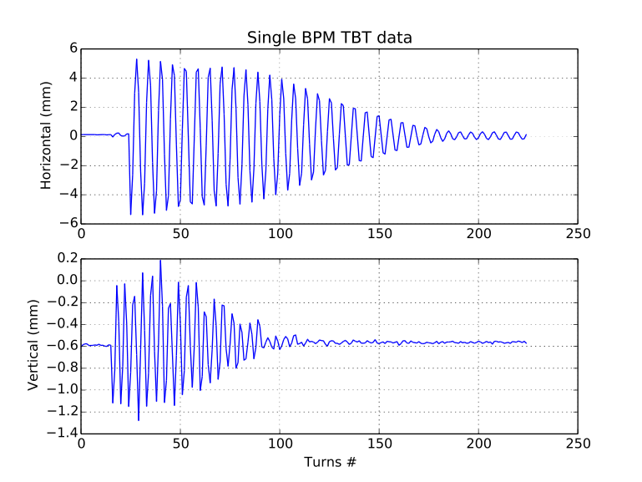
Mixed BPM tune measurement
Single turn pinger magnet kick in both transverse planes
Used 8 bunches, 2mA current in each bunch

Slide 4
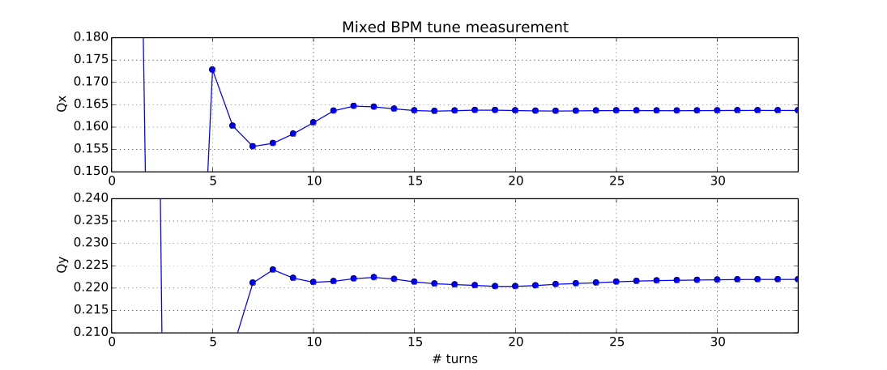
Mixed BPM tune measurement
TbT data from 43 BPMs used together with NAFF to measure tune

