Slide 1
Early Prediction of Lithium-Ion Battery End-of-Life
GNEM Research Fellow · Levon Lau · July 2026 github.com/levonl22/gnem-battery-degradation

Slide 2
Problem & motivation
Lithium-ion cells lose capacity over cycling; full life tests can run hundreds to thousands of cycles
Goal: predict end-of-life (EOL) from early-cycle measurements before obvious fade
EOL definition: first cycle where discharge capacity < 80% of initial capacity (cycle_index ≥ 1)
Dataset: MIT-Stanford-Toyota fast-charging cohort (Severson et al., 2019)
Approach: reproducible Python pipeline → hand-crafted features + tree models vs GRU sequence model → monotonic SOH check → early-cycle window ablation

Slide 3
Dataset & pipeline
Raw: 140 JSON files (FastCharge_*_structure.json) from MATR.io
Cleaned: 134 unique cells (duplicate barcodes → longest run kept; one partial cell dropped)
Grain: about 111k per-cycle rows in cycle_summary.csv; 44 cell-level features in cell_features.csv
Split: cell-level 94 / 20 / 20 train · val · test (random_state = 42) — never random row splits
Pipeline: notebooks 01–10 · processed CSVs · metrics JSON · figures in results/

Slide 4
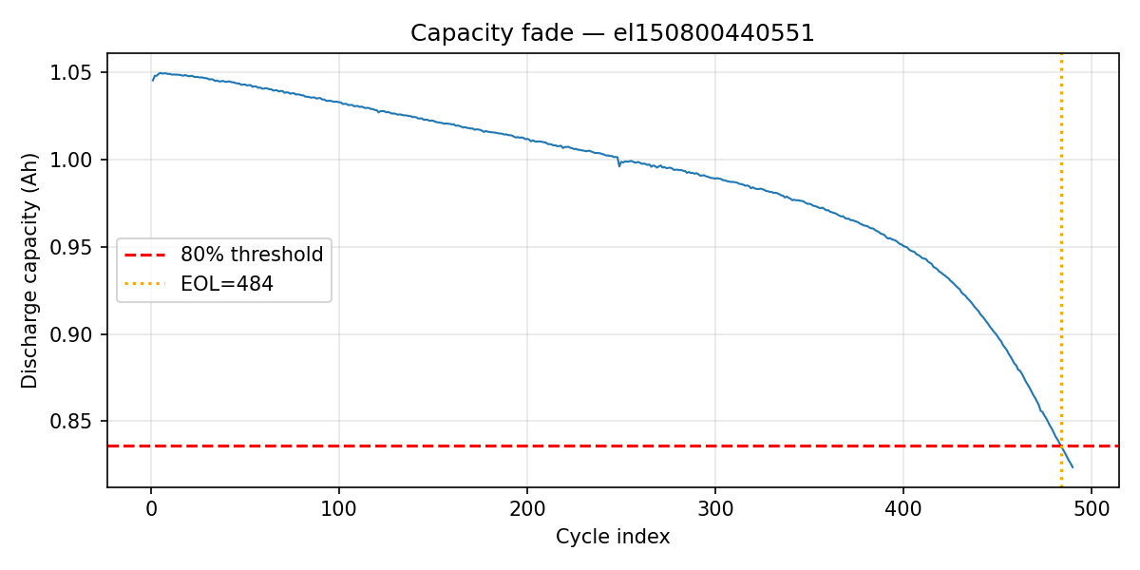
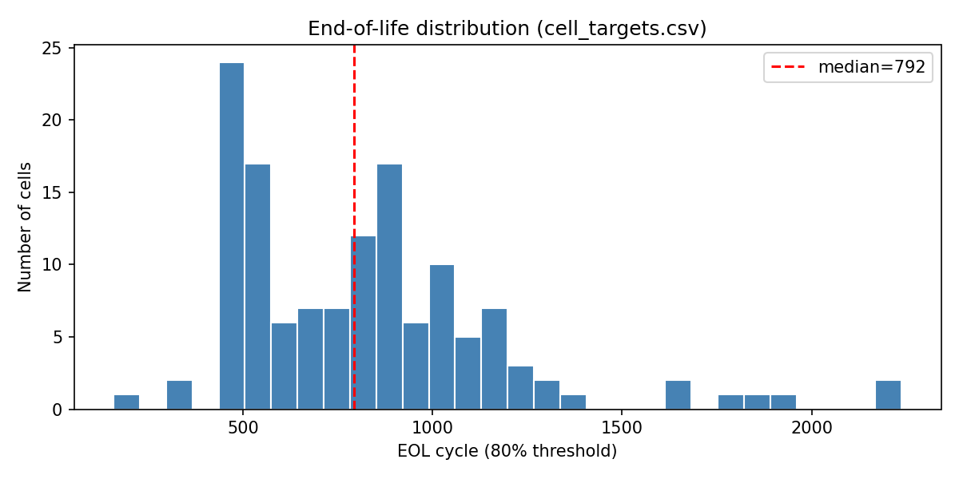
Labels — capacity fade & cycle-life spread
Single cell: discharge capacity vs cycle
Red dashed: 80% threshold · orange: computed EOL
Figure: results/figures/capacity_fade_example.png
134 cells · median EOL about 792 cycles · range 159–2,237
Wide spread motivates cell-level modeling and cautious test metrics
Figure: results/figures/eol_distribution.png

Slide 5
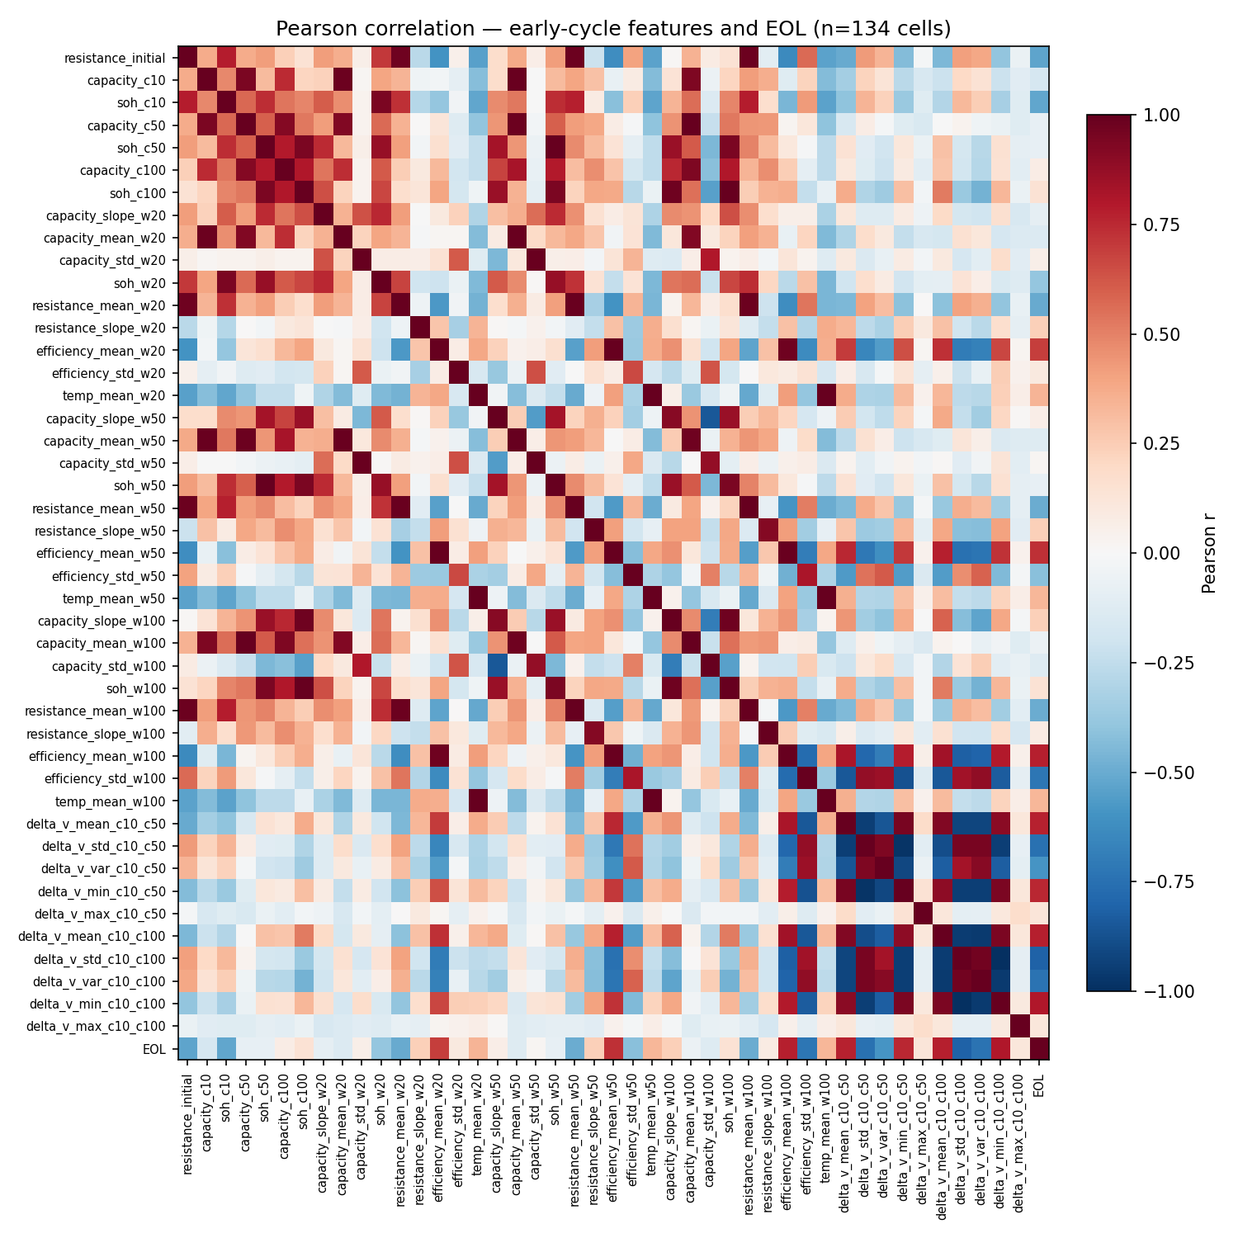
Early-cycle features (Week 3)
Input windows: first 20 / 50 / 100 cycles per cell
44 features per cell: capacity, SOH, resistance, energy efficiency, temperature summaries + Severson-style ΔV(Q) (voltage-curve change between cycles 10→50 and 10→100)
Exploratory screening: Pearson correlation vs EOL on all 134 cells
Strongest linear signals: ΔV(Q) spread (delta_v_std_c10_c100, |r| about 0.8) · efficiency (efficiency_mean_w100, r about 0.78)
Weaker alone: raw capacity at cycle 100 — curve shape and efficiency shift before obvious fade
Figure: results/figures/feature_correlation.png

Slide 6
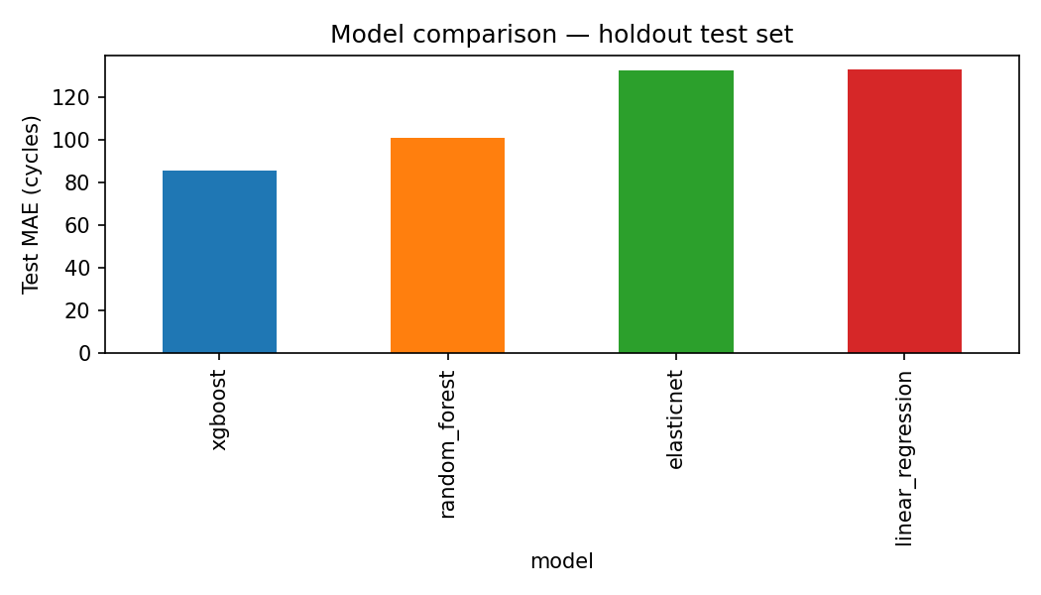
Classical ML baselines (20-cell test set)
Input: cell_features.csv — 44 features · Target: EOL
Models: linear regression · ElasticNet · random forest · XGBoost
Tuning: validation MAE · Test set untouched during hyperparameter search
Model | MAE | MAPE (about)
Linear | 133 | 18%
ElasticNet | 132 | 19%
Random forest | 101 | 13%
XGBoost | 85 | 11%
Figure: results/figures/model_comparison_baselines.png

Slide 7
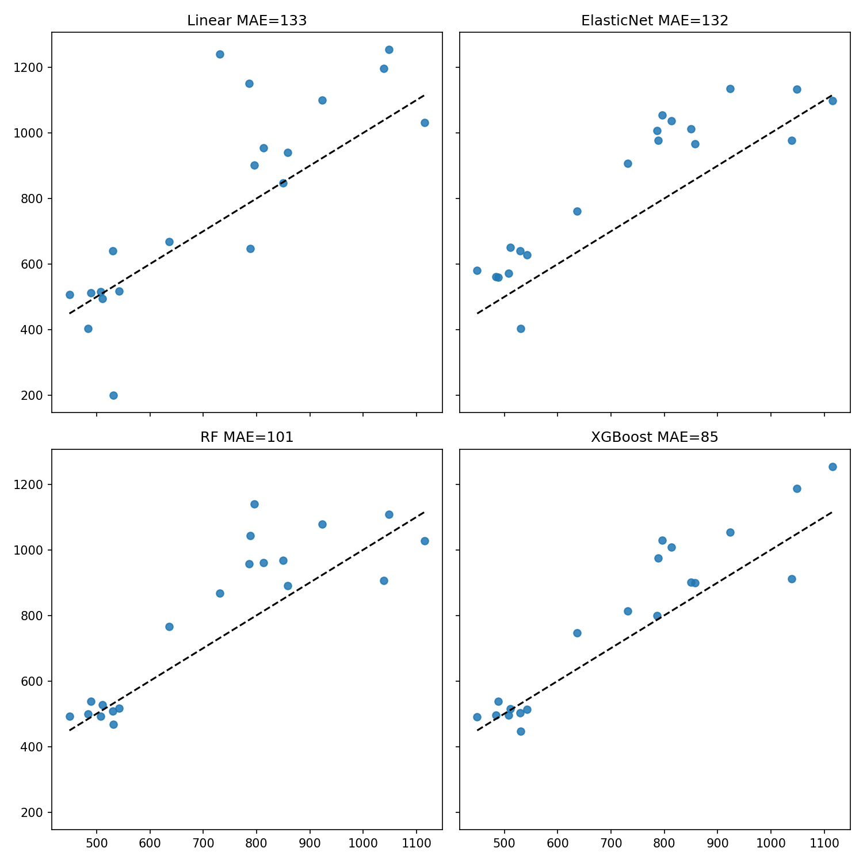
Tabular models — predicted vs true EOL (test)
Tree ensembles clearly beat linear models on holdout
XGBoost best: about 85 cycles MAE (about 11% MAPE)
RF / XGBoost importance: ΔV(Q) and energy efficiency rank highest (consistent with correlation)
Caveat: only 20 test cells → indicative metrics
Figure: results/figures/pred_vs_true_eol_baselines.png

Slide 8
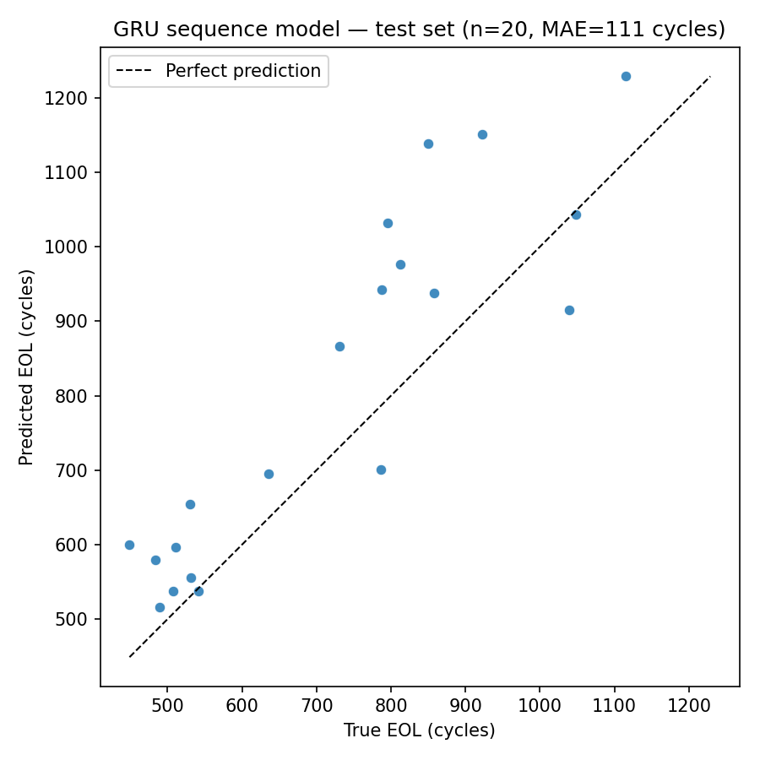
GRU on early per-cycle trajectories
Input: first 100 cycles × 4 channels — SOH, resistance, energy efficiency, temperature (cycle_summary.csv)
Model: PyTorch GRU · 16-combo hyperparameter grid on validation MAE
Not in sequence input: ΔV(Q) features (live in raw JSON only)
Test MAE: about 110 cycles — competitive but behind XGBoost (about 85)
Plausible reasons: 94 training cells · no voltage-curve channels · little capacity fade in first 100 cycles
Figure: results/figures/pred_vs_true_eol_sequence.png

Slide 9
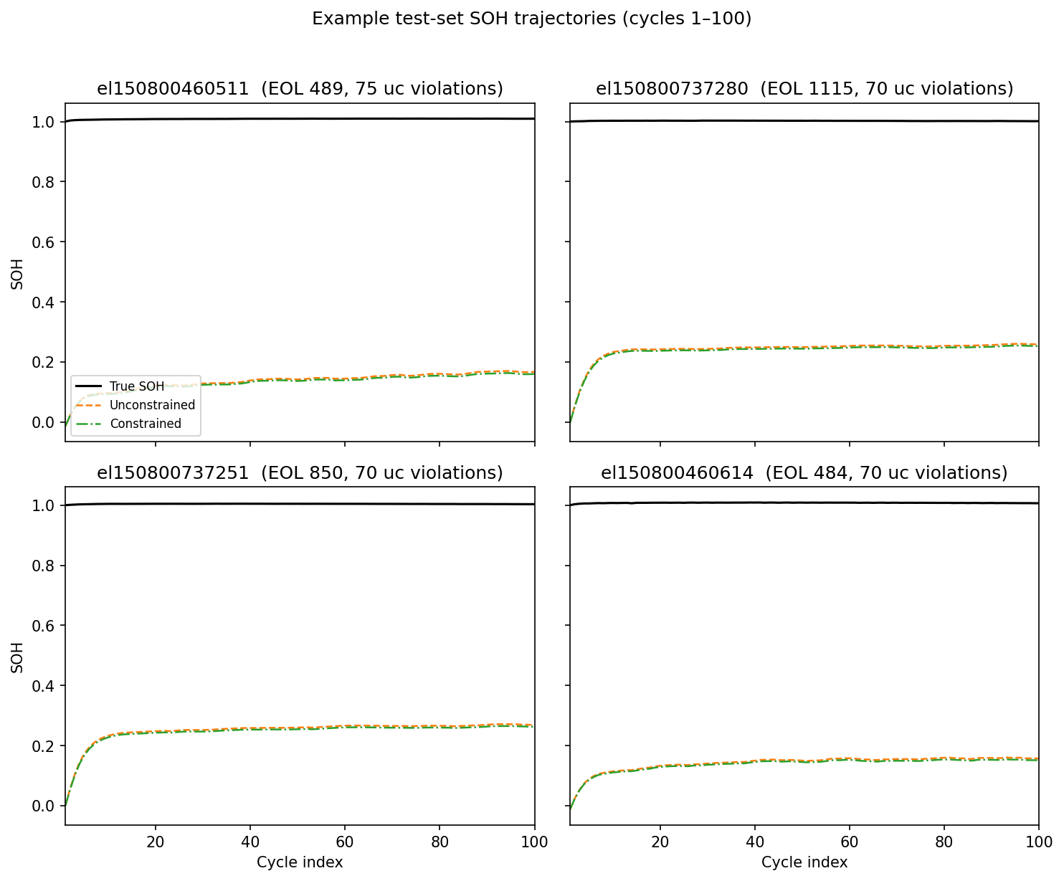
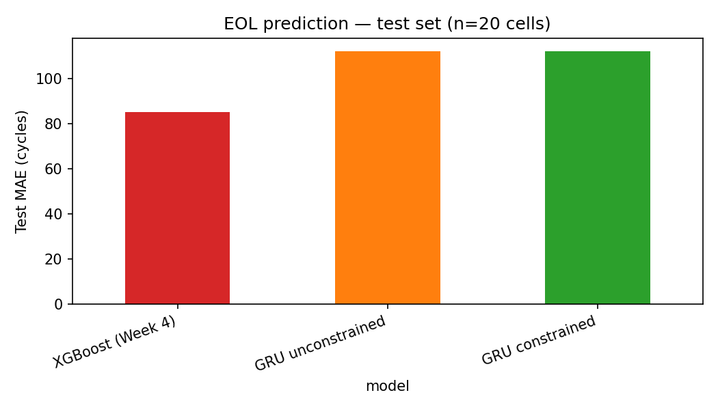
Physics-inspired SOH regularization (Week 6)
Dual-head GRU: predicts EOL + SOH trajectory (100 values per cell)
Monotonic penalty: discourage SOH increasing cycle-to-cycle (λ ∈ {0.01, 0.1, 1.0})
EOL test MAE: about 112 cycles constrained vs unconstrained — essentially unchanged
Violation rate drops only slightly; XGBoost still best for EOL
Light regularizer — not a full physics-informed neural network
Figures: results/figures/soh_curves_constrained.png, results/figures/model_comparison_soh_penalty.png

Slide 10
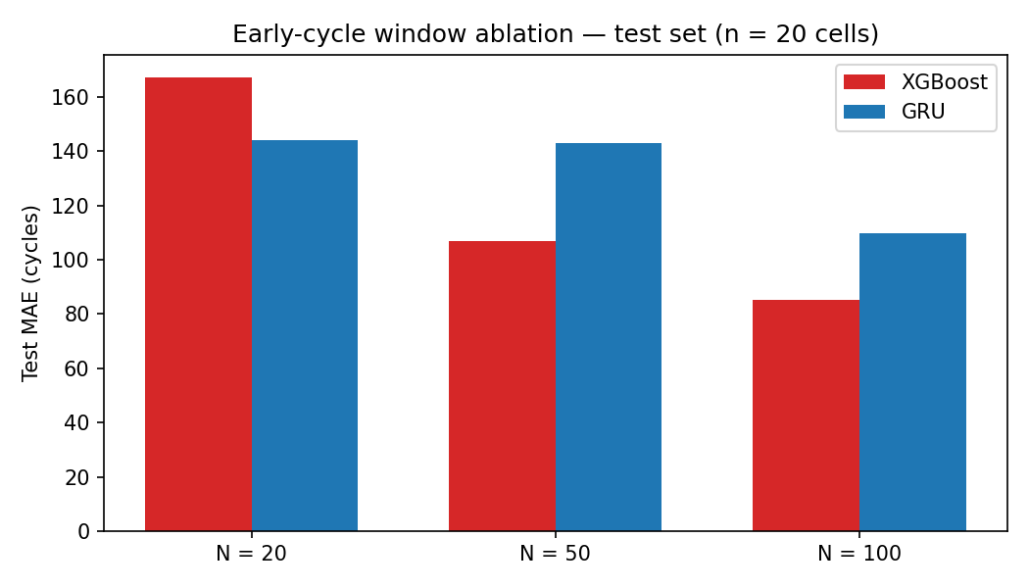
Classical ML baselines (20-cell test set)
Question: if you only observe the first N cycles, how well can you predict EOL?
Same split & metrics · XGBoost uses valid feature subset at each N · GRU uses first N timesteps
N | XGBoost | GRU
20 | 167 | 144
50 | 107 | 143
100 | 85 | 110
XGBoost gains sharply with N (ΔV(Q) from N ≥ 50)
GRU flat at 20–50, improves at 100
Best model is context-dependent on window length
Figure: results/figures/ablation_early_cycles.png

Slide 11
Limitations
Small cohort: 134 cells · 20-cell test holdout → high metric variance
Single dataset: LFP/graphite · fast-charge protocol only; transfer untested
Asymmetric inputs: XGBoost uses ΔV(Q) from raw JSON; GRU uses four summary channels only
Duplicate barcodes in raw files (longest run kept); residual protocol heterogeneity possible
Mechanism-agnostic features — capacity summaries do not identify degradation mode
EOL definition — 80% of first measured capacity is one convention among many

Slide 12
Conclusions & future work
Built a reproducible pipeline from raw JSON to ML-ready tables, models, and figures
Best overall: XGBoost at N = 100 — test MAE about 85 cycles (about 11% MAPE)
Early screening: about 50–100 cycles + voltage-curve / efficiency features support useful lifetime estimates
Sequence model: GRU viable but does not beat tabular model at full window on this dataset size
Monotonic SOH penalty: small curve-shape effect; does not improve EOL error
Future work:
External validation (NASA / CALCE) · ΔV(Q) channels in sequence models · larger cohorts
Deliverables: 8–12 page report · GitHub repo · docs/future_work.md

