Slide 1
FLIMPA User Manual
v2.0.0
Phasor-plot analysis of TCSPC-FLIM data

Slide 2
Getting started
Installation and system requirements
• macOS: download the v2.0.0 .dmg, drag FLIMPA to Applications; if blocked use System Settings → Privacy & Security → Open Anyway.
• Windows: download the latest executable; if SmartScreen appears choose More info → Run anyway.
• From source: Python 3.11+, install requirements and run main.py.
• Recommended image size ≤512×512 px; time-lapse analysis is not supported.

Slide 3
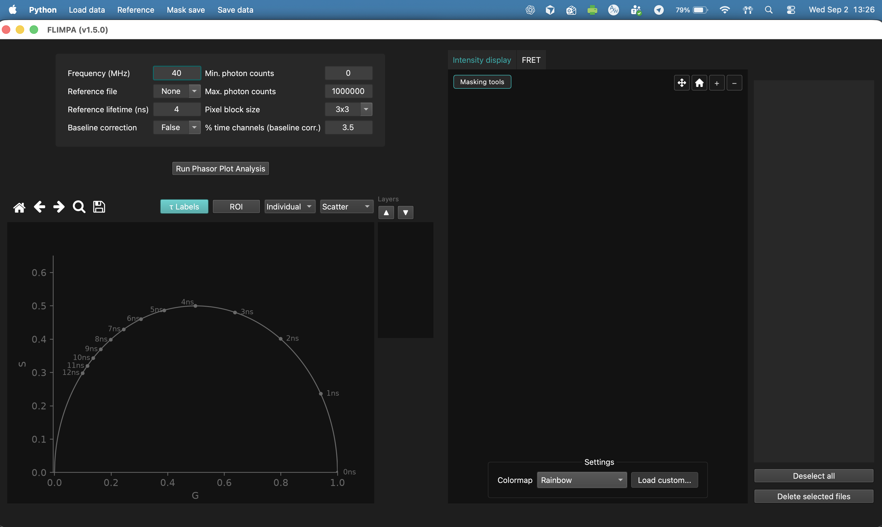
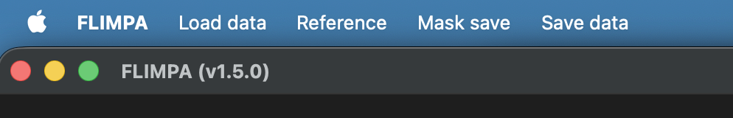
Main window and menus
• Left: analysis parameters and phasor plot.
• Centre: Intensity display / result tabs.
• Right: loaded-file table.
• Top menus: Load data, Reference, Mask save, Save data.

Slide 4
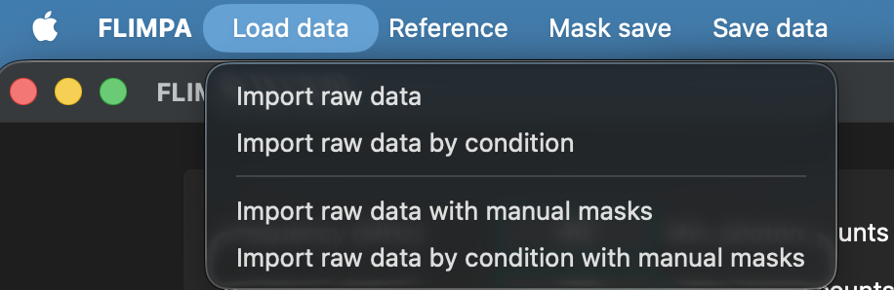
Loading data
• Supported formats: .sdt, .ptu, .tif/.tiff.
• TIFF ordering: (time, x, y).
• Load raw data directly, by condition, with manual masks, or both by condition and with masks.
• Single files/samples only; no time-lapse analysis.

Slide 5
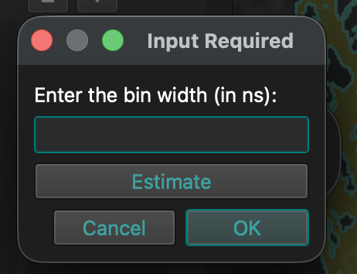
TIFF and PTU import
• TIFF: provide the bin width in ns; Estimate is available but the instrument value is preferred.
• PTU: select channel and time binning.
• For time dimensions >512, time binning reduces memory use and speeds analysis.
• Avoid excessive binning for low-photon data (<100 photons/pixel).

Slide 6
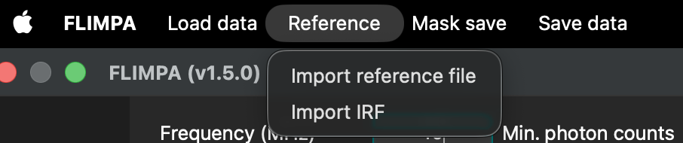
Reference and calibration
• A mono-exponential reference with known lifetime is recommended for instrumental correction.
• Reference → Import reference file; enter Reference lifetime (ns).
• The same lifetime is used as donor τ_D for FRET.
• Reference → Import IRF accepts .sdt or two-column .csv; IRF-based correction is less accurate than a mono-exponential reference.

Slide 7
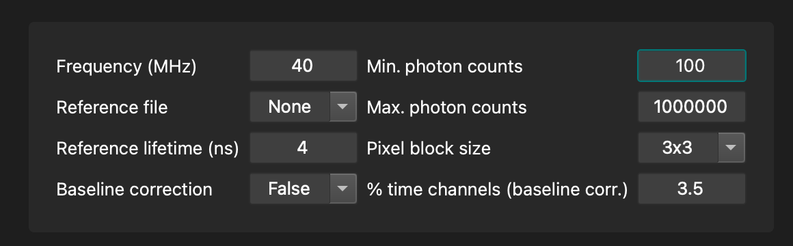
Running Phasor Plot Analysis
• Frequency (MHz): laser repetition rate.
• Reference file and lifetime.
• Pixel block size: spatial N×N binning (None, 3×3, 7×7, 9×9, 12×12).
• Min/max photon counts define the threshold mask.
• Baseline correction uses the earliest time channels; default fraction 3.5%.
• If real signal is present in early bins, baseline correction can create artefacts.

Slide 8
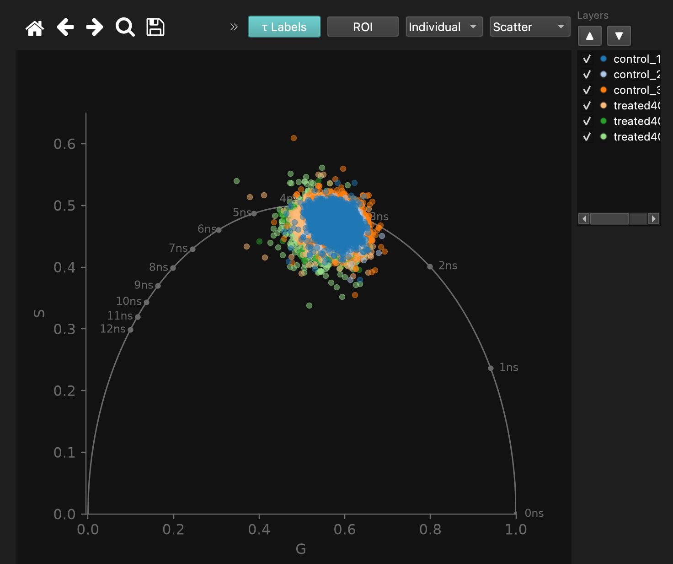
Phasor plot
• G is the horizontal axis; S is the vertical axis.
• Universal circle and τ Labels support lifetime interpretation.
• Display clouds as Scatter, Histogram or Contour; colour by Individual or Condition.
• Gallery Layers can show/hide and reorder files.

Slide 9
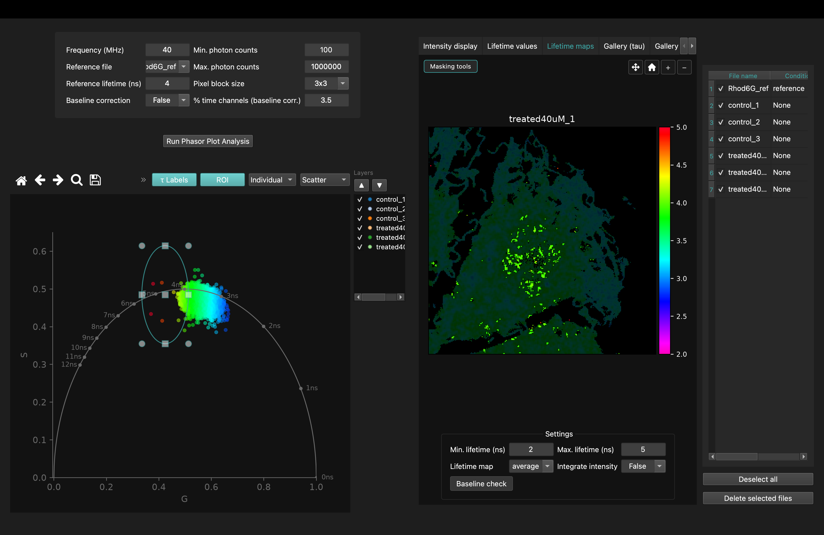
Phasor ROI
• Draw an elliptical ROI in phasor space.
• Pixels outside the selected phasor region are dimmed in the lifetime-map preview.
• Save the selection using Mask save → Save ROI mask.

Slide 10
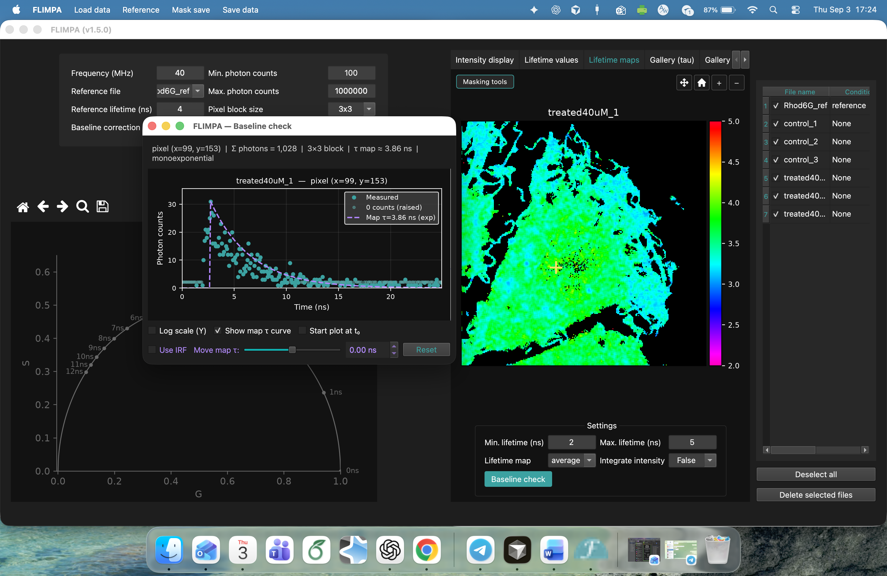
Lifetime maps and Baseline check
• Choose average, M or phi lifetime and set the colour-bar range.
• Intensity can be integrated into the lifetime display.
• Enable Baseline check and click a pixel to inspect its decay.
• Inspector options: Log scale, map-τ curve, start at t₀, IRF, and display-only ±5 ns τ shift.

Slide 11
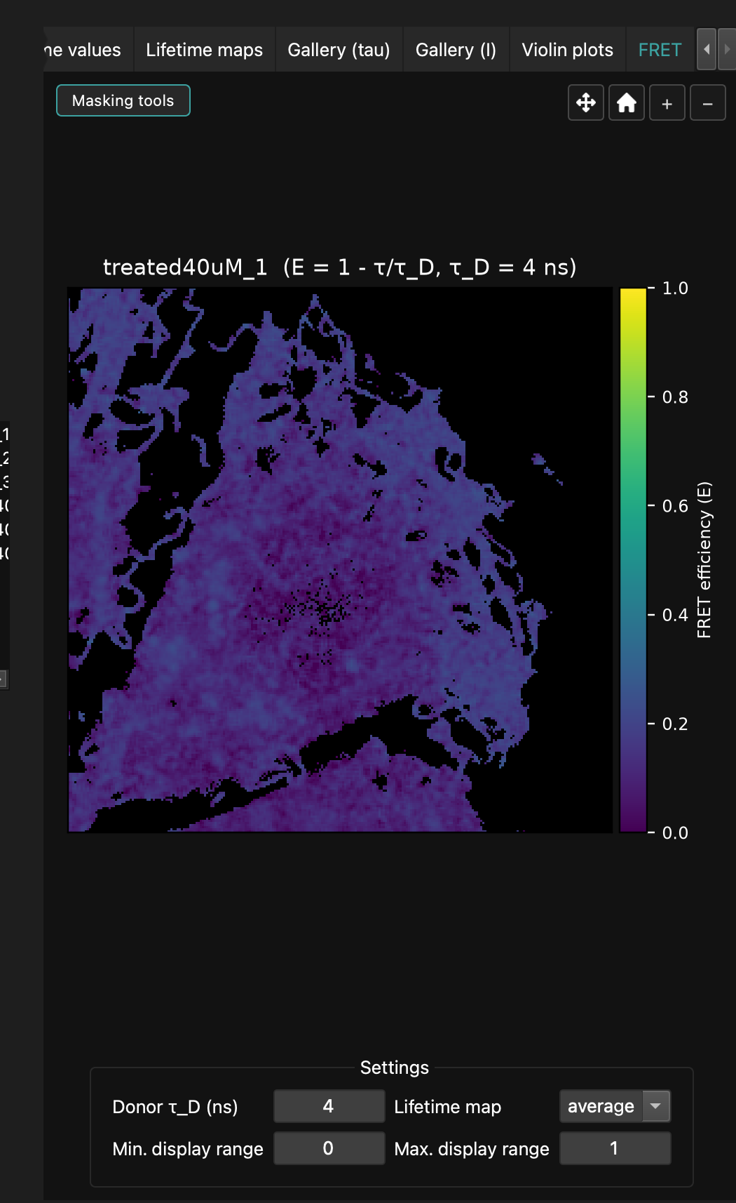
FRET efficiency maps
• FRET efficiency: E = 1 − τ/τ_D.
• Display range is 0–1.
• τ_D is the donor/reference lifetime entered for analysis.
• After analysis, FRET is the rightmost tab.
• Intensity, lifetime and FRET views support pan, zoom and reset.

Slide 12
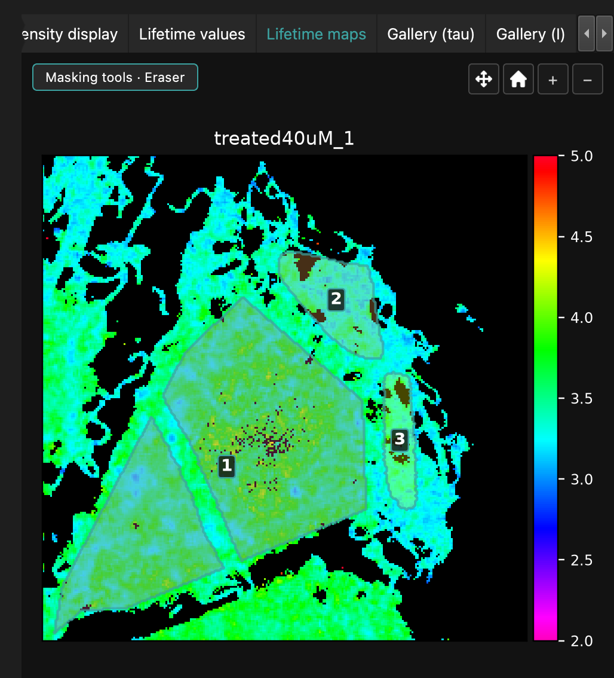
Masking
• Three restrictions: manual mask, phasor ROI mask, photon-count threshold.
• Saved masks are uint16 labelled TIFFs: 0 background, 1…N regions.
• Tools: Polygon, Lasso, Brush (1–30 px), Delete region, Eraser, Clear mask.
• Eraser removes pixels locally; Delete region removes the entire label ID.

Slide 13
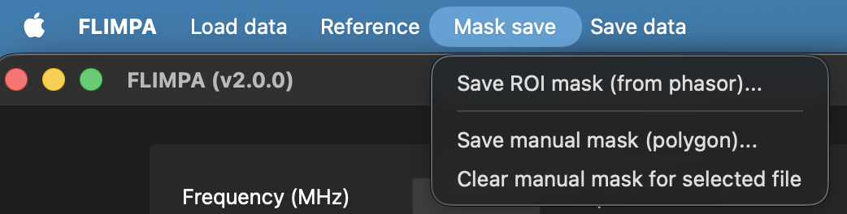
Saving and re-importing masks
• Mask save → Save manual mask / Save ROI mask / Clear manual mask.
• Saving writes the TIFF and applies it in the current session.
• After restarting FLIMPA, saved masks are not automatically rediscovered.
• Re-import via Load data → Import raw data with manual masks.

Slide 14
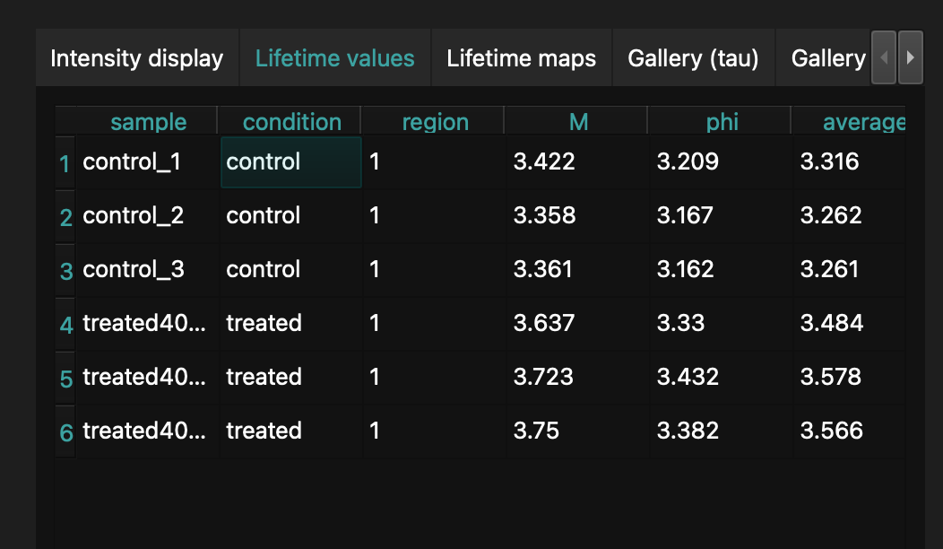
Results: Lifetime values
• Reports modulation (M), phase (phi), and average lifetime.
• With multi-ROI masks, values are reported per ROI.
• Group by Condition gives the condition mean.
• Group by Sample gives the image mean when multiple ROIs are present.

Slide 15
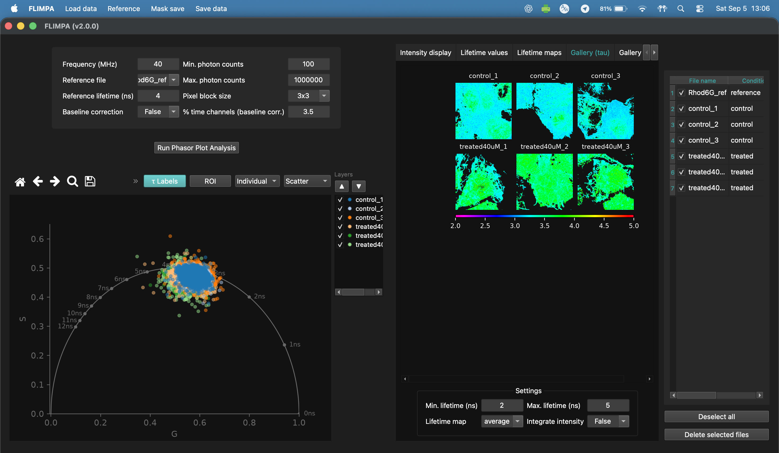
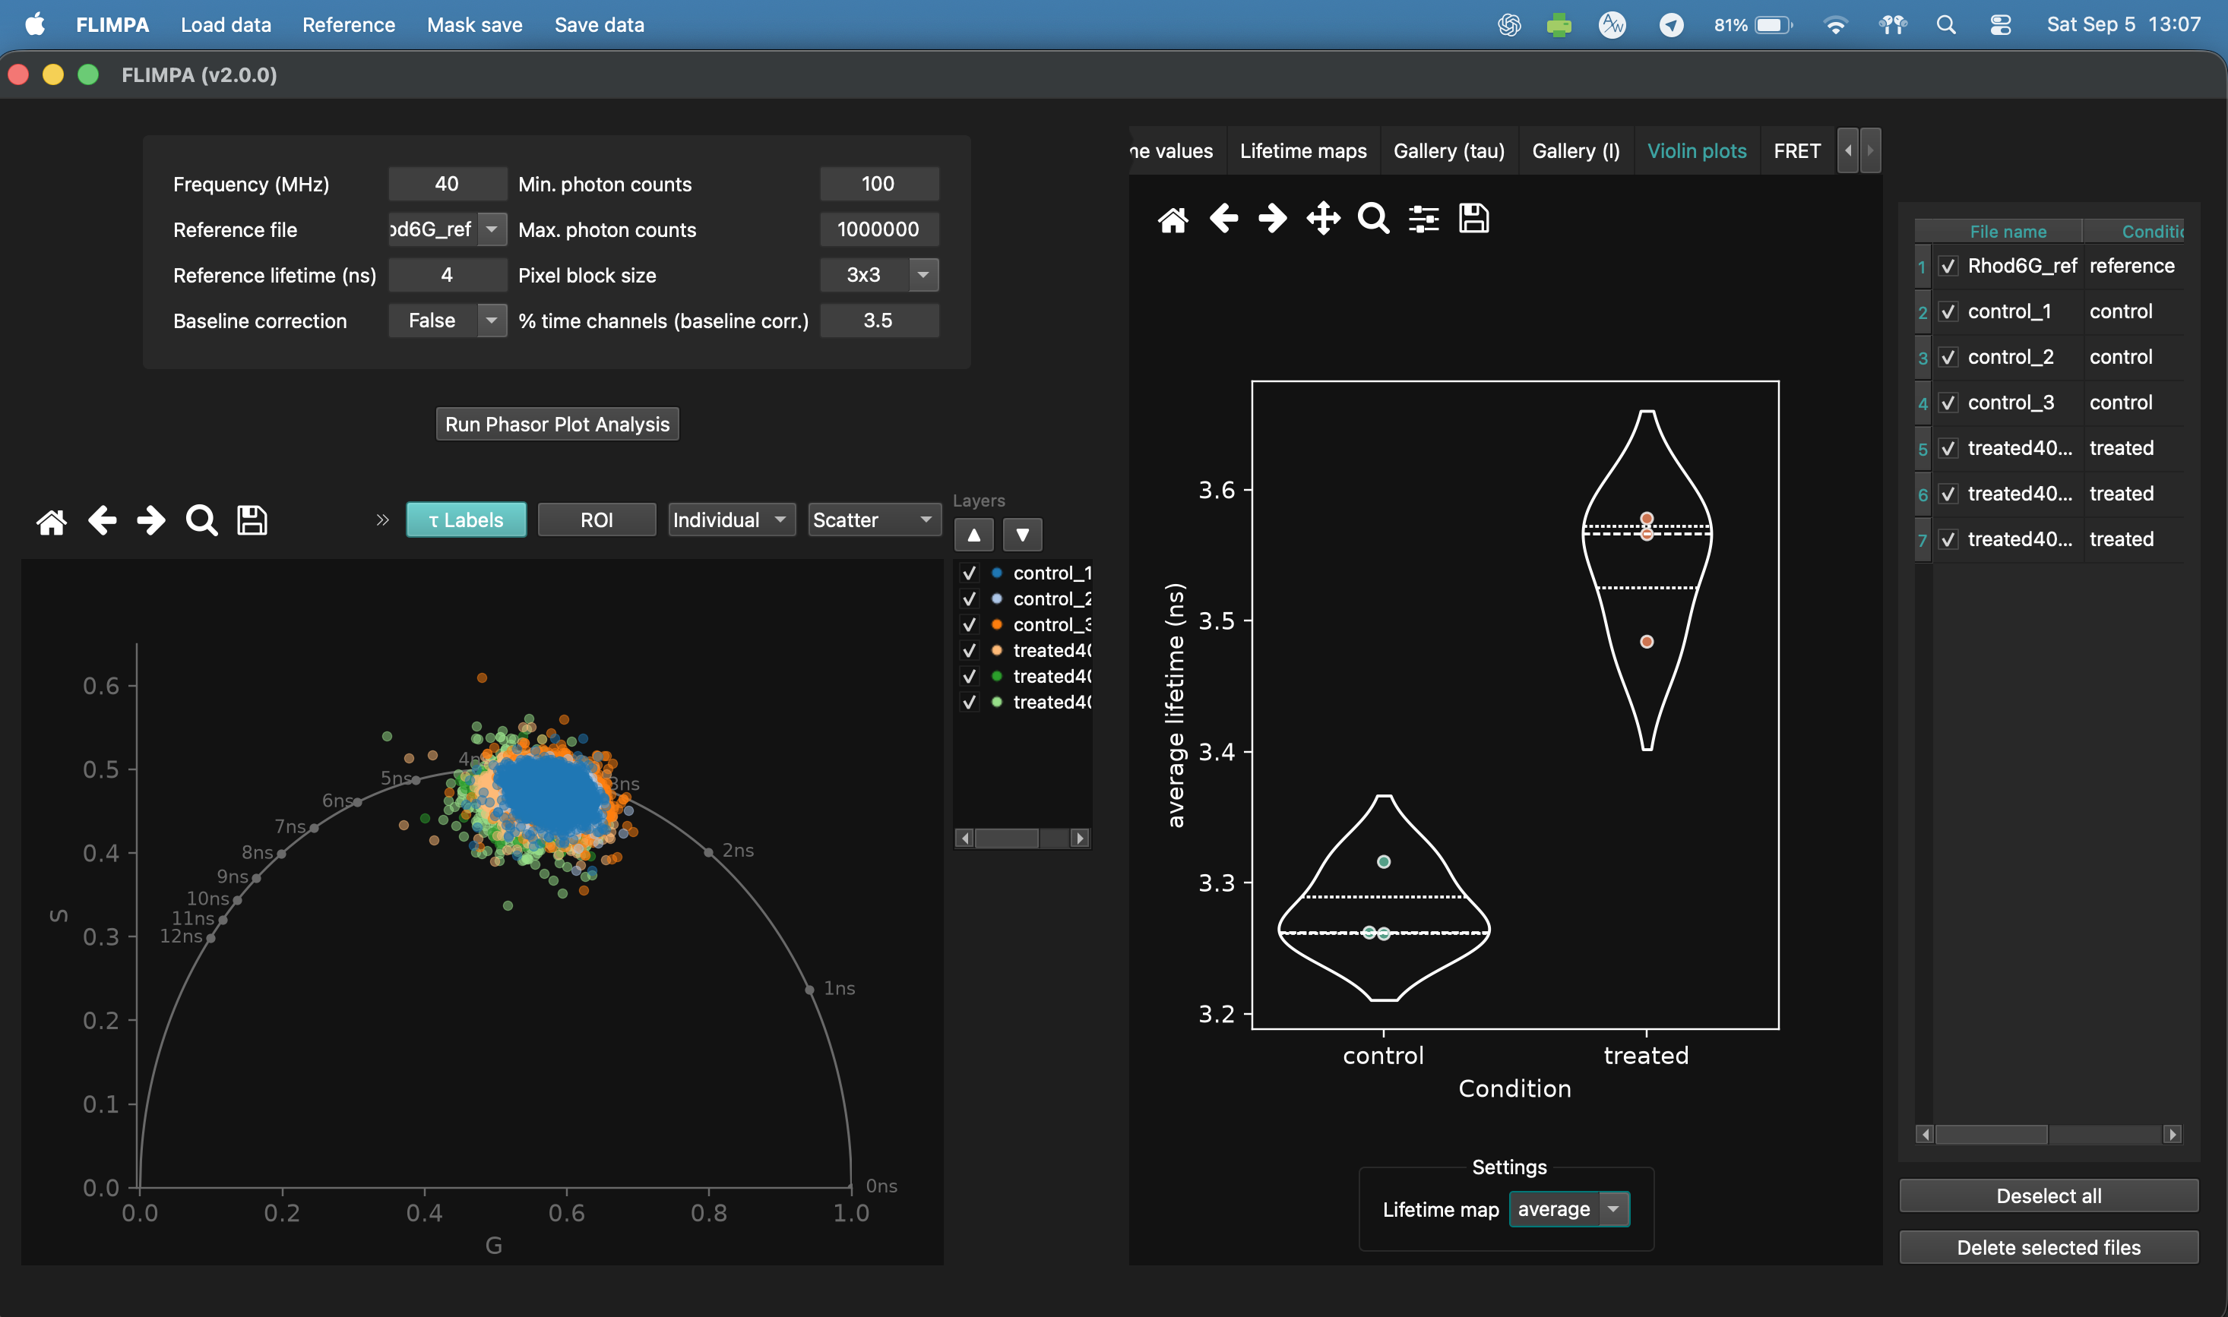
Results: galleries and violin plots
• Gallery (tau): compare lifetime maps and phasor clouds across samples/conditions.
• Gallery (I): compare intensity maps and set photon-count display limits.
• Violin plots: distributions of average, M or phi lifetime per image or ROI.

Slide 16
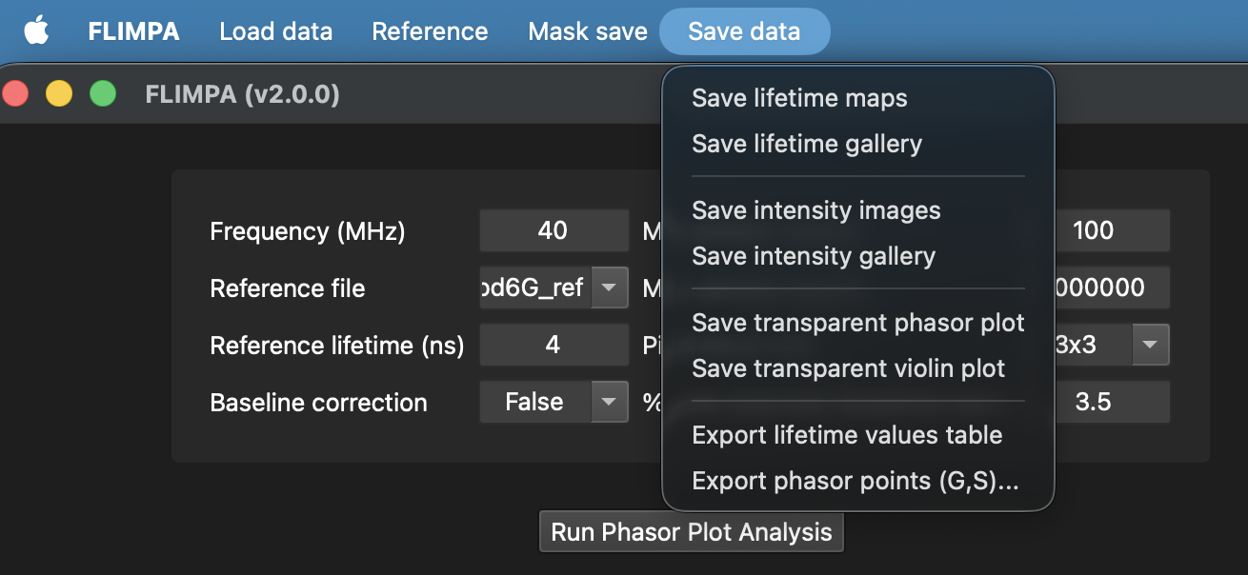
Saving and exporting data
• Save lifetime maps (.png + raw .tif).
• Save lifetime/intensity galleries and intensity images.
• Save transparent phasor and violin plots.
• Export lifetime values table (.csv).
• Export phasor points (G,S) for a selected file.

Slide 17
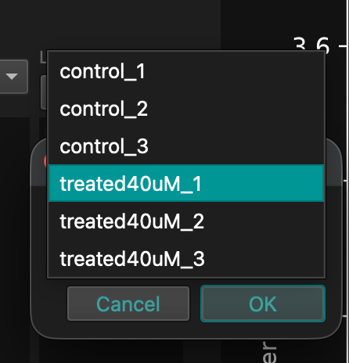
Export phasor points (G, S)
• Choose Save data → Export phasor points (G,S)…
• Select the source file and CSV destination.
• CSV columns: G, S, row, col for non-zero pixels only.
• row = y and col = x; both are zero-based image coordinates.

Slide 18
What changed from FLIMPA 1.4.2 to 2.0.0
• In-app polygon/lasso/brush masking, Delete region and Eraser.
• Mask save and mask re-import workflow.
• FRET efficiency maps.
• Baseline-check decay inspector.
• G/S axis labels and Gallery Layers.
• Pan, zoom and reset on image tabs.
• Colormap presets/custom colormaps.
• Save data menu and G,S,row,col phasor export.

Slide 19
Thank you for using FLIMPA
Please consider citing the original FLIMPA publication.

