Slide 1

Bayesian networks
Gergely Lukács
Pázmány Péter Catholic University
Faculty of Information Technology
Budapest, Hungary
lukacs / karacs @itk.ppke.hu

Slide 2
Bayes theorem (Conditional Probabilities)
2
Probability of event H given evidence E:
A priori probability of H:
Probability of event before evidence has been seen
A posteriori probability of H:
Probability of event after evidence has been seen

Slide 3
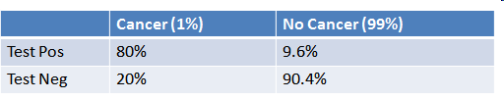
Bayes theorem - example
1% of women have breast cancer, P(H) (and therefore 99% do not)
80% of mammograms detect breast cancer when it is there (and therefore 20% miss it). (P(E|H)
9.6% of mammograms detect breast cancer when it’s not there, P(E|¬H) (and therefore 90.4% correctly return a negative result).
H
E

Slide 4

Bayes theorem – example 2
Positive test result. What are the chances you have cancer?
Positive result: we’re in the top row of our table: true positive or a false positive.
The chances of a true positive = chance you have cancer * chance test caught it = 1% * 80% = .008
The chances of a false positive = chance you don’t have cancer * chance test caught it anyway = 99% * 9.6% = 0.09504
Normalizing (instead of : dividing by Pr[E], ensuring that Pr[H|E] + Pr[¬H|E] = 1 ) true positive = 0.008 / (0.008 + 0.09504) = 8 % false positive = 0.09504 /(0.008 + 0.09504) = 92 %

Slide 5
Bayesian network
Bayesian network
graphical model for representing multivariate probability distributions
Directed acyclic network
Nodes: attributes
Probability distribution
No incoming edges: Apriori (no conditions)
Incoming edges: conditional
Edges show conditions
H
E
H P(E|H) T 0.8 F 0.096
P(H) 0.01

Slide 6
Bayesian Network
burglary-alarm example:
P(B)
.001
burglary
earthquake
P(E)
.002
B E P(A)
T T .95
T F .94
F T .29
F F .001
alarm
A P(J)
T .90
F .05
JohnCalls
MaryCalls
A P(M)
T .70
F .01
Acyclic directed network !
Prior probability for roots, conditional (on parents) for lower levels

Slide 7
Inference in Belief Networks
P(B)
.001
burglary
earthquake
P(E)
.002
B E P(A)
T T .95
T F .94
F T .29
F F .001
alarm
A P(J)
T .90
F .05
A P(M)
T .70
F .01
JohnCalls
MaryCalls
Many (all) types of questions can be answered, using Bayes Rule.
What is the probability that there is no burglary, nor earthquake, but that the alarm went and both John and Mary called?
= P (J ∧ M ∧ A ∧ ¬B ∧ ¬E) = 0.00062
What is the probability that there is a burglary, given that John calls?
= P(B | J) = ?
0.016
(Bayes)

Slide 8
Entropy

Slide 9

Information theory
X random variable:
Claude E Shannon (1948) A Mathematical Theory of Communication, The Bell System Technical Journal, Vol. 27, pp. 379–423, 623–656, July, October
How to describe information sources
How to represent information from a source
How to transmit information over a channel

Slide 10
How „surprising” is an event? (amount of information..)
Case 1: Birmingham on 15 July at midday
cloudy
sunny
Case 2: Cairo on 15 July at midday
cloudy
sunny
Both reasonable
That’s a surprise! (highly unlikely!)
Nothing really new…

Slide 11

Features of entropy
Lower probability of event – higher surprise (higher entropy)
Continuous in probability
If event A has a certain amount of surprise and event B has a certain amount of suprise - if event A and event B are independent (P(A ˄B)=P(A)*P(B)) : the amount of surprise should sum up

Slide 12
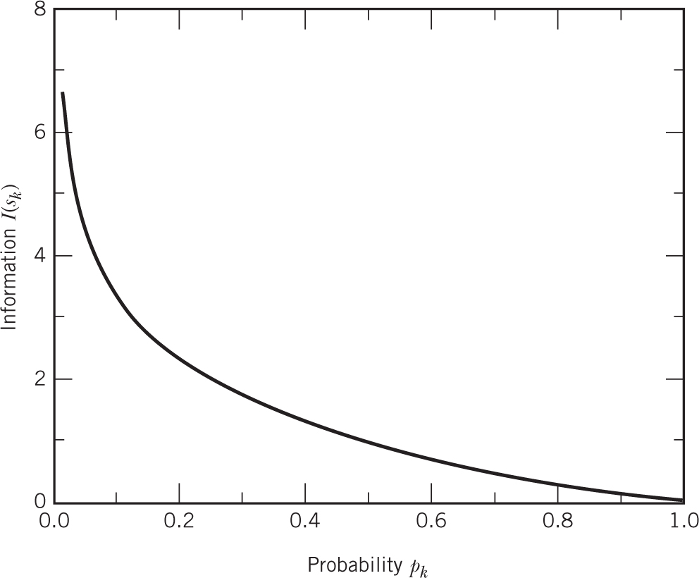
Base of logarithm?
Base of logarithm?
The choice of the logarithm base 2, and the arbitrary multiplicative constant of 1, simply give the unit of information, in this case the bit

Slide 13
Expected „surprise” of a source
Entropy of random variable (information source)
Expected surprise or
How surprised you expect to be on average after sampling it
log₂ -- bits/symbol

Slide 14
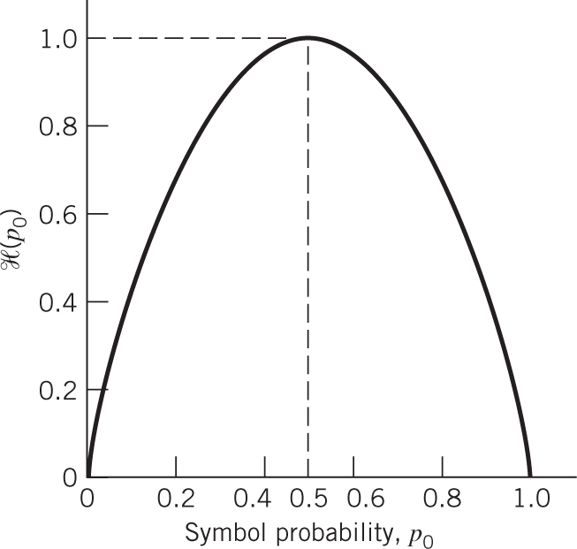
Information sources
Source with two outputs whose probabilities: p and 1 – p
The weather forecast
The entropy of this information source is:
When either outcome becomes certain (p = 0 or p = 1), the entropy takes the value 0
The entropy becomes maximum when p = 1 – p = ½

Slide 15
Information sources
If (source with 2 outputs) p=0.5 (and 1-p=0.5), then entropy = 1, or average information content per symbol of 1 bit per symbol
For a binary source, the entropy is maximised when both outcomes are equally likely
This property is generally true for any number of symbols:
If an information source X has k symbols, its maximum entropy is log₂k and this is obtained when all k outcomes are equally likely
Thus, for a k symbol source:

Slide 16
Source coding
It is intuitively reasonable that an information source of entropy H needs on average only H binary bits to represent each symbol
The equiprobable binary source generates on average 1 information bit per symbol bit
Cairo weather example:
Suppose the probability of cloud (C) is 0.1 and that of sun (S) 0.9
Entropy: 0.47 bits/symbol

Slide 17
Source coding/1 (naive)
Source coding: codewords for symbols e.g., 0/1 for rain/no-rain
This representation uses 1 binary bit per symbol
Thus we are using more binary bits per symbol than entropy suggests is necessary
We want to reduce the number of bits! (== reducing redundancy)

Slide 18
Source coding/2 (sequences)
Use of sequences!
codewords are not associated to a single outcome, but to a sequence of outcomes
Example: weather on 15, 16 and 17 July coded together

Slide 19
Source coding/3
The table here shows such a variable length code and the probability of each codeword occurring for our weather forecasting example
It is easy to compute that this code will on average use 1.2 bits/sequence
Each sequence contains three symbols, so the code uses 0.4 bits/symbol
Sequence | Probability | Codeword
SSS | 0.729 | 0
SSC | 0.081 | 1
SCS | 0.081 | 01
CSS | 0.081 | 10
CCS | 0.009 | 11
CSC | 0.009 | 00
SCC | 0.009 | 000
CCC | 0.001 | 111

Slide 20
Source coding/4
Using sequences decreases the average number of bits per symbol
We have found a code that has an average bit usage less than the source entropy ???
Parsing!
No codeword may be a prefix of any other codeword
sequence 011 01-1 (SCS followed by SSC) or 0-11 (i.e. SSS followed by CCS) ?? Ambiguous!!

Slide 21
Source coding/5
The table here shows an instantaneously parseable variable length code and it satisfies the prefix condition
It is easy to compute that this code uses on average 1.6 bits/sequence
The code uses 0.53 bits/symbol
This is a 47% improvement on identifying each symbol with a bit
Sequence | Probability | Codeword
SSS | 0.729 | 1
SSC | 0.081 | 011
SCS | 0.081 | 010
CSS | 0.081 | 001
CCS | 0.009 | 00011
CSC | 0.009 | 00010
SCC | 0.009 | 00001
CCC | 0.001 | 00000

Slide 22
(Source coding)
The code for each sequence is found by generating the Huffman code tree for the sequence
A Huffman code tree is an unbalanced binary tree
The derivation of the Huffman code tree is shown in the next slide
STEP 1: Have the n symbols ordered according to non-increasing values of their probabilities
STEP 2: Group the last two symbols x_{n-1} and x_{n} into an equivalent “symbol” with probability p_{n-1} + p_{n}
STEP 3: Repeat steps 1 and 2 until there is only one “symbol” left
STEP 4: Looking at the tree originated by the above steps (see next slide), associate the binary symbols 0 and 1 to each pair of branches at each intermediate node – the code word for each symbol can be read as the binary sequence found when starting at the root of the tree and reaching the terminal leaf node associated with that symbol

Slide 23
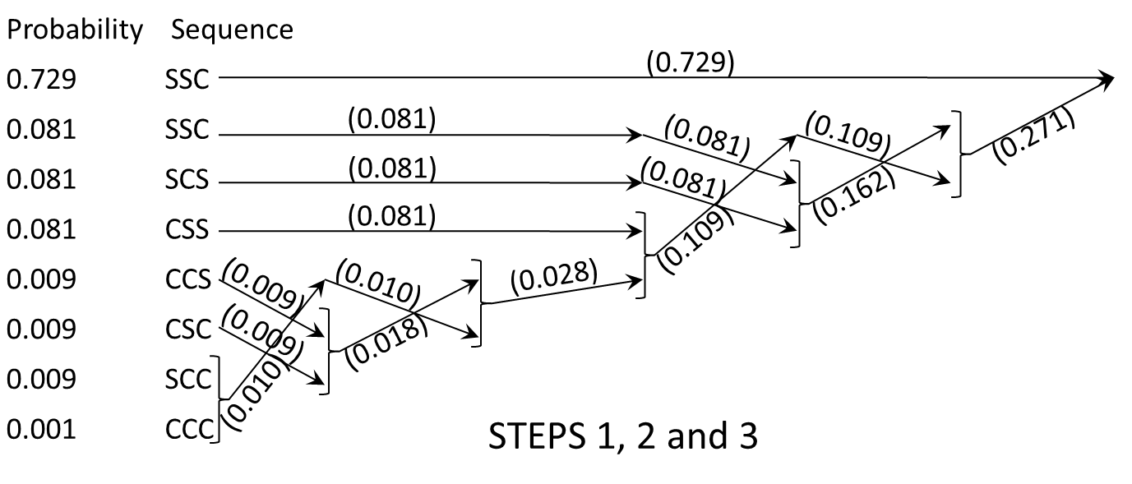
(Source coding)

Slide 24
(Source coding)
1
0
SSS
STEP 4
(1)
1
0
1
0
1
0
SSC
SCS
CSS
(011)
(010)
(001)
1
0
1
0
1
0
CCS
CSC
SCC
CCC
(00011)
(00010)
(00001)
(00000)

Slide 25
Summary
Bayes’ theorem (formula, simple example)
Entropy
event
source;
formula,
intuitive explanation
upper bound (value, location)

