Slide 1

DM & ML Input: Instances, attributes
Gergely Lukács
Pázmány Péter Catholic University
Faculty of Information Technology and Bionics
Budapest, Hungary
lukacs@itk.ppke.hu

Slide 2
Contents
Instances
Attributes
Nominal
Ordinal
Interval
Ratio
ARFF file format

Slide 3

What’s in an instance?
Instance: specific type of example
Thing to be classified, associated, or clustered
Individual, independent example
Characterized by a predetermined set of attributes
Input to learning scheme: set of instances/dataset
Represented as a single relation (=table)/flat file
One line (vector) for each instance
Most common form in practical data mining when there are no relationships between objects
Rather restricted form of input
analog signal, time-series, multiple-instance learning,…

Slide 4
What’s in an attribute?
Each instance is described by a fixed predefined set of features, its “attributes”
Possible attribute types (“levels of measurement”):
Nominal, ordinal, interval and ratio

Slide 5
Nominal quantities
Values are distinct symbols, „categories”
Values themselves serve only as labels or names
Nominal comes from the Latin word for name
Examples:
marital status (single, married, divorced),
gender (male/female)
No relation is implied among nominal values (no ordering or distance measure)
Only equality tests can be performed

Slide 6
Ordinal quantities
Impose order on values
Comparisons possible (<,>,=,…)
But: no distance between values defined
Example:
Satisfaction: very unsatisfied < satisfied < very satisfied
temperature: cool< mild < hot
Note: addition and subtraction don’t make sense
Example rule: temperature < hot c play = yes

Slide 7
Interval quantities
Interval quantities are not only ordered but measured in fixed and equal units
Examples
attribute “temperature” expressed in degrees Fahrenheit
the difference between 70 and 75 degrees is the same as the difference between 75 and 80 degrees.
You cannot say that 80 degrees is twice as hot as 40 degrees because the zero point on an interval scale is arbitrary
attribute “year”
Difference of two values makes sense
Product doesn’t make sense
Sum:
difference of two values + third value: OK
two values: not defined

Slide 8
Ratio quantities
Ratio quantities are ones for which the measurement scheme defines a zero point
Examples:
Distance
Age in years
Ratio quantities are treated as real numbers
All mathematical operations are allowed

Slide 9
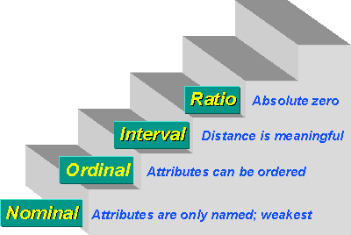
=, ≠, ‹, › , -, +,*, /
=, ≠, ‹, › , -, ((+))
=, ≠, ‹, ›
=, ≠

Slide 10
Attribute type conversions
Many algorithms (and tools) accommodate just two levels of measurement (or even directly just one!)
nominal (special case: boolean)
numeric
Conversions:
nominal->n-1 binary-nominal attributes: separate binary attributes for each nominal value
Python scikit learn: one-hot encoder
nominal -> numeric attribute: integers are assigned to the nominal values
Python sklearn ordinal encoder
False assumptions: order, difference on numeric attribute!
ordinal -> n-1 Boolean attributes
ordinal -> nominal attribute: information (order) lost!
Temperature
Cold
Medium
Hot
Temperature > cold | Temperature > medium
False | False
True | False
True | True

Slide 11
Inaccurate values
Reason: data has not been collected for mining it
Result: errors and omissions that don’t affect original purpose of data (e.g. age of customer)
Typographical errors in nominal attributes
⇒ values need to be checked for consistency
Typographical and measurement errors in numeric attributes
⇒ outliers need to be identified
Other problems: duplicates, stale data

Slide 12
Missing values
Types: unknown, unrecorded, irrelevant
Reasons: malfunctioning equipment, changes in experimental design, collation of different datasets, measurement not possible, …
In data sources: frequently indicated by out-of-range entries (db: NULL)
Two types:
Missing by chance, non-systematic missing
Missing value has significance in itself
e.g. classification male/female, attribute age – males are more precise about their age
most algorithms assume non-systematic missing ⇒ “missing” may need to be coded as additional value

Slide 13
Preparing the input: Generating a flat file
Process of flattening called denormalization
Several relations are joined together to make one
Denormalization may produce spurious regularities that reflect structure of database
Example: “supplier” predicts “supplier address”

Slide 14
Preparing the input
Problem: different data sources (e.g. sales department, customer billing department, …)
Differences: styles of record keeping, conventions, time periods, data aggregation, primary keys, errors
Data must be assembled, integrated, cleaned up
“Data warehouse”: consistent point of access
External data may be required (“overlay data”)
Critical: type and level of data aggregation

Slide 15
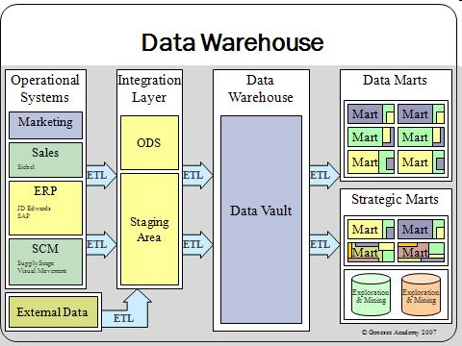
(Data Warehouse)

Slide 16
Getting to know the data
Simple visualization !!! tools are very useful for identifying problems
Nominal attributes: histograms (Distribution consistent with background knowledge?)
Numeric attributes: diagrams (Any obvious outliers?)
2-D and 3-D visualizations show dependencies
(R, Python, Tableau, PowerBI, Weka)

Slide 17
Getting to know the data 2
 | Central location | Dispersion
Nominal | Mode | Information only
Ordinal | Median | Percentages
Interval | Arithmetic Mean | Standard or Average Deviation
Ratio | Geometric or Harmonic Mean | Percent Variation

Slide 18
Getting to know the data 3
Too much data to inspect? Take a sample!
( ~ "The single most important factor in the quality of an individual's software development is the length of the compile/debug cycle„ – similar in data analysis)
Domain experts need to be consulted!!
In combination with data inspection

Slide 19
(Weka: ARFF (Attribute-Relation File Format))
% % ARFF file for weather data with some numeric features % @relation weather @attribute outlook {sunny, overcast, rainy} @attribute temperature numeric @attribute humidity numeric @attribute windy {true, false} @attribute play? {yes, no} @data sunny, 85, 85, false, no sunny, 80, 90, true, no overcast, 83, 86, false, yes ...

Slide 20
(Attribute types)
ARFF supports numeric and nominal attributes
Interpretation depends on learning algorithm (scheme)
Numeric attributes are interpreted for example as
ordinal scales if less-than and greater-than are used
ratio scales if distance calculations are performed (normalization/standardization may be required)

Slide 21
Summary
Standard form of data for data mining
Instance
independence
Types of attributes/Levels of measurement
name, description, operations
conversions
lost information, false assumption
Missing values
Missing: meaning or just by chance?
Getting to know your data

