Slide 1

DM & ML
Basic Methods
Gergely Lukács
Pázmány Péter Catholic University
Faculty of Information Technology and Bionics
Budapest, Hungary
lukacs@itk.ppke.hu

Slide 2
Simplicity first
Different kinds of simple structures/algorithms exist:
  One attribute
  All attributes independently
  A linear combination
  An instance-based representation
Simple algorithms often work surprisingly well
Useful for understanding data
Basis for more complicated algorithms

Slide 3
1R
(One Rule:
decision tree with only one level)

Slide 4
1R: Output format
1R: „one rule”
  for classification
  set of „rules” that all test one particular attribute
  (== 1-level „decision tree” – see later; „decision stump” )
X
Y (class)
Outlook | Temp. | Humidity | Windy | Play
Sunny | Hot | High | False | No
Sunny | Hot | High | True | No
Overcast | Hot | High | False | Yes
Rainy | Mild | High | False | Yes
Rainy | Cool | Normal | False | Yes
Rainy | Cool | Normal | True | No
Overcast | Cool | Normal | True | Yes
Sunny | Mild | High | False | No
Sunny | Cool | Normal | False | Yes
Rainy | Mild | Normal | False | Yes
Sunny | Mild | Normal | True | Yes
Overcast | Mild | High | True | Yes
Overcast | Hot | Normal | False | Yes
Rainy | Mild | High | True | No
IF outlook=sunny THEN play=yes
IF outlook=overcast THEN play=yes
IF outlook=rainy THEN play=no
Outlook
Sunny
Overcast
Rainy
Play=Yes
Play=No
Play=Yes

Slide 5
1R: Algorithm
Basic version (assuming nominal attributes)
  Create a ruleset for each of the attributes
    One branch for each of the attribute’s values
    Each branch assigns most frequent class
    Error rate: proportion of instances that don’t belong to the majority class of their corresponding branch
  Choose attribute and the corresponding ruleset with lowest error rate

Slide 6
1R Example: weather attributes
Outlook | Temp. | Humidity | Windy | Play
Sunny | Hot | High | False | No
Sunny | Hot | High | True | No
Overcast | Hot | High | False | Yes
Rainy | Mild | High | False | Yes
Rainy | Cool | Normal | False | Yes
Rainy | Cool | Normal | True | No
Overcast | Cool | Normal | True | Yes
Sunny | Mild | High | False | No
Sunny | Cool | Normal | False | Yes
Rainy | Mild | Normal | False | Yes
Sunny | Mild | Normal | True | Yes
Overcast | Mild | High | True | Yes
Overcast | Hot | Normal | False | Yes
Rainy | Mild | High | True | No
Attribute | Rules | Errors | Total errors
Outlook | Sunny → No | 2/5 | 4/14
 | Overcast → Yes | 0/4
 | Rainy → Yes | 2/5
Temperature | Hot → No* | 2/4 | 5/14
 | Mild → Yes | 2/6
 | Cool → Yes | 1/4
Humidity | High → No | 3/7 | 4/14
 | Normal → Yes | 1/7
Windy | False → Yes | 2/8 | 5/14
 | True → No* | 3/6
* A random choice is made
between 2 equal outcomes

Slide 7
Pseudo-code for 1R
“missing” is treated as a separate attribute value
For each attribute, For each value of the attribute, make a rule as follows: count how often each class appears find the most frequent class make the rule assign that class to this attribute-value Calculate the error rate of the rules Choose the rules with the smallest error rate

Slide 8
Dealing with numeric attributes
Numeric attributes are discretized: the range of the attribute is divided into a set of intervals:
  Instances are sorted according to attribute’s values
  Breakpoints are placed where the class changes (so that the total error is minimized)
    Equal values, different classes: majority class
Example: temperature from weather data
64 65 68 69 70 71 72 72 75 75 80 81 83 85
Yes |No |Yes Yes Yes |No No |Yes Yes Yes |No |Yes Yes |No
/
|

Slide 9
The problem of overfitting
Discretization procedure is very sensitive to noise
  A single instance with an incorrect class label will most likely result in a separate interval
Simple solution: enforce minimum number of instances in majority class per interval
Weather data example (with minimum set to 3):
64 65 68 69 70 71 72 72 75 75 80 81 83 85
Yes |No |Yes Yes Yes |No No |Yes Yes Yes |No |Yes Yes |No
/
/
/
/
/
64 65 68 69 70 71 72 72 75 75 80 81 83 85
Yes No Yes Yes Yes |No No Yes Yes Yes |No Yes Yes No

Slide 10
Result of overfitting avoidance
Resulting rule sets:
Attribute | Rules | Errors | Total errors
Outlook | Sunny → No | 2/5 | 4/14
 | Overcast → Yes | 0/4
 | Rainy → Yes | 2/5
Temperature | ≤ 77.5 → Yes | 3/10 | 5/14
 | > 77.5 → No* | 2/4
Humidity | ≤ 82.5 → Yes | 1/7 | 3/14
 | > 82.5 and ≤ 95.5 → No | 2/6
 | > 95.5 → Yes | 0/1
Windy | False → Yes | 2/8 | 5/14
 | True → No* | 3/6
* A random choice is made between 2 equal outcomes

Slide 11
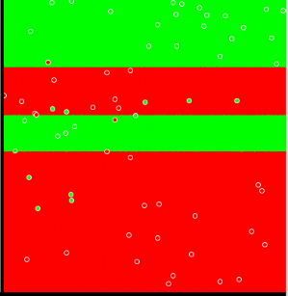
Discussion of 1R
1R was described in a paper by Holte (1993)
  Contains an experimental evaluation on 16 datasets (using cross-validation so that results were representative of performance on future data)
  After some experimentation the minimum number of instances in majority class was set to 6
Simplicity first …
Data investigation …
how important individual attributes are
Part of more complexe algorithms
(ensemble learning)
Decision boundary
  illustration with 2 input variables (two axes),
  binary classification (class: colour)

Slide 12
Naïve Bayes

Slide 13

NB: The model
y
(class attribute,
y, dependent/output variable)
x₁
x₂
x₃
(x, independent/input variables)
“Opposite” of 1R: use all attributes
Assumption: Attributes are statistically independent, given the class value
    This means that knowledge about the value of a particular attribute doesn’t tell us anything about the value of another attribute -- if the class is known
  Fixed structure (s. above
Although assumption almost never (entirely) correct,
this scheme works quite often well in practice!

Slide 14
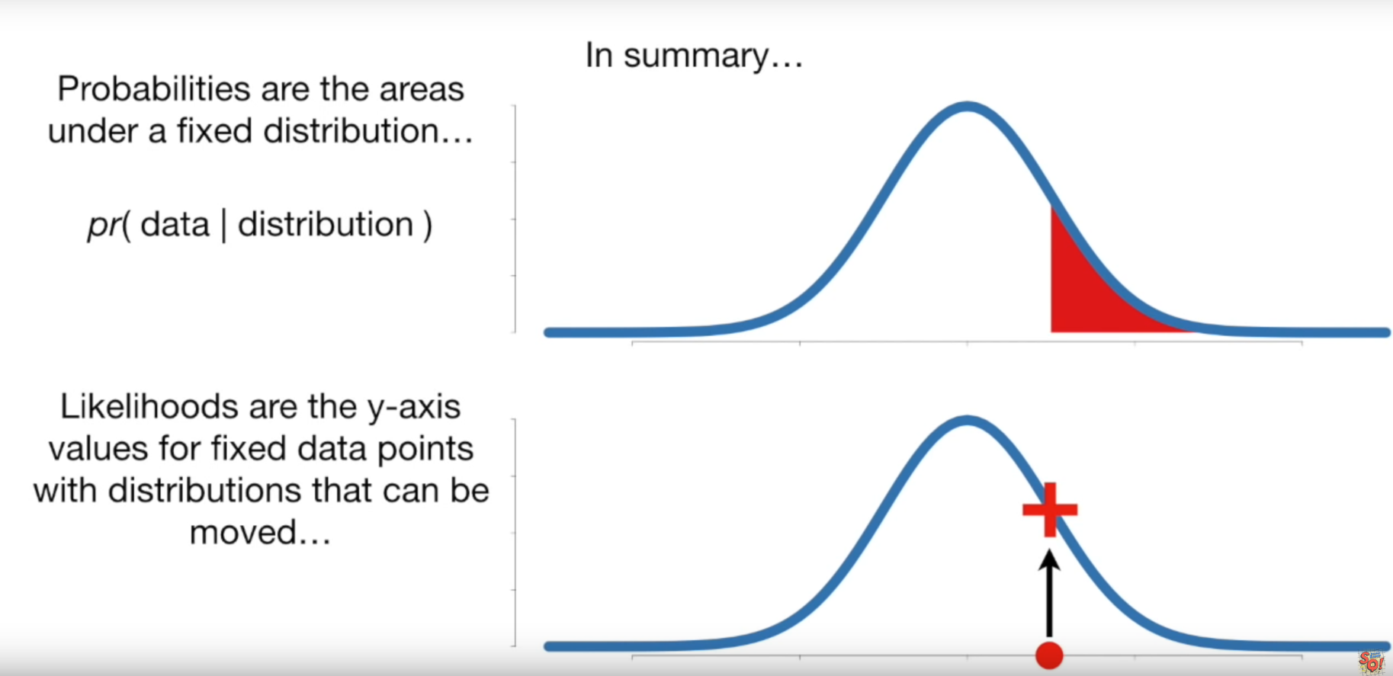
Likelihood vs probability
StatQuest: Probability vs Likelihood
https://www.youtube.com/watch?v=pYxNSUDSFH4

Slide 15
Maximum Likelihood Estimation
maximum likelihood estimation (MLE) of parameters given observations. MLE attempts to find the parameter values that maximize the likelihood function, given the observations
Naive Bayes: learning: estimating parameter values of the model given data, based on the MLE
(Details: http://www.datasciencecourse.org/notes/mle/)

Slide 16

Naive Bayes: learning (training)
(Relative) frequencies of values in training data
  For binary classifier:
y
P(y)
x₁
x₂
x₃
P(x₁ | y)
P(x₂ | y)
P(x₃ | y)

Slide 17
x₁
x₄
y
Probabilities for
the weather data: Frequencies of cases
Outlook | Temp. | Humidity | Windy | Play
Sunny | Hot | High | False | No
Sunny | Hot | High | True | No
Overcast | Hot | High | False | Yes
Rainy | Mild | High | False | Yes
Rainy | Cool | Normal | False | Yes
Rainy | Cool | Normal | True | No
Overcast | Cool | Normal | True | Yes
Sunny | Mild | High | False | No
Sunny | Cool | Normal | False | Yes
Rainy | Mild | Normal | False | Yes
Sunny | Mild | Normal | True | Yes
Overcast | Mild | High | True | Yes
Overcast | Hot | Normal | False | Yes
Rainy | Mild | High | True | No
Outlook |  |  | Temperature |  |  | Humidity |  |  | Windy |  |  | Play
 | Yes | No |  | Yes | No |  | Yes | No |  | Yes | No | Yes | No
Sunny | 2 | 3 | Hot | 2 | 2 | High | 3 | 4 | False | 6 | 2 | 9 | 5
Overcast | 4 | 0 | Mild | 4 | 2 | Normal | 6 | 1 | True | 3 | 3
Rainy | 3 | 2 | Cool | 3 | 1

Slide 18
Probabilities for the weather data: probability estimations
Outlook |  |  | Temperature |  |  | Humidity |  |  | Windy |  |  | Play
 | Yes | No |  | Yes | No |  | Yes | No |  | Yes | No | Yes | No
Sunny | 2 | 3 | Hot | 2 | 2 | High | 3 | 4 | False | 6 | 2 | 9 | 5
Overcast | 4 | 0 | Mild | 4 | 2 | Normal | 6 | 1 | True | 3 | 3
Rainy | 3 | 2 | Cool | 3 | 1
Sunny | 2/9 | 3/5 | Hot | 2/9 | 2/5 | High | 3/9 | 4/5 | False | 6/9 | 2/5 | 9/14 | 5/14
Overcast | 4/9 | 0/5 | Mild | 4/9 | 2/5 | Normal | 6/9 | 1/5 | True | 3/9 | 3/5
Rainy | 3/9 | 2/5 | Cool | 3/9 | 1/5
P(Outlook=Sunny| Play=Yes)
(Outlook: X1, E)
P(Play=Yes)
(Play: Y, class, H)
Can you draw the Naive Bayes network,
including the (conditional and apriori) probabilites?

Slide 19
NB: prediction
(new/unknown instances)
Classification learning: what’s the probability of the class given the input attributes?

Slide 20
Probabilities for the weather data: Prediction task
A new day:
Outlook |  |  | Temperature |  |  | Humidity |  |  | Windy |  |  | Play
 | Yes | No |  | Yes | No |  | Yes | No |  | Yes | No | Yes | No
Sunny | 2 | 3 | Hot | 2 | 2 | High | 3 | 4 | False | 6 | 2 | 9 | 5
Overcast | 4 | 0 | Mild | 4 | 2 | Normal | 6 | 1 | True | 3 | 3
Rainy | 3 | 2 | Cool | 3 | 1
Sunny | 2/9 | 3/5 | Hot | 2/9 | 2/5 | High | 3/9 | 4/5 | False | 6/9 | 2/5 | 9/14 | 5/14
Overcast | 4/9 | 0/5 | Mild | 4/9 | 2/5 | Normal | 6/9 | 1/5 | True | 3/9 | 3/5
Rainy | 3/9 | 2/5 | Cool | 3/9 | 1/5
Outlook | Temp. | Humidity | Windy | Play
Sunny | Cool | High | True | ?

Slide 21

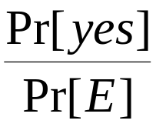

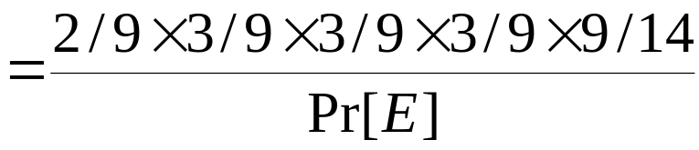
The weather data example
Outlook | Temp. | Humidity | Windy | Play
Sunny | Cool | High | True | ?
Evidence
E (== X)
Cond. probability for class “yes”
P(Play=yes|Outlook=Sunny ^ ….)

Slide 22
Probabilities for the weather data
A new day:
Outlook |  |  | Temperature |  |  | Humidity |  |  | Windy |  |  | Play
 | Yes | No |  | Yes | No |  | Yes | No |  | Yes | No | Yes | No
Sunny | 2 | 3 | Hot | 2 | 2 | High | 3 | 4 | False | 6 | 2 | 9 | 5
Overcast | 4 | 0 | Mild | 4 | 2 | Normal | 6 | 1 | True | 3 | 3
Rainy | 3 | 2 | Cool | 3 | 1
Sunny | 2/9 | 3/5 | Hot | 2/9 | 2/5 | High | 3/9 | 4/5 | False | 6/9 | 2/5 | 9/14 | 5/14
Overcast | 4/9 | 0/5 | Mild | 4/9 | 2/5 | Normal | 6/9 | 1/5 | True | 3/9 | 3/5
Rainy | 3/9 | 2/5 | Cool | 3/9 | 1/5
Numerator For “yes” = 2/9 × 3/9 × 3/9 × 3/9 × 9/14 = 0.0053 For “no” = 3/5 × 1/5 × 4/5 × 3/5 × 5/14 = 0.0206 Conversion into a probability by normalization (instead of by calculating the denominator, P(X)): P(“yes”) = 0.0053 / (0.0053 + 0.0206) = 0.205 P(“no”) = 0.0206 / (0.0053 + 0.0206) = 0.795
Outlook | Temp. | Humidity | Windy | Play
Sunny | Cool | High | True | ?

Slide 23


The “zero-frequency problem”
What if an attribute value doesn’t occur with every class value (e.g. “Outlook = Overcast” for class “no”)?
  Probability will be zero!
  A posteriori probability will also be zero!
  (No matter how likely the other values are!)
Remedy: add 1 to the count of every value-class combination for such problematic attribute
(„Laplace estimator”)
Result: probabilities will never be zero

Slide 24
Applying Laplace estimator
Outlook |  |  | Temperature |  |  | Humidity |  |  | Windy |  |  | Play
 | Yes | No |  | Yes | No |  | Yes | No |  | Yes | No | Yes | No
Sunny | 2 | 3 | Hot | 2 | 2 | High | 3 | 4 | False | 6 | 2 | 9 | 5
Overcast | 4 | 0 | Mild | 4 | 2 | Normal | 6 | 1 | True | 3 | 3
Rainy | 3 | 2 | Cool | 3 | 1
Sunny | 2/9 | 3/5 | Hot | 2/9 | 2/5 | High | 3/9 | 4/5 | False | 6/9 | 2/5 | 9/14 | 5/14
Overcast | 4/9 | 0/5 | Mild | 4/9 | 2/5 | Normal | 6/9 | 1/5 | True | 3/9 | 3/5
Rainy | 3/9 | 2/5 | Cool | 3/9 | 1/5
Outlook |  |  | Temperature |  |  | Humidity |  |  | Windy |  |  | Play
 | Yes | No |  | Yes | No |  | Yes | No |  | Yes | No | Yes | No
Sunny | 2 | 4 | Hot | 2 | 2 | High | 3 | 4 | False | 6 | 2 | 9 | 5
Overcast | 4 | 1 | Mild | 4 | 2 | Normal | 6 | 1 | True | 3 | 3
Rainy | 3 | 3 | Cool | 3 | 1
Sunny | 2/9 | 4/8 | Hot | 2/9 | 2/5 | High | 3/9 | 4/5 | False | 6/9 | 2/5 | 9/14 | 5/14
Overcast | 4/9 | 1/8 | Mild | 4/9 | 2/5 | Normal | 6/9 | 1/5 | True | 3/9 | 3/5
Rainy | 3/9 | 3/8 | Cool | 3/9 | 1/5

Slide 25
Missing values
Training
  instance is not included in frequency count for attribute-value/class combination
Classification
  attribute will be omitted from calculation
  Example:
Outlook | Temp. | Humidity | Windy | Play
? | Cool | High | True | ?
Numerator for “yes” = 3/9 × 3/9 × 3/9 × 9/14 = 0.0238 Numerator for “no” = 1/5 × 4/5 × 3/5 × 5/14 = 0.0343 P(“yes”) = 0.0238 / (0.0238 + 0.0343) = 41% P(“no”) = 0.0343 / (0.0238 + 0.0343) = 59%

Slide 26
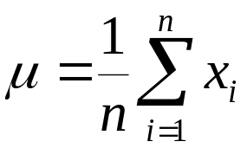
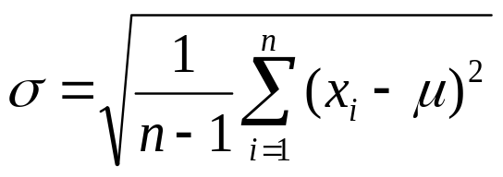
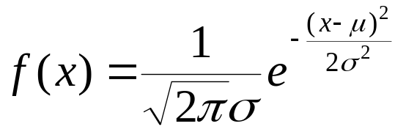
Dealing with numeric attributes
Usual assumption: attributes have a normal/Gaussian probability distribution (given the class)
The probability density function for the normal distribution is defined by two parameters:
  The sample mean μ:
  The standard deviation σ:
  The density function f(x):

Slide 27
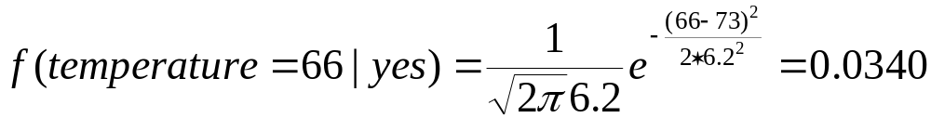
Statistics for the weather data
Outlook |  |  | Temperature |  |  | Humidity |  |  | Windy |  |  | Play
 | Yes | No |  | Yes | No |  | Yes | No |  | Yes | No | Yes | No
Sunny | 2 | 3 |  | 83 | 85 |  | 86 | 85 | False | 6 | 2 | 9 | 5
Overcast | 4 | 0 |  | 70 | 80 |  | 96 | 90 | True | 3 | 3
Rainy | 3 | 2 |  | 68 64 | 65 72 |  | 80 65 | 70 95
 |  |  |  | 69 .... | 71 |  | 70 .... | 91
Sunny | 2/9 | 3/5 | mean | 73 | 74.6 | mean | 79.1 | 86.2 | False | 6/9 | 2/5 | 9/14 | 5/14
Overcast | 4/9 | 0/5 | std dev | 6.2 | 7.9 | std dev | 10.2 | 9.7 | True | 3/9 | 3/5
Rainy | 3/9 | 2/5
Example density value:

Slide 28
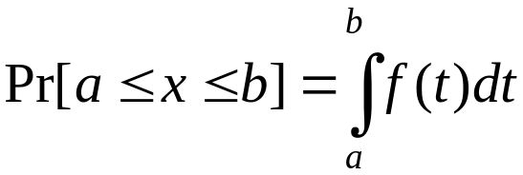
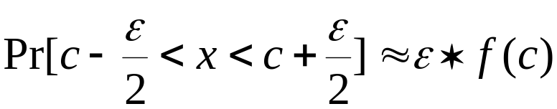
Probability densities
Relationship between probability and density:
But: this doesn’t change calculation of a posteriori probabilities because ε cancels out

Slide 29
Classifying a new day
A new day:
Note also: many numeric attributes are not normally distributed
  Known distribution: work with it
  Unknown distribution: kernel density estimators
Missing values during training: not included in calculation of mean and standard deviation
Outlook | Temp. | Humidity | Windy | Play
Sunny | 66 | 90 | true | ?
Numerator of “yes” = 2/9 × 0.0340 × 0.0221 × 3/9 × 9/14 = 0.000036 Numerator of “no” = 3/5 × 0.0291 × 0.0380 × 3/5 × 5/14 = 0.000136 P(“yes”) = 0.000036 / (0.000036 + 0. 000136) = 20.9% P(“no”) = 0. 000136 / (0.000036 + 0. 000136) = 79.1%

Slide 30
Discussion of Naïve Bayes
Naïve Bayes works surprisingly well (even if independence assumption is clearly violated)
Too many redundant attributes (e.g. identical attributes) will cause problems
Irrelevant attributes are OK, they are filtered out
Fast to train, fast to classify
  even for large number of attributes
  incremental model building possible (streamed data)
Outputs probability (?) distribution, not just a single class (+)
(Does not learn training data perfectly (+/-))
Typical application: text/spam detection

Slide 31
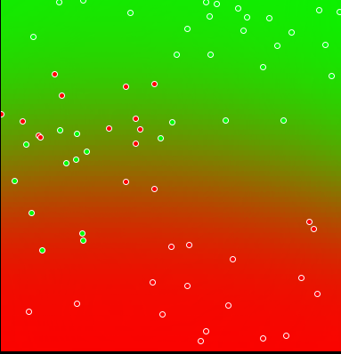
Discussion of Naïve Bayes, 2
Decision boundary….

Slide 32
Divide-and-conquer
Decision tree
ID3

Slide 33
DECISION TREE – AS KNOWLEDGE REPRESENTATION

Slide 34
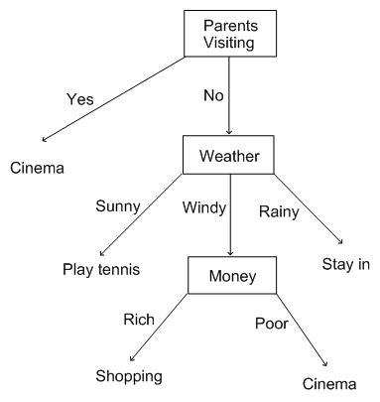
Decision trees
(classification, regression)
Nodes involve testing a particular attribute
  usually, attribute value is compared to constant;
  other possibilities:
    comparing values of two attributes
    using a function of one or more attributes
Leaves assign
  class value, or
  set of class values, or
  probability distribution
  to instances

Slide 35
Testing nominal and numeric attributes
Nominal attribute: number of children (branches) usually equal to number values ⇒ attribute won’t get tested more than once
  Other possibility: division into two subsets
Numeric attribute: test whether value is greater or less than constant ⇒ attribute may get tested several times
  Other possibility: three/multi-way split)
    Integer: less than, equal to, greater than
    Real: below, within, above

Slide 36
Example: Labor negotiations data
(Instances)
Attribute | Type | 1 | 2 | 3 | … | 40
Duration | (Number of years) | 1 | 2 | 3 |  | 2
Wage increase first year | Percentage | 2% | 4% | 4.3% |  | 4.5%
Wage increase second year | Percentage | ? | 5% | 4.4% |  | 4.0%
Wage increase third year | Percentage | ? | ? | ? |  | ?
Cost of living adjustment | {none,tcf,tc} | none | tcf | ? |  | none
Working hours per week | (Number of hours) | 28 | 35 | 38 |  | 40
Pension | {none,ret-allw, empl-cntr} | none | ? | ? |  | ?
Standby pay | Percentage | ? | 13% | ? |  | ?
Shift-work supplement | Percentage | ? | 5% | 4% |  | 4%
Education allowance | {yes,no} | yes | ? | ? |  | ?
Statutory holidays | (Number of days) | 11 | 15 | 12 |  | 12
Vacation | {below-avg,avg,gen} | avg | gen | gen |  | avg
Long-term disability assistance | {yes,no} | no | ? | ? |  | yes
Dental plan contribution | {none,half,full} | none | ? | full |  | full
Bereavement assistance | {yes,no} | no | ? | ? |  | yes
Health plan contribution | {none,half,full} | none | ? | full |  | half
Acceptability of contract | {good,bad} | bad | good | good |  | good
(Attributes)
(Class attribute)

Slide 37
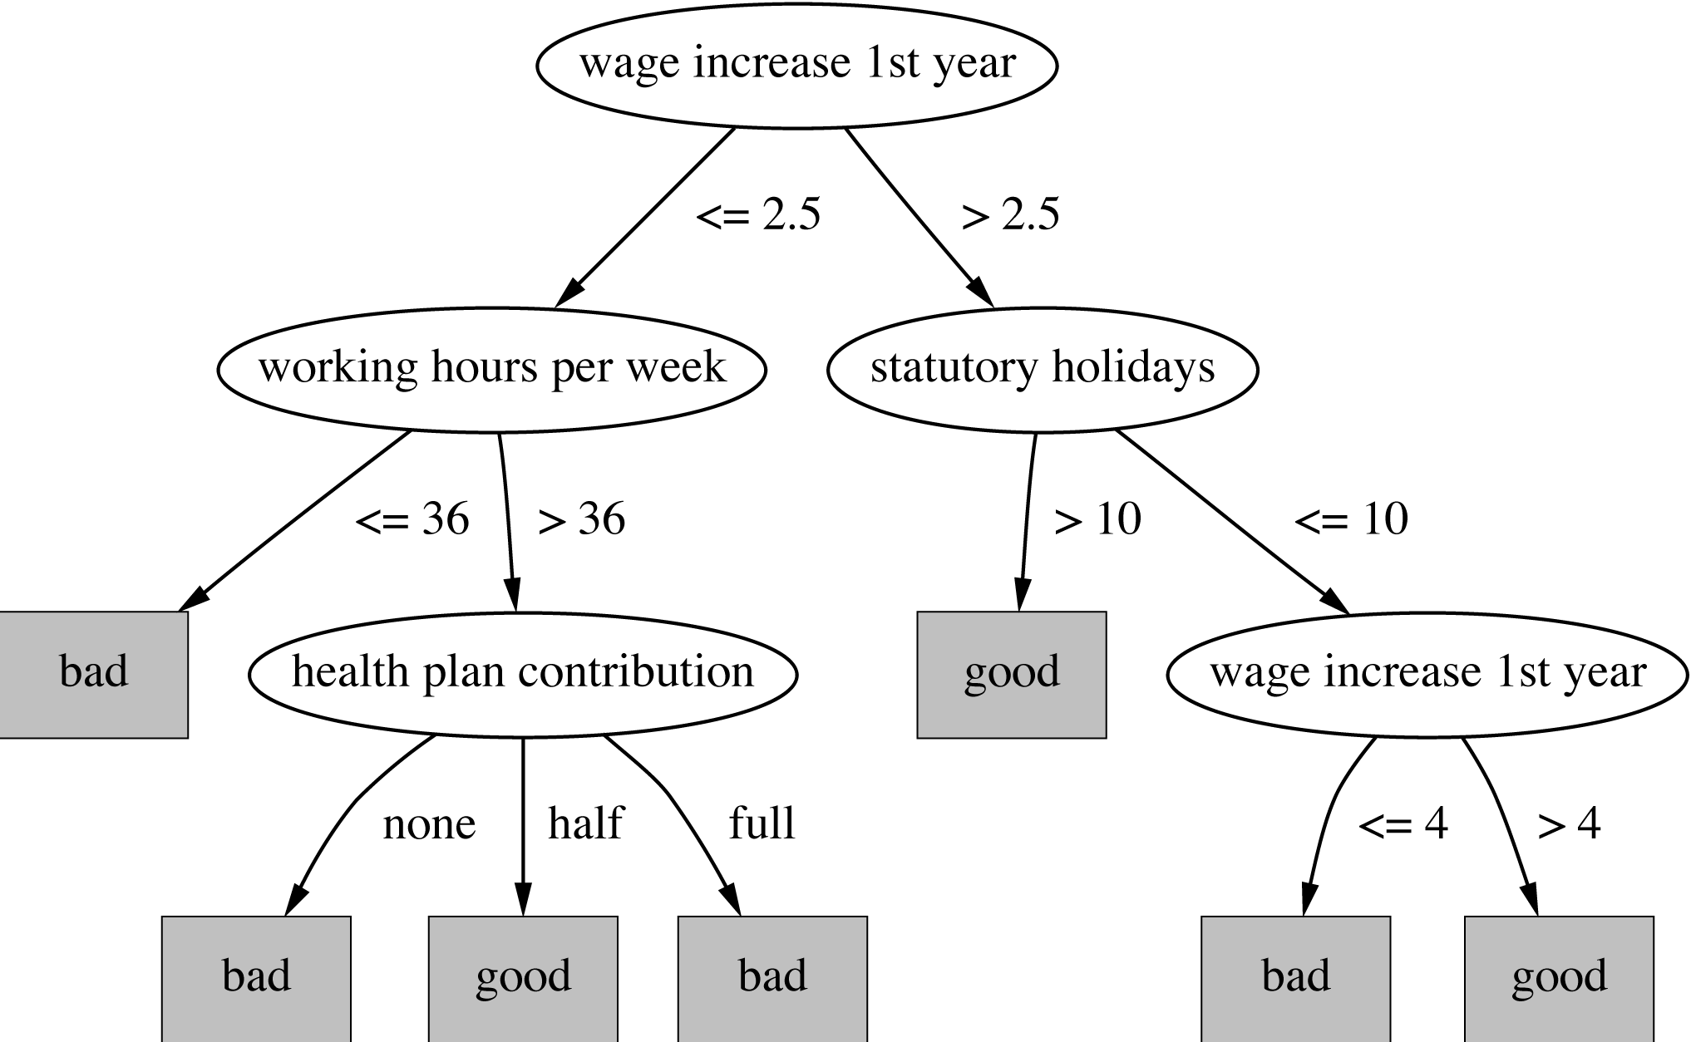
Decision tree for labor negotiations data

Slide 38
Missing values
Does absence of value have some significance?
Yes ⇒ “missing” is a separate value
No ⇒ “missing” must be treated in a special way
  Solution A: assign instance to most popular branch
  Solution B: split instance into pieces
    Pieces receive weight according to fraction of training instances that go down each branch
For both, we need some statistics on the training data in the tree
– in addition to the previous tests

Slide 39
LEARNING A DECISION TREE – ID 3 ALGORITHM

Slide 40
Constructing decision trees
Preferred: small decision tree (== small number of levels/attributes tested)
Greedy algorithm
Normal procedure: top down in recursive divide-and-conquer fashion
  Attribute is selected for root node and branch is created for each possible attribute value
  Instances are split into subsets (one for each branch extending from the node)
  Procedure is repeated recursively for each branch, using only instances that reach the branch
Process stops if all instances have the same class
  or no further split makes them purer

Slide 41
Example data
(class attr,
y)
Outlook | Temp. | Humidity | Windy | Play
Sunny | Hot | High | False | No
Sunny | Hot | High | True | No
Overcast | Hot | High | False | Yes
Rainy | Mild | High | False | Yes
Rainy | Cool | Normal | False | Yes
Rainy | Cool | Normal | True | No
Overcast | Cool | Normal | True | Yes
Sunny | Mild | High | False | No
Sunny | Cool | Normal | False | Yes
Rainy | Mild | Normal | False | Yes
Sunny | Mild | Normal | True | Yes
Overcast | Mild | High | True | Yes
Overcast | Hot | Normal | False | Yes
Rainy | Mild | High | True | No

Slide 42
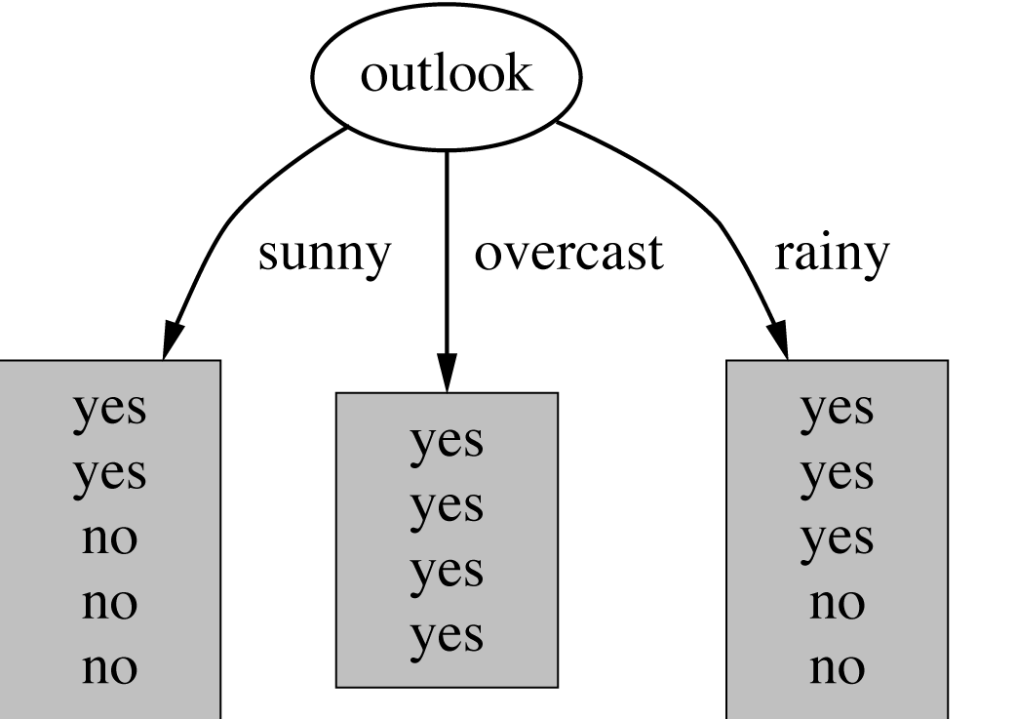
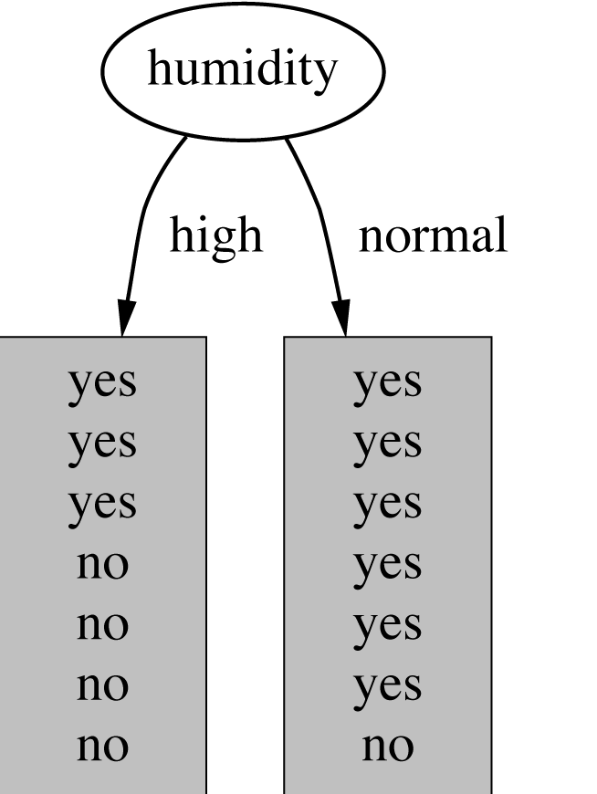
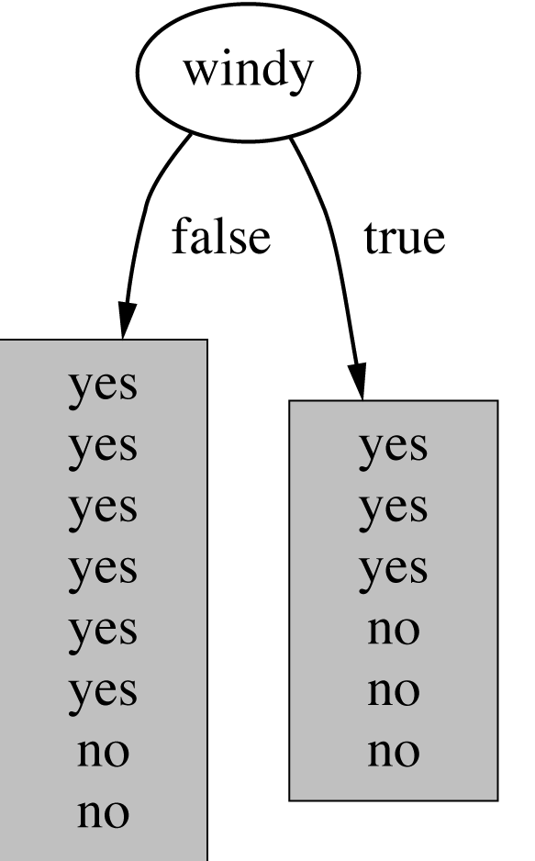
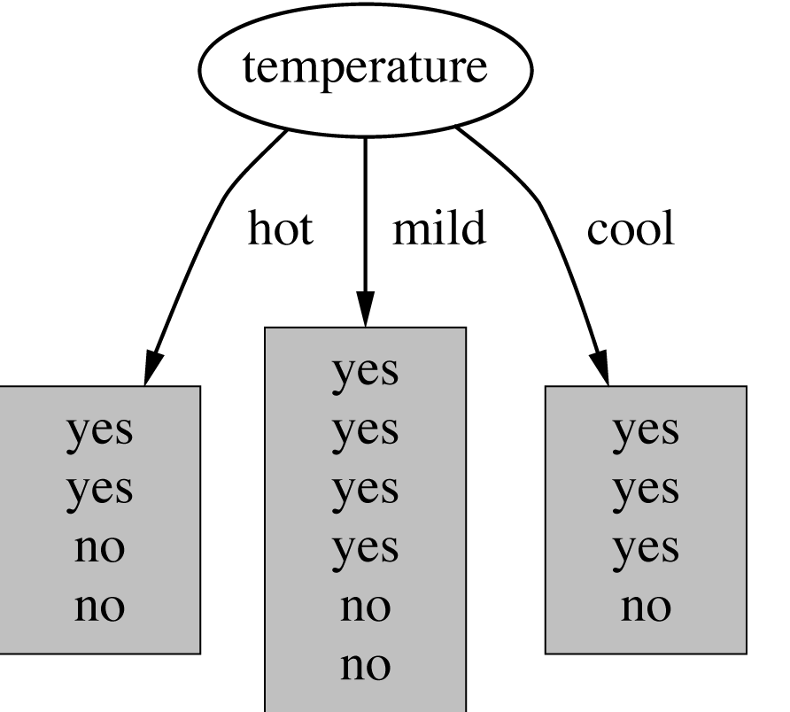
Which attribute to select?

Slide 43
A criterion for attribute selection
Which is the best attribute?
  The one which will result in the smallest tree
  Heuristic: choose the attribute that produces the “purest” nodes
Popular impurity criterion: information gain
  Information gain increases with the average „purity” of the subsets that an attribute produces
Strategy: choose attribute that results in greatest information gain
„purity”: entropy

Slide 44
Example: attribute Outlook
Outlook = Sunny :
  Info([2,3]) = entropy(2/5,3/5)=
  = -2/5log₂(2/5)-3/5log₂ (3/5)=0.971 bits
Outlook = Overcast :
Info([4,0]) = entropy(1,0)= 0 bits
Outlook = Rainy :
  Info([3,2]) = entropy(3/5,2/5)=
  = -3/5log₂ (3/5)-2/5log₂ (2/5)=0.971 bits
Expected information for attribute
(weighed sum, weighs: number of instances):
  Info([2,3], [4,0], [3,2]) = 5/14 * 0.971 + 4/14 * 0 + 5/14 * 0.971 =
  = 0.693 bits

Slide 45
Computing information gain
Information gain:
  information before splitting – information after splitting
gain(Outlook ) = info([9,5]) – info([2,3],[4,0],[3,2])
= 0.940 – 0.693 = 0.247 bits

Slide 46
Which attribute to select?
  gain(Outlook ) = 0.247 bits
  gain(Humidity ) = 0.152 bits
  gain(Windy ) = 0.048 bits
  gain(Temperature ) = 0.029 bits

Slide 47
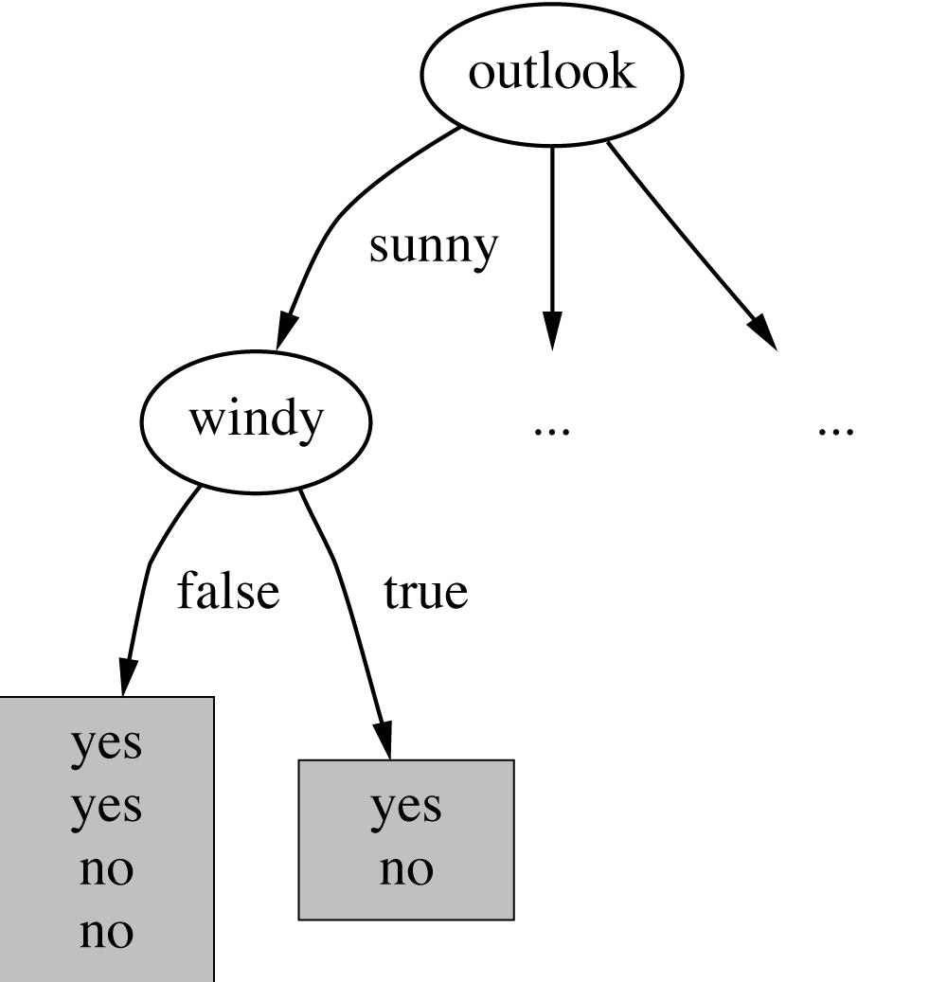
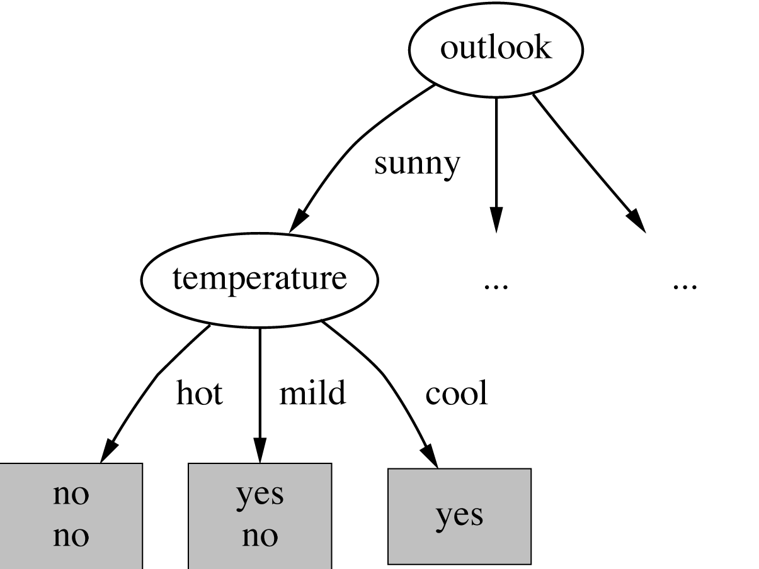
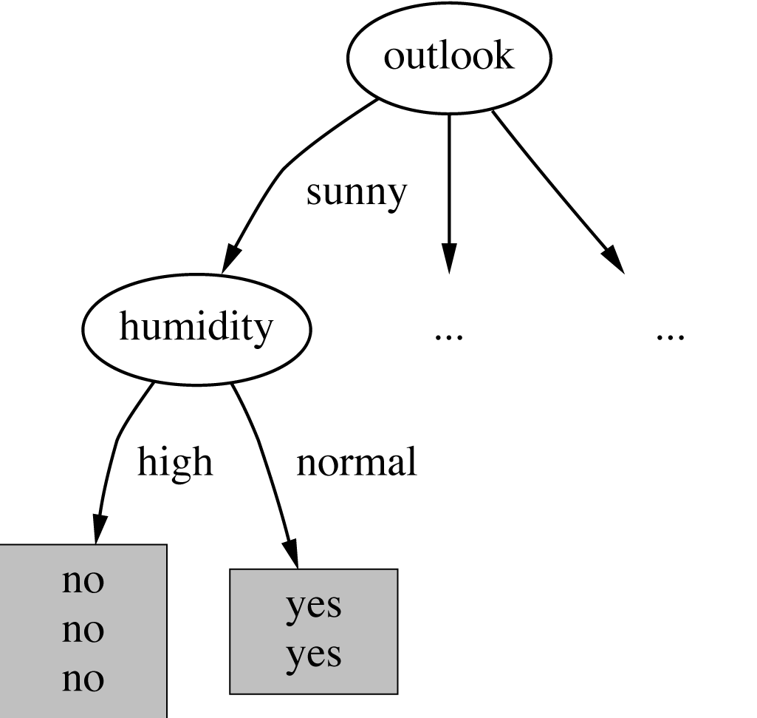

Continuing to split

Slide 48
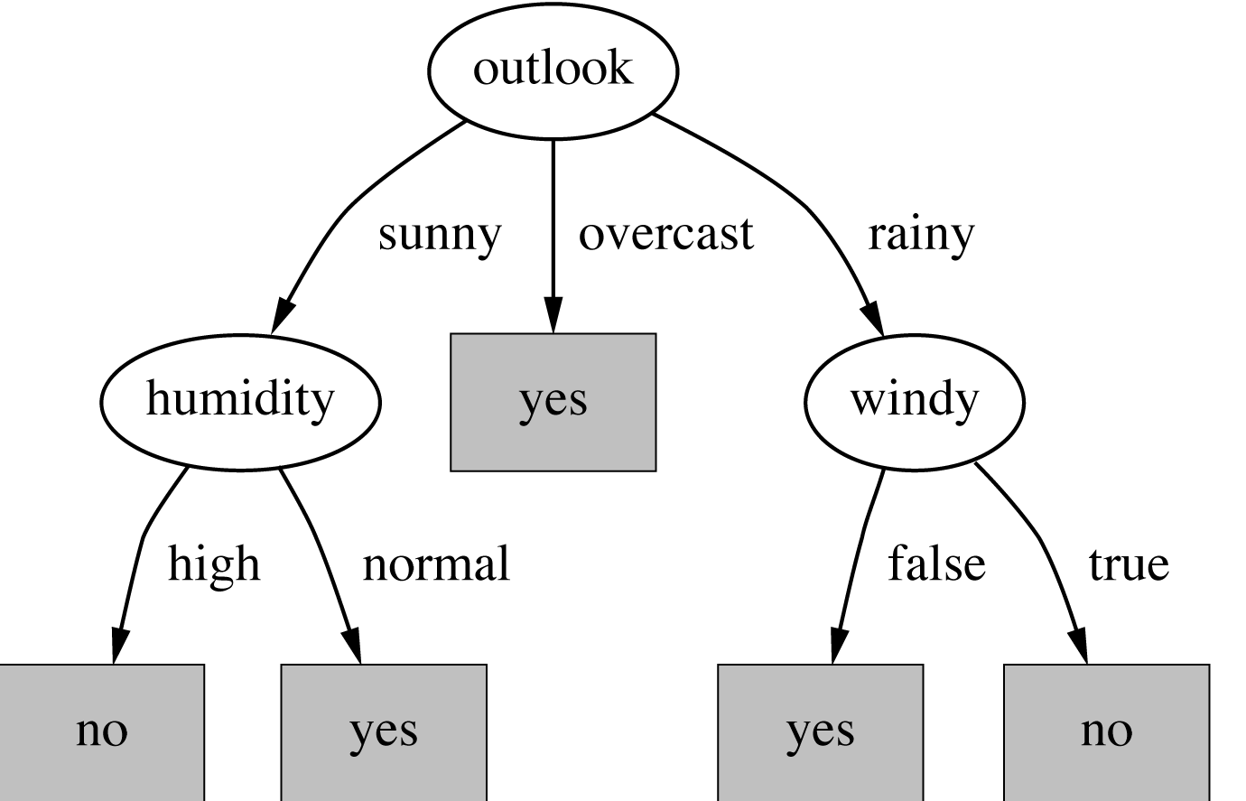
The final decision tree
Note: not all leaves need to be pure; sometimes identical instances have different classes
⇒ Splitting stops when data can’t be split any further

Slide 49
Wish list for a purity measure
Properties we require from a purity measure:
  Pure node: zero
  Impurity is maximal (i.e. all classes equally likely): maximal (e.g., binary case: 1)
  Multistage property (i.e. decisions can be made in several stages):
Entropy is the only function that satisfies all three properties!

Slide 50
Computing information
Information is measured in bits
  Given a probability distribution, the info required to predict an event is the distribution’s entropy
  Entropy gives the information required in bits (this can involve fractions of bits!)
Formula for computing the entropy:

Slide 51
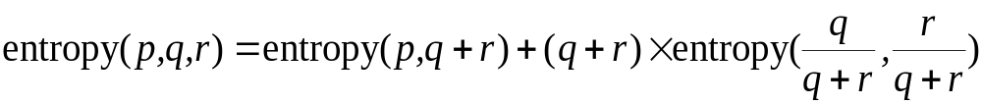
Some properties of the entropy
The multistage property:
  (where p+q+r = 1)
Simplification of computation:

Slide 52
Highly-branching attributes
Problematic: attributes with a large number of values (extreme case: ID code)
Subsets are more likely to be pure if there is a large number of values
  Information gain is biased towards choosing attributes with a large number of values
  This may result in overfitting (selection of an attribute that is non-optimal for prediction)

Slide 53
The weather data with ID code (extreme example)
ID code | Outlook | Temp. | Humidity | Windy | Play
A | Sunny | Hot | High | False | No
B | Sunny | Hot | High | True | No
C | Overcast | Hot | High | False | Yes
D | Rainy | Mild | High | False | Yes
E | Rainy | Cool | Normal | False | Yes
F | Rainy | Cool | Normal | True | No
G | Overcast | Cool | Normal | True | Yes
H | Sunny | Mild | High | False | No
I | Sunny | Cool | Normal | False | Yes
J | Rainy | Mild | Normal | False | Yes
K | Sunny | Mild | Normal | True | Yes
L | Overcast | Mild | High | True | Yes
M | Overcast | Hot | Normal | False | Yes
N | Rainy | Mild | High | True | No

Slide 54
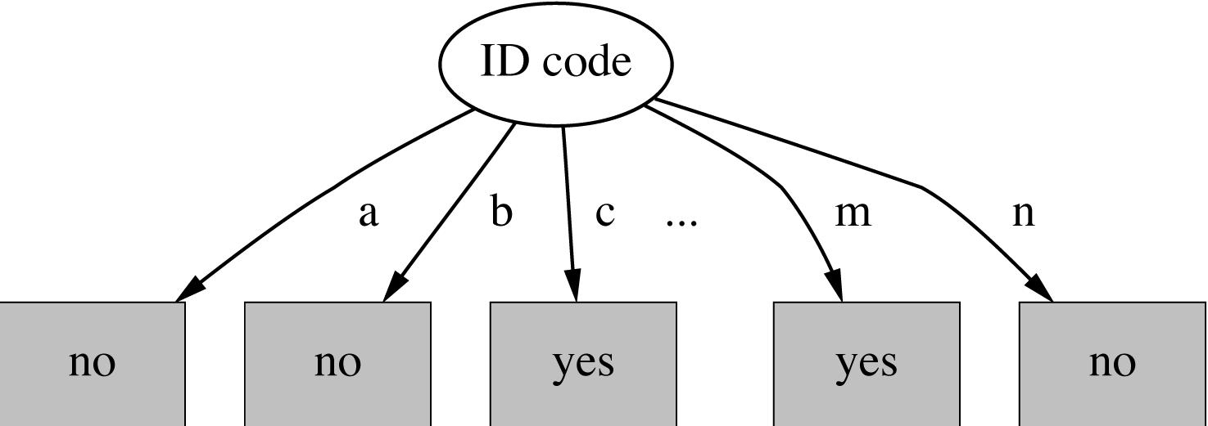
Tree stump for ID code attribute
Entropy of split:
  Information gain is maximal for ID code (namely 0.940 bits)

Slide 55
The gain ratio
Gain ratio: a modification of the information gain that reduces its bias towards highly branching attributes
Gain ratio takes the number and the size of branches into account when choosing an attribute (disregarding the class values!)
  It corrects the information gain by taking the intrinsic information of a split into account
Intrinsic information: entropy of distributing instances into branches (i.e. how much info do we need to tell which branch an instance belongs to)

Slide 56
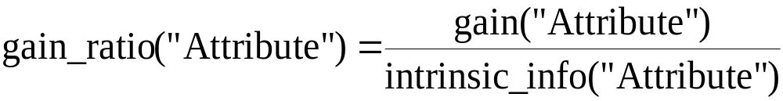
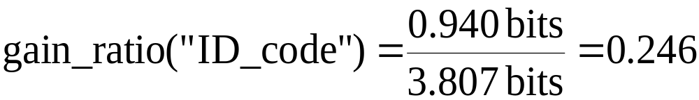
Computing the gain ratio
Example: intrinsic information for ID code
Value of attribute decreases as intrinsic information gets larger
Definition of gain ratio:
Example:

Slide 57
Gain ratios for weather data
Outlook |  | Temperature
Info: | 0.693 | Info: | 0.911
Gain: 0.940-0.693 | 0.247 | Gain: 0.940-0.911 | 0.029
Split info: info([5,4,5]) | 1.577 | Split info: info([4,6,4]) | 1.362
Gain ratio: 0.247/1.577 | 0.156 | Gain ratio: 0.029/1.362 | 0.021
Humidity |  | Windy
Info: | 0.788 | Info: | 0.892
Gain: 0.940-0.788 | 0.152 | Gain: 0.940-0.892 | 0.048
Split info: info([7,7]) | 1.000 | Split info: info([8,6]) | 0.985
Gain ratio: 0.152/1 | 0.152 | Gain ratio: 0.048/0.985 | 0.049

Slide 58
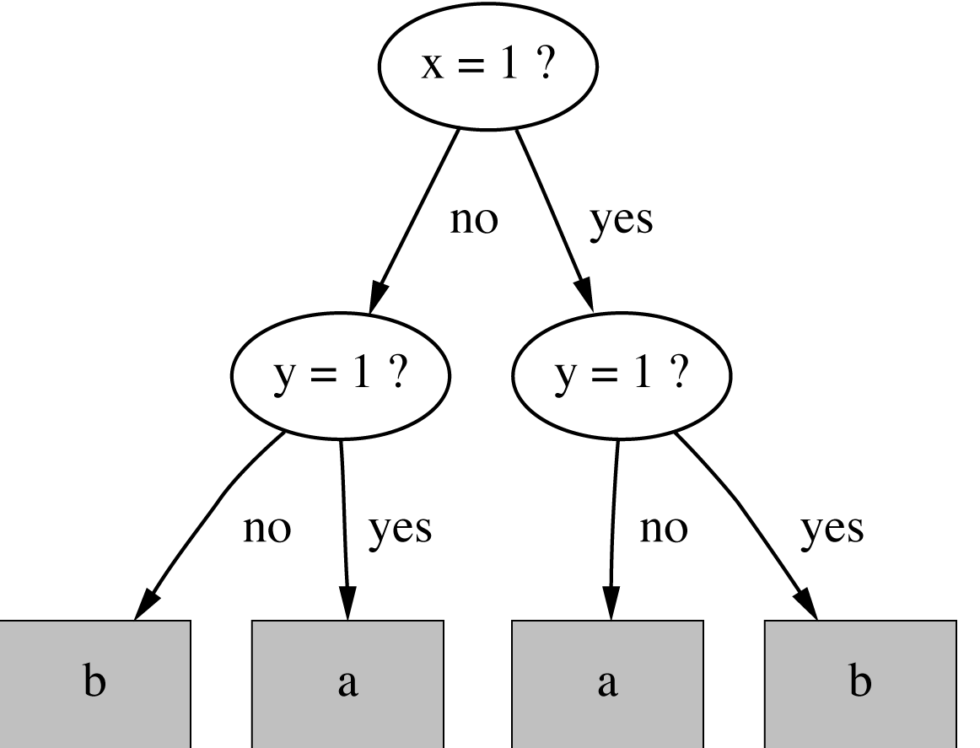
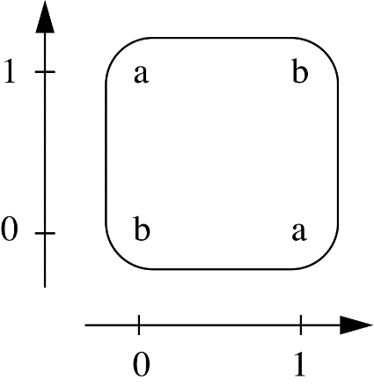
Knowledge representation:
decision tree (extension): XOR
awkward representation
hard to learn
XOR problem fortunately rare

Slide 59
Discussion
Algorithm for top-down induction of decision trees (“ID3”) was developed by Ross Quinlan
  Led to development of C4.5, which can deal with numeric attributes, missing values, and noisy data
Similar approach: Regression tree (CART: Classification and Regression Tree)
There are many other attribute selection criteria! (But almost no difference in accuracy of result.)
Decision Tree: „white box”
Decision Trees: traditionally most widely used ML models!

Slide 60
Classification Rule learning
(Covering algorithm)
(Generating rules)
(PRISM)

Slide 61
Knowlege Representation: Classification rules
Popular alternative to decision trees
Antecedent (pre-condition): a series of tests (just like the tests at the nodes of a decision tree)
  tests are usually logically AND-ed together
  but may also be general logical expressions
Consequent (conclusion):
  classes, or
  set of classes, or
  probability distribution assigned by rule
Individual rules are often logically OR-ed together…

Slide 62
Classification rule - example
antecedent
IF second person’s gender = female
AND first person’s parent1 = second person’s parent1
THEN sister-of = yes
consequent
Typically conjuctive antecedents

Slide 63
“Nuggets” of knowledge
Are rules independent pieces of knowledge? (It seems easy to add a rule to an existing rule base.)
Problem: ignores how rules are executed
Two ways of executing a rule set:
  Ordered set of rules (“decision list”)
    Order is important for interpretation
  Unordered set of rules
    Rules may overlap and lead to different conclusions for the same instance

Slide 64
Interpreting rules
What if two or more rules conflict?
  Give no conclusion at all?
  Go with rule that is most popular on training data?
  …
What if no rule applies to an instance?
  Give no conclusion at all?
  Go with class that is most frequent in training data?
  …

Slide 65
Special case: boolean class
Assumption: if instance does not belong to class “yes”, it belongs to class “no”
Trick: only learn rules for class “yes” and use default rule for “no”
Order of rules is not important. No conflicts!
If x = 1 and y = 1 then class = a If z = 1 and w = 1 then class = a Otherwise class = b

Slide 66
From trees to rules
Easy: converting a tree into a set of rules
  one rule for each leaf:
    antecedent contains a condition for every node on the path from the root to the leaf
    consequent is class assigned by the leaf
Produces rules that are unambiguous
  doesn't matter in which order they are executed
But: resulting rules are unnecessarily complex

Slide 67
From rules to trees
More difficult: transforming a rule set into a tree
  tree cannot easily express disjunction between rules

Slide 68
Linear models for regression (=predicting numeric value)

Slide 69

Linear models
Inputs (attribute values) and output are all numeric
Output is the sum of weighted attribute values
  The trick is to find good values for the weights

Slide 70
Example:
Predicting CPU performance
209 different computer configurations
 | Cycle time (ns) | Main memory (Kb) |  | Cache (Kb) | Channels |  | Performance
 | MYCT | MMIN | MMAX | CACH | CHMIN | CHMAX | PRP
1 | 125 | 256 | 6000 | 256 | 16 | 128 | 198
2 | 29 | 8000 | 32000 | 32 | 8 | 32 | 269
…
208 | 480 | 512 | 8000 | 32 | 0 | 0 | 67
209 | 480 | 1000 | 4000 | 0 | 0 | 0 | 45

Slide 71
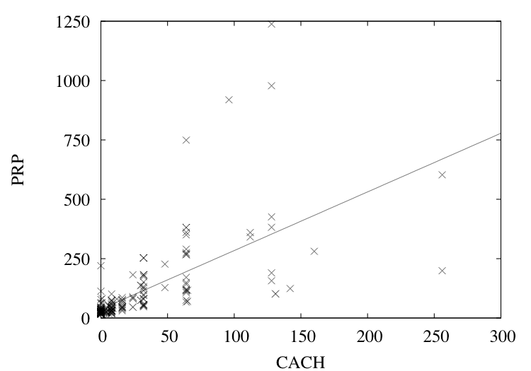
A linear regression function for the CPU performance data
PRP =
- 56.1
+ 0.049 MYCT
+ 0.015 MMIN
+ 0.006 MMAX
+ 0.630 CACH
- 0.270 CHMIN
+ 1.46 CHMAX

Slide 72
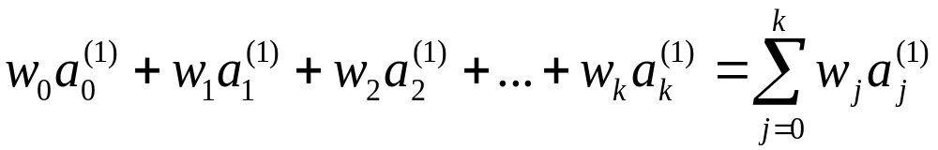
Linear regression
Outcome is linear combination of attributes
Weights are calculated from the training data
Predicted value for first training instance a⁽¹⁾

Slide 73
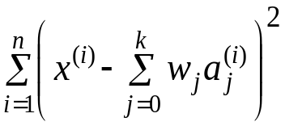
Goal: Minimum
Mean Squared Error (MSE)
Mean Squared Error (MSE), or L2 loss
k+1 coefficients are chosen so that MSE the training data is minimized
Assumptions …
  Error: Normal distribution
MSE sensitive to outliers!
Minimization of absolute error is more difficult!

Slide 74
Training: Minimizing Mean Squared Error (MSE)
Coefficients can be derived using matrix inversion
Iterative solution -- gradient decent -- computationally less expensive
Can be done if there are more instances than attributes (roughly speaking)

Slide 75
Linear models for
binary classification
Binary classification
Prediction is made by plugging in observed values of the attributes into the expression
  Predict one class if output > 0 (or 0.5, …), and the other class if output < 0 (or 0.5, …)
Decision boundary
  defines where the decision changes from one class value to the other
  hyperplane (high-dimensional plane)

Slide 76
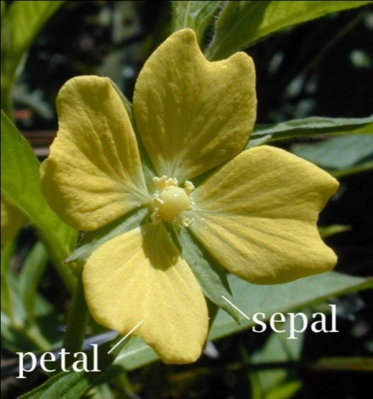
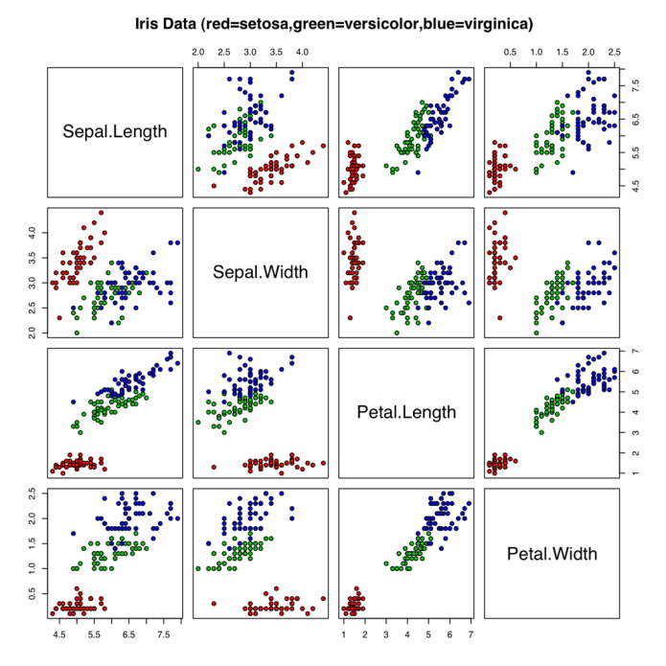
Example: Classifying iris flowers
 | Sepal length | Sepal width | Petal length | Petal width | Type
1 | 5.1 | 3.5 | 1.4 | 0.2 | Iris setosa
2 | 4.9 | 3.0 | 1.4 | 0.2 | Iris setosa
…
51 | 7.0 | 3.2 | 4.7 | 1.4 | Iris versicolor
52 | 6.4 | 3.2 | 4.5 | 1.5 | Iris versicolor
…
101 | 6.3 | 3.3 | 6.0 | 2.5 | Iris virginica
102 | 5.8 | 2.7 | 5.1 | 1.9 | Iris virginica
…
http://en.wikipedia.org/wiki/Iris_flower_data_set

Slide 77
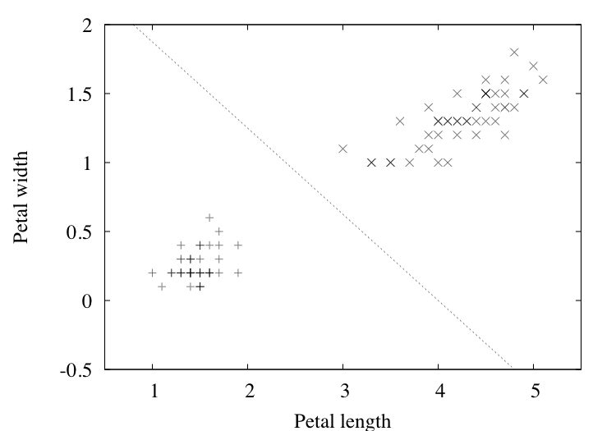
Separating setosas from versicolors
2.0 – 0.5PETAL-LENGTH – 0.8PETAL-WIDTH = 0
(2 input attributes)

Slide 78
Classification
Problems
  membership values are not in [0,1] range, so aren't proper probability estimates
  assumptions used in least-square regression
    normal distribution with same standard deviation for 0 -1 values ??!!

Slide 79

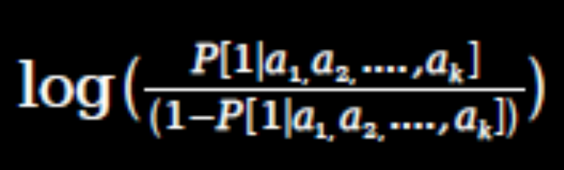
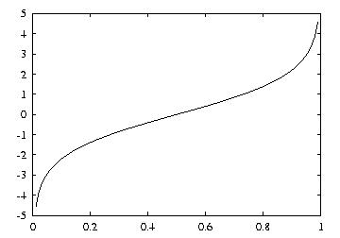
Linear models:
logistic regression
Linear model for a transformed target variable
Assume we have two classes
Logistic regression replaces
the target
by this target
Logit transformation maps
[0,1] to (-oo , +oo )
(Inverse function of logit:
sigmoid function)

Slide 80
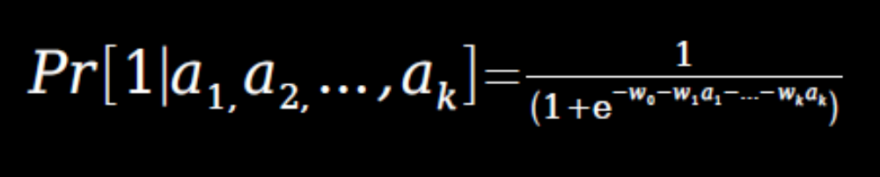
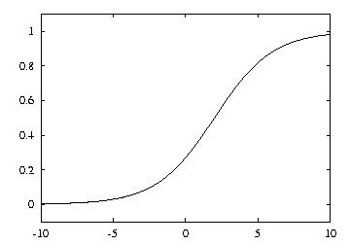
Logit transformation
(Sigmoid function):
Resulting model
Example
  Model with
    w₀ = 0.5 (moves curve left-right) and
    w₁ = 1 (steepness)

Slide 81
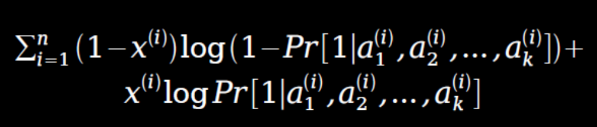
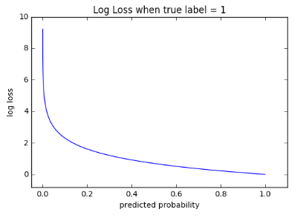

Maximum likelihood
Parameters are found from training data using maximum likelihood
Aim: choosing parameters to maximize probability of training data („maximum likelihood”)
  Independence: probabilities multiplied
  Maximizing multiplied probabilites : maximizing sum of logarithms of probabilities
where the x^{(i)} are either 0 or 1
Log loss ∑

Slide 82
Logistic regression 2
The independent variables should be independent of each other. That is, the model should have little or no multicollinearity.
The independent variables are linearly related to logit function - probability.
Logistic regression requires quite large sample sizes.

Slide 83
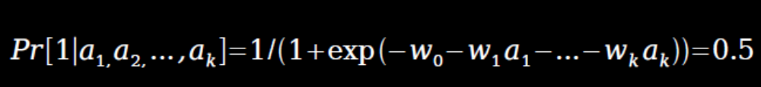
Linear models are hyperplanes
Decision boundary for two-class logistic regression is where probability equals 0.5:
which occurs when

Slide 84

Linear models: the perceptron
Don't actually need probability estimates if all we want to do is classification
Different approach: learn separating hyperplane
Assumption: data is linearly separable
Hyperplane:
where we again assume that there is a constant attribute with value 1 (bias)
If sum is greater than zero we predict the first class, otherwise the second class

Slide 85

Perceptron learning rule
Set all weights to zero
Until all instances in the training data are classified correctly
For each instance I in the training data
If I is classified incorrectly by the perceptron
If I belongs to the first class add it to the weight vector
else subtract it from the weight vector
Why does this work?
Consider situation where instance a pertaining to the first class has been added:
This means output for a has increased by:
This number is always positive, thus the hyperplane has moved into the correct direction (and we can show output decreases for instances of other class)
Convergence guaranteed -- if data linearly separable --, upper bound on number of steps

Slide 86
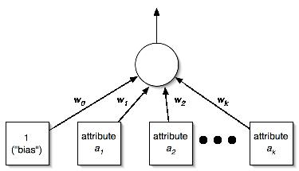
Perceptron as a neural network
Output layer
Input layer

Slide 87

Linear models: Winnow
Binary classification
Mistake-driven
Multiplicative updates (perceptron: additive updates):
  Weights are multiplied (or divided) by a user-specified parameter (alpha > 1)
User-specific threshold (perceptron: 0)
  Predict first class, if:

Slide 88
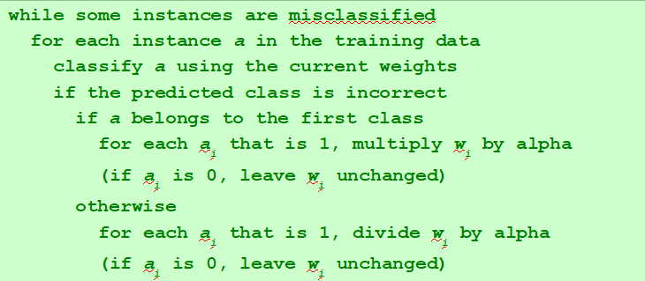
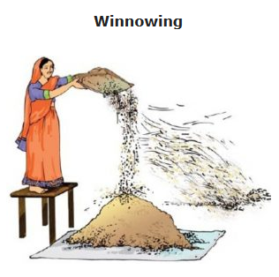
Winnow learning rule
Effectively focuses on
relevant features

Slide 89
Instance-based learning

Slide 90
Instance-based representation
Simplest form of learning: rote learning
  Training instances are searched for instance that most closely resembles new instance
  The instances themselves represent the knowledge
    Lazy learning!
  Also called instance-based learning
Similarity function

Slide 91
The distance function
Simplest case: one numeric attribute
  Distance is the difference between the two attribute values involved (or a function thereof)
Several numeric attributes: typically Euclidean distance is used and attributes are normalized
Taking the square root is not required when comparing distances
Other popular metric: city-block metric
  Adds differences without squaring them

Slide 92
The distance function
Nominal attributes: distance is set to 1 if values are different, 0 if they are equal
Are all attributes equally important?
  weighting the attributes might be necessary

Slide 93
Discussion of nearest-neighbor learning
Statisticians have used k-NN since early 1950s
Often very accurate
Limitations (of the basic algorithm)
White box, generalisation ?!
Speed (of prediction!!)
  E.g. 1E6 instances, 100 attributes (dimensions)
Noisy data ?!
Domains of attributes different ?!
  comparing e.g. [0,1] with [-5000,5000] ?
Irrelevant attributes (only noise, with no relevance)

Slide 94
Clustering

Slide 95
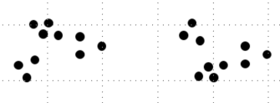
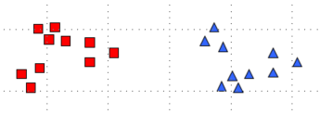
Clustering:
Knowledge Representation
Divide instances into “natural” groups (clusters)
  Instances in a group (cluster) similar to each other, in some or the other way
  No class attribute, unlabelled data
  Unsupervised learning
Cluster 1
Cluster 2

Slide 96
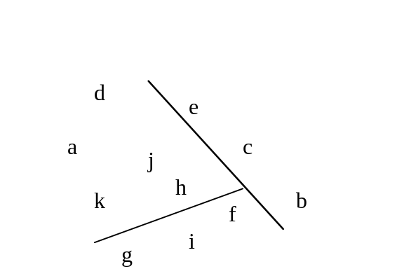
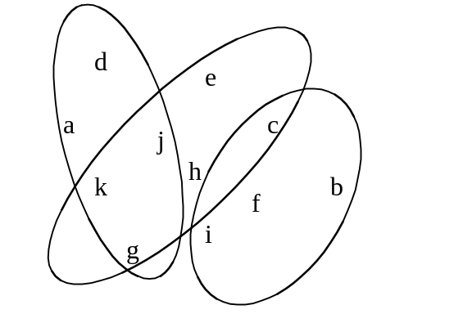
Representing clusters I
Simple 2-D representation
Venn diagram
  disjoint vs. overlapping

Slide 97
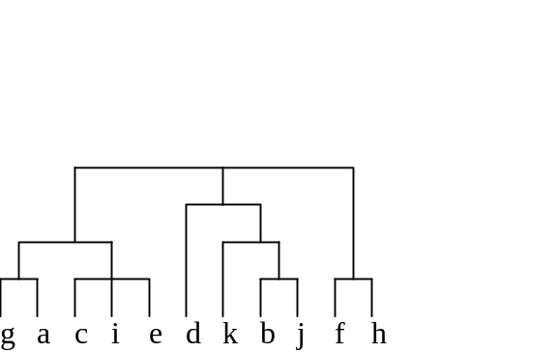
Representing clusters II
Probabilistic assignment
Dendrogram
1 2 3
a 0.4 0.1 0.5
b 0.1 0.8 0.1
c 0.3 0.3 0.4
d 0.1 0.1 0.8
e 0.4 0.2 0.4
f 0.1 0.4 0.5
g 0.7 0.2 0.1
h 0.5 0.4 0.1
…
NB: dendron is the Greek word for tree
  probabilistic
  (vs. deterministic)
  hierarchical
  (vs. flat)

Slide 98
The k -means algorithm
disjoint, deterministic, and flat clusters
number of clusters (k) preselected
Choose k cluster centers (e.g. randomly)
Repeat until convergence
  assign instances to clusters (based on distance; closest cluster center)
  compute centroids of clusters
  (convergence: assignment of instances to clusters do not change)

Slide 99
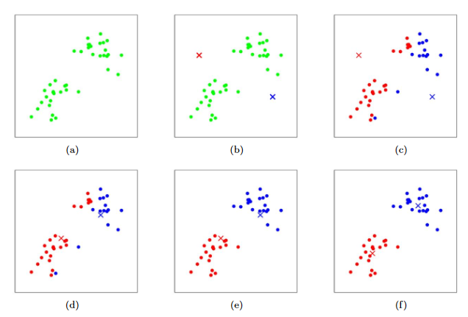
K-means: illustration
Andrew N.G.

Slide 100
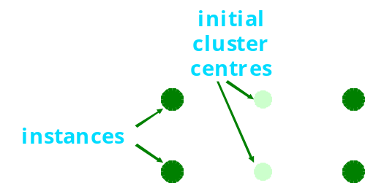


Discussion
Algorithm minimizes squared distance to cluster centers
Converges
  distortion function (==sum of squared errors) converges
  typically also cluster centers and assignment of instances to clusters)
Result can vary significantly
  based on initial choice of seeds
  (restarting with different random seeds)
Can get trapped in local minimum
(in practice not typical)
Number of clusters?
Distance?
Speed of distance calculations…
Probabilistic, hierarhical, overlapping…

Slide 101
Mining Association Rules
(Apriori Algorithm)

Slide 102
Association rules (knowledge representation)
Form of rules
If a and b and c occurs in the set, then t is also part of the set
    if Milk = true and
    Bread = True
    then Eggs = true and
    Coke = True
Typically boolean attributes
  Compact notation: if Milk and Bread then Eggs and Coke
No selected class attribute
Multiple attributes on consequent side possible/typical
Rules interpreted individually!
    if Milk and True then Eggs and Coke
Notes:
Új-Zéland
Szezon végén tehenek 20%-át levágják
Betegségek
Kor
Termékenység
Mennyire könnyen szül
Természet (agresszió)
700 tulajdonság több millió tehénhez
----
CRM/marketing
Insurance
Academic
Telecommunications
Web ---
vásárlók....
Adattemető
---
Bioinformatika, genetika, gyógyszerészet
(multifactor dimensionality reduction)

Slide 103


Association rule mining, applications
Application areas
  Market basket analysis
  ~Sequence mining
{Diaper} → {Beer},
{Milk, Bread} → {Eggs,Coke},
{Beer, Bread} → {Milk},
Notes:
Új-Zéland
Szezon végén tehenek 20%-át levágják
Betegségek
Kor
Termékenység
Mennyire könnyen szül
Természet (agresszió)
700 tulajdonság több millió tehénhez
----
CRM/marketing
Insurance
Academic
Telecommunications
Web ---
vásárlók....
Adattemető
---
Bioinformatika, genetika, gyógyszerészet
(multifactor dimensionality reduction)

Slide 104
Association rule mining
Immense number of potential rules…
a,b,c,d,e
b,c,d
a,b,c,d
a,b,c,d,e
a,c,e,f
d,c,e,f
a,b,c,d,f
Sufficiently general rules
Sufficiently correct/
precise rules
b,c,d co-occur
in 71% of the cases
If b and c then d
in 100% of the cases
Notes:
Új-Zéland
Szezon végén tehenek 20%-át levágják
Betegségek
Kor
Termékenység
Mennyire könnyen szül
Természet (agresszió)
700 tulajdonság több millió tehénhez
----
CRM/marketing
Insurance
Academic
Telecommunications
Web ---
vásárlók....
Adattemető
---
Bioinformatika, genetika, gyógyszerészet
(multifactor dimensionality reduction)

Slide 105
Support and confidence of a rule
(Rule: X -> Y)
Support/coverage: number of instances predicted correctly
  Supp(X and Y) „Itemset” – no matter, whether an item (attribute) is on the left or on the right hand side of the rule
  Can also be calculated as a relative number (relative to the number of all instances)
Confidence/accuracy: number of correct predictions, as proportion of all instances that rule applies to
  confidence=Supp(X and Y)/Supp(X)
Lift: How popular is Y, when X, considering also how popular Y is
  lift= Confidence of Rule / Relative support of Y
  1: no association,
  >1 Y is more likely when X,
  <1 Y is less likely when X

Slide 106
Association rules
Example for support & confidence
If temperature = cool then humidity = normal
Outlook | Temp. | Humidity | Windy | Play
Sunny | Hot | High | False | No
Sunny | Hot | High | True | No
Overcast | Hot | High | False | Yes
Rainy | Mild | High | False | Yes
Rainy | Cool | Normal | False | Yes
Rainy | Cool | Normal | True | No
Overcast | Cool | Normal | True | Yes
Sunny | Mild | High | False | No
Sunny | Cool | Normal | False | Yes
Rainy | Mild | Normal | False | Yes
Sunny | Mild | Normal | True | Yes
Overcast | Mild | High | True | Yes
Overcast | Hot | Normal | False | Yes
Rainy | Mild | High | True | No
  support = 4
  confidence = 100%
If temperature = cool then play= yes
  support = 3
  confidence = 75%

Slide 107
Interpreting association rules
Interpretation is not obvious:
is not the same as the two rules
It means that the following also holds:
If windy = false and play = no then outlook = sunny and humidity = high
If windy = false and play = no then outlook = sunny
If windy = false and play = no then humidity = high
If humidity = high and windy = false and play = no then outlook = sunny
Why?

Slide 108
Interpreting association rules
Interpretation is not obvious:
is not the same as the two rules
It means that the following also holds:
If windy = false and play = no then outlook = sunny and humidity = high
If windy = false and play = no then outlook = sunny
If windy = false and play = no then humidity = high
If humidity = high and windy = false and play = no then outlook = sunny
Why? Support…
Confidence…

Slide 109
ASSOCIATION RULES:
APRIORI ALGORITHM

Slide 110

Mining association rules
Normally: minimum support and confidence pre-specified (e.g. for weather data:
support ≥ 2 and confidence ≥ 95%, -> 58 rules)
Brute force: All rules, filtering on the bases of support and confidence
Immense number
of possible associations
Computational complexity!

Slide 111
Association rules
But: we can look for high support rules (itemsets) and high confidence rules directly!
Two steps
  High support (frequent item sets)
  High confidence

Slide 112
Frequent Item sets
Support: number of instances correctly covered by association rule
  The same as the number of instances covered by all tests in the rule (LHS and RHS!)
Item: one test (that is, attribute-value pair)
Item set: all items occurring in a rule
(LHS and RHS !!)
Goal: only rules that exceed pre-defined support
  ⇒ We can do it by finding all item sets with the given minimum support (=frequent item sets) and generating rules from them!

Slide 113
Frequent Item Sets
for weather data
One-item sets | Two-item sets | Three-item sets | Four-item sets
Outlook = Sunny (5) | Outlook = Sunny Temperature = Mild (2) | Outlook = Sunny Temperature = Hot Humidity = High (2) | Outlook = Sunny Temperature = Hot Humidity = High Play = No (2)
Temperature = Cool (4) | Outlook = Sunny Humidity = High (3) | Outlook = Sunny Humidity = High Windy = False (2) | Outlook = Rainy Temperature = Mild Windy = False Play = Yes (2)
… | … | … | …
Number of frequent item sets (with minimum support of two) :
  12 with 1 item,
  47 with 2 items,
  39 with 3 items,
  6 with 4 items
  0 with 5 items

Slide 114
Generating item sets efficiently
How can we efficiently find all frequent item sets (item sets with support value higher than the threshold for support)?
If (A B) is frequent item set, then (A) and (B) have to be frequent item sets as well!
  Necessary, but not sufficient condition:
  if (A) and (B) are frequent item sets, (A B) is not necessaryily frequent, too.
In general: if X is frequent k-item set, then all (k-1)-item subsets of X are also frequent

Slide 115
Generating item sets efficiently
Find frequent (support larger than threshold) one-item sets
  Compute candidate frequent k-item sets by merging frequent (k-1)-item sets
Check (real) support of candidate frequent k-items sets
by reading through the whole database
Remark: The algorithm reduces the number of k-item sets, the support of which has to be checked by reading through the whole database.

Slide 116
An example
Given: five frequent three-item sets
(A B C), (A B D), (A C D), (A C E), (B C D)
Lexicographically ordered!
Candidate frequent four-item sets:
(A B C D) candidate
e (B C D E) no candidate, e.g., because of (C D E)
Check real support by counting instances in dataset!

Slide 117
Generating rules
from an item set
Once all item sets with minimum support have been generated, we can turn them into rules
Example:
Seven (2^{N}-1) potential rules:
Humidity = Normal, Windy = False, Play = Yes (4)
If Humidity = Normal and Windy = False then Play = Yes If Humidity = Normal and Play = Yes then Windy = False If Windy = False and Play = Yes then Humidity = Normal If Humidity = Normal then Windy = False and Play = Yes If Windy = False then Humidity = Normal and Play = Yes If Play = Yes then Humidity = Normal and Windy = False If True then Humidity = Normal and Windy = False and Play = Yes | 4/4 4/6 4/6 4/7 4/8 4/9 4/14
Rules with same itemset: all k-1 consequent rules have at least the same confidence, as k consequent rules

Slide 118
Generating rules efficiently
We are looking for all high-confidence rules
  Which items on the RHS of the rule?
  But: brute-force method is (2^{N}-1)
Observation: (c + 1)-consequent rule can only have a confidence above the threshold if all corresponding c-consequent rules also have
Building (c + 1)-consequent rules from c-consequent ones!

Slide 119
Example
1-consequent rules:
Corresponding candidate 2-consequent rule:
Final check of antecedent against data!
If Outlook = Sunny and Windy = False and Play = No then Humidity = High (2/2)
If Humidity = High and Windy = False and Play = No then Outlook = Sunny (2/2)
If Windy = False and Play = No then Outlook = Sunny and Humidity = High (2/2)

Slide 120
Discussion of association rules
Above method makes one pass through the data for each different size item set
  Other possibility: generate (k+2)-item sets just after (k+1)-item sets have been generated
    Result: more (k+2)-item sets than necessary will be considered but less passes through the data
Practical issue: generating a certain number of rules (e.g. by incrementally reducing min. support)

Slide 121
Summary/concepts/questions
1R
  Model
  Algorithm
  Unknown values
  Numeric attributes
Naive Bayes
  Model
  Algorithm (Learning, predicting)
  Laplace estimator
  Unknown values
  Numeric attributes
ID3 decision tree
  Level of surprise, entropy, information gain, algorithm
Rules: problem with interpretation

Slide 122
Summary/concepts/questions - 2
Linear models
  Form of linear model for regression
  Form of error to be minimized
Linear models for classification
  Logistic regression
  Perceptron
  Winnow
  Instance based (Nearest neighbour) learning
  „Knowledge representation”
  Algorithm
  Problems
Clustering
  Knowledge representation
  K-means: algorithm + limitations
Association rule mining
  Knowledge representation
  Item, itemset, support, confidence, lift
  Apriori algorithm

