Slide 1

DM & ML
Credibility: Evaluating what’s been learned
Gergely Lukács
Pázmány Péter Catholic University
Faculty of Information Technology and Bionics
Budapest, Hungary
lukacs@itk.ppke.hu

Slide 2
Evaluation: the key to success
How predictive is the model we learned?
Also: Basis for developing useful data mining algorithms

Slide 3
Basic performance measure
Natural performance measure for classification: error rate
  Success: instance’s class is predicted correctly
  Error: instance’s class is predicted incorrectly
  Error rate: proportion of errors made over the whole set of instances

Slide 4
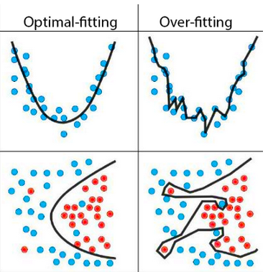
Overfitting
  Model fits training data well, but only training data; but: model generalizes poorly, consequently, bad prediction for data not used for model building
  model too complex and has a bad prediction performance
Good modell
Overfitted modell
Regression
Classification
„Overfitting is when you have a complicated model
that gives worse predictions, on average,
than a simpler model” (Andrew Gelman)

Slide 5
Overfitting - resubstitution error
Error on the training data – resubstitution error – is not a good indicator of performance on future data
Resubstitution error is (hopelessly) optimistic!

Slide 6
Test Set
Test set: set of independent instances that have played no part in formation of classifier
  Assumption: both training data and test data are representative samples of the underlying problem
It is important that the test data is not used in any way to create the classifier used for performance evaluation („data leakage”)

Slide 7
Test Set in Practice
Test and training data may differ in nature
  Example: classifiers built using customer data from two different towns A and B
    To estimate performance of classifier from town A in a completely new town, test it on data from B
Changes over time

Slide 8
Performance measures:
Binary classification
The confusion matrix
 |  | Predicted class
 |  | Yes | No
Actual class | Yes | True positive (TP) | False negative (FN, Type II error)
 | No | False positive (FP, Type I error) | True negative (TN)

Slide 9
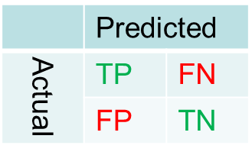
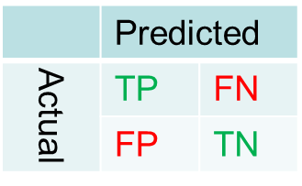
Measures
Success rate: (TP + TN)/(TP+FP+TN+FN)
Error rate: (FP + FN)//(TP+FP+TN+FN)
Focus on true positives
used in information retrieval
(selecting relevant „document”)
  Proportion of true positives
  to all retrieved
  precision=TP/(TP +FP)
  Proportion of (retrieved) true positives
  to all positives
  recall = TP /(TP + FN)
Focus on positives and negatives
used in medical testing
  Proportion of positives that are correctly identified:
  Sensitivity (True Positive Rate) = TP / (TP + FN) (==recall)
  Proportion of negatives that are correctly identified
  Specificity (True Negative Rate) = TN / (FP + TN)

Slide 10
Multiclass problems
Some measures work directly
  confusion matrix
  success rate
  error rate
Some measures have to be adapted/extendend
  Precision values for each of the classes
  Average precision
  Precision, recall …

Slide 11
Unbalanced classes?
Medical test, 1% of cases positive, 99% negative
If we always predict negative, we have a success rate of 99% !!

Slide 12
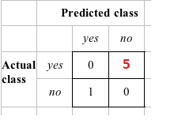
Taking costs into account
Real problem
  Different types of errors not equally bad
  Medical test …
  Aeroplane fault diagnosis (missing an engine failout?)
  Terrorist profiling (not terrorist correct 99.99% of the time, but missing one has very high costs!)
  …
Success rate is replaced by average cost per prediction
  Cost is given by appropriate
  entry in the cost matrix

Slide 13
Cost-sensitive prediction
Given: predicted class probabilities
Normally we just predict the most likely class
Here, we should make the prediction that minimizes the expected cost
    Expected cost: dot product of vector of class probabilities and appropriate column in cost matrix
    Choose column (class) that minimizes expected cost

Slide 14
Modifying learning for considering costs
Most learning algorithms generate the same classifier, independently of the cost matrix
  Cost matrix only influences final prediction
So far we haven't taken costs into account at training time
Most learning schemes do not perform cost-sensitive learning
  They generate the same classifier no matter what costs are assigned to the different classes
Considering cost matrix during training (and ignoring during prediction)
  Simple methods for cost-sensitive learning:
    Resampling of instances according to costs
    Weighting of instances according to costs
  Some algorithmscan take costs into account by varying a parameter,
    e.g. naïve Bayes

Slide 15
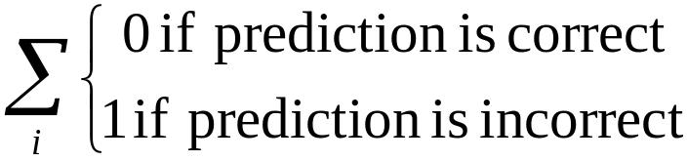
Probability estimation performance
Performance measure so far:
  success rate, i.e. „0-1 loss function”:
Some classifiers produce class probabilities
Depending on the application, we might want to check the accuracy of the probability estimates
  rather than simply comparing them to a fixed threshold, 0-1 loss
  e.g. prediction incorrect when
  class probability ~1 vs ~.51

Slide 16
Probability estimation performance 1:
Cross entropy
average number of bits needed to identify an event drawn from the set, if a coding scheme is used that is optimized for predicted probability distribution, rather than the "true" distribution
For single instance
  –log(p_{c}),where c is the index of the instance’s actual class
Minimum is reached at true probabilities

Slide 17
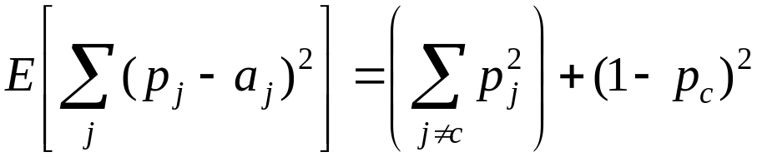
Probability estimation performance 2:
Mean Quadratic Loss / Brier Score
For a single instance:
  p₁,…, p_{k} are probability estimates for an instance
  c is the index of the instance’s actual class
  a₁,…, a_{k}=0, except for a_{c}, which is 1
For test set: mean quadratic loss or Brier Score
Can show that this is minimized when p_{j} = p_{j}*, the true probabilities

Slide 18
Cross entropy vs Brier score
probability of single class vs all probabilities
unbounded (values up to infinity) vs bounded to 2
Standard: cross entropy
Argument for Brier:
  you seek to describe model performance using a measure the model was not optimizing
  avoiding infinity

Slide 19
Limits of performance predictions
Example:
  The estimated error rate is 25%.
  How close is this to the true error rate?
  S=750 successes in N=1000 trials
    Estimated success rate (p): 75%
  S=75 and N=100
    Estimated success rate (p): 75%
  Depends on the amount of test data
We can say: p lies within a certain specified interval with a certain specified confidence

Slide 20
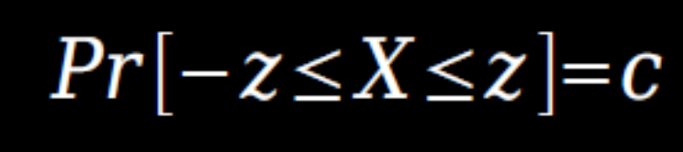

Bernoulli trial
Prediction is just like tossing a biased coin
  “Head” is a “success”, “tail” is an “error”
  Bernoulli trial, Bernoulli process
For a Bernoulli trial:
  Mean: p, variance p(1-p)
Expected success rate f=S/N
  Mean: p, variance p (1–p)/N
For large enough N, f follows a Normal distribution
c% confidence interval [–z =< X =< z] for random variable with 0 mean is given by:
Symmetric distribution:

Slide 21
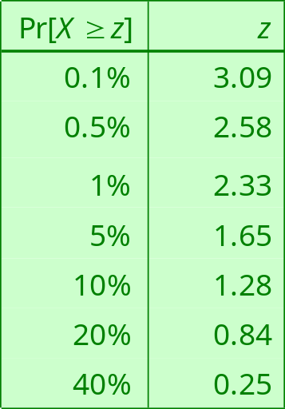
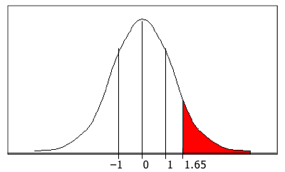
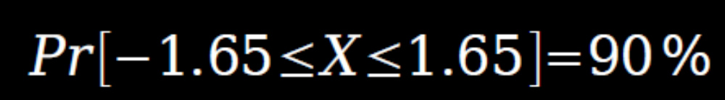
Confidence limits
Confidence limits for the normal distribution with 0 mean and a variance of 1
To use this we have to reduce our random variable f to have 0 mean and unit variance

Slide 22


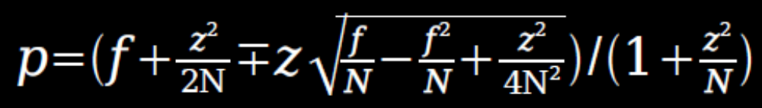
Transforming f
Transformed value for f :
(i.e. subtract the mean and divide by the standard deviation)
Resulting equation:
Solving for p :

Slide 23
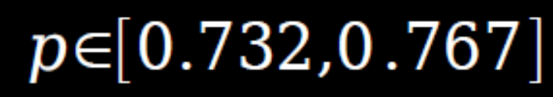


Examples
f = 75%, N = 1000, c = 80% (so that z = 1.28):
f = 75%, N = 100, c = 80% (so that z = 1.28):
Note that normal distribution assumption is only valid for large N (i.e. N > 100)
f = 75%, N = 10, c = 80% (so that z = 1.28):
?? (Normal distribution N > 100)

Slide 24
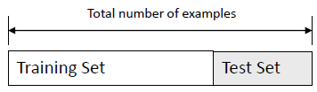
Holdout method
Method of splitting original data into training and test set
The holdout method reserves a certain amount for testing and uses the remainder for training

Slide 25
Making the most of the data
Generally, the larger the training data the better the classifier (but with diminishing return)
The larger the test data the more accurate the error estimate
Usually: one third for testing, the rest for training
Once evaluation is complete, all the data can be used to build the final classifier (for „simple” classifiers)
  Performance is improved over the previously estimated level

Slide 26
Problems
The samples might not be representative
  Example: some class might be missing in the test data
Modification: stratification
  Ensures that each class is represented with approximately equal proportions in both subsets
Data is usually (costly and) limited! (e.g., human/expert knowledge for creating labelled data)
  More sophisticated techniques need to be used
Family of resampling methods at the expense of higher computational cost
  Cross validation
    (Random subsampling)
    K-fold cross-validation
    Leave-one-out cross-validation
  Bootstrap

Slide 27
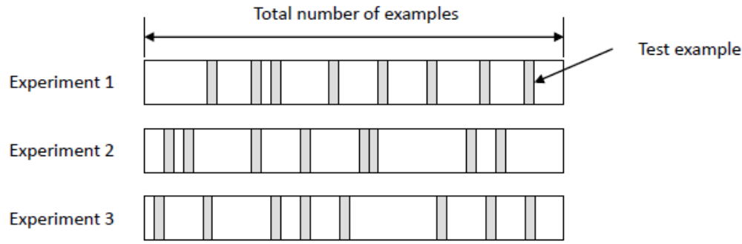

Repeated holdout method;
Random subsampling
K data splits of the entire dataset
  Each data split randomly selects a (fixed) number of examples without replacement
  For each data split we retrain the classifier from scratch with the training examples and then estimate E_{i} with the test examples
The true error estimate is obtained as the average of the separate estimates
This estimate is significantly better than the holdout estimate
Still not optimum: the different test sets overlap

Slide 28
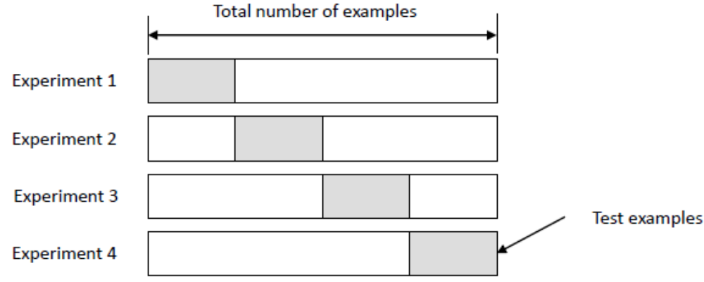
K-fold Cross Validation
K-fold cross validation
  data is split into k subsets of equal size
  Second step: each subset in turn is used for testing and the remainder for training
The error estimates are averaged (as before)
Often the subsets are stratified before the cross-validation is performed

Slide 29
More on cross-validation
Standard method for evaluation: stratified ten-fold cross-validation
Why ten-fold? Extensive experiments have shown that this is the best choice to get an accurate estimate
  There is also some theoretical evidence for this
Stratification reduces the estimate’s variance
Even better: repeated stratified cross-validation
  E.g. ten-fold cross-validation is repeated ten times and results are averaged (reduces the variance) – for performance estimation

Slide 30
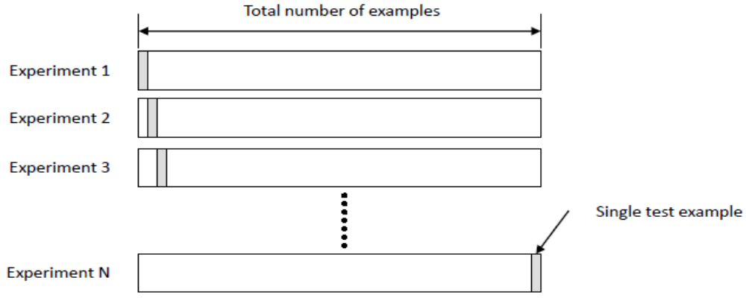
Leave-one-out cross-validation
(LOO-CV)
Leave-one-out cross-validation is a degenerate case of K-Fold CV:
The number of folds is set to the number of training instances
Advantages
  Makes maximum use of the data
  No random subsampling involved
Computationally very expensive (in general)
  for some DM algorithms it can be efficient

Slide 31
LOO-CV and stratification
Disadvantage of LOO-CV:
stratification is not possible
  It guarantees a non-stratified sample because there is only one instance in the test set!
Extreme example: completely random dataset with two classes and equal proportions for both of them
  Best inducer predicts majority class
  50% accuracy on fresh data
  LOO-CV error rate estimate for this inducer will be 100%!

Slide 32
The bootstrap
CV uses sampling without replacement
The bootstrap is an estimation method that uses sampling with replacement to form the training set
  A dataset of n instances is sampled n times with replacement to form a new dataset of n instances
  This data is used as the training set
  The instances from the original dataset that don’t occur in the new training set are used for testing

Slide 33
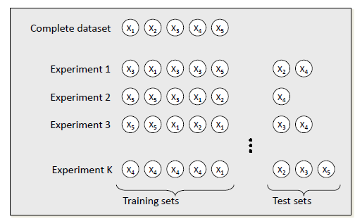
The bootstrap - example
  A dataset of n instances
  Test set: instances not in the training set
  Training set: sampling n times with replacement

Slide 34
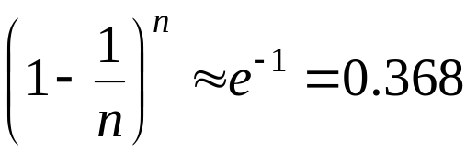
The 0.632 bootstrap
N instances sampled n times
  A particular instance has a probability of 1-1/n of not being picked
  Thus its probability of ending up in the test data is:
  This means the training data will contain approximately 63.2% of the instances

Slide 35
Estimating error with the bootstrap
The error estimate on the test data will be very pessimistic
  Training set contains only ~63% of the instances
Thus it is combined with the resubstitution error:
The resubstitution error gets less weight than the error on the test data
Process is repeated several times, with different replacement samples, and the results averaged
It is probably the best way of estimating performance for very small datasets

Slide 36
Three-way data splits
Up to now: performance evaluation of a single model
Now: model selection (and/or model tuning) and
performance evaluation of selected/best/tuned model
  Training set: used for learning
  Validation set: used to select among several trained classifiers
  Test set: used only to assess the performance of a fully-trained classifier
Why separate test and validation sets?
  The error rate of the final model on validation data will be biased (smaller than the true error rate) since the validation set is used to select the final model
  After assessing the final model on the test set, YOU MUST NOT tune the model any further!

Slide 37
Three-way data split - 2
Procedure outline (with holdout method)
  Divide the available data into training, validation and test set
  Repeat the following steps with different models(algorithms)/parameters
    Select model
    Train the model using the training set
    Evaluate the model using the validation set
  Select the best model and train it using data from the training and validation sets
  Assess this final model using the test set
If CV or bootstrap are used, steps 2.2 and 2.3 have to be repeated for each of the K folds
Performance evaluation
of single model

Slide 38
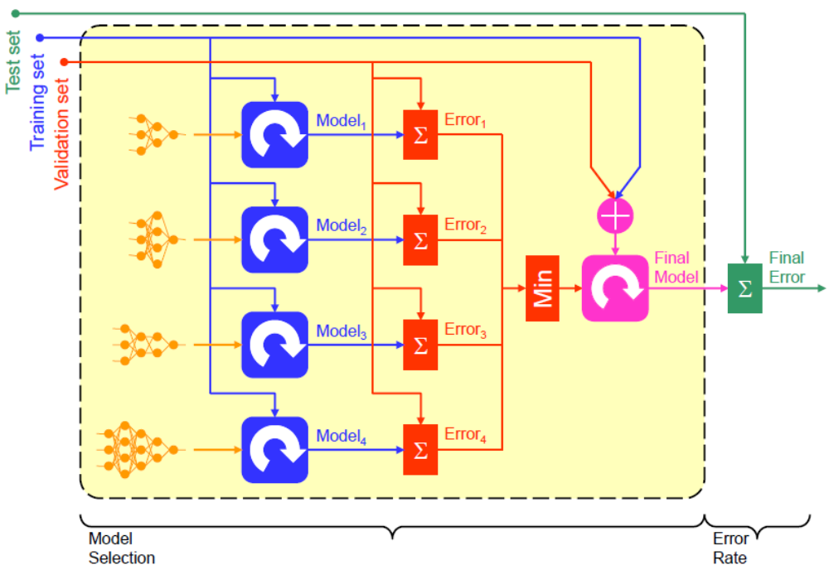
Three-way data splits
Competitions: Number of uploads limited, public/private test set

Slide 39
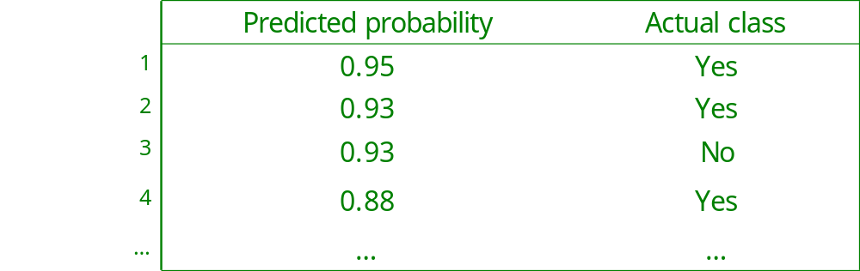
Charts, muptiple values
More detailed evaluation, diagram
  Costs are rerely known
Case 1: output with some confidence measure
    Sort instances according to predicted probability of being positive
    Different result sets by cutting the sorted list at different positions
Case 2: model with tuning parameter for several result sets
Measures for result sets in a diagram
Result set 1
Result set 2

Slide 40
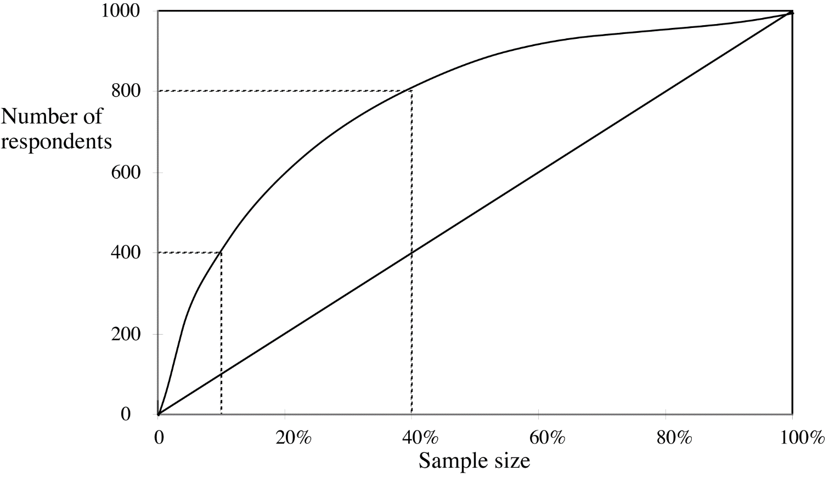
Lift chart
number of true positives
sample size
80% of responses for 40% of cost
40% of responses for 10% of cost

Slide 41
Lift chart: promotional mailing example
400 responses (40%)
for 100 000 mails (10% of costs)
800 responses (80%)
for 400 000 mails (40% of costs)
1000 responses (100%)
for 1 000 000 mails (100% of costs)

Slide 42
ROC („Receive Operation Characteristic”) curves
ROC curves are similar to lift charts
  Used in signal detection to show tradeoff between hit rate and false alarm rate over noisy channel
Differences to lift chart:
  x axis
  FPR: False Positive Rate = FP/(FP+TN) =
  =1 –True Negative Rate = 1- Specificity
  (Lift chart: sample size )
  y axis
  TPR: True Positive Rate = TP/(TP+FN) = sensitivity
  (Lift chart: absolute number)

Slide 43
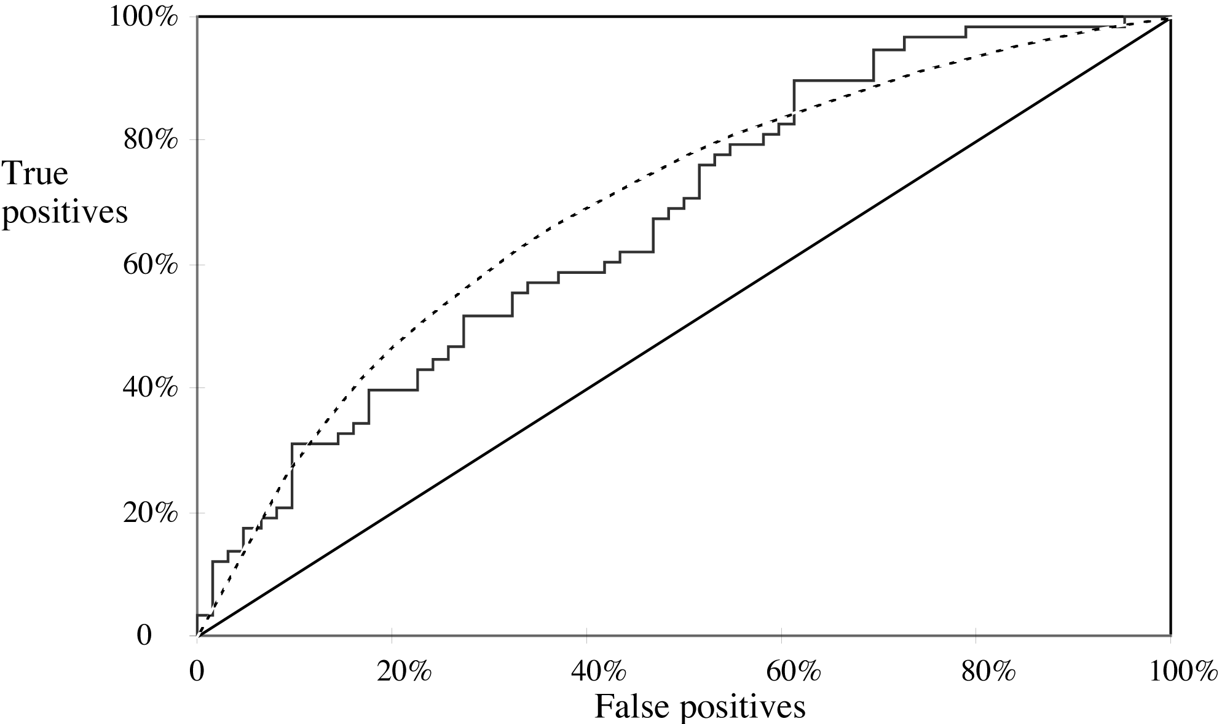
A sample ROC curve
True Positive Rate;
Sensitivity
False Positive Rate;
100% - Specificity

Slide 44
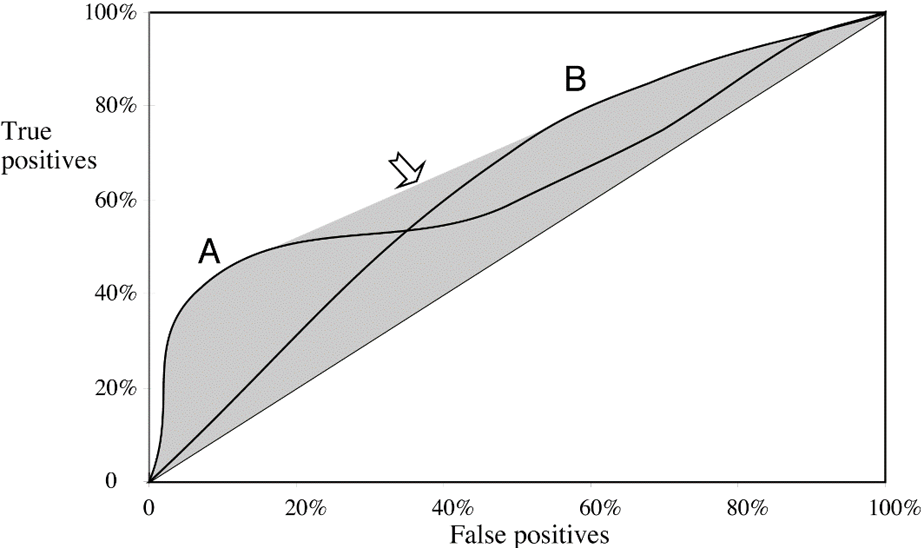
Combining ROC curves
For a small, focused sample, use method A
For a larger one, use method B
In between, choose between A and B with appropriate probabilities

Slide 45
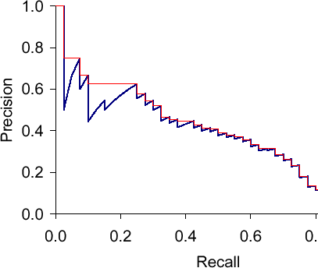
Precision-recall curve

Slide 46
Aggregated (summary) measures...
F-measure=(2 × recall × precision)/(recall+precision)
(harmonic mean of precision and recall)
average precision at 20%, 50% and 80% recall
three-point average recall
Specificity * sensitivity
Area under the ROC curve (AUC): probability that randomly chosen positive instance is ranked above randomly chosen negative one
  Random: 0.5
  Ideal: 1
  Good performance depends on domain

Slide 47
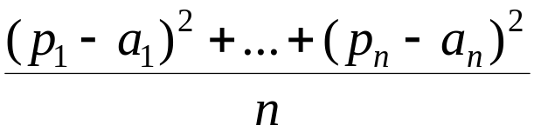
Evaluating numeric prediction
Same strategies
  independent test set, cross-validation, significance tests, etc.
Difference
  Error measure
Actual target values: a₁, a₂,…,a_{n}
Predicted target values: p₁, p₂,…,p_{n}
Most popular measure: mean-squared error
  Easy to work with mathematically

Slide 48
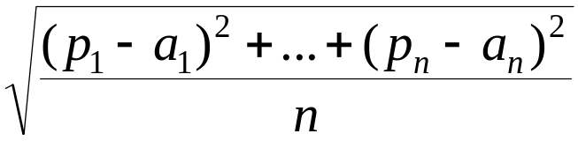
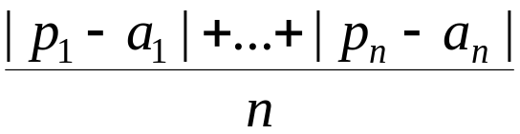
Other measures
The root mean-squared error:
The mean absolute error is less sensitive to outliers than the mean-squared error:
Sometimes relative error values are more appropriate (e.g. 10% for an error of 50 when predicting 500)

Slide 49

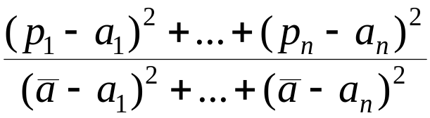
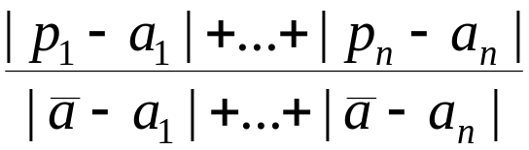
Improvement on the mean
Often we want to know how much the scheme improves on simply predicting the average (a very simple predictor, ).
(Relative squared error)
(Relative absolute error)

Slide 50
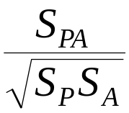
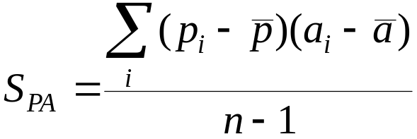
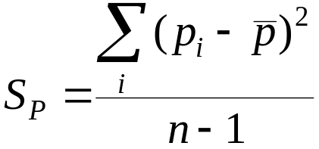
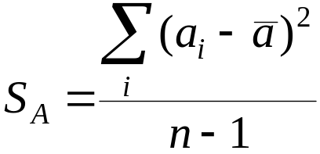
The correlation coefficient
It measures the statistical correlation between the predicted values and the actual values
Scale independent, between –1 and +1

Slide 51
Which measure?
Best to look at all of them
Often it doesn’t matter
Example:
 | A | B | C | D
Root mean-squared error | 67.8 | 91.7 | 63.3 | 57.4
Mean absolute error | 41.3 | 38.5 | 33.4 | 29.2
Root relative squared error | 42.2% | 57.2% | 39.4% | 35.8%
Relative absolute error | 43.1% | 40.1% | 34.8% | 30.4%
Correlation coefficient | 0.88 | 0.88 | 0.89 | 0.91

Slide 52
Evaluating clustering
Not trivial! (classification, numeric prediction much more straightforward!)
Two major types
  External: additional information on the data
  Internal: just the data, nothing else

Slide 53
Clustering: external evaluation
External information source, e.g.
  classes available
  human judgement
  utility of clustering with respect to its application
Measure (overlapping between clusters and external information)
  Purity, normalized mutual information, Rand-index, F-measure

Slide 54
Clustering: internal evaluation
Evaluation based on data that was clustered
Intra-cluster similarity high
Inter-cluster similarity low
When same measure used as for clustering…
  E.g. K-means with distance-based internal evaluation

Slide 55
Model elegance vs. errors
Theory 1: very simple, elegant theory that explains the data almost perfectly
Theory 2: significantly more complex theory that reproduces the data without mistakes
Which one is better?

Slide 56
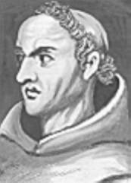
Model selection criteria
Model selection criteria attempt to find a good compromise between:
  The complexity of a model
  Its prediction accuracy on the training data
Reasoning: if no difference in prediction accuracy, simple modell preferred
Also known as Occam’s Razor :
the best theory is the smallest one
that describes all the facts
William of Ockham, born in the village of Ockham in Surrey (England) about 1285, was the most influential philosopher of the 14th century and a controversial theologian.

Slide 57
The MDL principle
MDL stands for minimum description length
The description length is defined as:
space required to describe a theory
+
space required to describe the theory’s mistakes
In our case the theory is the classifier and the mistakes are the errors on the training data
Aim: we seek a classifier with minimal DL
MDL principle is a model selection criterion

Slide 58
MDL and compression
MDL principle relates to data compression:
  The best theory is the one that compresses the data the most
  I.e. to compress a dataset we generate a model and then store the model and its mistakes

Slide 59
Summary/concepts/questions
Overfitting, resubstitution error
success rate, error rate
confusion matrix
  true positive, false positive, true negative, false negative
Precision, recall, sensitivity, specificity
training set, test set
three-way data split: training, validation, test set
holdout method
stratification
cross validation (tenfold, repeated)
  leave one out cross validation
bootstrap

Slide 60
Summary/concepts/questions - 2
Predicting probabilities
  quadratic loss function, informational loss function
Considering costs
  cost matrix
  cost-based prediction
lift chart, ROC, Precision-recall curve
F-measure, Area under ROC

Slide 61
Summary/concepts/questions - 3
Root mean-squared error
Mean absolute error
Correlation coefficient
Evaluating clustering
  External
  internal
MDL principle

