Slide 1

DM & ML
Ensemble learning
Gergely Lukács
Pázmány Péter Catholic University
Faculty of Information Technology
Budapest, Hungary
lukacs@itk.ppke.hu

Slide 2
Combining multiple models
„Crowd can be smarter than the individuals”
Basic idea of “meta” learning schemes: build different “experts” – or crowd -- and let them vote
  Sufficiently diverse crowd…
Advantage:
  often very good predictive performance
Disadvantage:
  interpretation of model ? (black box…)

Slide 3
Stacking / 1
Train different machine learning models on same dataset
  Level-0 Models (Base-Models)
    (Different algorithms)
  Standard ML algorithms
  (e.g., Decision tree, Bayesian network)
  Special algorithms of the application area
  (e.g. Natural Language Processing, parsing)
  Models of different teams in competitions („team merging”)
Combine the results of those models
  Level-1 Model (Meta-Model)
  Often simple model (in principle: any model)
  David Wolpert: “relatively global, smooth” model
    Base learners do most of the work
    Reduces risk of overfitting

Slide 4
Stacking / 2
Output of Level-0 models
  Classification: label
    Even better: also probabilities!
  Numeric prediction („Regression”): Value
  These are used to train Level-1 model
    Optional: additionally attributes of data as additional context

Slide 5
Stacking / 3
Data used for training level-0 models not to be used to train level-1 model! – overfitting!
  Cross-validation-like scheme is employed
Training of Level-0 models
  Some sort of validation, typical: cross validation – for training Level-1 model
  Finally: all data used for training
Training of Level-1 model
  Data not used to train Level-0 models

Slide 6
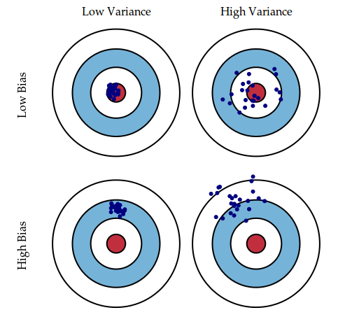
Bagging
Same algorithm (learning scheme) for all classifiers
Different datasets
“Idealized” version:
  Sample several training sets of size n
  (instead of just having one training set of size n)
  Build a classifier for each training set
Combining predictions by voting/averaging
  Simplest way (e.g. each model
  receives equal weight)
  Reduces variance by
  voting/averaging, thus reducing
  the overall expected error

Slide 7
Bagging – creating several datasets
Problem: we only have one dataset!
Solution: generate new datasets of size n by sampling with replacement from original dataset
  B-Agging = Bootstrap aggregating

Slide 8
Bagging classifiers
model generation
Let n be the number of instances in the training data.
For each of t iterations:
Sample n instances with replacement from training set.
Apply the learning algorithm to the sample.
Store the resulting model.
classification
For each of the t models:
Predict class of instance using model.
Return class that has been predicted most often.

Slide 9
Bagging
Original dataset
Dataset 1
Dataset 2
Combining results:
voting / averaging
Sampling with replacement
Dataset n
Same algorithm! (e.g. decision tree, Bayesian Network,…. anything)

Slide 10
More on bagging
Learning scheme is unstable
(Small change in training data can make big change in model;e.g. decision trees)
-> almost always improves performance
Theoretically, bagging would reduce variance without changing bias
  In practice, bagging can reduce both bias and variance
    For high-bias classifiers, it can reduce bias
    For high-variance classifiers, it can reduce variance
  Usually, the more classifiers the better
  Can help a lot if data is noisy
  In the case of classification there are pathological situations where the overall error might increase

Slide 11
Bagging with costs
good probability estimates
  instead of voting, the individual classifiers' probability estimates are averaged
also for learning problems with costs

Slide 12
Randomization
Can randomize learning algorithm instead of data
Some algorithms already have a random component:
  e.g. initial weights in neural net
Most algorithms can be randomized, e.g. greedy algorithms:
  Pick from the N best options at random instead of always picking the best options
  E.g.:
    attribute selection in decision trees
    random subspaces: random subsets of attributes in nearest-neighbor scheme
Can be combined with bagging

Slide 13
Random forest
„Forest” – multiple decision trees
Random:
  Feature randomness:
  Only considers attributes in a random subset of all attributes for a split (instead of all attributes)
  Data randomness:
  usually bootstrapping data (sampling with replacement)
Voting

Slide 14
Rotation forest accurate and diverse ensemble members
(2006, Rodríguez at al.)
Bagging creates ensembles of accurate classifiers with relatively low diversity
  Bootstrap sampling creates training sets with a distribution that resembles the original data
Randomness in the learning algorithm increases diversity but sacrifices accuracy of individual ensemble members
Accuracy-diversity dilemma
Rotation forests have the goal of creating accurate and diverse ensemble members

Slide 15
Rotation forest/2
An iteration involves
  Randomly dividing the input attributes into k disjoint subsets
  Applying PCA to each of the k subsets in turn
    (all attributes are kept; it preserves all information!)
  Learning a decision tree from the k sets of PCA directions

Slide 16
Rotation forest/3
„Rotation forest”
  Base classifier: decision tree → „forest”
  PCA is a simple rotation of the coordinate axes → „rotation”
Rotation forest has the potential to improve on diversity significantly without compromising the individual accuracy

Slide 17
Boosting
Boosting: explicitely seeks models that complement one another
Works well with weak models

Slide 18
Boosting 2
Similar to Bagging
  Voting (classification), averaging (numeric prediction)
  Models of the same type (e.g. decision trees)
Different from bagging
  Iterative, models not built separately
  New model is encouraged to become expert for instances classified incorrectly by earlier models
    Intuitive justification: models should be experts that complement each other
  Weighted voting!
There are several variants of this algorithm

Slide 19
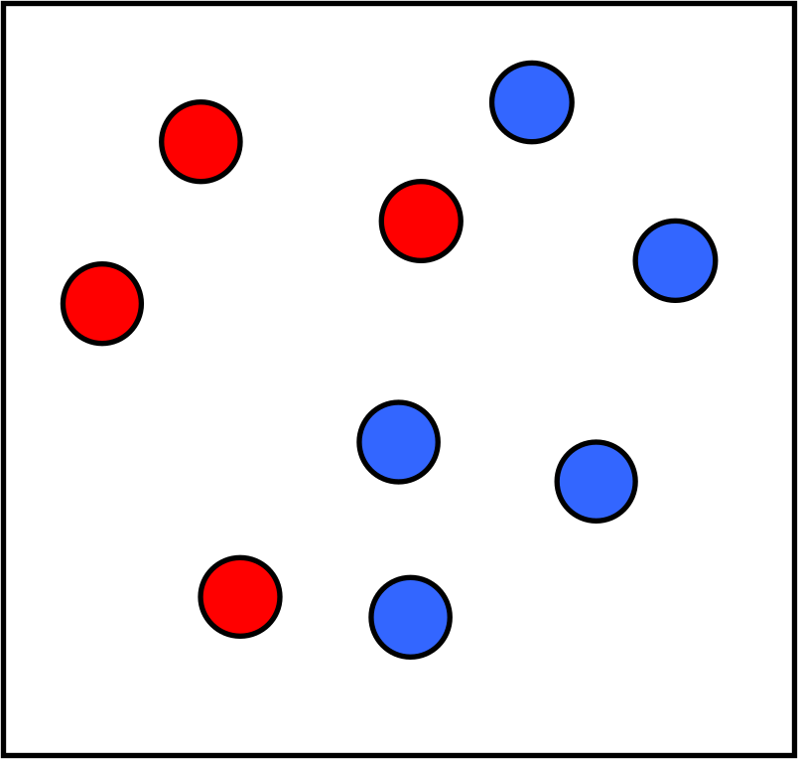
Boosting illustration
Classifier 1

Slide 20
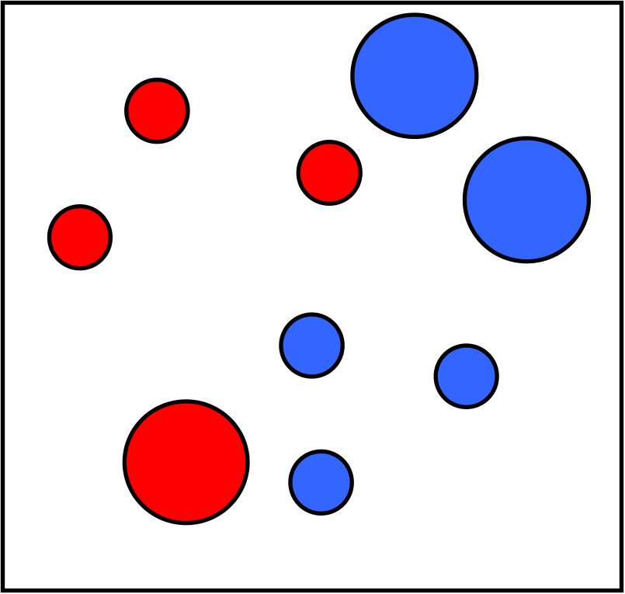
Boosting illustration
Weights
Increased

Slide 21
Boosting illustration
Classifier 2

Slide 22
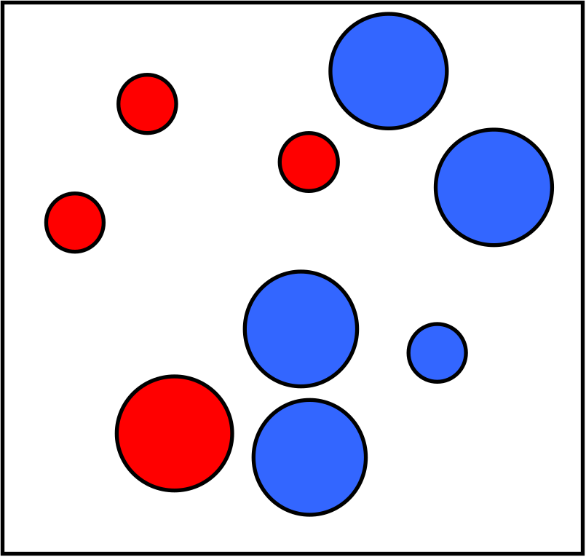
Boosting illustration
Weights
Increased

Slide 23
Boosting illustration
Classifier 3

Slide 24
Boosting illustration
Final classifier is
a combination of single classifiers

Slide 25
AdaBoost.M1
Model Generation
Assign equal weight to each training instance.
For each of t iterations:
Apply learning algorithm to weighted dataset and store resulting model.
Compute error e of model on dataset and store error.
If e equal to zero, or e greater or equal to 0.5
Terminate model generation.
For each instance in dataset:
If instance classified correctly by model
Multiply weight of instance by e / (1 - e).
Normalize weight for all instances.
Classification
Assign weight of zero to all classes.
For each of the t (or less) models:
Add -log(e/(1-e)) to weight of class model predicts.
Return class with highest weight.

Slide 26
More on boosting
Theoretical result:
  Upper limit for training error decreases exponentially
  Boosting works with weak learners only condition: error doesn’t exceed 0.5
    Week learner: only slightly better, than random predictor
Practical issue: Boosting needs weights
  adapting learning algorithm to use weights
  resample with probability determined by weights
AdaBoost in fact
  Additive model
  Particular loss function (exponential loss)

Slide 27
MIT OpenCourseWare:
(17. Learning: Boosting)
https://www.youtube.com/watch?v=UHBmv7qCey4&t=2752s

Slide 28
Gradiant Boosting
AdaBoost: adjusting weights of data points…
Difference between the prediction and the ground truth.
  Optimization problem
    on suitable cost function
    over function space
  Iterative, greedy
  by choosing function pointing in negative gradient direction

Slide 29



Elements of Learning
Example:
Linear regression
Model
  Parameters
Objective Function
  Training loss
  + regularisation!!!

Slide 30
XGBoost – theoretical advantages
Decision tree ensembles
Regularisation!
  Formalizes complexity of tree classifiers
  overfitting reduced!!
Custom optimization objectives and evaluation criteria
+… (handling missing values, built-in cross validation, continue existing model…)

Slide 31
XGBoost – computing advantages
Use of sparse matrices with sparsity aware algorithms
Improved data structures for better processor cache utilization which makes it faster.
Better support for multicore processing which reduces overall training time.

Slide 32
XGBoost – Parameter Tuning!
https://www.analyticsvidhya.com/blog/2016/03/complete-guide-parameter-tuning-xgboost-with-codes-python/

Slide 33
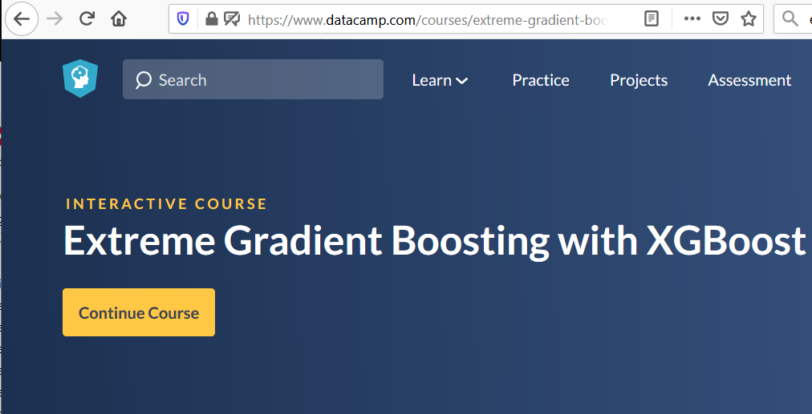

Slide 34
XGBoost vs Deep learning
Start with simple models!!
XGBoost
  Easier to train
  Less computational resources
  Better if categorical + numeric features
Deep learning
  Image Recognition, Computer Vision, Natural Language Processing (some sort of structure, space)

Slide 35
Comparison
Stacking | Bagging | Boosting
Data1 = Data2 = … = Data m | Data1 ≠ Data2 ≠ … ≠ Data m
 | Resample training data |  | Reweight training data
Learner1 ≠ Learner2 ≠ … ≠ Learner m | Learner1 = Learner2 = … = Learner m
Level-1 model | Vote |  | Weighted vote

Slide 36
Summary/concepts/questions
Bias-variance decomposition
Stacking
Bagging
Randomization
  Random Forest
  Rotation forest
Boosting
  AdaBoost
  Gradient Boosting
    XGBoost

