Slide 1
Oconee County Fire Rescue Web Portal
Team 24: Bailey Kaplon, Christian McGill, Levi Roth, Yuqi Yang

Slide 2


The Problem at Hand
Tracking the certifications and certification status of each of the Oconee County Fire Department volunteers is nearly a full-time job and taking precedent over other responsibilities for Ms. Smoake which is decreasing productivity
The department would like a web-based application that does much of the tracking and can centralize the input process

Slide 3

The Requirements
Data Entry
View basic information of members
View list of certifications
Add, edit, and delete records
Detail View
View certification detail with members holding that certification
View member detail showing certifications of that member
Reports
Members who have expired certs (with filter ability)
Member list with basic information

Slide 4
Our Resources
Team 24 Consulting possesses 4 valuable members with experience in application development
Development skills from the team members includes PHP, javascript, HTML, SQL, and CSS
The project will be completed over the course of 4 weeks with iterations done every week
Team 24 also has a boss, Mr. Gregory, with extensive experience in application development that can be utilized as a resource
The project will be made for ease of use for the Oconee County Fire Department Team not for use by the general population

Slide 5
How We approached It
User stories and use cases were created and prioritized
Sketches and diagrams were drawn for a sample product
Shell design was created using HTML and CSS for all pages
Database table diagrams were mapped and then created in MySQL
JavaScript and PHP was coded from a collective perspective
Received test product feedback from experienced designers
Iterated design
Launched in the cloud

Slide 6
Design Document
Expired Certification Report
Members Page
Home Page
Nav Bar
Member Description
Home
Report 1
Report 2
Member Report
Form
Members Table
Update member button
Certifications Page
Delete member button
Add member button
Certification Description
Form Page
Form
Update cert button
Certifications Table with certifications for this member
Certification Table
Delete cert button
Form
Add cert button
Form Page
Members Table for members with this certification
Add/Update cert button

Slide 7




Design-Making DECISIONs
Team 24 wanted the application to be functional for an employee at the fire department, not a tool to present to the outside world
The home page directly presents members and certificates instead of an introduction to the company
The goal was for the ability to add/delete/update to be within two clicks of the home page for ease of use and accessibility
Prioritized the ability to export files in order to compile reports for the department
Automated as much as possible to avoid mistakes and improve efficiency
Drop-down certification selection from only current certifications
Certain fields must be filled out
Automatic assignment of unique identifiers

Slide 8
Our Demo
See Our Site in Action

Slide 9
What It cost
Team of 4 people
Total number of 100 hours
$100/hr
$10,000 Total

Slide 10
FUTURE DESIGNS
Optimize code
Currently there are some redundancies in php and javascript files
Error handling can be perfected
Revisit data validation
Provide more robust validation client side
Implement server-side validation
Implement login
Layout enhancement
Current design developed for small number of records
Adjust form input to be more consolidated
Additional Resources
20 hours per individual for a team of 4
$8,000 additional costs ($100/hr)
Allow access for users identified by Oconee County
Protect web pages with cookies PHP methodology

Slide 11

How We Operated
Focused heavily on working collaboratively
Made design decisions together and drew out options
To better understand code, we would take turns watching each other code
Attempted to allow everyone to touch the different aspects of code
Completed multiple iterations that always had a working product before committing code

Slide 12
What We Learned - Bailey
Learned how API’s work on the back-end of a website
Effectively use and navigate github
Deploy a website to the cloud
Link data between pages

Slide 13
What We Learned - Christian
Learned how to use model-view-controller with different types of code (i.e. PHP)
Learned how to launch an application on a web server through the cloud
Learned how to make web pages responsive with SQL and Vue
Learned how to modularize applications for collaborative coding environment
Learned to create an iterative product

Slide 14
What We Learned - Levi
Developed php programming skills
Learned how to use Vue.js to create dynamic content
Gained prioritization skills for selecting features
Found the importance of having a working product for each iteration
Expanded debugging knowledge for html, javascript, php, and SQL
Launched a live website using AWS

Slide 15
What We Learned - Yuqi
Developed understanding in full stack development for both front end and back end
Learned to use JavaScript to add functionality and PHP to interact with database
Gained more experience with CSS and Bootstrap to create responsive web features
Deployed websites on Docker and cloud

Slide 16
Appendix

Slide 17
Our APPROACH - User Stories
User Story | Acceptance Criteria
As a user, I want to create a new member record so I can add members to the workforce | Member record created and added into the members table
As a user, I want to view a list of members to track their information | Members table viewable with all member information
As a user, I want to view a list of certifications by member to see what certifications our members have | Ability to view certifications by member
As a user, I want to see a report of members with expired certifications so that I can inform the member of the expiry | Ability to see table with members who have expired certifications
As a user, I want to see a report with members and their respective station, radio number, and email address so that I can contact them easily | Ability to see report with members and their respective station, radio number, and email address

Slide 18
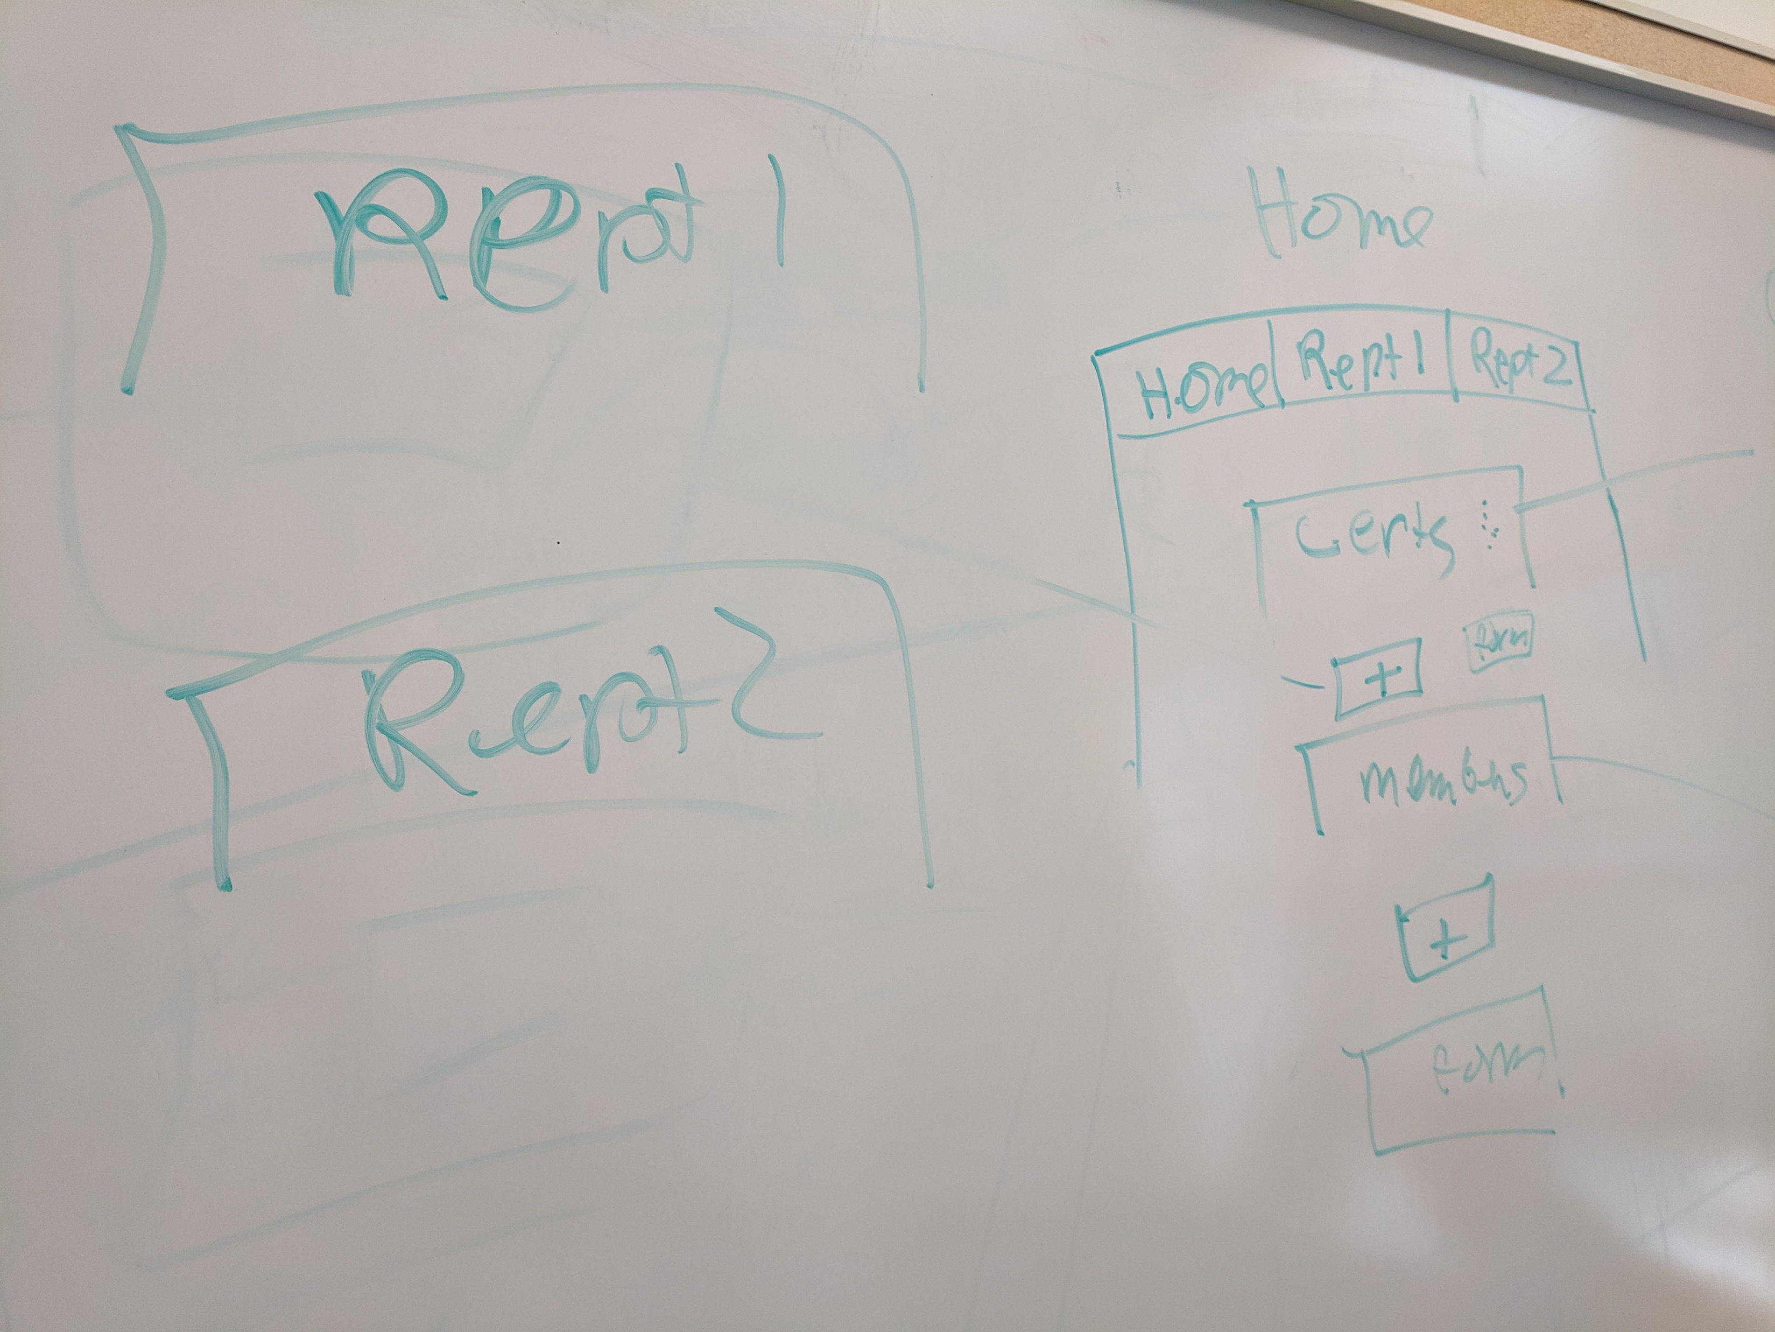
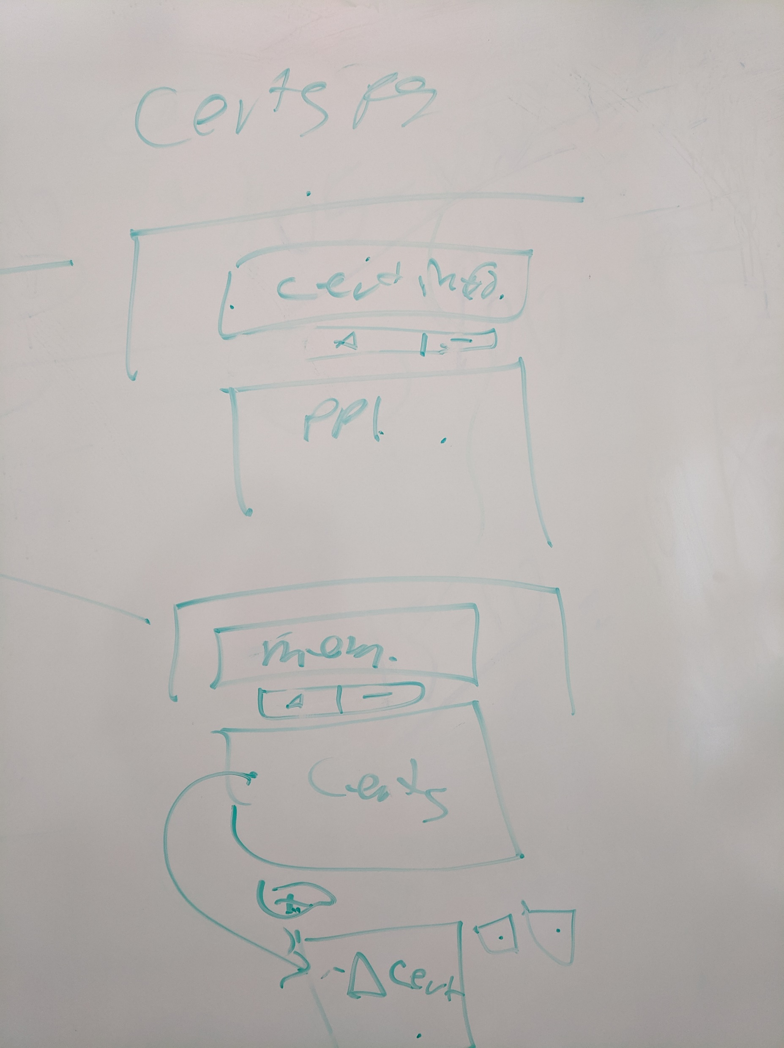
Hand Drawn Pictures

Slide 19
Data Model
Person
pId : String (Pk)
firstName : String
lastName : String
gender : Character
dob : Date
position : String
radioNumber : String
stationNumber : Integer
isActive : Boolean
startDate : Date
email : String
homePhone : String
mobilePhone : String
workPhone : String
Address : string
CurrentCert
pId: String (Pk) (Fk)
cId: String (Pk) (Fk)
renewedDate : Date
expDate : Date
Certification
cId : String (Pk)
agency : String
certName : String
expiry: Integer

Slide 20
Risks and Mitigation
Probability
Impact
Risk | Severity | Mitigation
Currently, there is no coded server-side validation opening the risk of storing incorrect data |  | We have implemented client-side validation and attempted to automate as much input as possible to prevent data errors
No login requirements meaning that anyone can access the system who is physically present |  | The system doesn’t have confidential information meaning that any information accessed can’t be used to harm anyone
No one at the fire department has administrative privileges so if there is any error, issues might arise |  | Team 24 will provide monitoring during the duration of the rest of the development
 | X
 | X
 |  | X

