Slide 1

Introduction to Bayesian Statistics
Natalia Levshina©
Leipzig University
December 4 2018, Ghent

Slide 2
Course outline
1. Basic concepts of Bayesian statistics
2. A simple illustration: Binomial proportions and online dating
3. Bayesian regression with brms
4. A linguistic illustration: help + (to) Infinitive

Slide 3
Why Bayesian?
You can the research hypothesis directly, instead of trying to reject the null hypothesis.
e.g. How confident can I be that eating too many sweets will lead to diabetes?
Compare with the frequentist approach: can I reject the null hypothesis that eating too many sweets will not lead to diabetes?
No p-values and hence no p-value hacking!
Every result is interpretable and useful, not only the ‘significant’ ones. Good for scientific progress.

Slide 4
Types of probabilities
p(x) is the probability of event x
The probability of getting the bullet when playing Russian roulette
The probability of a random person in this room being a linguist, liking beer, crime series, etc.
p(x, y) is the joint probability that events x and y will happen together
E.g. the probability that a random person in this room is a linguist and loves ice-cream; the probability that a random person in this room likes beer and crime series.
p(x|y) is the conditional probability of event x given event y, i.e. that event x will happen if y happens
E.g. The probability of finding an ice-cream fan if one picks a linguist; the probability that a person who likes beer also likes crime series.
Can be computed as p(x|y) = p(x,y)/p(y)

Slide 5
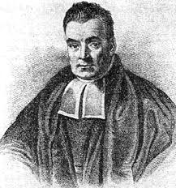

Bayes’ rule
$$P(y|x)=\frac{P\left(x | y\right) P(y)}{P(x)}$$
The mysterious
Thomas Bayes (1702 – 1761)

Slide 6
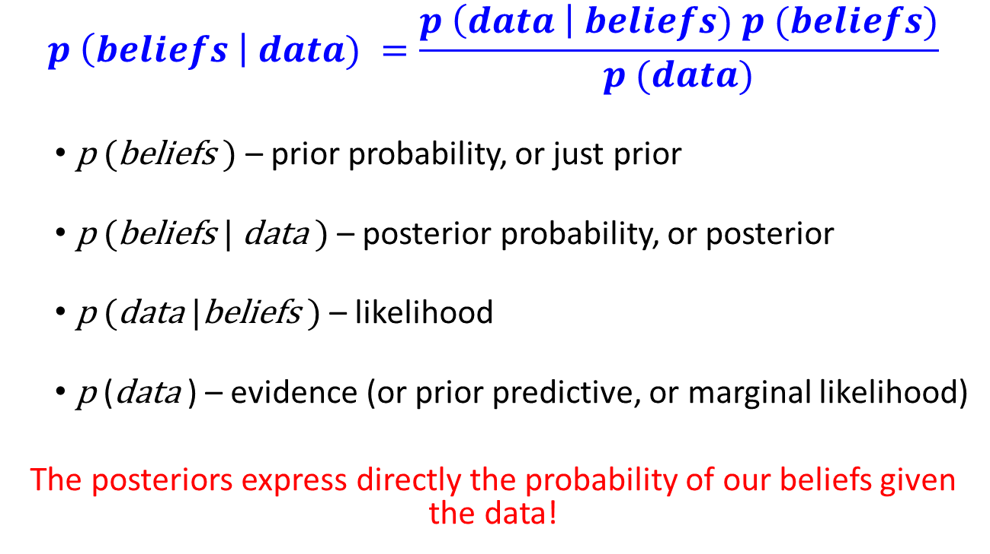
Why would you care?
$$p \left(beliefs \right| data) =\frac{p \left(data \right| beliefs) p (beliefs)}{p (data)}$$
p (beliefs ) – prior probability, or just prior
p (beliefs | data ) – posterior probability, or posterior
p (data |beliefs ) – likelihood
p (data ) – evidence (or prior predictive, or marginal likelihood)
The posteriors express directly the probability of our beliefs given the data!

Slide 7
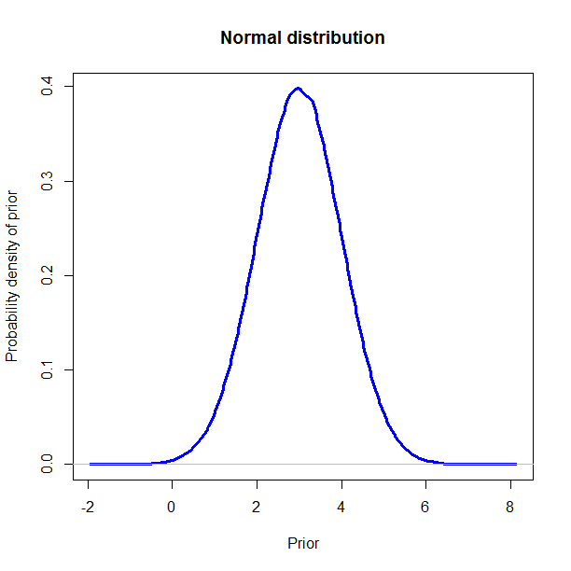
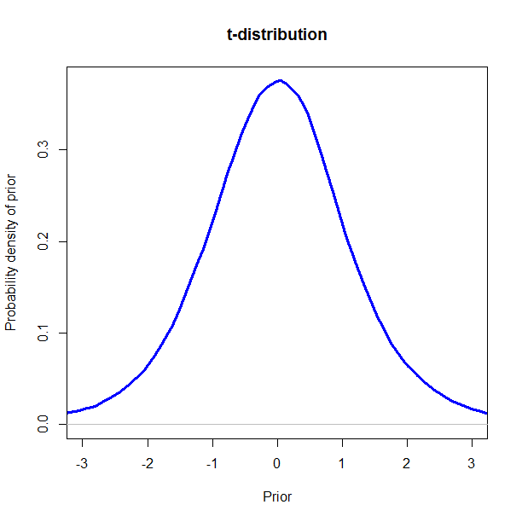
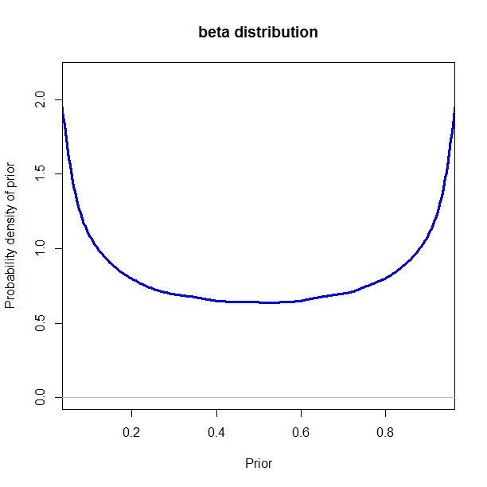
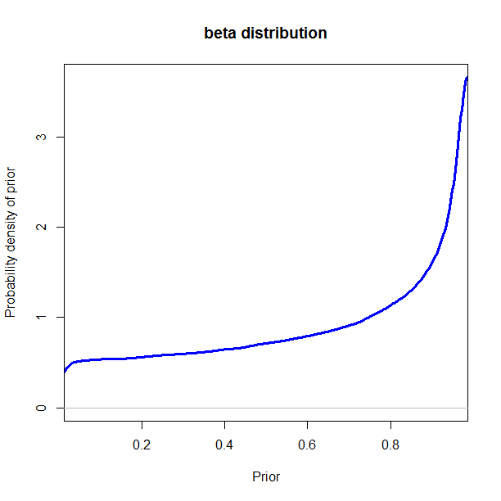
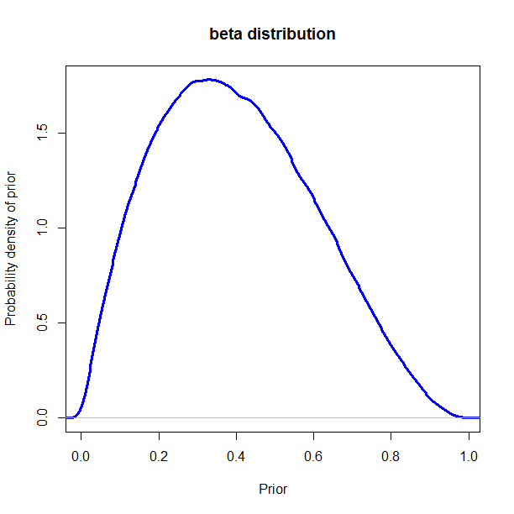
Beliefs as probabilities

Slide 8
Types of prior distributions
Flat, or uniform non-informative priors have no impact on the posteriors. All values have the same likelihood. The results are nearly identical to the ones obtained with the help of frequentist methods.
Informative priors have impact on the posteriors:
weak vs. strong (e.g. normal distribution with sd = 10 vs. normal distribution with sd = 1)
generic vs. specific (e.g. normal distribution with sd = 5 and mean = 0 vs. normal distribution with sd = 5 and mean = 3).

Slide 9
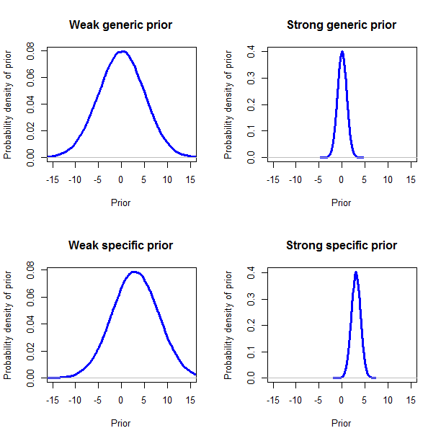

Slide 10
Probability distributions
What are your prior beliefs about a 10 cent coin? Is it fair?
What are your prior beliefs about the heights of Belgian men?
About the IQ of the world’s population?
About word frequencies in a corpus?
About the probabilities (from 0 to 1) generated by a random probabilities generator for internet poker?

Slide 11
Posterior probabilities
Posteriors are the conditional probabilities of a parameter (or model) after the relevant evidence (data) has been taken into account.
Posteriors are probability distributions, too.
One can use 95% Highest Density Intervals / Credible Intervals for inference, where 95% of the posterior distribution lies. Do not confuse them with confidence intervals in frequentist statistics!

Slide 12
Course outline
1. Basic concepts of Bayesian statistics
2. A simple illustration: Binomial proportions and online dating
3. Bayesian regression with brms
4. A linguistic illustration: help + (to) Infinitive

Slide 13
Success or failure?
Imagine a user of an online dating app. The user sends invitations to the persons he or she is interested in. They may reply (‘success’) or not reply (‘failure’).
This represents a binomial distribution with a certain number of trials, a number of successes and a number of failures (similar to a toss of a coin). For example, there are 10 trials, 6 successes and 4 failures.
Everybody has some prior expectations about his or her attraction powers, based on their previous romantic experience.
But the real world experience may change them -> posterior beliefs.

Slide 14
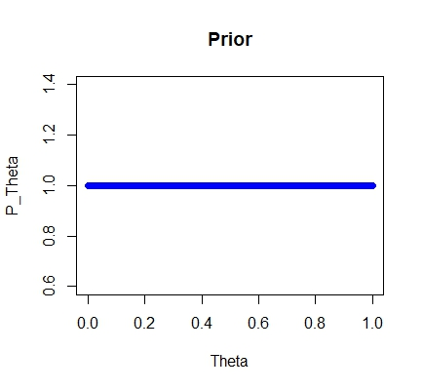
Prior beliefs: uniform
I have no clue how attractive I am.

Slide 15
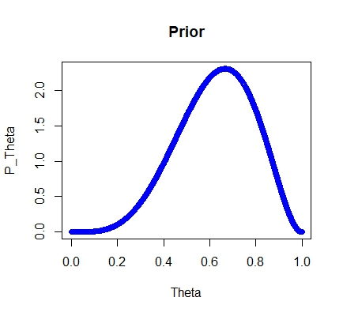
Prior beliefs: cautiously optimistic
I think I’m rather attractive…

Slide 16
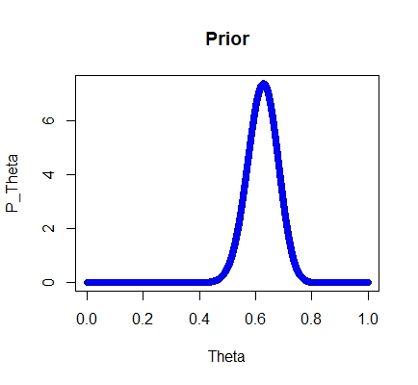
Prior beliefs: experienced optimistic user
I know my chances very well.

Slide 17
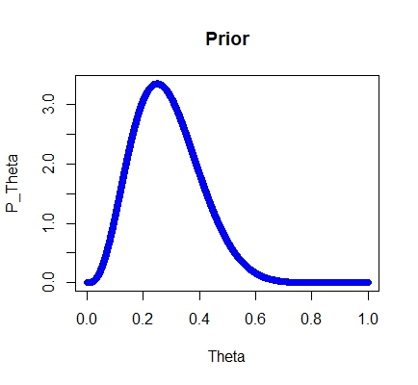
Prior beliefs: pessimistic user
I don’t expect much…

Slide 18
Beta distributions
a = 1, b = 1
a = 50, b = 30
a = 5, b = 3
a = 4, b = 10

Slide 19
Beta distributions in R
E.g. for the uniform prior:
a <- 1
b <- 1
Theta <- seq(from = 0, to = 1, by = 0.0001)
P_Theta <- dbeta(Theta, a, b)
plot(Theta, P_Theta, main = "Prior", col = "blue")

Slide 20
Exercise
Create a beta distribution that would reflect your prior beliefs whether or not you would understand Bayesian statistics.
OR
Create a beta distribution that would reflect your prior beliefs whether or not it will rain on Christmas eve.

Slide 21
Data: first experience with the dating app
The user sent 5 invitations and received 4 replies. One person did not reply.
Success <- 4
Failure <- 1
Total_N <- Success + Failure

Slide 22
How to compute the posteriors
The posteriors are influences both by the priors and the data.
If the priors were of the type “pessimistic user”, i.e.
a <- 4
b <- 10
… then the probabilities of theta given the data are computed as follows:
P_Theta_Given_Data <- dbeta(Theta, a + Success, b + Failure)
plot(Theta, P_Theta_Given_Data, main = "Posterior", col = "blue")

Slide 23
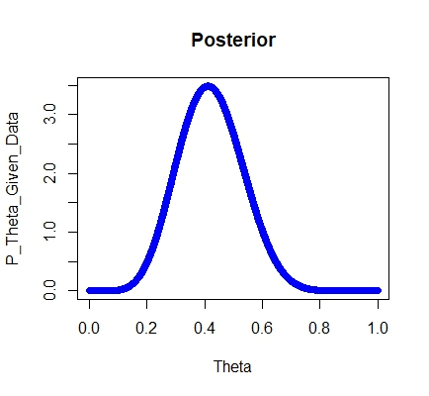
Posteriors: first encouraging experience…

Slide 24
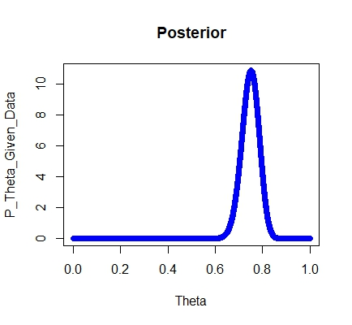
Data: more experience, the same ratio
Success <- 100
Failure <- 25
What a change!

Slide 25
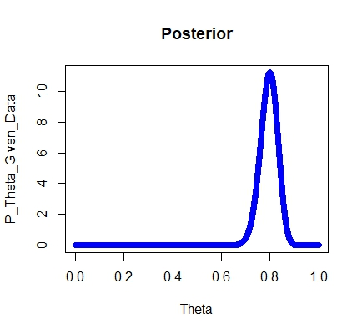
Compare with the uniform prior
a <- 1
b <- 1
Important: with uniform priors, only the data influence the posteriors!

Slide 26
Exercise
Try some more combinations of the priors and the data and see how the posteriors change. What are your conclusions…
about the influence of data size?
about the influence of different types of priors?

Slide 27
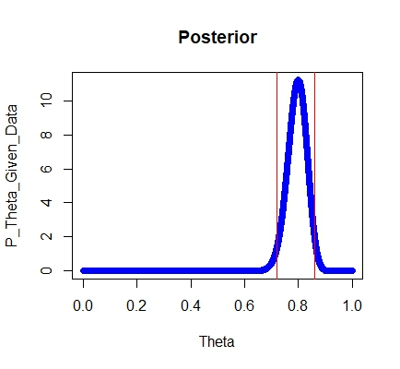
95% credible intervals
abline(v = qbeta(0.975, a + Success, b + Failure), col = "red")
abline(v = qbeta(0.025, a + Success, b + Failure), col = "red")

Slide 28
Course outline
1. Basic concepts of Bayesian statistics
2. A simple illustration: Binomial proportions and online dating
3. Bayesian regression with brms
4. A linguistic illustration: help + (to) Infinitive

Slide 29
Before we start…
Think about the following question: What is the effect of eating cookies on one’s weight? In other words, what will happen to your weight if you eat more cookies per day? Fewer cookies?
Write down your hypothesis: The more cookies one eats, …

Slide 30
A cookie diet
Name | Cookies eaten per day | Kilos gained
John | 0 | -0.1
Mary | 3 | 0.4
Bill | 5 | -0.7
Jane | 7 | 1.7
Laura | 9 | 1.3
Ann | 10 | 0.2
Chris | 13 | 0.8
Eve | 16 | 2.5
Peter | 18 | 1.0
Steve | 20 | 2.8

Slide 31
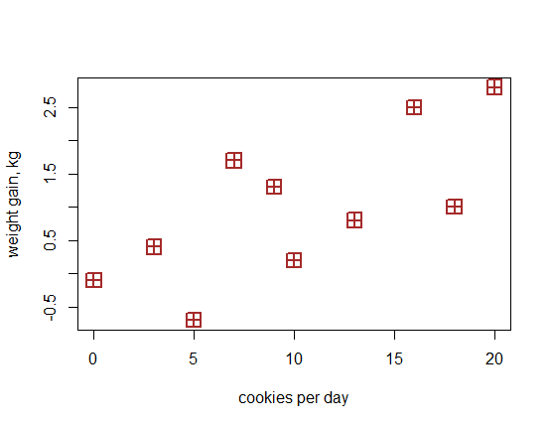

Slide 32
Fundamental concepts of regression
Dependent variable (response): weight gain
Independent variable (predictor): cookies
Regression line: line that can be drawn through the cloud of points such as the distances between the line and all points are as small as possible
Intercept: value of y where the line crosses the y-axis
Slope: increase of y per unit of x
Fitted values: the y-coordinates of the projections of the points on the line
Residuals: the differences between the observed and fitted response values (the distances between the points and their projections on the line)

Slide 34
Fundamental concepts of regression
Dependent variable (response): weight gain
Independent variable (predictor): cookies
Regression line: line that can be drawn through the cloud of points such as the distances between the line and all points are as small as possible
Intercept: value of y where the line crosses the y-axis
Slope: increase of y per unit of x
Fitted values: the y-coordinates of the projections of the points on the line
Residuals: the differences between the observed and fitted response values (the distances between the points and their projections on the line)

Slide 36
Fundamental concepts of regression
Dependent variable (response): weight gain
Independent variable (predictor): cookies
Regression line: line that can be drawn through the cloud of points such as the distances between the line and all points are as small as possible
Intercept: value of y where the line crosses the y-axis
Slope: increase of y per unit of x
Fitted values: the y-coordinates of the projections of the points on the line
Residuals: the differences between the observed and fitted response values (the distances between the points and their projections on the line)

Slide 37
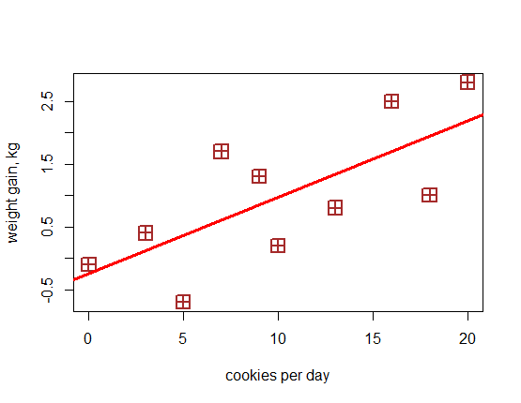

Slide 38
Fundamental concepts of regression
Dependent variable (response): weight gain
Independent variable (predictor): cookies
Regression line: line that can be drawn through the cloud of points such as the distances between the line and all points are as small as possible
Intercept: value of y where the line crosses the y-axis
Slope: increase of y per unit of x
Fitted values: the y-coordinates of the projections of the points on the line
Residuals: the differences between the observed and fitted response values (the distances between the points and their projections on the line)

Slide 40
Fundamental concepts of regression
Dependent variable (response): weight gain
Independent variable (predictor): cookies
Regression line: line that can be drawn through the cloud of points such as the distances between the line and all points are as small as possible
Intercept: value of y where the line crosses the y-axis
Slope: increase of y per unit of x on the line
Fitted values: the y-coordinates of the projections of the points on the line
Residuals: the differences between the observed and fitted response values (the distances between the points and their projections on the line)

Slide 42
Fundamental concepts of regression
Dependent variable (response): weight gain
Independent variable (predictor): cookies
Regression line: line that can be drawn through the cloud of points such as the distances between the line and all points are as small as possible
Intercept: value of y where the line crosses the y-axis
Slope: increase of y per unit of x
Fitted values: the y-coordinates of the projections of the points on the line
Residuals: the differences between the observed and fitted response values (the distances between the points and their projections on the line)

Slide 44
Fundamental concepts of regression
Dependent variable (response): weight gain
Independent variable (predictor): cookies
Regression line: line that can be drawn through the cloud of points such as the distances between the line and all points are as small as possible
Intercept: value of y where the line crosses the y-axis
Slope: increase of y per unit of x
Fitted values: the y-coordinates of the projections of the points on the line
Residuals: the differences between the observed and fitted response values (the distances between the points and their projections on the line)

Slide 46
The magic of linear regression
Observed value of y =
Intercept α
+
Slope β*value of x
+
Residual ε
y = α + βx + ε = ȳ + ε
Fitted value
ȳ

Slide 47
Exercise
Your colleague fitted a regression model which shows that happiness measured on a scale from 0 to 100 depends on Belgian chocolate (in grams).
The formula looks as follows:
Happiness = 38 + 0.5*Chocolate + Error
How can you interpret these numbers?
How happy will you be if you eat 50 grams, as predicted by the model? If you eat 100 grams?

Slide 48
Enter the data
subjects <- c("John", "Mary", "Bill", "Jane", "Laura", "Ann", "Chris", "Eve", "Peter", "Steve")
cookies <- c(0, 3, 5, 7, 9, 10, 13, 16, 18, 20)
kilos <- c(-0.1, 0.4, -0.7, 1.7, 1.3, 0.2, 0.8, 2.5, 1, 2.8)
mydata <- data.frame(kilos, cookies)

Slide 49
Simple linear regression in R
lm(kilos ~ cookies)
Call:
lm(formula = kilos ~ cookies)
Coefficients:
(Intercept) cookies
-0.2364 0.1214

Slide 50
Simple linear regression in R: Summary
summary(lm(kilos ~ cookies))
Call:
lm(formula = kilos ~ cookies)
Residuals:
Min 1Q Median 3Q Max
-1.0707 -0.7189 0.2043 0.5668 1.0864
Coefficients:
Estimate Std. Error t value Pr(>|t|)
(Intercept) -0.23645 0.49341 -0.479 0.6446
cookies 0.12143 0.04151 2.925 0.0191 *
---
Signif. codes:
0 ‘***’ 0.001 ‘**’ 0.01 ‘*’ 0.05 ‘.’ 0.1 ‘ ’ 1
Residual standard error: 0.8228 on 8 degrees of freedom
Multiple R-squared: 0.5169, Adjusted R-squared: 0.4565
F-statistic: 8.558 on 1 and 8 DF, p-value: 0.01913

Slide 51
Bayesian regression in R: some examples
brms (a wrapper for Stan)
rstan (for advanced, requires programming in Stan)
MCMCglmm (logistic regression was a bit tricky, in my experience)
arm
blme

Slide 52
Bayesian linear regression
library(brms)
mybrm <- brm(kilos ~ cookies, data = mydata)
Compiling the C++ model
SAMPLING FOR MODEL 'bb9e16ac0c58e0aeba05bd726f2e6628' NOW (CHAIN 1).
…
Chain 1: Adjust your expectations accordingly!
Chain 1: Iteration: 1 / 2000 [ 0%] (Warmup)
Chain 1: Iteration: 200 / 2000 [ 10%] (Warmup)
…
What is going on?

Slide 53
Markov Chain Monte Carlo
We cannot always derive the posterior distribution mathematically, as was the case with beta distributions (the dating example).
Instead, one can get the posterior distribution by sampling a large number of representative points from the posterior distribution with the help of a Markov Chain Monte Carlo algorithm
Monte Carlo simulation: any simulation that draws random values from a distribution, e.g. rnorm(), rt() in R.
Markov Chain process: a random walk when the next step does not depend on the steps before the current position.

Slide 54
Metropolis algorithm
President X of country Y (no names!) wants to sell weapons in order to promote peace in the world.
Goes to a rich country Z to negotiate the deals with several sheikhs.
Some of them have more money, some have less.
Obviously, the more money, the more X should be interested!
But X doesn’t know how much money each has (he doesn’t know much, in general).

Slide 55

The Sheikhs’palaces
This consumption is very conspicuous: the more money, the more splendid the palace.
10bn
20bn
30bn
40bn
50bn
60bn

Slide 56
The random walk
Imagine the president arrives first in Sheikh 3’s palace. Let’s call him the Current Sheikh (CS). Flips a coin if he should go to the sheikh on the left or to the one on the right. The Sheikh selected in this process is called the Proposed Sheikh (PS).
X doesn’t know how much money each sheikh has, but he is not totally stupid. He can look from the window of the CS’s palace and compare the sizes of the palaces, computing the ratio PS/CS with the help of a top secret supercomputer.
If the PS’s palace is larger and more lavish, PS/CS > 1 and the president goes to the PS.

Slide 57
The random walk (continued)
If the PS’s palace is smaller and more modest, 0 < PS/CS < 1, then X generates randomly the probability from 0 to 1 using a top secret random probability generator.
If the randomly generated probability is less than the PS/CS ratio, then he moves to the PS. If the probability is greater, then he stays, and the steps are repeated again.
An amazing fact: In the long run, the frequency of stays at each palace will approximate the sheikhs’ relative wealth!

Slide 58
Some implications for Bayesians
If some value (e.g. the wealth of the current sheikh) is very large, the algorithm may get stuck at it and not traverse the space quickly enough. One should use diagnostic plots for that purpose.
The results of the first walks are usually excluded (aka burn-in, or warm-up period) because the initial position can introduce substantial bias.
It’s recommended to have several Markov chains and check if they behave similarly.

Slide 59
How to control Markov chains and warm-up
chains = 2 #to speed up the things a little bit, 4 Markov chains by default
iter = 500 #number of iterations in the random walk, 2000 by default. Again, we just want to speed the things up.
warmup = 200 #default first half, i.e. 250 with 500 iterations

Slide 60
Experiment with different settings
mybrm1 <- brm(kilos ~ cookies, data = mydata,
chains = 2, iter = 500, warmup = 200)

Slide 61
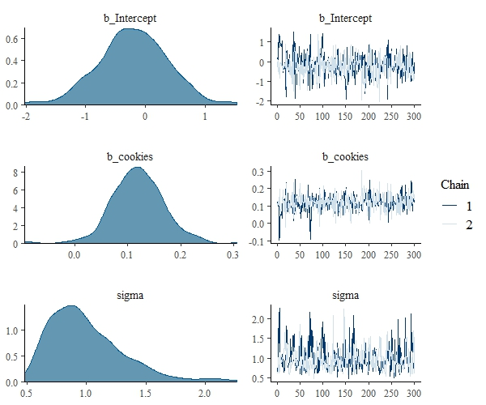
Density and trace plots in brms
plot(mybrm1)
The density plots should not be bimodal (with two humps).
The trace plots should look like fat hairy caterpillars, not bending anywhere.

Slide 62
Effective sample size and r-hat
Effective sample size: the number of posteriors in Markov chains discounted for autocorrelation between them (when the chain gets stuck). The greater effective sample size, the more reliable the results.
R-hat metric: the ratio of the between-chain and the within-chain variability of posteriors. If the chains have converged, these measures will be similar; otherwise, the between-chain variability will be larger. R-hat should be 1.

Slide 63
Effective sample size and rhat in brms
summary(mybrm1)
Population-Level Effects:
Estimate Est.Error l-95% CI u-95% CI
Intercept -0.21 0.58 -1.34 0.86
cookies 0.12 0.05 0.03 0.22
Eff.Sample Rhat
Intercept 348 1.01
cookies 416 1.01
Family Specific Parameters:
Estimate Est.Error l-95% CI u-95% CI Eff.Sample
sigma 1.00 0.31 0.58 1.79 311
Rhat
sigma 1.00
…

Slide 64
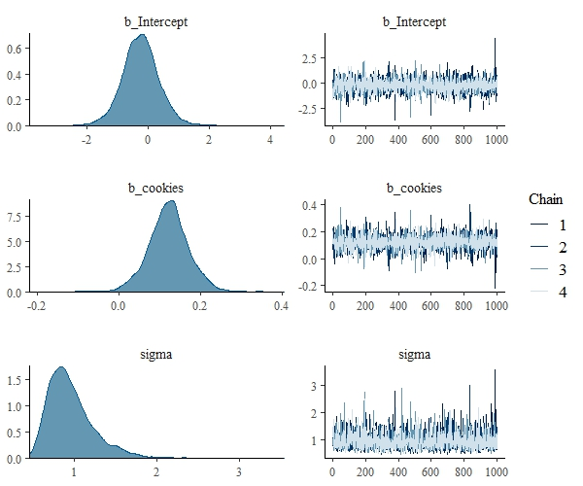
Back to the default settings
mybrm <- brm(kilos ~ cookies, data = mydata)
plot(mybrm)
The rhat indices are also better!

Slide 65
Table of coefficients in the summary
summary(mybrm)
…
Population-Level Effects:
Estimate Est.Error l-95% CI u-95% CI Eff.Sample Rhat
Intercept -0.24 0.62 -1.44 0.98 2318 1.00
cookies 0.12 0.05 0.02 0.22 2479 1.00
…

Slide 66
Interpreting the summary output
Estimate: the mean of the posterior distribution
Est.error: standard error of the posterior distribution
l-95% CI: the lower boundary of the 95% credible interval
u-95% CI: the upper boundary of the 95% credible interval

Slide 67
Posterior distribution
ps_beta <- posterior_samples(mybrm, pars = "cookies")
dim(ps_beta)
[1] 4000 1
summary(ps_beta)
b_cookies
Min. :-0.21978
1st Qu.: 0.09086
Median : 0.12186
Mean : 0.12142
3rd Qu.: 0.15130
Max. : 0.40287
compare with the table!

Slide 68
Posterior distribution and 95% CI
hist(ps_beta[, 1])
abline(v = quantile(ps_beta[, 1], 0.025), col = "red")
abline(v = quantile(ps_beta[, 1], 0.975), col = "red")

Slide 69
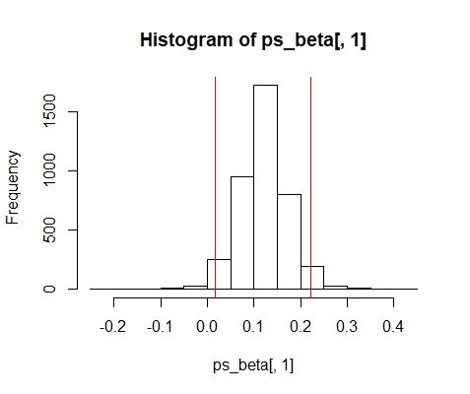
Posterior distribution and 95% CI

Slide 70
Testing the research hypothesis
Our expectation was that the effect of cookies on weight is positive: the more cookies, the more weight.
Now we can easily compute the proportion of all posterior estimates that are positive:
mean(ps_beta[, 1] > 0)
[1] 0.98925
This means that there is almost a 99% probability that the effect of cookies on weight is positive. This is the probability of our research hypothesis.

Slide 71
Popular informative priors
normal(mean, scale)
student_t(df, mean, scale)
cauchy(mean, scale)
See examples in ?set_prior and ?brm

Slide 72
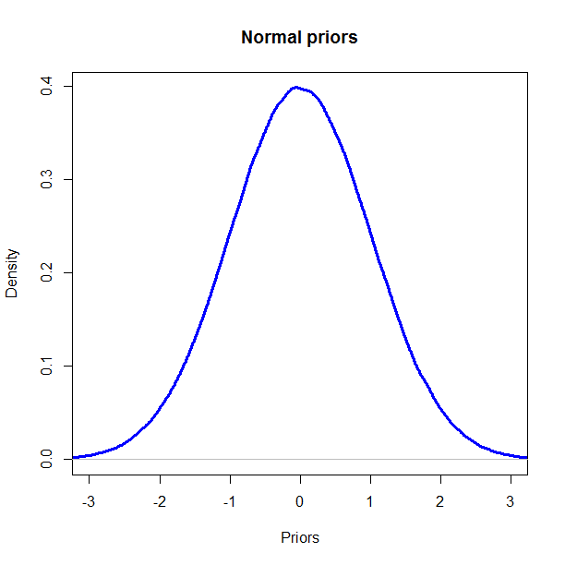
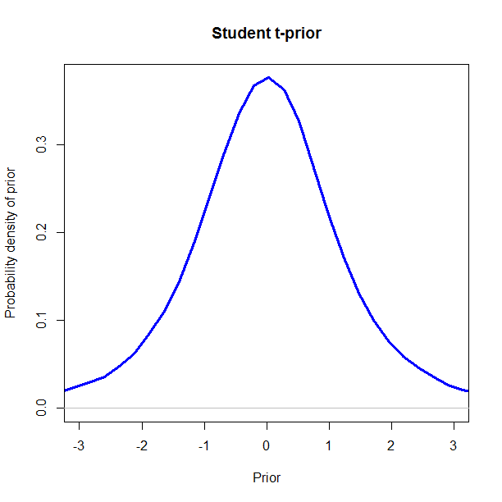
Watch the tails
Student t-priors allow for outliers.

Slide 73
Specific informative priors
Purely hypothetically, imagine that there is some previous research that suggests that the estimate of ‘cookies’ is -2. That is, we expect that eating cookies leads to weight loss. You are highly confident about this result and expect very little deviation from this effect.
You want to use this information as your priors. How to do it?

Slide 74
Using specific informative priors
mybrm2 <- brm(kilos ~ cookies, data = mydata, prior = prior(normal(-2, 0.3), class = b))
ps_beta2 <- posterior_samples(mybrm2, "cookies")
summary(ps_beta2[, 1])
Min. 1st Qu. Median Mean 3rd Qu. Max.
-2.62506 -1.67767 -1.44587 -1.42823 -1.19162 0.02805

Slide 75
How to visualize your priors
Normal distribution:
plot(density(rnorm(n = 10000, mean = -2, sd = 0.3)))
Mean is the expected estimate (the central value), sd is standard deviation, which shows how much certainty you have.
Student t-distribution:
plot(density(rt(n = 10000, df = 3)*0.03 - 2))
where -2 is the central value, df = 3 shows the thickness of tails (the lower, the thicker), and 0.03 is scaling parameter (certainty).

Slide 76
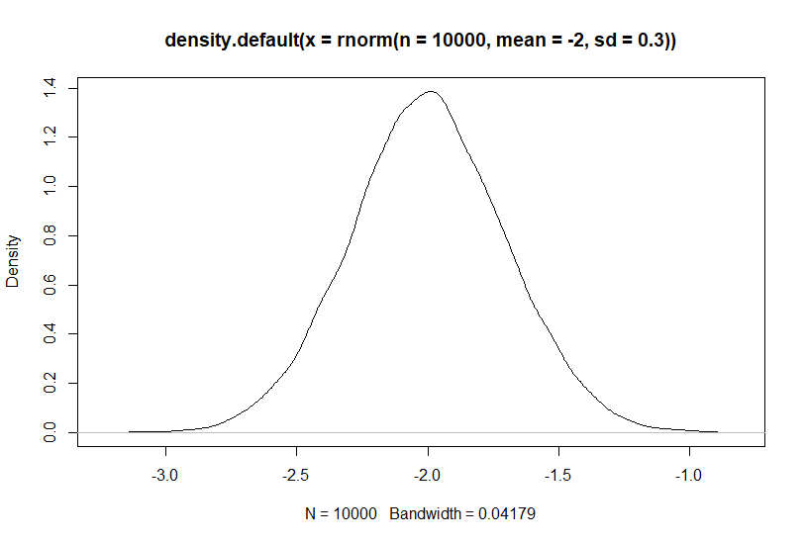
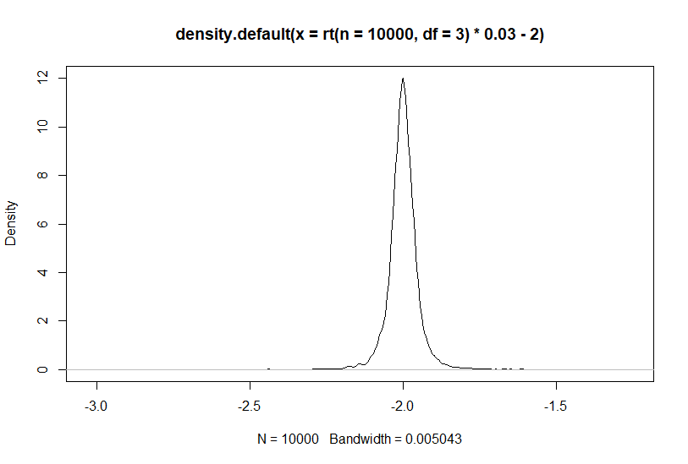
Resulting plots

Slide 77
Goodness of fit
R² is the best known goodness-of-fit measure, which ranges from 0 (useless model) to 1 (perfect fit). Its evaluation depends on the discipline. The brms package provides a Bayesian version of this statistic.
bayes_R2(mybrm)
Estimate Est.Error Q2.5 Q97.5
R2 0.4646035 0.1813101 0.02738844 0.6722349

Slide 78
Exercise
Examine the following model. What do you think it shows? Are there any problems? If yes, how would you fix them?
beers <- c(1, 1, 1, 2, 2, 3, 3, 4, 4, 5, 5, 6)
reaction_times <- c(330, 410, 380, 420, 470, 500, 490, 680, 520, 730, 690, 710)
exper_data <- data.frame(beers, reaction_times)

Slide 79
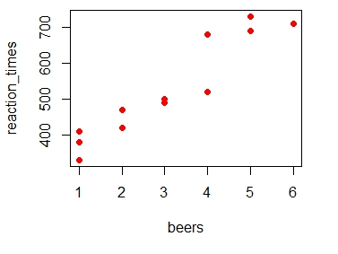
Exercise (cont.)
plot(beers, reaction_times, pch = 16, col = "red")

Slide 80
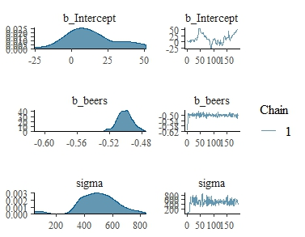
Exercise (cont.)
exper_brm <- brm(reaction_times ~ beers, data = exper_data, warmup = 10, chains = 1, iter = 200, prior = prior(normal(-0.5, 0.01), class = b))
plot(exper_brm)

Slide 81
Exercise (cont.)
summary(exper_brm)
…
Samples: 1 chains, each with iter = 200; warmup = 10; thin = 1;
total post-warmup samples = 190
Population-Level Effects:
Estimate Est.Error l-95% CI u-95% CI Eff.Sample
Intercept 13.28 17.47 -16.04 50.31 9
beers -0.50 0.01 -0.52 -0.48 178
Rhat
Intercept 0.99
beers 1.00

Slide 82
Additional useful features in brms
Generalized Linear Models (e.g. logistic)
Random effects, like in mixed models
Smooth terms, like in Generalized Additive Models
Many useful visualization tools

Slide 83

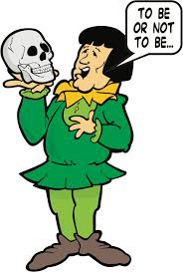
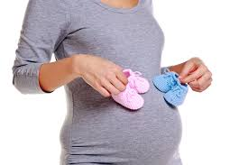

Logistic regression
Situations with two or more categorical outcomes:

Slide 84
T or V?
The distinction is present in most European languages
T forms: informal, familiar, e.g. French tu, German du, Russian ty + Verb 2nd SG
V forms: formal, polite, e.g. French vous, German Sie, Russian vy + Verb 2nd PL or 3rd SG/PL

Slide 85
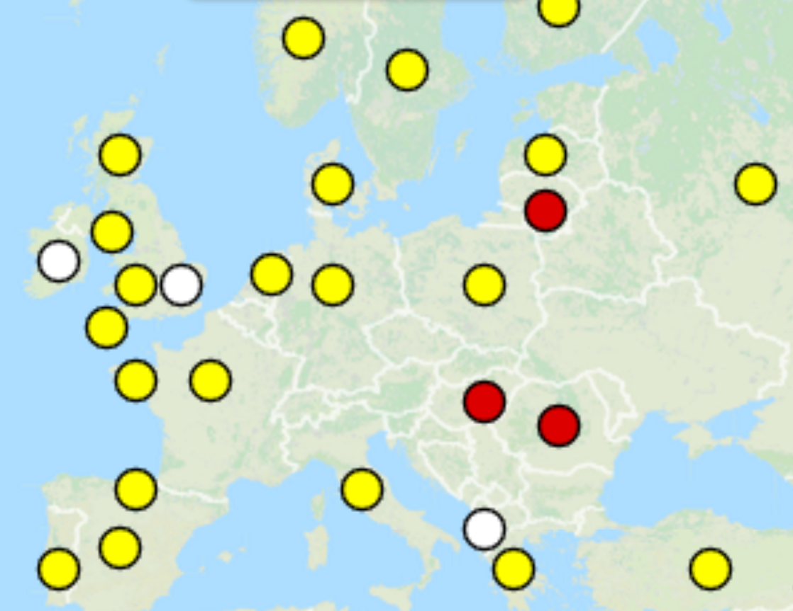
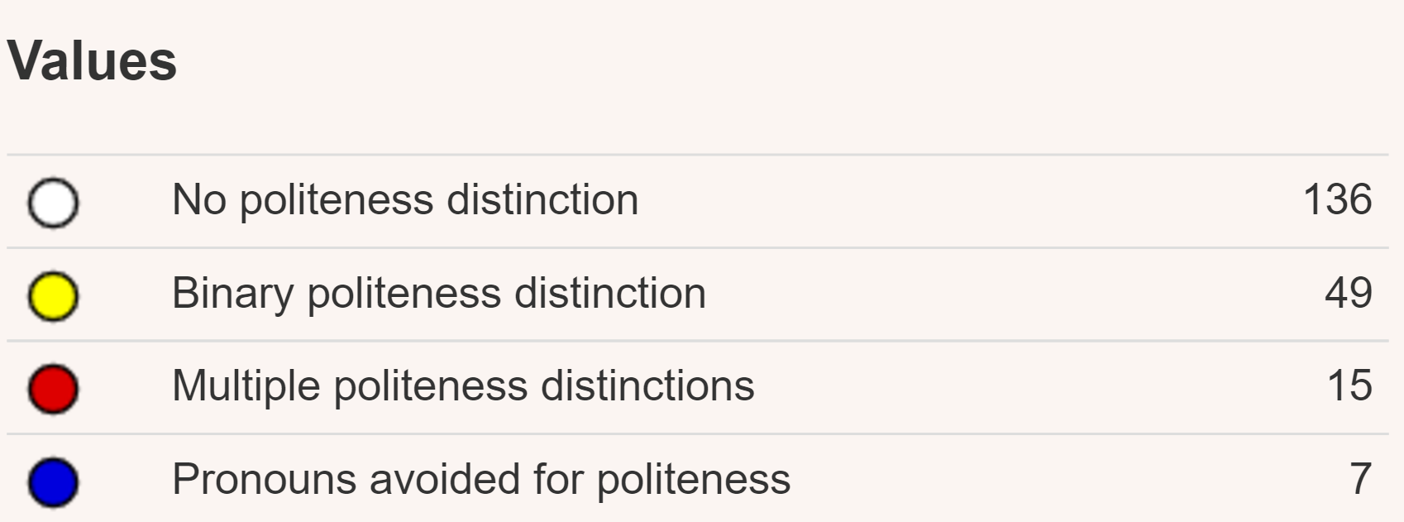
Cross-linguistic research
WALS Chapter 45, Helmbrecht 2013

Slide 86
Power and solidarity (Brown and Gilman 1960)
Power dimension:
Based on “older than”, “richer than”, “parent of”, etc.
T = lower status of the Hearer, V = higher status of the Hearer
Systematic distinction already in the late Middle Ages. Everyone had his/her fixed place in the society.
Solidarity dimension:
Based on “the same age/family/class as”.
T = closeness, V = distance
Emerged with social mobility and egalitarian ideology. Starting from the French revolution (Citoyen, tu).
Currently dominates in major European languages, but there are subtle cross-linguistic differences.

Slide 87
Data for the case study
T/V forms
50 subjects, 18 questions
Communicative situations:
Q_ID (ID of the question in the questionnaire)
Familiarity (Close, Middle and Far)
H_Age (Younger, Older and Same)
Subject’s characteristics
S_ID (Subject’s ID)
S_Extrav (index of extraversion)
S_Age (age)

Slide 88
Data in R
str(tvdata)
'data.frame': 900 obs. of 9 variables:
$ S_ID : Factor w/ 50 levels "1","2","3","4",..:
$ S_Year : int 1934 1934 1934 1934 1934 1934 1934
$ S_Extrav : int 74 74 74 74 74 74 74 74 74 74 ...
$ S_Age : num 84 84 84 84 84 84 84 84 84 84 ...
$ Q_ID : int 1 2 3 4 5 6 7 8 9 10 ...
$ Familiarity: Factor w/ 3 levels "Close","Far",..: 1 1
$ H_Age : Factor w/ 3 levels "Older","Same",..: 3 2
$ Form : Factor w/ 2 levels "T","V": 2 1 2 2 2 2
$ Name : Factor w/ 3 levels "Short","First"

Slide 89
A mega-model with all kinds of complications
For logistic models, add family = Bernoulli.
Random effects are specified as in lme4.
For smooths, one can currently use either s() or t2():
mega_brm <- brm(Form ~ t2(S_Age, S_Extrav) + H_Age*Familiarity + (1|S_ID), data = tvdata, family = bernoulli, chains = 2, iter = 1000, warmup = 200)

Slide 90
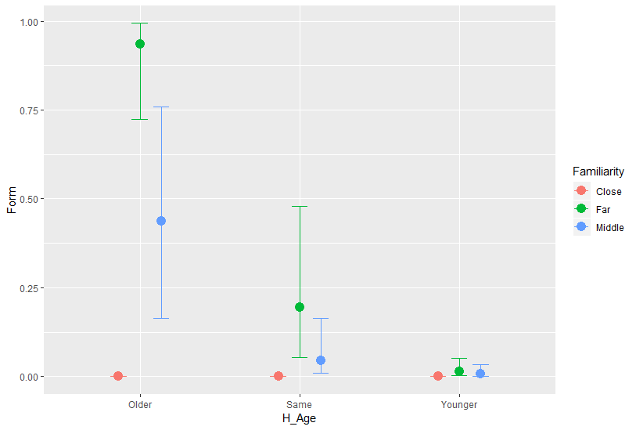
Visualization of interactions
marginal_effects(mega_brm)
A selected plot:

Slide 91
Adjustments per subject
ranef(mega_brm)
$S_ID
, , Intercept
Estimate Est.Error Q2.5 Q97.5
1 0.67845283 1.0264882 -1.25134855 2.8637459
2 0.12872995 0.7484718 -1.39487999 1.6670851
3 -0.05758030 0.8080955 -1.73774628 1.5519841
4 0.10880918 0.7484347 -1.36317190 1.6178879…

Slide 92
Plotting the smooths
ms <- marginal_smooths(mega_brm) #to save time, because it’s computationally intensive
plot(ms, stype = "contour")
plot(ms, stype = "raster")

Slide 93
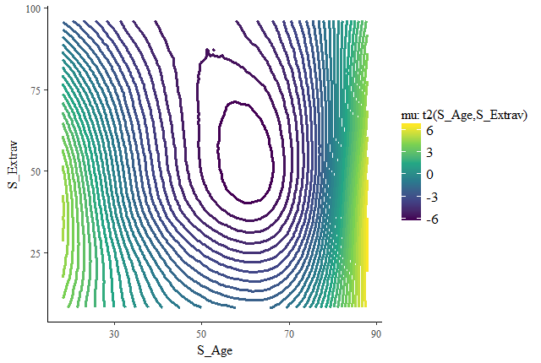
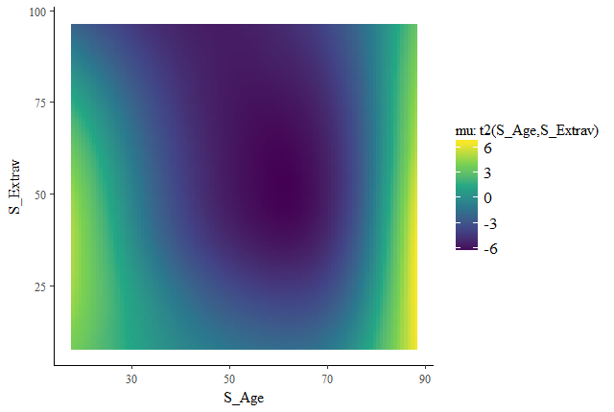
Marginal smooth plots

Slide 94
Course outline
1. Basic concepts of Bayesian statistics
2. A simple illustration: Binomial proportions and online dating
3. Bayesian regression with brms
4. A linguistic illustration: help + (to) Infinitive

Slide 95
Help + (to) Infinitive
a. If this book does not help you to survive the Zombie Apocalypse, a full refund may be obtained from the author.
b. Just to be on the safe side you might want to start doing these 8 exercises that will help you survive the zombie apocalypse.
https://www.amazon.co.uk/Z-Day-UK-surviving-Apocalypse-Britain/dp/1490389873
http://steadystrength.com/8-exercises-that-will-help-you-survive-the-zombie-apocalypse/

Slide 96
Data and method
GloWBE (7 geographic varieties of English)
Samples of 5 to 7 thousands observations with help (to) Infinitive in each country
Bayesian models with mixed effects (random intercepts for individual verbs and websites). The default priors (very weak generic ones).

Slide 97
Relevant factors
Linguistic distance (the principle of cognitive complexity, Rohdenburg 1996)
…it’s a way for me to make a contribution, to help the country in a small way to get back on its feet.
Avoidance of identity, or horror aequi (Rohdenburg 2003)
Sorry, but how is this supposed to help answer the question?
Register (formal -> to-infinitive)
Inflectional form (helping +to-infinitive)
Presence or absence of the Helpee (presence -> bare infinitive)
And a few other factors.

Slide 98
Linguistic distance
Note: positive estimates mean the higher likelihood for the to-infinitive, negative estimates mean the higher likelihood of the bare infinitive.

Slide 99
Horror aequi
Note: positive estimates mean the higher likelihood for the to-infinitive, negative estimates mean the higher likelihood of the bare infinitive.

Slide 100
Formality (average word length in a text)
Note: positive estimates mean the higher likelihood for the to-infinitive, negative estimates mean the higher likelihood of the bare infinitive.

Slide 101
Informativity effects in language
There is ample evidence that more predictable elements are reduced in language production.
E.g. Jaeger (2010): if a complement clause is predictable given the verb, the complementizer that is more likely to be omitted.
I think you’re right.
I show that alternatives exist.
https://doi.org/10.5281/zenodo.1542857

Slide 102
Slot-filler predictability
InfoVerb: -log predictability of the verb given HELP
InfoHelp: -log predictability of HELP given the verb

Slide 103
Slot-filler predictability

Slide 104
Interpretation
Remarkably, all varieties show some kind of effects of using to when the predictability of HELP given the verb is low.
This is the case of high-frequency verbs, e.g.
Oh Lord, help me to be pure, but not yet. (St. Augustine)

Slide 105
More details
Levshina, Natalia. 2018. Probabilistic grammar and constructional predictability: Bayesian generalized additive models of help + (to) Infinitive in varieties of web-based English. Glossa 3(1). 55.1-22. DOI: 10.5334/gjgl.294/

