Slide 1

Introduction to R
Natalia Levshina © 2018
Leipzig University
December 4 2018, Ghent

Slide 2
Outline
1. Introduction to R
2. Basics of R syntax
3. Main objects in R
4. Creating and importing your data into R

Slide 3
What is R?
statistical computing environment (from t-test to generalized linear models, and more…)
- core distribution “base”
- add-on packages (> 12K as of March 2017)
programming language
tools for creation of publication-quality plots (e.g. ggplot2)

Slide 4
Where to get R?
Distribution and packages: CRAN (Comprehensive R Archive Network) http://cran.r-project.org/
Information: http://www.r-project.org/

Slide 5
RStudio
Highly recommended (easy to manage projects, packages, data, graphs, etc.)!
Available from http://www.rstudio.com/products/RStudio/

Slide 6
Outline
1. Introduction to R
2. Basics of R syntax
3. Main objects in R
4. Creating and importing your data into R

Slide 7
Input and output
2 + 2
[1] 4
sample(100, 25) #random sampling of 25 elements from integers 1 to 100
[1] 49 45 70 51 54 5 7 19 60 82 35 55 6 76 93 89 44
[18] 8 48 87 53 34 86 96 63

Slide 8
Basic arithmetic functions
25^2
[1] 625
625^0.5
[1] 25
sqrt(625)
[1] 25
log(5)
[1] 1.609438

Slide 9
Creation of objects
a <- 3
a
[1] 3
a + 5
[1] 8

Slide 10
Exercise
Create two numeric vectors with 1 element in each:
a) the population of Ghent
b) the population of Bruges
Compute their sum.
Compute their difference.
By how many times is the population of Ghent larger than that of Bruges?

Slide 11
Beware: = and ==
a = 3 # creates an object a with the value 3, an alternative to "a <- 3"
a == 3 # tests if a equals 3
[1] TRUE
a == 10 # tests if a equals 10
[1] FALSE

Slide 12
Exercise
Perform an R test whether the population of Ghent is equal to that of Bruges, using the vectors.

Slide 13
R is case-sensitive!
b <- 7
a + b
[1] 10
a + B
Error: object 'B' not found

Slide 14
Managing your objects
ls() #returns a list of objects
[1] "a" "b"
rm(b) #removes an object
ls()
[1] "a"

Slide 15
Saving your workspace
Click on the cross button or type
q()
Select the action (to save or not to save).
getwd() #to find out where your workspace will be saved
[1] "C:/Users/Your/Directory"
setwd("C:/Users/Your/Directory") #to change it, if you like

Slide 16
Getting help
?cor #to open a help file with information about function ‘cor’
??correlation #returns a list of functions that contain this expression

Slide 17
Exercise
Get help on the function summary().

Slide 18
Errors
x <- 1:10 # creates a numeric vector with integers from 1 to 10
x
[1] 1 2 3 4 5 6 7 8 9 10
meann(x) # we want to compute the mean value of x: a typo
Error: could not find function "meann"
mean(x) # correct
[1] 5.5

Slide 19
Warning messages
mytable <- rbind(c(1, 2), c(3, 4)) #create a 2-by-2 table
mytable
[,1] [,2]
[1,] 1 2
[2,] 3 4
chisq.test(mytable)
Pearson's Chi-squared test with Yates' continuity correction
data: mytable
X-squared = 0, df = 1, p-value = 1
Warning message:
In chisq.test(mytable) : Chi-squared approximation may be incorrect

Slide 20
Outline
1. Introduction to R
2. Basics of R syntax
3. Main objects in R
4. Creating and importing your data into R

Slide 21
Important data types in R
Numeric vectors
Character vectors
Factors
Data frames
Contingency tables
Matrices

Slide 22
Numeric vectors
vnum <- 1:5 # a vector of integers from 1 to 5
vnum
[1] 1 2 3 4 5
is(vnum)
[1] "integer" "numeric" "vector"
[….]
If not a sequence:
RT <- c(455, 773, 512, 667) #reaction times in an experiment
RT
[1] 455 773 512 667

Slide 23
Character vectors
sex <- c("f", "m", "m", "f")
sex
[1] "f" "m" "m" "f"
is(sex)
[1] "character" "vector"
[…]

Slide 24
Matrices
m <- cbind(1:5, 10:6)
m
[,1] [,2]
[1,] 1 10
[2,] 2 9
[3,] 3 8
[4,] 4 7
[5,] 5 6
is(m)
[1] "matrix" "array" […]

Slide 25
Factors
sex.f <- factor(sex)
sex.f
[1] f m m f
Levels: f m
is(sex.f)
[1] "factor" "integer"
[…]

Slide 26
Data frames
mydf <- data.frame(sex, RT) #char. vectors turn into factors
mydf
sex RT
1 f 455
2 m 773
3 m 512
4 f 667
is(mydf)
[1] "data.frame" "list" […]

Slide 27
Exercise
1. Create a character vector with the names of your fellow students.
2. Create a vector with their heights (in cm).
3. Combine the vectors in one data frame.

Slide 28
Contingency tables
Let’s add another factor to the dataframe, dialect:
mydf$dialect <- c("BrE", "AmE", "AmE", "BrE")
mydf
sex RT dialect
1 f 455 BrE
2 m 773 AmE
3 m 512 AmE
4 f 667 BrE
table(mydf$sex, mydf$dialect)
AmE BrE
f 0 2
m 2 0

Slide 29
Exercise
1. Add a factor to your data frame with the answers to the question, “Do you like beer?” (“Yes” or “No”)
2. Add another factor with the gender (“m” or “f”, or …)
3. Cross-tabulate the factors. Do you think there’s a gender bias?

Slide 30
Summarizing the data
summary(mydf)
sex RT dialect
f:2 Min. :455.0 Length:4
m:2 1st Qu.:497.8 Class :character
Median :589.5 Mode :character
Mean :601.8
3rd Qu.:693.5
Max. :773.0
str(mydf)
'data.frame': 4 obs. of 3 variables:
$ sex : Factor w/ 2 levels "f","m": 1 2 2 1
$ RT : num 455 773 512 667
$ dialect: chr "BrE" "AmE" "AmE" "BrE"

Slide 31
Selecting observations
mydf[1,]
sex rt dialect #the fist row
1 f 455 BrE
mydf[,2]
[1] 455 773 512 667 #the second column
mydf[1,2]
[1] 455 #the element in the fist row, second column

Slide 32
Using logical operators
mydf[mydf$sex == "f",]
sex RT dialect
1 f 455 BrE
4 f 667 BrE
mydf[mydf$sex != "m", ]
sex RT dialect
1 f 455 BrE
4 f 667 BrE
mydf[mydf$RT < 500,]
sex RT dialect
1 f 455 BrE

Slide 33
Exercise
Make a subset of your data frame with all colleagues taller than 170 cm.
How many rows (students) does the data frame contain?

Slide 34
A quest
1. Compute the square root of 1681.
2. Type in R: set.seed(x), where x is the result of step 1.
3. Create a random sample of 100 numbers from 1 to 100.
4. Find the 20th element. This will be your y.
5. Take the yth letter in the English alphabet. Write down the letter.
6. Open the help page of the function read.table and find the subsection “See also”. Find the first R function mentioned in that subsection. Remove the first letter and write down the result.
7. Find R citation information using citation(). Take the 3rd word and write down the letter.
8. Put all words together!

Slide 35
Outline
1. Introduction to R
2. Basics of R syntax
3. Main objects in R
4. Creating and importing your data into R

Slide 36
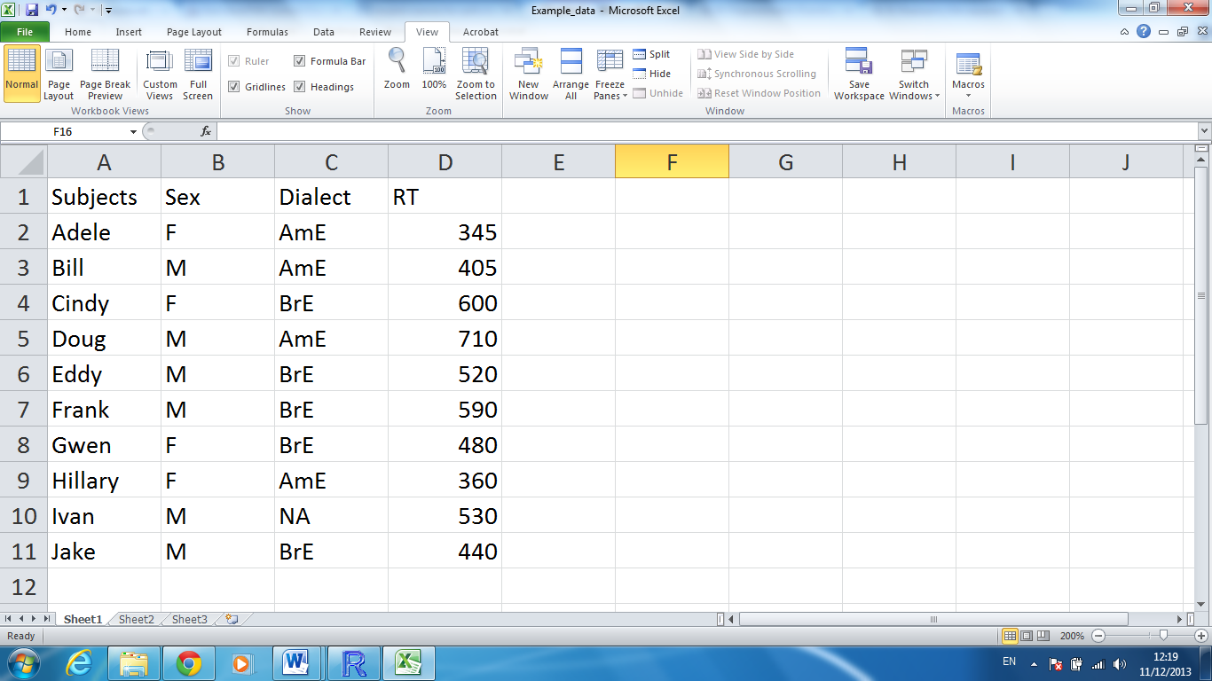
Importing your data into R

Slide 37
Importing your data into R
1. Create a similar table in Excel (or OpenOffice Calc). Don’t forget to create a header. In case of missing values, put NA. No empty cells!
2. Save the file as a tab delimited text file (.txt).
3. Read the file in R:
mydata <- read.table(file = file.choose(), header = TRUE)

Slide 38
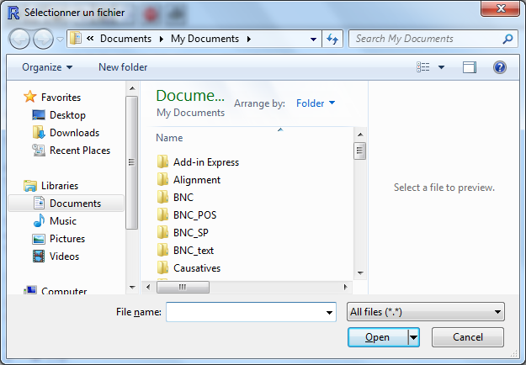
Interactive choice

Slide 39
Exercise
Create the following table in Excel (or OpenOffice Calc) and import it in R as a data frame under the name Linguists.
Last name | First name | Framework | Born | Died
de Saussure | Ferdinand | Structuralism | 1857 | 1913
Chomsky | Noam | Generative Linguistics | 1928 | NA
Lakoff | George | Cognitive Linguistics | 1941 | NA

Slide 40
A tip
If you have a table with white spaces, apostrophes, etc., use this bullet-proof code:
mydata <- read.table(file = file.choose(), header = TRUE, sep = "\t", comment = "", quote = "")

Slide 41
Exercise
Open a fragment of a Universal Dependencies corpus (ud_sample) as a table.
Make a subset with all common nouns (column: upos, value: NOUN).
Make a subset with all subjects (column: dep_rel, value: nsubj)
Cross-tabulate all parts of speech with all syntactic functions (dependencies).

