Slide 1

Introduction to regression analysis
Natalia Levshina © 2018
Jena University
WiSe 2017-2018

Slide 2
Outline
Linear regression: main concepts and functions
Introduction to logistic regression
Case study: help + (to) Infinitive in British English

Slide 3
Post-Christmas blues
Name | Cookies eaten per day | Kilos gained
John | 0 | -0.1
Mary | 3 | 0.4
Bill | 5 | -0.7
Jane | 7 | 1.7
Laura | 9 | 1.3
Ann | 10 | 0.2
Chris | 13 | 0.8
Eve | 16 | 2.5
Peter | 18 | 1.0
Steve | 20 | 2.8

Slide 4
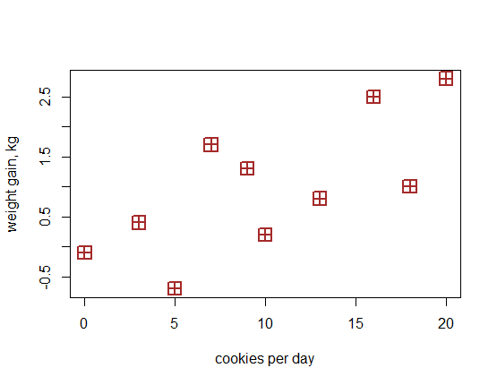

Slide 5
Fundamental concepts of regression
Dependent variable (response): weight gain
Independent variable (predictor): cookies
Regression line: line that can be drawn through the cloud of points such as the distances between the line and all points are as small as possible
Intercept: value of y where the line crosses the y-axis
Slope: increase of y per unit of x
Fitted values: the y-coordinates of the projections of the points on the line
Residuals: the differences between the observed and fitted response values (the distances between the points and their projections on the line)

Slide 6
Fundamental concepts of regression
Dependent variable (response): weight gain
Independent variable (predictor): cookies
Regression line: line that can be drawn through the cloud of points such as the distances between the line and all points are as small as possible
Intercept: value of y where the line crosses the y-axis
Slope: increase of y per unit of x
Fitted values: the y-coordinates of the projections of the points on the line
Residuals: the differences between the observed and fitted response values (the distances between the points and their projections on the line)

Slide 8
Fundamental concepts of regression
Dependent variable (response): weight gain
Independent variable (predictor): cookies
Regression line: line that can be drawn through the cloud of points such as the distances between the line and all points are as small as possible
Intercept: value of y where the line crosses the y-axis
Slope: increase of y per unit of x
Fitted values: the y-coordinates of the projections of the points on the line
Residuals: the differences between the observed and fitted response values (the distances between the points and their projections on the line)

Slide 10
Fundamental concepts of regression
Dependent variable (response): weight gain
Independent variable (predictor): cookies
Regression line: line that can be drawn through the cloud of points such as the distances between the line and all points are as small as possible
Intercept: value of y where the line crosses the y-axis
Slope: increase of y per unit of x
Fitted values: the y-coordinates of the projections of the points on the line
Residuals: the differences between the observed and fitted response values (the distances between the points and their projections on the line)

Slide 11
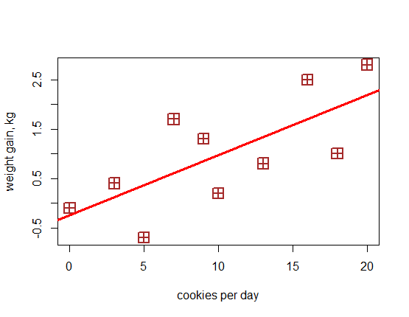

Slide 12
Fundamental concepts of regression
Dependent variable (response): weight gain
Independent variable (predictor): cookies
Regression line: line that can be drawn through the cloud of points such as the distances between the line and all points are as small as possible
Intercept: value of y where the line crosses the y-axis
Slope: increase of y per unit of x
Fitted values: the y-coordinates of the projections of the points on the line
Residuals: the differences between the observed and fitted response values (the distances between the points and their projections on the line)

Slide 14
Fundamental concepts of regression
Dependent variable (response): weight gain
Independent variable (predictor): cookies
Regression line: line that can be drawn through the cloud of points such as the distances between the line and all points are as small as possible
Intercept: value of y where the line crosses the y-axis
Slope: increase of y per unit of x on the line
Fitted values: the y-coordinates of the projections of the points on the line
Residuals: the differences between the observed and fitted response values (the distances between the points and their projections on the line)

Slide 16
Fundamental concepts of regression
Dependent variable (response): weight gain
Independent variable (predictor): cookies
Regression line: line that can be drawn through the cloud of points such as the distances between the line and all points are as small as possible
Intercept: value of y where the line crosses the y-axis
Slope: increase of y per unit of x
Fitted values: the y-coordinates of the projections of the points on the line
Residuals: the differences between the observed and fitted response values (the distances between the points and their projections on the line)

Slide 18
Fundamental concepts of regression
Dependent variable (response): weight gain
Independent variable (predictor): cookies
Regression line: line that can be drawn through the cloud of points such as the distances between the line and all points are as small as possible
Intercept: value of y where the line crosses the y-axis
Slope: increase of y per unit of x
Fitted values: the y-coordinates of the projections of the points on the line
Residuals: the differences between the observed and fitted response values (the distances between the points and their projections on the line)

Slide 20
Linear regression with R
> xmas_lm <- lm(gain ~ cookies)
> summary(xmas_lm)
Call:
lm(formula = gain ~ cookies)

Slide 21
Intercept and slope in lm summary
Coefficients:
Estimate Std. Error t value Pr(>|t|)
(Intercept) -0.23645 0.49341 -0.479 0.6446
cookies 0.12143 0.04151 2.925 0.0191 *
---
Signif. codes: 0 ‘***’ 0.001 ‘**’ 0.01 ‘*’ 0.05 ‘.’ 0.1 ‘ ’ 1

Slide 22
Fitted values of lm
> fitted(xmas_lm)
1 2 3 4
-0.2364469 0.1278442 0.3707050 0.6135658
5 6 7 8
0.8564266 0.9778570 1.3421481 1.7064393
9 10
1.9493001 2.1921609

Slide 23
Residuals
> residuals(xmas_lm)
1 2 3 4
0.1364469 0.2721558 -1.0707050 1.0864342
5 6 7 8
0.4435734 -0.7778570 -0.5421481 0.7935607
9 10
-0.9493001 0.6078391

Slide 24
Fitted, residuals and observed values
fitted residuals gain
1 -0.2364469 0.1364469 -0.1
2 0.1278442 0.2721558 0.4
3 0.3707050 -1.0707050 -0.7
4 0.6135658 1.0864342 1.7
5 0.8564266 0.4435734 1.3
6 0.9778570 -0.7778570 0.2
7 1.3421481 -0.5421481 0.8
8 1.7064393 0.7935607 2.5
9 1.9493001 -0.9493001 1.0
10 2.1921609 0.6078391 2.8

Slide 25
The magic of linear regression
Fitted value of y = intercept + slope*value of x
ȳ = α + βx
0bserved value of y = intercept + slope * value of x + residual
y = ȳ + ε = α + βx + ε

Slide 26
How good is the fit?
Multiple R-squared: 0.5169
Adjusted R-squared: 0.4565
R-squared equals Pearson’s correlation coefficients (one predictor):
> cor(gain, cookies)^2
[1] 0.5168564
Adjusted R-squared is usually a more realistic estimate. It may be substantially smaller if
a) there are many useless predictors
b) the model overfits the data, e.g. due to small sample size, like here.

Slide 27
Categorical predictors
But, some of our friends also did sports regularly, and some didn’t.

Slide 28
Name | Cookies eaten per day | Kilos gained | Sports
John | 0 | -0.1 | Yes
Mary | 3 | 0.4 | No
Bill | 5 | -0.7 | Yes
Jane | 7 | 1.7 | No
Laura | 9 | 1.3 | No
Ann | 10 | 0.2 | Yes
Chris | 13 | 0.8 | No
Eve | 16 | 2.5 | No
Peter | 18 | 1.0 | Yes
Steve | 20 | 2.8 | No

Slide 29
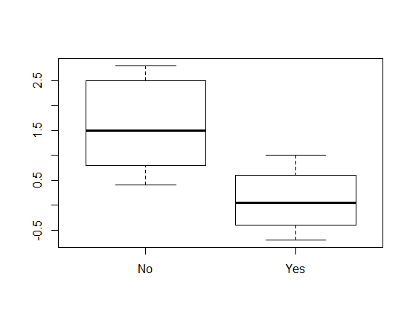

Slide 30
How to represent them in regression?
We can use dummy variables, representing categories as numbers.
There are several ways of representing categorical variables in R.
The default is so-called treatment contrasts.
Binary variable: reference level = 0, the other = 1:
one coefficient which shows the difference between the reference level and the other one.
More than two values: Reference level = 0, each of the rest = 1
One coefficient for each level with the exception of the reference level, each shows the difference between the given level and the reference level.

Slide 31
Treatment contrasts with lm
> xmas_lm1 <- lm(gain ~ sports)
> summary(xmas_lm1)
…
Coefficients:
Estimate Std. Error t value Pr(>|t|)
(Intercept) 1.5833 0.3514 4.505 0.00199 **
sportsYes -1.4833 0.5557 -2.669 0.02839 *
---
Signif. codes: 0 ‘***’ 0.001 ‘**’ 0.01 ‘*’ 0.05 ‘.’ 0.1 ‘ ’ 1

Slide 32
Interpreting the coefficient
> aggregate(gain ~ sports, FUN = mean)
sports gain
1 No 1.583333
2 Yes 0.100000
> 1.583333 - 0.1
[1] 1.483333

Slide 33
Multiple regression
> xmas2 <- lm(gain ~ cookies + sports)
> summary(xmas2)
…
Coefficients:
Estimate Std. Error t value Pr(>|t|)
(Intercept) 0.45842 0.40927 1.120 0.2996
cookies 0.09926 0.02968 3.344 0.0124 *
sportsYes -1.17729 0.37977 -3.100 0.0173 *
---
Signif. codes: 0 ‘***’ 0.001 ‘**’ 0.01 ‘*’ 0.05 ‘.’ 0.1 ‘ ’ 1

Slide 34
Outline
Linear regression: main concepts and functions
Introduction to logistic regression
Case study: help + (to) Infinitive in British English

Slide 35
Binary outcome
Binomial logistic regression is used when the response variable is binary.

Slide 36
Success of submissions to journals
Person ID | hours | acceptance
1 | 100 | No
2 | 180 | No
3 | 230 | No
4 | 350 | Yes
5 | 470 | No
6 | 510 | No
7 | 680 | No
8 | 700 | Yes
9 | 740 | Yes
10 | 920 | Yes
11 | 1080 | No
12 | 1260 | Yes
13 | 1300 | Yes
14 | 1430 | Yes
15 | 1500 | Yes

Slide 37
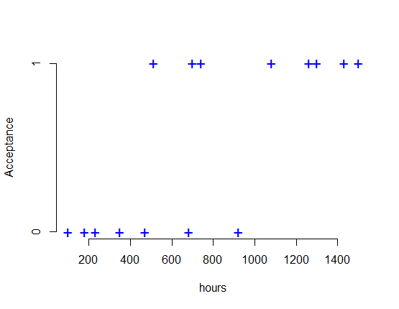

Slide 38
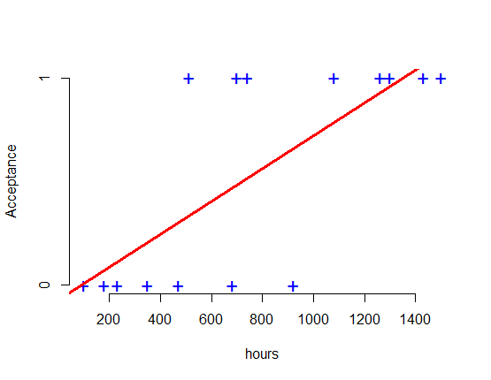
Linear regression

Slide 39
A small problem
There’s a small problem with fitted values.
For example, if you spend 2000 hours, your acceptance will be 1.51. If you spend 1 hour, your acceptance will be -0.07.

Slide 40
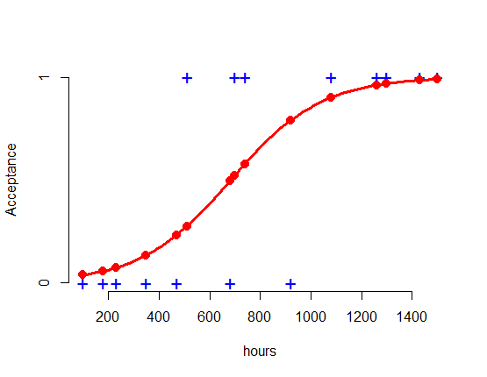
Logistic regression

Slide 41

The hocus pocus
Linear model:
ȳ = α + βx
Logistic model:
log $\frac{P (y=1)}{P (y=0)}$ = α + βx
Logit, or log odds

Slide 42
Fitted values in logistic regression
> dat[c(5:7), ]
acceptance hours predicted
5 No 470 0.2328821
6 Yes 510 0.2750818
7 No 680 0.4948156
If you spend 2000 hours, your acceptance will be 0.999.
If you spend 1 hour, your acceptance will be 0.02 (predictability)
Sounds more reasonable.

Slide 43
Two most useful functions
glm() from the basic distribution
For example:
> your.glm <- glm(Outcome ~ PredictorX + PredictorY + …, family = binomial, data = yourData)
> summary(your.glm)
lrm() from package rms by Frank Harrell
For example:
> your.lrm <- lrm(Outcome ~ PredictorX + PredictorY + …, data = yourData)
> your.lrm

Slide 44
GLM
> pubs_glm <- glm(acceptance ~ hours, data = dat, family = binomial)
> summary(pubs_glm)
…
Coefficients:
Estimate Std. Error z value Pr(>|z|)
(Intercept) -3.813746 1.988412 -1.918 0.0551 .
hours 0.005578 0.002781 2.006 0.0449 *
---
Signif. codes: 0 ‘***’ 0.001 ‘**’ 0.01 ‘*’ 0.05 ‘.’ 0.1 ‘ ’ 1

Slide 45
Interpretation of intercept in logistic regression
Intercept shows the log-odds of outcome = 1 (i.e. accepted) for x = 0 (i.e. 0 hours).
To get the normal odds, use exp():
> exp(-3.81)
[1] 0.02214818
If you spend 0 hours, the odds of being accepted to being rejected are about 0.02.
This doesn’t make much sense, of course.
Usually, the intercept does not represent very interesting information.

Slide 46
Interpretation of slope in logistic regression
Slope = log-odds ratio.
If the slope coefficient positive, the chances of outcome = 1 (accepted) increase with x (hours spent). If negative, they decrease.
To get the normal odds ratio, use exp():
> exp(0.005578)
[1] 1.005594
This means that for every unit increase in x (i.e. for every hour), the odds of outcome = 1 (accepted) are multiplied by 1.006.

Slide 47
Outline
Linear regression: main concepts and functions
Introduction to logistic regression
Case study: help + (to) Infinitive in British English

Slide 48
Help + (to) Infinitive
To to, or not to to?
Stanford psychologist shares a surprising trick that will help you (to) be more productive at work. (https://www.cnbc.com/2017/09/25/psychologist-shares-a-trick-that-will-help-you-be-more-productive.html , access 24.11.2017)
Which variant would you prefer?

Slide 49

How would you translate this?

Slide 50
Actual translation
My God, Help Me to Survive This Deadly Love (Dmitri Vrubel, the Berlin wall monument, translated from Russian and German)

Slide 51
Possible relevant factors
Semantic difference
a. John helped Mary eat the pudding (he ate half).
b. John helped Mary to eat the pudding (by guiding the spoon to her mouth, since she was still an invalid). (Dixon 1991: 199)
Linguistic distance (cognitive complexity, Rohdbenburg 1996)
It helps regulate muscle tone (…) and allows us to help the client with cerebral palsy to manage simple day-to-day tasks like getting dressed, engaging with peers or playing games

Slide 52
Possible relevant factors (Cont.)
Avoidance of identity, or horror aequi (Rohdenburg 2003):
To help make your Google Account more secure, follow these steps.
Register: The shorter variant with the bare infinitive is considered to be less formal than the one with the marked infinitive (e.g. Biber et al. 1999: 736–737).

Slide 53
Possible relevant factors (Cont.)
Inflectional form: the form helping tends to be more frequently used with the to-infinitive in British English than the other inflectional forms of help (e.g. Lohmann 2011).
Watching Ellen Page thanking Ellen Degeneres for helping her to come out is pretty moving.
Presence of the Helpee: the bare infinitive is particularly dominant in the pattern help + NP + infinitive (e.g. Biber et al. 1999: 735)
a. The new defence minister has previously helped to stop plans to make the UK more safe from nuclear attacks.
b. How Winnie-the-Pooh helped the country find its feet.

Slide 54
Data help_gb
> str(help_gb)
'data.frame': 5861 obs. of 11 variables:
$ Vinf : Factor w/ 832 levels "abduct","absorb",..: 1 2 2 3 3 3 3 3 4 5 ...
$ textID : Factor w/ 3665 levels "100305","100503",..: 2956 1613 3132 10 1801 2603 10 2389 1395 3295 ...
$ HelpForm : Factor w/ 4 levels "help","helped",..: 2 1 4 3 1 2 3 1 2 1 ...
$ To : Factor w/ 2 levels "No","Yes": 2 1 1 2 1 2 2 1 1 2 ...
$ LingDist : int 0 1 1 0 0 0 0 0 0 1 ...
$ ToHelp : Factor w/ 2 levels "No","Yes": 1 2 1 1 1 1 1 1 1 1 ...
…

Slide 55
Effect of formality
> help_glm1 <- glm(To ~ Formality, data = help_gb, family = binomial)
> summary(help_glm1)
…
Coefficients:
Estimate Std. Error z value Pr(>|z|)
(Intercept) -3.09509 0.35879 -8.626 < 2e-16 ***
Formality 0.48474 0.07763 6.245 4.25e-10 ***

Slide 56
Interpretation of slope
Again, the slope coefficient is a log odds ratios
The positive coefficient shows that the feature increases the chances of to (“Yes”) as formality increases.
By how much?
> exp(0.48474)
[1] 1.623753
With every unit of formality (i.e. letter in average word length), the chances of the to-infinitive increase by a factor of 1.62.

Slide 57
Exercise
What is the effect of LingDist on its own?

Slide 58
Binary predictor: Helpee
…
Coef S.E. Wald Z Pr(>|Z|)
Intercept -0.7300 0.0410 -17.79 <0.0001
Helpee=Yes -0.2628 0.0574 -4.58 <0.0001

Slide 59
More than two categories: wordform of help
…
Coef S.E. Wald Z Pr(>|Z|)
Intercept -1.2502 0.0391 -32.00 <0.0001
HelpForm=helped 0.6147 0.0840 7.32 <0.0001
HelpForm=helping 1.3279 0.0895 14.84 <0.0001
HelpForm=helps 1.0271 0.0877 11.71 <0.0001

Slide 60
Exercise
Fit a binomial GLM with the following predictors:
Formality
Helpee
HelpForm
LingDist
ToHelp
Valency
Interpret the coefficients.

Slide 61
Model selection and diagnostics
1. Do we need all predictors?
2. Are the main assumptions met?
- independence of observations
- no multicollinearity
- linear relationships between the numerical predictors and the response in log odds (logit)
3. Do we have interactions?
4. How well does the model fit the data?
5. Is there overfitting?

Slide 62
Do we need all predictors?
> help_all <- glm(To ~ Formality + HelpForm + Helpee + LingDist + ToHelp + Valency, data = help_gb, family = binomial)
> drop1(help_all)
Single term deletions
Model:
To ~ Formality + HelpForm + Helpee + LingDist + ToHelp + Valency
Df Deviance AIC
<none> 6369.4 6389.4
Formality 1 6396.1 6414.1
HelpForm 3 6480.4 6494.4
Helpee 1 6408.9 6426.9
LingDist 1 6394.1 6412.1
ToHelp 1 6730.4 6748.4
Valency 2 6370.1 6386.1

Slide 63
ANOVA
> help_less <- update(help_all, . ~ . -Valency)
> anova(help_less, help_all, test = "Chisq")
Analysis of Deviance Table
Model 1: To ~ Formality + HelpForm + Helpee + LingDist + ToHelp
Model 2: To ~ Formality + HelpForm + Helpee + LingDist + ToHelp + Valency
Resid. Df Resid. Dev Df Deviance Pr(>Chi)
1 5853 6370.1
2 5851 6369.4 2 0.68145 0.7113

Slide 64
ANOVA: models with and without Valency
> help_less <- update(help_all, . ~ . -Valency)
> anova(help_less, help_all, test = "Chisq")
Analysis of Deviance Table
Model 1: To ~ Formality + HelpForm + Helpee + LingDist + ToHelp
Model 2: To ~ Formality + HelpForm + Helpee + LingDist + ToHelp + Valency
Resid. Df Resid. Dev Df Deviance Pr(>Chi)
1 5853 6370.1
2 5851 6369.4 2 0.68145 0.7113

Slide 65
Exercise
Test if the predictors Info_HELP and Info_Verb are useful.
Some comments:
Info_HELP represents the negative log-transformed conditional probability of a given verb to occur after help compared with the other uses of that verb. Cf. Schmid’s (2000) Reliance.
Info_Verb is the negative log-transformed conditional probability of a verb to occur after help compared with all uses of HELP. Cf. Schmid’s (2000) Attraction.

Slide 66
Model selection and diagnostics
1. Do we need all predictors?
2. Are the main assumptions met?
- independence of observations
- no multicollinearity
- linear relationships between the numerical predictors and the response in log odds (logit)
3. Do we have interactions?
4. How well does the model fit the data?
5. Is there overfitting?

Slide 67
Independence of observations
Are the data points connected in any way?
Consider textID, the ID of the website where the observation comes from. Some observations come from the same source. Is that a problem?
> summary(help_gb$textID)
158401 407707 311202 104608 392406
53 23 19 14 14
etc.
Solution: use mixed models (more next week)

Slide 68
Model selection and diagnostics
1. Do we need all predictors?
2. Are the main assumptions met?
- independence of observations
- no multicollinearity
- linear relationships between the numerical predictors and the response in log odds (logit)
3. Do we have interactions?
4. How well does the model fit the data?
5. Is there overfitting?

Slide 69
Multicollinearity
Arises when some of the predictors are strongly correlated.
Test: variance inflation factors (VIF). Rule of thumb: not greater than 5.
> vif(help_add)
Formality HelpeeYes HelpFormhelped 1.024811 2.259589 1.155803
HelpFormhelping HelpFormhelps
1.115103 1.129757
ToHelpYes LingDist Info_HELP
1.086130 2.175191 1.058091

Slide 70
The damaging effect of multicollineatiry
Let’s create a variable that is very similar to Helpee, differs only in several values:
> help_gb$Helpee1 <- help_gb$Helpee
> help_gb$Helpee1[1:20]
[1] No Yes Yes No No No No No No Yes Yes
[12] Yes Yes Yes Yes Yes Yes Yes Yes Yes
Levels: No Yes
> help_gb$Helpee1[1:20] <- rep("No", 20)

Slide 71
VIF explosion
> help_multi <- glm(To ~ Formality + Helpee + HelpForm + ToHelp + LingDist + Info_HELP + Helpee1, data = help_gb, family = binomial)
> vif(help_multi)
Formality HelpeeYes HelpFormhelped
1.024797 103.809047 1.155843
HelpFormhelping HelpFormhelps ToHelpYes
1.115159 1.130335 1.087114
LingDist Info_HELP Helpee1Yes
2.173103 1.058436 101.909970

Slide 72
Exercise
Check the coefficients and the p-values of Helpee and Helpee1. What has changed?

Slide 73
Model selection and diagnostics
1. Do we need all predictors?
2. Are the main assumptions met?
- independence of observations
- no multicollinearity
- linear relationships between the numerical predictors and the response in log odds (logit)
3. Do we have interactions?
4. How well does the model fit the data?
5. Is there overfitting?

Slide 74
Generalized Additive Models
GAMs are a very convenient tool for modelling non-linear effects in different types of regression models.
> library(mgcv)
> help_gam <- gam(To ~ s(Formality, k = 20) + Helpee + HelpForm + ToHelp + s(LingDist, k = 5) + s(Info_HELP, k = 20), data = help_gb, family = binomial)
> plot(help_gam, ylim = c(-2, 2))

Slide 75
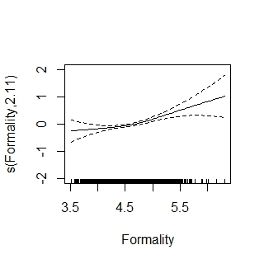

Slide 76
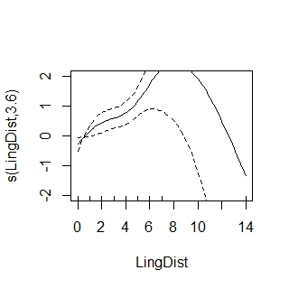

Slide 77
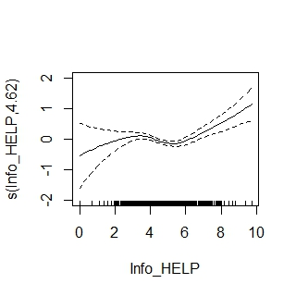

Slide 78
What’s going on with LingDist?
We seem to have an outlier!
> table(help_gb$LingDist)
0 1 2 3 4 5 6
2694 2499 459 121 37 29 17
7 14
4 1

Slide 79
Refitting the model
Refit the model without the outlier:
> help_gam1 <- gam(To ~ s(Formality, k = 20) + Helpee + HelpForm + ToHelp + s(LingDist, k = 5) + s(Info_HELP, k = 20), data = help_gb[help_gb$LingDist < 8, ], family = binomial)
> plot(help_gam1, ylim = c(-2, 2))
MORAL of the story: check the distribution of your variables first!

Slide 80
Exercise
Refit the GLM without the outlier. What has changed in the coefficients?
Tip: you can access the coefficients directly and juxtapose them, for instance:
> cbind(coef(help_glm5), coef(help_glm6))

Slide 81
Modelling non-linearity of Info_HELP in glm
Let’s first refit the model:
> help_poly1 <- glm(To ~ Formality + Helpee + HelpForm + ToHelp + LingDist + Info_HELP, , data = help_gb[help_gb$LingDist < 8, ], family = binomial)
Visualize the effect of Info_HELP:
> library(visreg) #install it first
> visreg(help_poly1, xvar = "Info_HELP")

Slide 82
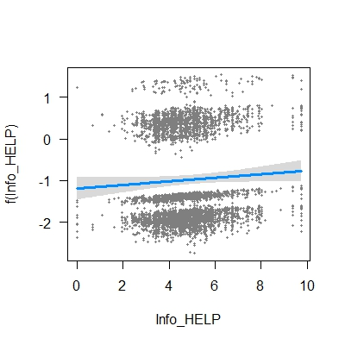

Slide 83
Add non-linear terms
> help_poly2 <- update(help_poly1, .~. + I(Info_HELP^2))
> help_poly3 <- update(help_poly2, .~. + I(Info_HELP^3))
> help_poly4 <- update(help_poly3, .~. + I(Info_HELP^4))
> help_poly5 <- update(help_poly4, .~. + I(Info_HELP^5))

Slide 84
Visualization of non-linear terms
> visreg(help_poly2, xvar = "Info_HELP", main = "poly2")
> visreg(help_poly3, xvar = "Info_HELP", main = "poly3")
> visreg(help_poly4, xvar = "Info_HELP", main = "poly4")
> visreg(help_poly5, xvar = "Info_HELP", main = "poly5")

Slide 85
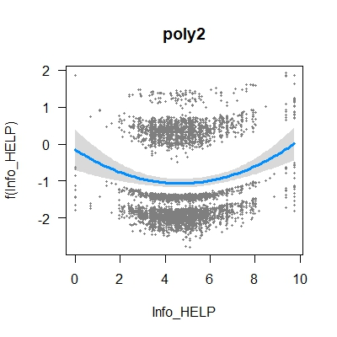
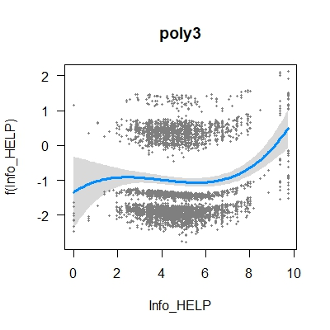
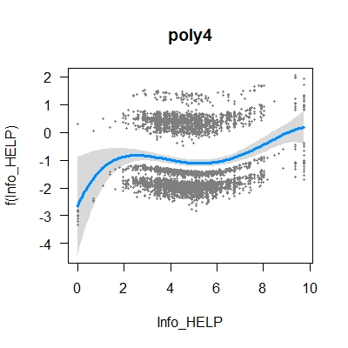
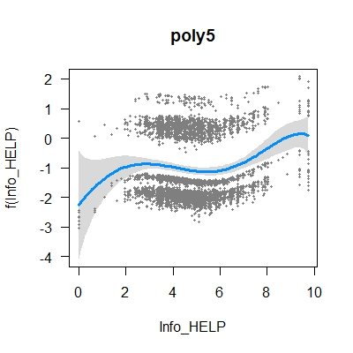

Slide 86
Which non-linear terms do we need?
> anova(help_poly1, help_poly2, help_poly3, help_poly4, help_poly5, test = "Chisq")
…
Resid. Df Resid. Dev Df Deviance Pr(>Chi)
1 5851 6362.2
2 5850 6345.0 1 17.1993 3.366e-05
3 5849 6336.7 1 8.3295 0.003901
4 5848 6330.7 1 5.9965 0.014334
5 5847 6329.9 1 0.7321 0.392196
We’ll be okay with poly4.

Slide 87
A simpler way of adding polynomial terms
> help_poly_new <- glm(To ~ Formality + Helpee + HelpForm + ToHelp + LingDist + poly(Info_HELP, 4), data = help_gb[help_gb$LingDist < 8, ], family = binomial)

Slide 88
Model selection and diagnostics
1. Do we need all predictors?
2. Are the main assumptions met?
- independence of observations
- no multicollinearity
- linear relationships between the numerical predictors and the response in log odds (logit)
3. Do we have interactions?
4. How well does the model fit the data?
5. Is there overfitting?

Slide 89
Adding interaction terms
Interaction of two or more predictors means that their effect is not additive
Consider Belgian fries and Belgian chocolate: both delicious, but not if you try to eat them together.

Slide 90
How to add interactions in R
Two ways:
Response ~ Predictor1 + Predictor2 + Predictor1:Predictor2
Or shorter:
Response ~ Predictor1*Predictor2

Slide 91
Interaction of LingDist and ToHelp (simplified)
> help_int <- glm(To ~ Helpee*HelpForm, data = help_gb)
> summary(help_int)
…
Coefficients:
Estimate Std. Error z value Pr(>|z|)
(Intercept) -1.249291 0.058892 -21.213 < 2e-16 ***
HelpeeYes -0.001654 0.078697 -0.021 0.9832
HelpFormhelped 0.670643 0.112227 5.976 2.29e-09 ***
HelpFormhelping 2.342238 0.161552 14.498 < 2e-16 ***
HelpFormhelps 1.212924 0.124874 9.713 < 2e-16 ***
HelpeeYes:HelpFormhelped -0.140754 0.171292 -0.822 0.4112
HelpeeYes:HelpFormhelping -1.586830 0.199806 -7.942 1.99e-15 ***
HelpeeYes:HelpFormhelps -0.377648 0.176315 -2.142 0.0322 *

Slide 92
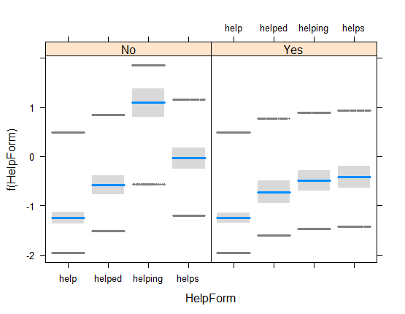
Interpreting an interaction
> visreg(help_int, xvar = "HelpForm", by = "Helpee")

Slide 93
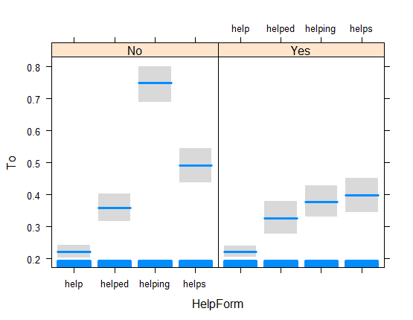
To visualize the probabilities of outcomes
> visreg(help_int, xvar = "HelpForm", by = "Helpee", scale = "response")

Slide 94
Exercises
1. Perform the same on the complete dataset (without the outlier). Are the results similar? Tip: you can simply add the interaction term.
> help_int1 <- update(help_poly_new, .~. + HelpForm:Helpee)
> anova(help_poly_new, help_int1)
2. Test the interaction between LingDist and ToHelp. What can you say about the result? Does it make sense theoretically?

Slide 95
Model selection and diagnostics
1. Do we need all predictors?
2. Are the main assumptions met?
- independence of observations
- no multicollinearity
- linear relationships between the numerical predictors and the response in log odds (logit)
3. Do we have interactions?
4. How well does the model fit the data?
5. Is there overfitting?

Slide 96
Even more informative: lrm in package rms
> help_lrm <- lrm(formula = help_int2, data = help_gb[help_gb$LingDist < 8,])
> help_lrm
Logistic Regression Model
…

Slide 97
Summary statistics
> help_lrm$stats
Obs Max Deriv Model L.R.
5.860000e+03 1.519866e-06 8.890144e+02
d.f. P C
1.500000e+01 0.000000e+00 7.216588e-01
Dxy Gamma Tau-a
4.433176e-01 4.454183e-01 1.846958e-01
R2 Brier g
2.001971e-01 1.793433e-01 1.137706e+00
gr gp
3.119605e+00 1.839968e-01

Slide 98
Concordance index C
If you take all possible pairs that contain a sentence with a to-infinitive and a sentence with a bare infinitive, and try all combinations, the index C will be the proportion of the times when the model predicts a higher probability of YES for the sentence with to, and a higher probability of NO for the sentence with a bare infinitive.
Rule of thumb:
C = 0.5 no discrimination
0.7 ≤ C < 0.8 acceptable discrimination
0.8 ≤ C < 0.9 excellent discrimination
C ≥ 0.9 outstanding discrimination

Slide 99
Model selection and diagnostics
1. Do we need all predictors?
2. Are the main assumptions met?
- independence of observations
- no multicollinearity
- linear relationships between the numerical predictors and the response in log odds (logit)
3. Do we have interactions?
4. How well does the model fit the data?
5. Is there overfitting?

Slide 100
How many observations are needed?
If there are too few observations, the model will be overfitted. This means that it will be useless when it is applied to new data.
Rule of thumb: not less than 10 obs. with the LESS frequent outcome per parameter in the model (see the regression coefficients).
> summary(help_gb$To)
No Yes
4128 1733
e.g. 16 parameters x 10 = 160
Seems OK! But we need to check it better. See non-parametric bootstrap in the book.

Slide 101
Exercise
Take the dataset help_in, with data from Indian English.
Try to find the best model and perform diagnostics.

