Slide 1

Introduction to R
Natalia Levshina © 2017
Jena, WiSe 2017

Slide 2
Outline
1. Introduction to R
2. Basics of R syntax
3. Main objects in R
4. Creating and importing your data into R

Slide 3
What is R?
statistical computing environment (from t-test to generalized linear models, and more…)
- core distribution “base”
- add-on packages (> 10K as of June 2017)
programming language
tools for creation of publication-quality plots

Slide 4
Where to get R?
Distribution and packages: CRAN (Comprehensive R Archive Network) http://cran.r-project.org/
Information: http://www.r-project.org/

Slide 5
RStudio
Highly recommended (easy to manage projects, packages, data, graphs, etc.)!
Available from http://www.rstudio.com/products/RStudio/

Slide 6
Outline
1. Introduction to R
2. Basics of R syntax
3. Main objects in R
4. Creating and importing your data into R

Slide 7
Input and output
> 2 + 2
[1] 4
> sample(100, 25) #random sampling of 25 elements from integers 1 to 100
[1] 49 45 70 51 54 5 7 19 60 82 35 55 6 76 93 89 44
[18] 8 48 87 53 34 86 96 63

Slide 8
Basic arithmetic functions
> 25^2
[1] 625
> 625^0.5
[1] 25
> sqrt(625)
[1] 25
> log(5)
[1] 1.609438

Slide 9
Creation of objects
> a <- 3
> a
[1] 3
> a + 5
[1] 8

Slide 10
Exercise
Create two vectors with 1 element in each:
a) The population of Germany
b) the population of Burkina Faso
Compute their sum.

Slide 11
Beware: = and ==
> a = 3 # creates an object a with the value 3, an alternative to "a <- 3"
> a == 3 # tests if a equals 3
[1] TRUE
> a == 10 # tests if a equals 10
[1] FALSE

Slide 12
R is case-sensitive!
> b <- 7
> a + b
[1] 10
> a + B
Error: object 'B' not found

Slide 13
Managing your objects
> ls() #returns a list of objects
[1] "a" "b"
> rm(b) #removes an object
> ls()
[1] "a"

Slide 14
Saving your workspace
1. Click on the cross or type
> q()
Select the action (to save or not to save).
> getwd() #to find out where your workspace will be saved
[1] "C:/Users/Your/Directory"
> setwd("C:/Users/Your/Directory") #to change it, if you like
2. Next session: restart R or, if you have many different workspaces, click on the R from the directory; alternatively:
> load("yourDirectory/yourFile.RData")

Slide 15
Getting help
> ?cor #to open a help file with information about function ‘cor’
> ??correlation #returns a list of functions that contain this expression

Slide 16
Exercise
Get help on the function summary().

Slide 17
Errors
> x <- 1:10 # creates a numeric vector with integers from 1 to 10
> x
[1] 1 2 3 4 5 6 7 8 9 10
> meann(x) # we want to compute the mean value of x: a typo
Error: could not find function "meann"
> mean(x) # correct
[1] 5.5

Slide 18
Warning messages
> mytable <- rbind(c(1, 2), c(3, 4)) #create a 2-by-2 table
> mytable
[,1] [,2]
[1,] 1 2
[2,] 3 4
> chisq.test(mytable)
Pearson's Chi-squared test with Yates' continuity correction
data: mytable
X-squared = 0, df = 1, p-value = 1
Warning message:
In chisq.test(mytable) : Chi-squared approximation may be incorrect

Slide 19
Outline
1. Introduction to R
2. Basics of R syntax
3. Main objects in R
4. Creating and importing your data into R

Slide 20
Important data types in R
Numeric vectors
Character vectors
Factors
Data frames
Contingency tables
Matrices
Distance matrices

Slide 21
Numeric vectors
> vnum <- 1:5 # a vector of integers from 1 to 5
> vnum
[1] 1 2 3 4 5
> is(vnum)
[1] "integer" "numeric" "vector"
[….]
If not a sequence:
> RT <- c(455, 773, 512, 667) #reaction times in an experiment
> RT
[1] 455 773 512 667

Slide 22
Character vectors
> sex <- c("f", "m", "m", "f")
> sex
[1] "f" "m" "m" "f"
> is(sex)
[1] "character" "vector"
[…]

Slide 23
Factors
> sex.f <- factor(sex)
> sex.f
[1] f m m f
Levels: f m
> is(sex.f)
[1] "factor" "integer"
[…]

Slide 24
Data frames
> mydf <- data.frame(sex, RT) #char. vectors turn into factors
> mydf
sex RT
1 f 455
2 m 773
3 m 512
4 f 667
> is(mydf)
[1] "data.frame" "list" […]

Slide 25
Exercise
Create a character vector with the names of your fellow students. Create a vector with their heights (in cm). Combine the vectors in one data frame.

Slide 26
Summarizing the data
> summary(mydf)
sex RT dialect
f:2 Min. :455.0 Length:4
m:2 1st Qu.:497.8 Class :character
Median :589.5 Mode :character
Mean :601.8
3rd Qu.:693.5
Max. :773.0
> str(mydf)
'data.frame': 4 obs. of 3 variables:
$ sex : Factor w/ 2 levels "f","m": 1 2 2 1
$ RT : num 455 773 512 667
$ dialect: chr "BrE" "AmE" "AmE" "BrE"

Slide 27
Selecting observations
> mydf[1,]
sex rt dialect #the fist row
1 f 455 BrE
> mydf[,2]
[1] 455 773 512 667 #the second column
> mydf[1,2]
[1] 455 #the element in the fist row, second column

Slide 28
Using logical operators
> mydf[mydf$sex == "f",]
sex RT dialect
1 f 455 BrE
4 f 667 BrE
> mydf[mydf$sex != "m", ]
sex RT dialect
1 f 455 BrE
4 f 667 BrE
> mydf[mydf$RT < 500,]
sex RT dialect
1 f 455 BrE

Slide 29
Exercise
Load the built-in data frame ChickWeight
What variables do you find there?
Make a subset of all chicks on diet 4.
How many chicks weigh more than 350g?

Slide 30
Contingency tables
Let’s add another factor to the dataframe, dialect:
> mydf$dialect <- c("BrE", "AmE", "AmE", "BrE")
> mydf
sex RT dialect
1 f 455 BrE
2 m 773 AmE
3 m 512 AmE
4 f 667 BrE
> table(mydf$sex, mydf$dialect)
AmE BrE
f 0 2
m 2 0

Slide 31
Matrices
> m <- cbind(1:5, 10:6)
> m
[,1] [,2]
[1,] 1 10
[2,] 2 9
[3,] 3 8
[4,] 4 7
[5,] 5 6
> is(m)
[1] "matrix" "array" […]

Slide 32
Distance matrices
> eurodist
[output omitted: distances between several European cities]
My journey this summer:
 | Frankfurt | Stockholm | Tampere
Frankfurt | 0 | 1186 | 1572
Stockholm | 1186 | 0 | 395
Tampere | 1572 | 395 | 0

Slide 33
My journey this summer
> mydist <- rbind(Frankfurt = c(0, 1186, 1572), Stockholm = c(1186, 0, 395), Tampere = c(1572, 395, 0))
> colnames(mydist) <- rownames(mydist)
> mydist
Frankfurt Stockholm Tampere
Frankfurt 0 1186 1572
Stockholm 1186 0 395
Tampere 1572 395 0
> is(mydist)
[1] "matrix" "array" "mMatrix" "structure" "vector"

Slide 34
From matrix to distance matrix
> mydist <- as.dist(mydist)
> mydist
Frankfurt Stockholm
Stockholm 1186
Tampere 1572 395
> is(mydist)
[1] "dist"

Slide 35
… and back
> m <- as.matrix(mydist)
> m
Frankfurt Stockholm Tampere
Frankfurt 0 1186 1572
Stockholm 1186 0 395
Tampere 1572 395 0

Slide 36
Exercise
Make your own distance matrix, depending on where you have travelled to this summer.

Slide 37
Quest
1. Compute the square root of 1681.
2. Type in R: set.seed(x), where x is the result of step 1.
3. Create a random sample of 100 numbers from 1 to 100.
4. Find the 20th element. This will be your y.
5. Take the yth letter in the English alphabet. Write down the letter.
6. Open the help page of the function read.table and find the subsection “See also”. Find the first R function mentioned in that subsection. Remove the first letter and write down the result.
7. Find R citation information using citation(). Take the 3rd word and write down the letter.
8. Put all words together!

Slide 38
Outline
1. Introduction to R
2. Basics of R syntax
3. Main objects in R
4. Creating and importing your data into R

Slide 39
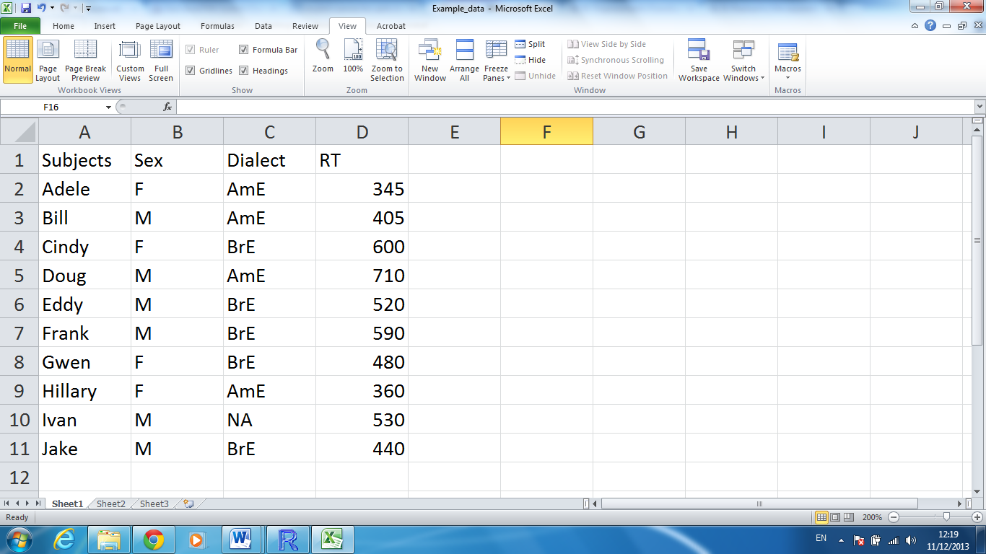
Importing your data to R

Slide 40
Importing your data into R
1. Create a similar table in Excel (or OpenOffice Calc). Don’t forget to create a header. In case of missing values, put NA. No empty cells!
2. Save the file as a tab delimited text file (.txt).
3. Read the file in R:
> mydata <- read.table(file = file.choose(), header = TRUE)

Slide 41
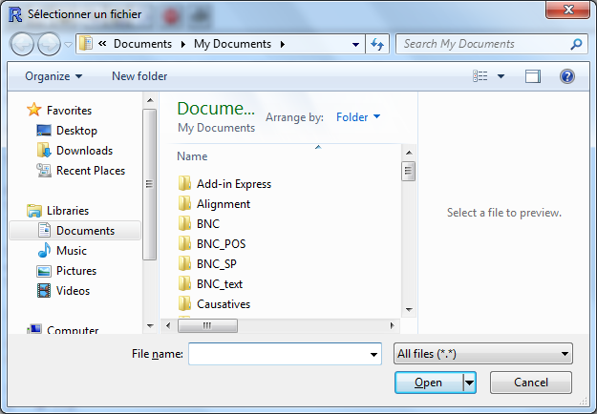
Interactive choice

Slide 42
Exercise
Create the following table in Excel (or OpenOffice Calc) and import it in R as a data frame under the name Linguists.
Last name | First name | Framework | Born | Died
de Saussure | Ferdinand | Structuralism | 1857 | 1913
Chomsky | Noam | Generative Linguistics | 1928 | NA
Lakoff | George | Cognitive Linguistics | 1941 | NA

