Slide 1
EE123 Final Project – Image Communication
Lev Tauz, Harrison Wang, Shane Barratt

Slide 2
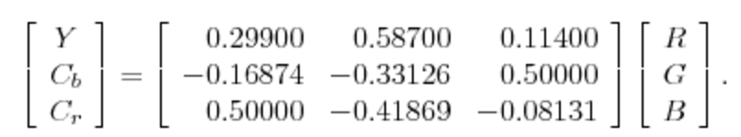
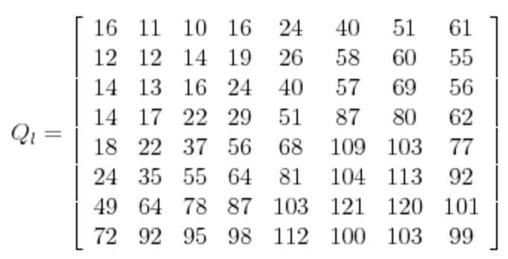
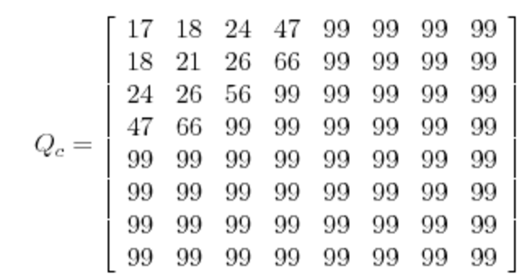
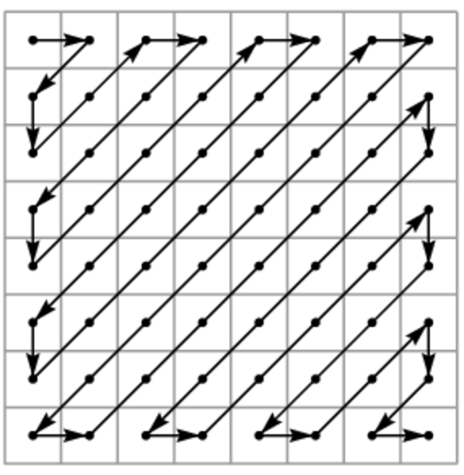
JPEG
Color Space Transform
Quantizes 2D DCT coefficients over 8x8 image blocks by point-wise dividing by 3 8x8 matrices and rounding (q in [1, 100] determines quality)
Source: http://www.ams.org/samplings/feature-column/fcarc-image-compression

Slide 3
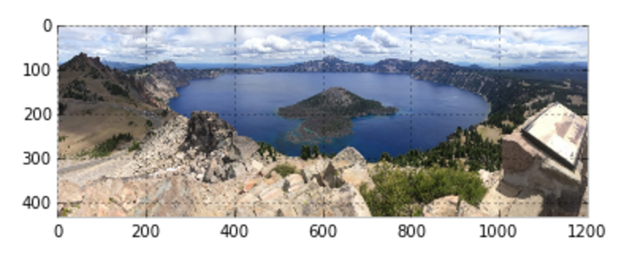
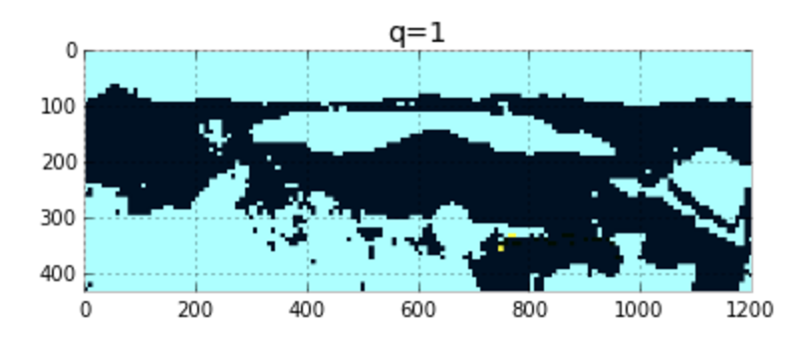
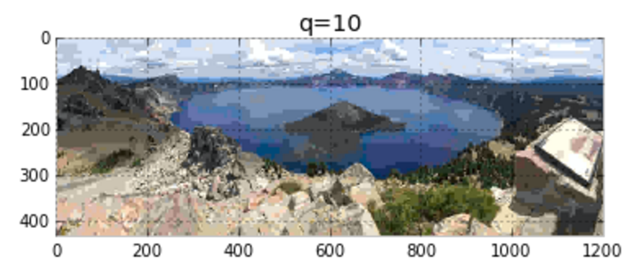
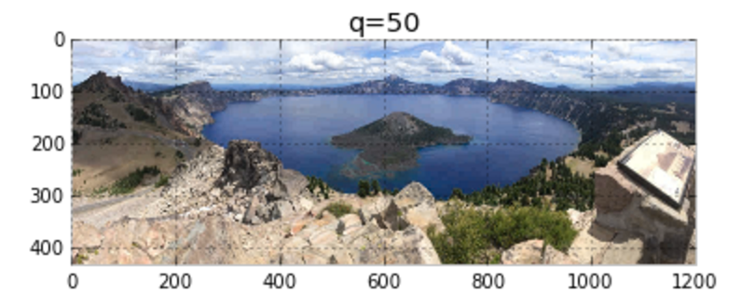
Our Implementation in Action
Original – 1.5MB
PSNR = 11.13
Size = 3kB
PSNR = 24.01
Size = 15kB
PSNR = 30.36
Size = 65kB

Slide 4
Lossless Compression
Gzip – LZ77 and Huffman Encoding
Python gzip library

Slide 5
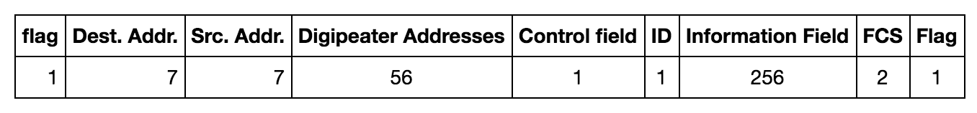
Packets
Used standard AX.25 packets
5 pre and post-flags

Slide 6
Network
# packet in field of packet. If receiver doesn’t receive one, it asks for a retransmission and the sender puts that number packet on its queue

Slide 7
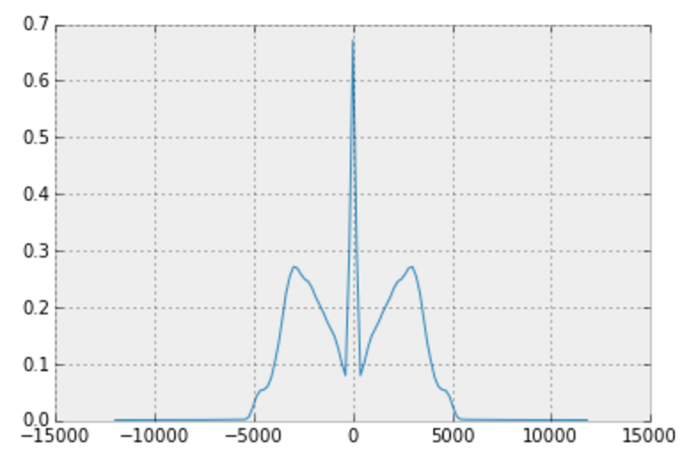
Physical Layer
Looked into Multiple Frequency Shift Keying (MFSK)
Went with Minimum Shift Keying (MSK) for simplicity
FM Bandwidth is only 3kHz
Went with mark = 1200 HZ, space = 2400 Hz and baud rate = 2400
Each bit encoded as half sinusoid (mark) or full sinusoid (space) as a result of having the mark and space frequencies divide the baud rate
Frequency Response of the radio’s audio bandpass filter

Slide 8
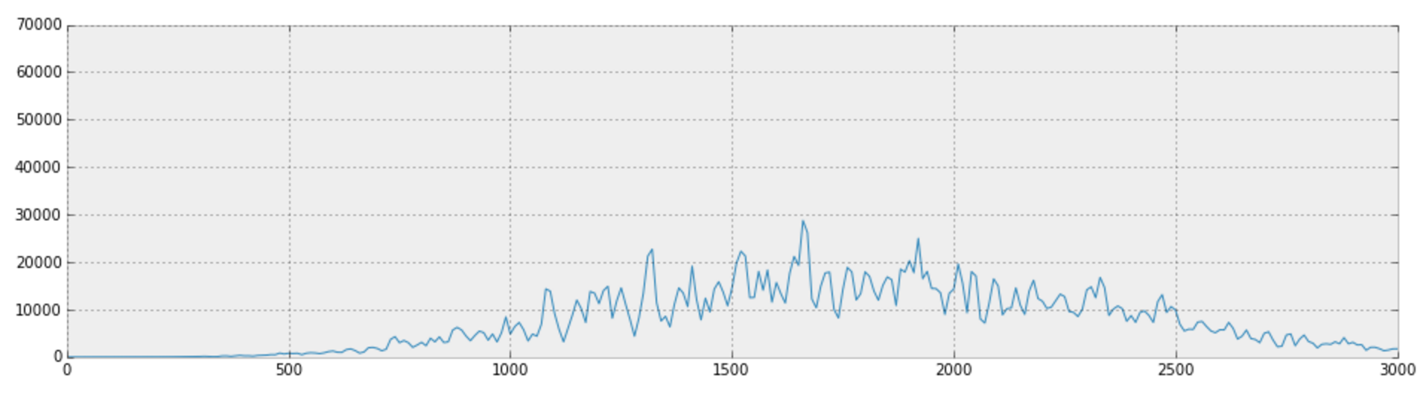
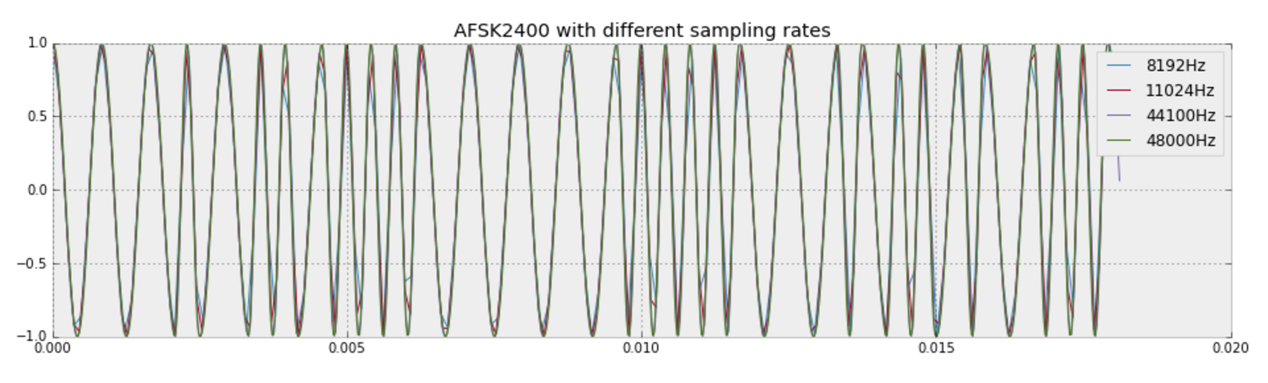

Slide 9
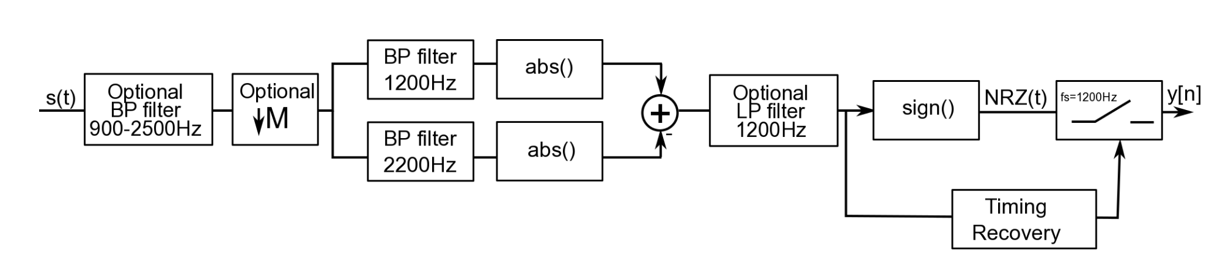
Modified Demodulator (no pun intended)
2400Hz
900-2700 Hz
1400
2400

Slide 10
Results and BER
We’ve doubled the baud rate and thus the amount of bits we can send in the time period
However, how much more likely is it for the transmission to fail and how does this affect our entire system?

