Slide 1
EE123 Final Project – Image Transmission
Lev Tauz, Harrison Wang, Shane Barratt

Slide 2
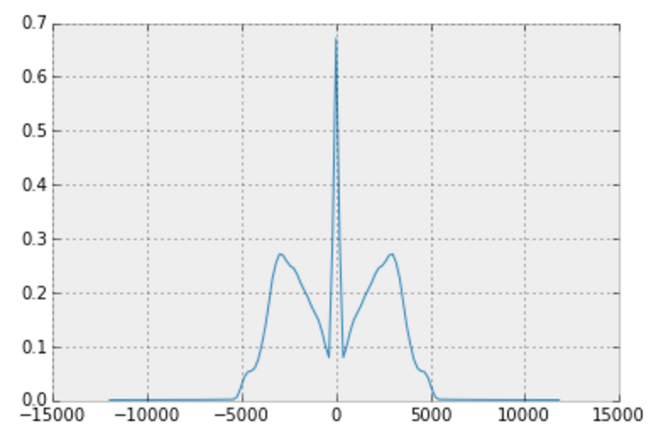
Transmission
Frequency Response of Audio BP Filter

Slide 3
MFSK
FSK with >2 frequencies
Each symbol corresponds to one element from a set of orthogonal waveforms
Send 2 bits at a time instead of 1
E.g. (M=4)
900, 1200, 1800, 2100
00, 01, 10, 11

