Slide 1
Monkey: Optimal Navigable key-value Store

Slide 2
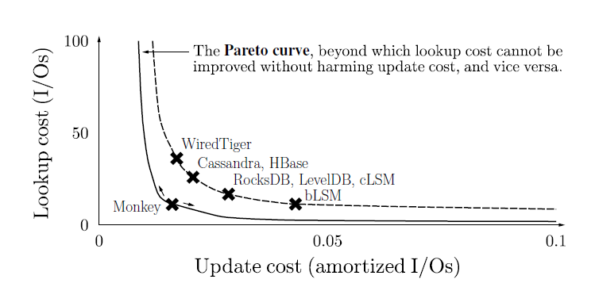
Introduction
LSM-Based Key-Value Stores

Slide 3
Problem
assign the same false positive rate (i.e., number of bits per element) to every Bloom filter.
the relationship between the different design knobs and performance is non-linear, and so it is difficult to co-tune the various design options in the LSM-tree design space to optimize performance.
Notes:
For example, the available main memory budget cannot only be used to increase Bloom filter accuracy but it can also be used to increase the size of the LSM-tree buffer

Slide 4
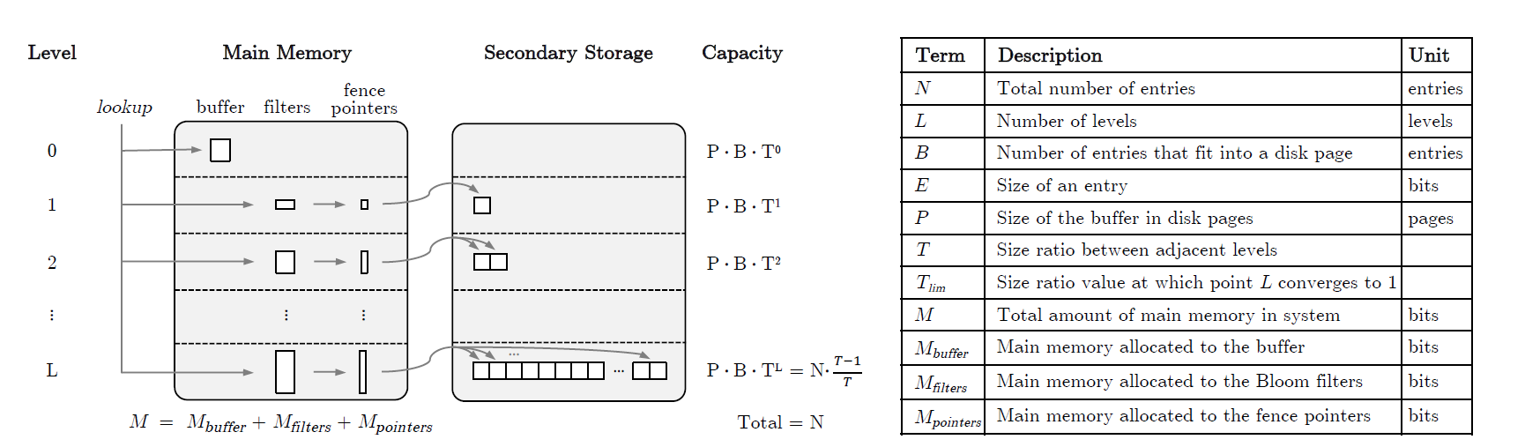




Background
$$L= \log_{T}(\frac{NE}{M_{Buffer}}∙\frac{T−1}{T})$$
$$P∙B∙T^{L}= N∙\frac{T−1}{T}$$
通过将各level的capacity相加，得到：
$$L= \log_{T}(1+\frac{NE}{M_{Buffer}}∙\frac{T−1}{T})$$
其中：
$$T_{lim}=\frac{N∙E}{M_{Buffer}}$$
Notes:
Merge Policy: leveling/tiering

Slide 5
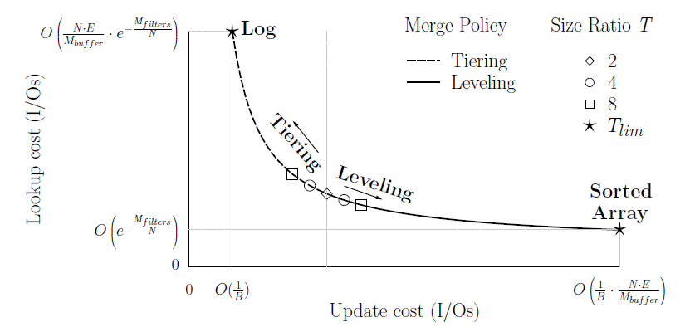
LSM-tree design space
Notes:
图中表示size ratio和merge policy对update cost和lookup cost的影响
另外T(lim) = NE / M(Buffer)表示memory分配给bloom filter和buffer对于曲线的走向也有影响

Slide 6
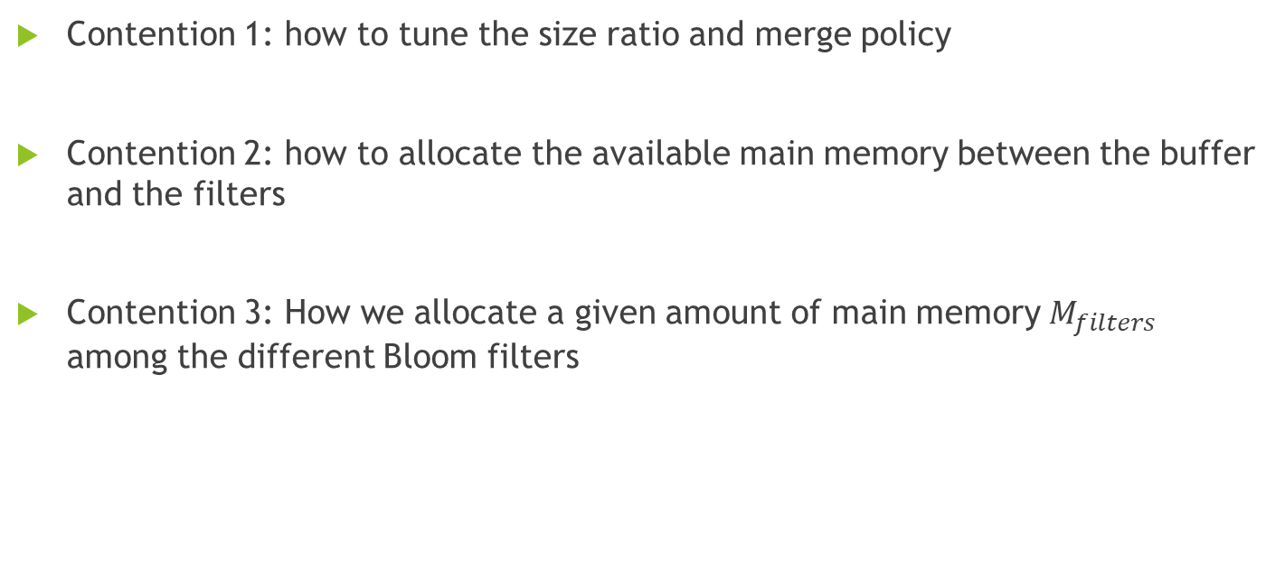
LSM-tree design space - contentions
Contention 1: how to tune the size ratio and merge policy
Contention 2: how to allocate the available main memory between the buffer and the filters
Contention 3: How we allocate a given amount of main memory $M_{filters}$ among the different Bloom filters

Slide 7
Monkey

Slide 8
Minimizing Lookup Cost
Preconditions:
Focus on zero-result lookups since they incur the highest possible pure I/O overhead
Assume a fixed entry size E

Slide 9
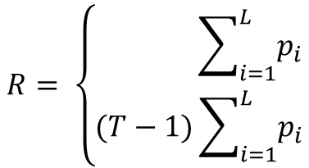
Minimizing Lookup Cost
average worst-case lookup cost:
$$R= \left\{\begin{aligned} \sum_{i=1}^{L}{p_{i}} \\ (T−1)\sum_{i=1}^{L}{p_{i}}\end{aligned}\right.$$
, with leveling
, with tiering

Slide 10
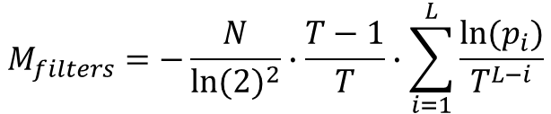




Minimizing Lookup Cost
Main memory footprint:
$$FPR=e^{−\frac{bits}{entries}∙{ln⁡(2)}^{2} }$$
$$bits=−entries ∙\frac{ln⁡(FPR)}{{ln⁡(2)}^{2}}$$
$$entries(last level)= N∙\frac{T−1}{T}$$
entries(level i) = $\frac{N}{T^{L−i}}∙\frac{T−1}{T}$
$$M_{filters}=−\frac{N}{{ln⁡(2)}^{2}}∙\frac{T−1}{T}∙\sum_{i=1}^{L}{\frac{ln⁡(p_{i})}{T^{L−i}}}$$

Slide 11
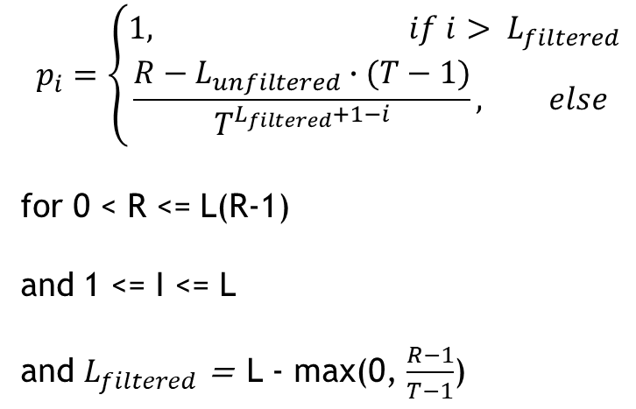
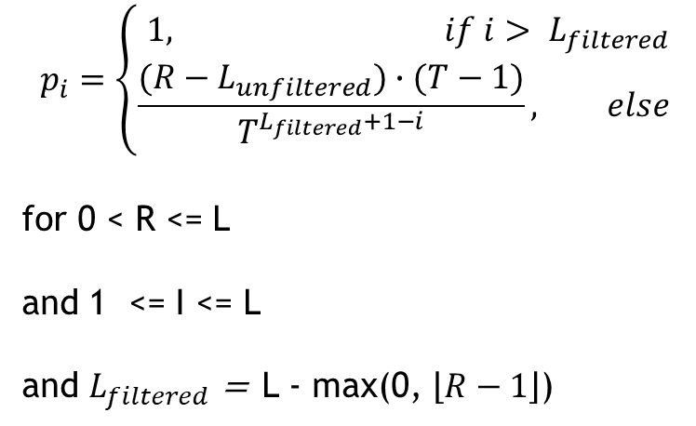
Minimizing Lookup Cost
optimal FPRs that minimizes $M_{filters}$for user-specified R
Leveling Tiering
$$p_{i}=\left\{\begin{aligned}1, if i> L_{filtered} \\ \frac{(R−L_{unfiltered})∙(T−1)}{T^{L_{filtered}+1−i}}, else \end{aligned}\right.$$
for 0 < R <= L
and 1 <= I <= L
and $L_{filtered}$ = L - max(0, $\left\lfloor R−1\right\rfloor$)
$$p_{i}=\left\{\begin{aligned}1, if i> L_{filtered} \\ \frac{R−L_{unfiltered}∙(T−1)}{T^{L_{filtered}+1−i}}, else \end{aligned}\right.$$
for 0 < R <= L(R-1)
and 1 <= I <= L
and $L_{filtered}$ = L - max(0, $\frac{R−1}{T−1}$)
Notes:
根据前面两个ppt计算得到的R和Mfilter，这连个公式都是关于p(i)的多变量表达式，两者带入，根据拉格朗日计算
可以获取该表达式

Slide 12
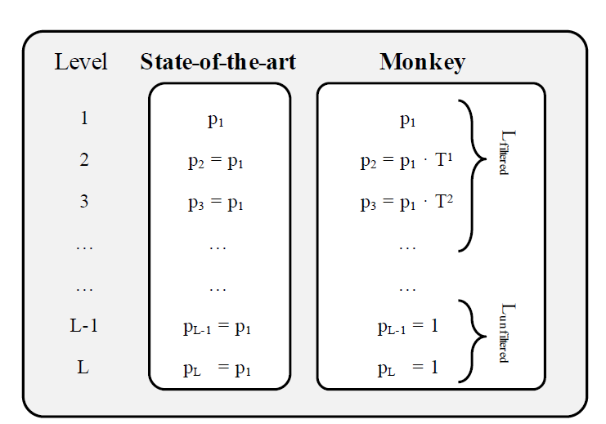
Minimizing Lookup Cost

Slide 13
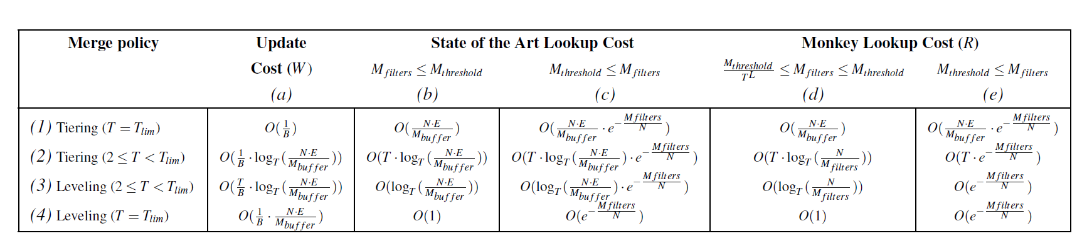

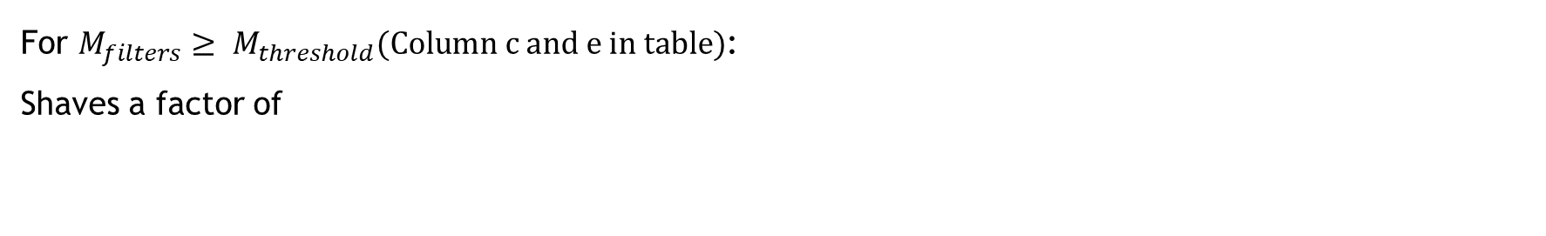
Predicting lookup and update cost
For $M_{filters}≥ M_{threshold}(Column c and e in table)$:
Shaves a factor of
$$\log_{T}(\frac{NE}{M_{Buffer}})$$

Slide 14

Predicting lookup and update cost
Shaves a factor:
1.As long as we scale the Bloom Filters’ footprint with the number of data entries(N), lookup cost in Monkey stays fixed whereas in the state of the art it increase at a logarithmic rate
2. Lookup cost is independent of the entry size(E), and so it does not increase for data sets with larger entry sizes
3. Lookup cost is independent of the buffer size. This simplifies tuning relative to the state of the art, because we do not need to carefully balance main memory allocation between the buffer and filters to optimize lookup performance
$$\log_{T}(\frac{NE}{M_{Buffer}})$$

Slide 15
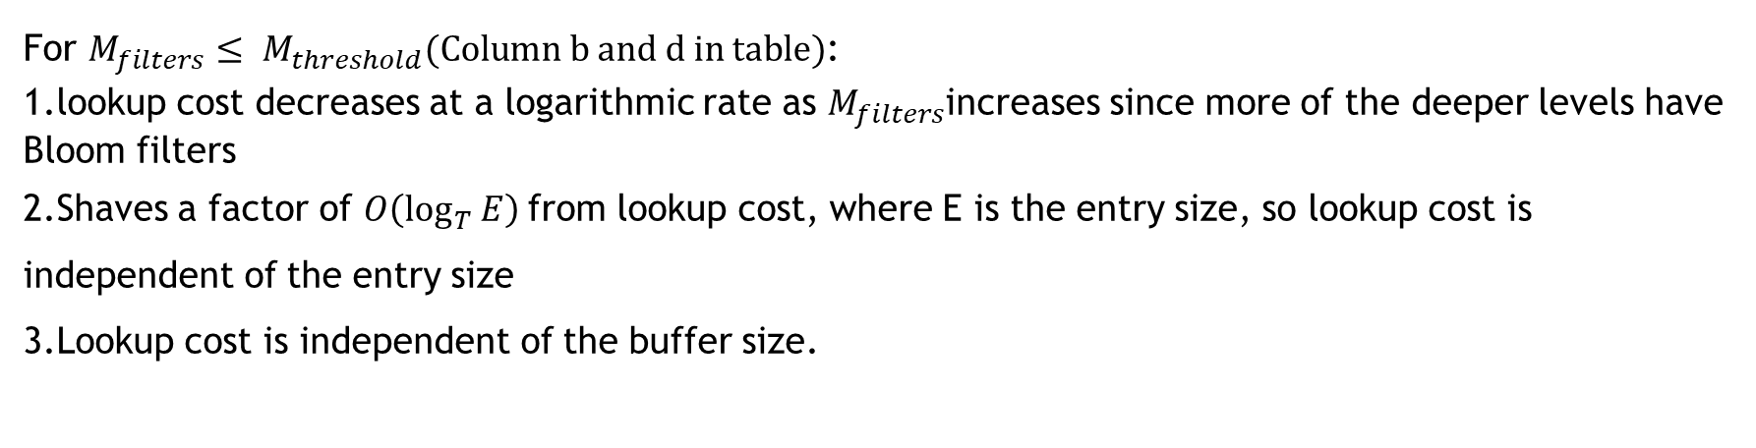
Predicting lookup and update cost
For $M_{filters}≤ M_{threshold}(Column b and d in table)$:
1.lookup cost decreases at a logarithmic rate as $M_{filters}$increases since more of the deeper levels have Bloom filters
2.Shaves a factor of $O\left(\log_{T}{E}\right)$from lookup cost, where E is the entry size, so lookup cost is independent of the entry size
3.Lookup cost is independent of the buffer size.
Notes:
This simplifies tuning relative to the state of the art, because we do not need to carefully balance main memory allocation between the buffer and filters to optimize lookup performance

Slide 16
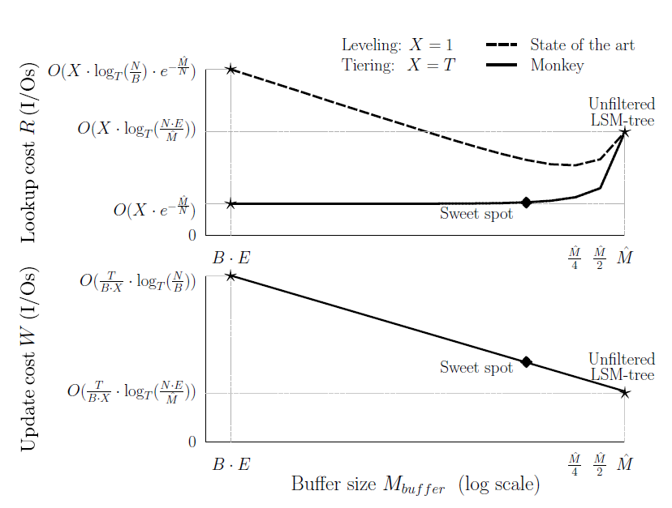
Predicting lookup and update cost

Slide 17
Predicting lookup and update cost
The overall insight is that it is desirable to set the buffer size as large as possible to
reduce update cost while still keeping it below the point where it begins to significantly
harm lookup cost.
Notes:
The overall insight is that it is desirable to set the buffer size as large as possible to reduce update cost while still keeping it below the point where it begins to significantly
harm lookup cost.
在甜点到来之前，令Mbuffer无限大

Slide 18
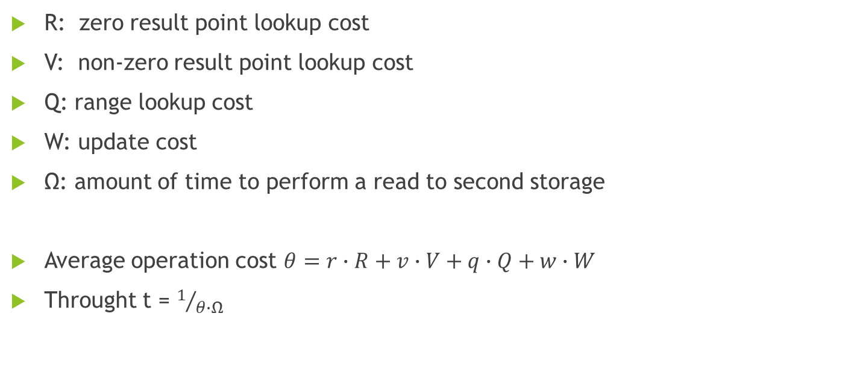
Navigate design space
R: zero result point lookup cost
V: non-zero result point lookup cost
Q: range lookup cost
W: update cost
Ω: amount of time to perform a read to second storage
Average operation cost $θ=r∙R+v∙V+q∙Q+w∙W$
Throught t = $1/{θ∙Ω}$
Notes:
controlling four tuning parameters:
1.the merge policy (tiering vs. leveling)
2.the size ratio
3.the amount of main memory allocated to the filters
4.The amount of main memory allocated to the buffer.

Slide 19
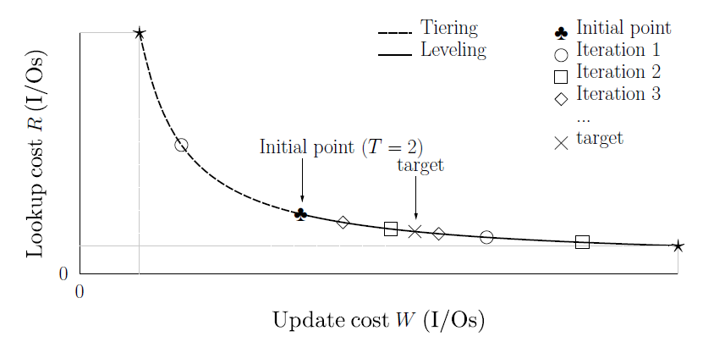
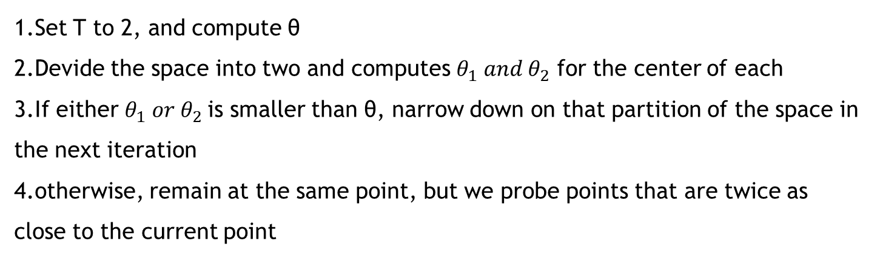
Tuning the size ratio and merge policy
1.Set T to 2, and compute θ
2.Devide the space into two and computes $θ_{1} and θ_{2}$ for the center of each
3.If either $θ_{1} or θ_{2}$is smaller than θ, narrow down on that partition of the space in the next iteration
4.otherwise, remain at the same point, but we probe points that are twice as close to the current point
Notes:
复杂度O(Tlim)

Slide 20
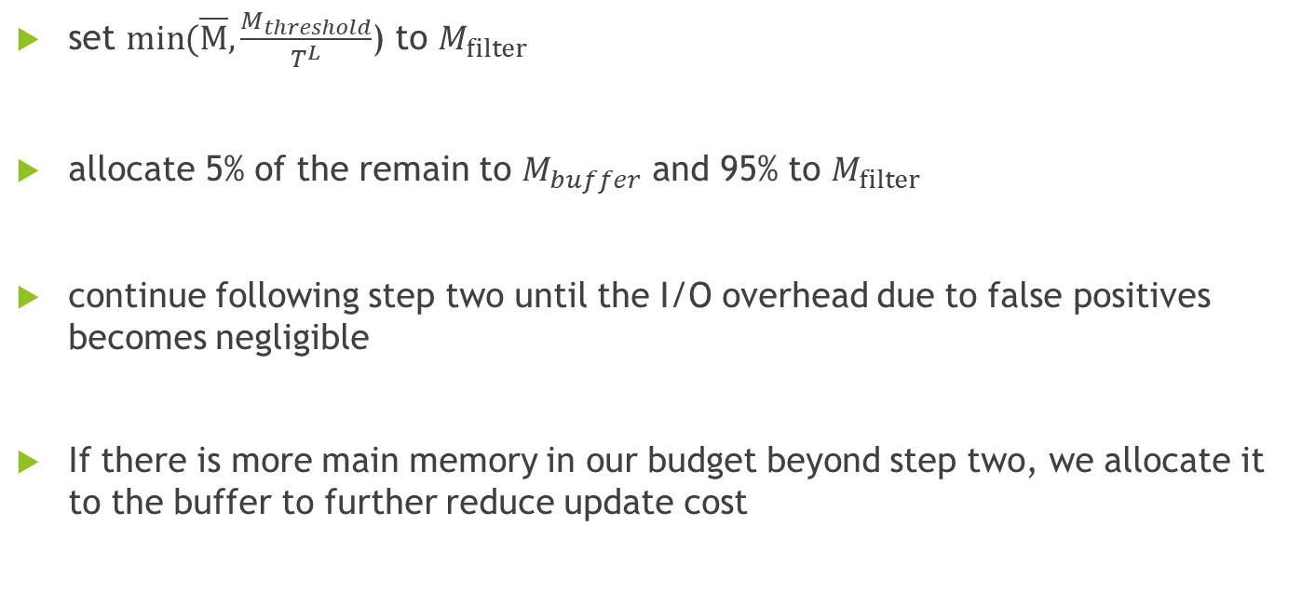
Tuning main memory allocation
set $min(\overline{M}, \frac{M_{threshold}}{T^{L}}$) to $M_{filter}$
allocate 5% of the remain to $M_{buffer}$ and 95% to $M_{filter}$
continue following step two until the I/O overhead due to false positives becomes negligible
If there is more main memory in our budget beyond step two, we allocate it to the buffer to further reduce update cost
Notes:
如果FPRs=10的-4次方，由于IO查询的时间消耗是10ms，那么由于FPRs带来的IO消耗则是10的-6次方，此时相对于系统中的其他消耗来说已经微不足道
M(filter)至少要等于M(threshold) / $T^{L}$, 因为如果小于等于的话，所有的level都FPR都等于1，对性能影响很大。根据FPR = $e^{−\frac{bits}{entries}∙ln{(2)}^{2}}推断$

Slide 21
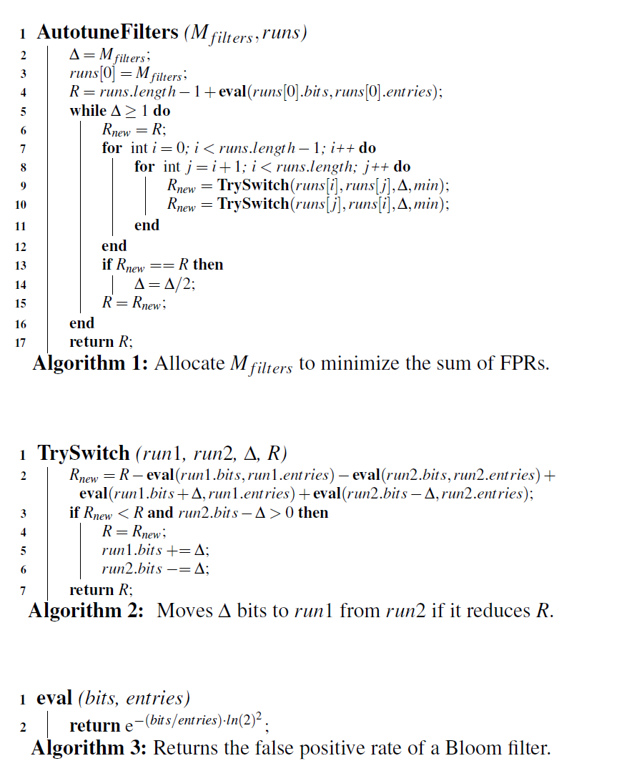
Appendix
Assume the entry size is fixed.
In fact, it may be variable, or change over time
Notes:
该算法周期性运行
初始情况，将Mfilter都分配给run[0]
R是FPRs
对所有的runs[i]和runs[j], 交换delta, 计算其FPRs，如果小则记录，否则

Slide 22
Thanks

