Slide 1
DDD in Action
Levente Kintzel
Cloud Software Architecture Training

Slide 2
Goals
Familiarize with DDD concepts
See CQRS and Event Sourcing in Action
Apply these in a Java environment
Look for some helping frameworks
Opt for a Spring close solution
Use GraphQL
Adjust architecture

Slide 3
The problem - Car rental app
As a Car Rental I register a car in order to be usable for rental
As a Car Rental I submit rental offers in order the customers can choose from them
As a Customer I create an account in order to use the system
As a Customer I request a rental by specifying the dates I need the car, the pickup location, drop location and the car category and the displayed price from (based on submitted offer)
As a Car Rental I confirm a rental request by assigning an exact car (choosing from the available ones) to the request, mark the car as being booked and assign a contract to the request
As a Customer I accept a rental by making a payment and signing the contract

Slide 4
The problem - Car rental app
As a Customer I pickup the car from the rental request on the dates contracted, and fill a pickup notes where I point all the important things: missing fuel, not registered damages to the car etc.
As a Customer I drop the car from the rental request on the dates contracted, and fill a drop notes where I point all the important things: lost keys, documents, eventually damages etc.
As a Car rental I verify the car from the rental request and fill a verification notes where I point all the important things: lost keys, documents, eventually damages, car not refueled, fines etc.
As a Car rental I prepare the car for next rental by refueling and cleaning it and marking it as available in the system.

Slide 5
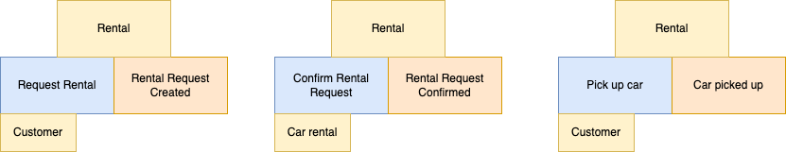
The problem - Car rental app

Slide 6
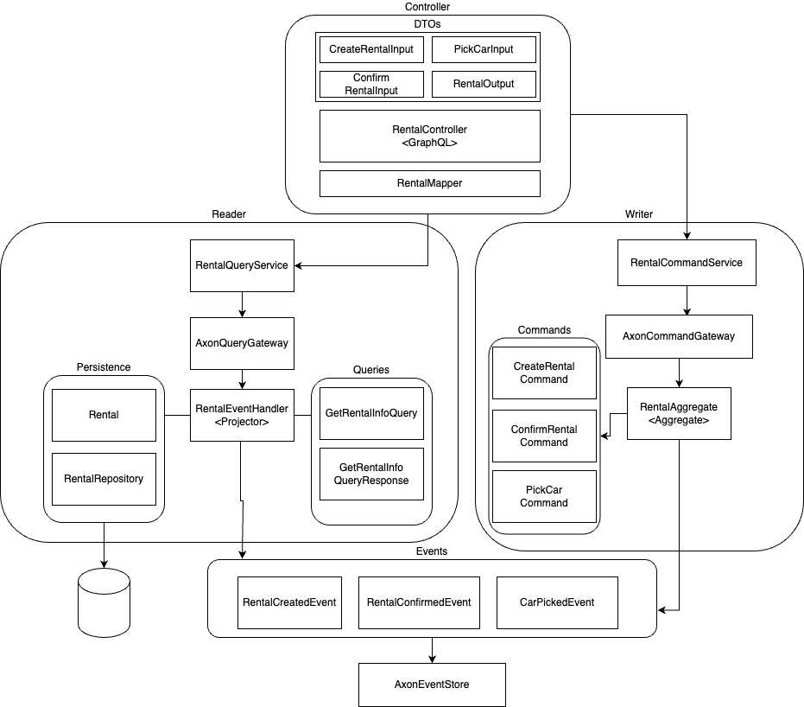
Solution

Slide 7




Frameworks and Tools
Java 17
Spring Framework
Spring Boot
Spring Data
Spring GraphQL
Axon
Postgres
Gradle
Docker

Slide 8
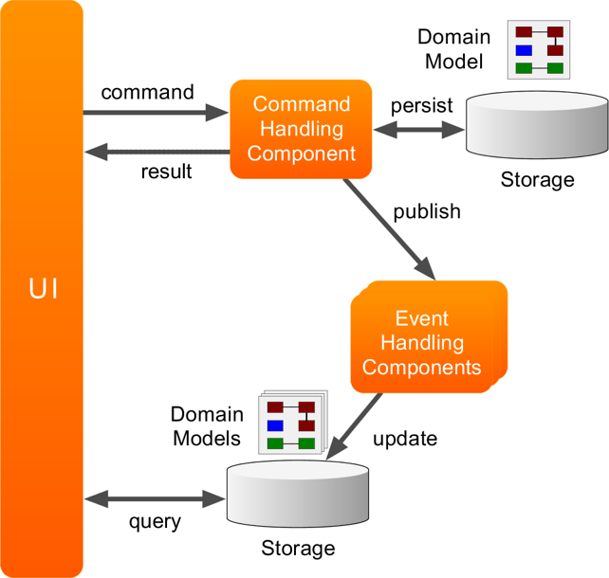
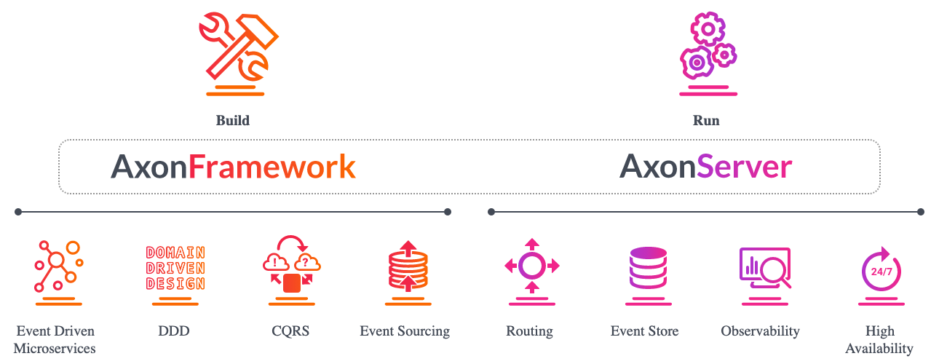
Axon

Slide 9
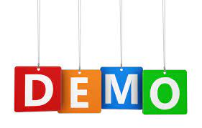

Slide 10
Lesson learnt
CQRS can add an ammount of complexity, but there are lot of frameworks and tools (in Java ecosystem) that can take this complexity away from the developer
There is a possibility to scale differently the reading and writing processes
Even if GraphQL provides a quite close terminology to the Commands and Query is not that easy to reuse the command and query models for that purpose and it may not be wise to do it

Slide 11
Future improvements
Develop the services for the other domains: car inventory, customers, payment …
Use Graphql to make introspections
Separate the reader part from the writer part in different projects
Deploy to cloud
Use Axon feature deeper
Try to substitute a lot of boiler plate code (example by mappers)
Try to map directly the Commands and Queries to Graphql types / inputs
Separate command handlers from event handlers

