Slide 1
Cypher Lithography Driver

Slide 2
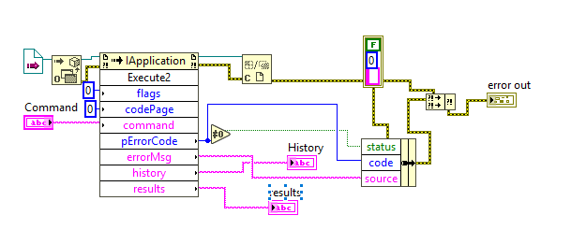
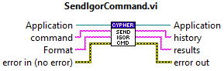
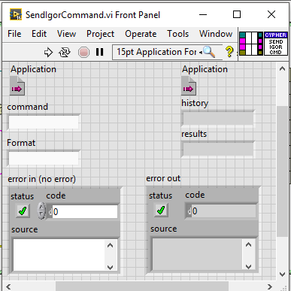
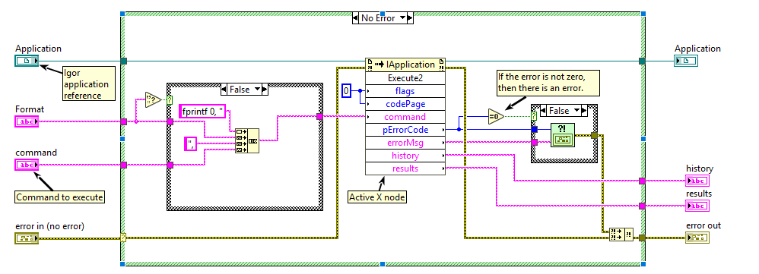
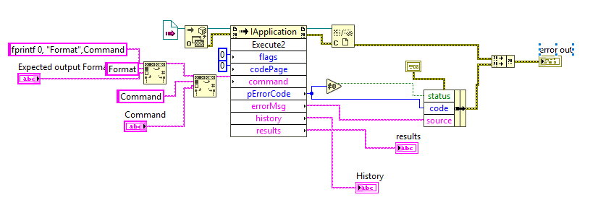
SendIgorCommand.vi
Merged Send Igor Command.vi and Send Igor Command_no Return.vi together.
Got rid of the opening of the application every time. Application should be opened once and then wired into subVIs each time.
Added an error in and an error out. Added more dynamic error handling.
Instead of searching and replacing the string I am concatenating multiple strings together, which is faster, and more modular in this case
Have dynamic handling that allows the program to not request a certain return format. (this is the part that I merged the two together.

Slide 3
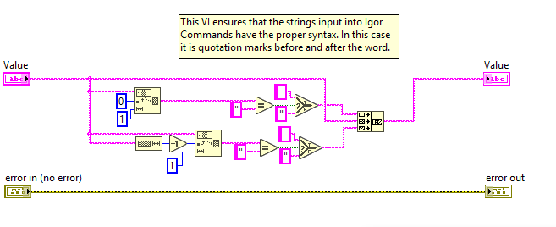
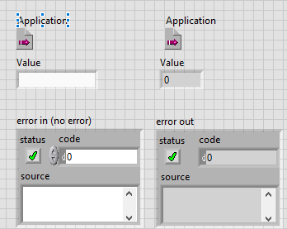

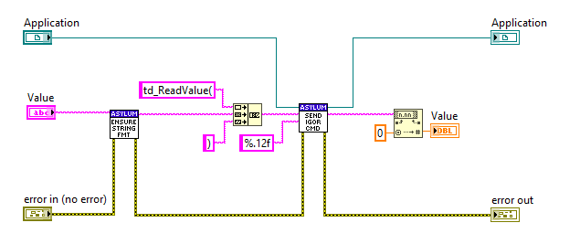
ReadValue.vi
Ensure string Format ensures that the String has “ on both ends.

Slide 4
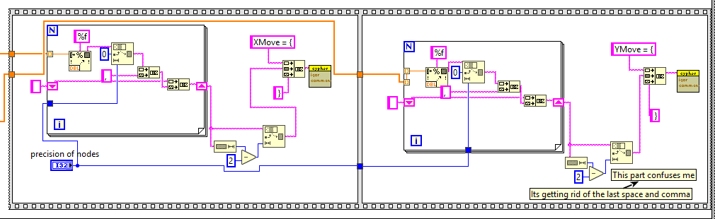
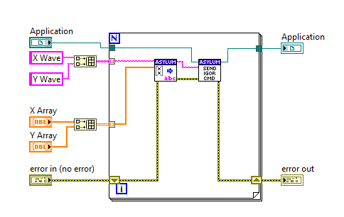
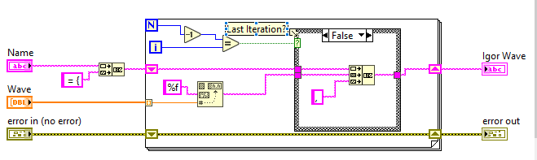
Build Igor Wave from LabVIEW Array
Polymorphic for both string and numeric arrays
Old Code
What new code equivalent looks like

