Slide 1
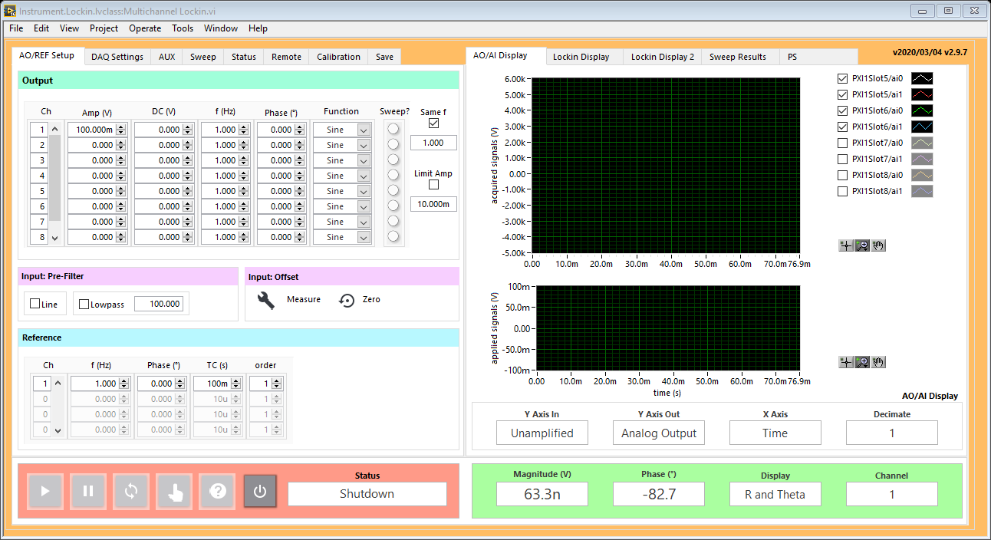

Slide 2
ADC
Filter
Offset
Mixer
REF Filter
Σ
AO
oscillator
DAC
DUT
REF
oscillator
Analog
Digital

Slide 3
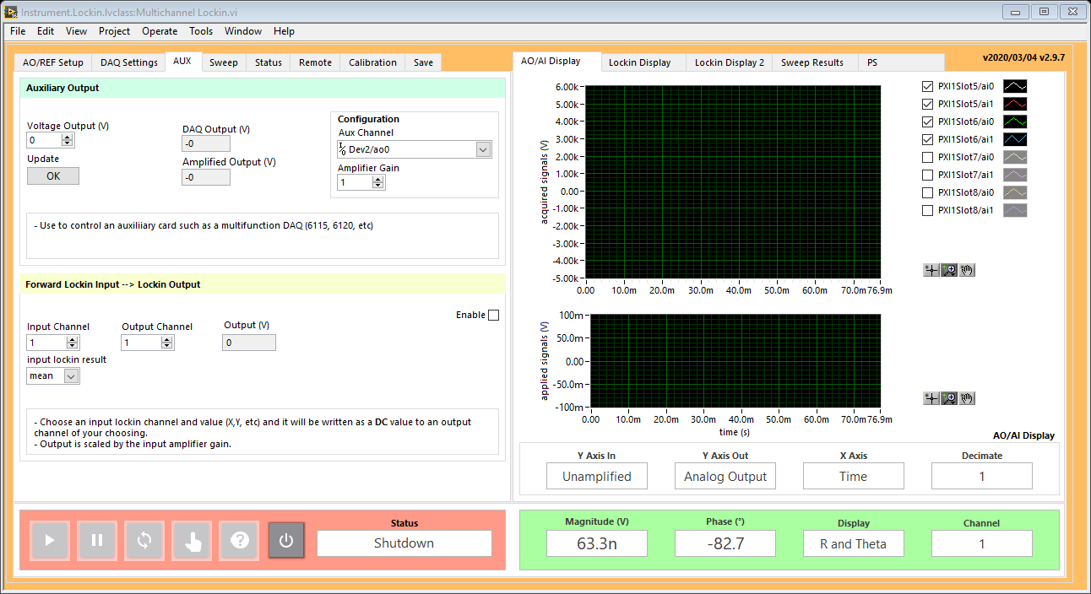
AUX
AUX DAC
ADC
Filter
Offset
Mixer
REF Filter
Σ
AO
oscillator
DAC
DUT
REF
oscillator
Analog
Digital

