Slide 1
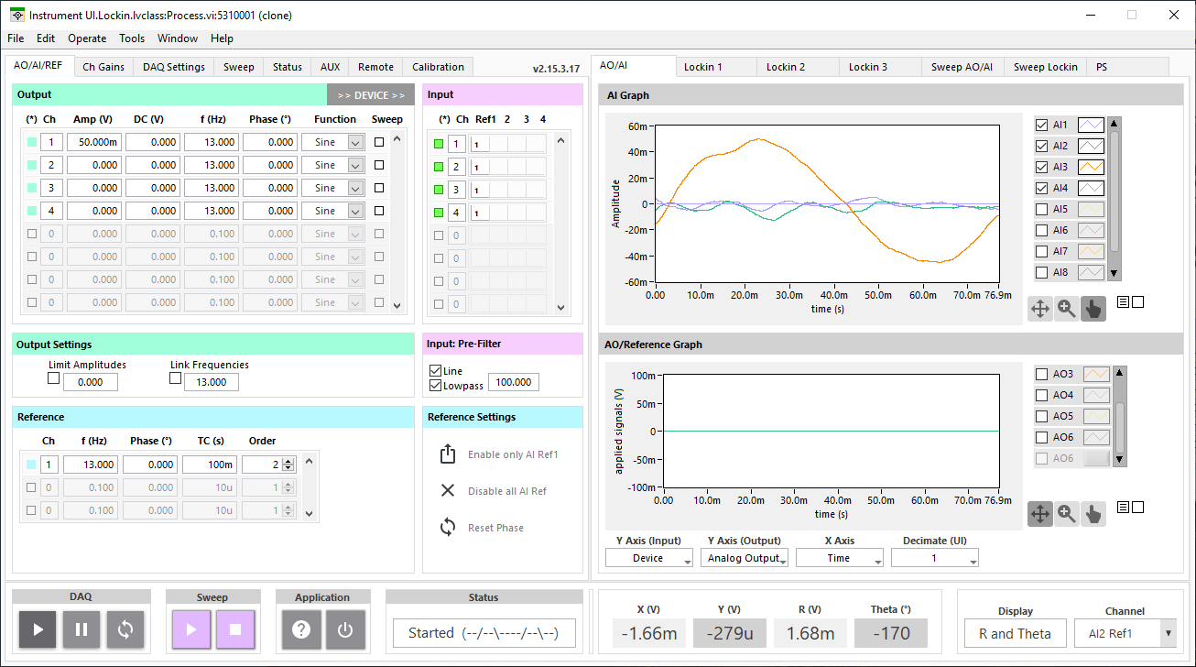

Slide 2
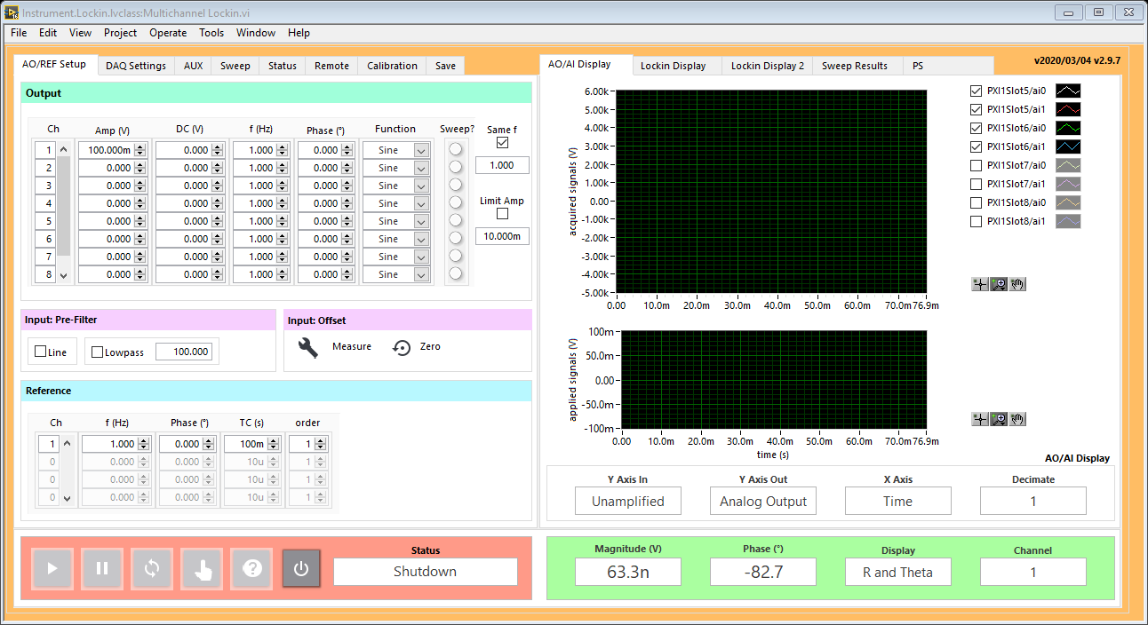
ADC
Filter
Offset
Mixer
REF Filter
DUT
Σ
AO
oscillator
DAC
Output
Input
REF
oscillator
Device

Slide 3
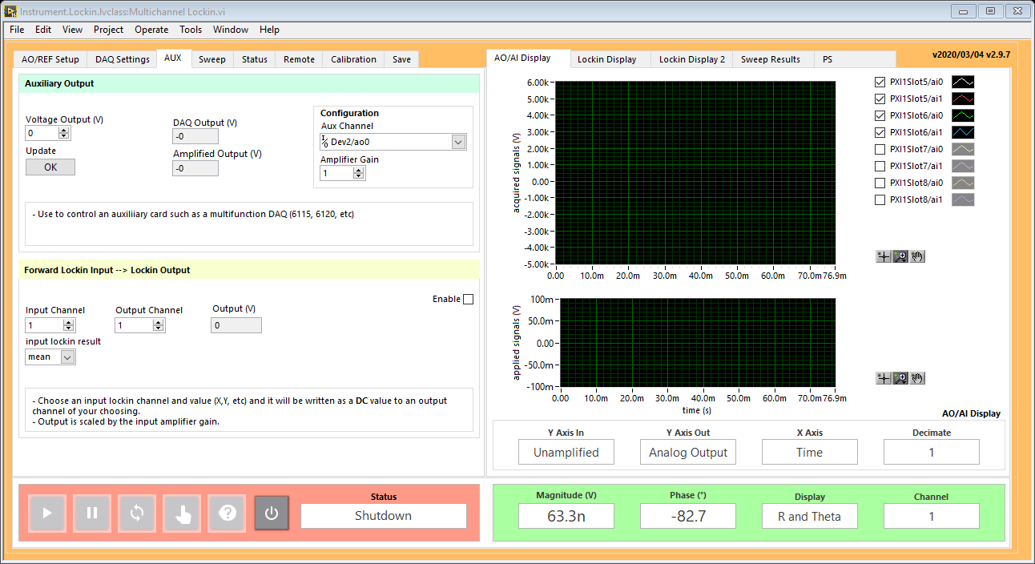
AUX DAC
ADC
Filter
Offset
Mixer
REF Filter
DUT
Σ
AO
oscillator
DAC
REF
oscillator

Slide 4
AUX DAC
ADC
Filter
Offset
Mixer
REF Filter
DUT
Σ
AO
oscillator
DAC
REF
oscillator

Slide 5
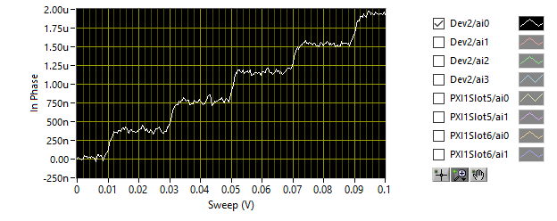
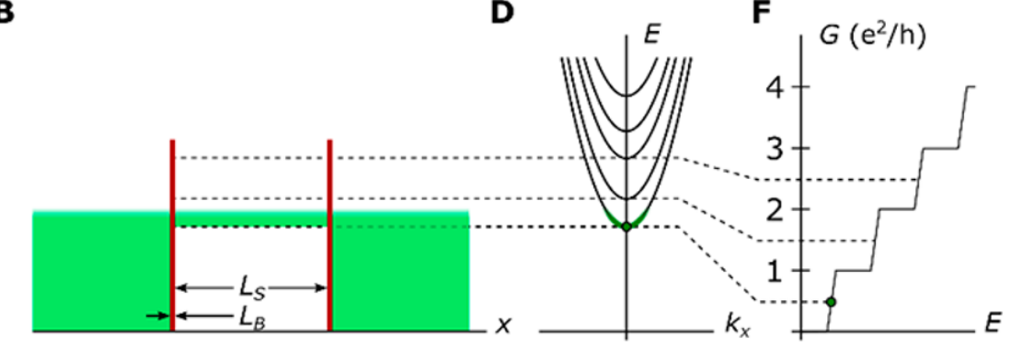
AO2
(Gate)
AO1
(Source)
AI1
(Drain)
AO1:
Amp = 10 mV
f = 13 Hz
Sweep AO2:
0 – 100 mV, 20s
AI1:
Gain = 50,000
REF:
f = 13 Hz
TC = 100 ms
ADC
Filter
Offset
Mixer
REF Filter
DUT
Σ
AO
oscillator
DAC
REF
oscillator

Slide 6
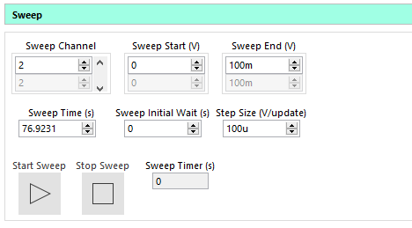
ADC
Filter
Offset
Mixer
REF Filter
DUT
Σ
AO
oscillator
DAC
REF
oscillator

Slide 7

Σ

