Slide 1
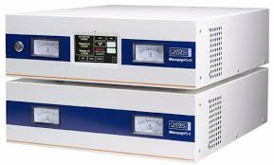
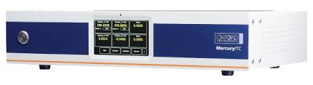








HW drivers
Instrument.Oxford1820:process.vi
Remote API
Remote Community Methods
Instrument.Oxford1820 UI:process.vi

