Slide 1
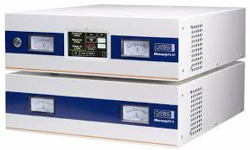
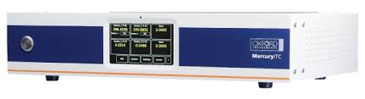











HW drivers
Instrument.Oxford1820:process.vi
Instrument.1820:process.vi
TCP Layer
Remote API Methods
Remote Community Methods
Instrument.Oxford1820 UI:process.vi

