Slide 1
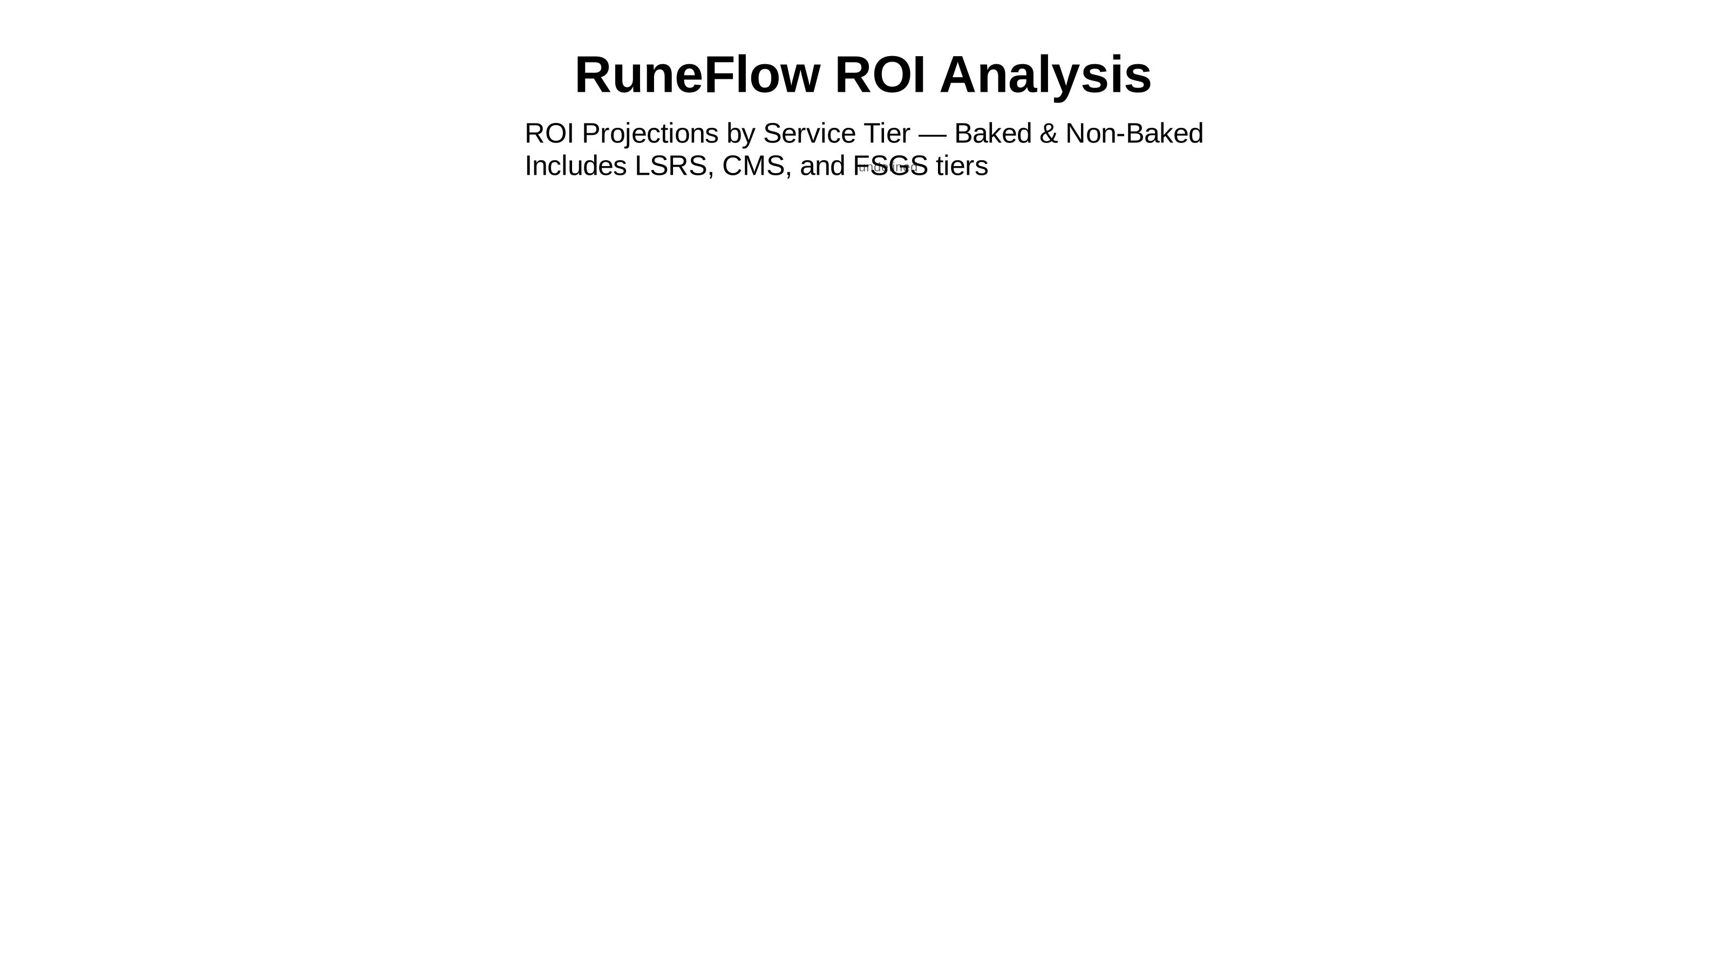

Slide 2
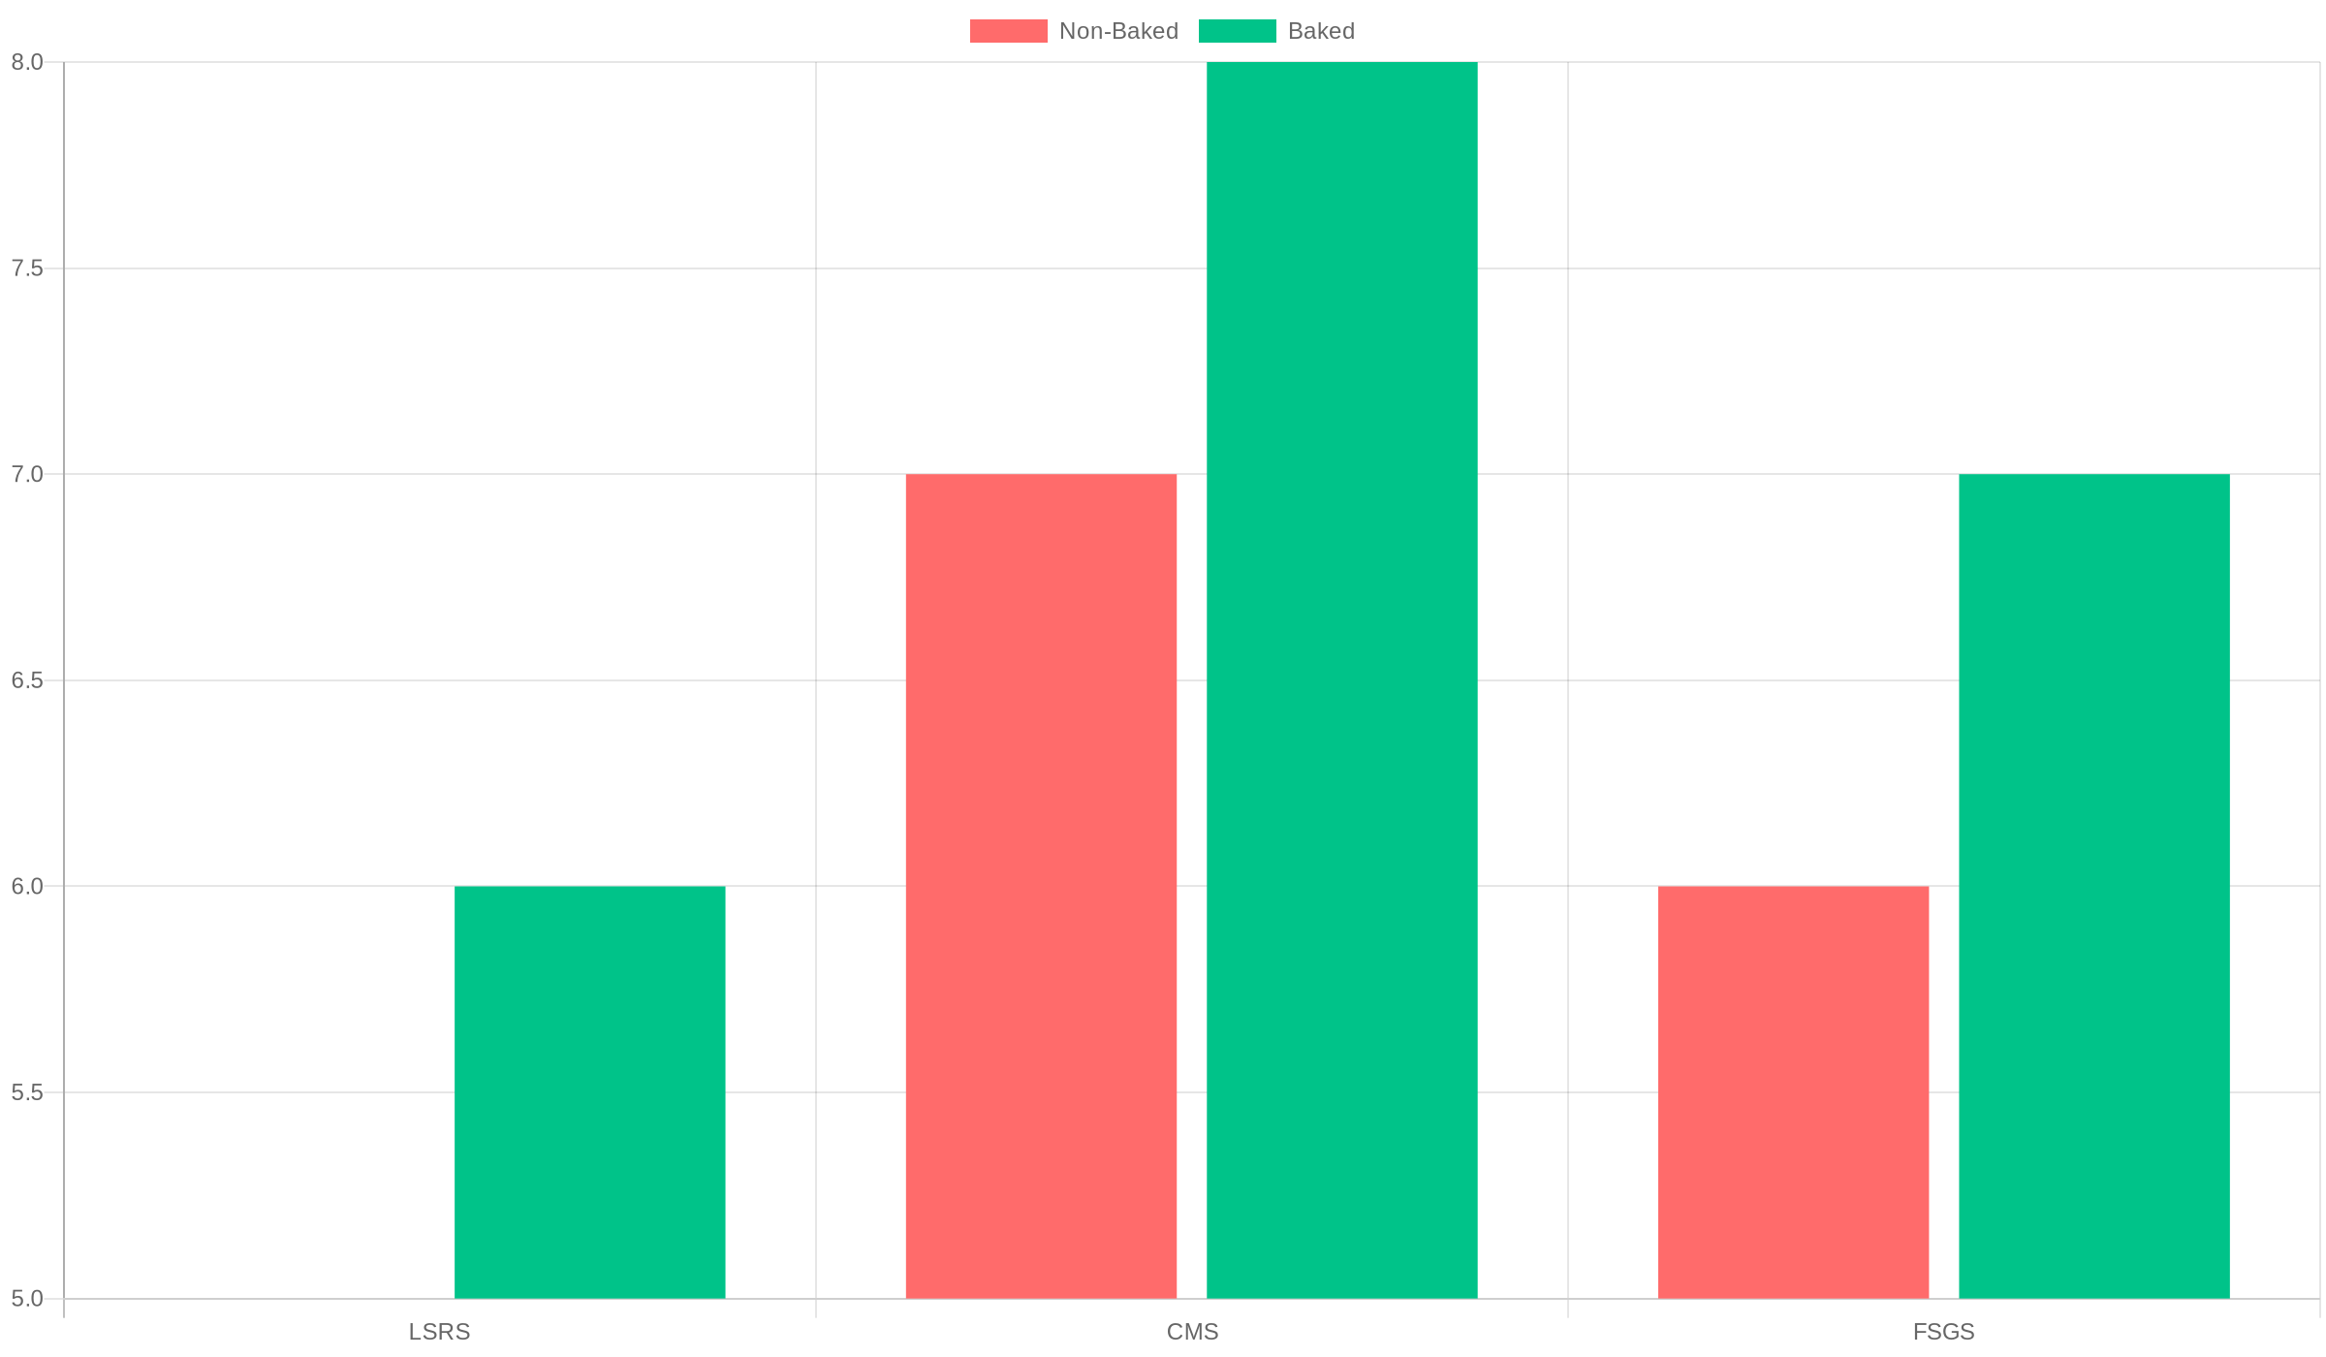
ROI (Weeks) by Tier

Slide 3
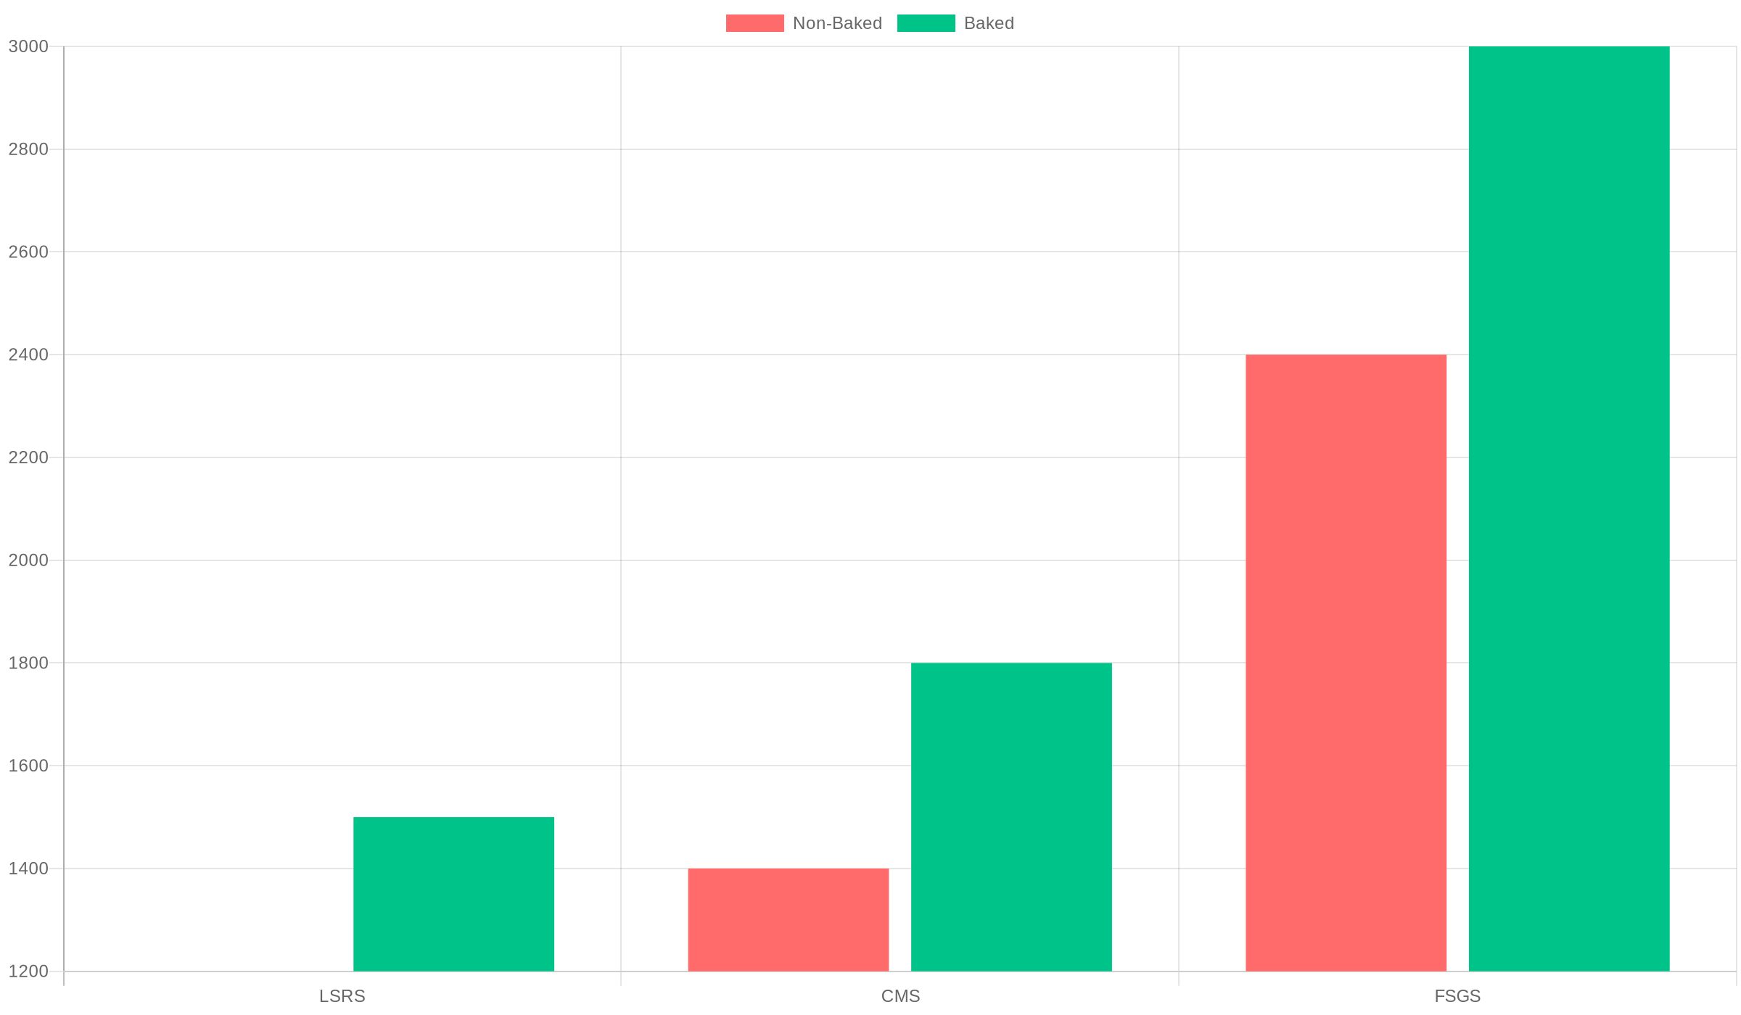
Monthly Savings by Tier ($/mo)

Slide 4
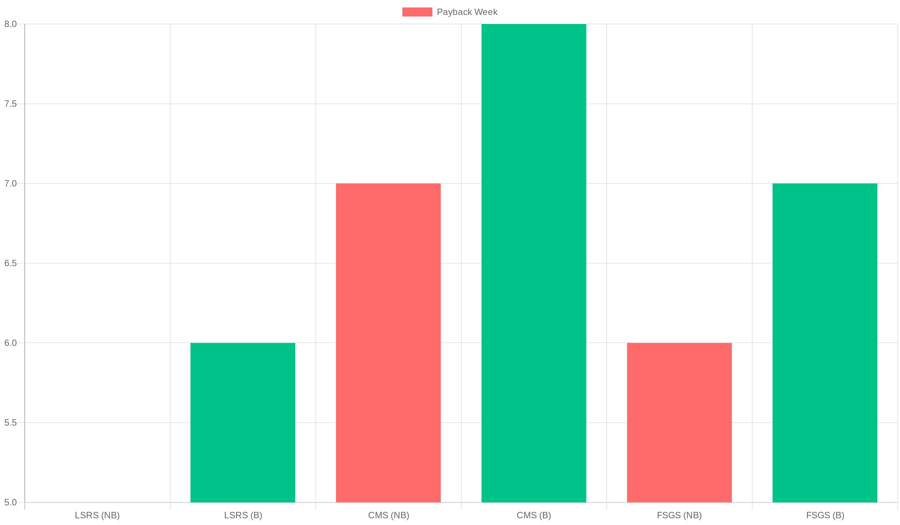
Payback Week by System Variant

Slide 5
ROI Comparison
System Type | Setup + Monthly | ROI (Weeks)
LSRS Non-Baked | $1,800 | 5
LSRS Baked | $3,200 + $450/mo | 6
CMS Non-Baked | $1,800 | 7
CMS Baked | $3,500 + $500/mo | 8
FSGS Non-Baked | $2,800 | 6
FSGS Baked | $5,500 + $800/mo | 7

Slide 6
