Slide 2
Augmented Animation, Camera, and Controls
Lewey Geselowitz
Microsoft Studios

Slide 3
Introduction
Speaker introduction
Game history – Thanks to Seth, David, Rom….
Talk for developers, designers, and animators:
Augmented animation – how we changed how we animate
Player analysis – how we analyze and quantify the player
Controls – how we bring it all together
Camera – how we changed how we look at the scene
Background: Image layers & acting

Slide 4
Background Thought 1: Graphics Shaders
In image processing, the image is often broken up into layers:
Diffuse / Specular / Normal maps, etc.
Our ability to express dynamic visuals is reliant on the separation of these layers
If specular was baked into diffuse, shiny things wouldn’t change as you walked past them
If normal maps were baked in, then lighting couldn’t change
What are the component layers of an animation?...

Slide 5
Background Thought 2: Acting
People watch actors a lot, and like it, why? (e.g. movies)
Actors utilize many core principals shared with Kinect:
Mirror neurons – we have mental hardware to copy and empathize with the human form
Kinesthetics – our physical motions are tied to our psychological emotions, and information flows both ways
Physical communication – actors use the above to communicate stories using their bodies

Slide 6
From Animation to Augmentation
Augmented Animation means
Acting the players motions back to them!
As an actor, the avatar is trying to express:
That they are an extension to the player
That they are a Jedi
That these things can be done synergistically

Slide 7
From Animation to Augmentation
Interactive Feedback Loop
Buttons → Kinect
Player Perception: Touch → Kinesthetics
Player Action: Thumbs → Whole Body
Motion: Button Sequence → Kata
Avatar Animation: Responsive → Extension (feels like button → matches the feelings received from your body while you are doing it)
Team-wise:
Designers identify gestures, rhythmic pacing, and physical storytelling
Programmers implement body quantification and matching
Animators contextualize and stylize kinesthetics
Player Perception
Designed Motion
Gesture Recognition
Authored Animation
Avatar on Screen
Player Action

Slide 8
Augmentation: Anticipation
Anticipation
Augmented posture should visually hint, emphasize, and make clear the movements that can be expected from that position. Every pose should tell something; anticipation is what it tells.

Slide 9
Augmentation: Anticipation Content Requirements
Each pose cleanly blends into neighboring poses
Each pose cleanly blends into motions that started there
Each pose shows why the character is posed such, never aimless
Large set of idle anticipation poses needed to match player extents

Slide 10
Augmentation: Anticipation Approaches to Pose Blending
Procedural Body Axis Metrics
Ex: anim_input = ( hand.x – shoulder.x ) / arm_length
Pros:
Programmers first thought, easy to code, easy to debug later
Fully customizable for smoothing and stabilization
Cons:
Programmers required to author, explain, tune, etc.
Often not ergonomic, arm response is not linear across space
Not connected with the blend tree, correlation difficult to ensure
Easy to forget or mis-implement body normalization

Slide 11
Augmentation: Anticipation Approaches to Pose Blending
Reference Blend Weighting
Ex: anim_input = weights( pose_0:N, user_pose )
Hierarchical distance between selected joints as a good weighting metric
Pros:
Data-driven allowing real-time physical authoring, blend tree coherence
Supports complex sets of poses that are ergonomically referenced
Programmers not required, can even run on animation content
Cons:
Programmers can’t “eyeball” the code to spot the bug
Traditional data-driven issues such as specialization and formatting

Slide 12
Augmentation: Anticipation Approaches to Pose Blending
pose_distance( ref_pose, user_pose, joint_selection )
For each joint in joint_selection
Find next selected parent while summing _offset and limb _length
Distance += length( ( ref_offset * ( user_length / ref_length ) ) – user_offset )
Optional: ( user_offset + user_velocity*velocity_affects_position*dt )
Optional: Distance += velocity_weight*(…) + force_weight*(…)
weights( pose_0:N, user_pose, joint_selection )
Easy way: Weight by nth closest match (e.g. 4th lowest distance)
inv_distance[i] = ( ( worst_dist – distance[i] ) / worst_dist ) ^ 2 )
weight[i] = inv_distance[i] / sum_of( inv_distance[ 0-N ] )
Best way: Tessellate the space and use Barycentric coordinates
Sum( weight[i] * ref_pose[i] ) = user_pose

Slide 13
Augmentation: Exaggeration
Exaggeration
Believable representation of someone’s body requires visual exaggeration to match the intensity of direct personal perception.
Never “drag” the avatar; rather create a positive feedback loop, where the user’s moves are extended and/or stressed, always adding more energy than is spent.

Slide 14
Augmentation: Exaggeration Content Requirements
Avatar should never underplay player, always empower
User pose → Augmented pose must feel like an extension
Whole body must move to show motion
Notice within yourself subtle motions of a pose, in the legs, hips, and opposing shoulders, and exaggerate those
Note the kinesthetic experience explicitly
Like a correcting dance instructor

Slide 15
Augmentation: Exaggeration Per-Joint Blend Masks
Retain responsiveness by blending onto the player pose
Utilize kinesthetic notes to bring out correct elements: hip and opposing shoulder twists
Whole body subtract/additive gets most of the way, but generally has unintended side effects
Make authoring blend masks easy
You will have lots of them!
Ideally, do this as an animation channel for per-frame control

Slide 16
Augmentation: Timing
Timing
“The body itself does not move all at once, but instead it stretches, catches up, twists, turns and contracts as the forms work against each other.” – The Illusion of Life

Slide 17
Augmentation: Timing Content Requirements
Coordinate motion with idle poses!
Separate “Prep” from “Swing” for early detection lead-ins
Support “skipping the middle” of subtle animations
Separate animation timings for overlapping motion
Identify lower body requirements
Standard fighting-game animation markups (cancels, etc.)

Slide 18
Augmentation: Timing Timing Tools
Frame selection with velocity
Start your triggered animations from the correct point
Utilize pose-blending systems and include velocity in metric
Force for hair-trigger preps
Directional acceleration can be utilized to fade in preparatory motions (hops, windups, etc.), and to support directional changes
Power for definite triggers
Starting and stopping can often be quantified by power spikes
Force and power of what?...

Slide 19
Augmentation: Timing Using the Force
Joint Motion ← Limb Motion ← Muscle Action
Kinesthetically matches your physical experience for optimal animation response!
Incorporates whole body motion into animation inputs
Provides directional and timing components (throwing/pushing/stopping/landing/momentum)
Use forces applied to selected limb’s center of mass
Better than individual joints (end points), which can exhibit complex motion paths that may not be good for binding

Slide 20
Body Motion: Calculation Inverse Dynamics
Kinect skeletal tracking (ST) provides only positional data
Challenge is that people are less aware of position, and far more aware of motion. Also most meaningful useful gestures are motions.
Even simple inverse dynamics provides a far more meaningful representation
Multi-frame buffers are costly and don’t handle turns well
Propagation of forces through the body can make even small but shared motions reliably detectable

Slide 21
Body Motion: Calculation Inverse Dynamics Model
Each joint is end-point of stored physics rod model
Stores Newmark smoothing for basic joint motion
Stores mass estimate from standard length → mass tables
Receives external forces acting on the joint ( kg * m / s² )
Tracks external limb segment’s center-of-mass w/ motion
Propagates implied forces to parent joint
Model runs from outer limbs (hands) to inner and then to feet
External forces combine with parent motion to separate internal muscle action (about the parent axis joint), from external force acting on the parent, which is then added to the parent’s data.
Arms are processed before neck so that all external forces are present.

Slide 22
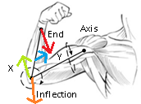
Body Motion: Calculation Inverse Dynamics Model
Physics for the forearm (wrist joint)
Force of hand onto wrist (red)
Motion of forearm (blue)
Motion of upper arm (green)
Torque from bicep about elbow
Force from elbow’s parent (orange)

Slide 23
Body Motion: Stabilization Multi-Joint Voting and Smoothing
Traditional physics software uses large matrix inversion
Whole body shakes from any noise. Tricky to tune to ST.
Ideal method would be to estimate noise response as input resolution * derivative of physics function. Not easy.
Inferred force provide built-in stabilization
Motions seen across multiple joints will be transferred well up the chain as they appear as external rather than internal forces
Forces are “lossy” aggregation (err towards not moving—that is, smooth), which tends to iron them out over time.

Slide 24
Body Motion: Normalization Kinesthetic Weight
Body Forces can be normalized by their weight
A limb’s weight (its mass*gravity) provides a force that feels “normal” and is shared across bodies
Has proven to work well across a number of body types
Mass estimate is not accurate, but Cancels out!
Because we divide out the mass to get normalized values, the error of the mass estimate is considerably less
Muscle alignment inferred from positions and motion
Trivial to transform forces into muscle space, and pass through the extension response curve to estimate muscle reflex

Slide 25
Body Motion: Visualization Debugging with Cartoons
Key to calculating/testing/using physics is getting it into a human consumable form!
Why not try drawing a cartoon of the player?
If the cartoon looks right, you’ve got something; otherwise, it will enable you to spot physics bugs perceptually
If users can see what they want in the cartoon, they have an easier input selection mechanism

Slide 26
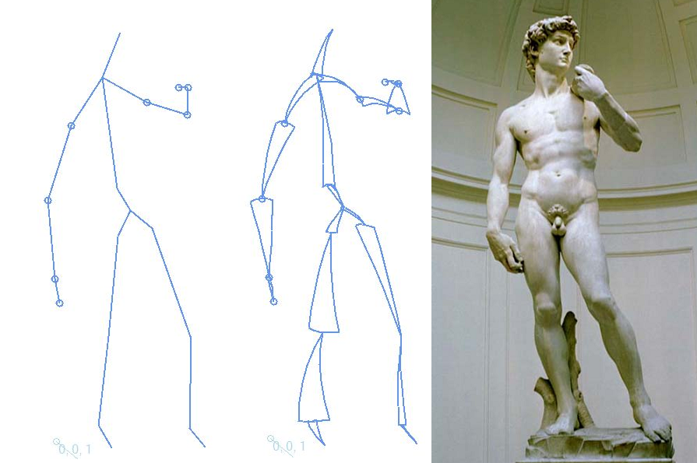
Body Motion: Visualization
Diagram composed of Bézier patches between joints
Patch Width =
Bone_length * golden_ratio * normalized_external_force
Patch Curvature =
Bone_length * golden_ratio * normalized_external_torque
Patch Direction =
Width = 0 on the end with the least amount of un-normalized force

Slide 27
Body Motion: Into the Game
Examples of using body physics to drive animation:
Weight shifting – foot forces to drive left/right, push and landing
Sword swinging – with prep, power trigger, and stop triggers
Dashing – when 1.5x body weight is applied to foot
Swimming – best when scaled to the response on the pectoral muscles
“What You Feel is What You Get” Gameplay
But to what end are these inputs going?
How do you know they are the right ones?

Slide 28
Controls: Spatial Metaphors
Every mode we have utilizes a “spatial metaphor”
Bike racing = your hands control the handles/throttles
Sword = your hand controls the sword
Boxing = hands control heavy weight hands
It is the mathematical and design kernel of the mode
Combines the design and artistic intent with the interaction
Quantifies good and bad response

Slide 29
Controls: Spatial Metaphors
World Space
Player’s View
Screen
Sensor
A spatial metaphor contains of a set of related points
Ex: Head, hands, feet
Each point exists in multiple spaces
Player space, screen space, world space, sensor space.
Metaphor strives to achieve spatial alignment and harmony
Hands appear above feet, to side of head, etc.
Draw line from real to virtual points in your eyes view!

Slide 30
Controls: Spatial Metaphors Implementation
Generally achieved by “tuning until it feels right”
Sad but true
Most importantly, make sure the core metaphor is a known design element that is agreed upon
Ideally start by tracking all core transforms
Sensor → skeleton → avatar → world → screen → sensor
Solve for identify matrix to achieve
Best example is work with camera composition…

Slide 31
Cinematography: Acting to the Camera
The avatar is at absolute most 30% of the screen… what about the other stuff?
Movies utilize strong visual themes, can these be captured?
Can this align with the interaction spatial metaphors?
Cinematography lets you directly back-solve for:
“The optimal camera to align the sensor with the virtual world, through the screen, with respect to the player.”
We broke cinematography into three core components
Composition / Relative Position / Motion

Slide 32
Cinematography: Core Analogies
Composition: Player’s physical line of action must perceptually flow into the golden composition.
Relation: Screen’s comparative composition must change consistently with the perceived composition.
Motion: Motion timing should analogize the physical focus and basis with the camera focus and frame.

Slide 33
Is it Tunable in the First Place?
Q: How do you “tune” your players’ actions?
A: Use real-world references + solid metaphors
Racing poses are from ballet poses
Combat pacing is largely pulled from exercise routines
Warm-ups are pulled from karate and yoga books
Sculpture and posture define good poses and motions
Acting says what these poses and motions mean! (that is, what they make the player feel and think experientially)

Slide 34
Closing Thoughts
Interactive entertainment is a full sensory experience:
What your actors show
What your screen shows
How your game responds
Most importantly: what the player feels!
That is Interactive Storytelling… Learn by Doing!

Slide 35
Q & A
Thanks to everyone at:
Microsoft IEB Studios
Terminal Reality, Inc.
LucasArts
Special thanks to:
Seth Hawkins
David Brickhill
Romesh Prakashpalan
Many others…

