Slide 1
PROJECT WORK
COURSE | PROGRAMME | DEGREE
 | BATCH | 21
 | SEMESTER | VIII
PROJECT BATCH DETAILS | REGISTER NUMBER | 14171055098, 14171055107, 15173055119
 | CANDIDATE NAME | Lewis Wanjara Masatu Halima Bongi Jackson Linus
 | PROJECT NUMBER | PRN
VIVA VOCE SCHEDULE | DATE OF VIVA VOCE | 18 April 2018
 | PROJECT REVIEW | 0

Slide 2
PROJECT WORK
PROJECT DETAILS | PROJECT TITLE | 1.BIOMETRIC ATTENDANCE INTERGRATED SYSTEM TROUGH WIRELESS
GUIDES | INTERNAL GUIDE | Dr V.S. Manjula
 | EXTERNAL GUIDE

Slide 3
BIOMETRIC ATTENDANCE INTERGRATED SYSTEM TROUGH WIRELESS

Slide 4

On this project attendance is taken through Biometric device which validate officers who attended according to the time they arrived and the information are stored in the database a including the leaving and arriving time, and the finger prints will be stored in the database for validating the user each time he/she arrives at the office. The android application will be taking details and storing them into the database and performing logics and determine the average attendance of the officers, there will be two parts of the system, first part will be of the administrator and the second part of the user. Biometric device will be used in both of the parts(Admin and User). Registering the officers will be done by the admin where by Information including fingerprints will be done in the administration, and the users will be able to validate their fingerprints through the biometric device.

Slide 5
EXISTING SYSTEM
Currently this system is used on different companies but the system is only depending on the system that is installed within the company database system which works within the company premises.

Slide 6
Drawbacks of the existing system
Expensiveness of the project implementation.
Time consuming.
Wired connection oriented.

Slide 7
PROPOSED SYSTEM
This system will be able to enable the signing of the attendance and this will make easier and save time. This system is proposed because the existing system does not use wires connection and this system will be using wireless

Slide 8
Advantages of proposed system
Time management since you don’t have to go to the place where the biometric device is located for authentication.
Efficient and faster means of attendance authentication.
Portability since it is based on smartphone and wireless network.

Slide 9
HARDWARE REQUIREMENTS
1gb of RAM
Biometric scanner
556 MHz Processor
Android Device

Slide 10
SOFTWARE REQUIREMENTS
Front end
Java
UI kit
Angular4
Back end.
Django Framework
MySQL
Regular Expression

Slide 11
SOFTWARE REQUIREMENTS
OPERATING SYSTEM:
Windows 10
DEVELOPING TOOLS:
Pycharm

Slide 12
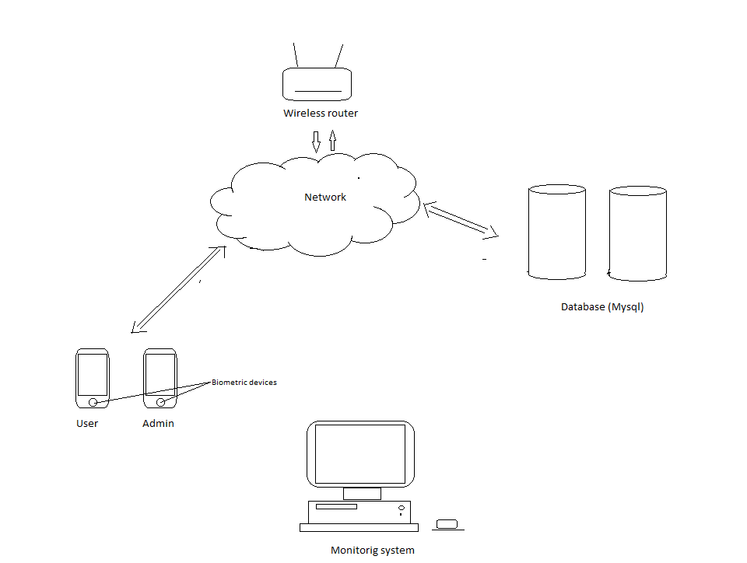
Architecture diagram

Slide 13
MODULES
Admin Interface
User Interface
System Backend
API development

Slide 14
PHASE II

Slide 15
Application programming Interface
Application programming Interface is used to interact between the application to exchange data between the applications.
For our project we used Django Rest Framework to perform CRUD operations which includes both CREATE, RETRIEVE, UPDATE and DELETE

Slide 16
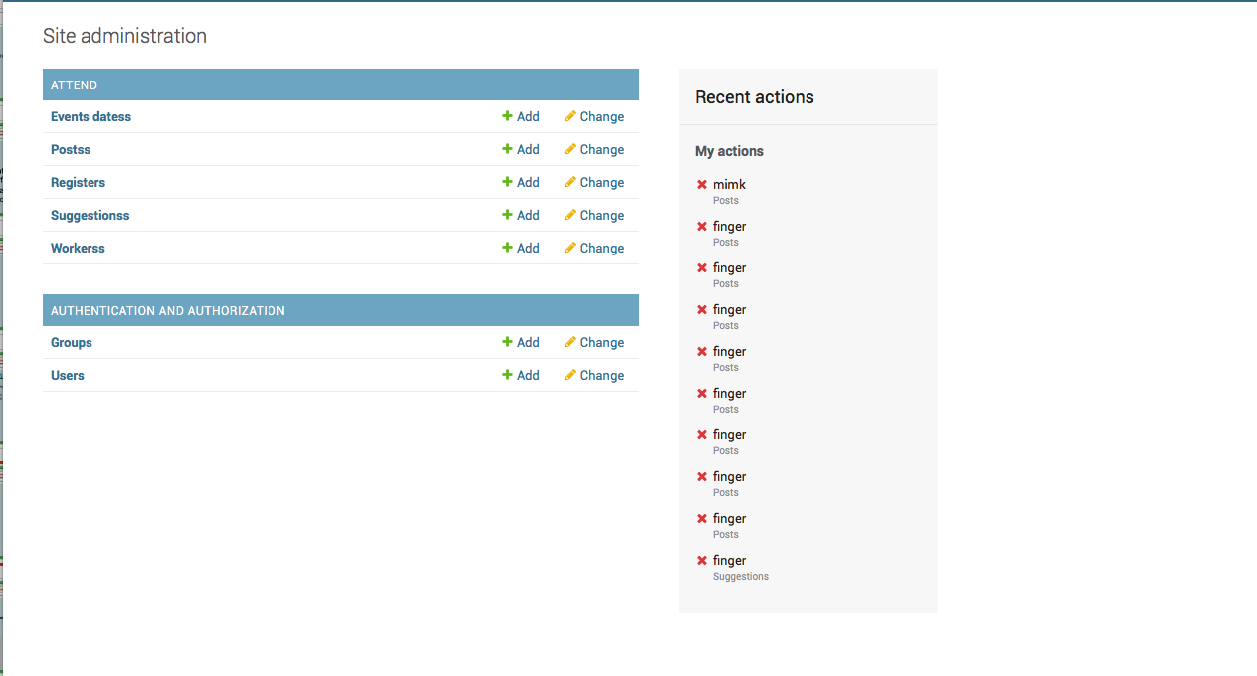
Database Interface

