Slide 1
E-Learning Platform Database
by
Lewis Tanguhwar
Oct, 2025

Slide 2
Project Objectives
Objective: To design, build, and optimize a robust database for a modern e-learning platform using MongoDB.
Key Focus Areas:
Data Modeling and Schema Design
Efficient Data Population
Advanced Queries and Aggregation for Analytics
Performance Optimization through Indexing
Data Validation and Error Handling

Slide 3
Schema Design & Data Modeling
Key Collections:
users: Stores students & instructors.
courses: Details on each course, including embedded lessons.
enrollments: Links students to courses, tracks progress.
assignments & submissions: Manages course work and grades.

Slide 4
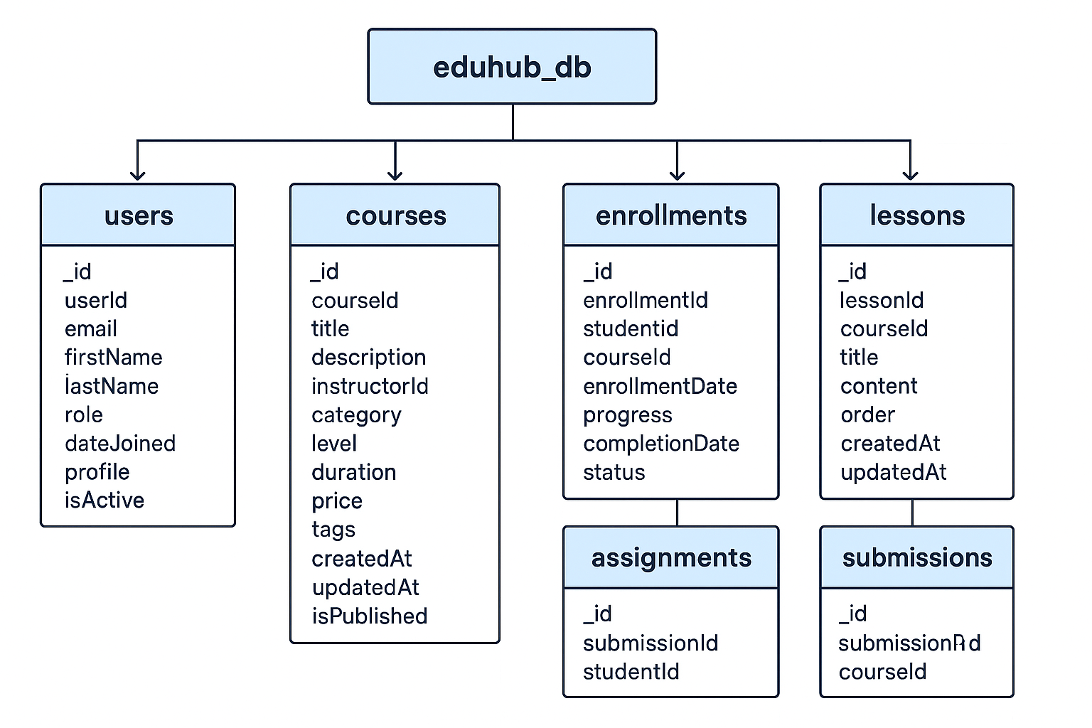

Slide 5
Data Population & Foundation
Methodology:
Used a Python script with PyMongo to programmatically insert a
large volume of realistic, dummy data.
Data Points:
20 Users (15 students, 5 instructors)
8 Courses with embedded lessons
15 Enrollments, 12 Assignments & Submissions

Slide 6
Performance Optimization with Indexing
Problem: Without indexes, MongoDB performs a "collection scan,"
which is slow and inefficient.
Solution: Created indexes on frequently queried fields to enable faster lookups.
Showcase Results:
users.email (Unique Index): Found users 90x+ faster.
courses.title & category (Compound Index): Found courses 90x+ faster.
enrollments.student_id & course_id (Compound Index): Found enrollments 90x+ faster.

Slide 7
Actionable Analytics with Aggregation
Key Metrics:
Most Popular Courses: Ranked courses by total enrollments.
Top-Performing Students: Identified students with the highest
average assignment grades.
Completion Rates: Calculated the percentage of students
completing each course.
Value: These reports provides actionable data for marketing,
student support, and content development teams.

Slide 8
Data Validation & Error Handling
Problem: Unvalidated data can lead to corrupted and unreliable results.
Solution: Implemented robust Python-based validation rules.
Error Handling:
Required Fields: Prevented insertions with missing information.
Data Types: Rejected documents with incorrect data types (e.g., a string for a number).
Unique Constraints: Handled and prevented duplicate instructorEmail entries using a unique index.

Slide 9
Conclusion & Key Learnings
Summary: The project successfully demonstrates how MongoDB can be used to build a robust, scalable, and high-performing database for an e-learning platform.
Key Learning: Combining good schema design with indexing and powerful analytics tools is essential for a successful data-driven application.
Scalability Prospects:
Develop an API to connect the database to a front-end application.
Integrate real-time analytics for live student engagement tracking.

