Slide 1

Milestone Presentation

Slide 2
end food waste. locally.
40% of all food grown in America is wasted. Meanwhile, 1 in 7 Americans are food insecure. My Neighbor’s Kitchen tackles food waste at the source: local communities. Instead of throwing out excess food, make it available to hungry people around you. Don’t go hungry when you can leverage the resource you have just a few feet away - the kitchen next door.

Slide 3
Outline
Heuristic Evaluation Results
Revised Design
Prototype Status
Demo

Slide 4
Heuristic Evaluation Results: Post
Post page:
Make it one scrolling form
Need positive reinforcement: “Congrats your meal was posted!” and shows you your personal success → popup modeled after Uber
Keep Post/Cancel buttons fixed position
Lack of confirmation that the food was posted

Slide 5
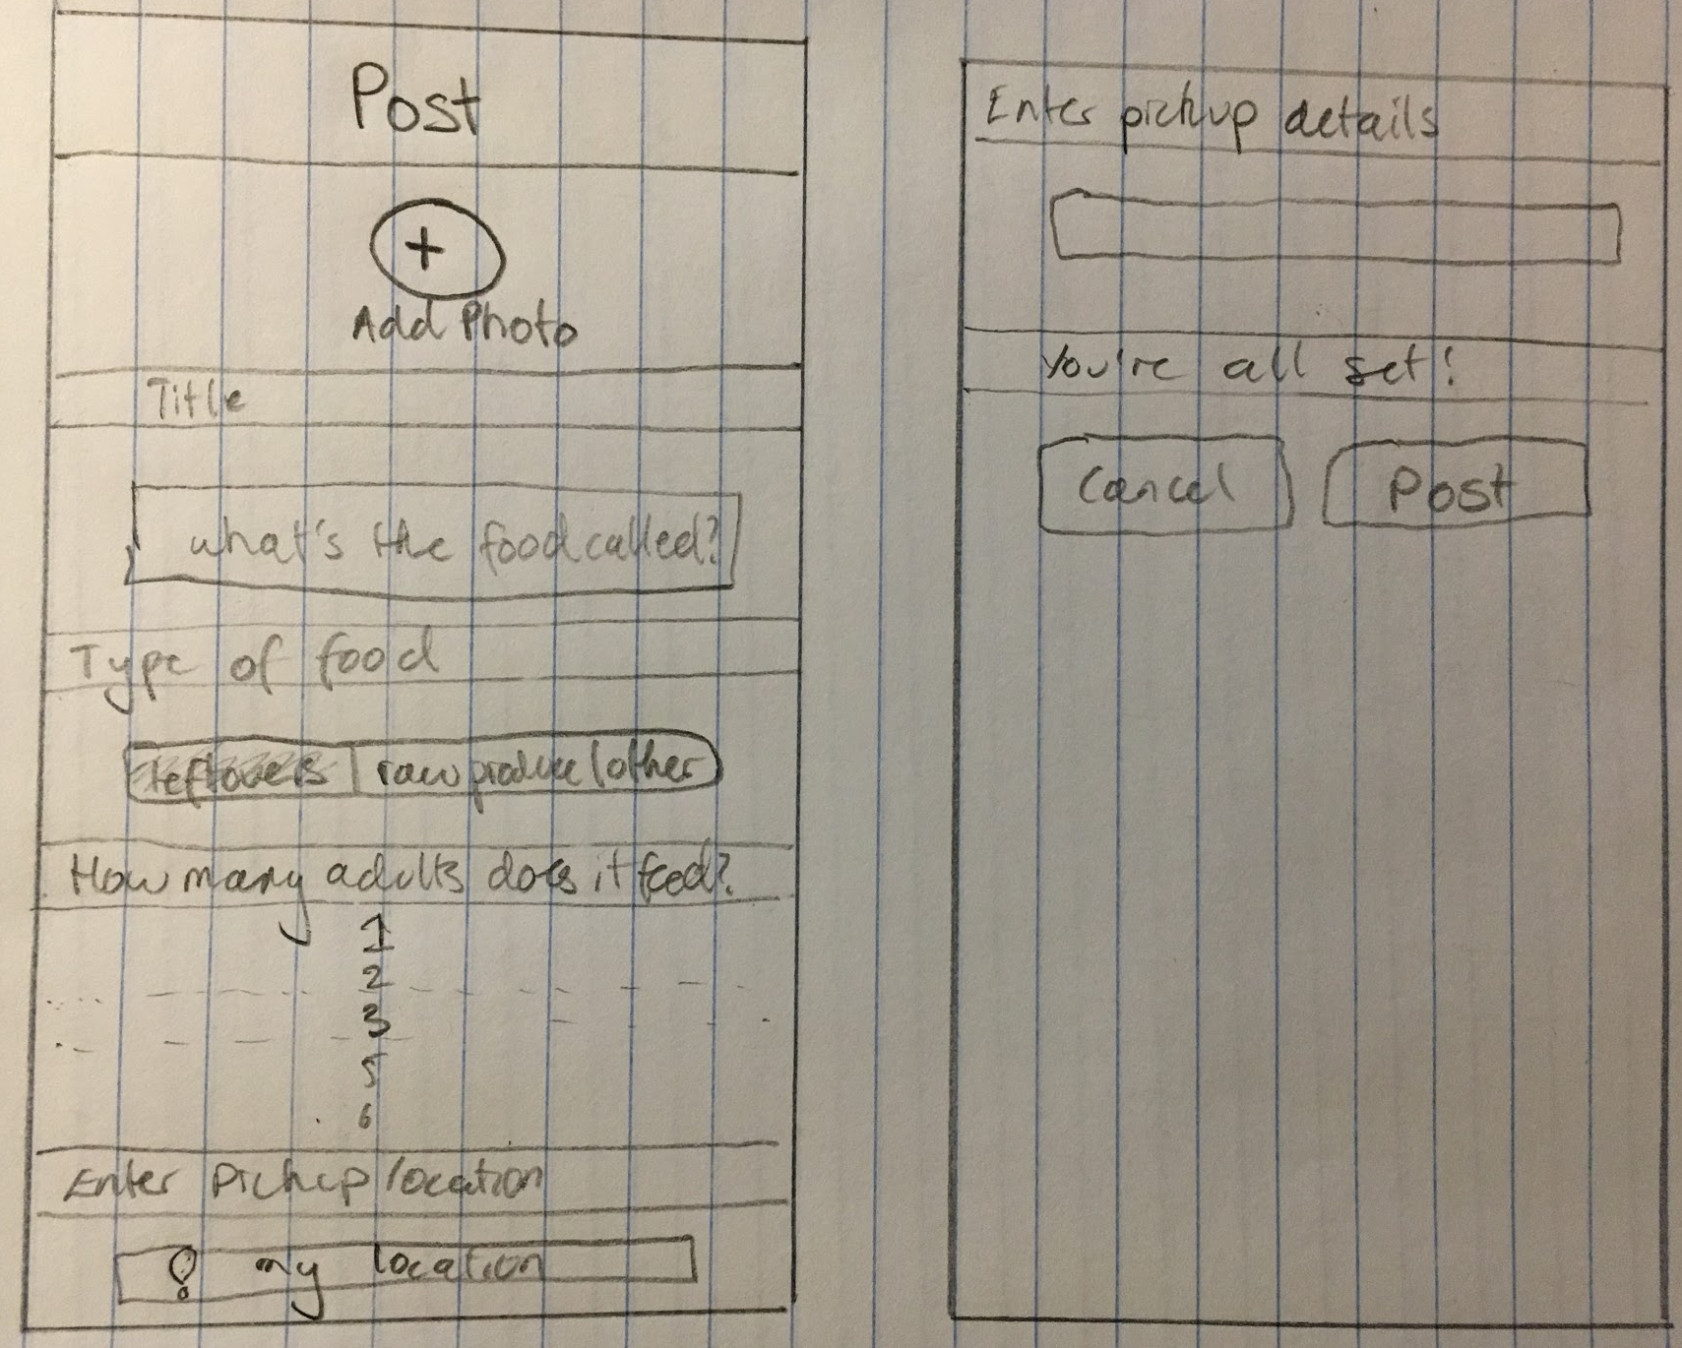
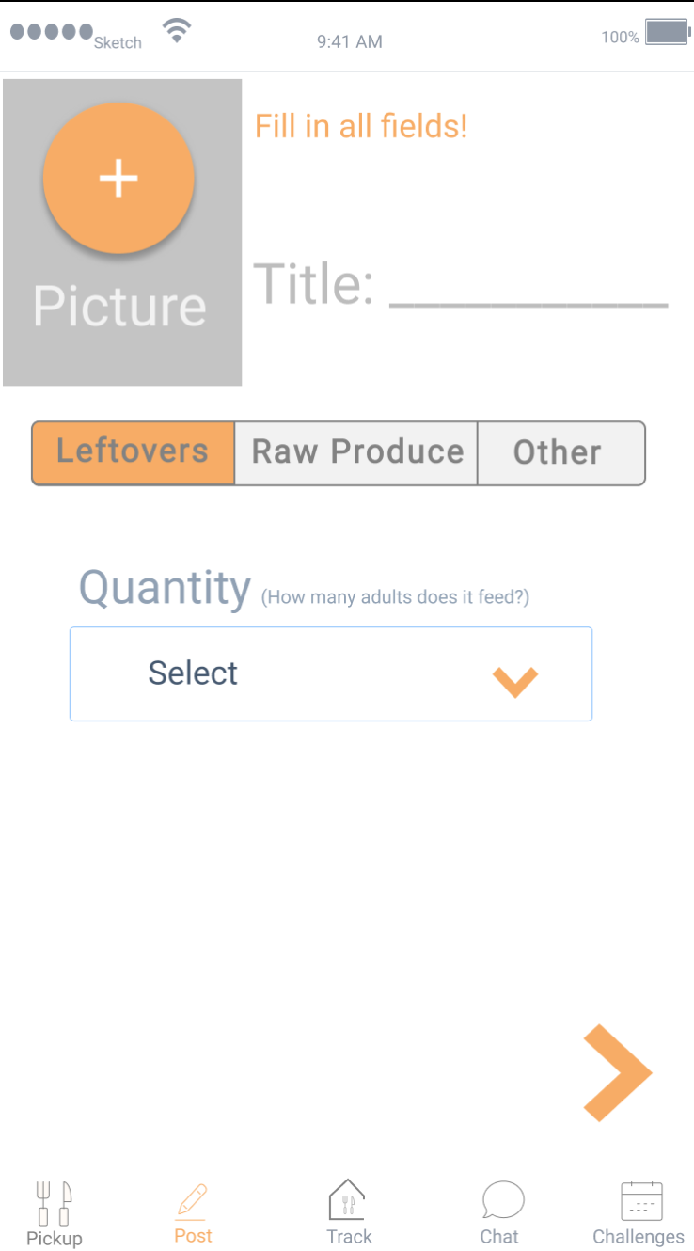
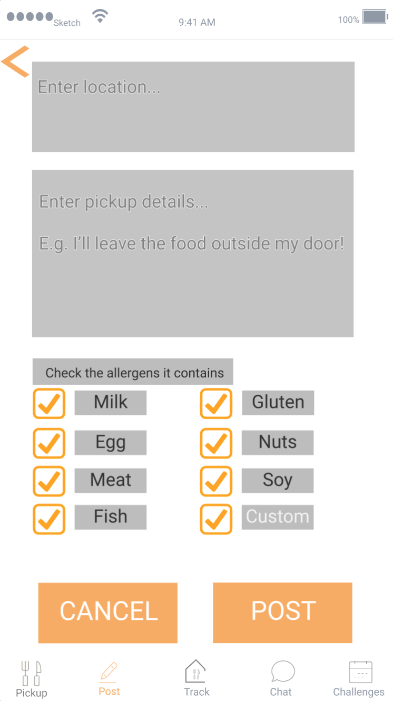
Revised Design: Post

Slide 6
Heuristic Evaluation Results: Chat
Chat page:
Food item needs to be linked in the conversation thumbnail
Image on the left, name and food title
Automatically generate chat when someone claims your food

Slide 7
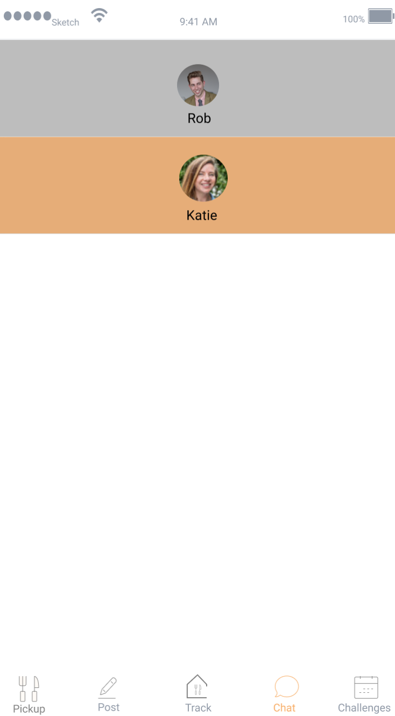
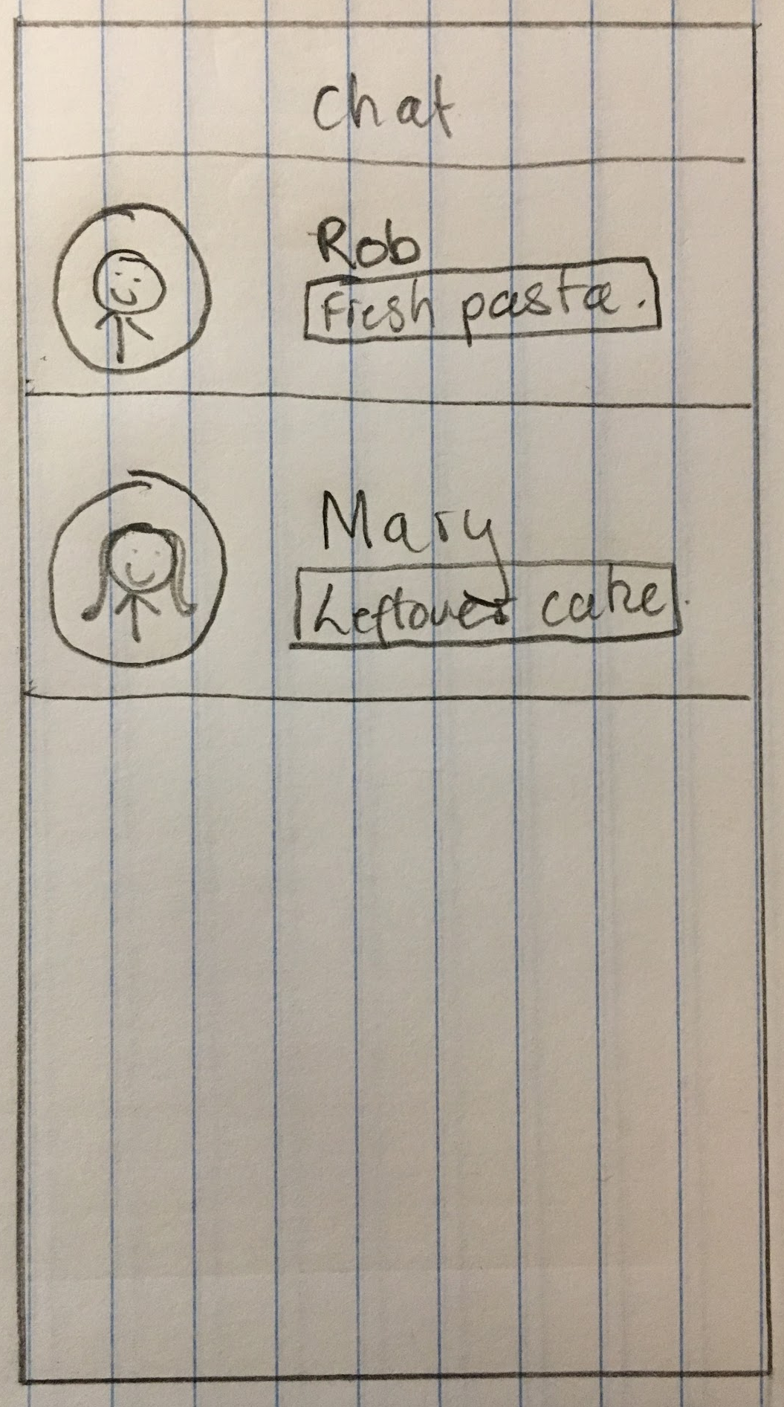
Revised Design: Chat

Slide 8
Heuristic Evaluation Results: My Meals
My Meals page (formerly Track):
Users were confused between posted and picked up items
Need ability to edit/remove a posted item
Need a way to unclaim an item
Toggle between my orders and my posts
Most recent at top (i.e. this order in progress)
Need an ‘unclaim’ button

Slide 9
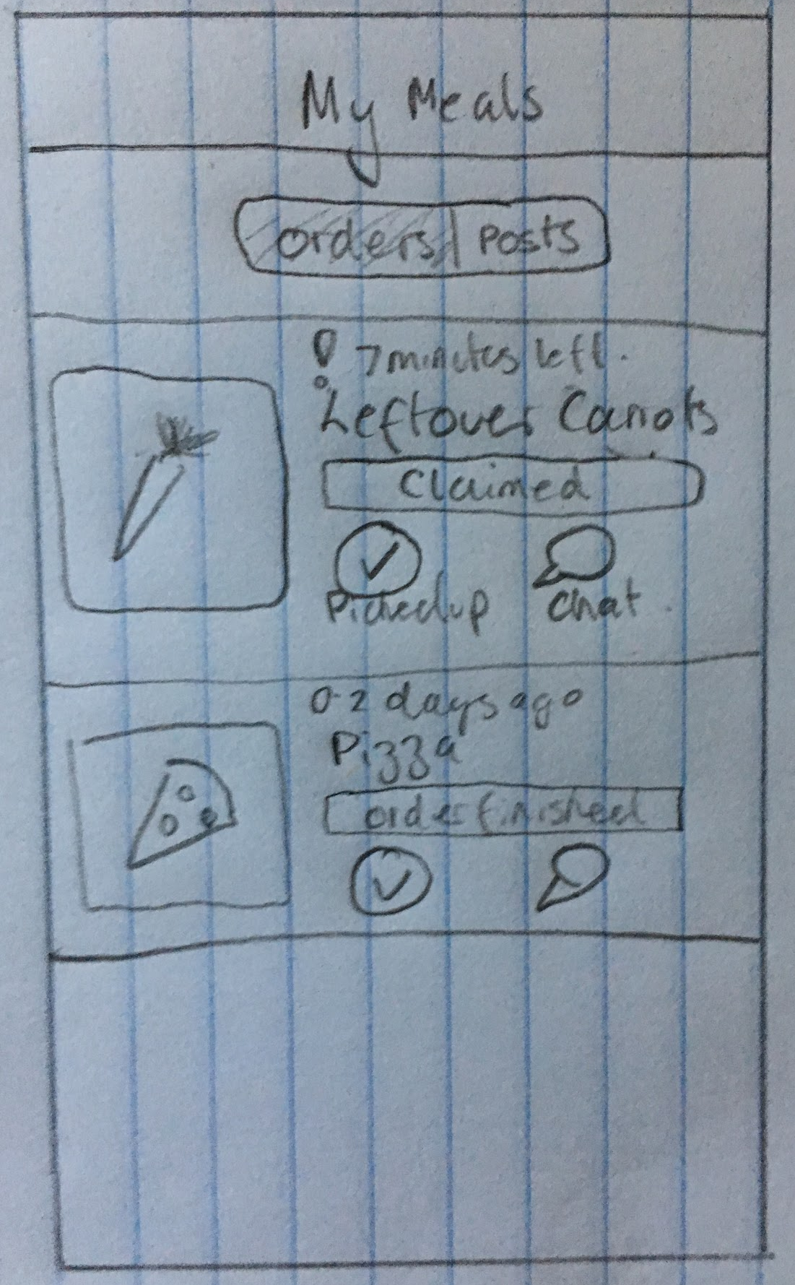
Revised Design: My Meals

Slide 10
Heuristic Evaluation Results: Impact
Impact Page (formerly ‘Challenges’):
Purpose of ‘challenges’ is currently unclear
Moving from ‘events’ to ‘impact statistics’
Format: name and progress bar on separate lines to reduce clutter
Push notifications once you join a challenge
Start and end date
Needs to be more interactive and action-oriented i.e. prompt the user rather than displaying static page
Explain rules to new users
Create a personal challenge that is ongoing for you to track your stats

Slide 11
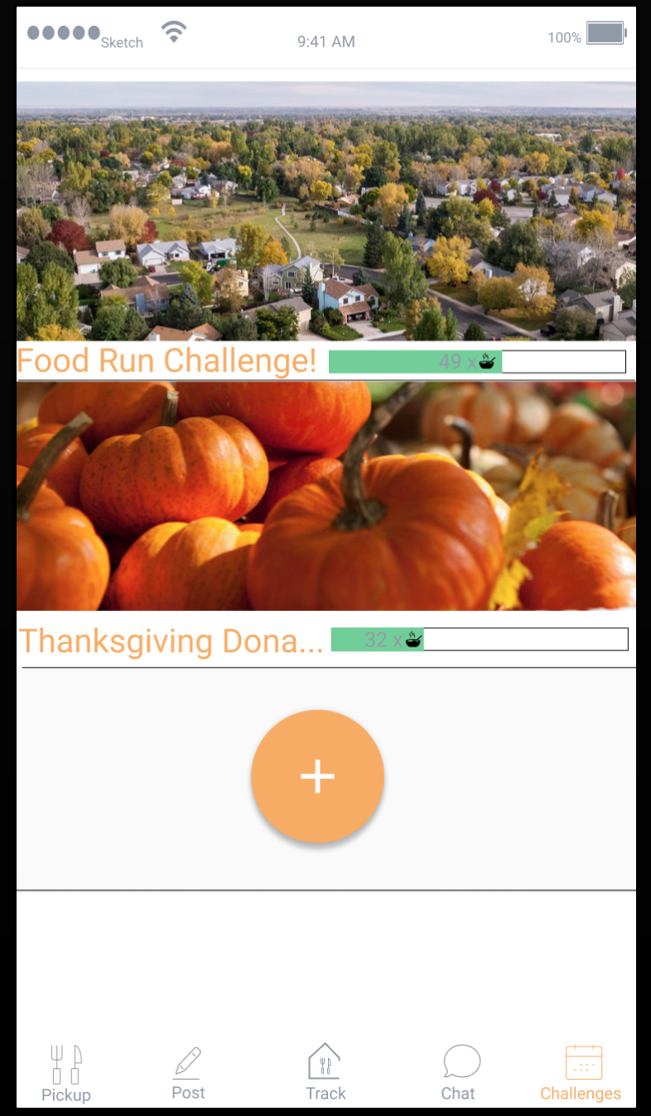
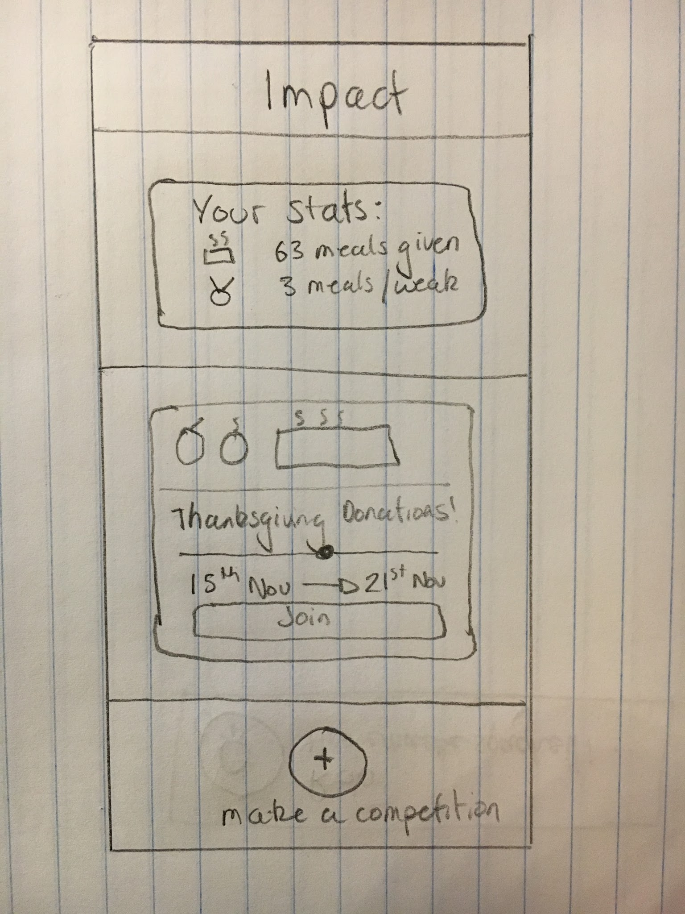
Revised Design: Impact

Slide 12
Prototype Status
Using Exponent XDE and React Native
Implemented:
Navigation between tabs
Map interface for pickup
Post form

Slide 13
Prototype Status
Unimplemented:
Impact page
Chat page
My Meals page
Pickup list functionality

Slide 14
Prototype Status
Monday 12/5:
Pickup list functionality
Chat page
My Meals page
Thursday 12/8:
Impact page
Aesthetic touches

Slide 15
Prototype Status
Wizard of Oz:
Hard-coded chat system
No registration system
Fake accounts for neighbors in challenges
Can’t actually save pictures from the camera

Slide 16
Prototype Status
Hard Coded Data:
Pre-set data for available food to pick up
Pre-set data for addresses
Chat responses

Slide 17
Summary
Overall, the Heuristic Evaluation results gave us important ideas in improving our design. We have made interface changes that allow for a smoother workflow and have strived to remove confusing aspects of every task.. So far, we have implemented the “Post” task of our Exponent App, and in the coming days, will be implementing the “Pickup,” “My Meals,” “Impact,” and “Chat” functionalities.

Slide 18
Questions + Comments?

