Slide 1

End food waste - locally.
40% of all food grown in America is wasted, while 1 in 7 Americans are food insecure. My Neighbor’s Kitchen tackles this problem of food waste on the scale of the local community. Instead of throwing out excess food, we want you to make it available for others around you, and instead of going hungry, we want you to leverage the resource you have just a few feet away - the kitchen next door.

Slide 2




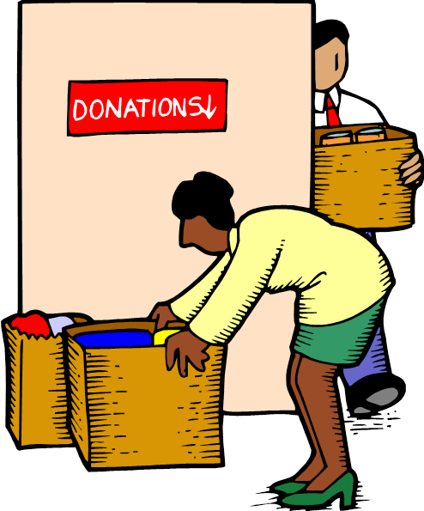
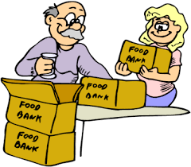
“Over the past few days, I realized I have so many extra groceries and leftover meals in the fridge. Now we’re going on a family trip for a week. I want to not waste all this excess food!”
Simple
“I just got back from work and don’t want to cook! I literally want to make the least effort to grab food from around me right now!” Or… “I quickly need a few food supplies to make dinner for family.”
Medium
I’m a retired citizen looking for a way to give back! I want to find something good I can do for my community. Or.. “I’m a high schooler who wants to volunteer but only have small chunks of time throughout the day - I want to find something meaningful to do right now!!
Complex

Slide 3
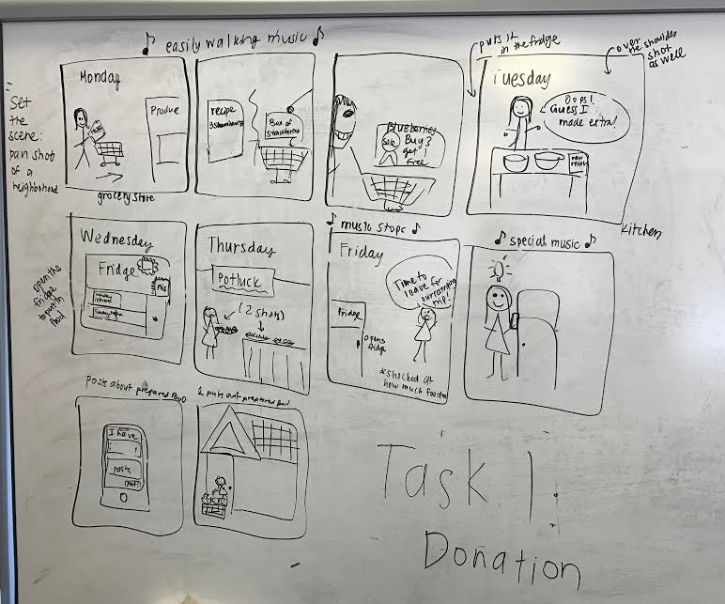
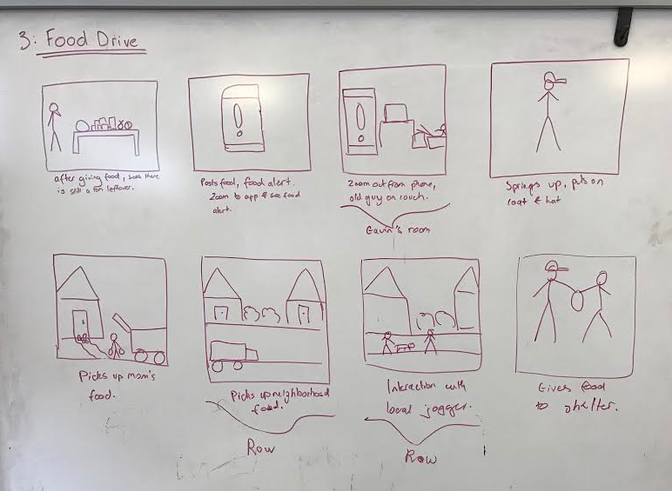
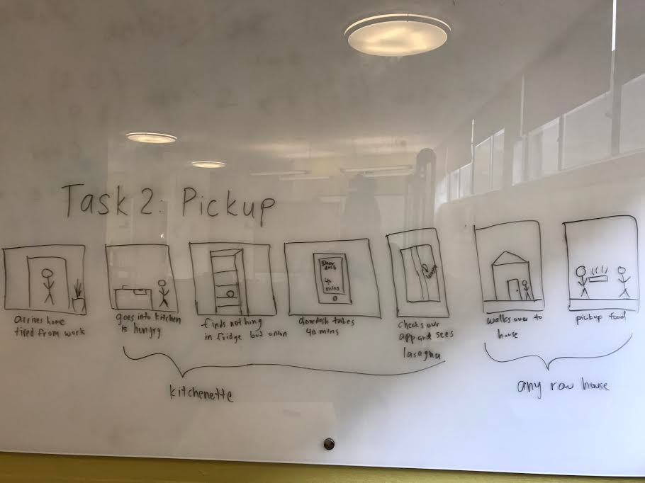
Task 1
Task 3
Task 2

