Slide 1


Slide 2
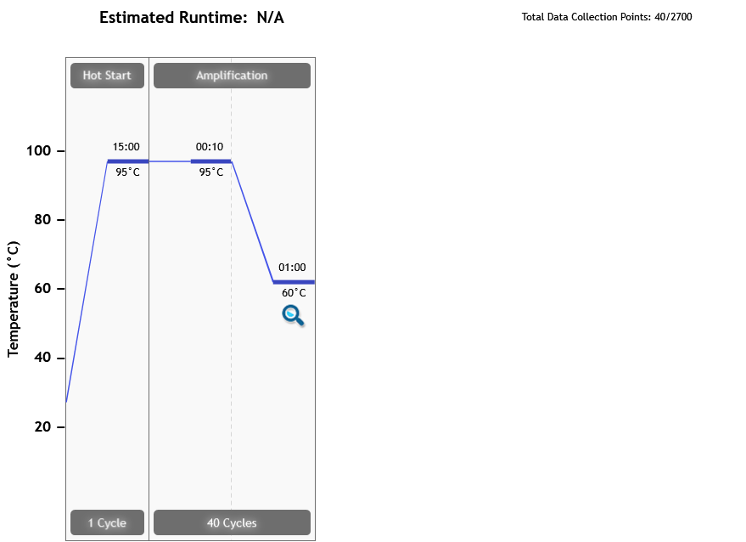
Thermal Profile
Page 2 of 8

Slide 3
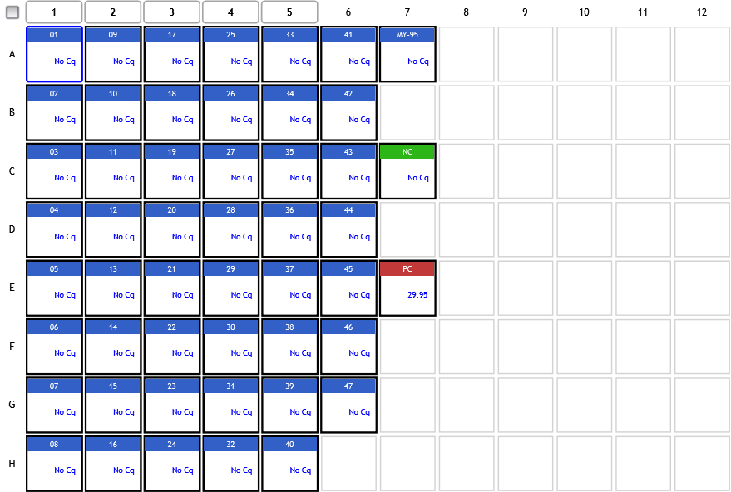
Analysis Criteria
Page 3 of 8

Slide 4
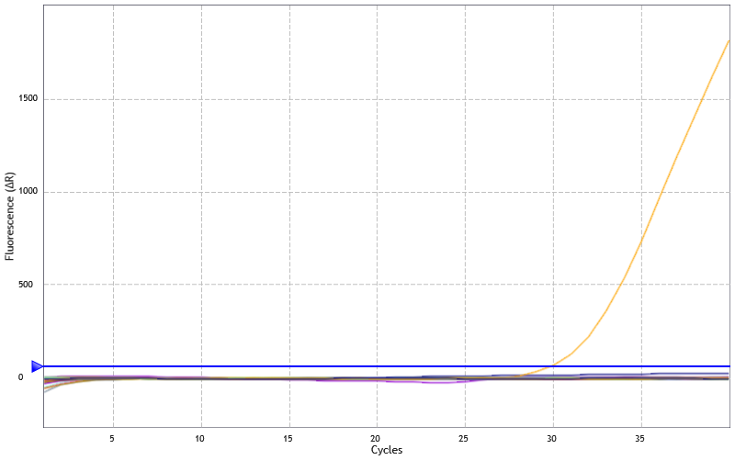
Amplification Plots
Threshold settings based on background: Start cycle = 5, End cycle = 9,
Sigma multiplier = 10, Baseline correction = Adaptive, Smoothing = On,
Crosstalk Correction: -
Page 4 of 8

Slide 5
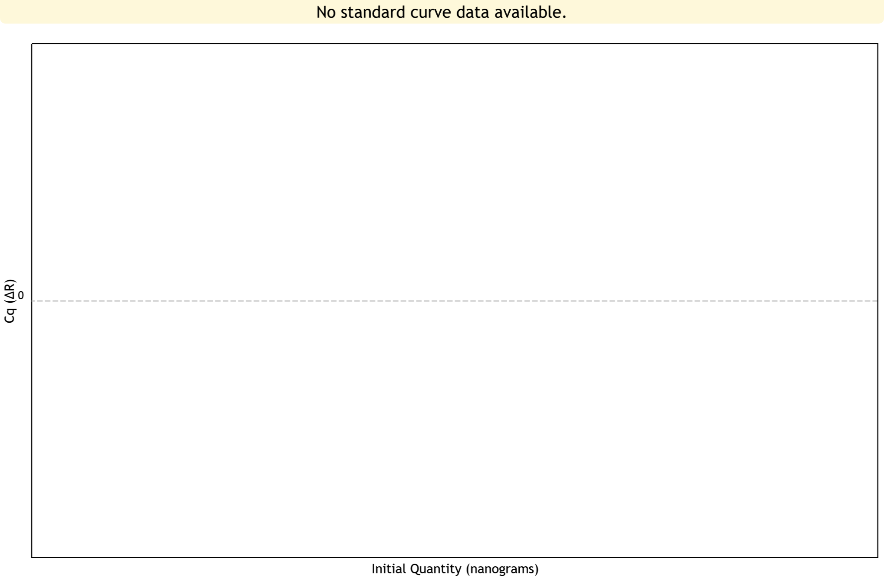
Standard Curve Plots
Confidence Level = Disabled
Page 5 of 8

Slide 6
Tabular Results (1 of 3)
Well | Well Name | Target | Cq (∆R) | Final Call (∆R)
A1 | 01 | vivax | No Cq | -
A2 | 09 | vivax | No Cq | -
A3 | 17 | vivax | No Cq | -
A4 | 25 | vivax | No Cq | -
A5 | 33 | vivax | No Cq | -
A6 | 41 | vivax | No Cq | -
A7 | MY-95 | vivax | No Cq | -
B1 | 02 | vivax | No Cq | -
B2 | 10 | vivax | No Cq | -
B3 | 18 | vivax | No Cq | -
B4 | 26 | vivax | No Cq | -
B5 | 34 | vivax | No Cq | -
B6 | 42 | vivax | No Cq | -
C1 | 03 | vivax | No Cq | -
C2 | 11 | vivax | No Cq | -
C3 | 19 | vivax | No Cq | -
C4 | 27 | vivax | No Cq | -
C5 | 35 | vivax | No Cq | -
C6 | 43 | vivax | No Cq | -
C7 | NC | vivax | No Cq | -
D1 | 04 | vivax | No Cq | -
D2 | 12 | vivax | No Cq | -
D3 | 20 | vivax | No Cq | -
D4 | 28 | vivax | No Cq | -
Page 6 of 8

Slide 7
Tabular Results (2 of 3)
Well | Well Name | Target | Cq (∆R) | Final Call (∆R)
D5 | 36 | vivax | No Cq | -
D6 | 44 | vivax | No Cq | -
E1 | 05 | vivax | No Cq | -
E2 | 13 | vivax | No Cq | -
E3 | 21 | vivax | No Cq | -
E4 | 29 | vivax | No Cq | -
E5 | 37 | vivax | No Cq | -
E6 | 45 | vivax | No Cq | -
E7 | PC | vivax | 29.95 | +
F1 | 06 | vivax | No Cq | -
F2 | 14 | vivax | No Cq | -
F3 | 22 | vivax | No Cq | -
F4 | 30 | vivax | No Cq | -
F5 | 38 | vivax | No Cq | -
F6 | 46 | vivax | No Cq | -
G1 | 07 | vivax | No Cq | -
G2 | 15 | vivax | No Cq | -
G3 | 23 | vivax | No Cq | -
G4 | 31 | vivax | No Cq | -
G5 | 39 | vivax | No Cq | -
G6 | 47 | vivax | No Cq | -
H1 | 08 | vivax | No Cq | -
H2 | 16 | vivax | No Cq | -
H3 | 24 | vivax | No Cq | -
Page 7 of 8

Slide 8
Tabular Results (3 of 3)
Well | Well Name | Target | Cq (∆R) | Final Call (∆R)
H4 | 32 | vivax | No Cq | -
H5 | 40 | vivax | No Cq | -
Page 8 of 8

