Slide 1
Introduction to viral genomics
Monday 25th March, 2024
KEMRI

Slide 2
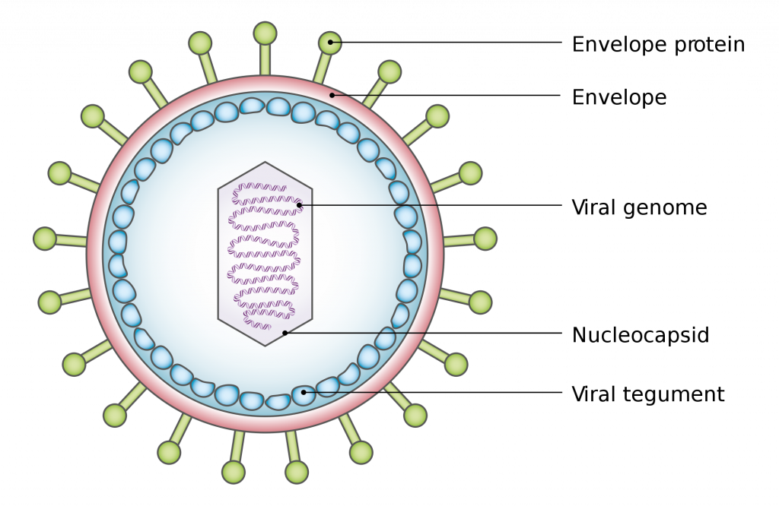
General viral characteristics
Metabolically inert; cannot make energy
Obligate intracellular parasites
Multiply inside living host cells using cell machinery
They consist of nucleic acid covered by a protein coat called capsid
Some viruses have envelopes outside the capsid
Caspid without the envelope is called naked virus e.g Fusaviridae

Slide 3
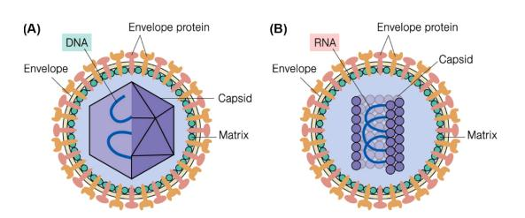
Viral Genomics
It is the study of the complete genetic material (genome) of viruses.
Viral genomics helps us understand how viruses evolve, how they are transmitted, and how they cause diseases, leading to better prevention and control strategies.
Study of viral genomes involves analyzing genes, proteins, regulatory elements, and non-coding regions.
Examples: Different viruses have distinct genome structures, such as DNA viruses (e.g., herpesvirus) and RNA viruses (e.g., SARS CoV-2 virus).

Slide 4
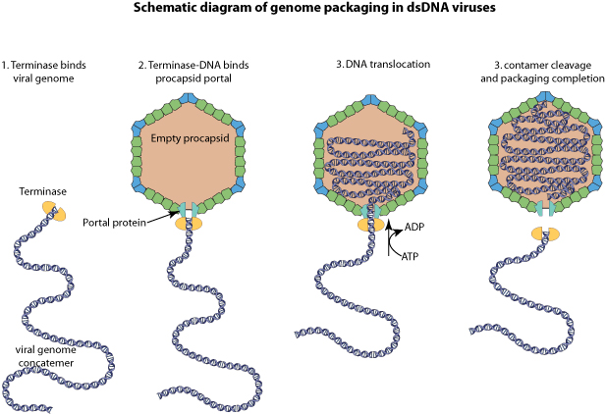
Overview of Viral Genome Structure
Viruses can have DNA genomes (single-stranded or double-stranded) or RNA genomes (positive-sense, negative-sense, or segmented).
Viral genomes contain genetic information necessary for viral replication, transcription, translation, and assembly.
They can range from a few thousand base pairs (e.g., parvovirus) to hundreds of thousands of base pairs (e.g., poxvirus).
Viruses exhibit high mutation rates, leading to genetic diversity and the emergence of new variants.

Slide 5
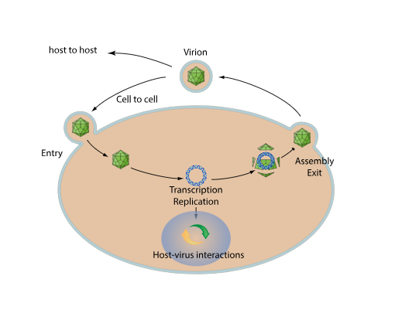
Viral replication
Release of virions from an infected cell to allow cell-to-cell spread of virus.
Once assembled at the replication site, viral particles can be released by budding, exocytosis, extrusion or host cell lysis.
Some viruses also mediate direct transport of their viral genome to adjacent cells thanks to movement proteins.

Slide 6
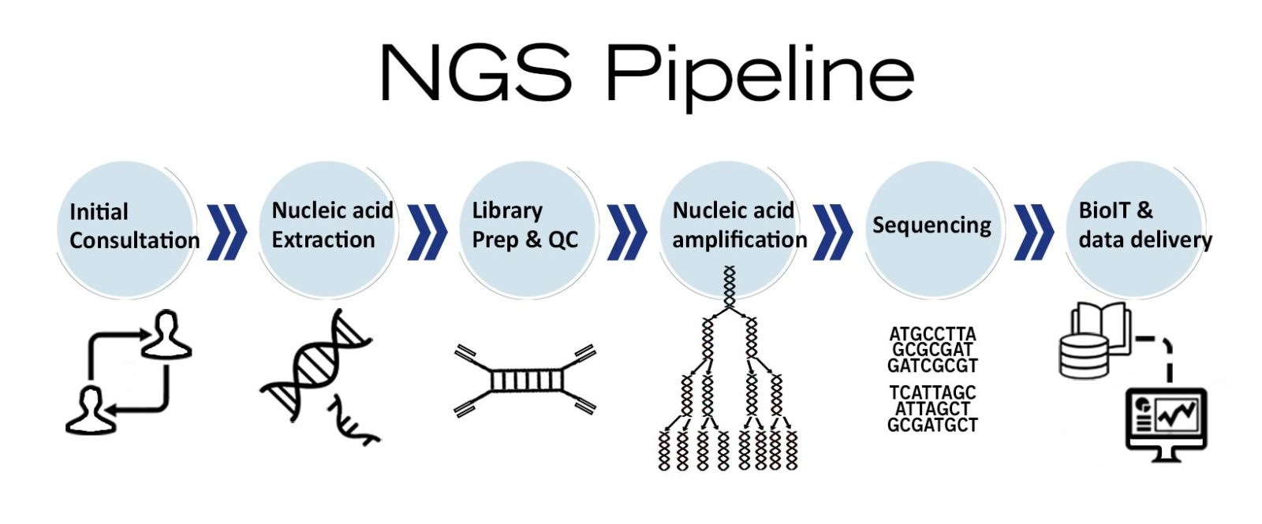
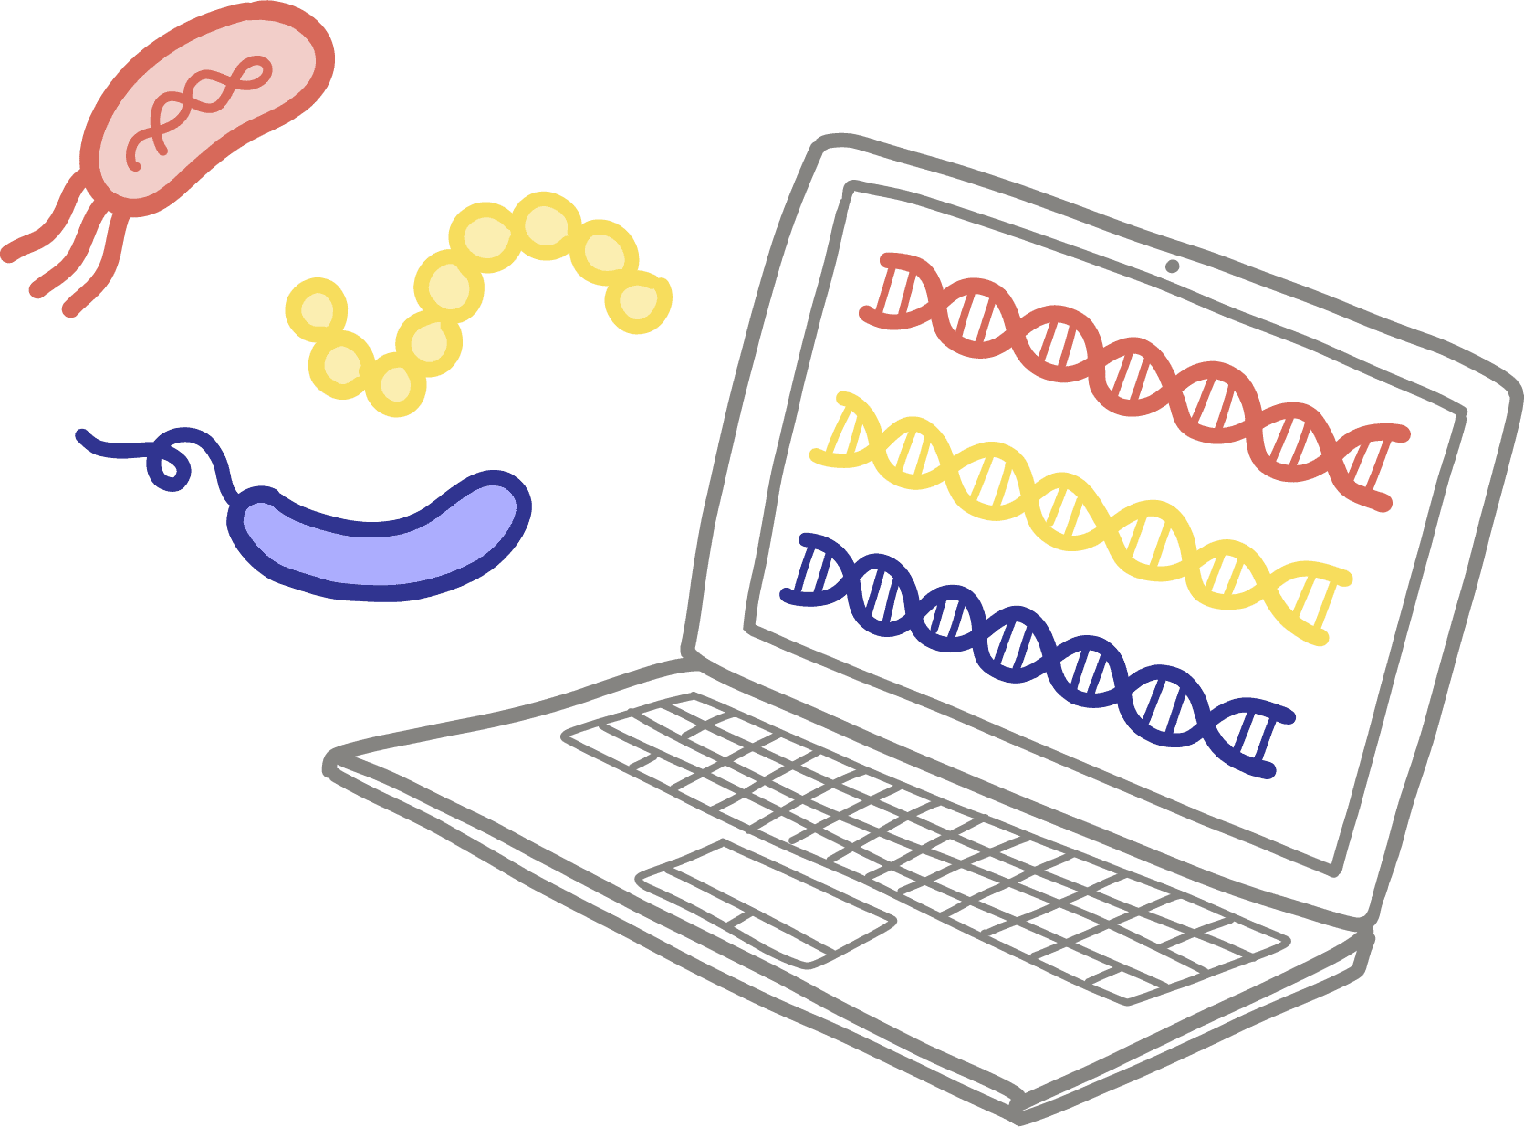
Techniques in Viral Genomics
Polymerase Chain Reaction (PCR): Used for amplifying specific viral DNA or RNA sequences, enabling detection and characterization of viruses.
Next-Generation Sequencing (NGS): Allows high-throughput sequencing of viral genomes, facilitating comprehensive genomic analysis and variant detection.
Metagenomics: Enables the study of viral communities in complex environments (e.g., clinical samples, environmental samples) without prior knowledge of specific viruses.
Bioinformatics tools: Computational tools and algorithms are used for genome assembly, annotation, phylogenetic analysis, and identification of genetic variations.
These techniques are essential for viral diagnosis, surveillance, epidemiological studies, and vaccine development.

Slide 7


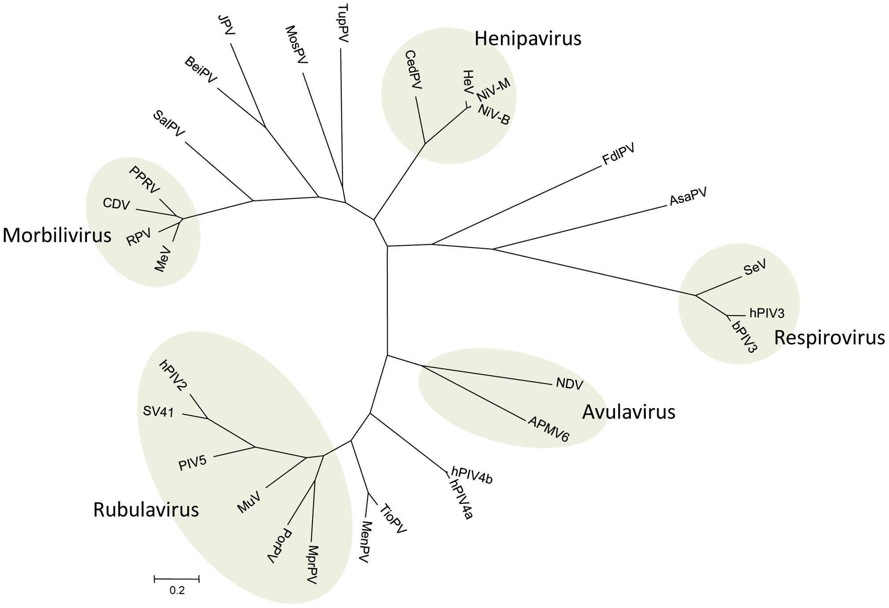
Applications of Viral Genomics
Epidemiological surveillance: Genomic data used to track viral spread, identify transmission clusters, and monitor changes in viral populations over time.
Vaccine development: Understanding viral genomes helps design effective vaccines by targeting conserved regions or antigens that induce protective immune responses.
Drug discovery: Genomic analysis guides the development of antiviral drugs targeting viral enzymes, replication processes, or host-virus interactions.
Evolutionary studies: Viral genomics provides insights into viral evolution, including the emergence of drug-resistant strains, zoonotic transmissions, and pandemic potential.
Public health interventions: Genomic surveillance informs public health policies, outbreak responses, contact tracing efforts, and vaccination campaigns.

Slide 8
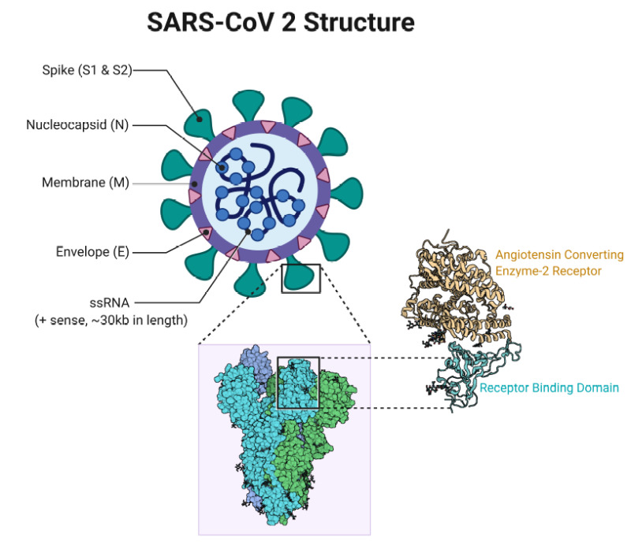
Introduction to SARS-CoV-2
SARS-CoV-2 is a novel coronavirus that causes COVID-19, first identified in Wuhan, China, in late 2019.
Belongs to the family Coronaviridae, genus Betacoronavirus, closely related to SARS-CoV and MERS-CoV.
It has a single-stranded RNA genome of about 30,000 base pairs, encoding structural and non-structural proteins.
Transmission: Primarily spreads through respiratory droplets, close contact with infected individuals, and fomites.

Slide 9
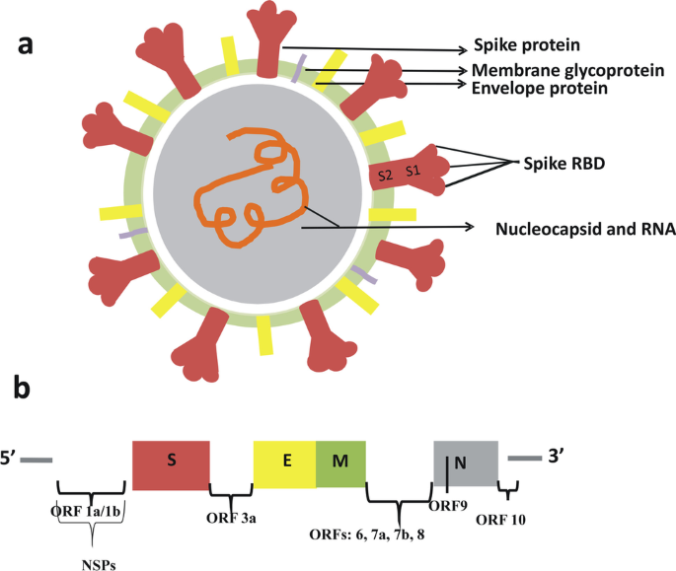
Evolution of SARS CoV
Variants of interest: Have specific genetic changes that may affect virus behavior but no demonstrated significance on public health.
Epsilon (B.1.427 and B.1.429); Zeta (P.2); Eta (B.1.525); Theta (P.3); Iota (B.1,526); Kappa (B.1.617.1); Lambda (C.37); and Mu (B.1.621)
Variants of concern: have a demonstrated impact on public health e.g. severe dx, reduced vaccine efficacy, increased transmissibility
Outbreaks are due to VoCs: Alpha (B.1.1.7), Beta (B.1.351), Gamma (P.1), Delta (B.1.617.2), and Omicron (B.1.1.529)
Kenya has suffered five waves of COVID-19 since its inception

Slide 10

Covid waves Dec 2019 – June 2022
Kenya’s pandemic is seeded in March 2020 and peaked in August 2020
First wave dominated by the early European lineages, B.1 and B.1.1
The second wave came in late November 2020 with the European sub-lineages dominant.
The third wave came in mid-April 2021: Alpha, Beta
Wave 4 hit in late August 2021: Delta
Fifth wave in mid-January 2022: Omicron
Wave 6?: JN.1[JN1.13, JN1.18], Omicron phased out.

Slide 11
No questions thank you😅
Visit https://viralzone.expasy.org/873 for further insights on viral structures and mechanisms.

